Slide 1
Software Testing & Quality Assurance Project
Final QA Technical Presentation
Anood Naimat
Software Testing & Quality Assurance Track

Slide 2





About me & Use Case
Educational Background
Use Case
Defines user-system interactions
Computer Science Graduate
Covers main system functions
QA Trainee
with hands-on testing experience
Base for test case design

Slide 3




Problem Statement
E-commerce systems are complex with multiple layers
01
E-commerce systems
Manual testing
Manual testing alone is insufficient for quality assurance
02
UI, API, and performance require validation
03
UI, API, performance
Critical user flows must work without failure
Critical user flows
04

Slide 4



My Solution: Multi-Layered Testing Strategy
Manual Testing
01
38 test cases executed
API Testing
225 automated requests
02
03
Performance Testing
k6 load testing with 23 VUs
UI Automation
Selenium framework with POM
04

Slide 5
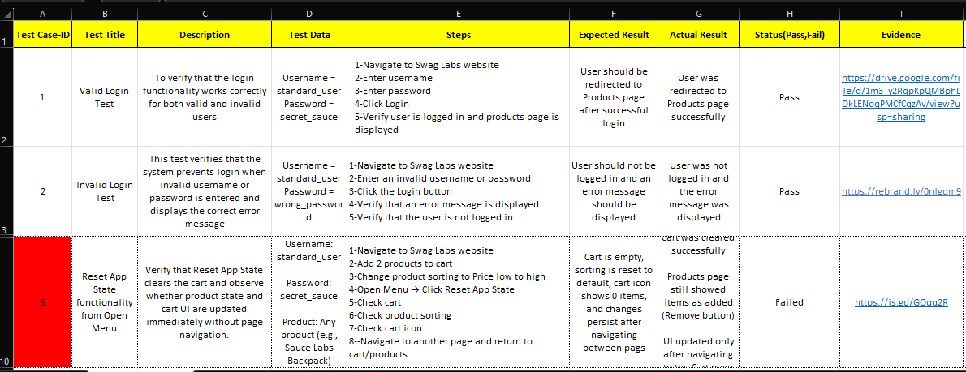




Manual Testing - Execution Summary
Test Execution Results
38 Total Test Cases
26 Passed ✓
12 Failed ✗
68% Pass Rate

Slide 6
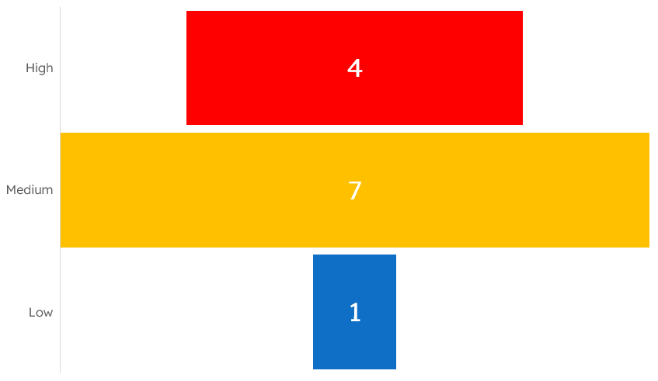
Defect Analysis - Severity Distribution

Slide 7

API Testing - Postman & Newman
225
Total Requests
570
Total Assertions
2
Failed Assertions
164ms
Avg. Response Time

Slide 8

Performance Testing - k6 Summary
172ms
Avg. Response Time
264ms
p95 Response Time
0%
Error Rate
23
Max Virtual Users

Slide 9
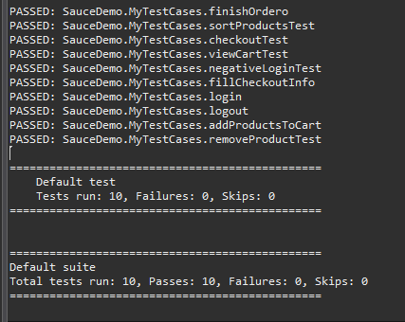




UI Automation
Technology Stack
Selenium WebDriver (Java)
Page Object Model
Technology Stack
Login Flow
Product Browsing
Add to Cart
Checkout Process

Slide 10


Impact & Next Steps
Value Delivered
38 manual test cases executed
What's Next
1
1
CI/CD integration
12 defects identified and documented
2
API, UI & performance testing implemented
2
Extended test coverage
3
3
Ready to demonstrate code and reports

Slide 11
Thank You!
Questions & Discussion
System Successfully Tested
Ready for Next Phase
Ready to demonstrate code and reports upon request

