Slide 1
Employee Data Analysis using Excel
STUDENT NAME: ANOOP S
REGISTER NO: 312220495
DEPARTMENT: B.Com Accounting & Finance
COLLEGE : Prince Shri Balaji College of Arts and Science

Slide 2
PROJECT TITLE
Employee Performance Analysis using Excel

Slide 3


AGENDA
Problem Statement
Project Overview
End Users
Our Solution and Proposition
Dataset Description
Modelling Approach
Results and Discussion
Conclusion
3/21/2024 Annual Review

Slide 4

PROBLEM STATEMENT
We aim to evaluate employee performance using key metrics such as productivity, sales targets achieved, and customer satisfaction ratings to identify top performers and areas needing improvement.
By examining employee data across various departments and job roles, we seek to uncover trends and patterns that can provide insights into factors influencing employee performance level
Using data analysis, we aim to identify underutilized resources and propose strategies for optimizing workforce allocation and enhancing overall organizational productivity.
The goal is to use Excel’s data visualization and analysis tools to support management in making informed decisions regarding promotions, training programs, and employee retention strategies.

Slide 5

PROJECT OVERVIEW
Data Collection and Preparation: We utilized employee data from Kaggle, including metrics like job role, department, tenure, performance ratings, and sales targets. The data was cleaned and organized in Excel to ensure accuracy and consistency for analysis.
Data Analysis and Visualization: Leveraging Excel tools, such as pivot tables, conditional formatting, and formulas, we analyzed the data to compute key performance indicators (KPIs). Visualization techniques, including charts and graphs, were used to display insights clearly and effectively.
Performance Trends and Insights: The analysis focused on identifying patterns and trends in employee performance across different departments and roles, highlighting factors such as experience, department, and job role that influence productivity and success.
Recommendations and Actionable Strategies: Based on the findings, we proposed strategies for improving employee performance, optimizing team structures, and supporting data-driven decision-making for HR and management teams to enhance overall organizational efficiency.

Slide 6

WHO ARE THE END USERS?
Human Resources (HR) Team: HR professionals can use the insights from this analysis to develop targeted training programs, manage performance reviews, and make informed decisions about promotions and employee retention.
Management and Leadership: Executives and department managers can utilize the data to understand performance trends, optimize team compositions, and make strategic decisions about resource allocation and operational efficiency.
Team Leaders and Supervisors: Team leaders can use the analysis to identify high and low performers within their teams, providing them with insights to tailor coaching and mentoring efforts.
Business Analysts: Analysts within the organization can use this data to further explore correlations between performance metrics and business outcomes, aiding in strategic planning and forecasting.
Employees: Employees themselves might be indirect end users, as the analysis can help shape performance improvement plans, feedback, and recognition programs tailored to their growth and development needs.

Slide 7

OUR SOLUTION AND ITS VALUE PROPOSITION
Activity | Description
Data wrangling | Used conditional formatting to identify the missing rows in the ExitDate column
 | Filter by cell color to remove the missing entry
Data manipulation | New column “Performance level” is created to the employee data using formula
Data visualization | Created pivot table using Business Unit as rows, Performance level as column, Gender Code as filter and First Name aggregation
 | Generated Clustered Column and 3D Pie chart using the pivot chart generated
hsdgdgdfg

Slide 8
Dataset Description
Dataset source – Kaggle
Total number of Features – 28
Field name | Field type
EmpID | String
FirstName | String
LastName | String
StartDate | Date
ExitDate | Date
Title | String
Supervisor | String
ADEmail | String
BusinessUnit | String
EmployeeStatus | String
EmployeeType | String
PayZone | Date
EmployeeClassificationType | String
Field name | Field type
TerminationType | String
TerminationDescription | String
DepartmentType | String
Division | String
DOB | Date
State | String
JobFunctionDescription | String
GenderCode | String
LocationCode | Integer
RaceDesc | String
MaritalDesc | String
Performance Score | Date
Current Employee Rating | Integer

Slide 9

THE "WOW" IN OUR SOLUTION
We transformed raw employee data into meaningful insights by creating new calculated fields using Excel formulas to measure performance metrics such as average sales per employee, productivity scores, and customer satisfaction rates. This enabled a more nuanced understanding of employee contributions beyond basic performance ratings.
These dashboards featured slicers and filters, enabling end users to drill down into specific departments, roles, or time periods, making the data highly accessible and actionable.
By applying Excel’s trend analysis tools and forecasting functions, we identified potential future performance trends and patterns.
We use conditional formatting to highlight key performance indicators and flag anomalies in real-time
3/21/2024 Annual Review
9

Slide 10
Modelling
1) Data Collection
We started by gathering comprehensive employee data from Kaggle, which included key variables such as EmpID, FirstName, LastName, StartDate, ExitDate, Title, Supervisor, ADEmail, BusinessUnit, EmployeeStatus, EmployeeType, PayZone, EmployeeClassificationType, TerminationType, TerminationDescription, DepartmentType,Division, DOB, State, JobFunctionDescription, GenderCode, LocationCode, RaceDesc, MaritalDesc, Performance Score, Current Employee and Rating satisfaction scores.
This data set provided a broad foundation for analyzing various aspects of employee performance across the organization.
2) Feature Selection
Next, we identified the most relevant features to include in our analysis. Key features selected were:
Quantitative Metrics: Performance Score, Current Employee Rating, PayZone, StartDate, ExitDate
Qualitative Metrics: EmpID, FirstName, LastName, Title, Supervisor, ADEmail, BusinessUnit, EmployeeStatus, EmployeeType, EmployeeClassificationType, TerminationType, TerminationDescription, DepartmentType, Division, DOB, State, JobFunctionDescription, GenderCode, LocationCode, RaceDesc, MaritalDescThese features were chosen to provide a balanced view of both the qualitative and quantitative aspects of employee performance.
These features were chosen to provide a balanced view of both the qualitative and quantitative aspects of employee performance.
10

Slide 11
Modelling
3) Data Cleaning:
The data was cleaned to ensure accuracy and consistency:
Handling Missing Values: We used techniques like filling missing values with the median or mean for numerical data, and the mode for categorical data.
Removing Duplicates: We identified and removed duplicate entries to prevent skewed analysis.
Standardizing Formats: Dates, numbers, and text fields were standardized to maintain uniformity.
4) Performance Level Calculation (New Column Creation):
We created a new column named "Performance Level" to categorize employees based on their performance metrics.
Using Excel's IFS formula, we assigned a performance level based on the "Current Employee Rating" (represented by cell Z8):
=IFS(Z8>=5, "VERY HIGH", Z8>=4, "HIGH", Z8>=3, "MED", TRUE, "LOW")
This formula categorizes employees into "VERY HIGH," "HIGH," "MED," or "LOW" performance levels, allowing for a clear and structured analysis of performance distribution within the organization.
11

Slide 12
Modelling
5) Data Visualization:
Pivot Table: We built a pivot table using key fields such as Performance Level, Business Unit, Gender Code, and First Name to summarize and analyze employee performance data across various dimensions.
Clustered Column Chart: A clustered column chart was created based on the pivot table to visually compare performance levels across different business units and genders.
Pie Chart: A pie chart was developed using the fields Business Unit and Performance Level (High) to represent the distribution of high-performing employees across various business units, providing a clear visual of where top performers are concentrated.
6) Overall summary
The final step was to summarize our findings and insights:Key Insights: Highlighted the top-performing departments and roles, as well as those that need improvement.
Trends Identified: Showed correlations between employee tenure and performance, indicating where additional support or training might be needed.
Actionable Recommendations: Suggested strategic initiatives for HR and management to enhance overall employee performance, such as targeted training programs, performance-based incentives, and realignment of team structures based on the data insights.
12

Slide 13
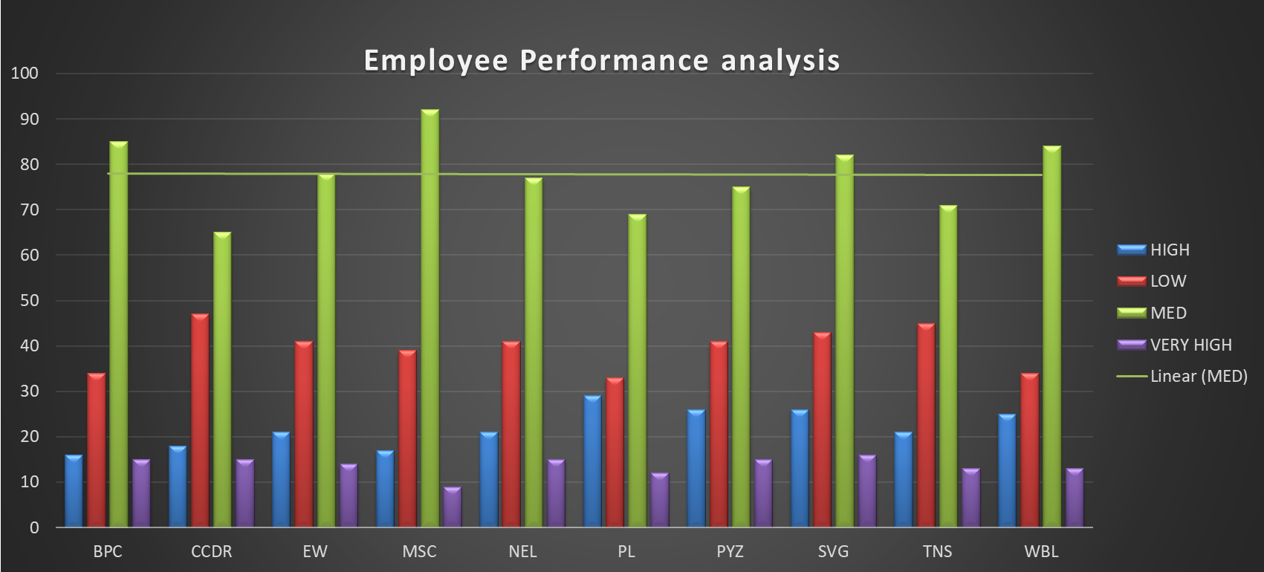
Results
13

Slide 14
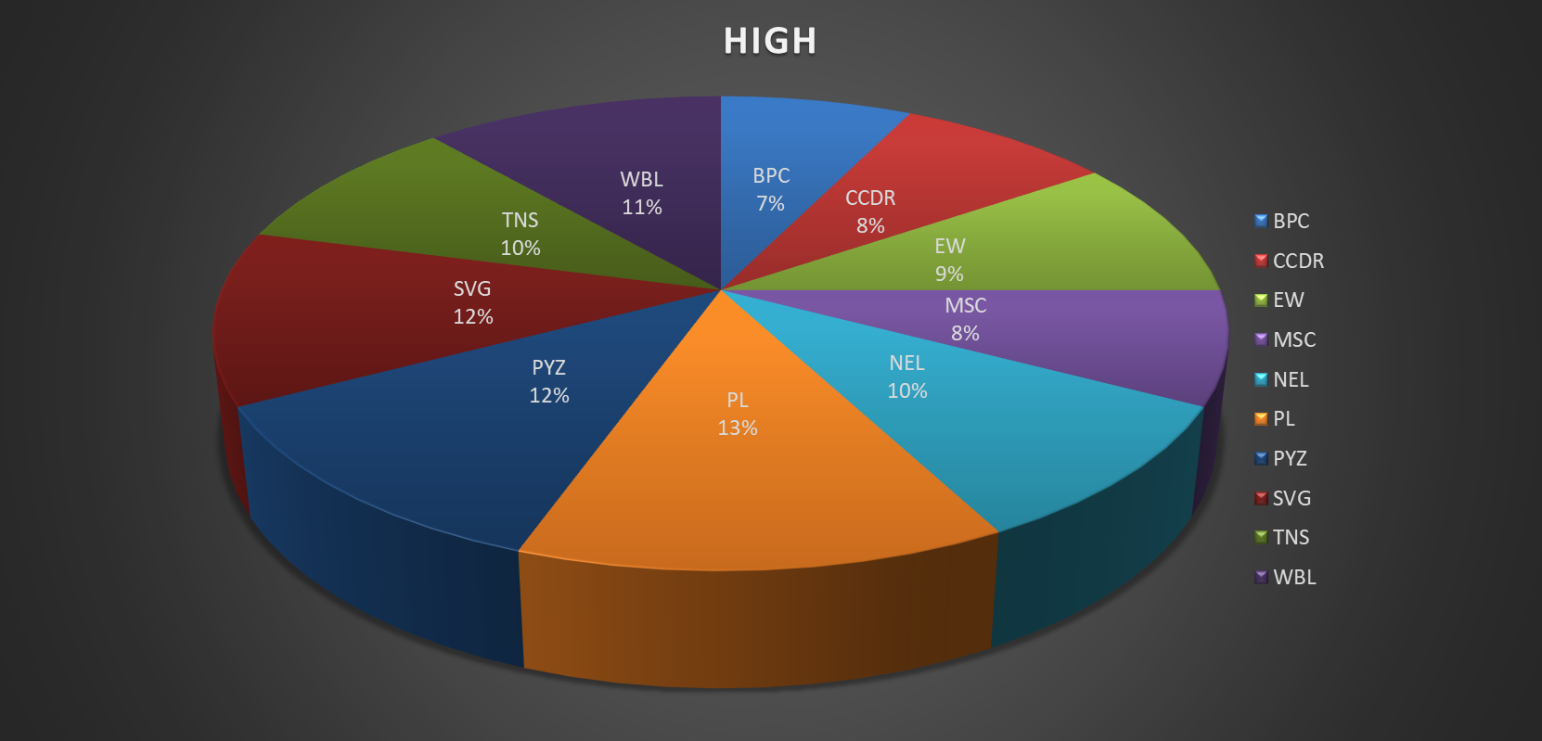
Results
14

Slide 15
Conclusion
Enhanced Understanding of Employee Performance:Through comprehensive data analysis using Excel, we gained valuable insights into the factors driving employee performance, allowing for a more nuanced understanding of workforce dynamics.
Data-Driven Decision Making:Our approach has equipped HR and management teams with actionable insights to make informed decisions regarding employee development, team optimization, and strategic planning.
Identification of Key Trends and Patterns:By leveraging advanced Excel tools and visualizations, we identified crucial trends in employee performance across different departments and roles, enabling targeted interventions and continuous improvement.
Recommendations for Continuous Improvement:Moving forward, we recommend regular updates to the performance analysis model and incorporating feedback mechanisms to ensure ongoing alignment with organizational goals and employee growth.
Future Opportunities:Expanding this analysis to include more advanced data analytics techniques, such as machine learning, can further enhance predictive capabilities and foster a proactive approach to talent management.

