Slide 1
Code Reviews

Slide 2
Challenges of Large Code Base
How to ensure…
  Maintainable code?
  DRY (don’t repeat yourself) code?
  Readable code?
  Bug-free code?
Average defect detection rate for various testing
  Unit testing: 25%
  Function testing: 35%
  Integration testing:45%
  How can this be improved?

Slide 3
Code Reviews
code review: A constructive review of a fellow developer’s code. A required sign-off from another team member before a developer is permitted to check in changes or new code.
Analogy: writing articles for a newspaper
  What is the effectiveness of…
  Spell-check/grammar check
  Author editing own article
  Others editing others’ articles

Slide 4
Mechanics of code reviews
who: Original developer and reviewer, sometimes together in person, sometimes offline.
what: Reviewer gives suggestions for improvement on a logical and/or structural level, to conform to previously agreed upon set of quality standards.
  Feedback leads to refactoring, followed by a 2nd code review.
  Eventually reviewer approves code.
when: When code author has finished a coherent system change that is otherwise ready for checkin
  change shouldn't be too large or too small
  before committing the code to the repository or incorporating it into the new build

Slide 5
Why Bother?
> 1 person has seen every piece of code
  Prospect of someone reviewing your code raises quality threshold.
Forces code authors to articulate their decisions
Hands-on learning experience for rookies without hurting code quality
  Pairing them up with experienced developers
Team members involved in different parts of the system
  Reduces redundancy, enhances overall understanding
Author and reviewer both accountable for committing code

Slide 6
Actual Studies
Average defect detection rates
  Unit testing: 25%
  Function testing: 35%
  Integration testing:45%
  Design and code inspections: 55% and 60%.
11 programs developed by the same group of people
  First 5 without reviews: average 4.5 errors per 100 lines of code
  Remaining 6 with reviews: average 0.82 errors per 100 lines of code
  Errors reduced by > 80 percent.
IBM's Orbit project: 500,000 lines, 11 levels of inspections. Delivered early and 1 % of the errors that would normally be expected.
After AT&T introduced reviews , study with > 200 people reported a 14 percent increase in productivity and a 90 percent decrease in defects.
(From Steve McConnell’s Code Complete)

Slide 7
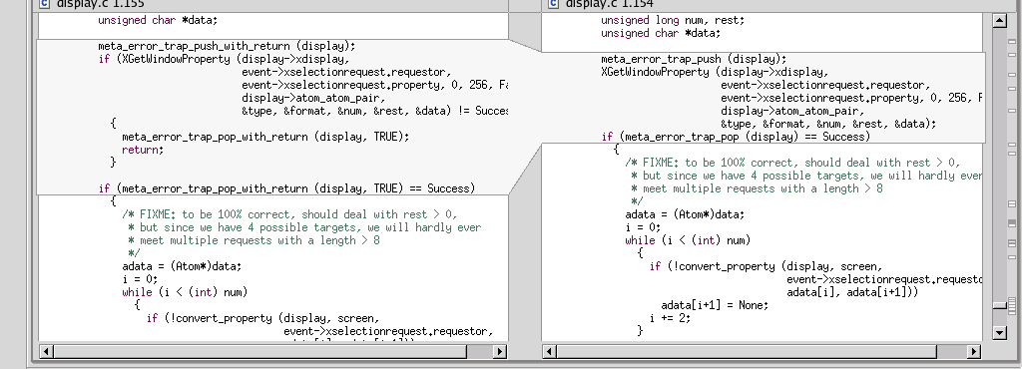
Code reviews in industry
Code reviews are a very common industry practice.
Made easier by advanced tools that:
  integrate with configuration management systems
  highlight changes (i.e., diff function)
  allow traversing back into history
  E.g.: Eclipse, SVN tools

Slide 8
Code review variations
inspection: A more formalized code review with:
  roles (moderator, author, reviewer, scribe, etc.)
  several reviewers looking at the same piece of code
  a specific checklist of kinds of flaws to look for
    possibly focusing on flaws that have been seen previously
    possibly focusing on high-risk areas such as security
  specific expected outcomes (e.g. report, list of defects)
walkthrough: informal discussion of code between author and a single reviewer
code reading: Reviewers look at code by themselves (possibly with no actual meeting)

Slide 9
Real life code reviews!

Slide 10
Code Reviews at Google
"All code that gets submitted needs to be reviewed by at least one other person, and either the code writer or the reviewer needs to have readability in that language. Most people use Mondrian [Rietveld] to do code reviews, and obviously, we spend a good chunk of our time reviewing code."
-- Amanda Camp, Software Engineer, Google

Slide 11
Code reviews at Yelp
“At Yelp we use review-board. An engineer works on a branch and commits the code to their own branch. The reviewer then goes through the diff, adds inline comments on review board and sends them back. The reviews are meant to be a dialogue, so typically comment threads result from the feedback. Once the reviewer's questions and concerns are all addressed they'll click "Ship It!" and the author will merge it with the main branch for deployment the same day.”
-- Alan Fineberg, Software Engineer, Yelp

Slide 12
Code reviews at WotC
“At Wizards we use Perforce for SCM. I work with stuff that manages rules and content, so we try to commit changes at the granularity of one bug at a time or one card at a time. Our team is small enough that you can designate one other person on team as a code reviewer. Usually you look at code sometime that week, but it depends on priority. It’s impossible to write sufficient test harnesses for the bulk of our game code, so code reviews are absolutely critical.”
-- Jake Englund, Software Engineer, MtGO

Slide 13
Code reviews at Facebook
"At Facebook, we have an internally-developed web-based tool to aid the code review process. Once an engineer has prepared a change, she submits it to this tool, which will notify the person or people she has asked to review the change, along with others that may be interested in the change -- such as people who have worked on a function that got changed.
At this point, the reviewers can make comments, ask questions, request changes, or accept the changes. If changes are requested, the submitter must submit a new version of the change to be reviewed. All versions submitted are retained, so reviewers can compare the change to the original, or just changes from the last version they reviewed. Once a change has been submitted, the engineer can merge her change into the main source tree for deployment to the site during the next weekly push, or earlier if the change warrants quicker release."
- Ryan McElroy, Software Engineer, Facebook

Slide 14
Code Reviews in 403
6 code reviews required for Beta
  Idea: 2-3 per week, one review per developer
Not required to review before checkin
Need to document code review in some fashion
  Email thread, checklist, tools, etc.
Exact structure up to group: something between walkthrough and inspection
Don't review "trivial" code but "trivial" threshold is probably lower than you think
  example: exception tests added, good

Slide 15
Rietveld
Setup Rietveld account, download upload.py
git init
git add remote origin ???
At this point you are ready to make changes that can be reviewed
git add ???
git commit -a -m "changes”
python upload.py \
  -t "Review Title” \
  -m "Review description” \
  -r “reviewer1@gmail.com,reviewer2@gmail.com” \
  --rev origin/master
Now visit the output url and publish the issue. When you get the g2g (good to go) then push your revisions.

