Slide 1
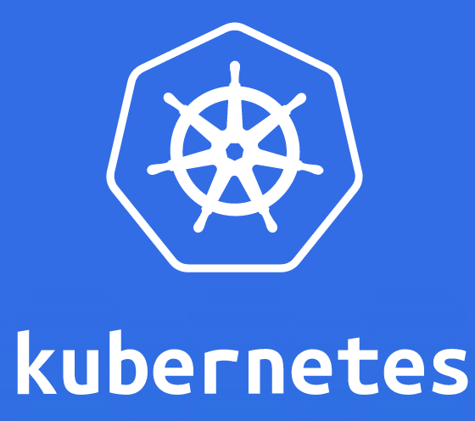

Slide 2
Daemon Set
info@zekeLabs.com | www.zekeLabs.com | +91 8095465880

Slide 3
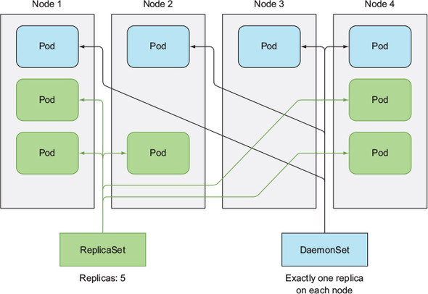
Daemon set

Slide 4
Daemon set
A DaemonSet makes sure it creates one pod on each existing node.
Certain cases exist when you want a pod to run on each and every node in the cluster and each node needs to run exactly one instance of the pod.
Those cases include infrastructure-related pods that perform system-level operations.
For example:
log collector and a resource monitor on every node.
kube-proxy process, which needs to run on all nodes to make services work.

Slide 5
Daemon set
A DaemonSet deploys pods to all nodes in the cluster, unless you specify that the pods should only run on a subset of all the nodes.
This is done by specifying the node-Selector property in the pod template, which is part of the DaemonSet definition.
Look at the ssd-monitor-daemonset.yaml and exercise in controllers.bash

