Slide 1
ReplicaSet & ReplicationControllers

Slide 2
ReplicationController
Pods running at any given time

Slide 3
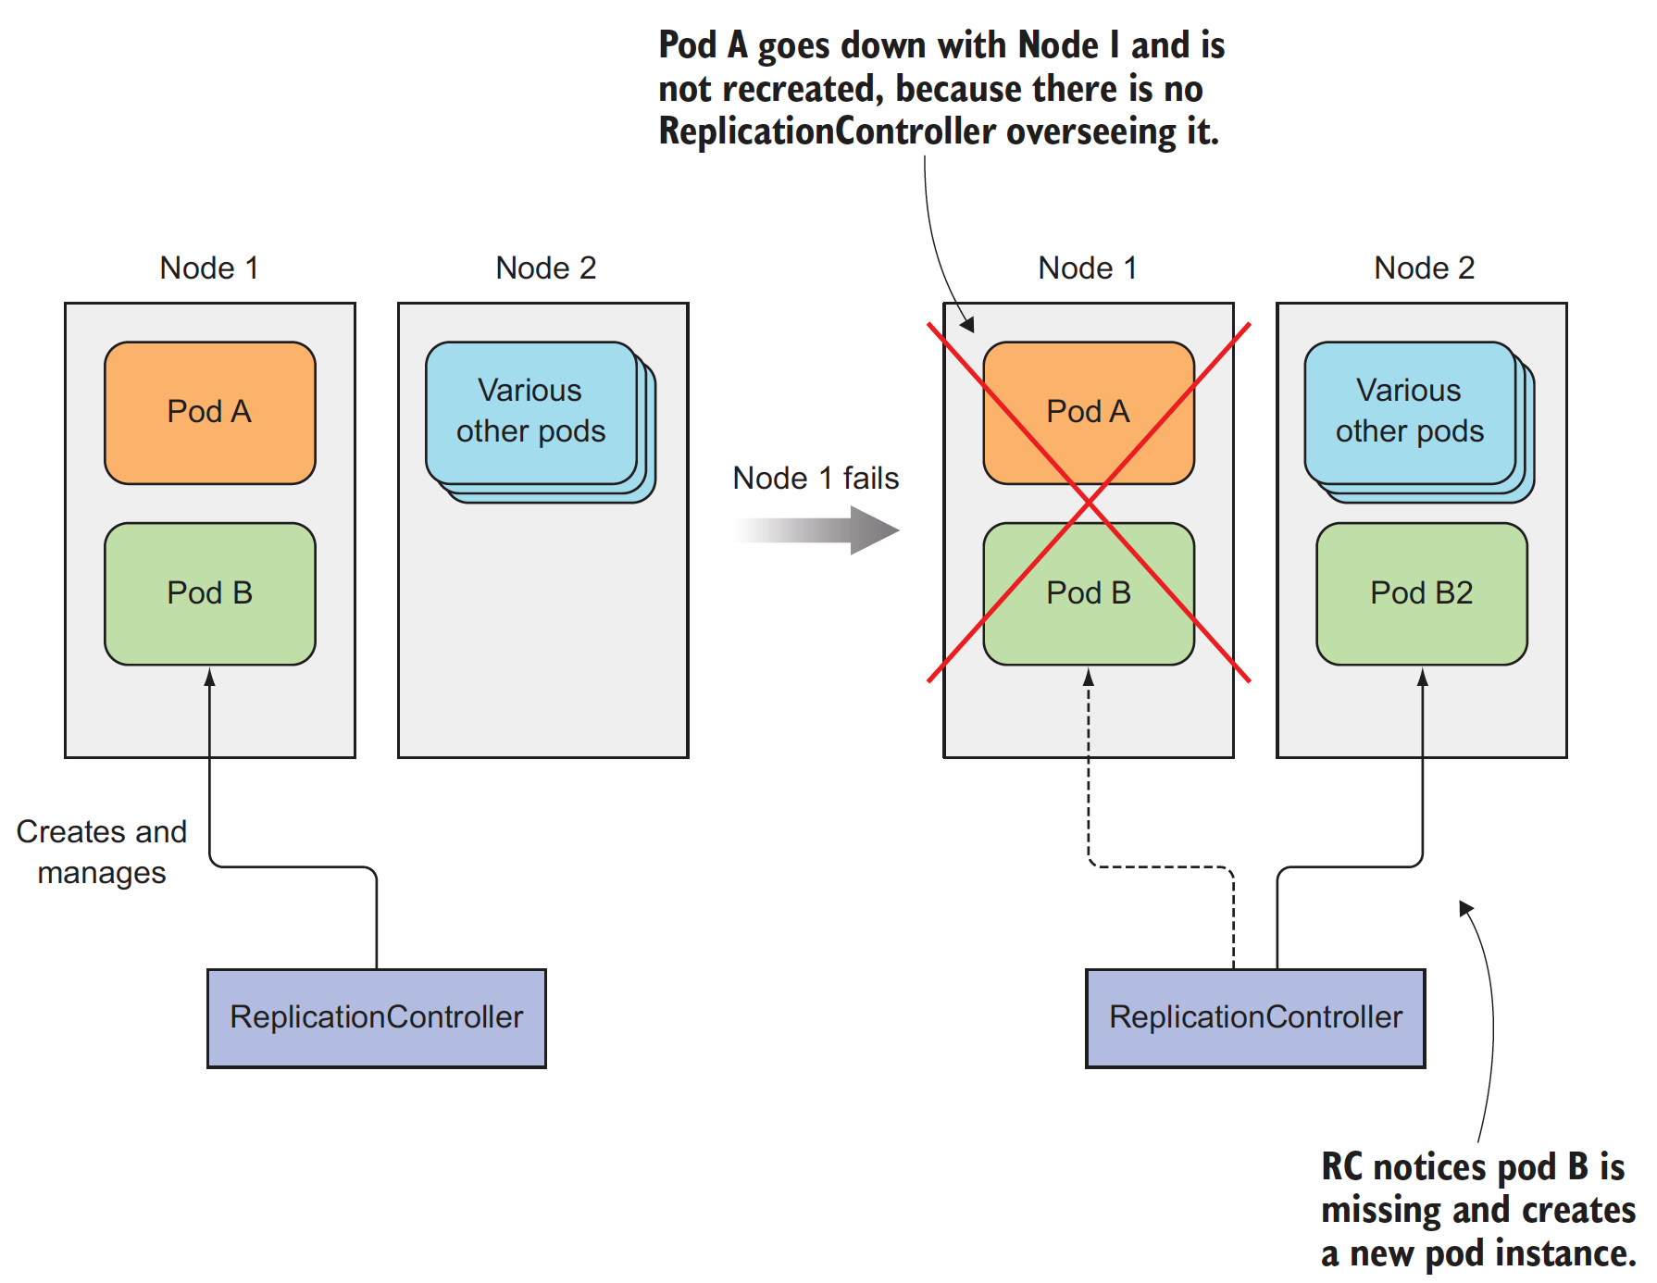
What when a node fails ?
When a node fails, only pods backed by a ReplicationController are recreated.

Slide 4
How it’s Operate ?
A ReplicationController constantly monitors the list of running pods and makes sure the actual number of pods of a “type that match a certain label selector” always matches the desired number.
If fewer pods are running, it creates new replicas from a pod template. If too many such pods are running, it removes the excess replicas.
But,how there can be more than the desired number of replicas. This can happen for a few reasons:
Someone creates a pod of the same type manually.
Someone changes an existing pod’s “type.”
Someone decreases the desired number of pods, and so on.
A ReplicationController’s job is to make sure that an exact number of pods always matches its label selector.
If it doesn’t, the ReplicationController takes the appropriate action to reconcile the actual with the desired number.

Slide 5
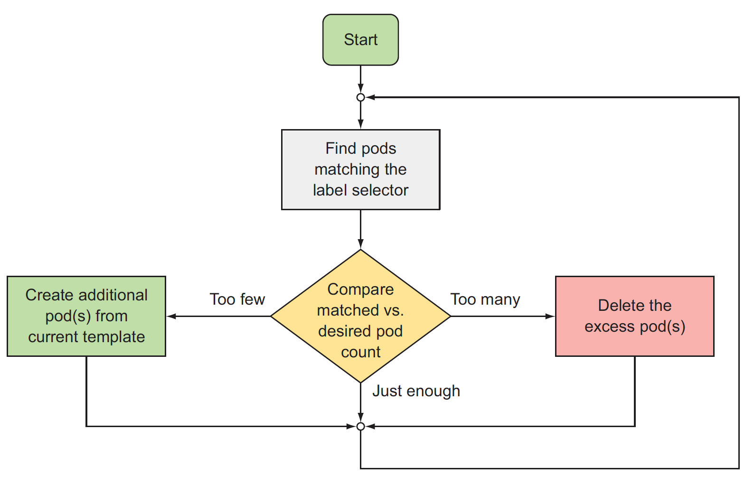
What when a node fails ?
A ReplicationController’s reconciliation loop

Slide 6
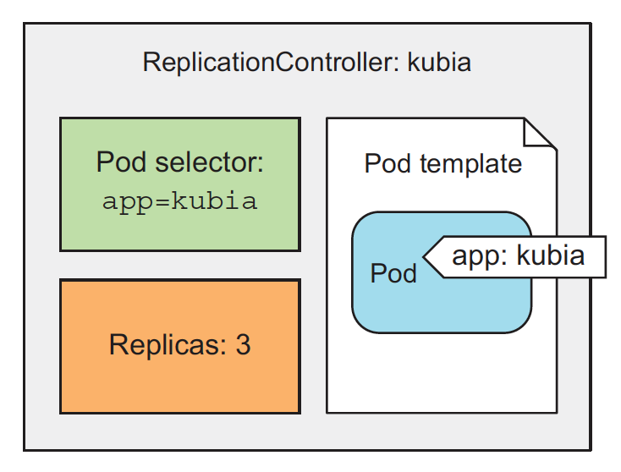
Three parts of RC?
A ReplicationController has three essential parts :
A label selector, which determines what pods are in the ReplicationController’s scope
A replica count, which specifies the desired number of pods that should be running
A pod template, which is used when creating new pod replicas
A ReplicationControllers- replica count, the label selector, and even the pod template can all be modified at any time, but only changes to the replica count affect existing pods.

Slide 7
Benefits of RC
It makes sure a pod (or multiple pod replicas) is always running by starting a new pod when an existing one goes missing.
When a cluster node fails, it creates replacement replicas for all the pods that were running on the failed node (those that were under the Replication- Controller’s control).
It enables easy horizontal scaling of pods—both manual and automatic

Slide 8
Understanding the parts of RC
Most applications should be scalable and all must be fault tolerant. Pods do not provide those features, ReplicaSets do.
Pods are the smallest unit in Kubernetes. But Pods are not fault tolerant. If a Pod is destroyed, Kubernetes will do nothing to remedy the problem. That is if Pods are created without Controllers.
One of the Controller is ReplicaSet . Its primary function, is to ensure that a specified number of replicas of a Pod matches the actual state (almost) all the time. That means that ReplicaSets make Pods scalable.
ReplicaSets acts as a self-healing mechanism in Kubernetes.
As long as Nodes have enough memory and CPU ,Pods associated with a ReplicaSet are guaranteed to run. They provide fault-tolerance and high availability.
ReplicaSet is the next-generation ReplicationController. The only significant difference is that ReplicaSet has extended support for selectors. Everything else is the same. ReplicationController is considered deprecated.

Slide 9
Understanding ReplicaSets
Most applications should be scalable and all must be fault tolerant. Pods do not provide those features, ReplicaSets do.
Pods are the smallest unit in Kubernetes. But Pods are not fault tolerant. If a Pod is destroyed, Kubernetes will do nothing to remedy the problem. That is if Pods are created without Controllers.
One of the Controller is ReplicaSet . Its primary function, is to ensure that a specified number of replicas of a Pod matches the actual state (almost) all the time. That means that ReplicaSets make Pods scalable.
ReplicaSets acts as a self-healing mechanism in Kubernetes.
As long as Nodes have enough memory and CPU ,Pods associated with a ReplicaSet are guaranteed to run. They provide fault-tolerance and high availability.
ReplicaSet is the next-generation ReplicationController. The only significant difference is that ReplicaSet has extended support for selectors. Everything else is the same. ReplicationController is considered deprecated.

Slide 10
Command Reference
To create the ReplicationController
kubectl create -f [rc-definition-file.yaml]
Retrieving the whole definition of a Running RC in YAML/JSON format
kubectl get rc [rc-name] -o yaml
kubectl get rc [rc-name] -o json
See the newly created POD
kubectl get rc
See the full details 0f POD
kubectl describe rc [rc-name]
Scale out
kubectl scale rc [rc-name] --replicas=10
Delete without deleting pods
kubectl delete rc [rc-name] --cascade=false

Slide 11
Lab: ReplicationController & ReplicaSets

Slide 12
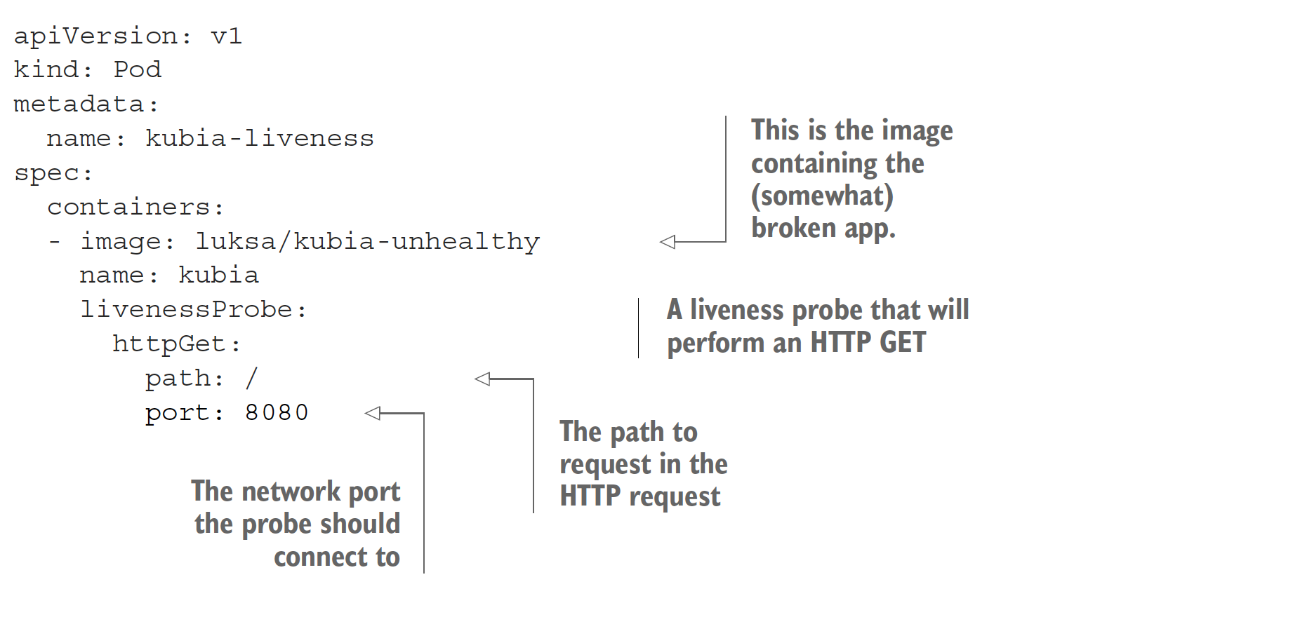
Example-Liveness Probe

Slide 13



