Slide 1

Face Detection And Recognition using Back propagation neural network.
Anoop kumar singh(14bcs008)
Chitranshu yadav(14bcs015)
Sangam kumar(14bcs045)

Slide 2
AGENDA
INTRODUCTION
HISTORY
VIOLA JONES METHOD
FACE DETECTION USING HAAR CASCADES METHOD
BRIEF ABOUT OPENCV
FACE RECOGNITION USING LOCAL BINARY PATTERN HISTOGRAM
ARTIFICIAL NEURAL NETWORK
BACK PROPAGATION
APPLICATIONS
FUTURE WORK
CONCLUSION

Slide 3
INTRODUCTION
Detection and recognition of the facial images of people is an intricate problem which has garnered much attention during recent years due to its ever increasing applications in numerous fields.
Face recognition is very important for our daily life. It can be used for remote identification services for security in areas such as banking, transportation, law enforcement, and electrical industries, etc.
Using the proper PIN gains access, but the use of the PIN is not verified. When credit and ATM cards are lost or stolen, an unauthorized user can often come up with the correct personal codes.
Facial recognition is one of classical applications of the Artificial Neural Network

Slide 4
HISTORY
In 1960s, the first semi-automated system for facial recognition made to locate the features ( such as nose and mouth) on the photos.
In 1970s, Goldstein and Harmon used 21 specific subjective markers such as hair colours and lip thickness to automate the recognition.
In 1988, Kirby and Sirovich used standard linear algebra technique, to the face recognition.
In 2001 by Paul Viola and Michael Jones gave Viola-jones object detection framework as the first object detection framework to provide competitive object detection.
The Haar classifier is a machine learning based approach first of its kind, an algorithm created by Paul Viola and Michael Jones.

Slide 5
VIOLA JONES METHOD
VIOLA JONES DETECTION IS THE FIRST OBJECT DETECTION FRAMEWORK TO PROVIDE COMPETITIVE OBJECT DETECTION RATES IN REAL TIME.
METHOD HAS FOUR STAGES
1. HAAR FEATURE SELECTION
2. CREATING AN INTEGRAL IMAGE
3. ADABOOST TRAINING
4. CASCADING CLASSIFIERS

Slide 6
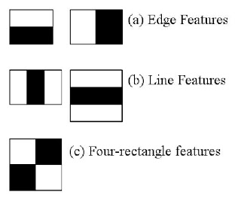
FACE DETECTION USING HAAR CASCADES
IT IS A MACHINE LEARNING BASED APPROACH WHERE A CASCADE FUNCTION IS TRAINED FROM A LOT OF POSITIVE AND NEGATIVE IMAGES. IT IS THEN USED TO DETECT OBJECTS IN OTHER IMAGES.
AFTER TRAINING THE FUNCTION WE EXTRACT HAAR FEATURES SUCH AS EDGE FEATURES, LINE FEATURES, FOUR-RECTANGLE FEATURES.

Slide 7
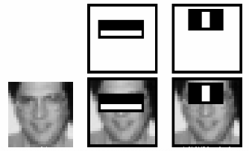
HAAR CASCADES CONTD..
EVEN A 24*24 WINDOW RESULTS OVER 160000 FEATURES. TO EXTRACT THE MOST RELEVANT FEATURES AMONG THEM WE USE ADABOOST.

Slide 8
HAAR DETECTION CONTD..
ADABOOST IS A TRAINING PROCESS FOR FACE DETECTION, WHICH SELECTS ONLY THOSE FEATURES KNOWN TO IMPROVE THE CLASSIFICATION (FACE/ NON-FACE) ACCURACY OF OUR CLASSIFIER.
NOW 24*24 WINDOW REDUCES TO GIVE AROUND 6000 FEATURES. WHICH IS IN FACT A BIG GAIN.
INSTEAD OF APPLYING ALL THE 6000 FEATURES ON A WINDOW, GROUP THE FEATURES THE DIFFERENT STAGES OF CLASSIFIERS AND APPLY ONE BY ONE. THE WINDOW WHICH PASSES ALL STAGES IS A FACE REGION.

Slide 9
OPENCV
OpenCV means Intel® Open Source Computer Vision Library. It is a collection of C functions and a few C++ classes that implement some popular Image Processing and Computer Vision algorithms. The OpenCV is an open source computer vision library.
The library is written in C and C++ and runs under Linux, Windows and Mac OS X. There is active development on interfaces for Python, Ruby, Matlab, and other languages.
Features of opencv: Basic image processing, image labelling, object
recognition, data manipulation.

Slide 10
LBPH
Local Binary Patterns Histograms,or LBPH in short,also needs to be trained on hundreds of images LBPH is a visual/texture descriptor, and thankfully, our faces are also composed of micro visual patterns.
For each block,LBPH looks at 9 pixels (3×3 window) at a time, and with a particular interest in the pixel located in the center of the window.
Then, it compares the central pixel value with every neighbor's pixel value under the 3×3 window. For each neighbor pixel that is greater than or equal to the center pixel, it sets its value to 1, and for the others, it sets them to 0.
After that, it reads the updated pixel values (which can be either 0 or 1) in a clockwise order and forms a binary number. Next, it converts the binary number into a decimal number, and that decimal number is the new value of the center pixel. We do this for every pixel in a block.

Slide 11
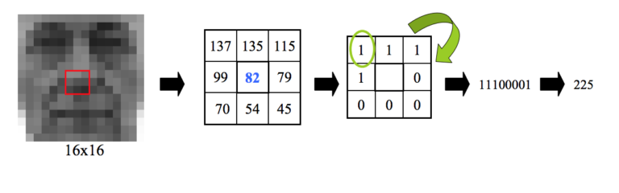
LBPH CONTD..
LBPH

Slide 12

ARTIFICIAL NEURAL NETWORK
Artificial Neural Networks are also referred to as “neural nets” , “artificial neural systems”, “parallel distributed processing systems”, “connectionist systems”.
This graph cannot be considered a neural network since the connections between the nodes are fixed and appear to play no other role than carrying the inputs to the node that computed their conjunction.

Slide 13



ARTIFICIAL NEURAL NETWORK CON..
The graph structure which connects the weights modifiable using a learning algorithm, qualifies the computing system to be called an artificial neural networks.

Slide 14
BACK PROPAGATION ALGORITHM
The backpropagation algorithm (Rumelhart and McClelland, 1986) is used in layered feed-forward Artificial Neural Networks.
Backpropagation is a multi-layer feedforward, supervised learning network based on gradient descent learning rule.
The idea of the backpropagation algorithm is to reduce this error, until the Artificial Neural Network learns the training data.

Slide 15




BACK PROPAGATION CONTD..
The activation function of the artificial neurons in ANNs implementing the backpropagation algorithm is a weighted sum (the sum of the inputs xi multiplied by their respective weights wji).
The most common output function is the sigmoidal function
Basic Block of BPN

Slide 16


BACK PROPAGATION CONTD..
Since the error is the difference between the actual and the desired output, the error depends on the weights, and we need to adjust the weights in order to minimize the error. We can define the error function for the output of each neuron.
And so, the adjustment to each weight will be

Slide 17
APPLICATIONS
Security/Counter terrorism: Access control, comparing surveillance images to Known.
Correctional institutions/prisons: Inmate tracking, employee access.
DayCare: Verify identity of individuals picking up the children.
Gaming Industry: Find card counters and thieves
Internet, E-commerce: Verify identity for internet purchases.

Slide 18
CONCLUSION
So we have accomplished face detection using haar cascade method , then have implemented facial recognition using LBPH method and also successfully implemented a neural network using back propagation algorithm for a dataset.

Slide 19
FUTURE WORK TO BE IMPLEMENTED
Facial Recognition through back propagation neural network.
Implementing different classifier such as Support Vector Machines (SVM).

Slide 20
THANK YOU
EVERYONE

