Slide 1
A NLP POWERED TRAVEL COMPANION CHATBOT
Submitted in the partial fulfillment for the award of the degree of
BACHELOR OF ENGINEERING
IN
BE –CSE AIT (AIML)
Submitted by:
Anoop Kaur 22BAI70096
Ankitaa Pupneja 22BAI70066
Under the Supervision of:
Uzzal Mondal
Department of AIT-CSE
DISCOVER . LEARN . EMPOWER

Slide 2
Outline
Introduction to Project
Scope of the Project
Problem Formulation
Objectives of the work
Methodology used

Slide 3
Introduction to Project
Our Chatbot Travel Platform is designed to simplify travel planning by providing personalized recommendations and real-time assistance. It offers detailed analytics on user interactions, including most searched destinations, booking preferences, and popular travel periods, all through an intuitive dashboard.
The chatbot uses advanced natural language processing (NLP) and smart recommendation algorithms to ensure accurate, relevant, and dynamic responses tailored to each user.
With a clean and user-friendly interface, accessibility features, and seamless integration with third-party travel services, our platform enhances the travel planning experience.
By leveraging machine learning for predictive insights, it helps users discover optimized travel options and offers personalized deals based on behavior and preferences.

Slide 4

INTRODUCTION (cont.)
Natural Language Processing (NLP):
spaCy – Used for Named Entity Recognition (NER) to extract travel-related entities such as destinations, dates, and other travel-specific information.
NLTK – Used for text preprocessing like tokenization, stopword removal, and stemming to prepare data for better understanding by the NLP model.
Intent Recognition Models – Simple rule-based or machine learning models (like Decision Trees or SVM) to identify the intent of user queries, such as booking flights, hotels, or providing travel advice.
Personalized Recommendations – Uses machine learning to offer personalized travel recommendations based on user preferences and past interactions.
Machine Learning :
scikit-learn – For basic machine learning tasks like intent classification and clustering user queries for better categorization.

Slide 5
Scope of the Project
The NLP Travel Companion uses Natural Language Processing to provide personalized travel assistance, going beyond basic queries to offer tailored recommendations.
Query Understanding: Analyzes user input with intent classification and NER for accurate responses.
Personalized Recommendations: Suggests destinations, flights, and hotels based on user preferences.
Real-time Data Retrieval: Fetches live travel data through API integrations for up-to-date information.
Multi-functional Assistance: Assists with tasks like booking flights and suggesting tourist attractions.
Scalability: Designed to handle high traffic, suitable for both individual users and organizations.
Future Enhancements:
Voice Integration for hands-free assistance.
Multi-language Support for wider accessibility.
AI-Powered Optimization for personalized travel planning.

Slide 6

Problem Formulation
Users face challenges in finding personalized, real-time travel information through traditional systems. The key issues include:
Understanding Queries: Traditional systems struggle to interpret complex, travel-related user queries.
Personalization: Generic recommendations fail to cater to individual preferences.
Real-time Data: Lack of integration with live travel data like flight and hotel availability.
Scalability: Difficulty handling high volumes of user queries effectively.
Thus, there’s a need for an NLP-powered Travel Companion that understands user input, provides personalized travel suggestions, and integrates real-time data.

Slide 7
Objectives of the Work
Understand User Queries: Utilize NLP to accurately interpret travel-related
questions and commands.
Personalized Recommendations: Provide tailored travel suggestions based on
user preferences and past interactions.
Multi-Step Task Assistance: Enable the chatbot to handle complex tasks such as booking flights,
suggesting itineraries, and providing travel advice.
Scalability and Efficiency: Ensure the system handles a high volume of queries
seamlessly for both individual users and organizations.

Slide 8
Methodology used
The NLP Travel Companion utilizes Natural Language Processing (NLP) to interpret and respond to travel-related queries.
Key technologies include:
NLP Models: Utilizes advanced models like spaCyfor intent recognition and named entity recognition (NER) to understand user input.
Machine Learning: Implements machine learning algorithms to enhance query understanding, enabling personalized travel recommendations based on user preferences.

Slide 9
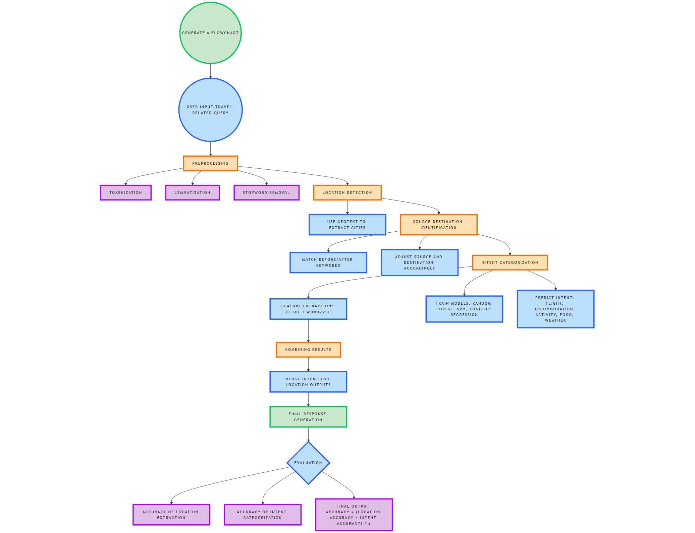
FLOWCHART OF PROCESS

