Slide 1
Capstone Project
The Battle of Neighborhoods (Week 2)

Slide 2
Purpose of the project :
Opening a new restaurant at a given location. The location
selected is Delhi the capital of India. Within Delhi we are
considering to open the restaurant in Kalkaji area.
As Subway is a popular food chain so we have considered
to open this type of restaurant.
To meet our requirement the area selected must have very
Very few similar chain of restaurant. More over if they do
exist, their rating should not be very high as this would give
new restaurant a target to achieve high rating and beat the
competition which already exist in the selected area.

Slide 3
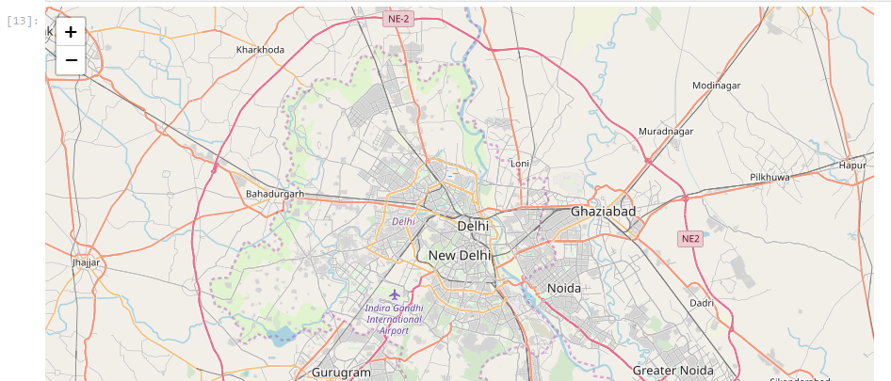

Slide 4
Description of Data:
Data from Foursquare will be used in the project. It would
help to identify the subway restaurant already existing in
the defined radius and also provide their rating.
Geodata will be used to getting the coordinates (latitude
and longitude)
The area selected needs to popular place and have
convenient accessibility by road or metro.

Slide 5
Methodology:
-- Use of Foursquare data to get the near by subway list and their rating
-- Use of Geo Data to get the location coordinates
-- Analysis the final list and present the conclusion if the selected location is suitable for opening Subway.
-- Plot map if required

Slide 6
Result:
Considered Kalkaji, New Delhi as the area for the Subway. The result shows that there is already one similar restaurant in the area. The next we looked at the rating of existing restaurant. It does seems to be not very high. So it seems the selected area has potential for opening new subway restaurant provided it display high standards and can beat the existing competition.

Slide 7
Conclusion:
The area selected has several opportunity for new investor.
As Kalkaji has good infrastructure so it has potential to attract customers.
The competition is less as results shows only one similar restaurant. And the rating of the existing restaurant is not very high.
If we can maintain high standard in the new restaurant and offer unique service to customer then we can beat the competition and gain better rating.
So it was decided to open the Subway restaurant in Kalkaji area.
.

