Slide 1
Classical Machine Learning:
Linear Regression
Ramesh S

Slide 2
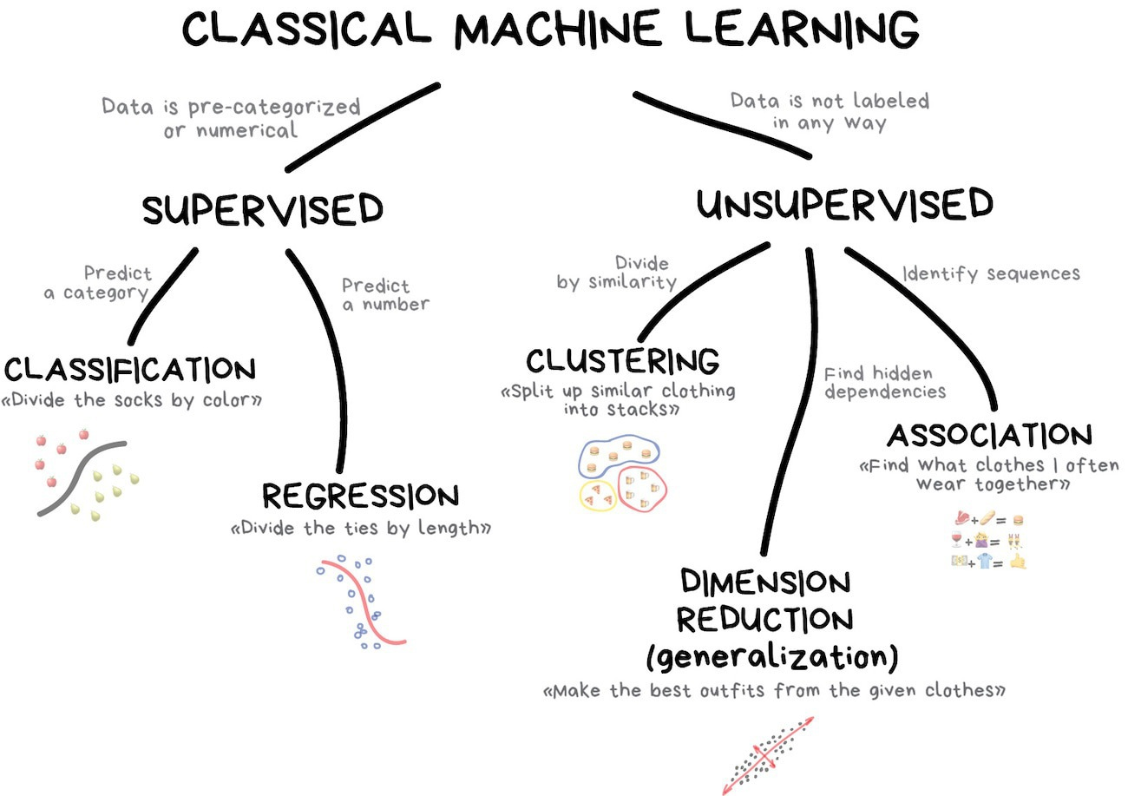

Slide 3
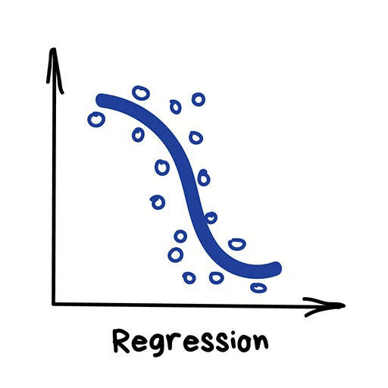
Regression
“Draw a line through these dots. Yep, that's linear regression”
Today this is used for:
Stock price forecasts
Demand and sales volume analysis
Medical diagnosis
Any number-time correlations

Slide 4
Regression
Regression is basically classification where we forecast a number.
Examples are
car price by its mileage
traffic by time of the day
demand volume by growth of the company etc.
Regression is perfect when something depends on time.

Slide 5
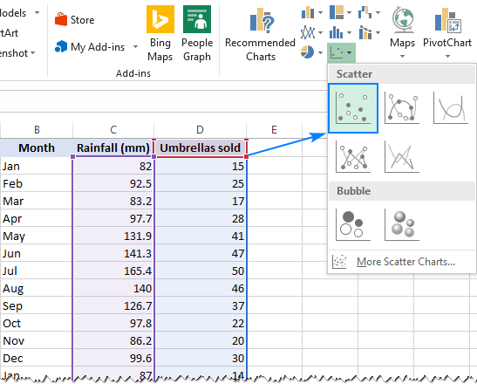
Regression
Everyone who works with finance and analysis loves regression.
It's even built-in to Excel.
And it's super smooth inside — the machine simply tries to draw a line that indicates average correlation.
Though, unlike a person with a pen and a whiteboard, machine does so with mathematical accuracy, calculating the average interval to every dot.

Slide 6
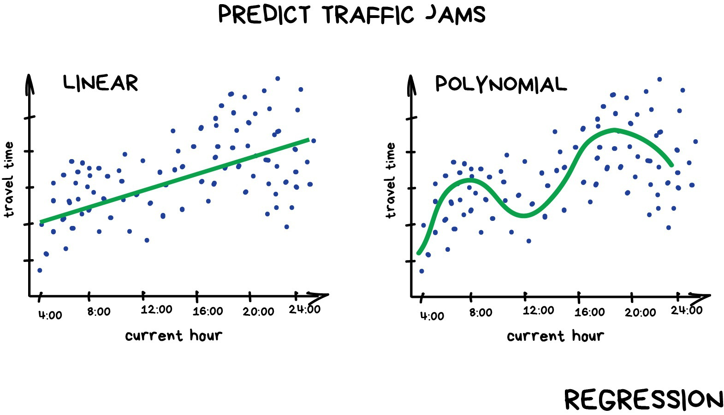
Regression
When the line is straight — it's a linear regression
When it's curved – polynomial regression

Slide 7
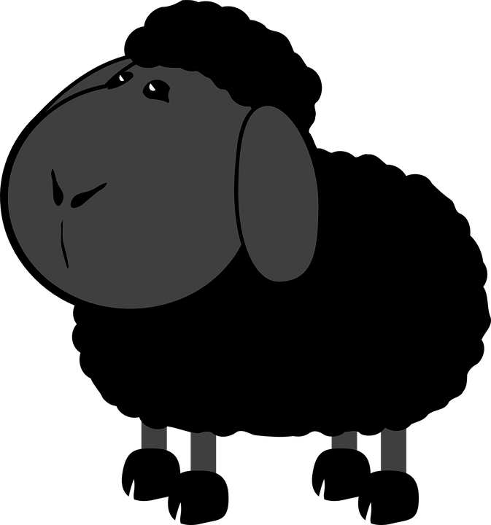

Regression
Linear and Polynomial are two major types of regression.
The other ones are more exotic.
Logistic regression is a black sheep in the flock.
Don't let it trick you, as it's a classification method, not regression.

Slide 8
Regression Models
Regression predicts a continuous target variable.
It allows you to estimate a value, such as housing prices or human lifespan, based on input data.
Here, target variable means the unknown variable we care about predicting, and continuous means there aren’t gaps (discontinuities) in the value that can take on.
A person’s weight and height are continuous values.
Discrete variables, on the other hand, can only take on a finite number of values — for example, the number of kids somebody has is a discrete variable.

Slide 9
Regression Models
This technique is used for forecasting, time series modelling and finding the causal effect relationship between the variables.
For example, relationship between rash driving and number of road accidents by a driver is best studied through regression.
Regression analysis is an important tool for modelling and analyzing data.
Here, we fit a curve / line to the data points, in such a manner that the differences between the distances of data points from the curve or line is minimized.

Slide 10
Why Use Regression Analysis?
Regression Analysis estimates the relationship between two or more variables. Let’s understand this with an easy example:
Say, you want to estimate growth in sales of a company based on current economic conditions.
You have the recent company data which indicates that the growth in sales is around two and a half times the growth in the economy.
Using this insight, we can predict future sales of the company based on current & past information.

Slide 11
Regression Analysis
No. of Independent Variables
There are various kinds of regression techniques available to make predictions.
These techniques are mostly driven by three metrics.
Regression
Shape of the Regression Line
Type of Dependent Variables

Slide 12
Linear Regression
A linear regression refers to a regression model that is completely made up of linear variables.
Linear Regression
Simple Linear Regression
Multi-variate Linear Regression

Slide 13
Linear Regression
Single Variable Linear Regression is a technique used to model the relationship between a single input independent variable (feature variable) and an output dependent variable using a linear model i.e., a line.
𝑦 = 𝑚𝑥 + 𝑐 where, y is the dependent variable
x is the independent variable
c is the intercept
m is the slope

Slide 14
Linear Regression
The difference between simple linear regression and multiple linear regression is:
multiple linear regression has (>1) independent variables, whereas simple linear regression has only 1 independent variable.
The more general case is Multi Variable Linear Regression where a model is created for the relationship between multiple independent input variables (feature variables) and an output dependent variable.
The model remains linear in that the output is a linear combination of the input variables.
𝑦= 𝑎₁ 𝑥₁+𝑎₂ 𝑥₂+𝑎₃ 𝑥₃ + …. + aₙ 𝑥ₙ + 𝑏 where, 𝑎ₙ are the coefficients
𝑥ₙ are the variables and b is the bias

Slide 15
Linear Regression - Steps
Build the Model
Estimate the Cost (Loss) Function
Obtain the best fit line. (How?) - Use Least Squares Method
Model Development and Improvement (Gradient Descent)
Model Validation and Diagnostics

Slide 16
Building the Model
Study the problem and the data
Correlate them and plan for the cost function

Slide 17

Estimate the Cost Function
Includes calculating the necessary variables and their coefficients. (Like Lalitha did for the Party)
Notes:
How much to pay for whom?

Slide 18

Estimate the Cost Function
Lalitha moved to a new city
She is need of new friends.
So, she plans for a party

Slide 19



Estimate the Cost Function
There are three supermarkets nearby: A-Mart, B-Mart and C-Mart
Now she needs to buy groceries for the party.
She went to all three supermarkets individually and noted prices for the required groceries

Slide 20


Estimate the Cost Function
A-Mart has discount on sugar
B-Mart has discount on vegetables
C-Mart has discount on rice
Each supermarket has their own prices for the items

Slide 21
Estimate the Cost Function
She deduced an equation like:
Party = 5(Sugar) + 10(Veggies) + 10(Rice)
5 and 10 being their weights in Kg
Now she decides what to buy where, that has minimum value for the Cost Function Party
Notes:
Cost Function

Slide 22

Estimate the Cost Function
What Lalitha just did is optimization or Gradient Descent
She made the final price to descend to the least value.

Slide 23
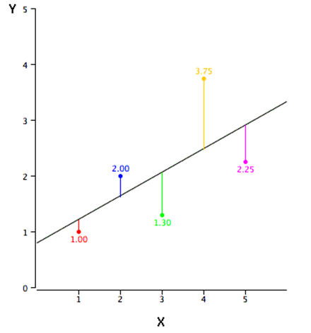
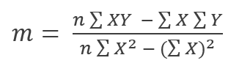

Goodness of Fit
Least Squares Method calculates the best-fit line for the observed data by minimizing the sum of the squares of the vertical deviations from each data point to the line.
Because the deviations are first squared, when added, there is no cancelling out between positive and negative values.

Slide 24
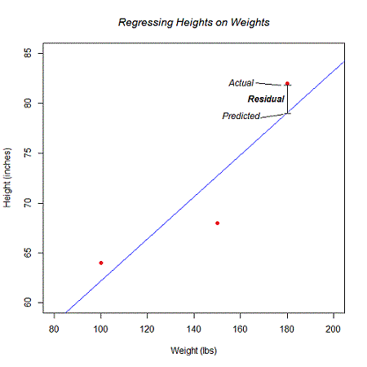
Goodness of Fit
A model fits the data well if the differences between the observed values and the model's predicted values are small and unbiased.
This should be minimum.

Slide 25
Model Development and Improvement
We need a better way to figure out how well we’ve fit the data than staring at the graph.
A common measure is the coefficient of determination (or R-squared), which measures the fraction of the total variation in the dependent variable that is captured by the model

Slide 26
What is R-Squared?
R-squared is a statistical measure of how close the data are to the fitted regression line.
It is also known as the coefficient of determination, or the coefficient of multiple determination for multiple regression.
It represents the proportion of the variance for a dependent variable that's explained by an independent variable.
Correlation explains the strength of the relationship between an independent and dependent variable, R-squared explains to what extent the variance of one variable explains the variance of the second variable.
The sum of squared errors must be at least 0, which means that the R-squared can be at most 1.
The higher the number, the better our model fits the data.

Slide 27
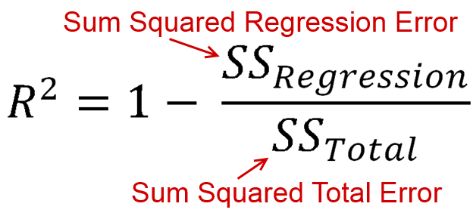
R-Squared

Slide 28
Other Performance Metrics
Performance Statistic | Usage Condition | What it should be?
R - Squared | Any Regression Model | Closer to 1, better the model
Mean Absolute Deviation | Continuous Data | Should be as less as possible
Median Absolute Deviation | When Errors are skewed | Should be as less as possible
Root Mean Square Errors | To magnify errors | Should be as less as possible

