Slide 1
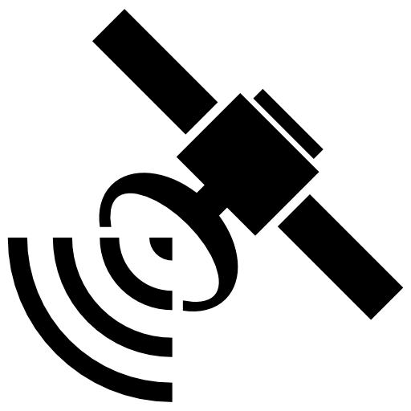
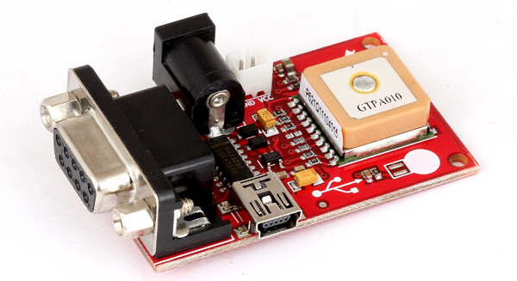
GPS MODULE

Slide 2
GPS MODULE
The Global Positioning System (GPS) is a radio navigation system that determines precise and accurate location, velocity, and time regardless of weather conditions. Additionally, GPS works on land, air, and sea..
GPS modules are devices that allow your devices or circuits to receive GPS data.
Interfaced using RS232 / USB with computer or microcontroller.
GPS settings are standard on phones, computers, and other intelligent devices that allow you to share your location or track the location of another object or person.

Slide 3
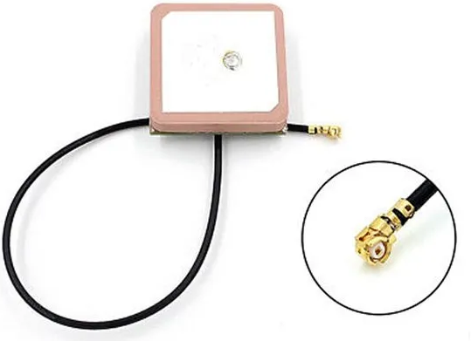
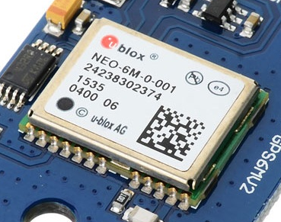
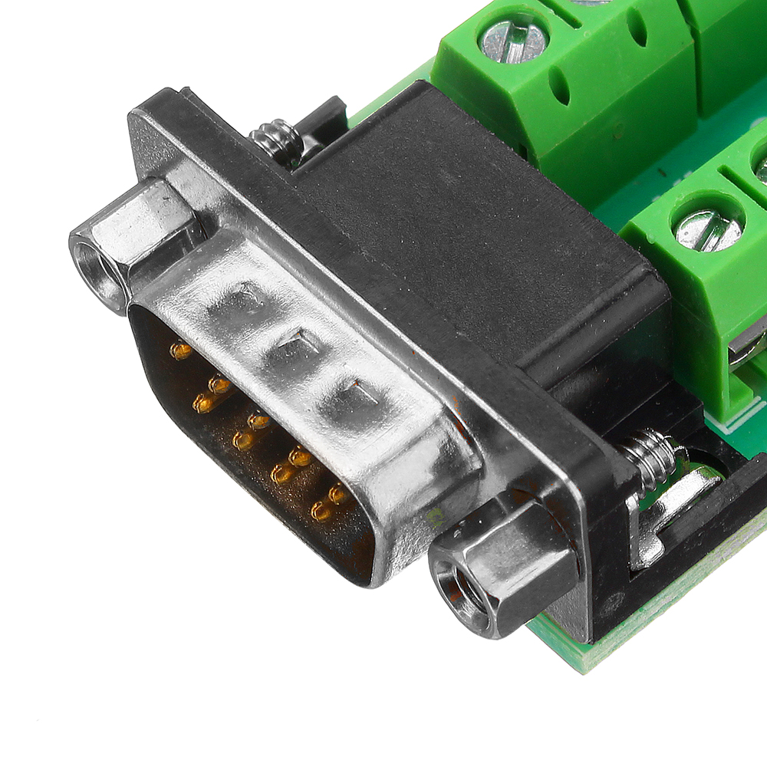
PARTS
GPS MODEM
Antenna
RS232 CONVERTER

Slide 4
APPLICATION
SATELITES
Microcontroller
POWER
SERIAL
GPS MODULE

