Slide 1
Natural Scene Text Detection
ANOOP
KIRUTHIKA
JAVID

Slide 2
Problem
To detect text in natural scene images, with unconstrained variations in background, illumination, texture.

Slide 3
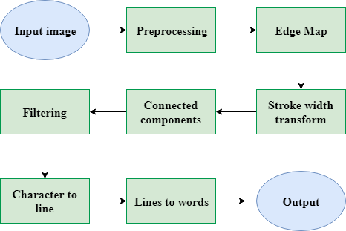
Overview
Fig.1. System overview

Slide 4
Pre-Processing
Gamma corrected gray scale Image.
Resized to 640x480 pixels.
Gradients calculated using Scharr filter.
Gradient directions are calculated.

Slide 5
Stroke Width Transform
Stroke : A stroke in the image is a continuous band of a nearly constant width.
Text tends to have higher uniformity in its stroke when compared to any other non text regions .
The Stroke Width is calculated in the entire image and regions with uniform Stroke Width are grouped together.

Slide 6
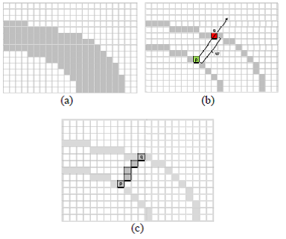
Stroke Width
We consider the edges as possible stroke boundaries, and we wish to find the width of such stroke.
Then all Pixel are assigned with the Min or Median Intensity value in Every Stroke in the Image.

Slide 7
Implementation
If p is an edge pixel, the direction of the gradient is roughly perpendicular to the orientation of the stroke boundary.
We move in gradient’s direction and look for an other edge pixel q with gradient in the opposite direction, and the distance between then would be stroke width.
Stokes have to detected by moving in the direction of negative gradient.( Dark text on Bright background)
Then replace all the pixels in the rays of stroke with min or the median.

Slide 8
Connected Components
The algorithm consists of two passes. In the first pass, the algorithm goes through each pixel. It checks the pixel above and to the left. And using these pixel's labels (which have already been assigned), it assigns a label to the current pixel.
In the second pass, it cleans up any mess it might have created, like multiple labels for connected regions.

Slide 9
Filtering non text regions
The aspect ratio must be within in small range to reject long and narrow components which removes foliage like textures that is common in natural scene images.
Components too large and too small are ignored
Variance of stroke width is computed, regions with variance greater than mean stroke width are removed

Slide 10
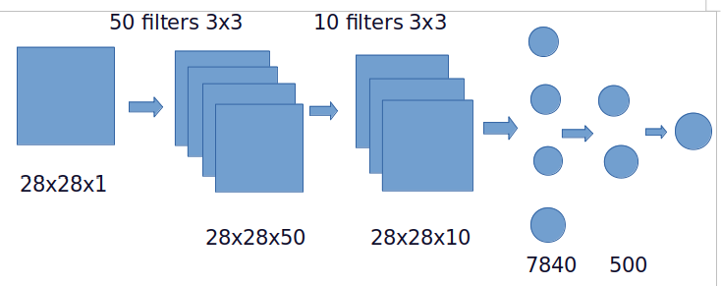
Filtering non text regions Using Neural Networks
We train the model using training set of around 6000 characters(0-9,a-z,A-Z) of icdar 2003 dataset.
For stride 1 and padding 1 from above CNN we get 62 outputs.
If all the outputs are less than 0.1 we don’t consider the window in image as having text

Slide 11
Finding Lines
We find individual lines by comparing the row location of the bounding box for each pixel.
If the row locations of one character lies within the other character they belong to a line else a separate line is created.
The min and max row values are found using a median value to get the bounding box of the line.
Some more boxes are removed as in a single line if only a single text bounding box is present.
If a bounding box height is 3 times more than median bounding box present in the line it is removed.

Slide 12
Finding Words
To split the lines into words, for each line, the median of the distance between the characters is found and a line if split into two words between two characters if their distance is greater than thrice the median value.

Slide 13
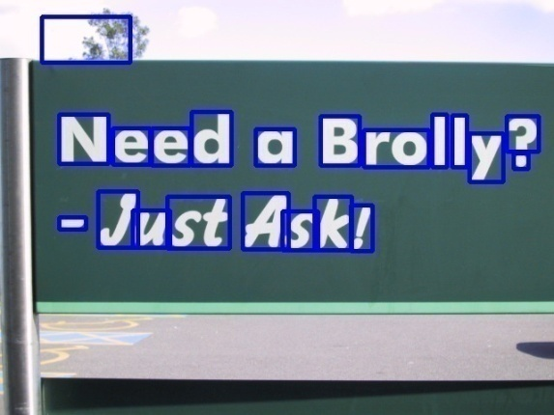
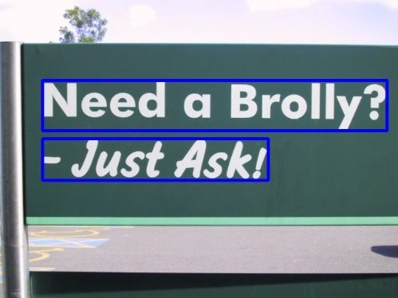




Success Results
Detected Leters Detected Lines Detected Words
Detected Leters Detected Lines Detected Words

Slide 14
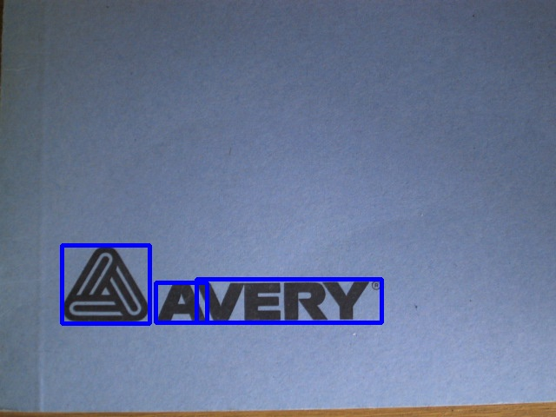
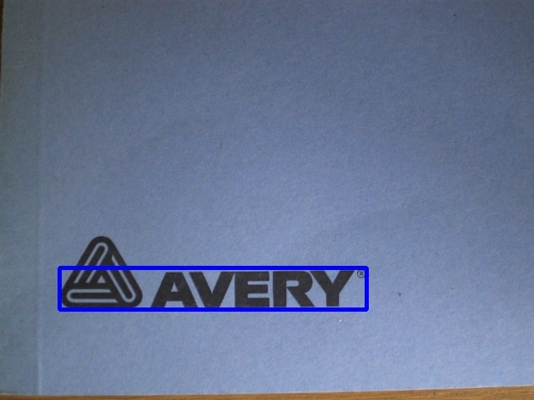



Failure Cases
Detected Leters Detected Lines Detected Words
Detected Leters Detected Lines Detected Words

Slide 15
Text Detection result
Detection Accuracy | Positive (IOU>0.5) | Negative (IOU<0.5) | False Detection (IOU=0)
Dark text Bright Background | 0.572 | 0.311 | 0.117
Bright Text Dark Background | 0.591 | 0.326 | 0.102
Number of Test Images is 196

Slide 16
Conclusion
We use the concept of stroke width transform to detect text in natural scene images
The robustness of the system is increased by applying additional filtering techniques.
A system that provides an end-to-end module to detect text in images posing various challenges is built.

