Slide 1
6: IPv6 Multicast Addresses
Rick Graziani
Cabrillo College
Rick.Graziani@cabrillo.edu

Slide 2
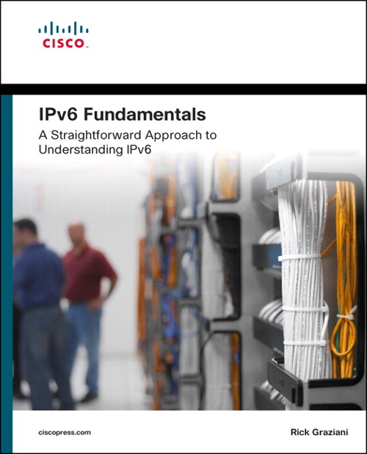
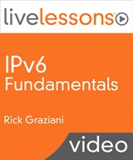
For more information please check out my Cisco Press book and video series:
IPv6 Fundamentals: A Straightforward Approach to Understanding IPv6
By Rick Graziani
ISBN-10: 1-58714-313-5
IPv6 Fundamentals LiveLessons: A Straightforward Approach to Understanding IPv6
By Rick Graziani
ISBN-10: 1-58720-457-6

Slide 3
6.1: Purpose and Format of IPv6 Multicast Addresses

Slide 4
IPv6 Address Types
IPv6 Addresses
Unicast
Multicast
Anycast
Assigned
Solicited-Node
FF00::/8
FF02::1:FF00:0000/104
Global Unicast
Link-Local
Loopback
Unspecified
Unique Local
Embedded IPv4
2000::/3
FE80::/10
::1/128
::/128
FC00::/7
::/80
IPv6 does not have a “broadcast” address.

Slide 5
IPv6 Multicast Addresses
IPv6 Addresses
Multicast
Assigned
Solicited-Node
FF00::/8
FF02::1:FF00:0000/104
Used by a device to send a single packet to multiple destinations simultaneously (one-to-many).
Equivalent to 224.0.0.0/4 in IPv4.
Two types of multicast addresses:
Assigned
Solicited-Node

Slide 6
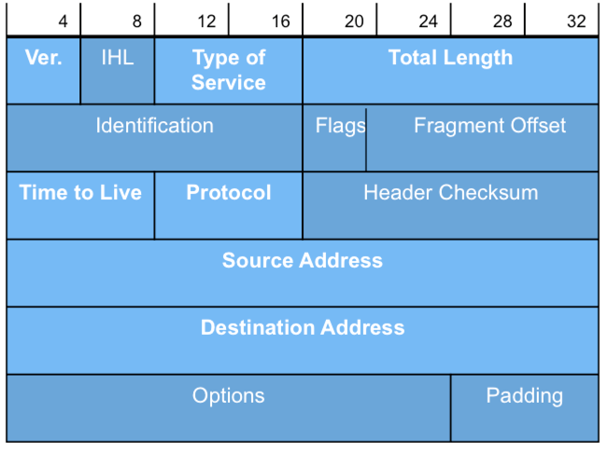
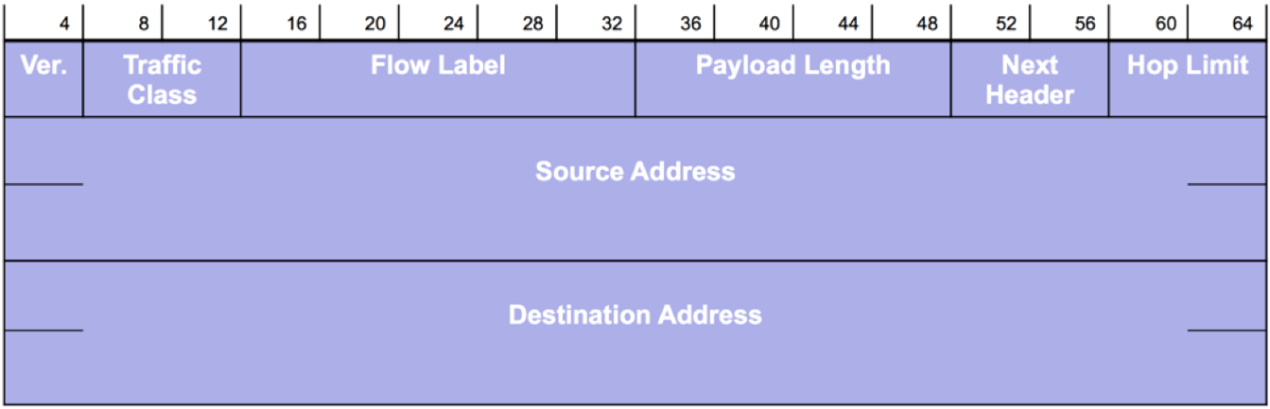
IPv6 Multicast Addresses
IPv6 Source – Always a unicast
IPv6 Destination – Unicast, multicast, or anycast.
IPv4
IPv6
Notes:
Multicast is a
technique used for a device to send a single packet to multiple destinations simultaneously
(one-to-many) in contrast to a unicast address, which sends a single packet to a single
destination (one-to-one). Multiple destinations can actually be multiple interfaces on the
same device but they are typically different devices.
An IPv6 multicast address defines a group of devices known as a multicast group. It is
the IPv4 equivalent of 224.0.0.0/4. A packet sent to a multicast group always has a unicast
source address. A multicast address can never be the source address. Unlike IPv4, there is
no broadcast address in IPv6.

Slide 7
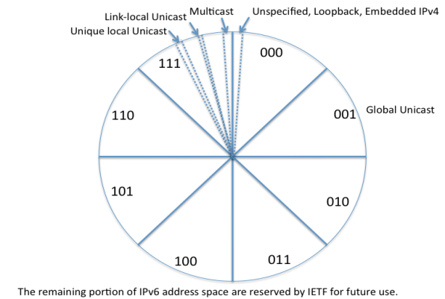
Multicast Range
8 bits
4 bits
4 bits
112 bits
1111 1111
Flag
Scope
Group ID
Multicast
FF00::/8
IPv6 multicast addresses have the prefix FF00::/8
Notes:
More in lesson 4

Slide 8
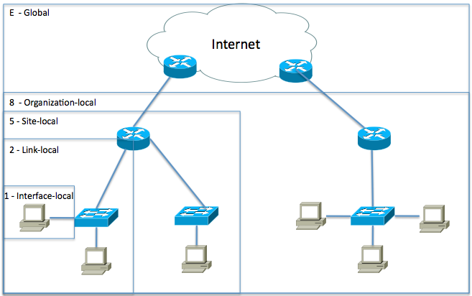
IPv6 Multicast Addresses - Scope
8 bits
4 bits
4 bits
112 bits
1111 1111
Flag
Scope
Group ID
Scope is a 4-bit field used to define the range of the multicast packet.
Scope (partial list):
0 Reserved
1 Interface-Local scope
2 Link-Local scope
5 Site-Local scope
8 Organization-Local
scope
E Global scope
Notes:
RFC 4007, IPv6 Scoped Address Architecture, specifies the characteristics, expected
behavior, and usage of IPv6 addresses of different scopes. A more graphical representation
of these scopes is illustrated in Figure 4-33. The Scope field allows devices to define
the range of the multicast packet and allows routers to immediately determine how
broadly to propagate it. This improves efficiency by eliminating traffic from being sent
outside the intended area.

Slide 9
IPv6 Multicast Addresses - Flag
8 bits
4 bits
4 bits
112 bits
1111 1111
Flag
Scope
Group ID
Flag
0 - Permanent, well-known multicast address assigned by IANA.
Includes both assigned and solicited-node multicast addresses.
1 - Non-permanently-assigned, “dynamically" assigned multicast address.
An example might be FF18::CAFE:1234, used for a multicast application with organizational scope.
Notes:
Note: At the time of this recording there is a draft RFC with some proposed changes to these flag but it mostly additional features.

Slide 10
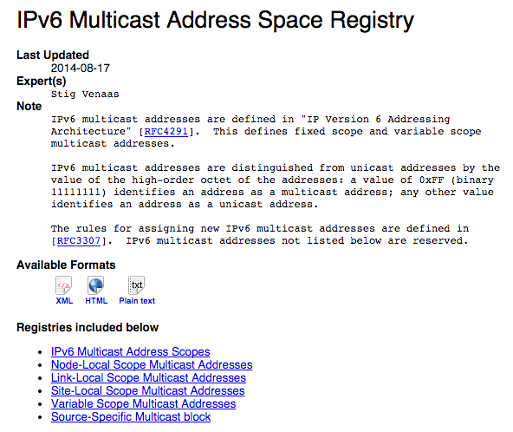
Assigned IPv6 Multicast Addresses
IPv6 Addresses
Multicast
Assigned
Solicited-Node
FF00::/8
FF02::1:FF00:0000/104
RFC 2375, IPv6 Multicast Address Assignments, defines the initial assignment of IPv6 multicast addresses that have permanently assigned Global IDs.
Reference for assigned multicast addresses:
(IANA) IPv6 Multicast Address Space Registry - http://www.iana.org/assignments/ipv6-multicast-addresses/ipv6-multicast-addresses.xhtml

Slide 11
Assigned Multicast Addresses with Link-local Scope
Flag = 0, Assigned multicast
Scope = 2, Link-local scope
Prefix | Flag | Scope | Predefined Group ID | Compressed Format | Description (IPv6 assumed)
FF | 0 | 2 | 0:0:0:0:0:0:1 | FF02::1 | All-devices
FF | 0 | 2 | 0:0:0:0:0:0:2 | FF02::2 | All-routers
FF | 0 | 2 | 0:0:0:0:0:0:5 | FF02::5 | OSPF routers
FF | 0 | 2 | 0:0:0:0:0:0:6 | FF02::6 | OSPF DRs
FF | 0 | 2 | 0:0:0:0:0:0:9 | FF02::9 | RIP routers
FF | 0 | 2 | 0:0:0:0:0:0:A | FF02::A | EIGRP routers
FF | 0 | 2 | 0:0:0:0:0:1:2 | FF02::1:2 | DHCP servers/relay agents
Notes:
All-devices – Any device enabled for IPv6, which in the case of windows, MAC and most newer operating systems is the case. The device will give itself a link-local unicast address.
All-routers – router configured with the ipv6 unicast-routing command
Notice:
Prefix = FF
Flag = 0 (because it is an assigned multicast address)
Scope = 2 (This means link-local scope. Similar to a packet with a link-local unicast address, routers will not forward this multicast packets onto other links or networks. Don’t get these confused with link-local unicast, these are multicast – for one or more devices. Scope is next)
If you are familiar with assigned IPv4 multicast addresses, notice that the lower-order or right most value is similar to that for IPv4. For example, the IPv6 multicast address for all OSPF routers is FF02::5, whereas the equivalent IPv4 multicast address is 224.0.0.5.

Slide 12
Assigned Multicast Addresses with Site-local Scope
Flag = 0, Assigned multicast
Scope = 5, Site-local scope
Prefix | Flag | Scope | Predefined Group ID | Compressed Format | Description (IPv6 assumed)
FF | 0 | 5 | 0:0:0:0:0:0:2 | FF05::2 | All-routers
FF | 0 | 5 | 0:0:0:0:0:1:3 | FF05::1:3 | All DHCP servers
Used to communicate within a “site”, possibly routed within the site.
Must have IPv6 multicast routing enabled:
Router(config)# ipv6 multicast-routing
DHCPv6, relay agents and DHCPv6 multicast addresses are included in Lesson 8.
Notes:
enabling “ipv6 multicast-routing” does enable PIM on all interfaces w/ an IPv6 address (i.e you don’t have to explicitly configure it on every interface like you did w/ IPv4)

Slide 13
“All IPv6 Devices” Assigned Multicast Address
ICMPv6 Router Advertisement
FF02::1
FE80::1
Rest of IPv6 Packet
Destination
IPv6 Address
Source
IPv6 Address
Router(config)# ipv6 unicast-routing
FF02::1 – All IPv6 Devices
All IPv6 devices, including the router, belong to this group.
Every IPv6 device will listen and process packets to this address.
Isn’t this the same as a broadcast?
No, because it maps to a Layer 2 MAC address which is more efficient… coming soon!
ICMPv6 Router Advertisement
Notes:
As discussed in other lesson 4 and other lessons, the ipv6 unicast-routing makes the router an “IPv6 router”. This enables IPv6 routing and the sending of ICMPv6 Router Advertisement messages.

Slide 14
“All IPv6 Routers” Assigned Multicast Address
ICMPv6 Router Solicitation
FF02::2
FE80::12:3456: 7890:ABCD
Rest of IPv6 Packet
Destination
IPv6 Address
Source
IPv6 Address
Router(config)# ipv6 unicast-routing
FF02::2 – All IPv6 Routers
All IPv6 routers belong to this group. (Process these packets.)
Used by devices to communicate with an IPv6 Router.
ICMPv6 Router Solicitation
Notes:
As discussed in other lesson 4 and other lessons, the ipv6 unicast-routing makes the router an “IPv6 router”. This enables IPv6 routing and the sending of ICMPv6 Router Advertisement messages.

Slide 15
Verifying IPv6 Multicast Addresses on the Router
Router# show ipv6 interface gigabitethernet 0/0
GibabitEthernet0/0 is up, line protocol is up
IPv6 is enabled, link-local address is FE80::1
Global unicast address(es):
2001:DB8:CAFE:1::1, subnet is 2001:DB8:CAFE:1::/64
Joined group address(es):
FF02::1
FF02::2
FF02::5
FF02::6
FF02::1:FF00:1
<output omitted for brevity>
Member of these Multicast Groups
All-IPv6 devices on this link
All-IPv6 routers on this link: IPv6 routing enabled
OSPFv3 All OSPF Routers (similar to 224.0.0.5)
OSPFv3 All DR Routers (similar to 224.0.0.6)
Solicited-node multicast addresses
FF02 – “2” means link-local scope
What is a solicited node multicast address?
Notes:
All-IPv6 devices – This interface joined this group when configured a GUA address or used the ipv6 enable command on the interface.
All ipv6 routers – when ipv6 unicast-routing command was enabled.
OSPFv3 groups – when OSPFv3 was enabled on this interface (later)
Solicited-node – coming next

Slide 16
6.2: Introducing IPv6 Solicited-Node Multicast Addresses

Slide 17
Solicited-Node IPv6 Multicast Addresses
IPv6 Addresses
Multicast
Assigned
Solicited-Node
Unicast: GUA, Link-Local,…
FF00::/8
FF02::1:FF00:0000/104
In addition to every unicast address assigned to an interface, a device will also have a special multicast address known as a solicited-node multicast address.

Slide 18
Solicited-Node Multicast Addresses
 | Unicast Addresses | Solicited Node Multicast
Global Unicast | 2001:DB8:CAFE:1::200 | FF02::1:FF00:200
Link-local unicast | FE80::1111:2222:3333:4444 | FF02::1:FF33:4444
PC2
What is a solicited node multicast address?
A Layer 3 multicast address with link-local scope “FF02” (within the subnet/VLAN).
There is a solicited node multicast address for every IPv6 unicast (or anycast) address including:
Global Unicast Address (GUA)
Link-local Address
Used in ICMPv6 Neighbor Discovery messages during:
Address Resolution – Similar to ARP for IPv4
Duplicate Address Detection (DAD) – Similar to gratuitous ARP for IPv4

Slide 19
Solicited-Node Multicast Addresses
PC2
 | Unicast Addresses | Solicited Node Multicast
Global Unicast | 2001:DB8:CAFE:1::200 | FF02::1:FF00:200
Link-local unicast | FE80::1111:2222:3333:4444 | FF02::1:FF33:4444
How is created?
There is a direct relationship between the unicast/anycast address and its solicited node multicast address.
The solicited node multicast address formed by:
Prefix FF02:0:0:0:0:1:FF00::/104 (FF02::1:FFxx:xxxx)
Append the low-order 24 bits of the address (unicast or anycast)
Like other multicast addresses, solicited node multicast addresses are also mapped to an Ethernet MAC address (coming)

Slide 20
How Solicited-Node Multicast Addresses Are Created
PC2’s Global Unicast Address
Global Routing Prefix
Subnet ID
Interface ID
24 bits
2001:0DB8:CAFE
0001
0000:0000:00
00:0200
Copy 24 bits
PC2’s IPv6 Solicited-Node Multicast Address
Ability to filter at the NIC
FF02
0000
0000
0000
0000
0001
FF
00:0200
104 bits
Solicited-node Multicast address mapped to Ethernet destination MAC address
Copy 32 bits
Low-order 32 bits of IPv6 multicast address mapped to low-order 32 bits of MAC address.
IPv6 Multicast
33-33
FF-00-02-00
PC2’s IPv6 global unicast address: 2001:DB8:CAFE:1::200
PC2’s IPv6 solicited-node multicast address: FF02::1:FF00:200
PC2’s mapped Ethernet multicast address : 33-33-FF-00-02-00

Slide 21
Duplicate Solicited-Node Multicast Addresses
Same for both PCs
 | Unicast Addresses | Solicited Node Multicast
PCA Global Unicast | 2001:DB8:CAFE:1:AAAA::200 | FF02::1:FF00:200
PCB Global Unicast | 2001:DB8:CAFE:1:BBBB::200 | FF02::1:FF00:200
Global Routing Prefix
Subnet ID
Interface ID
40 bits
24 bits
PCA
00:0200
2001:0DB8:CAFE
0001
AAAA:0000:00
PCB
2001:0DB8:CAFE
0001
BBBB:0000:00
00:0200
Although rare, solicited node multicast addresses may not be unique.
Possible to have multiple devices with the same solicited node multicast address (and same Ethernet multicast) if the low-order 24 bits match
High-order 40 bits of Interface ID will differ.
No problem, ICMPv6 NS contains target unicast address (coming soon).

Slide 22
6.3: IPv6 Solicited-Node Multicast Advantages and Ethernet

Slide 23
Advantages of Solicited-Node Multicast
PC2
 | Unicast Addresses | Solicited Node Multicast | Ethernet MAC
Global Unicast | 2001:DB8:CAFE:1::200 | FF02::1:FF00:200 | 33-33-FF-00-02-00
Link-local | FE80::1111:2222:3333:4444 | FF02::1:FF33:4444 | 33-33-FF-33-44-44
So, why are solicited node multicasts better than broadcasts?
Multicasts can be mapped to Ethernet MAC addresses and Ethernet NICs (hardware or drivers) can filter these frames. (More on this mapping in a moment.)
Why is that a good thing?

Slide 24
Advantages of Solicited-Node Multicast
Ethernet Broadcast
Destination MAC Address: Broadcast
Data must be passed to upper layer for processing (ARP for example).
IPv4 or IPv6 Multicast
IP multicast packets can be filtered by the switch, only sending packets to members of that group
IPv4 - IGMP (Internet Group Management Protocol)
IPv6 - MLD (Multicast Listener Discovery)
However, Solicited Node Multicasts are forwarded out all ports because of the potentially huge forwarding tables needed to to store these addresses… but wait…
Ethernet Broadcast
IPv4/IPv6 Multicast
IGMP/MLD Snooping
Notes:
However, Solicited Node Multicasts are forwarded out all ports because of the potentially huge forwarding tables needed to to store these addresses. (For now.) But wait….

Slide 25
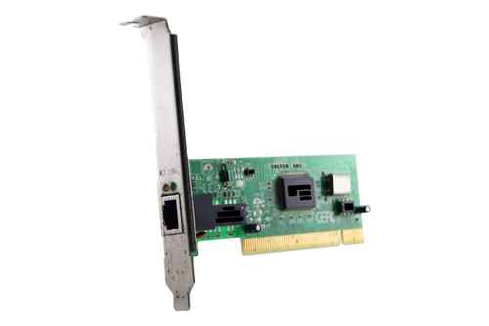
Ethernet NICs and Solicited-Node Multicasts
PC2 Processes the following IPv6 and Ethernet MAC Addresses
32 bits
 | Unicast Addresses | Solicited Node Multicast | Ethernet MAC
Ethernet NIC | N/A | N/A | 00-1B-24-04-A2-1E
Global Unicast | 2001:DB8:CAFE:1::200 | FF02::1:FF00:200 | 33-33-FF-00-02-00
Link-local | FE80::1111:2222:3333:4444 | FF02::1:FF33:4444 | 33-33-FF-33-44-44
Multicast (All-IPv6-Devices) | FF02::1 | N/A | 33-33-00-00-00-01
24 bits
Besides its own MAC address, the Ethernet NIC will accept multicast addresses created from the:
Solicited node multicast (global unicast address)
Solicited node multicast (link-local address)
Any assigned multicast address such as All-IPv6-Devices.
Mapping of IPv6 multicast to Ethernet addresses discussed soon.
00-1B-24-04-A2-1E
* Ethernet MAC addresses such as IPv4 broadcasts and those associated with other protocols are not shown.
LAN Card © Copyright lamart1971
Notes:
So when is the solicted node multicast and its associatated ethernet MAC used? Coming soon!

Slide 26
Verifying the Solicited-Node Multicasts
Router# show ipv6 interface gigabitethernet 0/0
GigabitEthernet0/0 is up, line protocol is up
IPv6 is enabled, link-local address is FE80::FE99:47FF:FE75:C3E0
Global unicast address(es):
2001:DB8:CAFE:1::1, subnet is 2001:DB8:CAFE:1::/64
Joined group address(es):
FF02::1
FF02::2
FF02::1:FF00:1
FF02::1:FF75:C3E0
<output omitted for brevity>
Member of these Multicast Groups
All-IPv6 devices on this link
All-IPv6 routers on this link: IPv6 routing enabled
Solicited-node multicast address Global Unicast
Solicited-node multicast address link-local
FF02 – “2” means link-local scope
Router’s NIC will process destination MAC addresses for assigned and solicited node multicasts such as 33-33-FF-00-00-01 and 33-33-FF-75-C3-E0 (solicited node)

Slide 27
6.4: IPv6 Solicited-Node Multicast Example

Slide 28
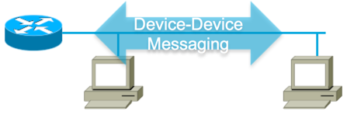
ICMPv6 ND – Address Resolution
Know IPv4, what is the MAC?
My IPv4! Here is the MAC…
2
1
PC2
ARP Reply
ARP Request
PC1
ARP Cache
3
My IPv6! Here is the MAC…
2
1
Neighbor Advertisement
Neighbor Solicitation
Know IPv6, what is the MAC?
Neighbor Cache
3
IP to data link (MAC) address mapping:
IPv4 addresses use ARP
IPv6 addressing use ICMPv6 Neighbor Discovery messages
Neighbor Solicitation (via Solicited-Node)
Neighbor Advertisement
Devices store this mapping in their Neighbor Cache
ICMPv6 Neighbor Discovery
Neighbor Solicitation
Neighbor Advertisement

Slide 29
Advantages of Solicited-Node Multicast
IPv4 ARP Requests
Destination MAC Address: Layer 2 Broadcast
Data must be passed by NIC to upper layer for processing – examine target IPv4 address.
Ethernet Broadcast passed to upper layer
Ethernet
ARP Message
DA: Broadcast
ARP Message with Target IPv4 Address
IPv6 Address Resolution
Destination IPv6: Solicited-Node Multicast
Destination MAC Address: Layer 2 Multicast
Ethernet Multicast filtered by the NIC
Ethernet
IPv6
ICMPv6 NS
DA: Multicast
DA: Solicited-Node Multicast
ICMPv6 NS with Target IPv6 Address
Notes:
ARP Requests: Layer 2 broadcasts:
Ethernet broadcasts are sent to all devices.
Flood the entire broadcast domain (subnet/VLAN).
Ethernet NIC must process the frame.
Any filtering is done by a higher layer protocol such as ARP.
Solicited Node Multicasts: Layer 2 and Layer 3 multicasts:
Although solicited node multicasts are forwarded out all ports by the switch, ….
Layer 2 multicast allows frames to be filtered by the NIC and not have send data to an upper layer protocol for inspection.

Slide 30
My IPv6! Here is the MAC?
Solicited-Node Example
Know IPv6, what is the MAC?
2001:DB8:CAFE:1::/64
PC2
4
3
PC1
Neighbor Advertisement
Neighbor Solicitation
MAC Address
00-1B-24-04-A2-1E
MAC Address
00-21-9B-D9-C6-44
2001:DB8:CAFE:1::200/64
FF02::1:FF00:200 (Solicited Node Multicast)
2001:DB8:CAFE:1::100/64
2
5
Neighbor Cache
2001:DB8:CAFE:1::200
00-1B-24-04-A2-1E
ICMPv6 NS: Target IPv6 Address (GUA of PC2)
Destination IPv6: Solicited-Node Multicast
Destination MAC Address: Layer 2 Multicast
1
PC1> ping 2001:DB8:CAFE:1::200
Ethernet
IPv6
ICMPv6 Neighbor Solicitation
Destination MAC:
33-33-FF-00-02-00
Destination Address:
FF02::1::FF00:200
Target IPv6 Address
2001:DB8:CAFE:1::200

Slide 31
Neighbor Solicitation from PC1 (IPv4 ARP Request)
Ethernet II, Src: 00:21:9b:d9:c6:44, Dst: 33:33:ff:00:02:00
Internet Protocol Version 6
0110 .... = Version: 6
.... 0000 0000 .... .... .... .... .... = Traffic class: 0x00000000
.... .... .... 0000 0000 0000 0000 0000 = Flowlabel: 0x00000000
Payload length: 32
Next header: ICMPv6 (0x3a)
Hop limit: 255
Source: 2001:db8:cafe:1::100
Destination: ff02::1:ff00:200
Internet Control Message Protocol v6
Type: 135 (Neighbor solicitation)
Code: 0
Target: 2001:db8:cafe:1::200
ICMPv6 Option (Source link-layer address)
Type: Source link-layer address (1)
Length: 8
Link-layer address: 00:21:9b:d9:c6:44
Mapped multicast address for PC2
Global unicast address of PC1
Solicited-node multicast address of PC2
Neighbor Solicitation message
Target IPv6 address, needing MAC address (if two devices have the same solicited node address, this resolves the issue)
Note: Some fields omitted for brevity.

Slide 32
Neighbor Advertisement from PC2 (IPv4 ARP Reply)
Ethernet II, Src: 00:1b:24:04:a2:1e, Dst: 00:21:9b:d9:c6:44
Internet Protocol Version 6
0110 .... = Version: 6
.... 0000 0000 .... .... .... .... .... = Traffic class: 0x00000000
.... .... .... 0000 0000 0000 0000 0000 = Flowlabel: 0x00000000
Payload length: 32
Next header: ICMPv6 (0x3a)
Hop limit: 255
Source: 2001:db8:cafe:1::200
Destination: 2001:db8:cafe:1::100
Internet Control Message Protocol v6
Type: 136 (Neighbor advertisement)
Code: 0
Target: 2001:db8:cafe:1::200
ICMPv6 Option (Target link-layer address)
Type: Target link-layer address (2)
Length: 8
Link-layer address: 00:1b:24:04:a2:1e
Unicast addresses
Unicast addresses
Neighbor Advertisement message
IPv6 address of the sender, PC2
MAC address of the sender, PC2
Notes:
This goes into the neighbor cache (ARP Cache) for PC1

Slide 33
6.5: Mapping IPv6 Multicast to Ethernet Multicast

Slide 34
Mapping IPv6 Multicast to Ethernet Addresses
IPv6 Addresses
Multicast
Assigned
Solicited-Node
FF00::/8
FF02::1:FF00:0000/104
Ethernet MAC
33-33-xx-xx-xx-xx
On Ethernet links, all IPv6 Multicast Addresses are mapped to Ethernet MAC addresses.

Slide 35
Mapping IPv6 Multicast to Ethernet Addresses
Assigned Multicast
Assigned Multicast | Description (IPv6 assumed) | Ethernet MAC Address
FF02::1 | All-devices | 33-33-00-00-00-01
FF02::2 | All-routers | 33-33-00-00-00-02
FF02::5 | OSPF routers | 33-33-00-00-00-05
FF02::A | EIGRP routers | 33-33-00-00-00-0A
48-bit MAC addresses used for IPv6 multicast, range from: 33-33-00-00-00-00 to 33-33-FF-FF-FF-FF
Low-order 32 bits of IPv6 multicast address mapped to low-order 32 bits of MAC address.
Why 33-33?
Notes:
Source address (IPv6 and Ethernet) are always unicast

Slide 36
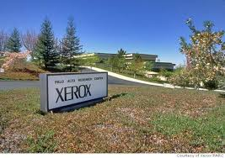

Why 33-33?
Ethernet IPv6 Multicast
Destination MAC:
33-33-xx-xx-xx-xx
3333 Coyote Hill Road, Palo Alto, California, is the address of XEROX PARC
Image courtesy of Computer History Museum
Image courtesy of Xerox PARC
Notes:
RFC 7042 Historical note: It was the custom during IPv6 design to use "3” for unknown or example values, and 3333 Coyote Hill Road, Palo Alto, California, is the address of PARC (Palo Alto Research Center, formerly "Xerox PARC”). Ethernet was initially developed at Xerox PARC.
GUI, mouse, ALTO, Ethernet,
Computer History Museum – ever in the San Jose, Ca area a must place to visit. Really!

Slide 37
Mapping IPv6 Multicast to Ethernet Addresses
Ethernet Multicast Destination Address
IPv6 Multicast Destination Address
33-33-00-00-00-01
FF02::1 (All-devices)
Rest of IPv6 Packet
33-33-00-00-00-02
FF02::2 (All-routers)
Rest of IPv6 Packet
33-33-00-00-00-0A
FF02::A (EIGRP routers)
Rest of IPv6 Packet
Another view of assigned IPv6 multicast address mappings to Ethernet MAC addresses.

Slide 38
Mapping IPv6 Solicited-Node Multicast Addresses
IPv6 Addresses
Multicast
Assigned
Solicited-Node
Unicast: GUA, Link-Local,…
FF00::/8
FF02::1:FF00:0000/104
Ethernet MAC
33-33-xx-xx-xx-xx
Remember, all IPv6 unicast addresses also have an associated IPv6 solicited-node multicast address.
Each solicited-node multicast address is mapped to an Ethernet MAC address.

Slide 39
Once Again: Ethernet NICs and Multicast Addresses
PC2 Processes the following IPv6 and Ethernet MAC Addresses
32 bits
 | Unicast Addresses | Solicited Node Multicast | Ethernet MAC
Ethernet NIC | N/A | N/A | 00-1B-24-04-A2-1E
Global Unicast | 2001:DB8:CAFE:1::200 | FF02::1:FF00:200 | 33-33-FF-00-02-00
Link-local | FE80::1111:2222:3333:4444 | FF02::1:FF33:4444 | 33-33-FF-33-44-44
Multicast (All-IPv6-Devices) | FF02::1 | N/A | 33-33-00-00-00-01
24 bits
Besides its own MAC address, the Ethernet NIC will accept multicast addresses created from the:
Solicited node multicast (global unicast address)
Solicited node multicast (link-local address)
Any assigned multicast address such as All-IPv6-Devices.
* Ethernet MAC addresses such as IPv4 broadcasts and those associated with other protocols are not shown.
LAN Card © Copyright lamart1971

Slide 40
6.6: Multicast Listener Discovery

Slide 41
Source for group
FF3E:40:2001:DB8:CAFE:1:AAAA:AAAA
FF3E:40:2001:DB8:CAFE:1:BBBB:BBBB
MLDv2 Joining a Group
General query to FF02::1
R1
(All-IPv6 devices with link-scope)
MLD Querier
Never mind, “A” got it.
A
B
C
Listener Report for group
FF3E:40:2001:DB8:CAFE:1:AAAA:AAAA
to FF02::16 (All MLDv2 Routers)
Listener Report for group
FF3E:40:2001:DB8:CAFE:1:BBBB:BBBB
to FF02::16 (All MLDv2 Routers)
Suppressed Listener Report for group
FF3E:40:2001:DB8:CAFE:1:AAAA:AAAA
to FF02::16 (All MLDv2 Routers)
Multicast Listener Discovery (MLDv2) for IPv6 similar to Internet Group Management Protocol (IGMPv2) for IPv4.
Hosts use MLD to dynamically register themselves in a multicast group on a particular network.
Hosts send Listener Report messages to their local multicast router, informing the router as to which multicast addresses it wants to receive traffic.
Routers configured for MLD (MLD Queriers) listen to Listener Report messages from hosts.
Routers periodically send out queries to discover which multicast groups are still active.
Notes:
Multicast addresses using RFC 3306 Unicast-Prefix-based IPv6 Multicast Addresses

Slide 42
Source for group
FF3E:40:2001:DB8:CAFE:1:AAAA:AAAA
FF3E:40:2001:DB8:CAFE:1:BBBB:BBBB
MLDv2 Leaving a Group
Is there anyone else?
MLD Querier
Address specific query for
FF3E:40:2001:DB8:CAFE:1:AAAA:AAAA
Traffic continues for
FF3E:40:2001:DB8:CAFE:1:AAAA:AAAA
R1
to FF3E:40:2001:DB8:CAFE:1:AAAA:AAAA
A
I’m done.
B
C
I still want it!
Listener Done for group
FF3E:40:2001:DB8:CAFE:1:AAAA:AAAA
to FF02::16 (All MLDv2 Routers)
Listener Report for group
FF3E:40:2001:DB8:CAFE:1:AAAA:AAAA
to FF02::16 (All MLDv2 Routers)
When a host no longer wants to receive traffic for a multicast group, it can inform the router by sending a Multicast Listener Done message.

Slide 43
MLDv2 Snooping
MLD Querier
I will send packets for this group out this interface.
I will also send packets for this group out this interface.
R1
A
C
Listener Report for group
FF3E:40:2001:DB8:CAFE:1:AAAA:AAAA
to FF02::16 (All MLDv2 Routers)
B
Listener Report for group
FF3E:40:2001:DB8:CAFE:1:AAAA:AAAA
to FF02::16 (All MLDv2 Routers)
A switch can snoop Listener Reports from the hosts and creates an entry in its Layer 2 forwarding table for the port it was received.
If another host sends a listener report for the same group, the switch snoops their reports and adds them to the existing Layer 2 forwarding table entry.
With MLD snooping enabled, multicast messages for this group are only sent out ports with hosts that are members of that group.
Remember, solicited node multicasts are forwarded out all ports because of the potentially huge forwarding tables needed to to store these addresses.
Notes:
http://www.cisco.com/c/en/us/td/docs/switches/lan/catalyst6500/ios/12-2SX/configuration/guide/book/snoopmld.html
ipv6 mld snooping
Globally enable MLD snooping on the switch.
Router# interface vlan 200
Router(config-if)# ipv6 address 2001:0DB8:0:1::/64 eui-64
Router(config-if)# ipv6 mld snooping querier
Router(config-if)# end
This example shows how to enable MLD snooping on VLAN 25 and verify the configuration:
Router# interface vlan 25
Router(config-if)# ipv6 mld snooping
This example shows how to enable MLD snooping globally and verify the configuration:
Router(config)# ipv6 mld snooping
Router(config)# end

Slide 44
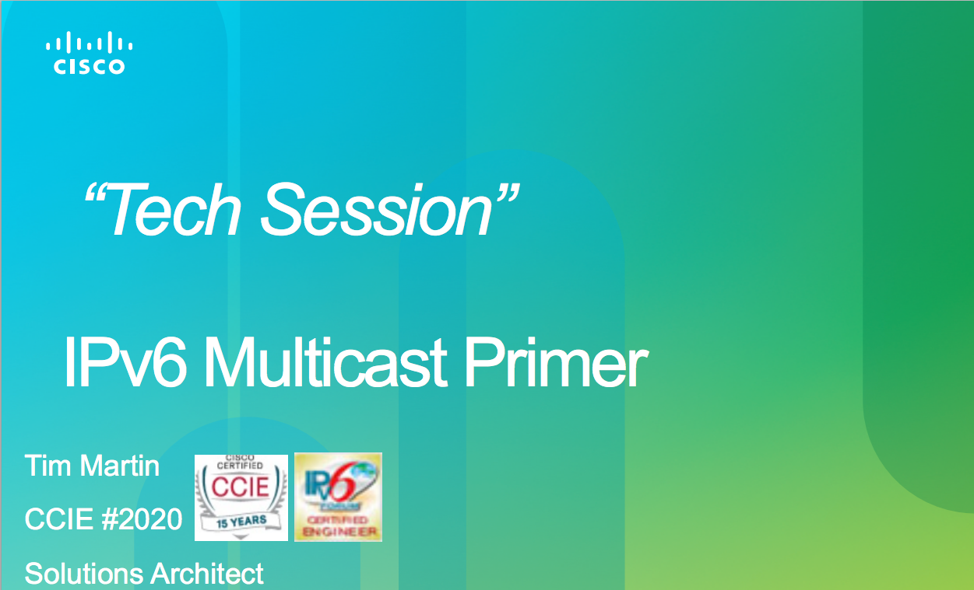
For more on IPv6 Multicast
MLD Querier
I will send packets for this group out this interface.
I will also send packets for this group out this interface.
R1
A
C
Listener Report for group
FF3E:40:2001:DB8:CAFE:1:AAAA:AAAA
to FF02::16 (All MLDv2 Routers)
B
Listener Report for group
FF3E:40:2001:DB8:CAFE:1:AAAA:AAAA
to FF02::16 (All MLDv2 Routers)
For more on Multicast and MLD see IPv6 Multicast Primer (PowerPoint PDF) by Tim Martin (CCIE #2020, Cisco Solutions Architect)
Notes:
http://www.txv6tf.org/wp-content/uploads/2013/07/Martin-IPv6-Multicast-TM-v3.pdf

Slide 45
For more information please check out my Cisco Press book and video series:
IPv6 Fundamentals: A Straightforward Approach to Understanding IPv6
By Rick Graziani
ISBN-10: 1-58714-313-5
IPv6 Fundamentals LiveLessons: A Straightforward Approach to Understanding IPv6
By Rick Graziani
ISBN-10: 1-58720-457-6

Slide 46
6: IPv6 Multicast Addresses
Rick Graziani
Cabrillo College
Rick.Graziani@cabrillo.edu

