Slide 1
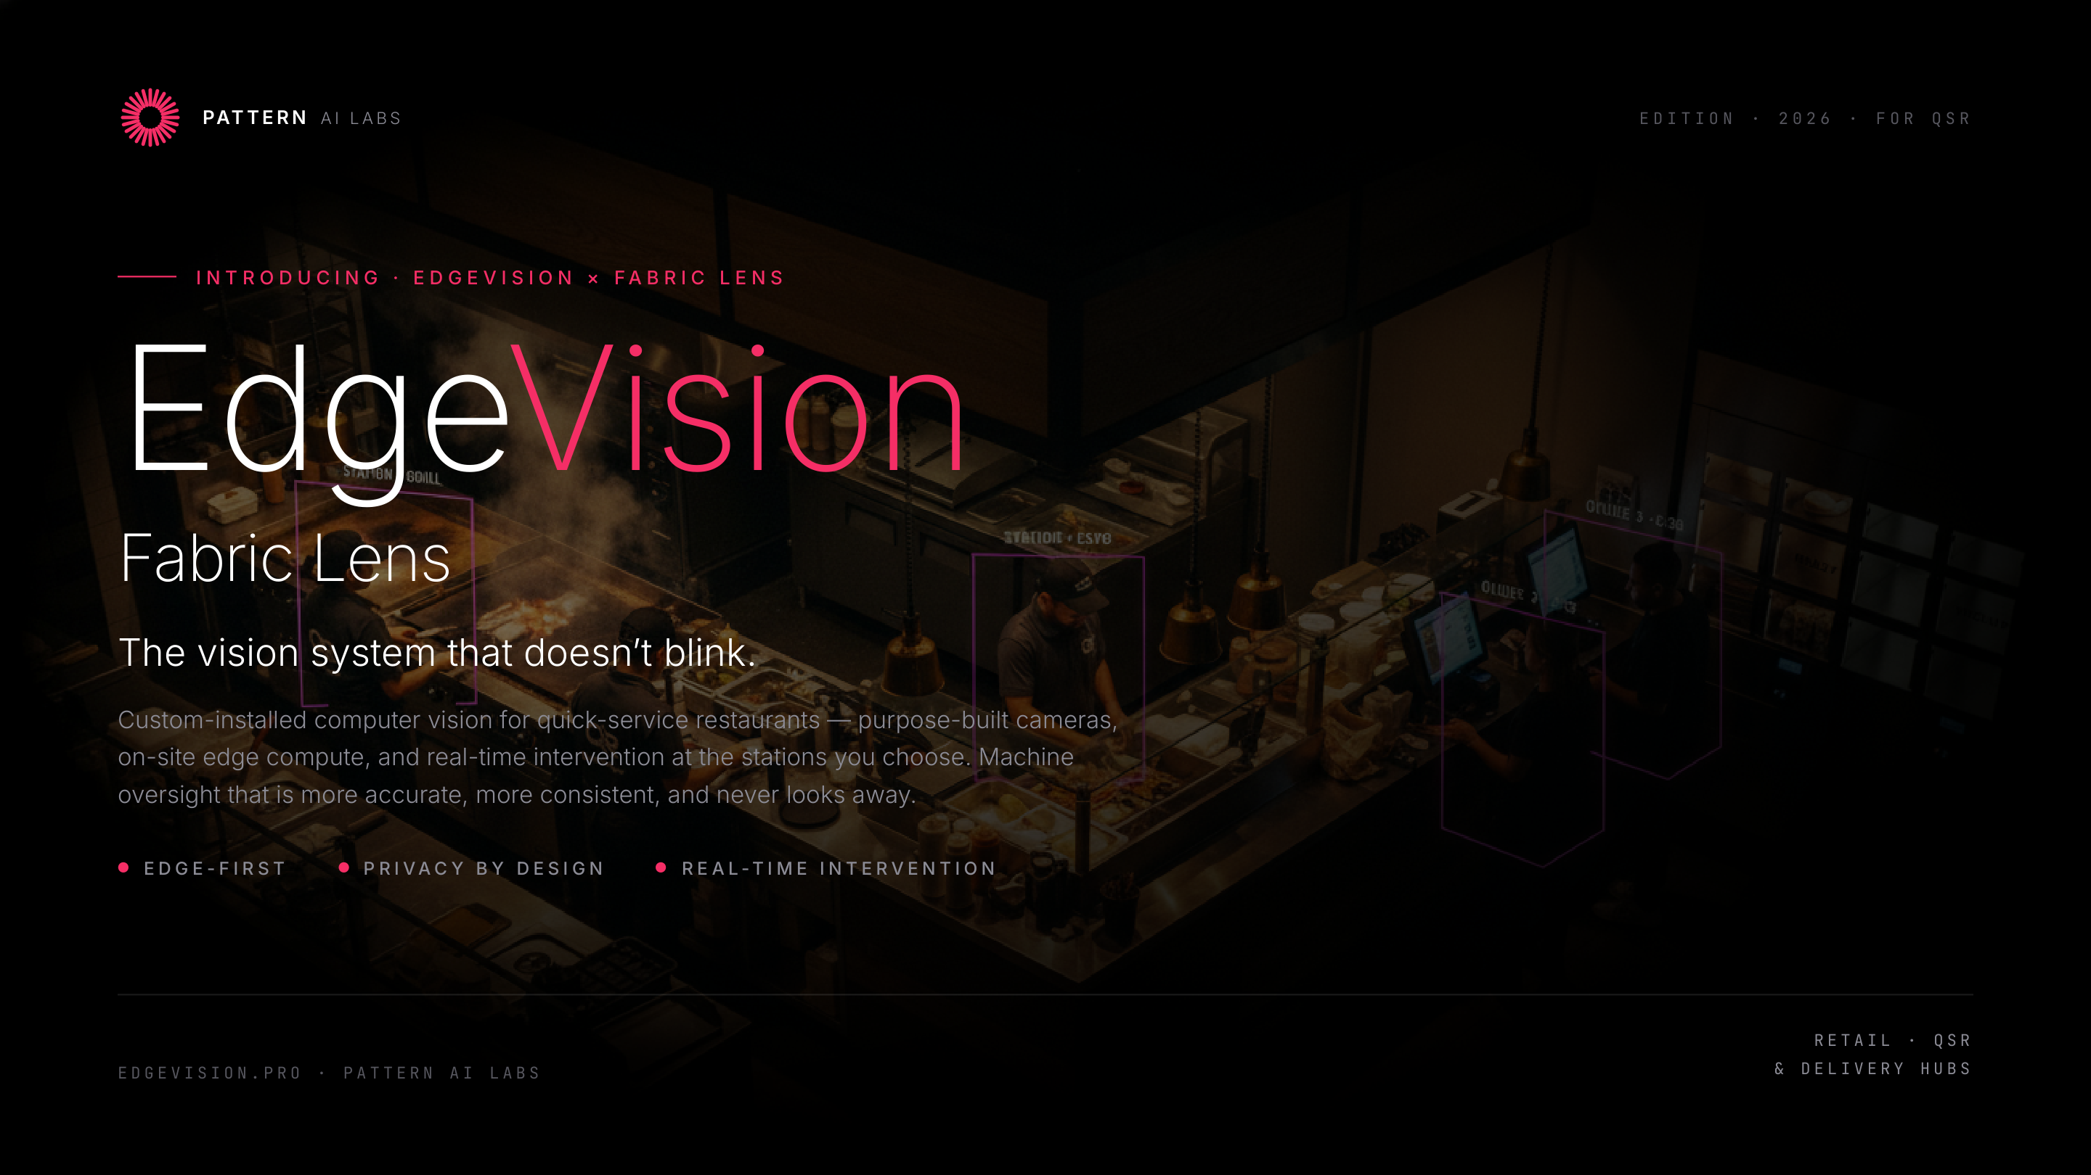
Notes:
Cover — EdgeVision Fabric Lens · Pattern AI Labs

Slide 2
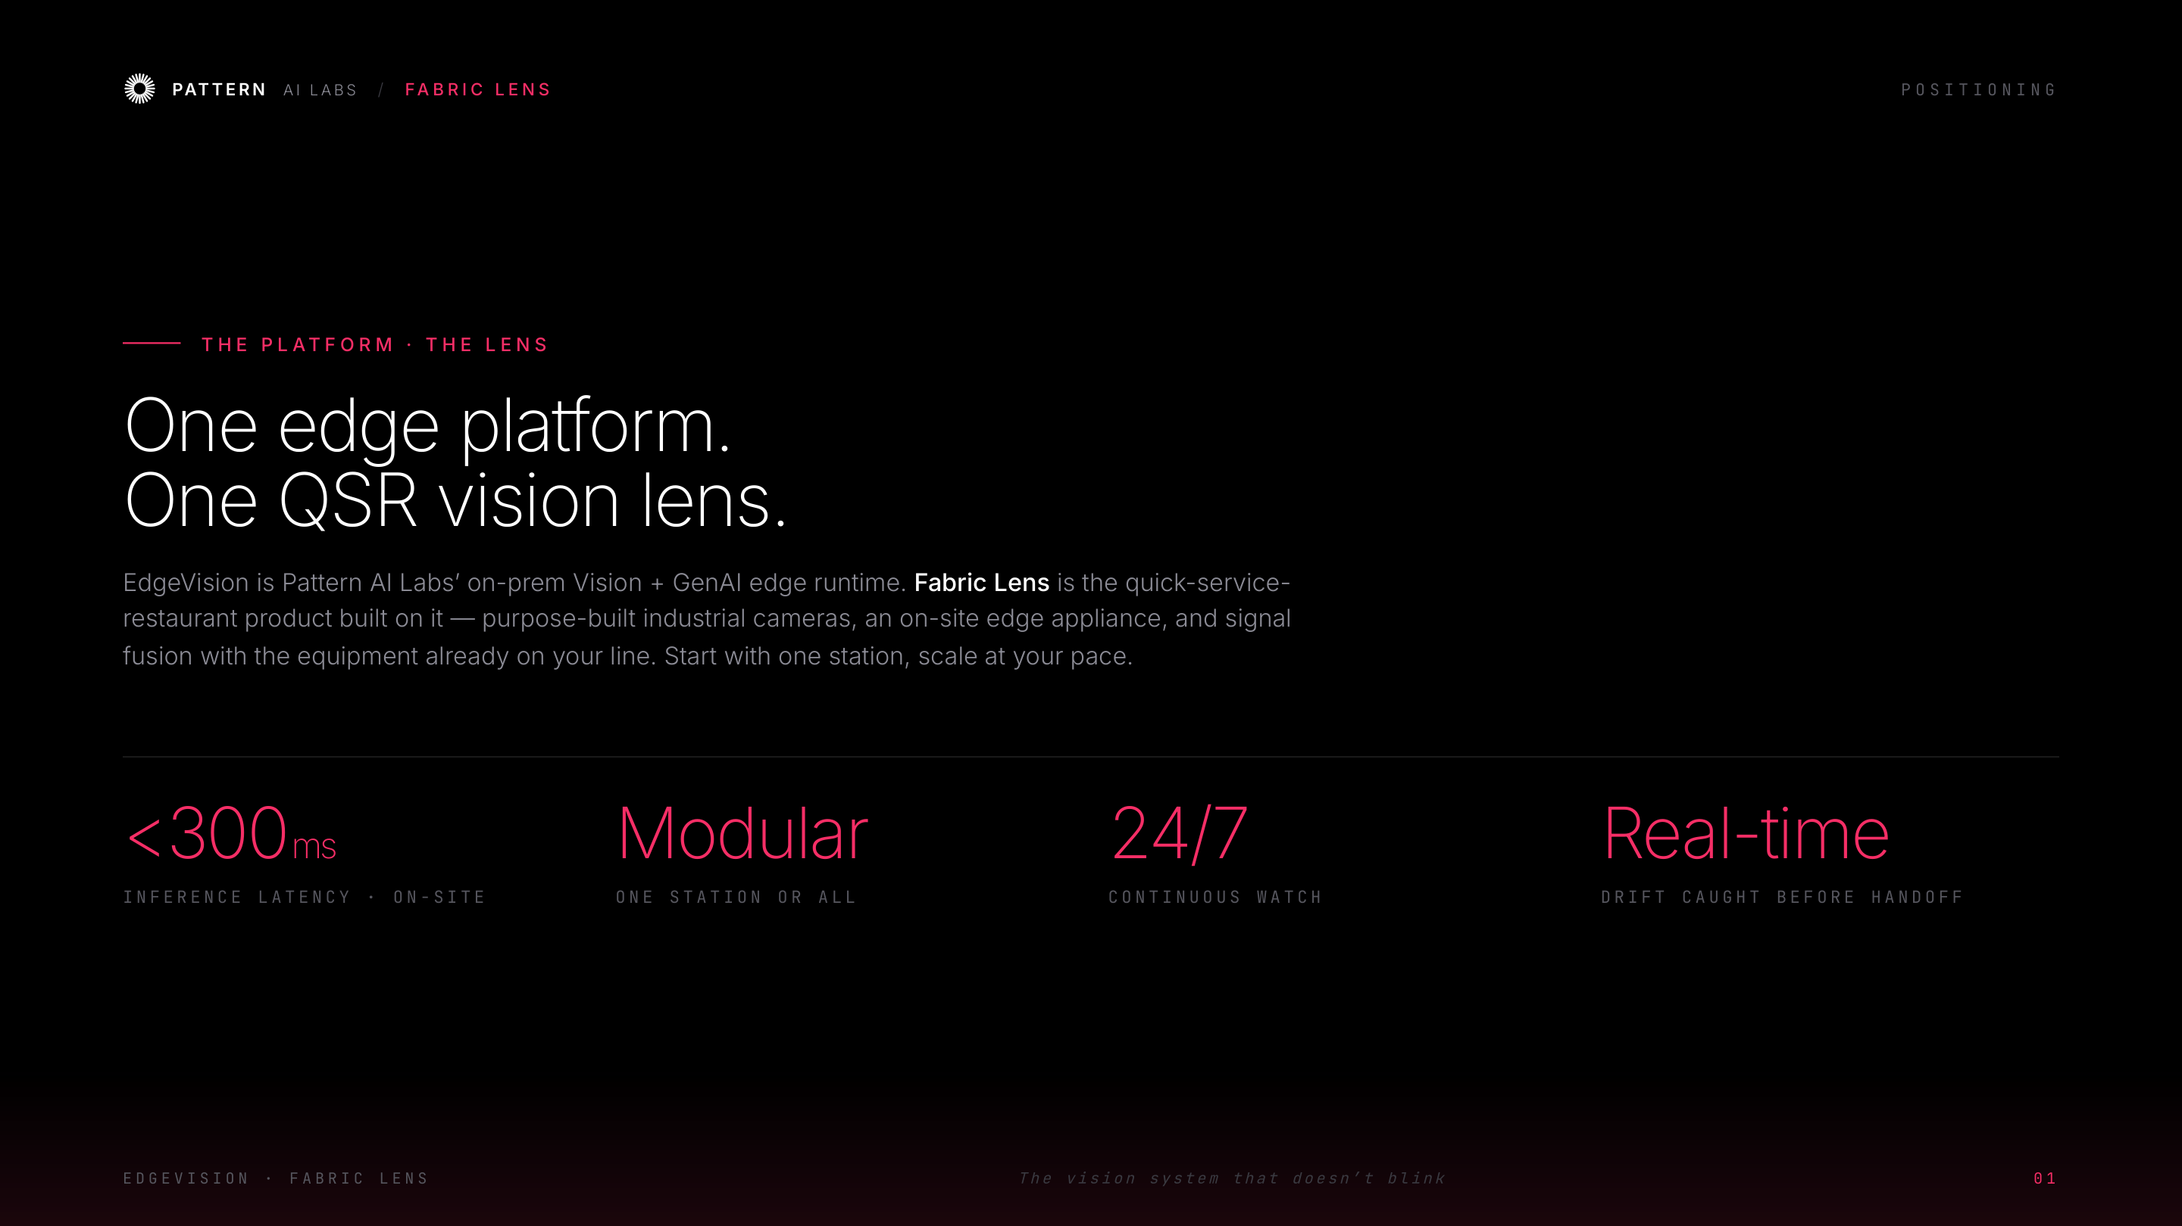
Notes:
Positioning — one edge platform, one QSR vision lens

Slide 3
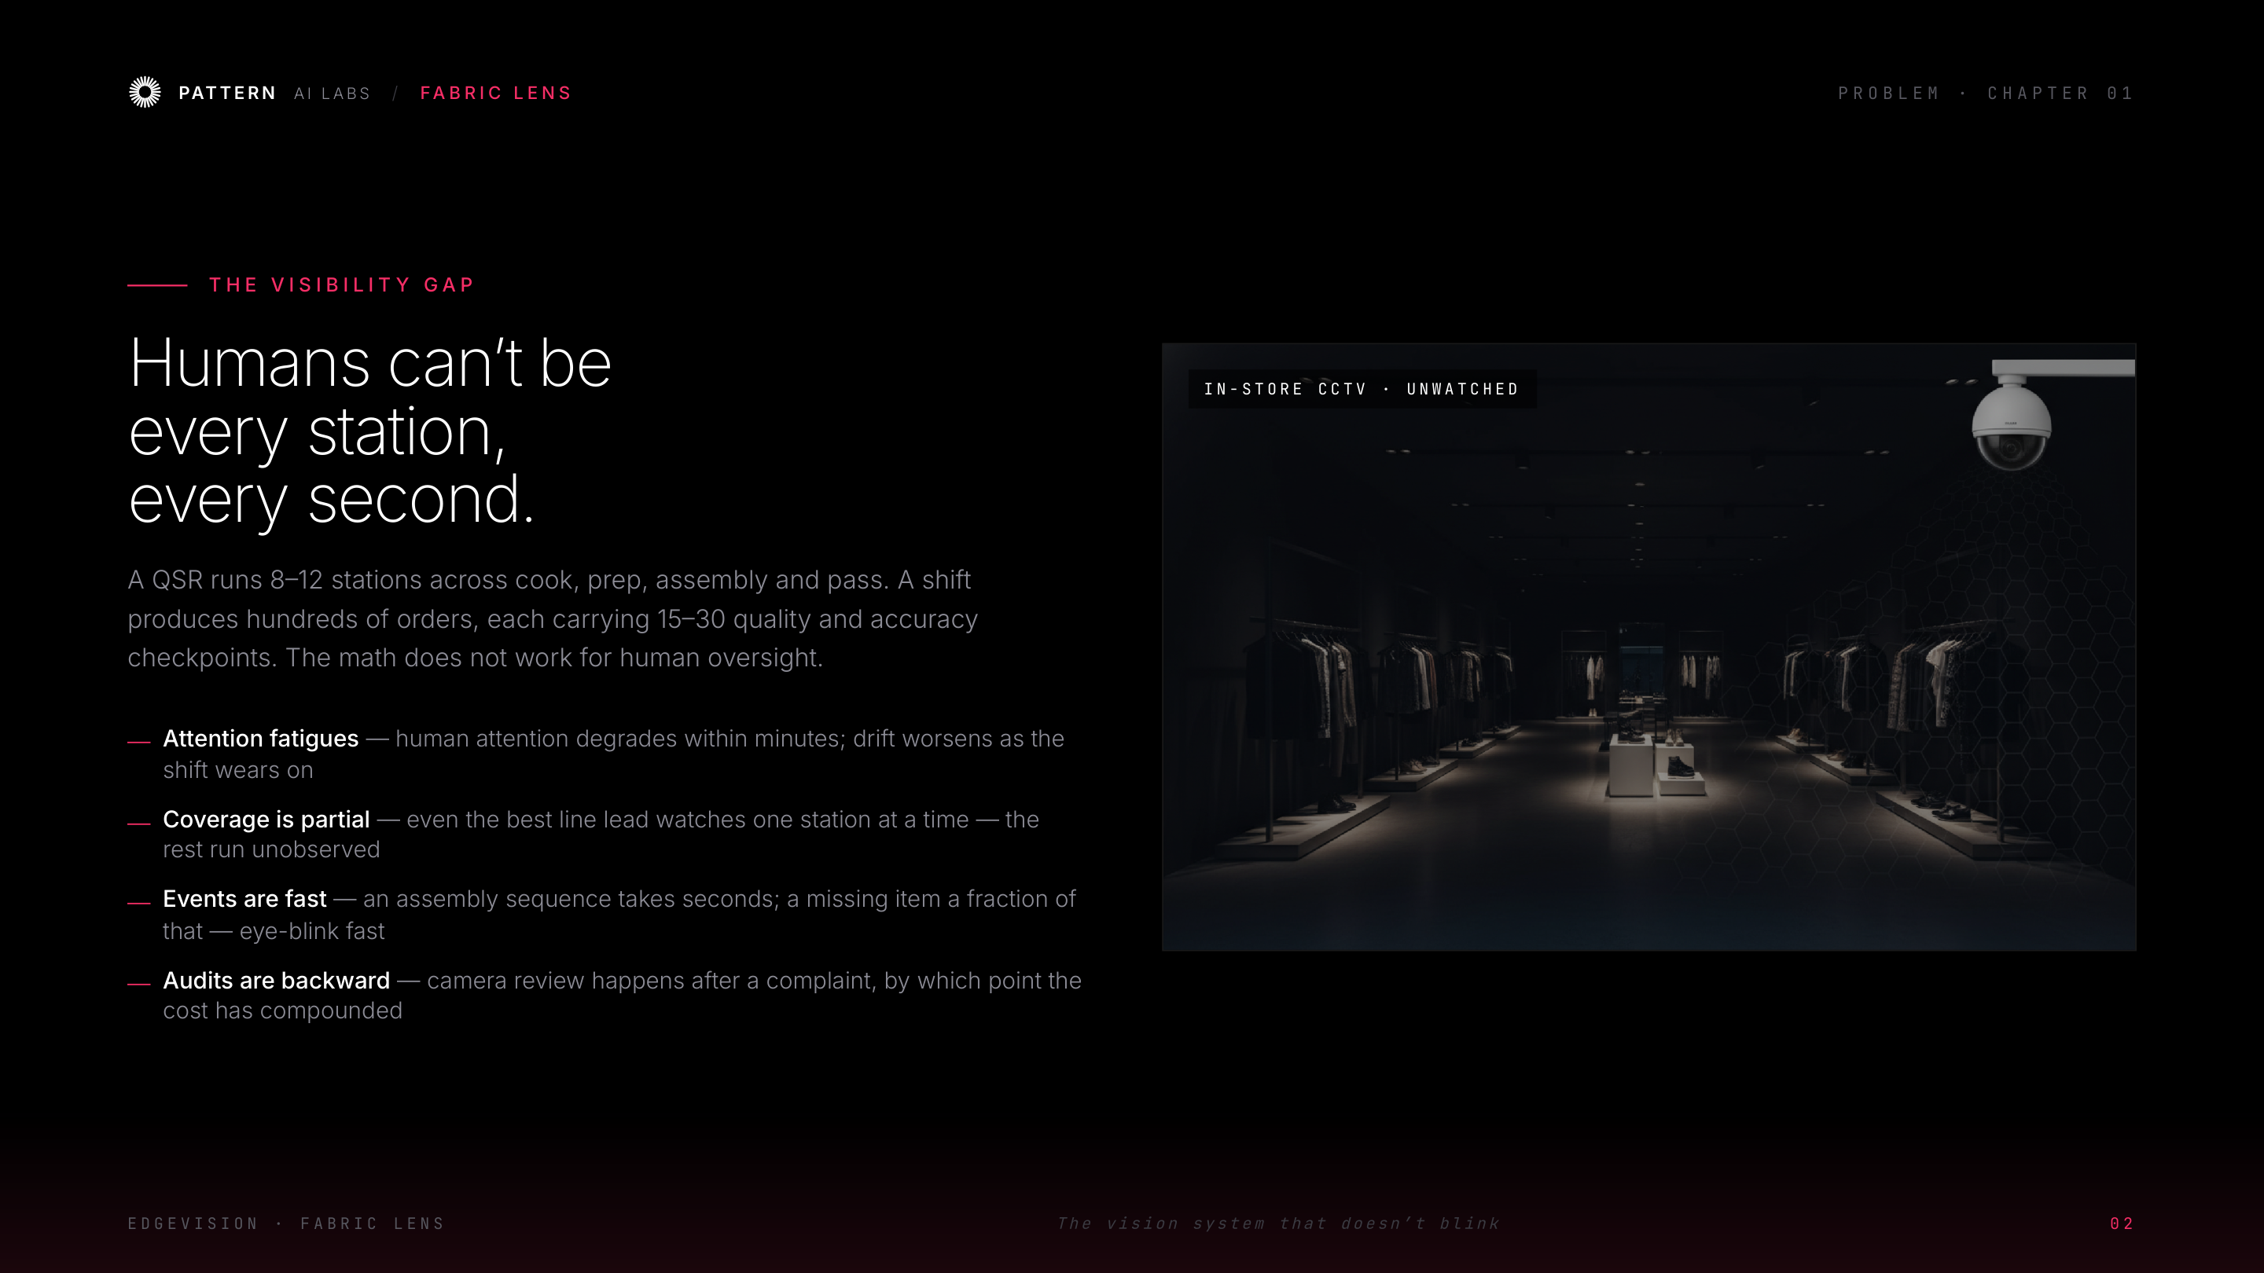
Notes:
Problem — the visibility gap

Slide 4
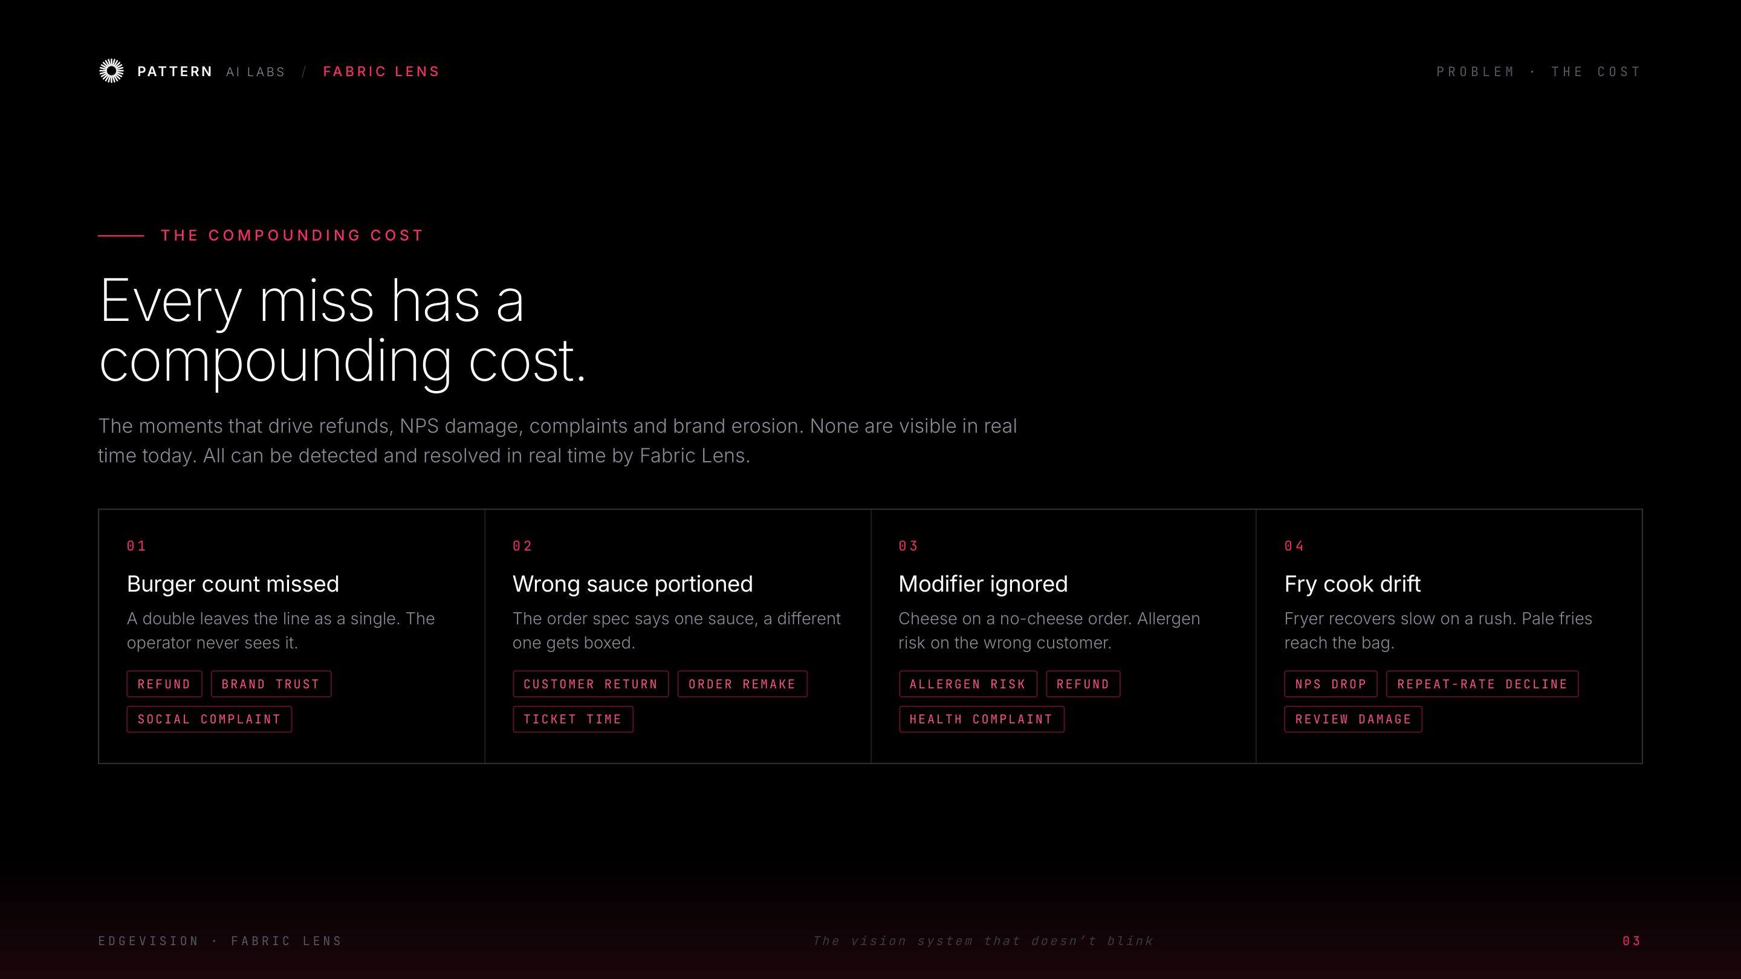
Notes:
Problem — the compounding cost

Slide 5
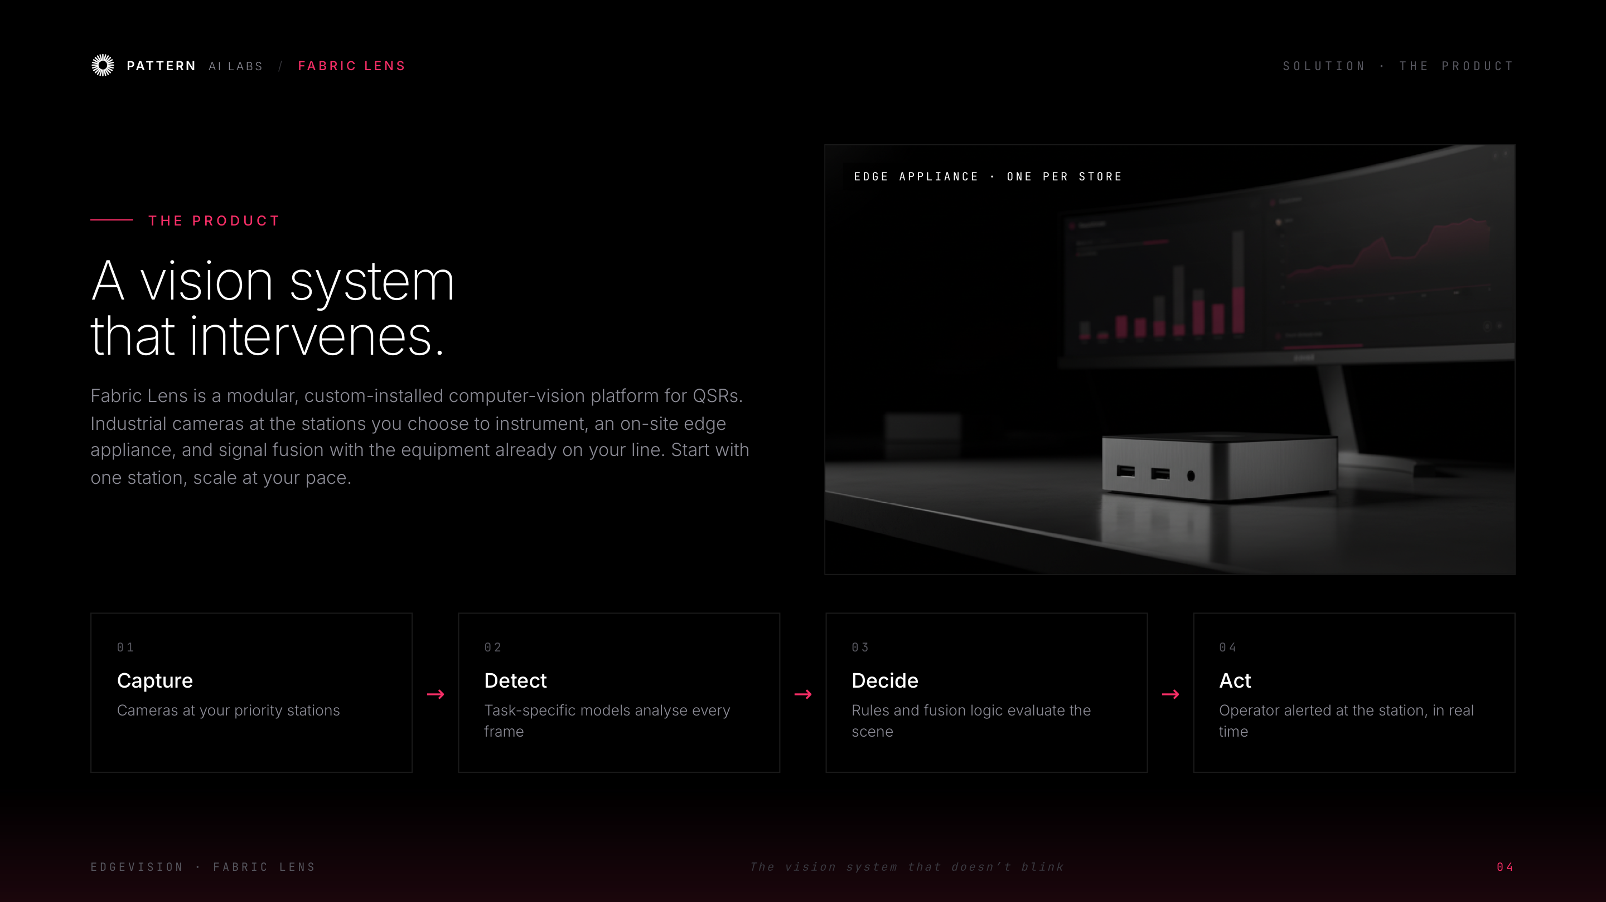
Notes:
Solution — a vision system that intervenes

Slide 6
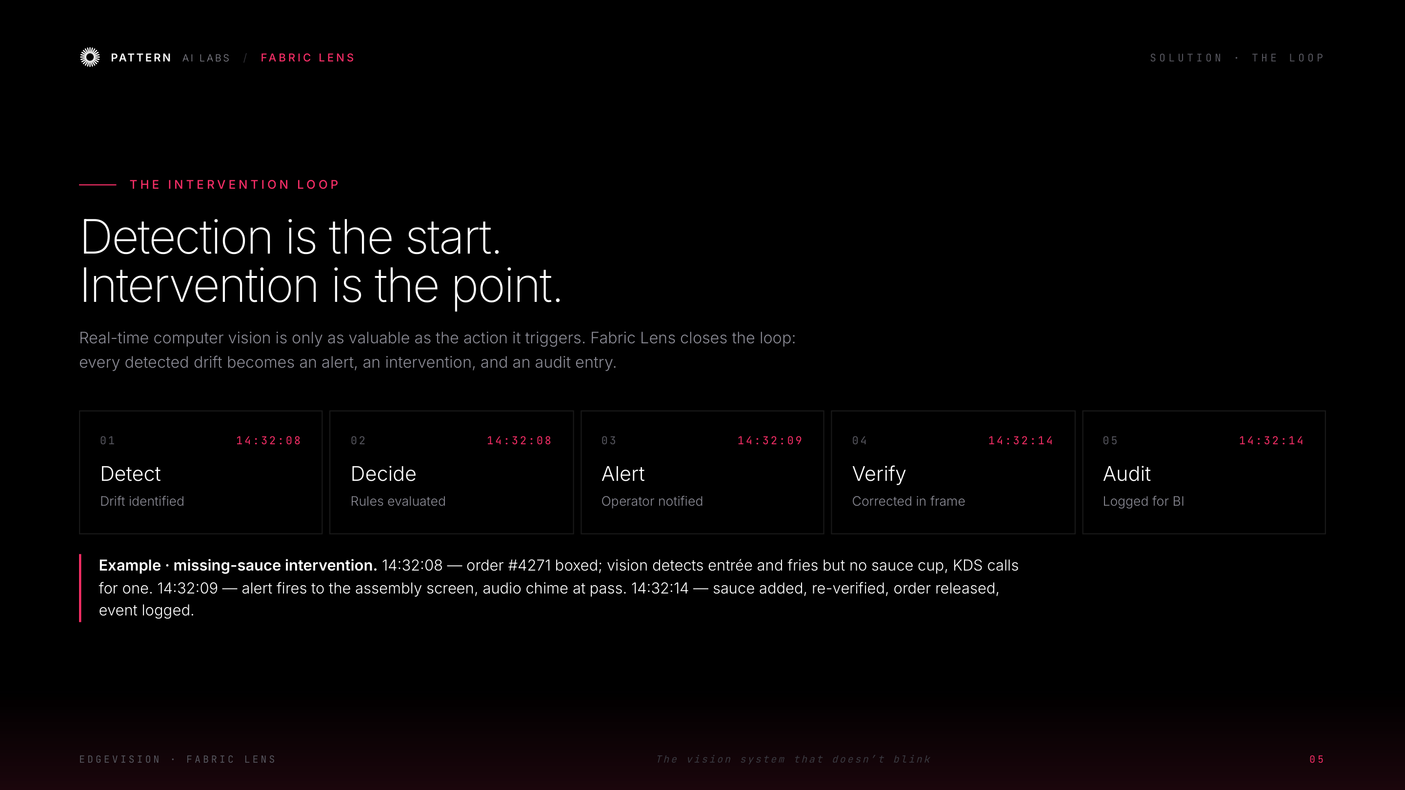
Notes:
Solution — the intervention loop

Slide 7
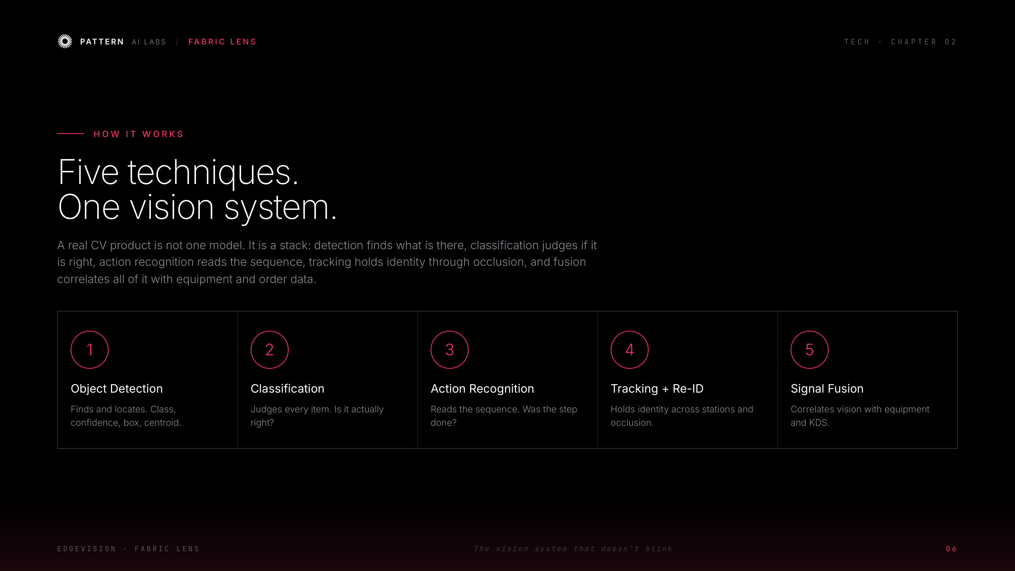
Notes:
Tech — five techniques, one vision system

Slide 8
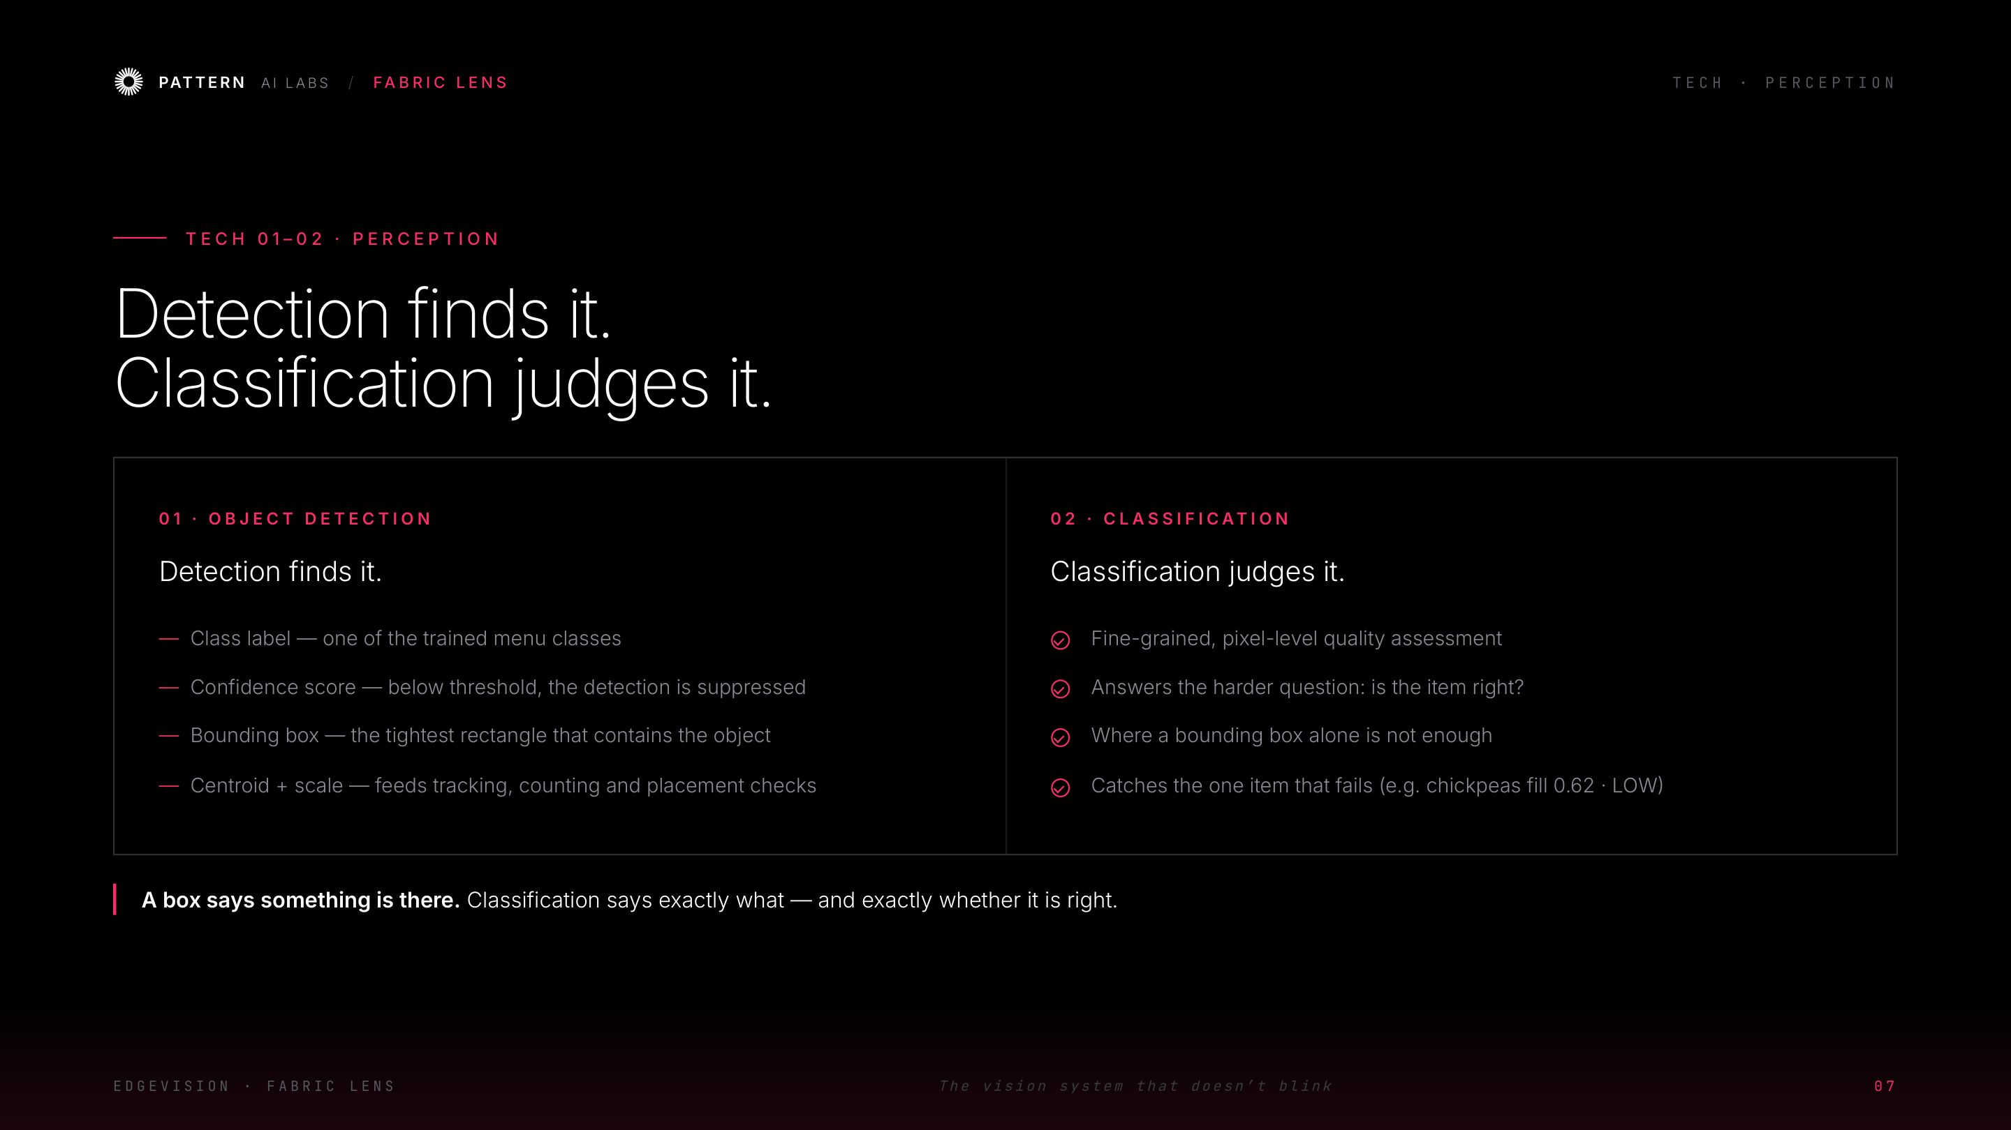
Notes:
Tech — object detection & classification

Slide 9
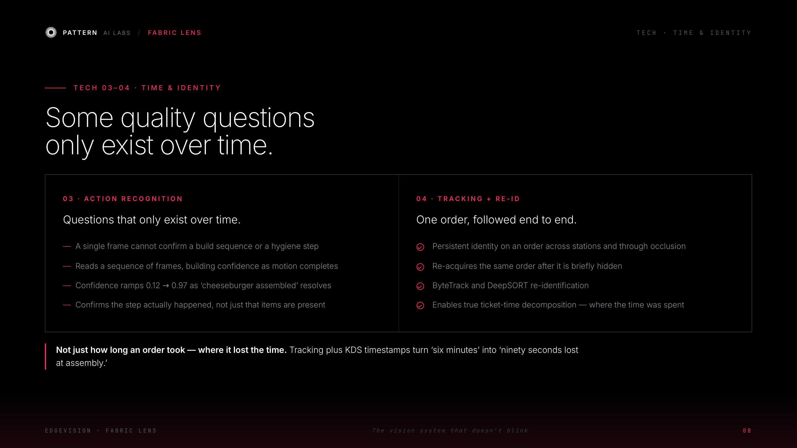
Notes:
Tech — action recognition & tracking/re-ID

Slide 10
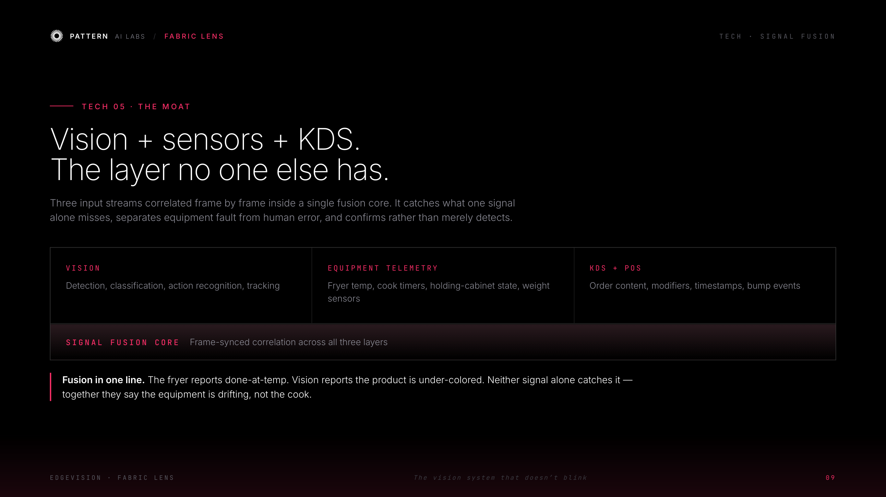
Notes:
Tech — signal fusion (the moat)

Slide 11
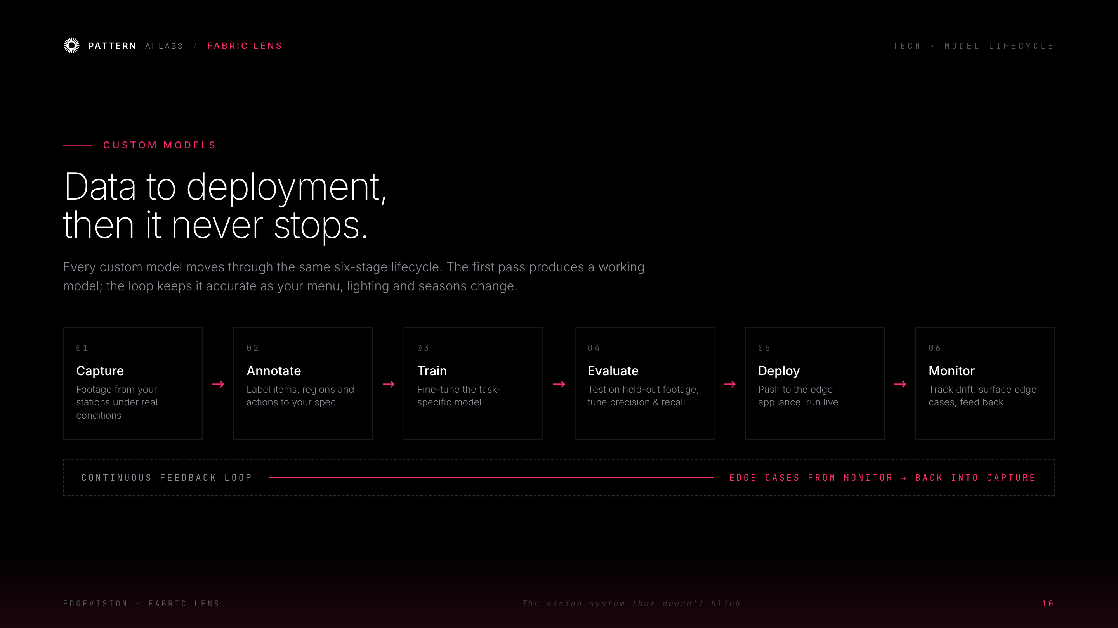
Notes:
Tech — custom-model lifecycle

Slide 12
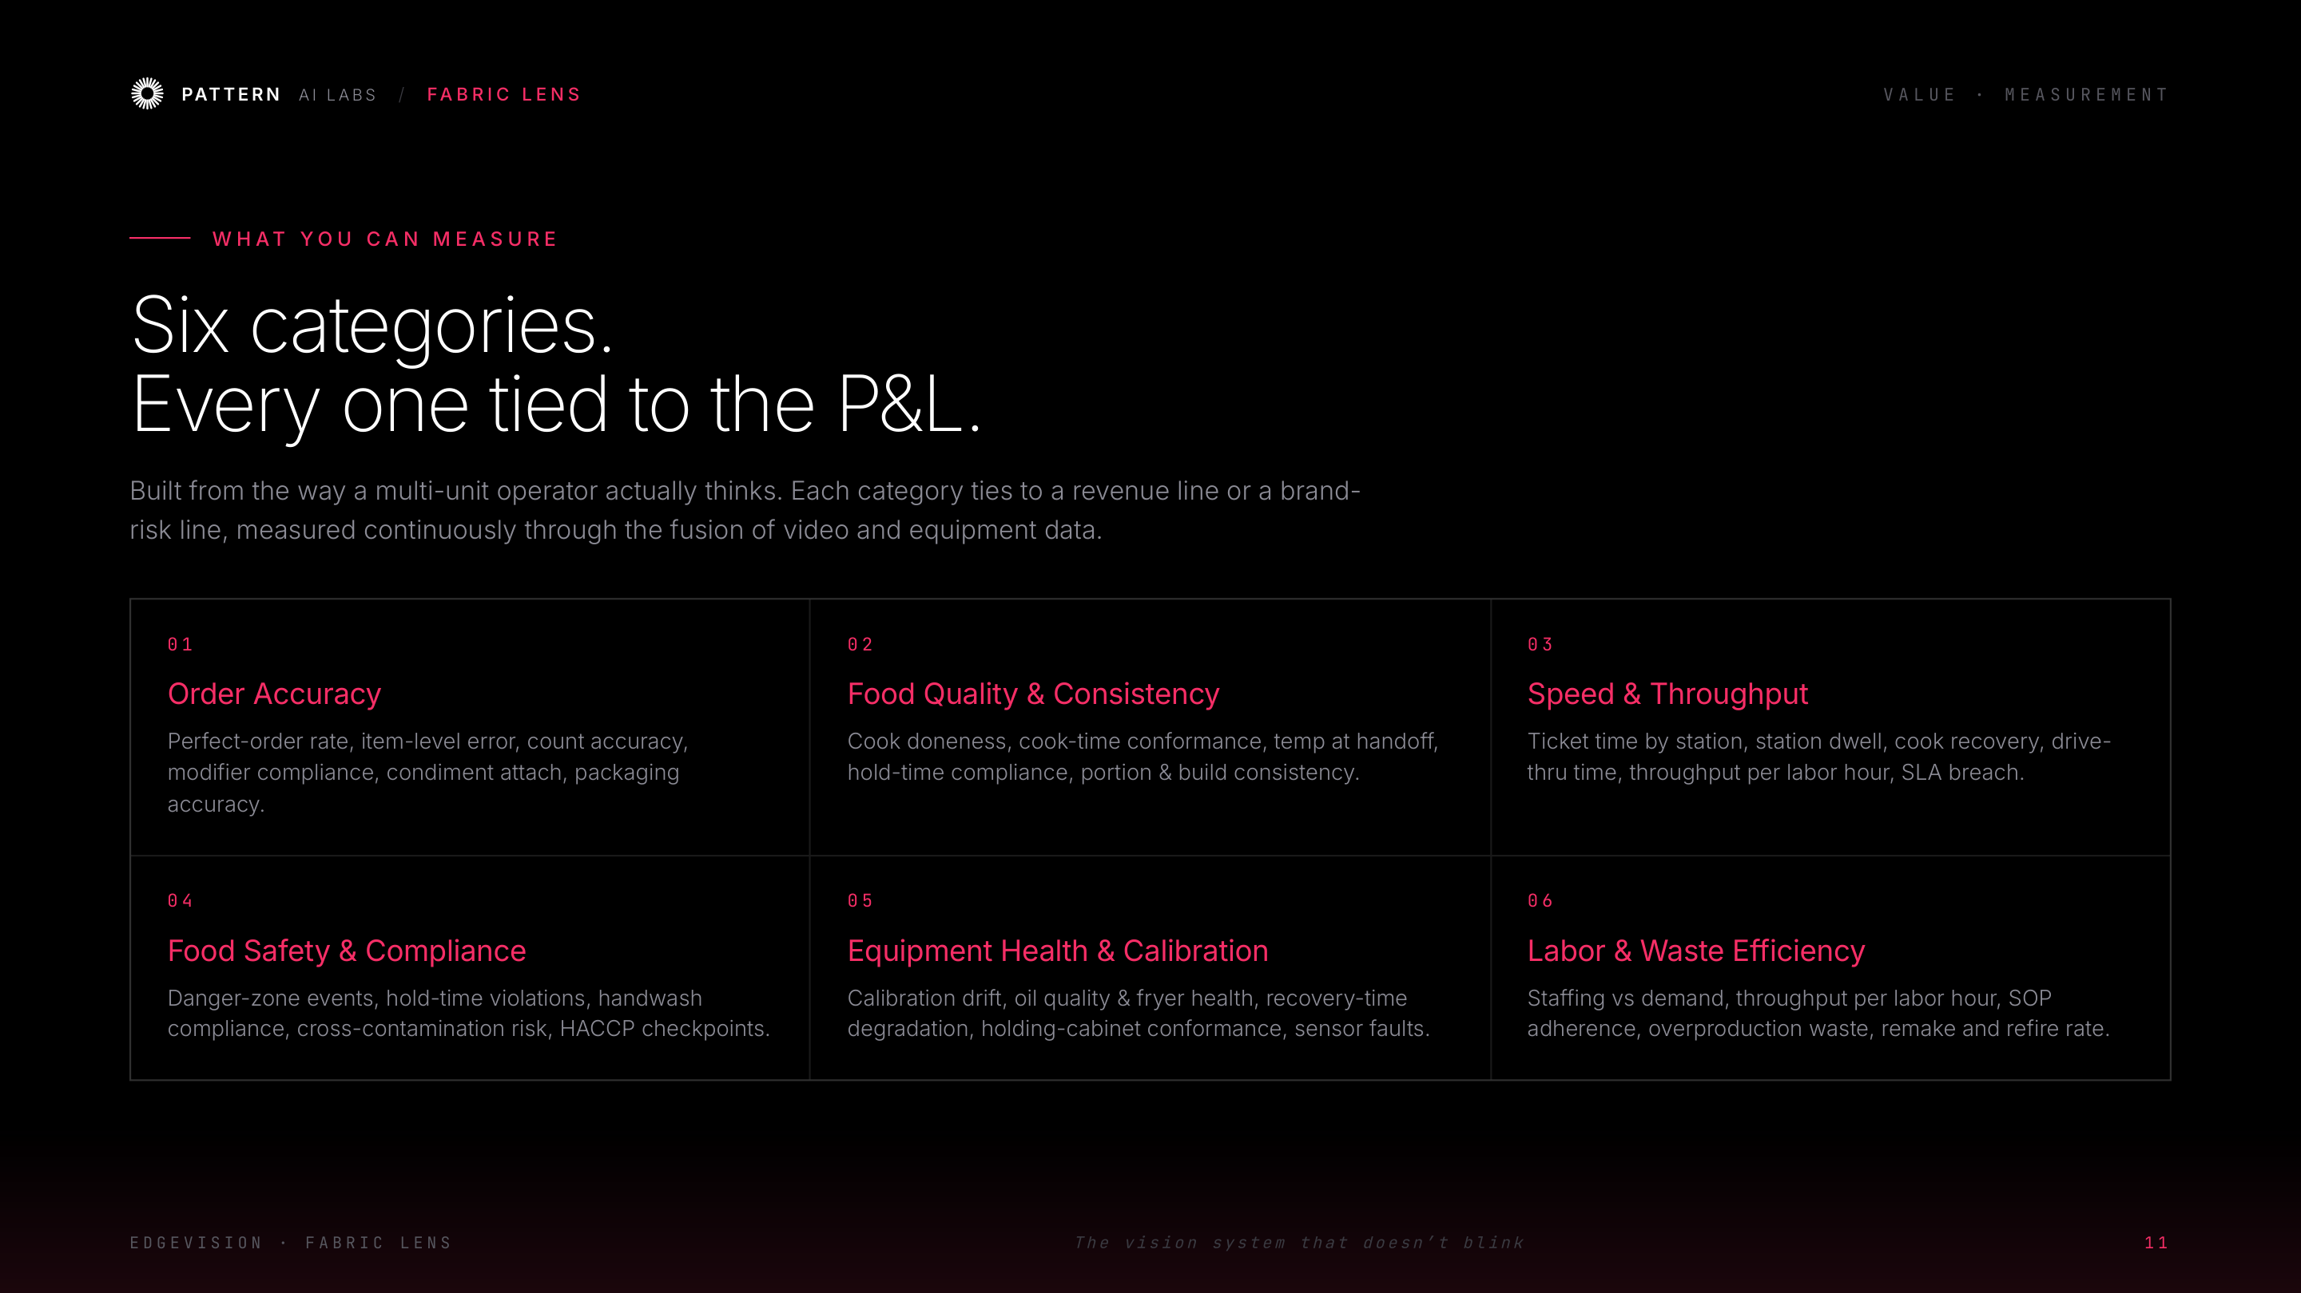
Notes:
Value — six P&L-tied measurement categories

Slide 13
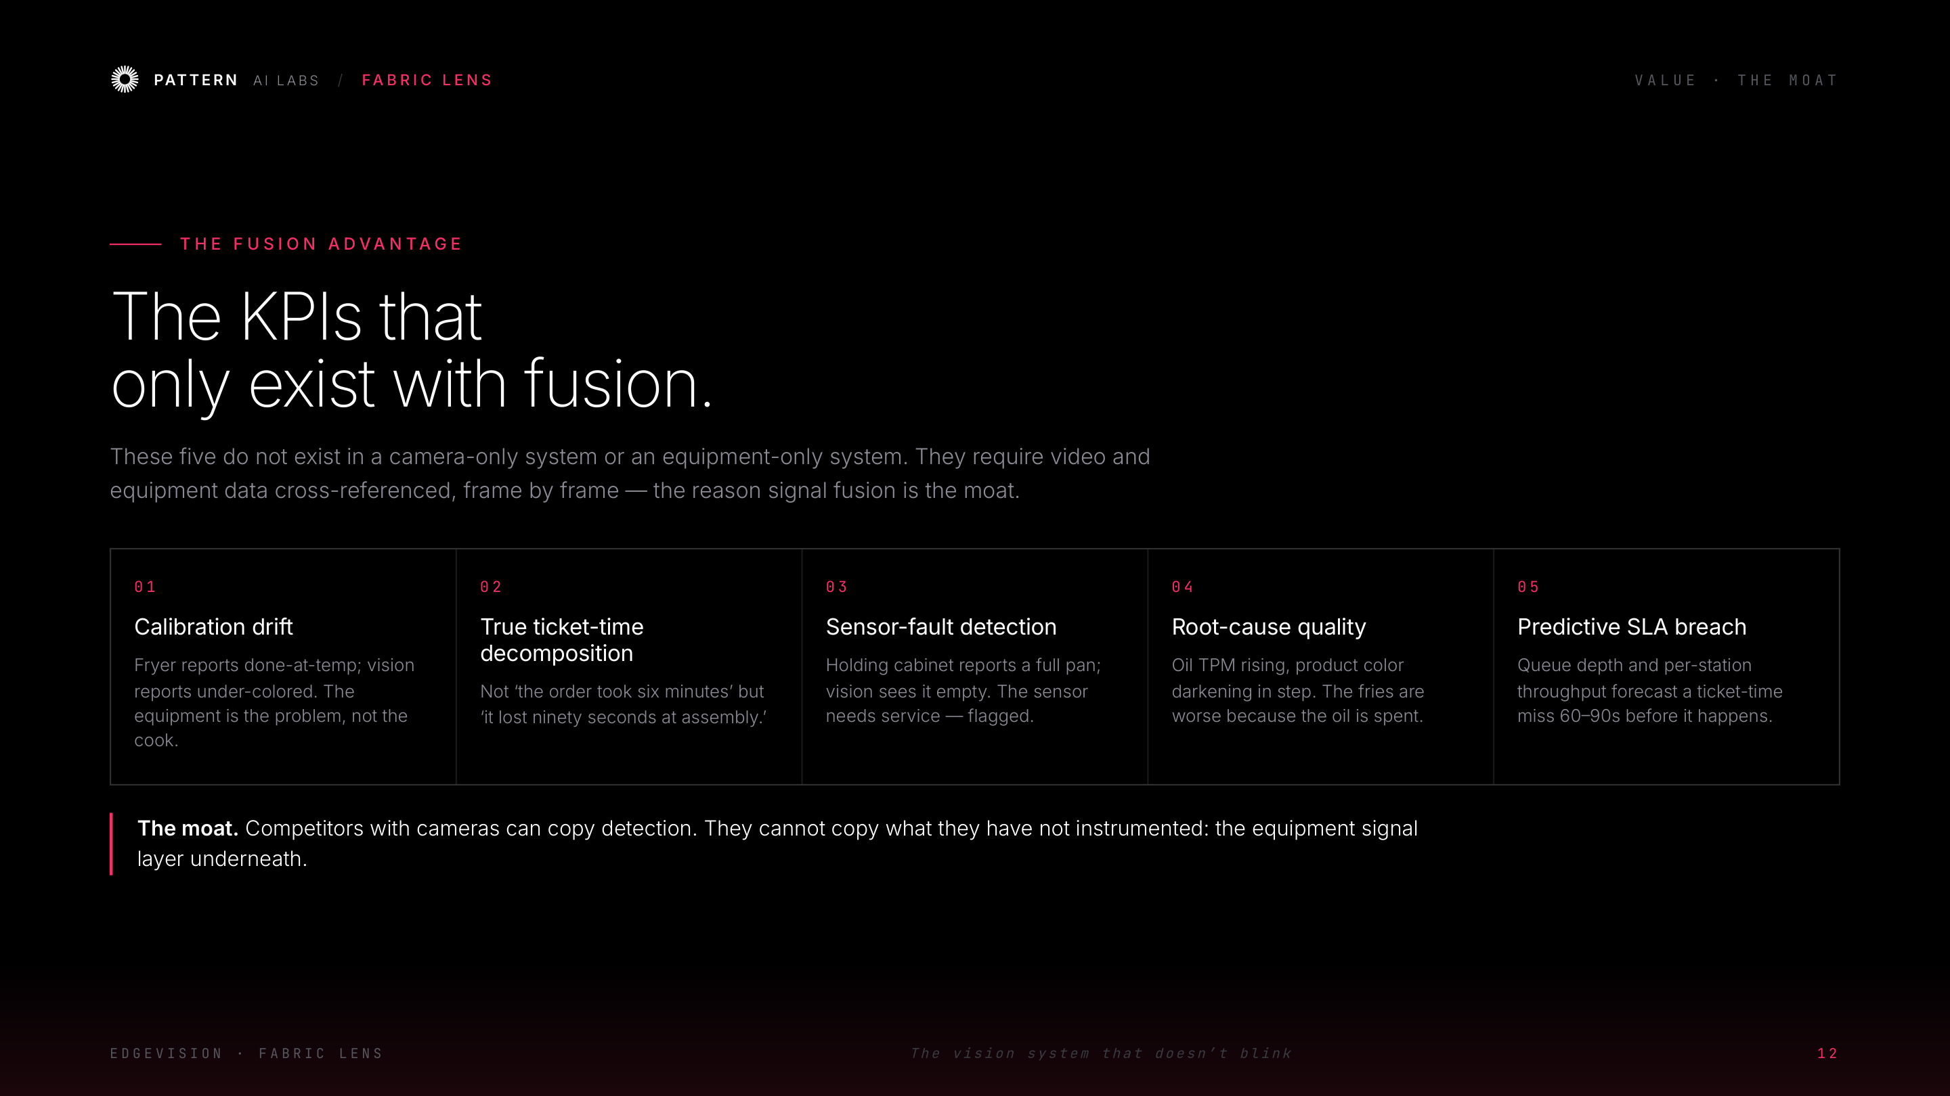
Notes:
Value — the fusion-only KPIs (the moat)

Slide 14
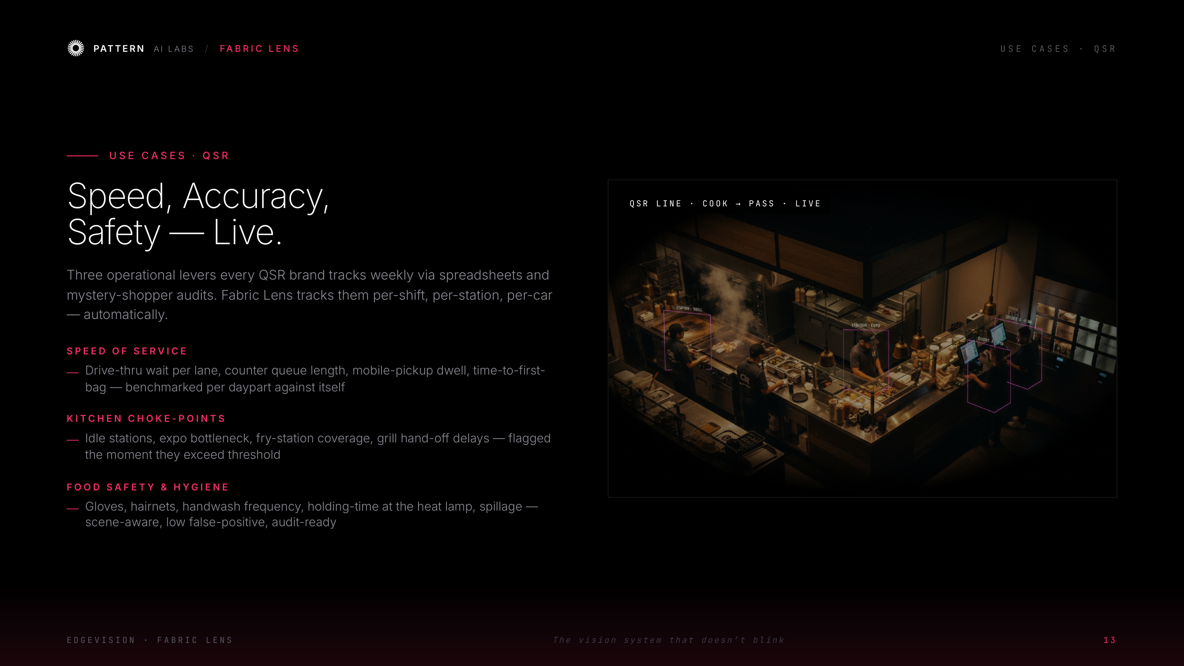
Notes:
Use cases — QSR: speed, accuracy, safety

Slide 15
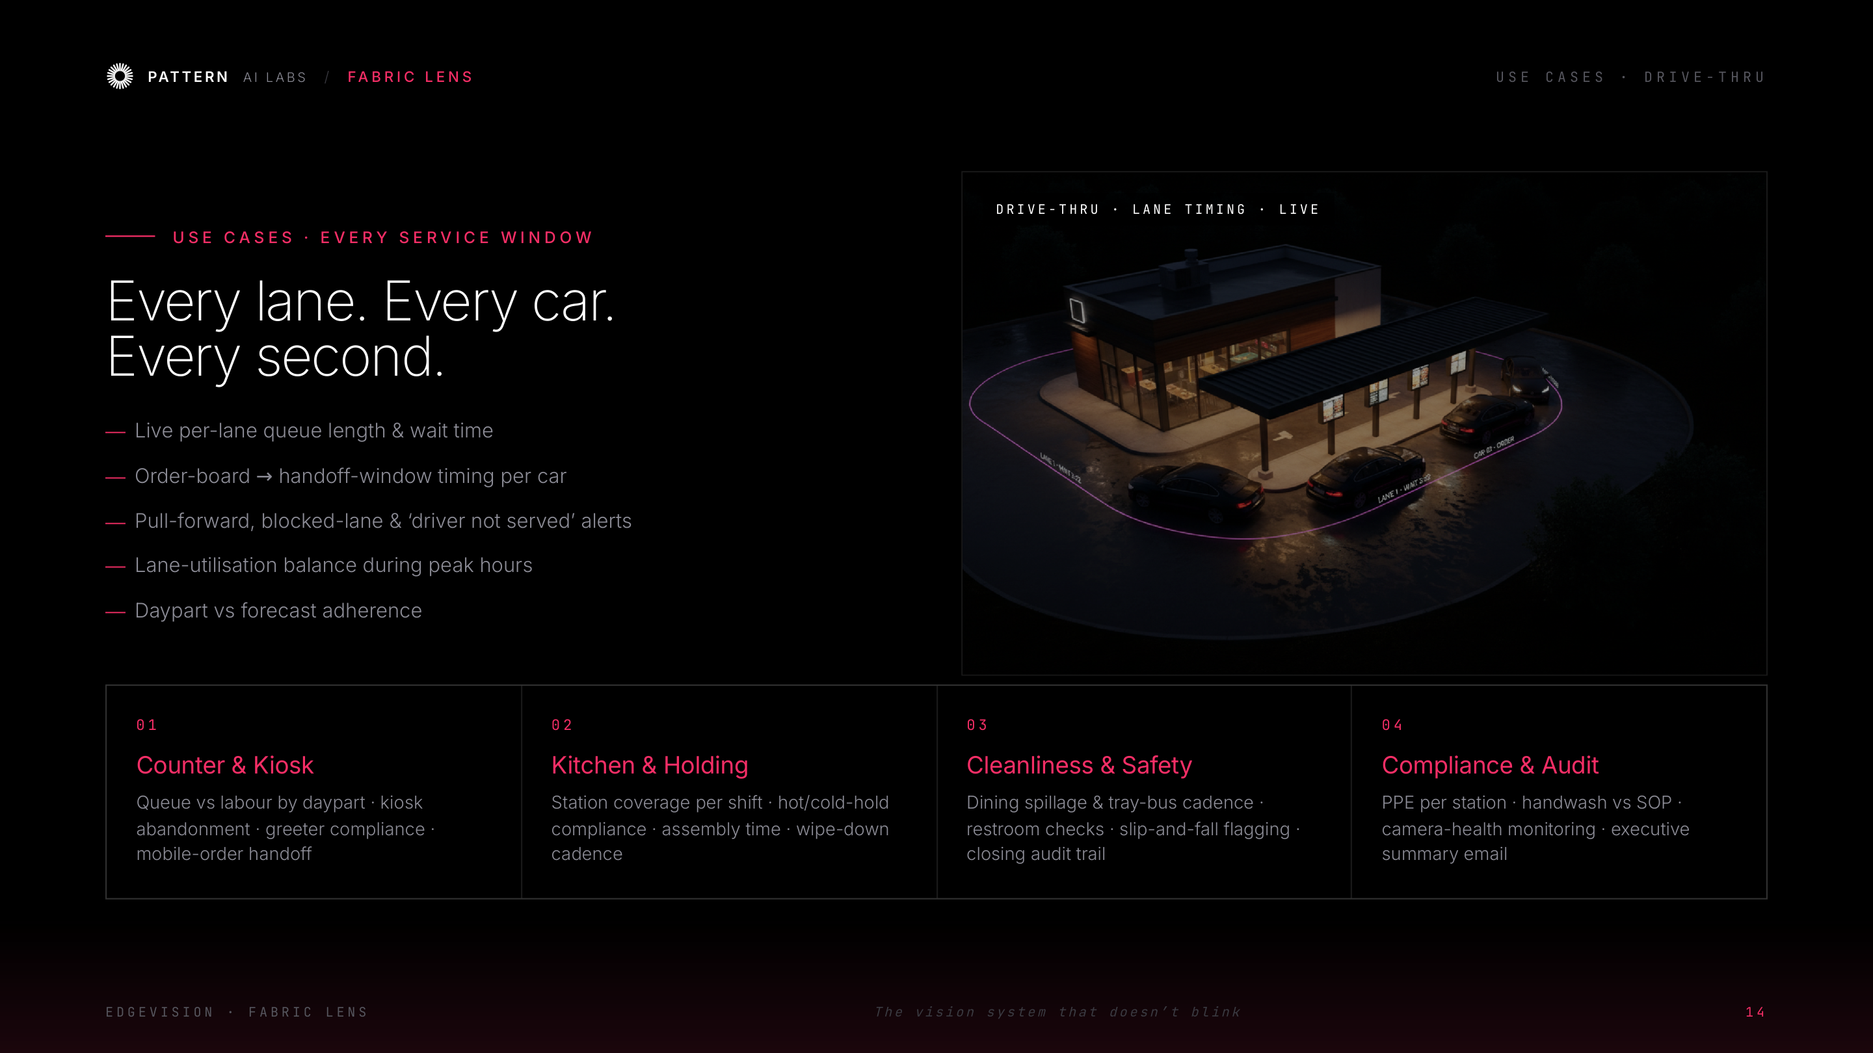
Notes:
Use cases — drive-thru & every service window

Slide 16
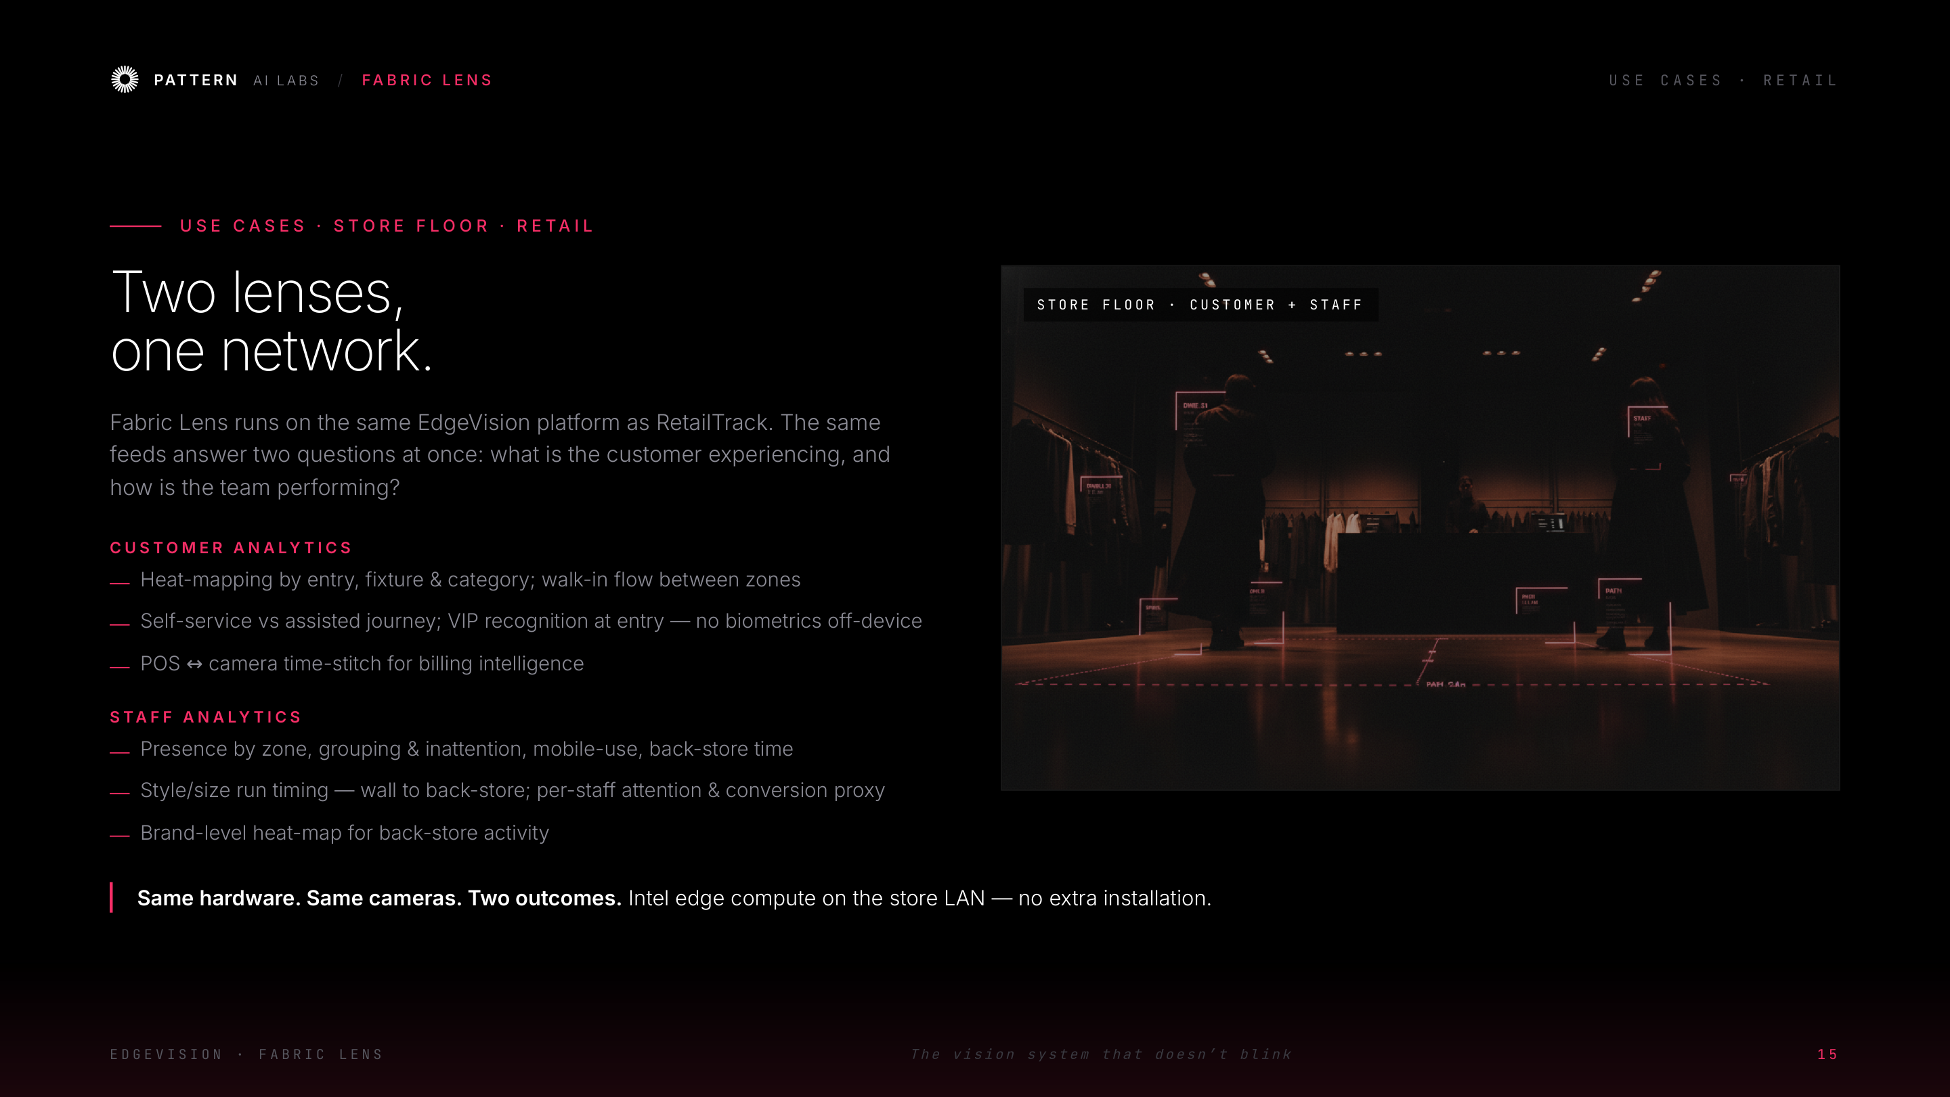
Notes:
Use cases — retail store floor (two lenses)

Slide 17
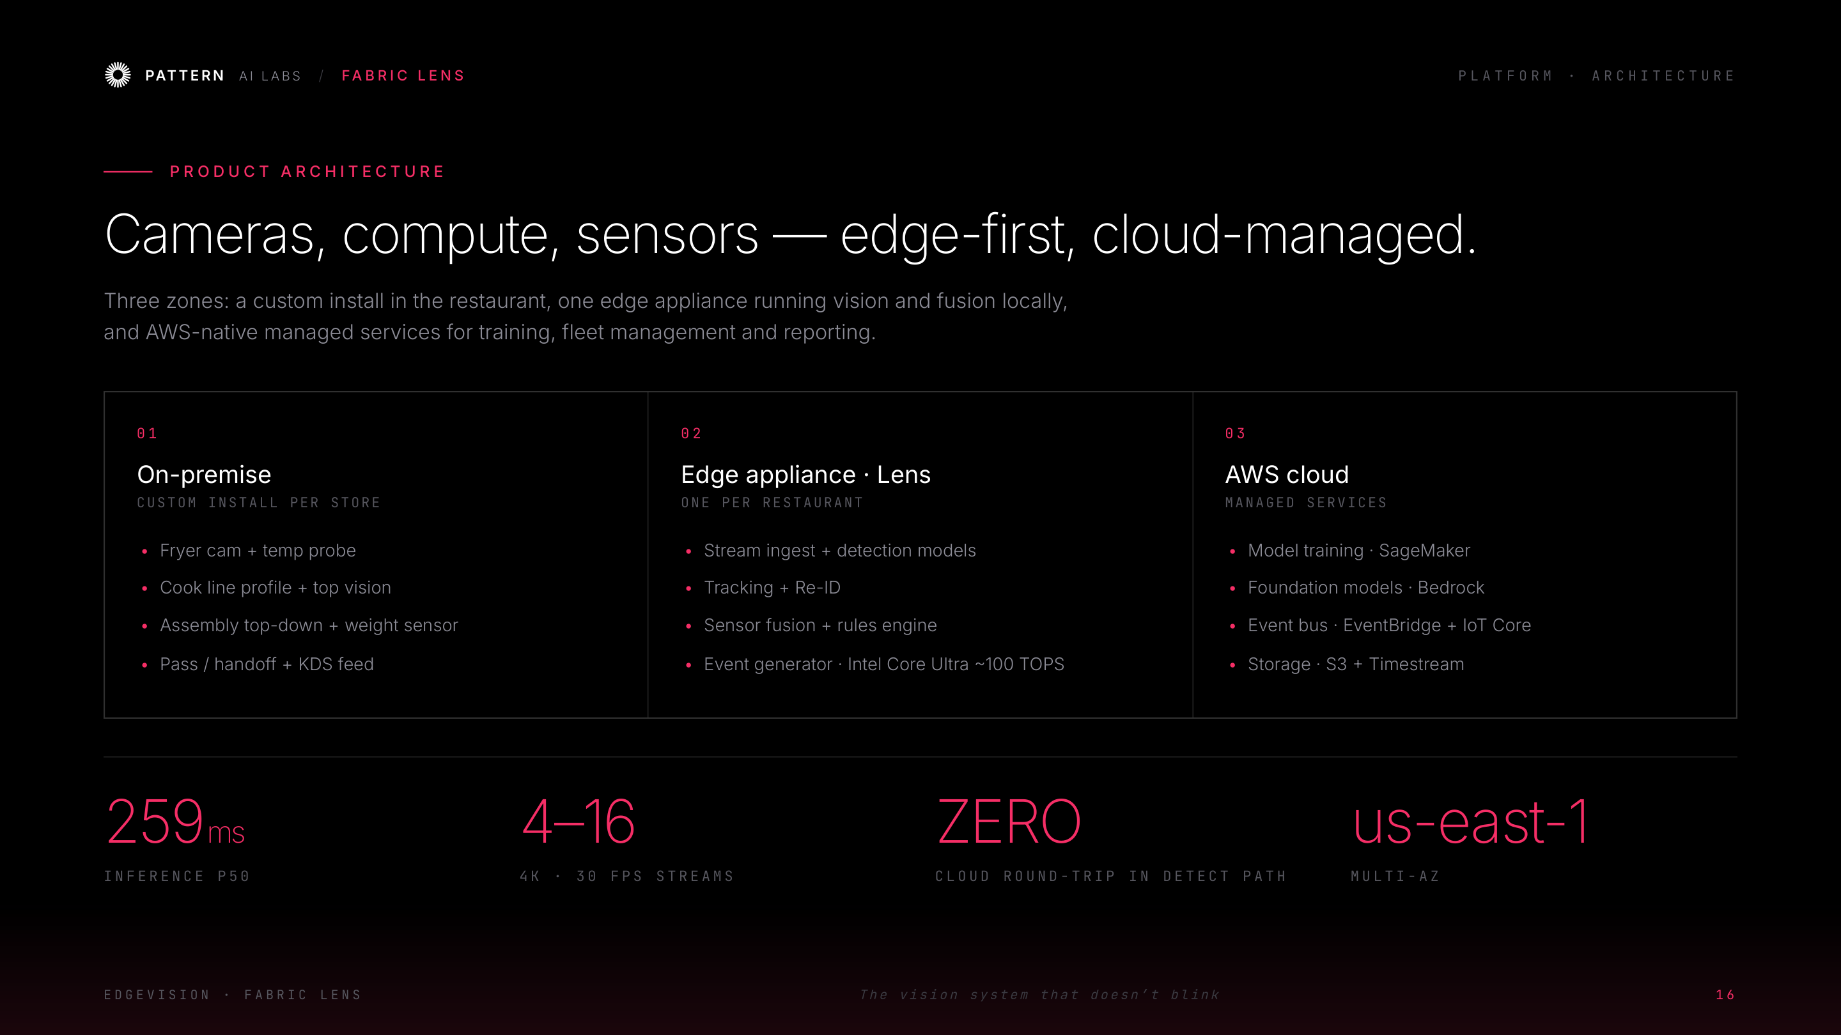
Notes:
Platform — product architecture (three zones)

Slide 18
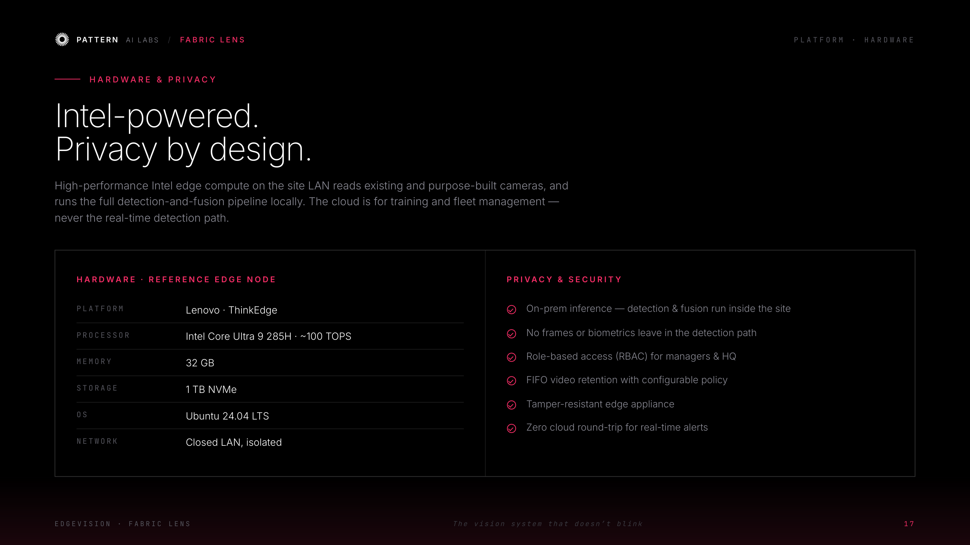
Notes:
Platform — Intel hardware & privacy by design

Slide 19
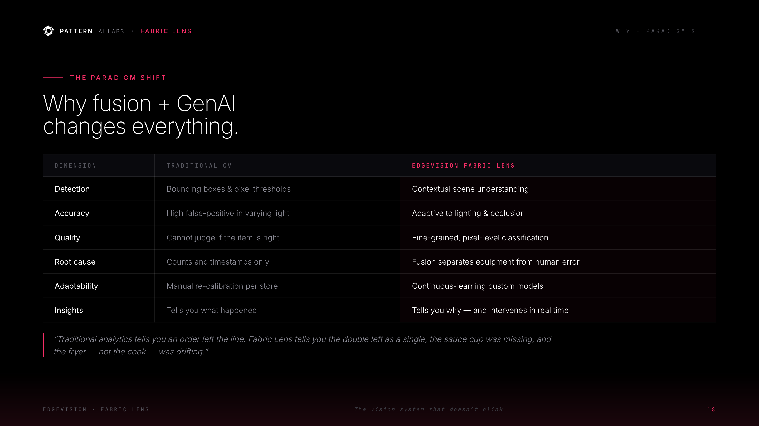
Notes:
Why — the paradigm shift

Slide 20
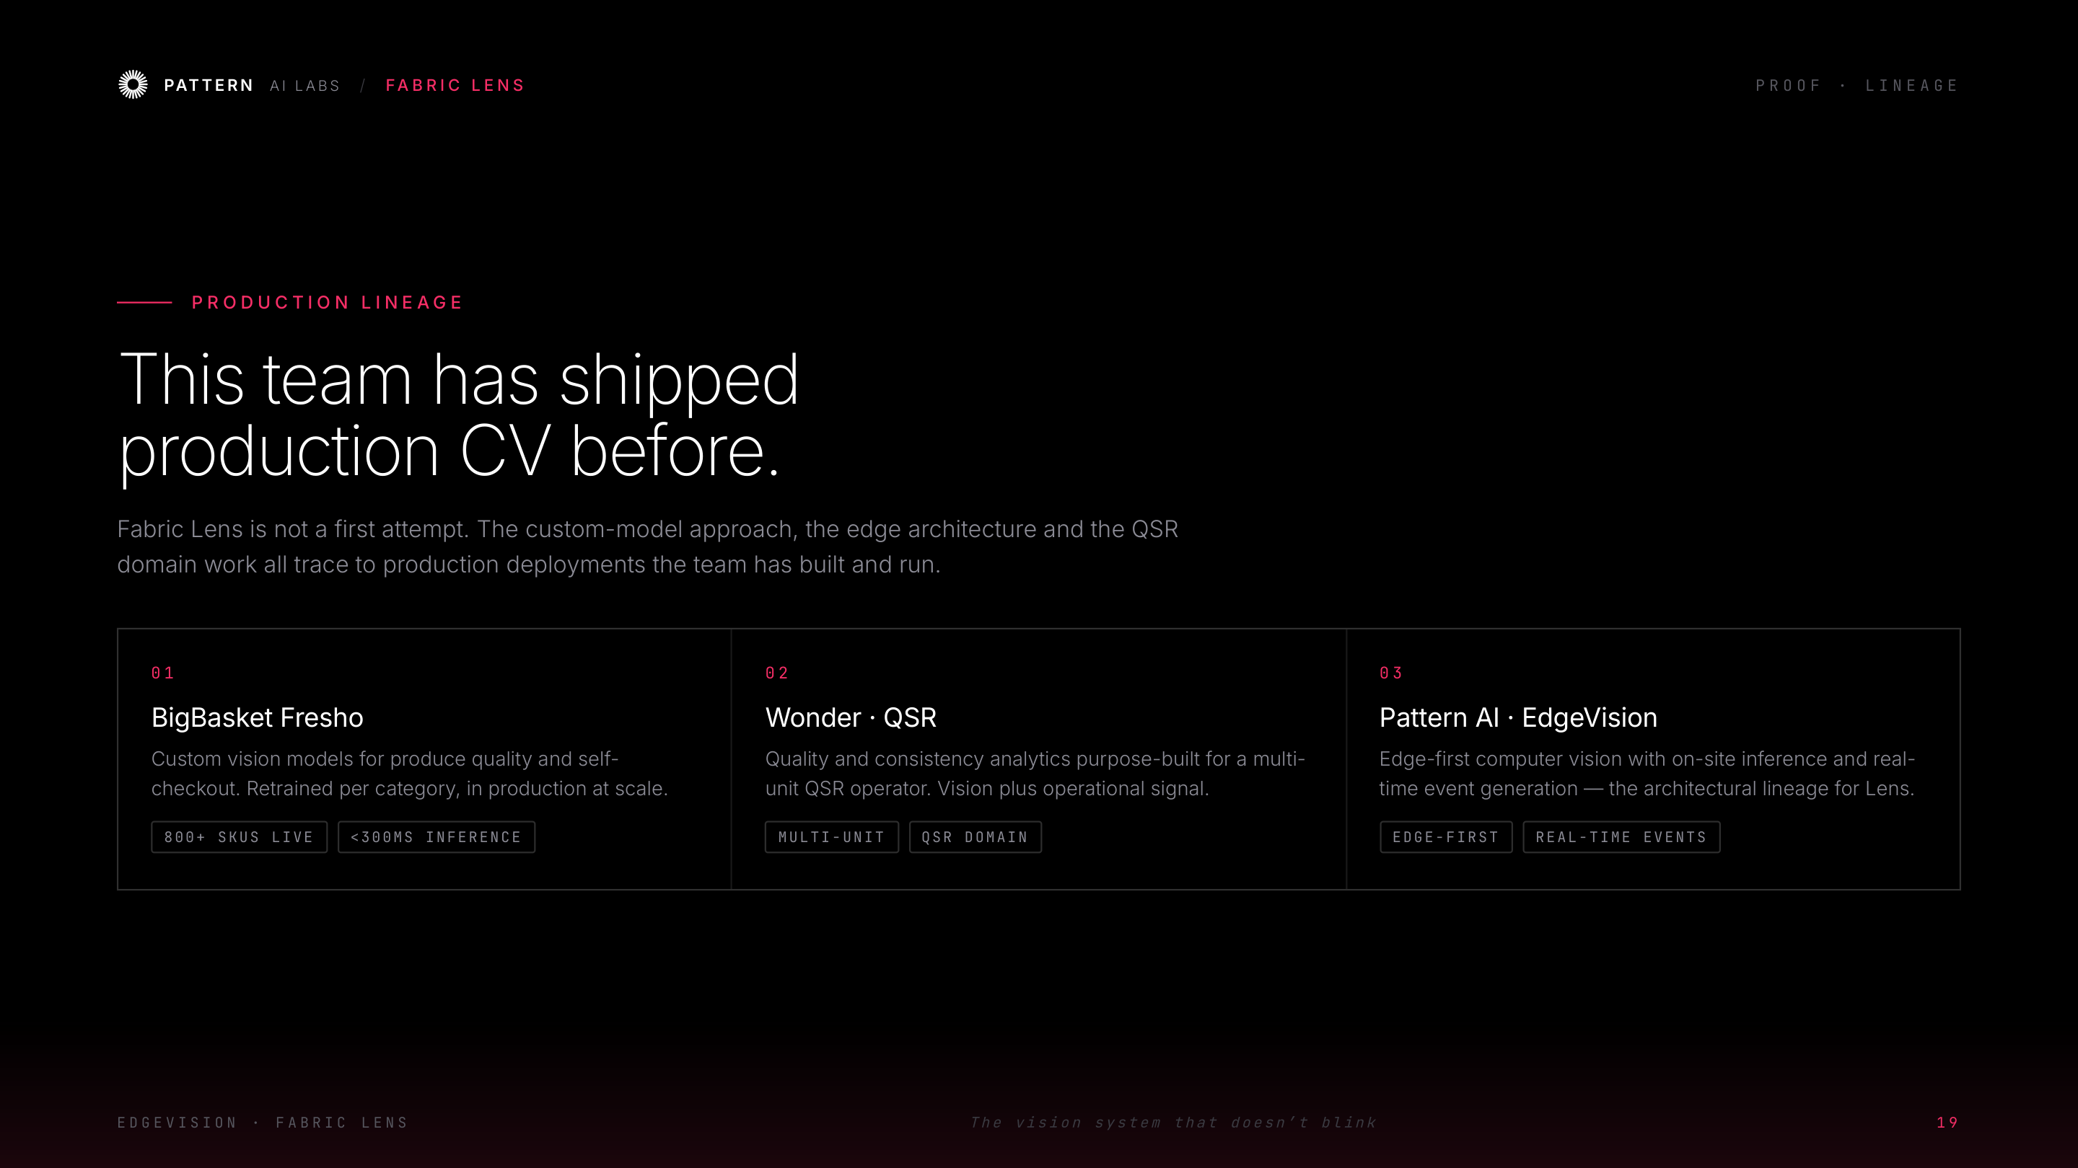
Notes:
Proof — production lineage

Slide 21
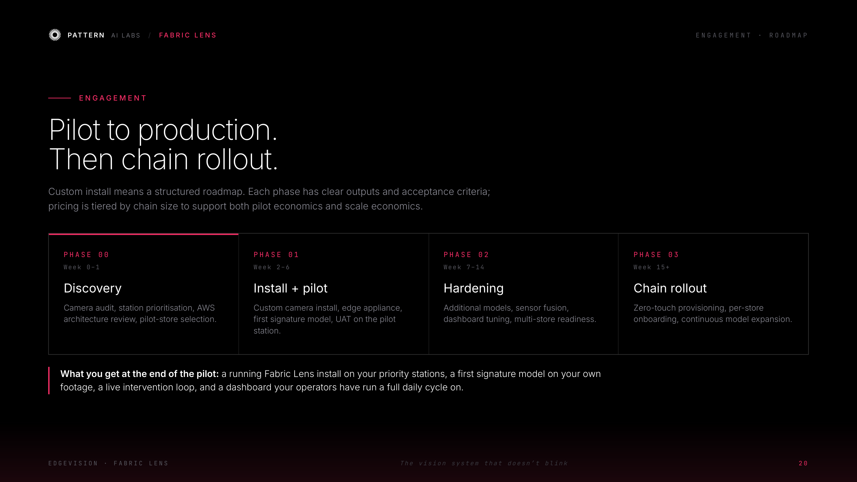
Notes:
Engagement — pilot to production to chain rollout

Slide 22
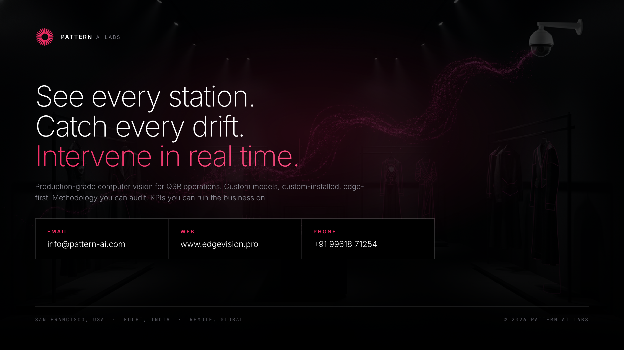
Notes:
Closing — see every station, catch every drift, intervene

