Slide 1
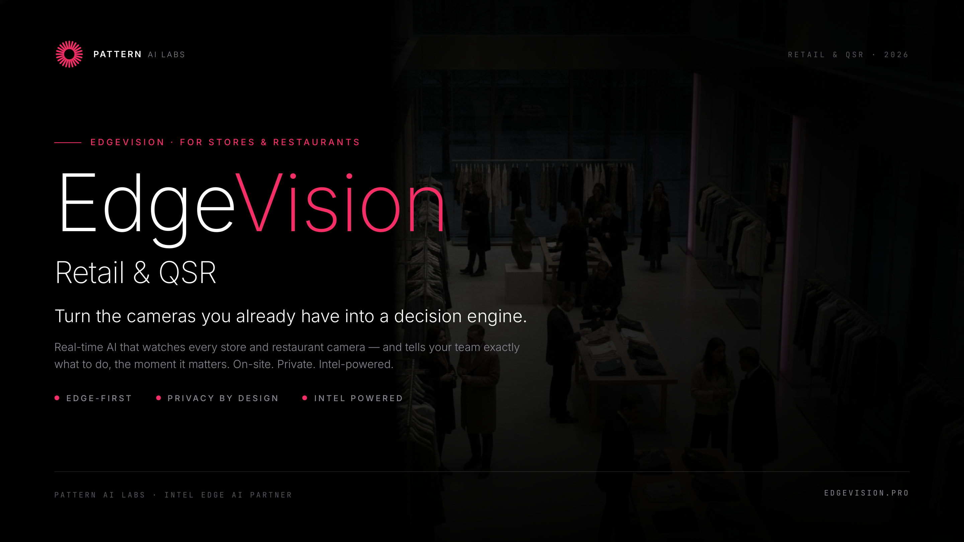
Notes:
Open warm — thank them for the closed-room time. One line: 'We turn the cameras you already have into something that helps you run the store, in real time.' Set the frame: ~25 min, then open discussion.

Slide 2
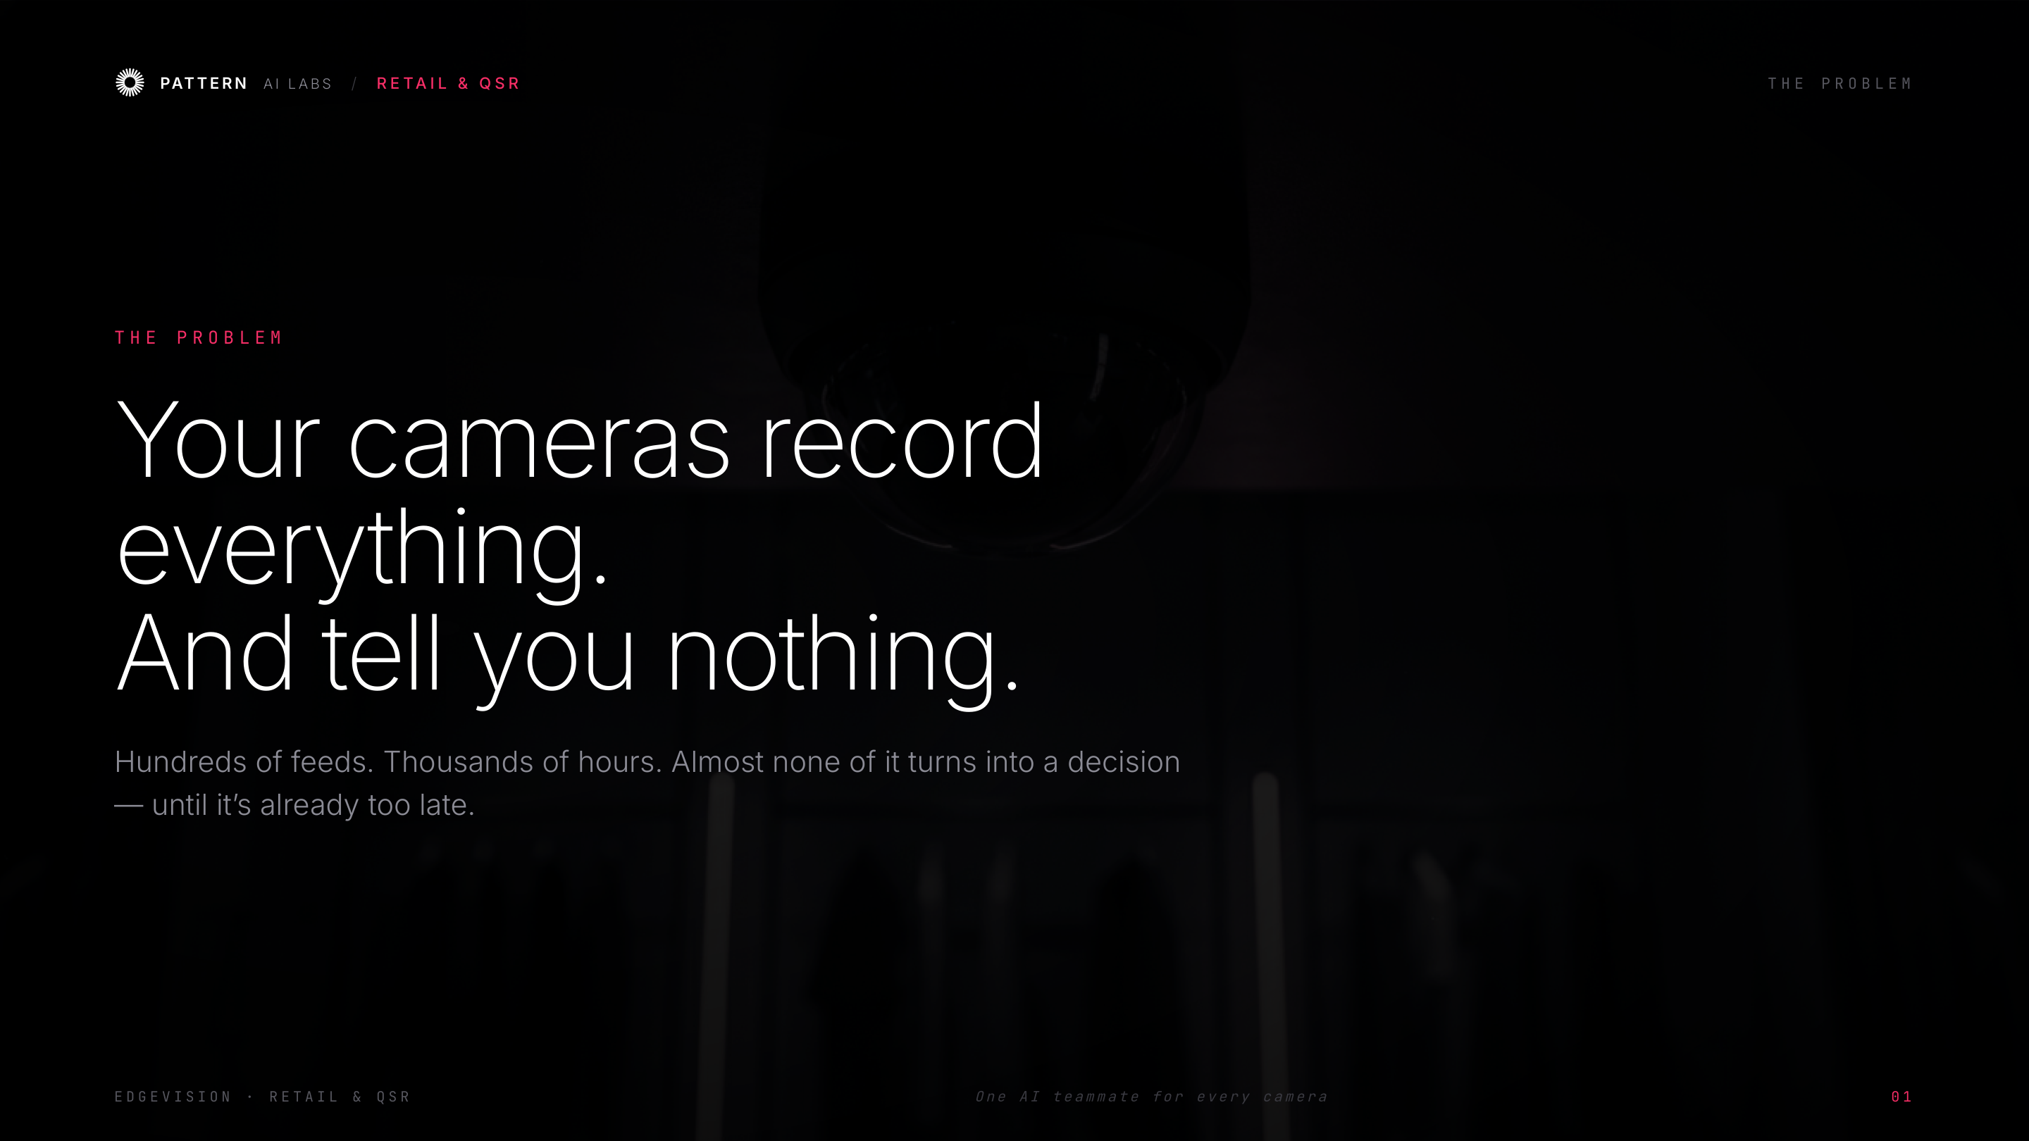
Notes:
Name the pain everyone feels: you've invested in cameras, but they only help AFTER something goes wrong. Quick show of hands: 'Who's reviewed footage only after a complaint?'

Slide 3
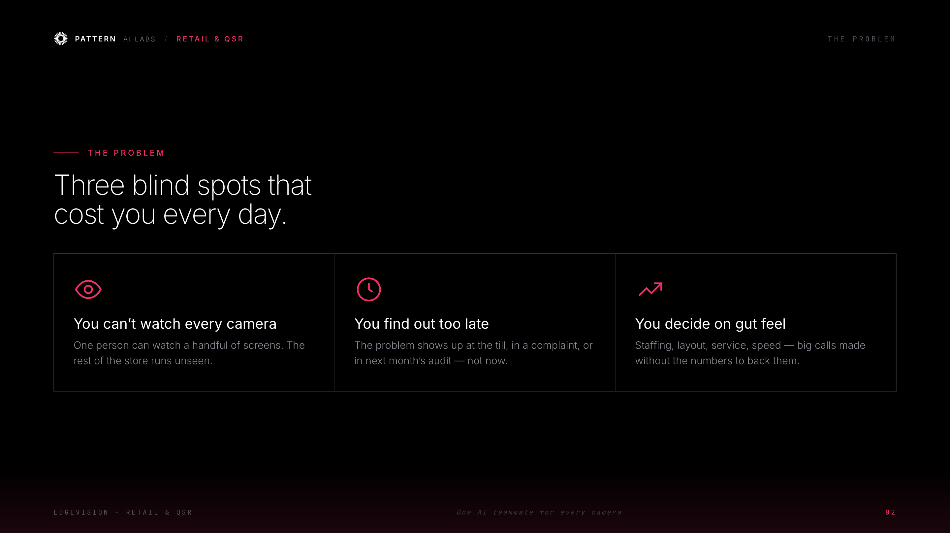
Notes:
Three blind spots that cost money every day. Keep it conversational and tie each to their world — staffing, layout, service. These are exactly what we remove.

Slide 4
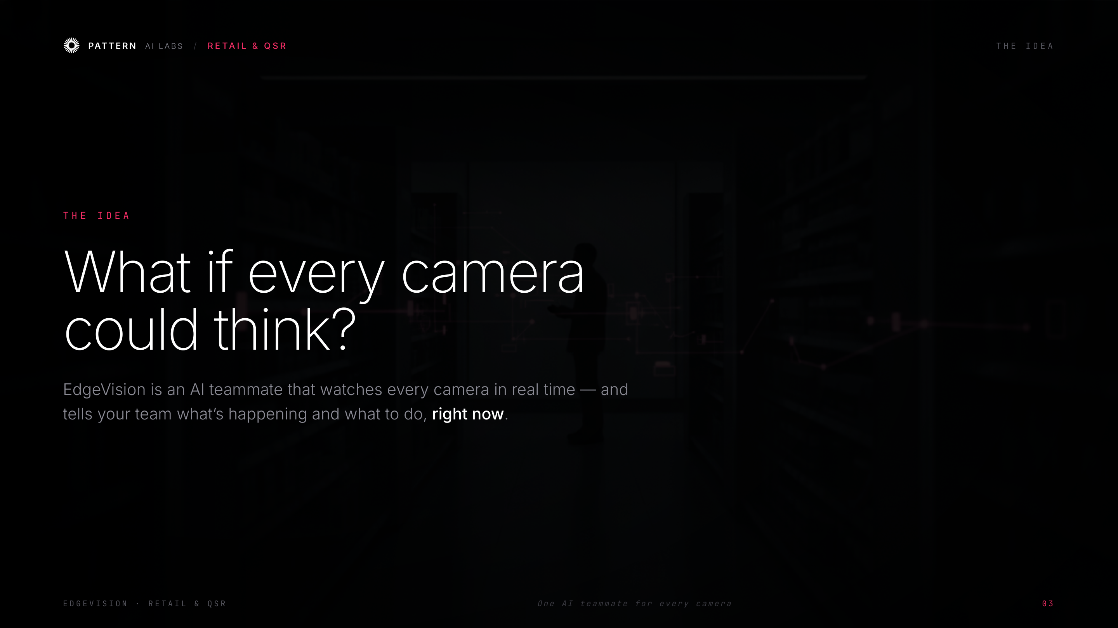
Notes:
The shift in one sentence: cameras that think. Not more screens to watch — an AI teammate that tells your team what to do, right now.

Slide 5
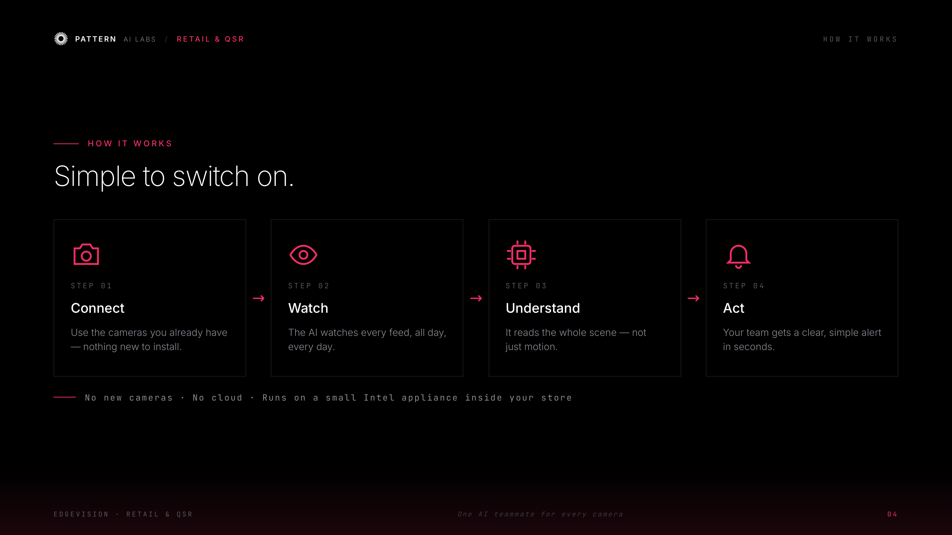
Notes:
Reassure the non-technical folks: nothing to rip out, no cloud, one small Intel box per site. Four simple steps — connect, watch, understand, act.

Slide 6
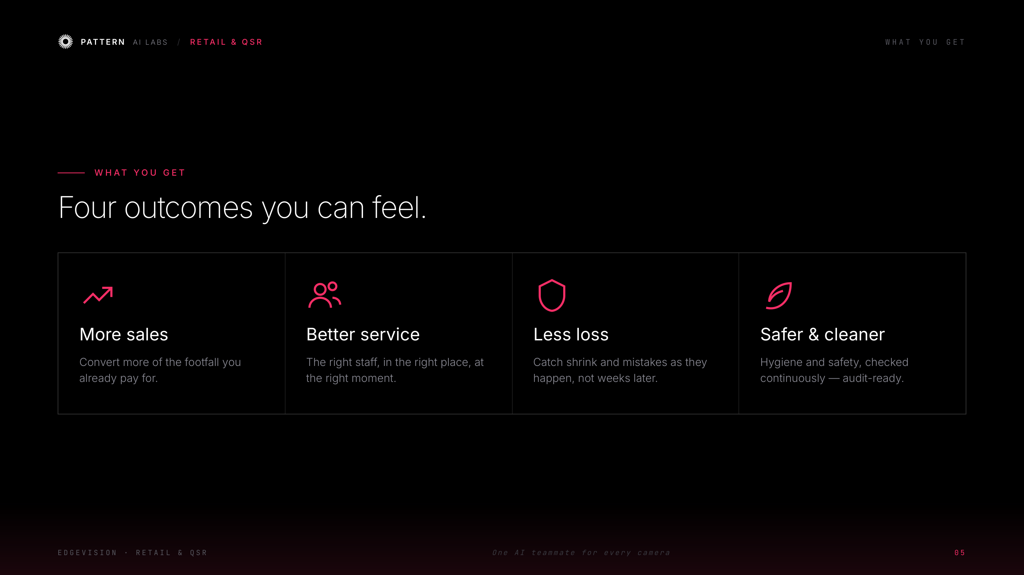
Notes:
Move from features to outcomes. Pick the one that matters most to THIS room (sales, service, loss, or safety) and expand with a quick example.

Slide 7
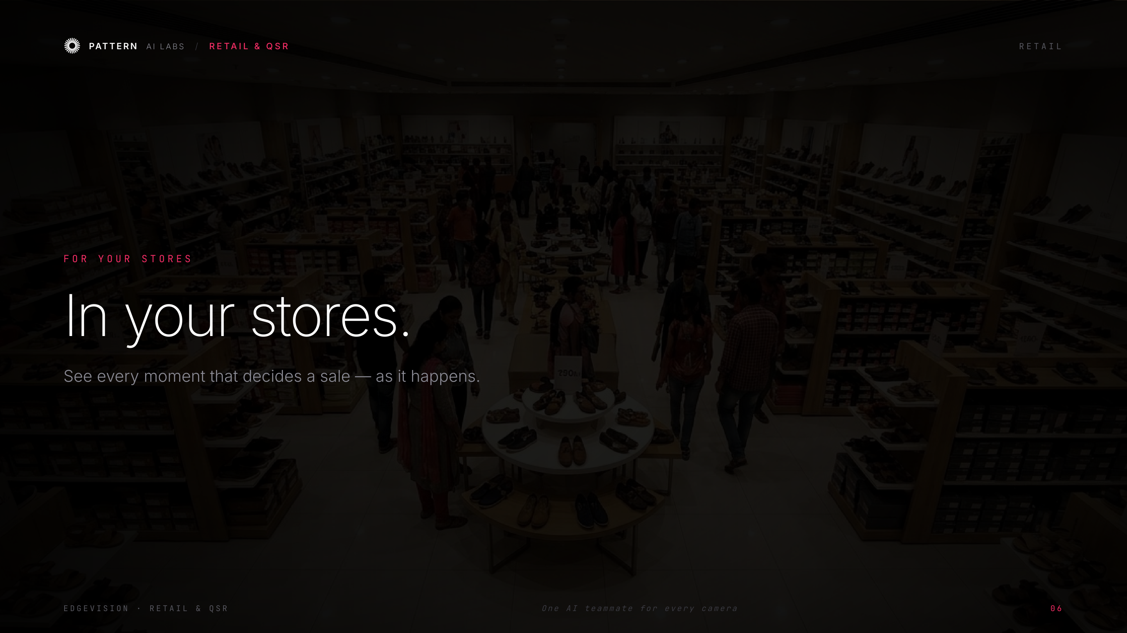
Notes:
Transition: 'Let's make it concrete — first, your stores.'

Slide 8
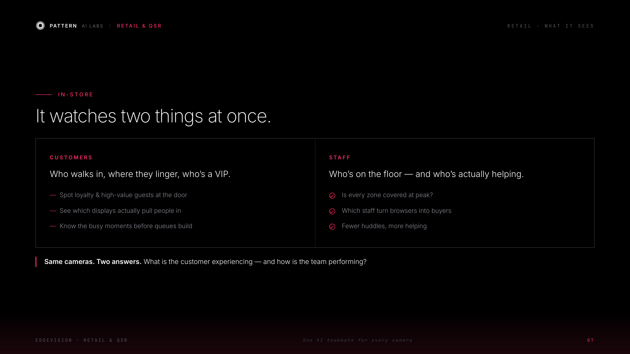
Notes:
Same cameras, two answers: what the customer is experiencing, and how the team is performing. Speaks to GMs and ops leaders.

Slide 9
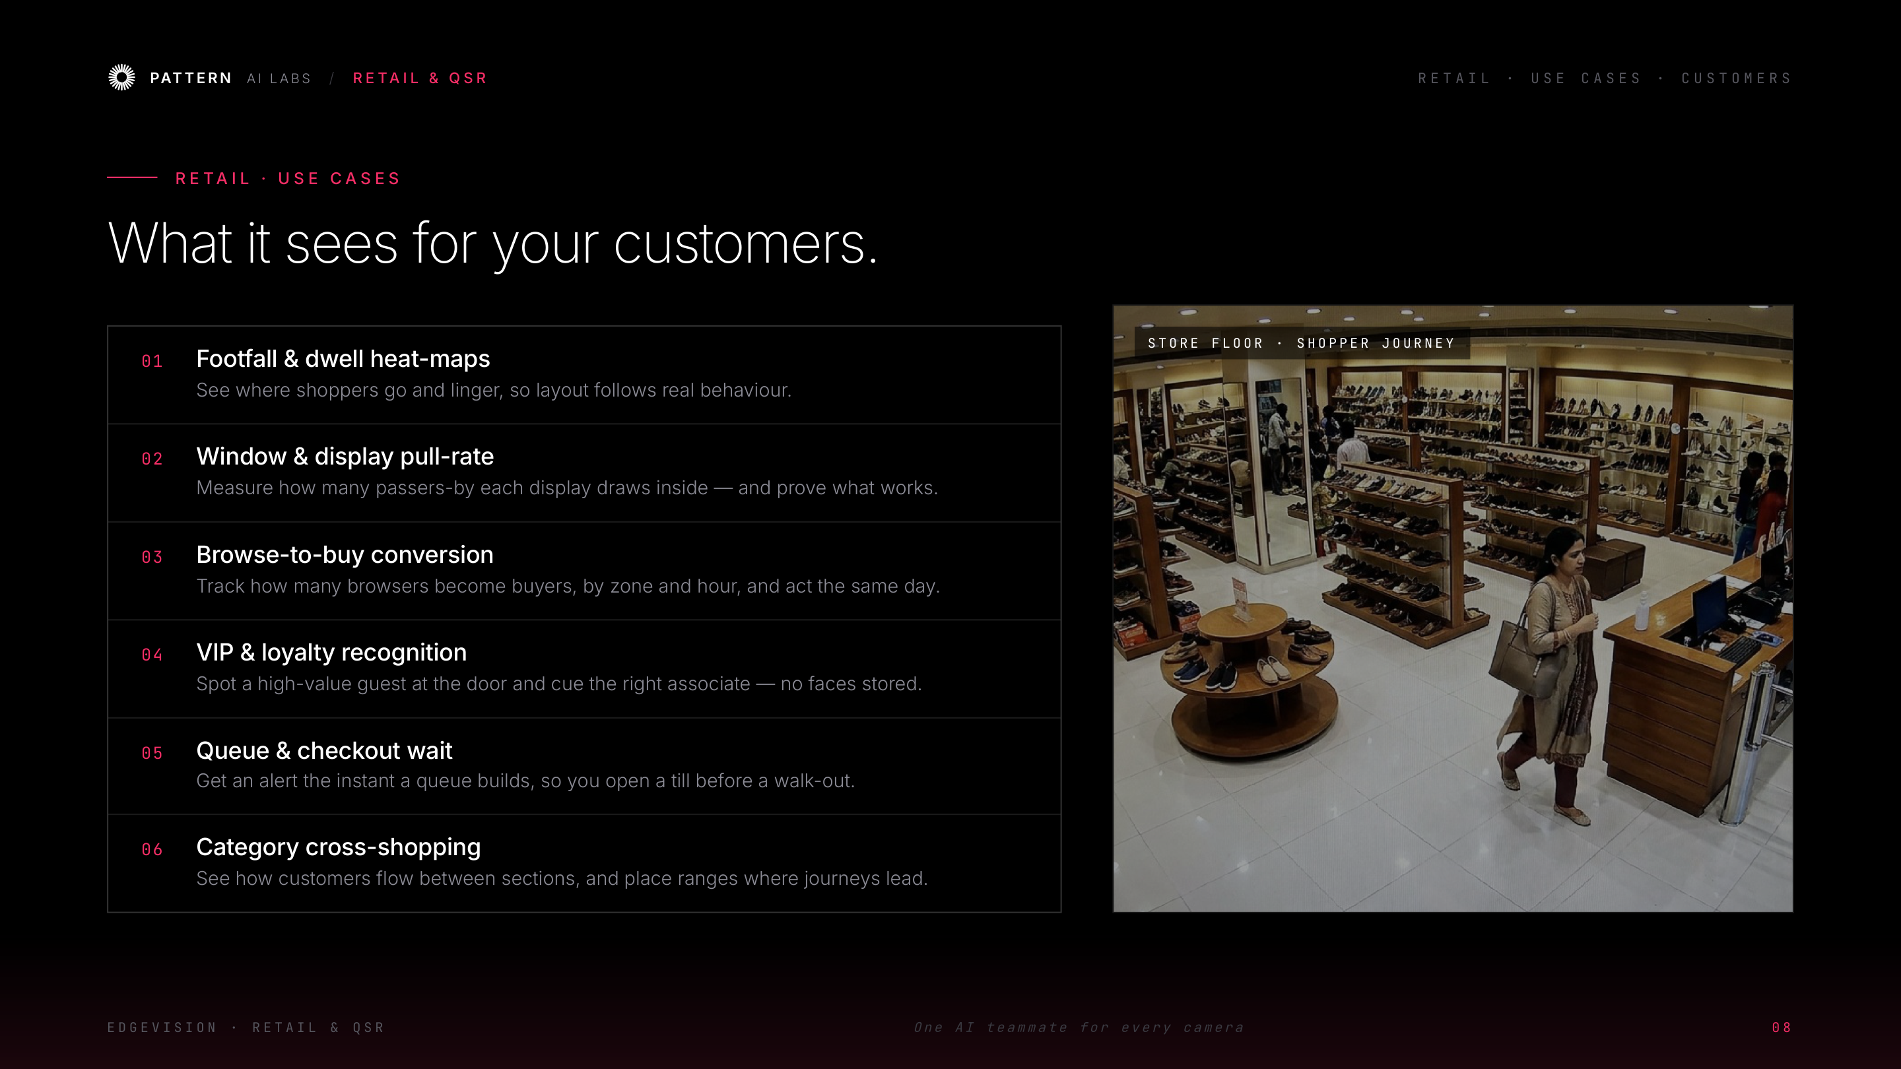
Notes:
Retail use cases, customer side — one line each. Don't read them all; pause on the two or three that match this room and let them react.

Slide 10
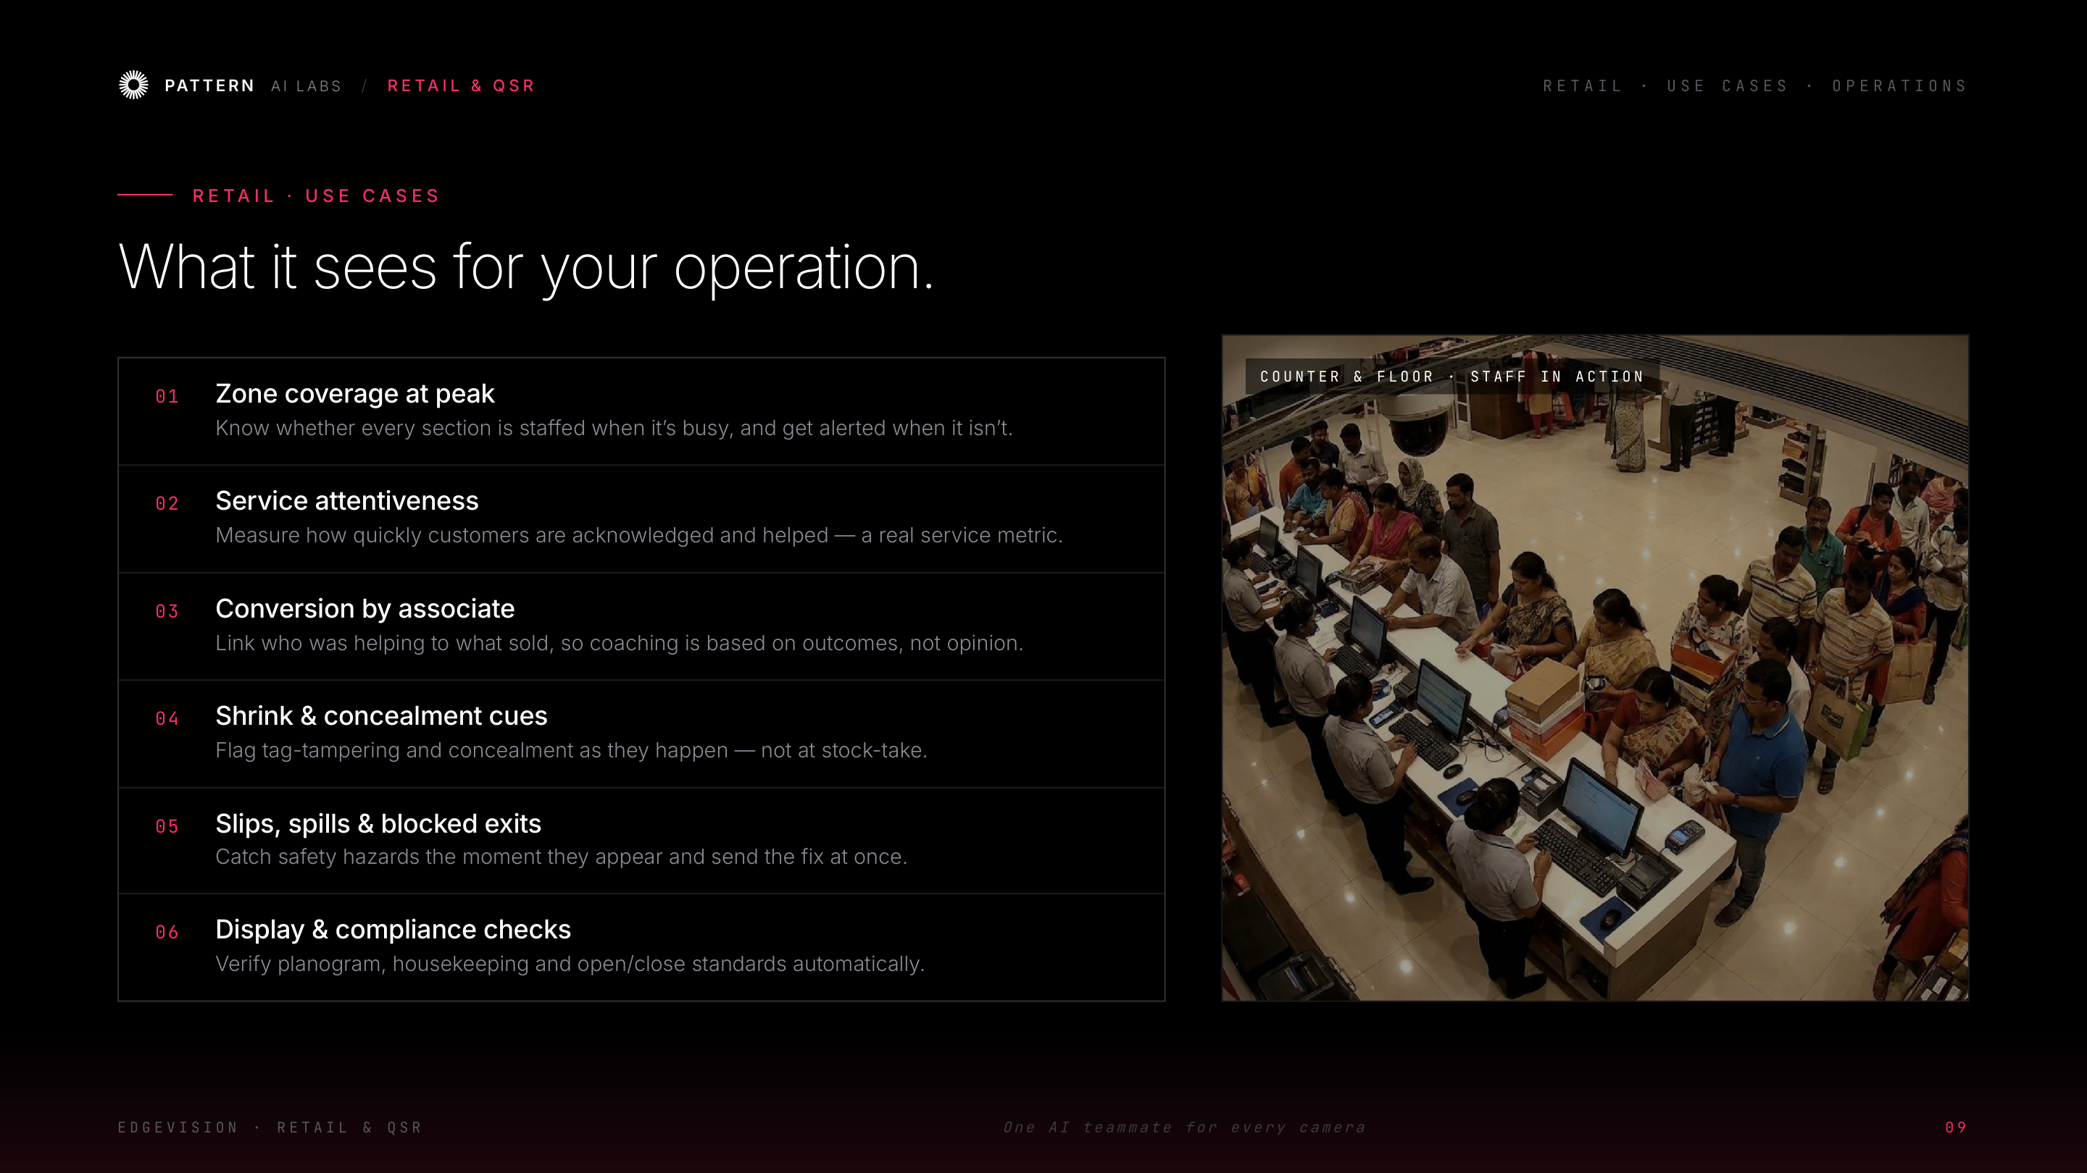
Notes:
Retail use cases, operations side — staffing, shrink, safety, compliance. Ask which of these currently costs them the most.

Slide 11
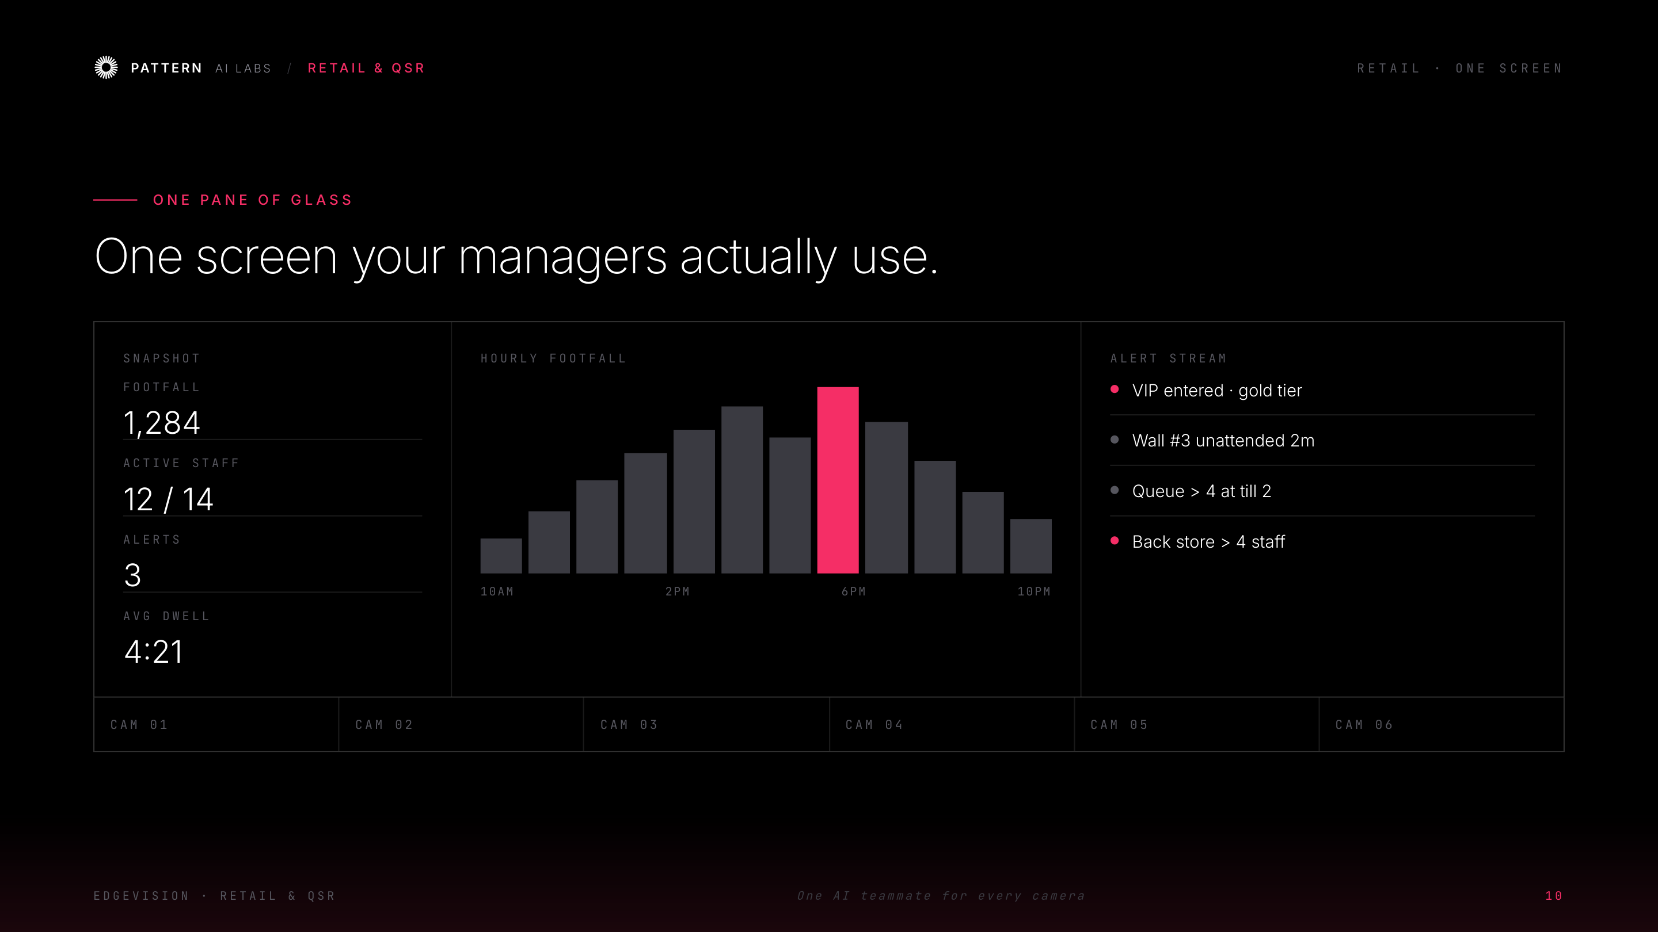
Notes:
Managers don't want AI — they want ONE screen. Walk the live snapshot, the footfall trend, and the alert stream they'd actually act on. Make it feel like their morning huddle.

Slide 12
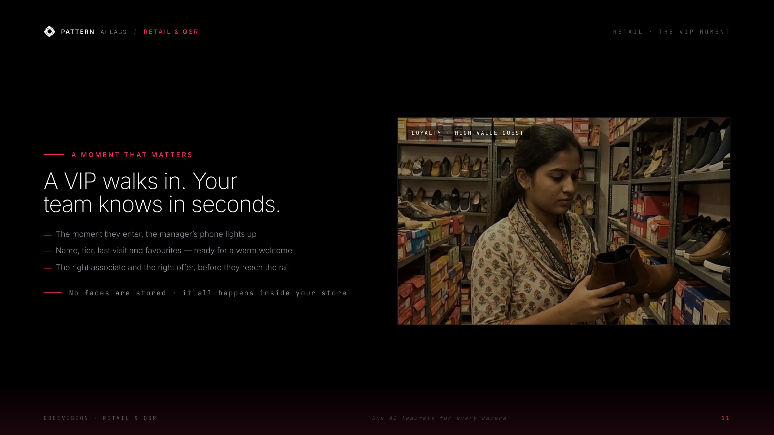
Notes:
Tell it as a story: a gold-tier guest walks in, the manager's phone lights up, the right welcome happens in seconds. Stress privacy — no faces are stored.

Slide 13
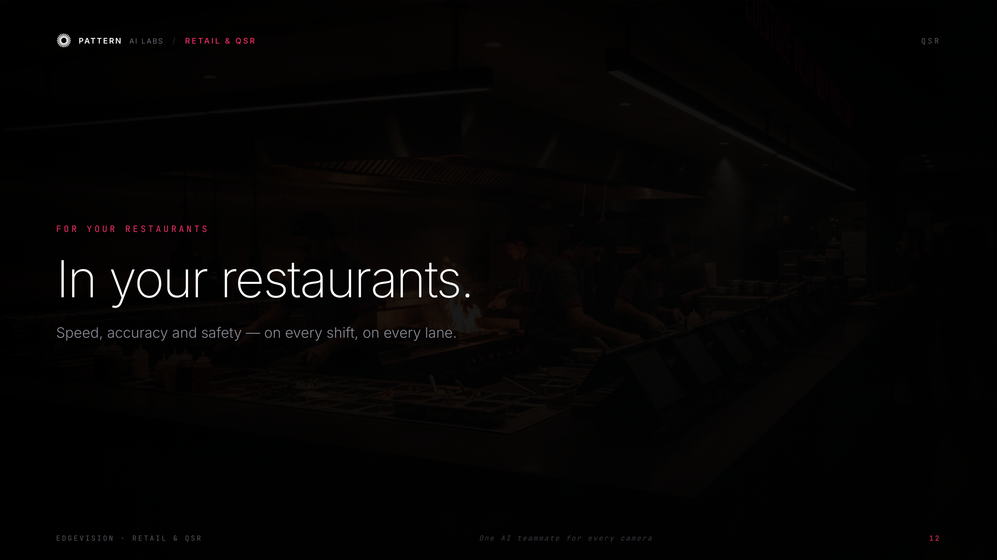
Notes:
Transition: 'Now your restaurants.'

Slide 14
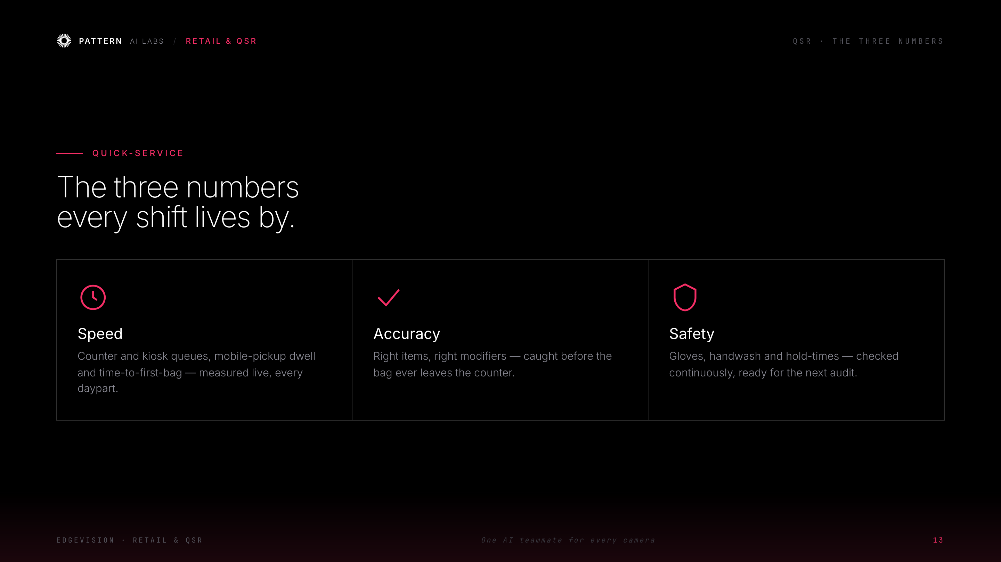
Notes:
Speed, accuracy, safety — the three things every QSR operator lives by. Tie to P&L and health/FSSAI audits.

Slide 15
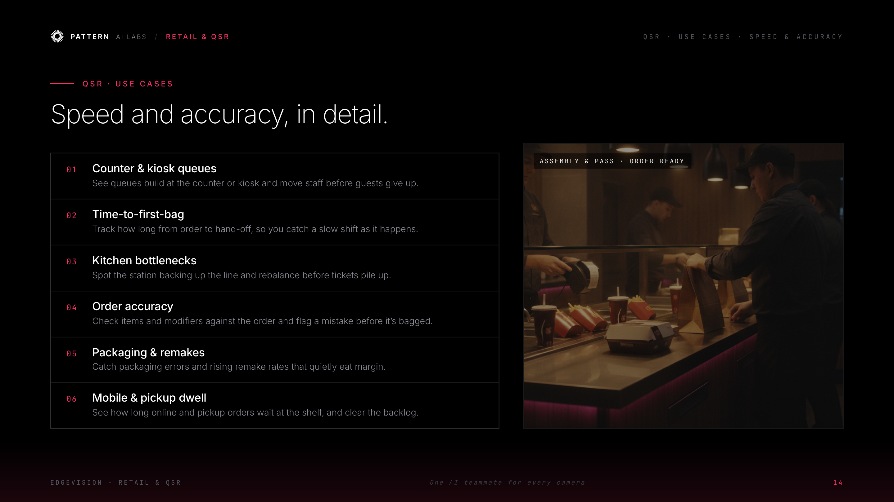
Notes:
QSR use cases, speed & accuracy — one line each, tied straight to revenue and throughput. Let operators point at their pain.

Slide 16
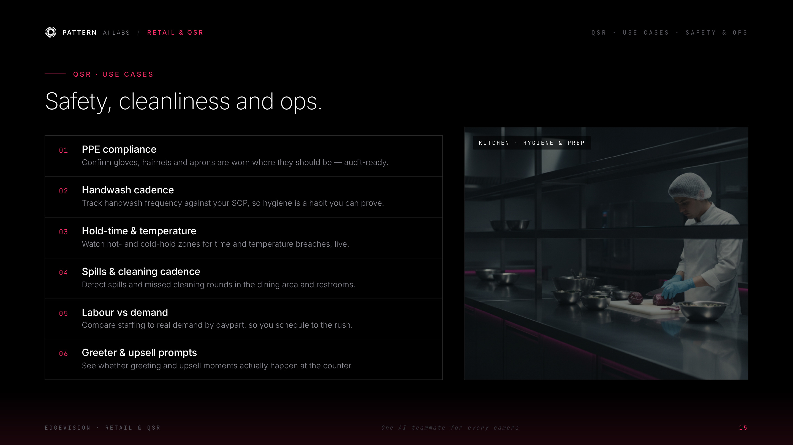
Notes:
QSR use cases, safety & ops — PPE, handwash, hold-times, cleaning, labour. This is the audit-and-compliance story; great for multi-unit operators.

Slide 17
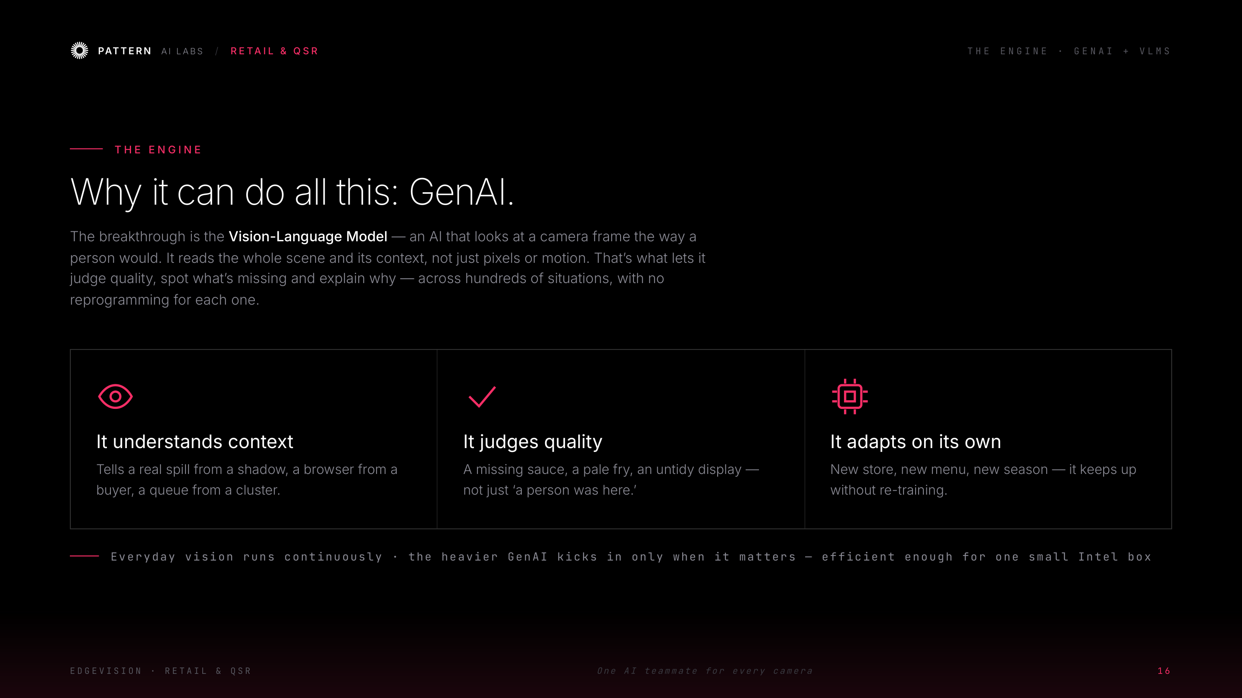
Notes:
This is the WHY. Keep it plain: a Vision-Language Model reads a frame like a person would. THAT is why it can judge quality and context, not just detect motion. Don't go deep on the tech — one or two sentences.

Slide 18
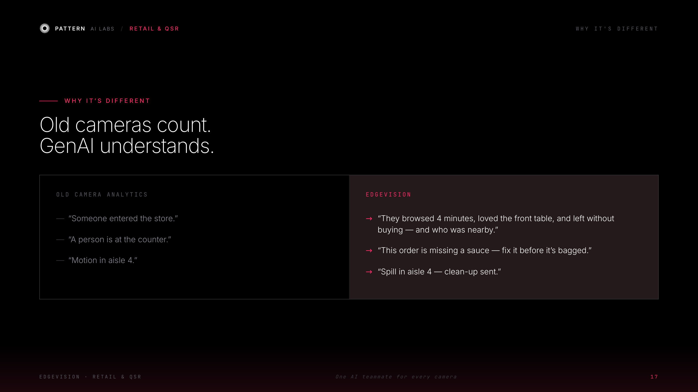
Notes:
The contrast lands the point — old cameras count, GenAI understands. Read one example out loud; it always gets a nod.

Slide 19
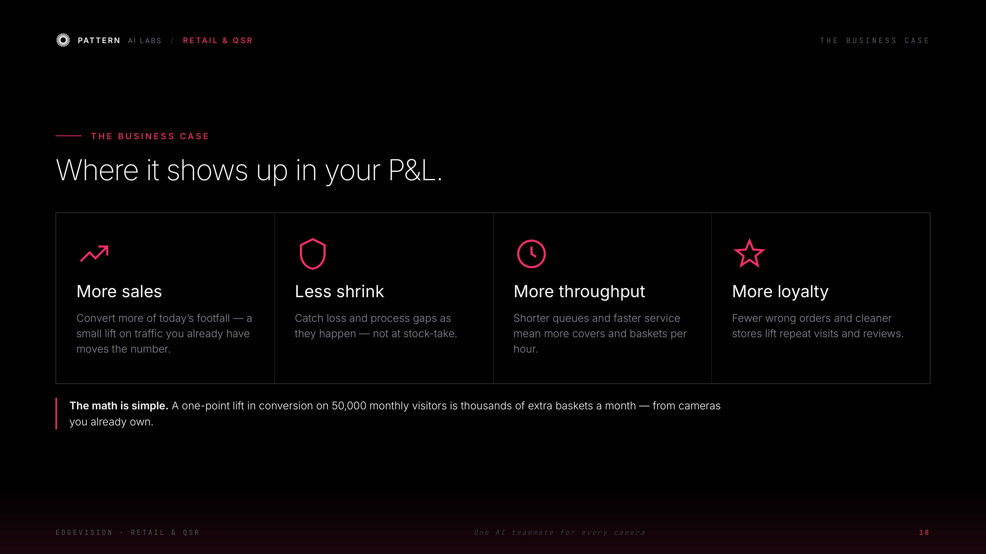
Notes:
Make it their money. Pick the lever that matters most to this room and do the quick mental math with them — small lifts on traffic they already have. Invite them to plug in their own numbers.

Slide 20
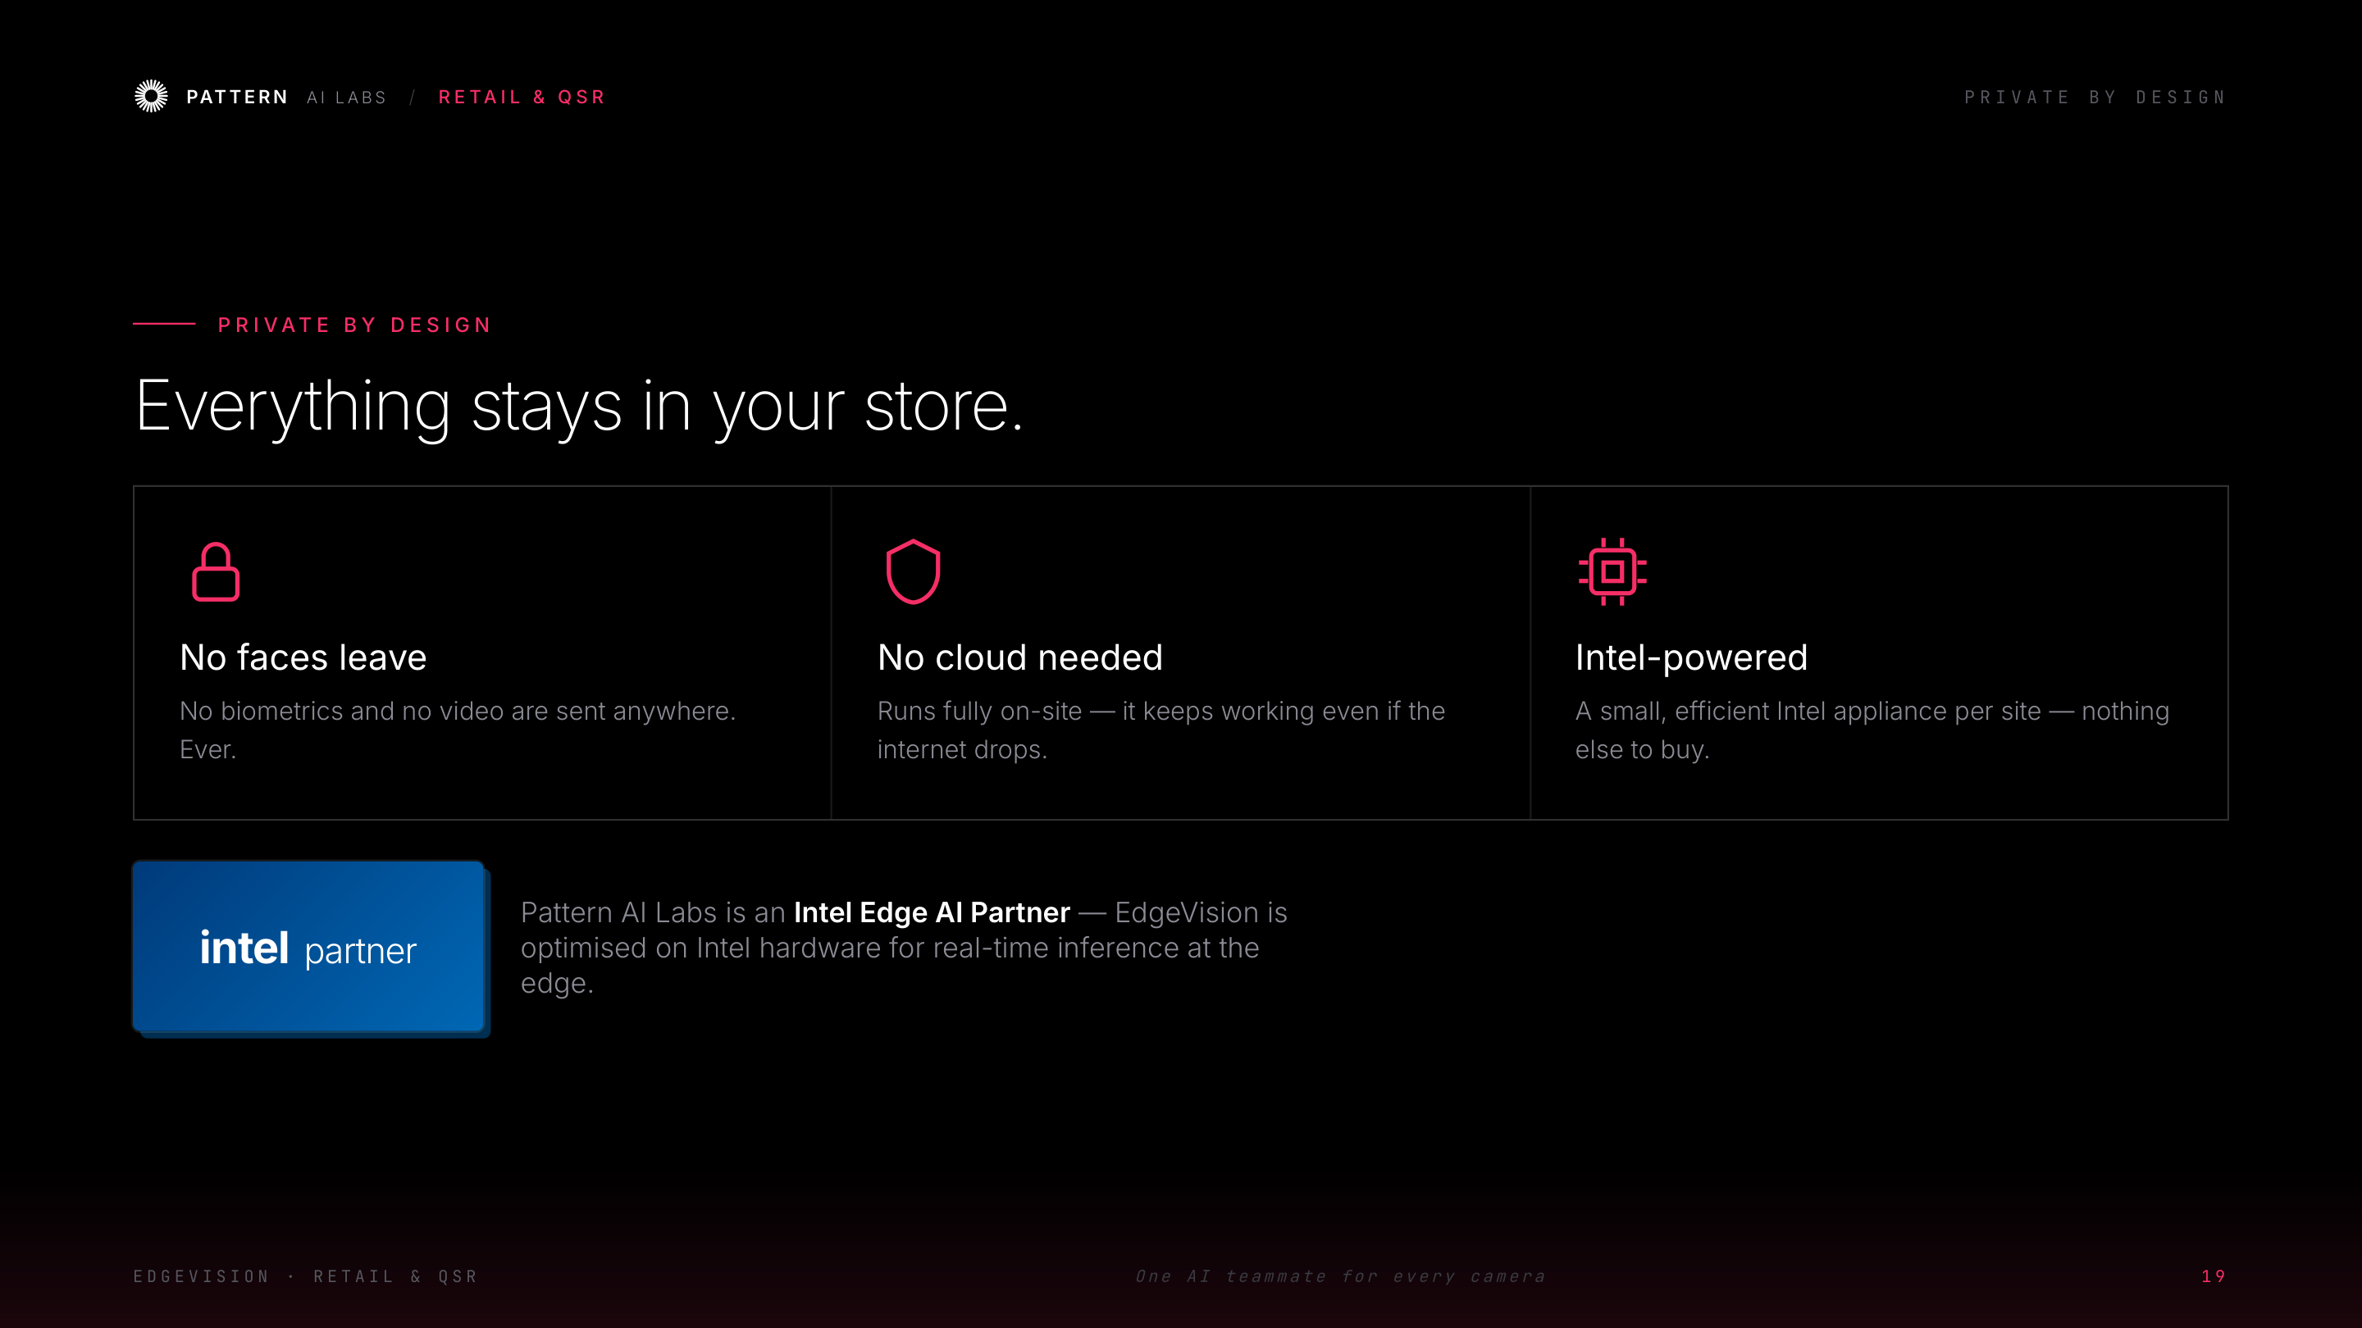
Notes:
Handle the two objections head-on: privacy and IT. Nothing leaves the store; it runs on Intel. Lean into the Intel partnership — we're at their event.

Slide 21
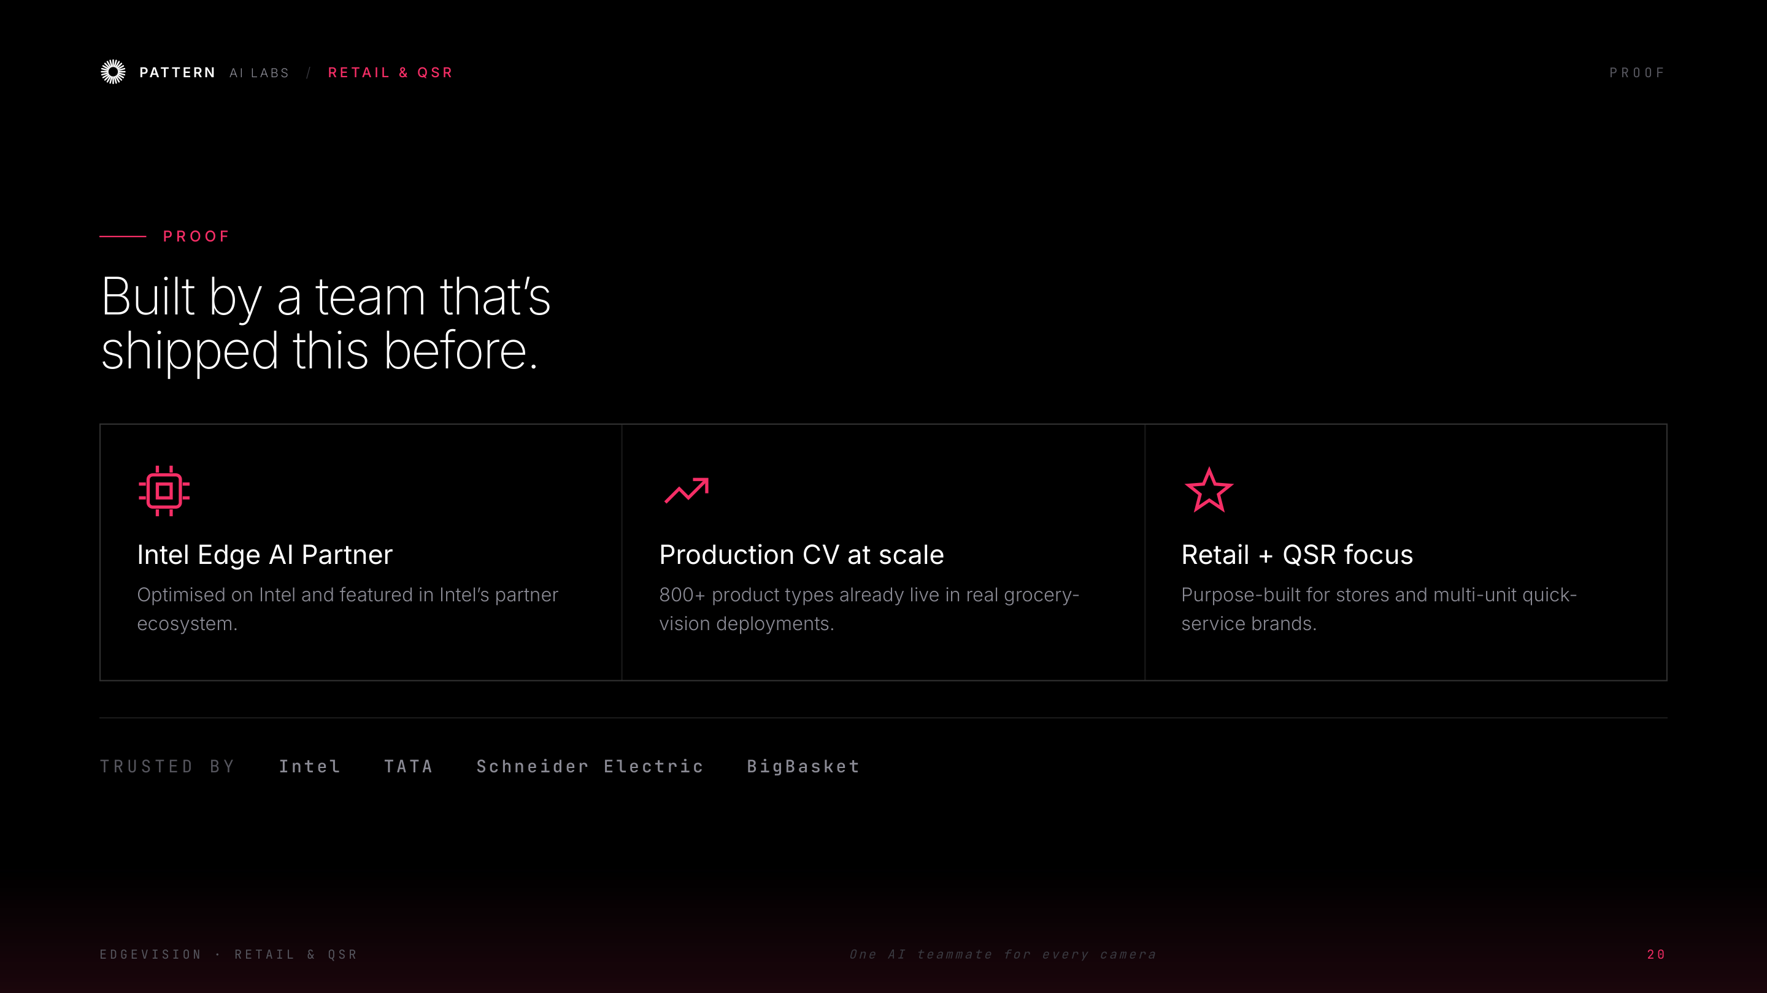
Notes:
Credibility: Intel Edge AI Partner, production computer vision at scale, purpose-built for retail + QSR. Names they'll recognise.

Slide 22
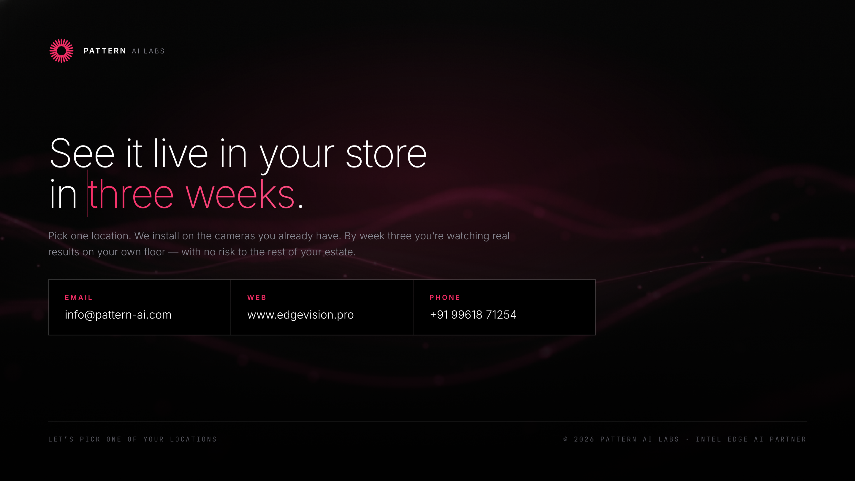
Notes:
Clear ask: pick ONE location, 3-week pilot, see live results with zero risk to the rest of the estate. Close with: 'Which location should we start with?'

