Slide 1
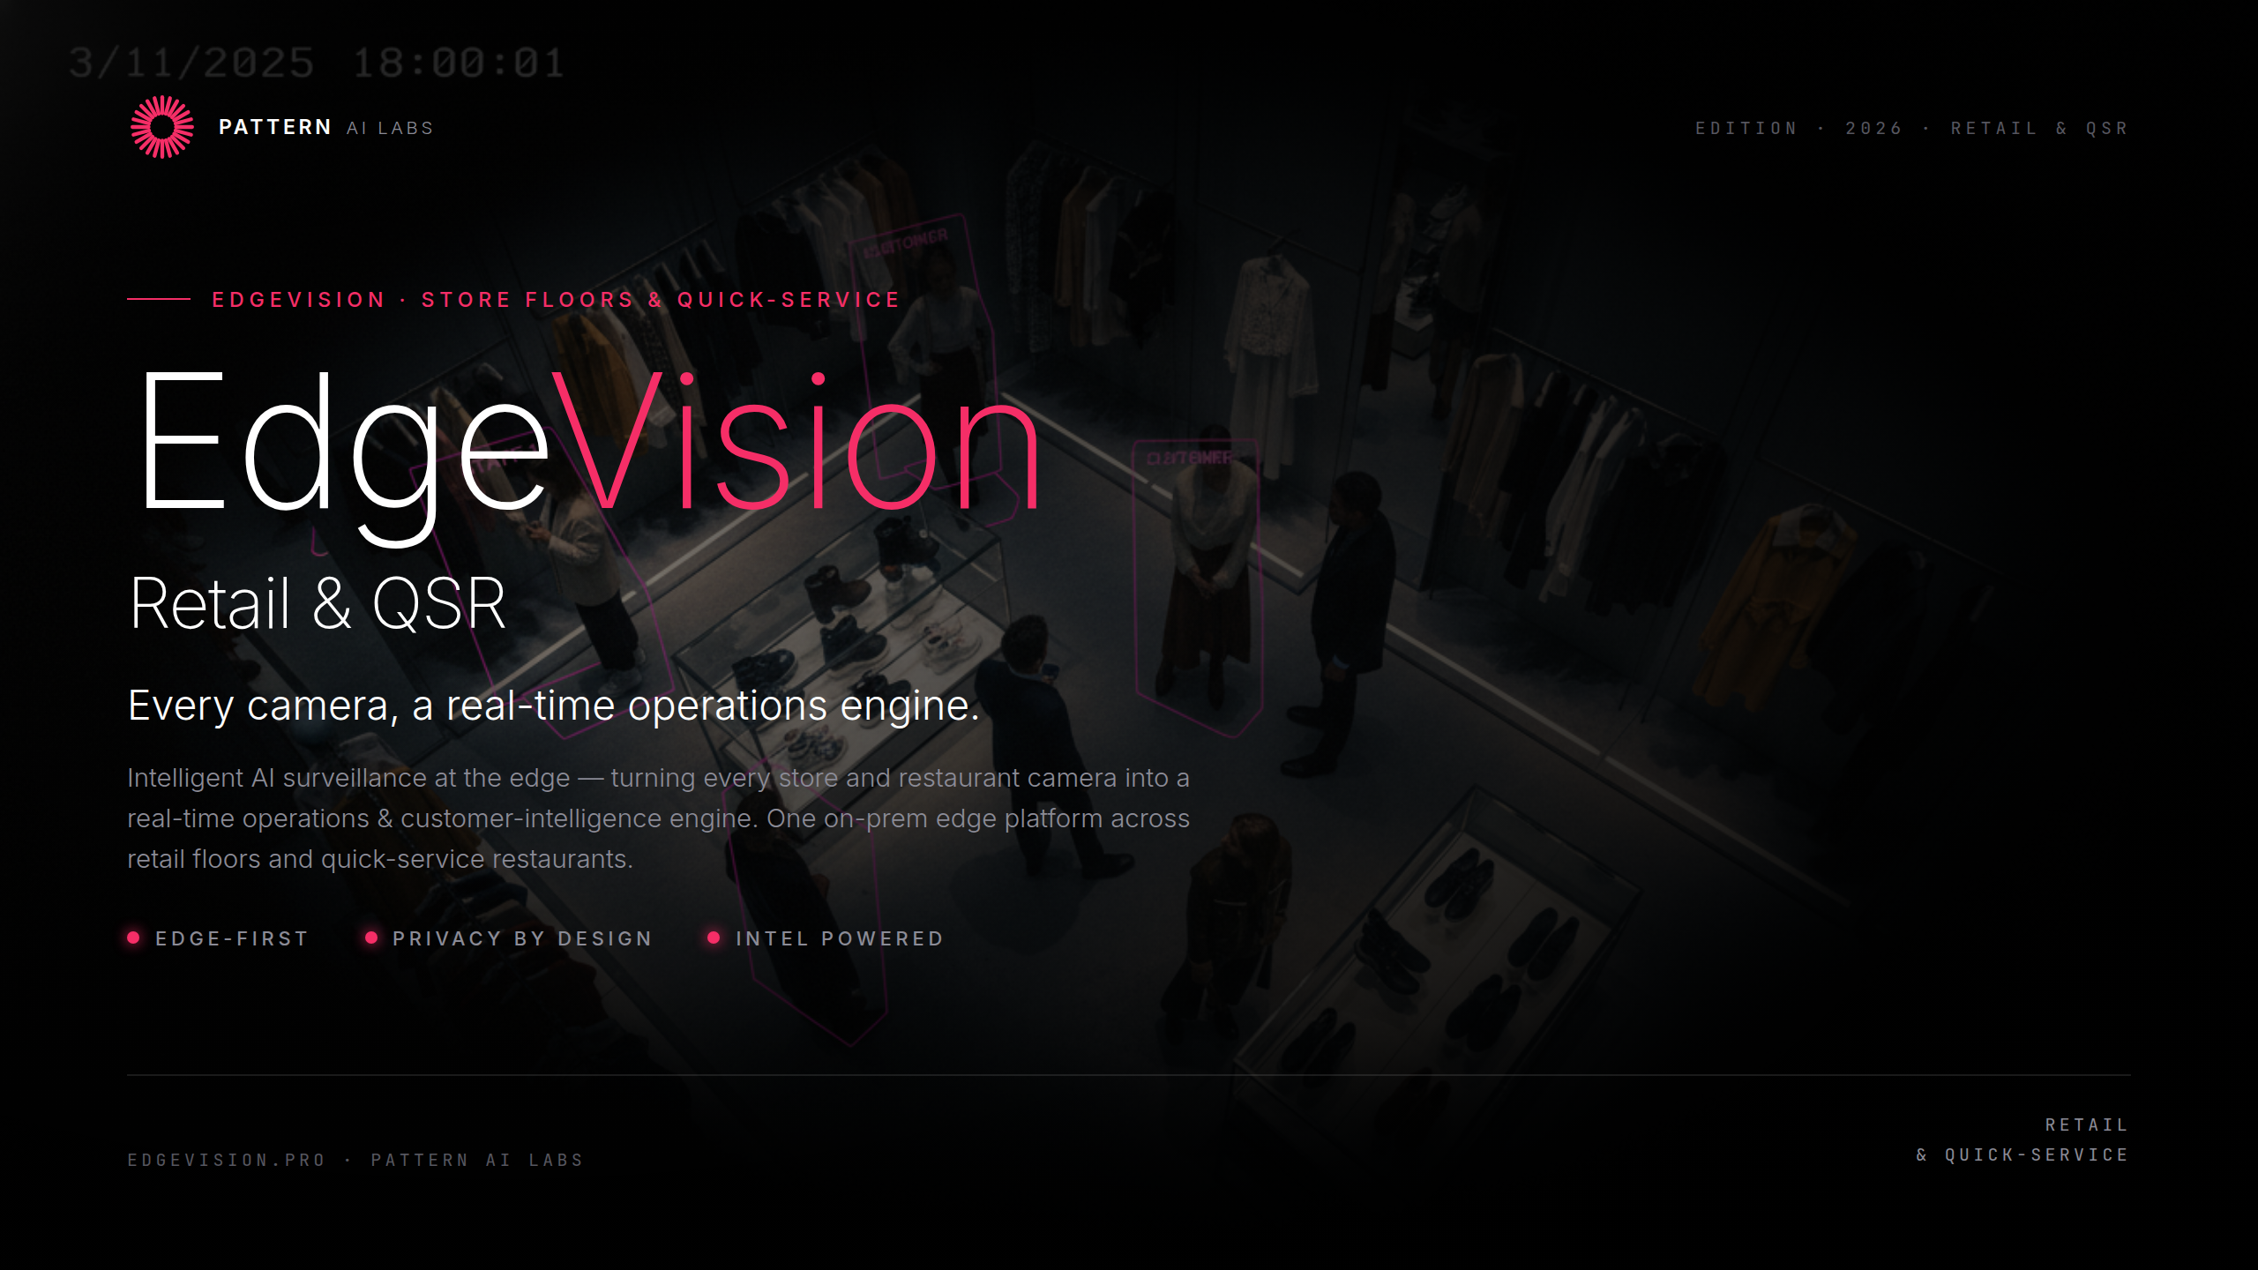
Notes:
Cover

Slide 2
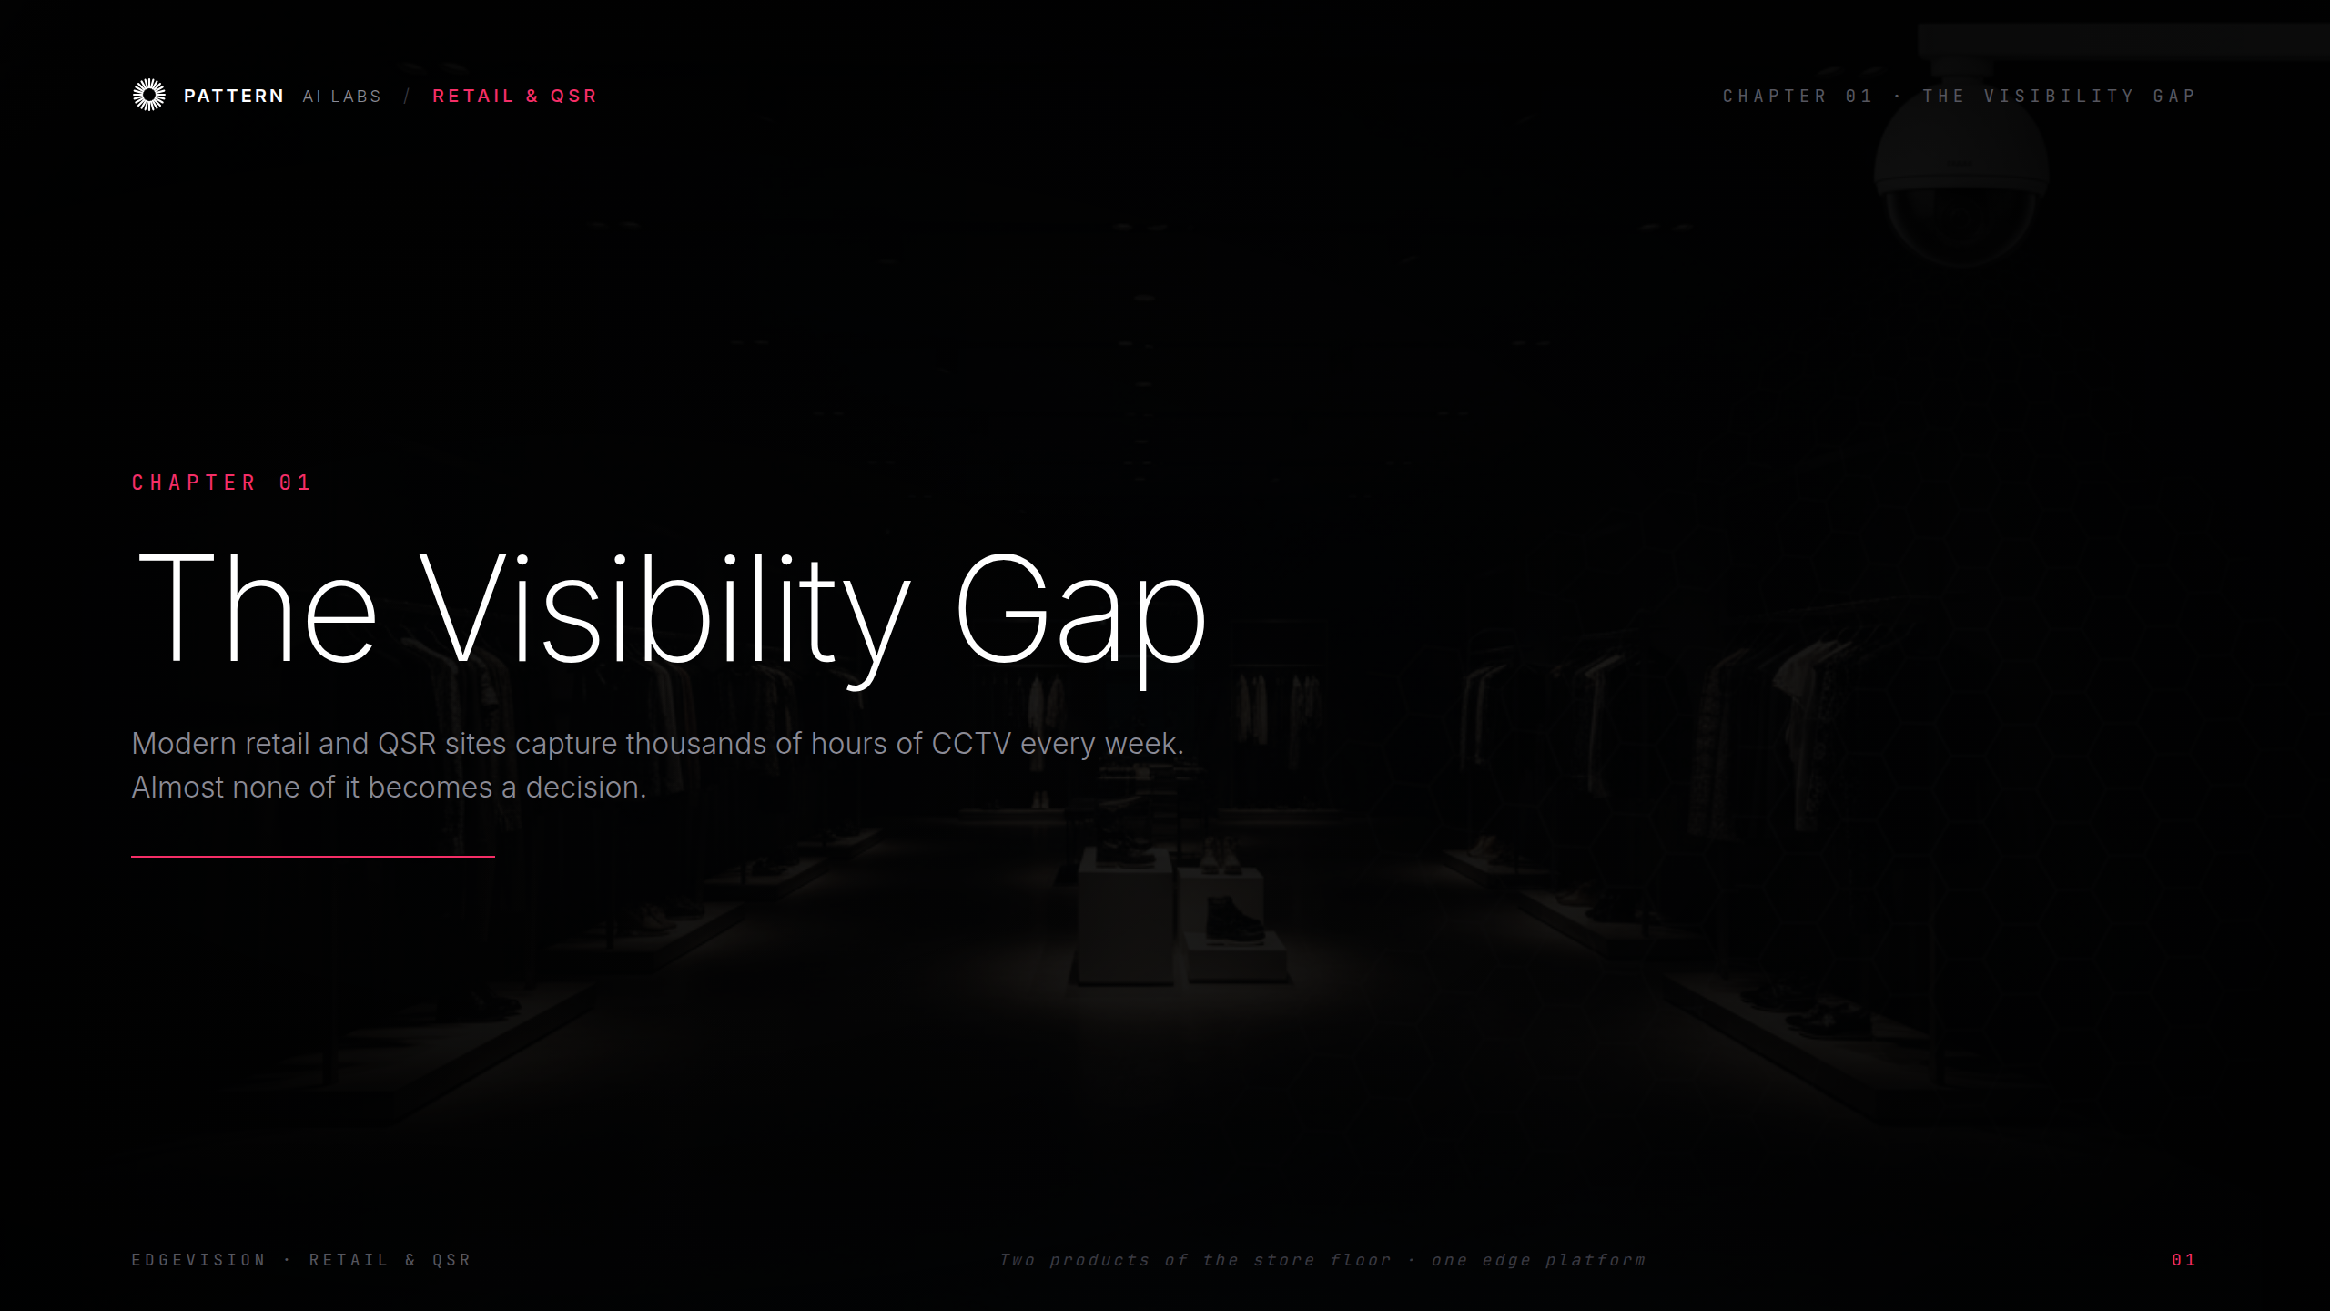
Notes:
Ch.01 The Visibility Gap

Slide 3
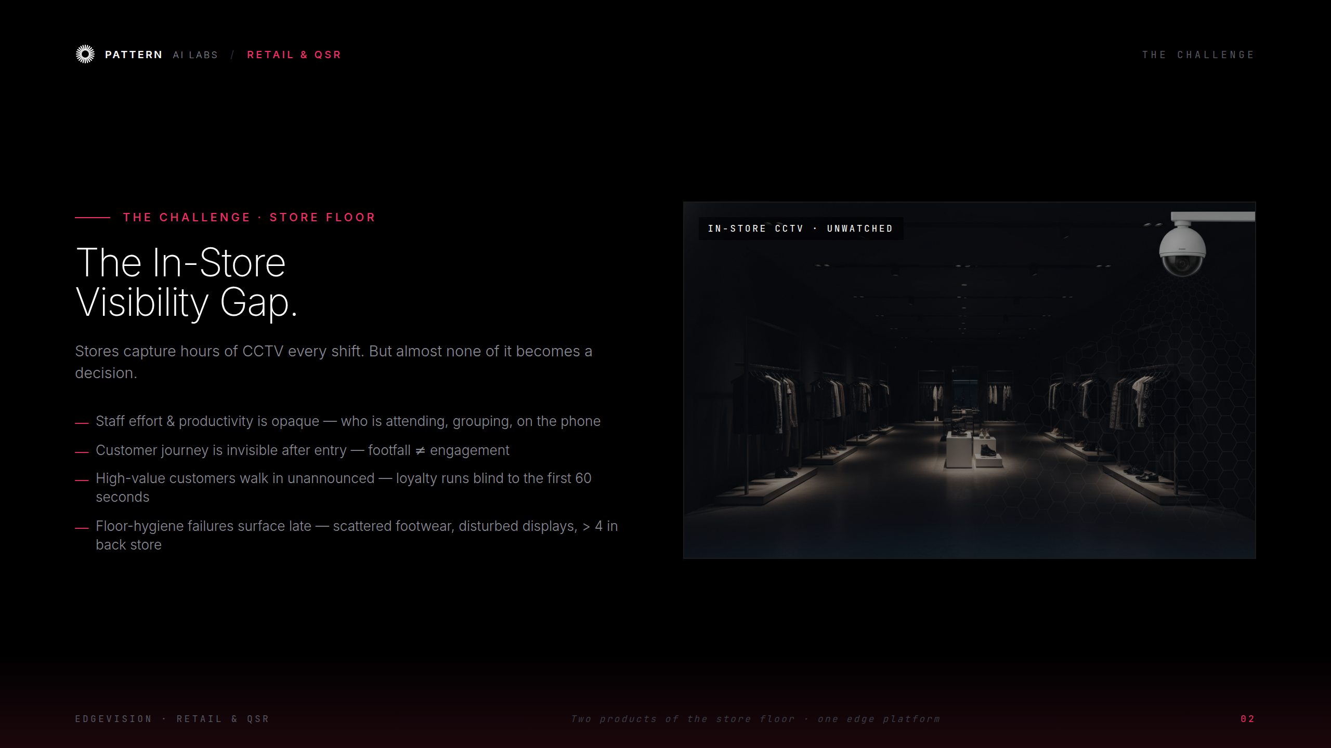
Notes:
The Challenge — store floor

Slide 4
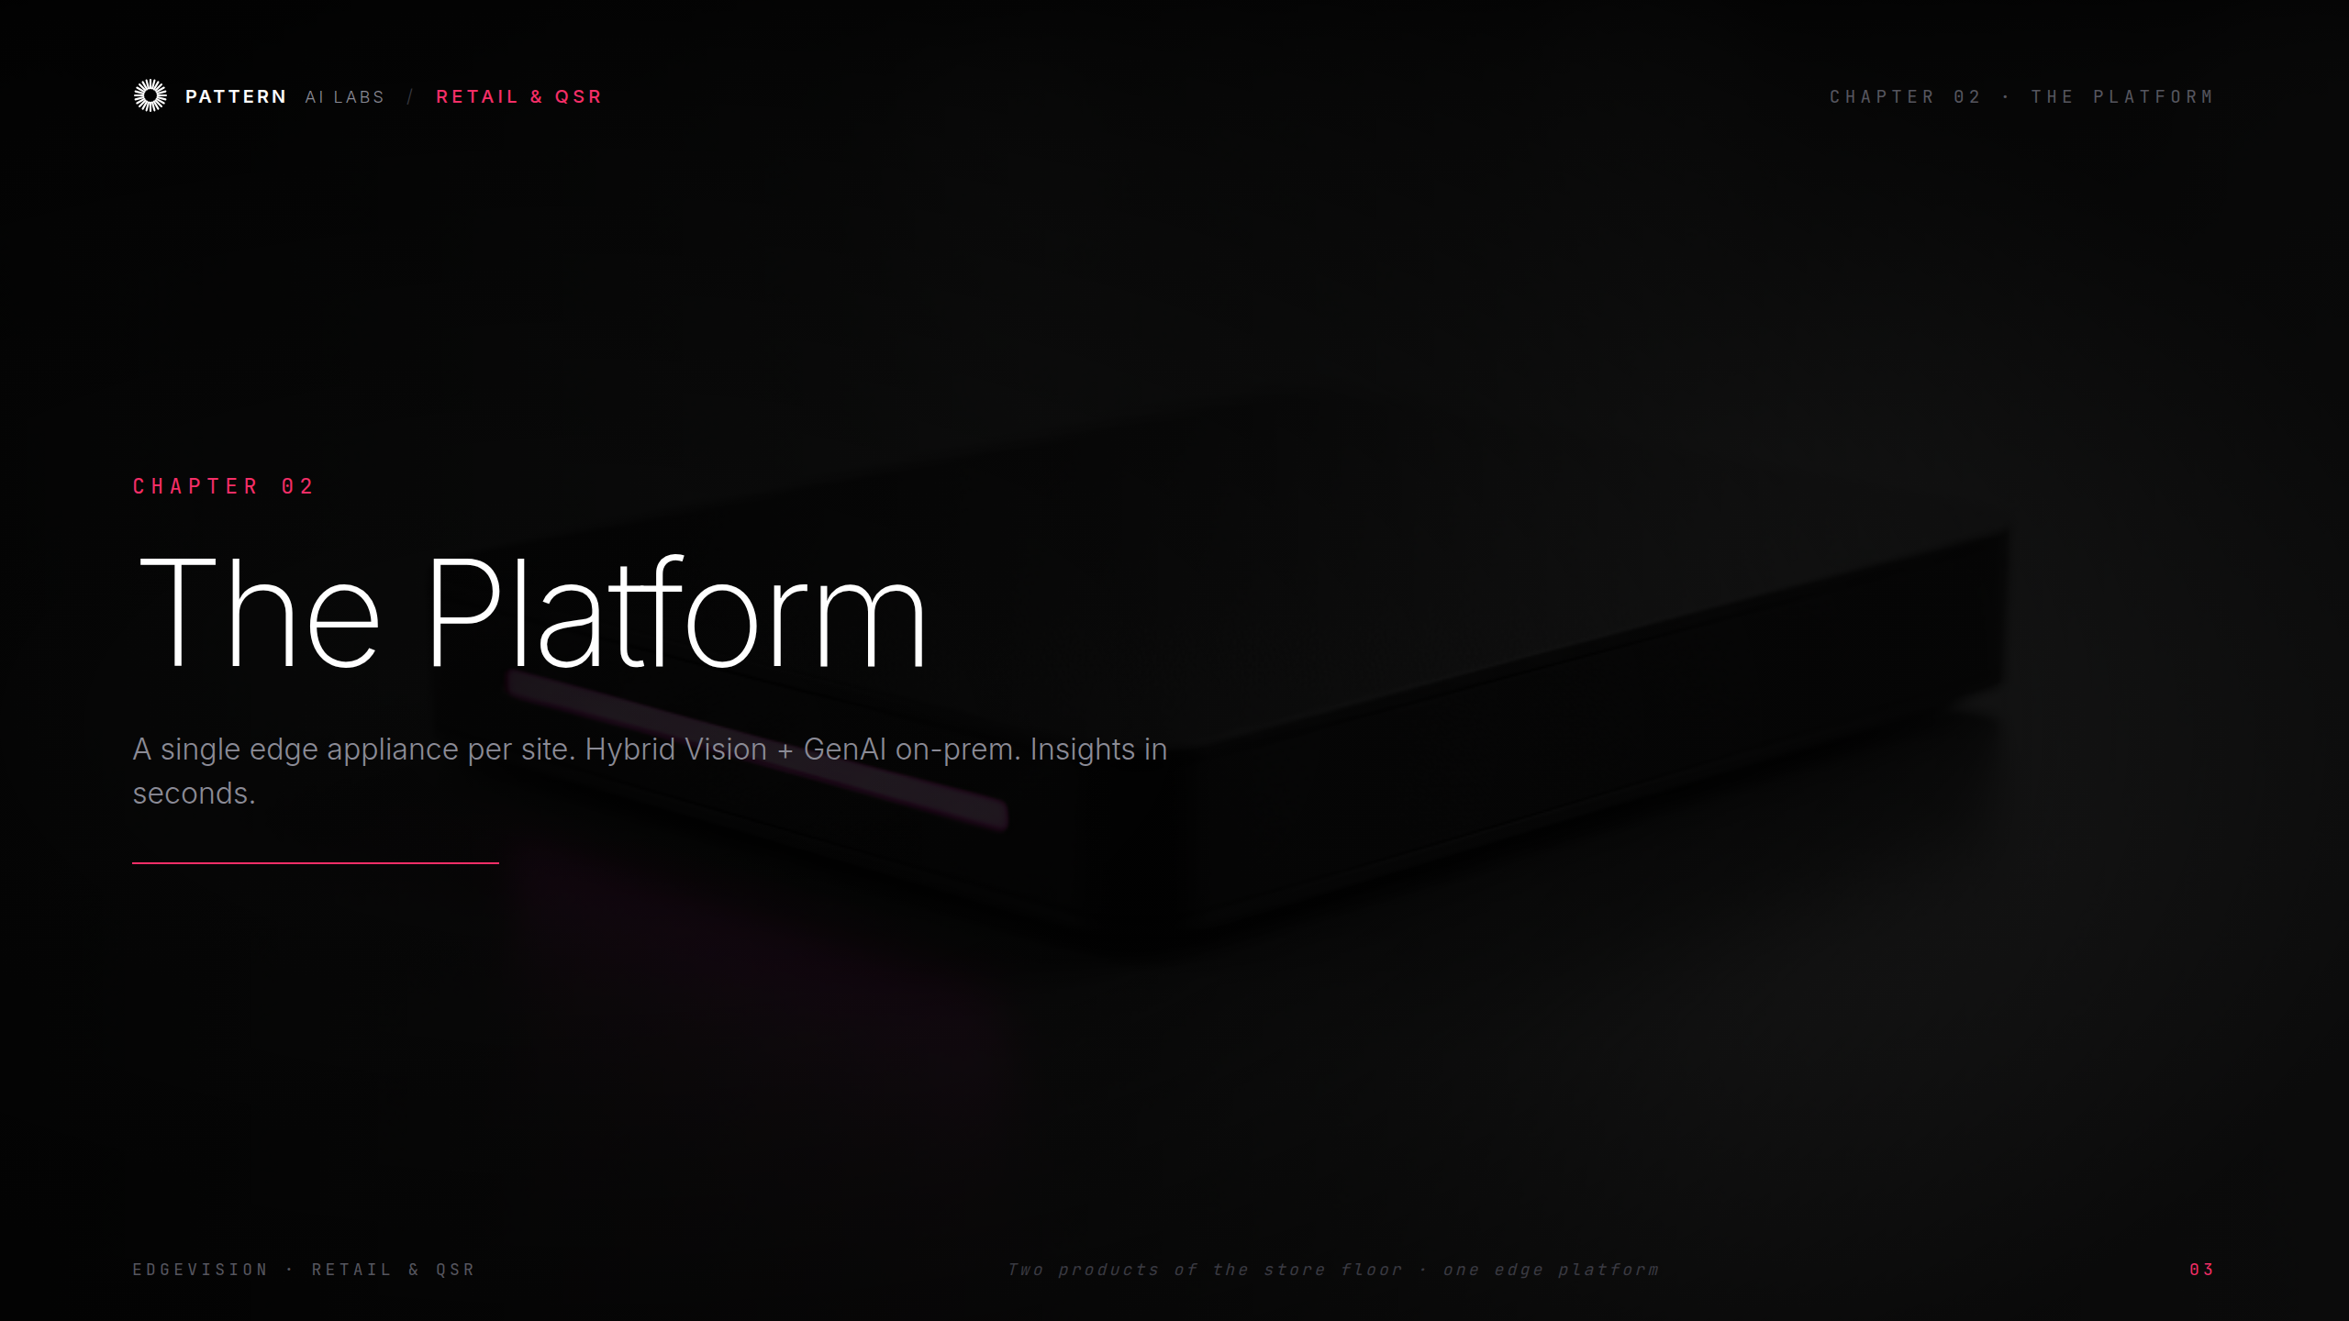
Notes:
Ch.02 The Platform

Slide 5
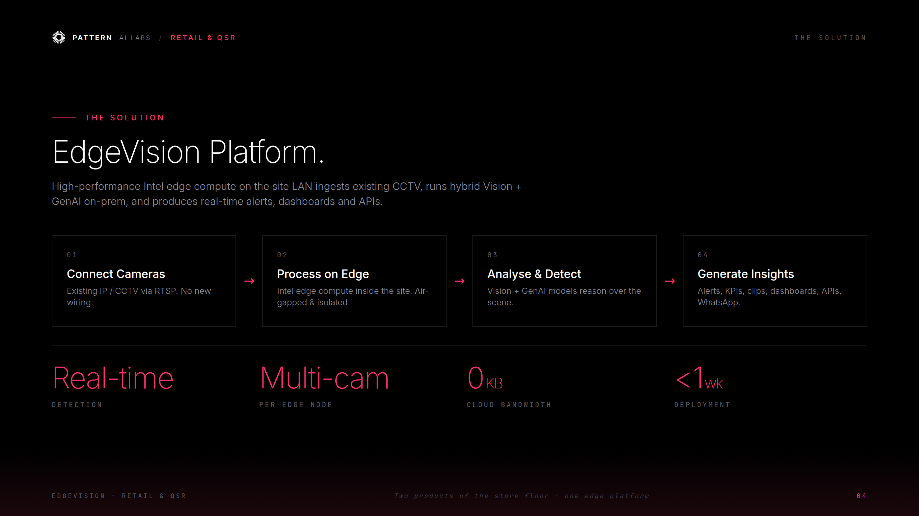
Notes:
The Solution — EdgeVision Platform

Slide 6
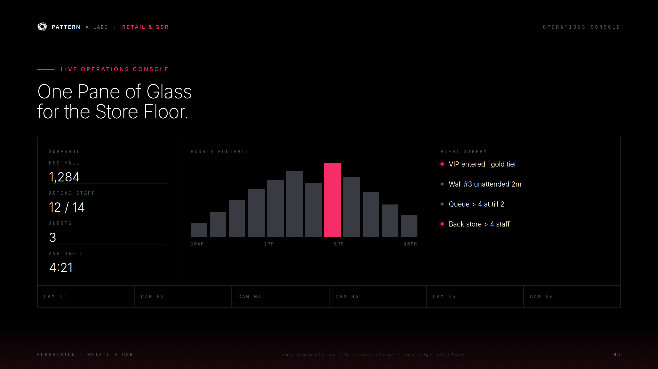
Notes:
Live Operations Console

Slide 7
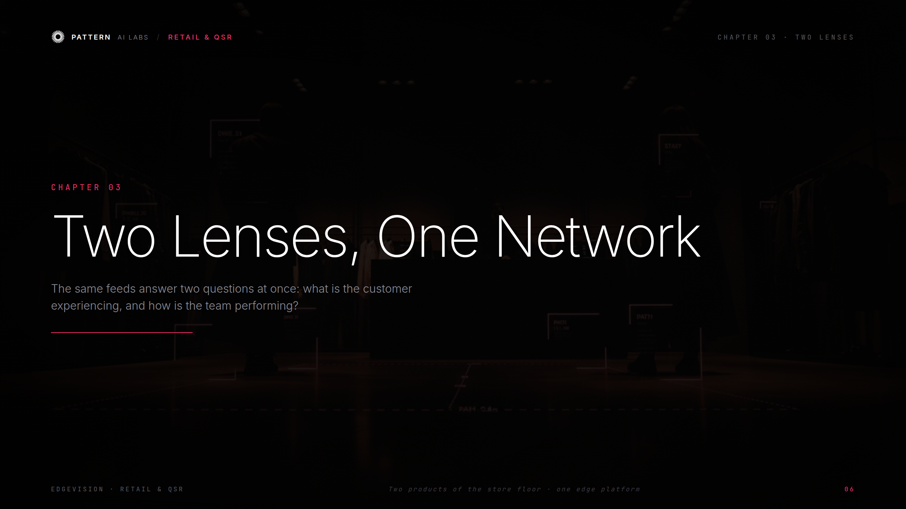
Notes:
Ch.03 Two Lenses, One Network

Slide 8
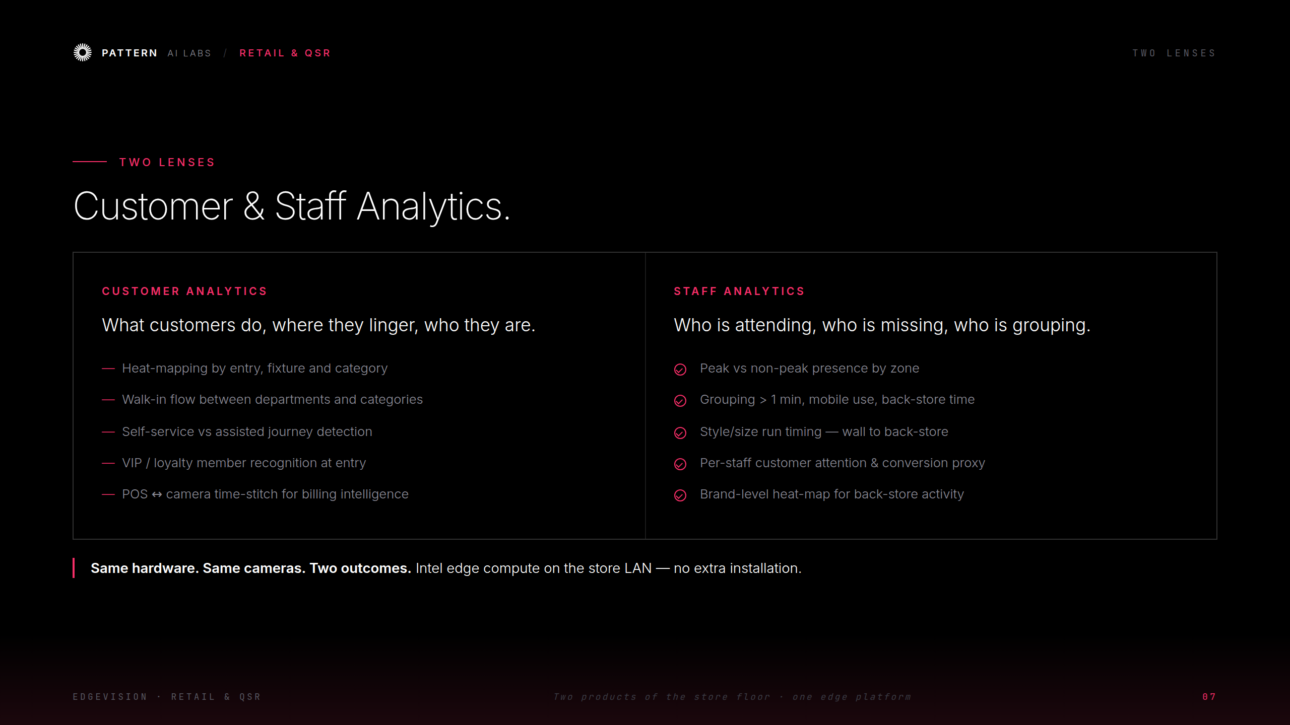
Notes:
Customer & Staff Analytics

Slide 9
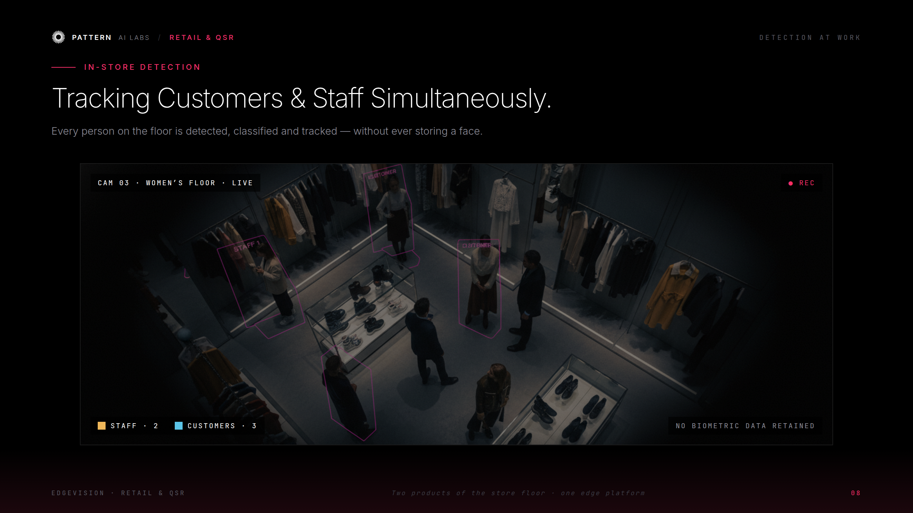
Notes:
Detection at Work

Slide 10
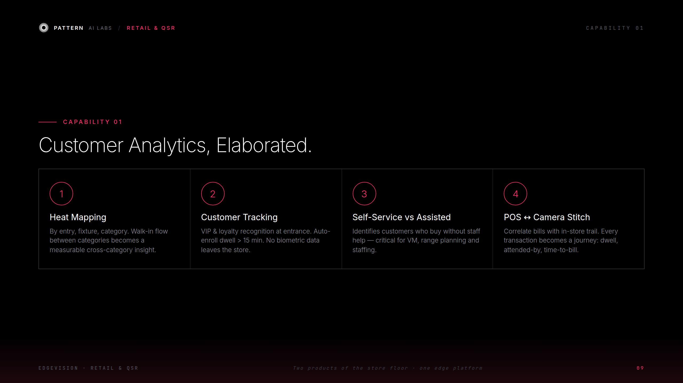
Notes:
Customer Analytics, elaborated

Slide 11
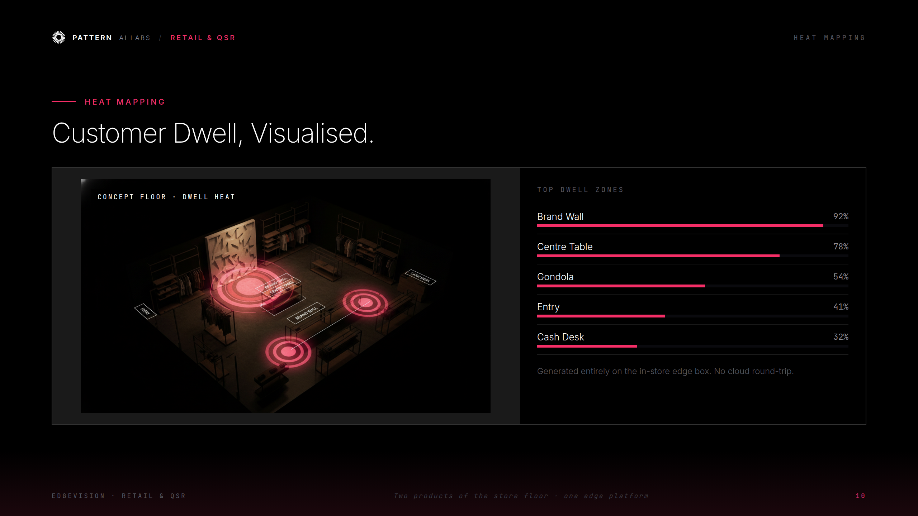
Notes:
Heat Mapping

Slide 12
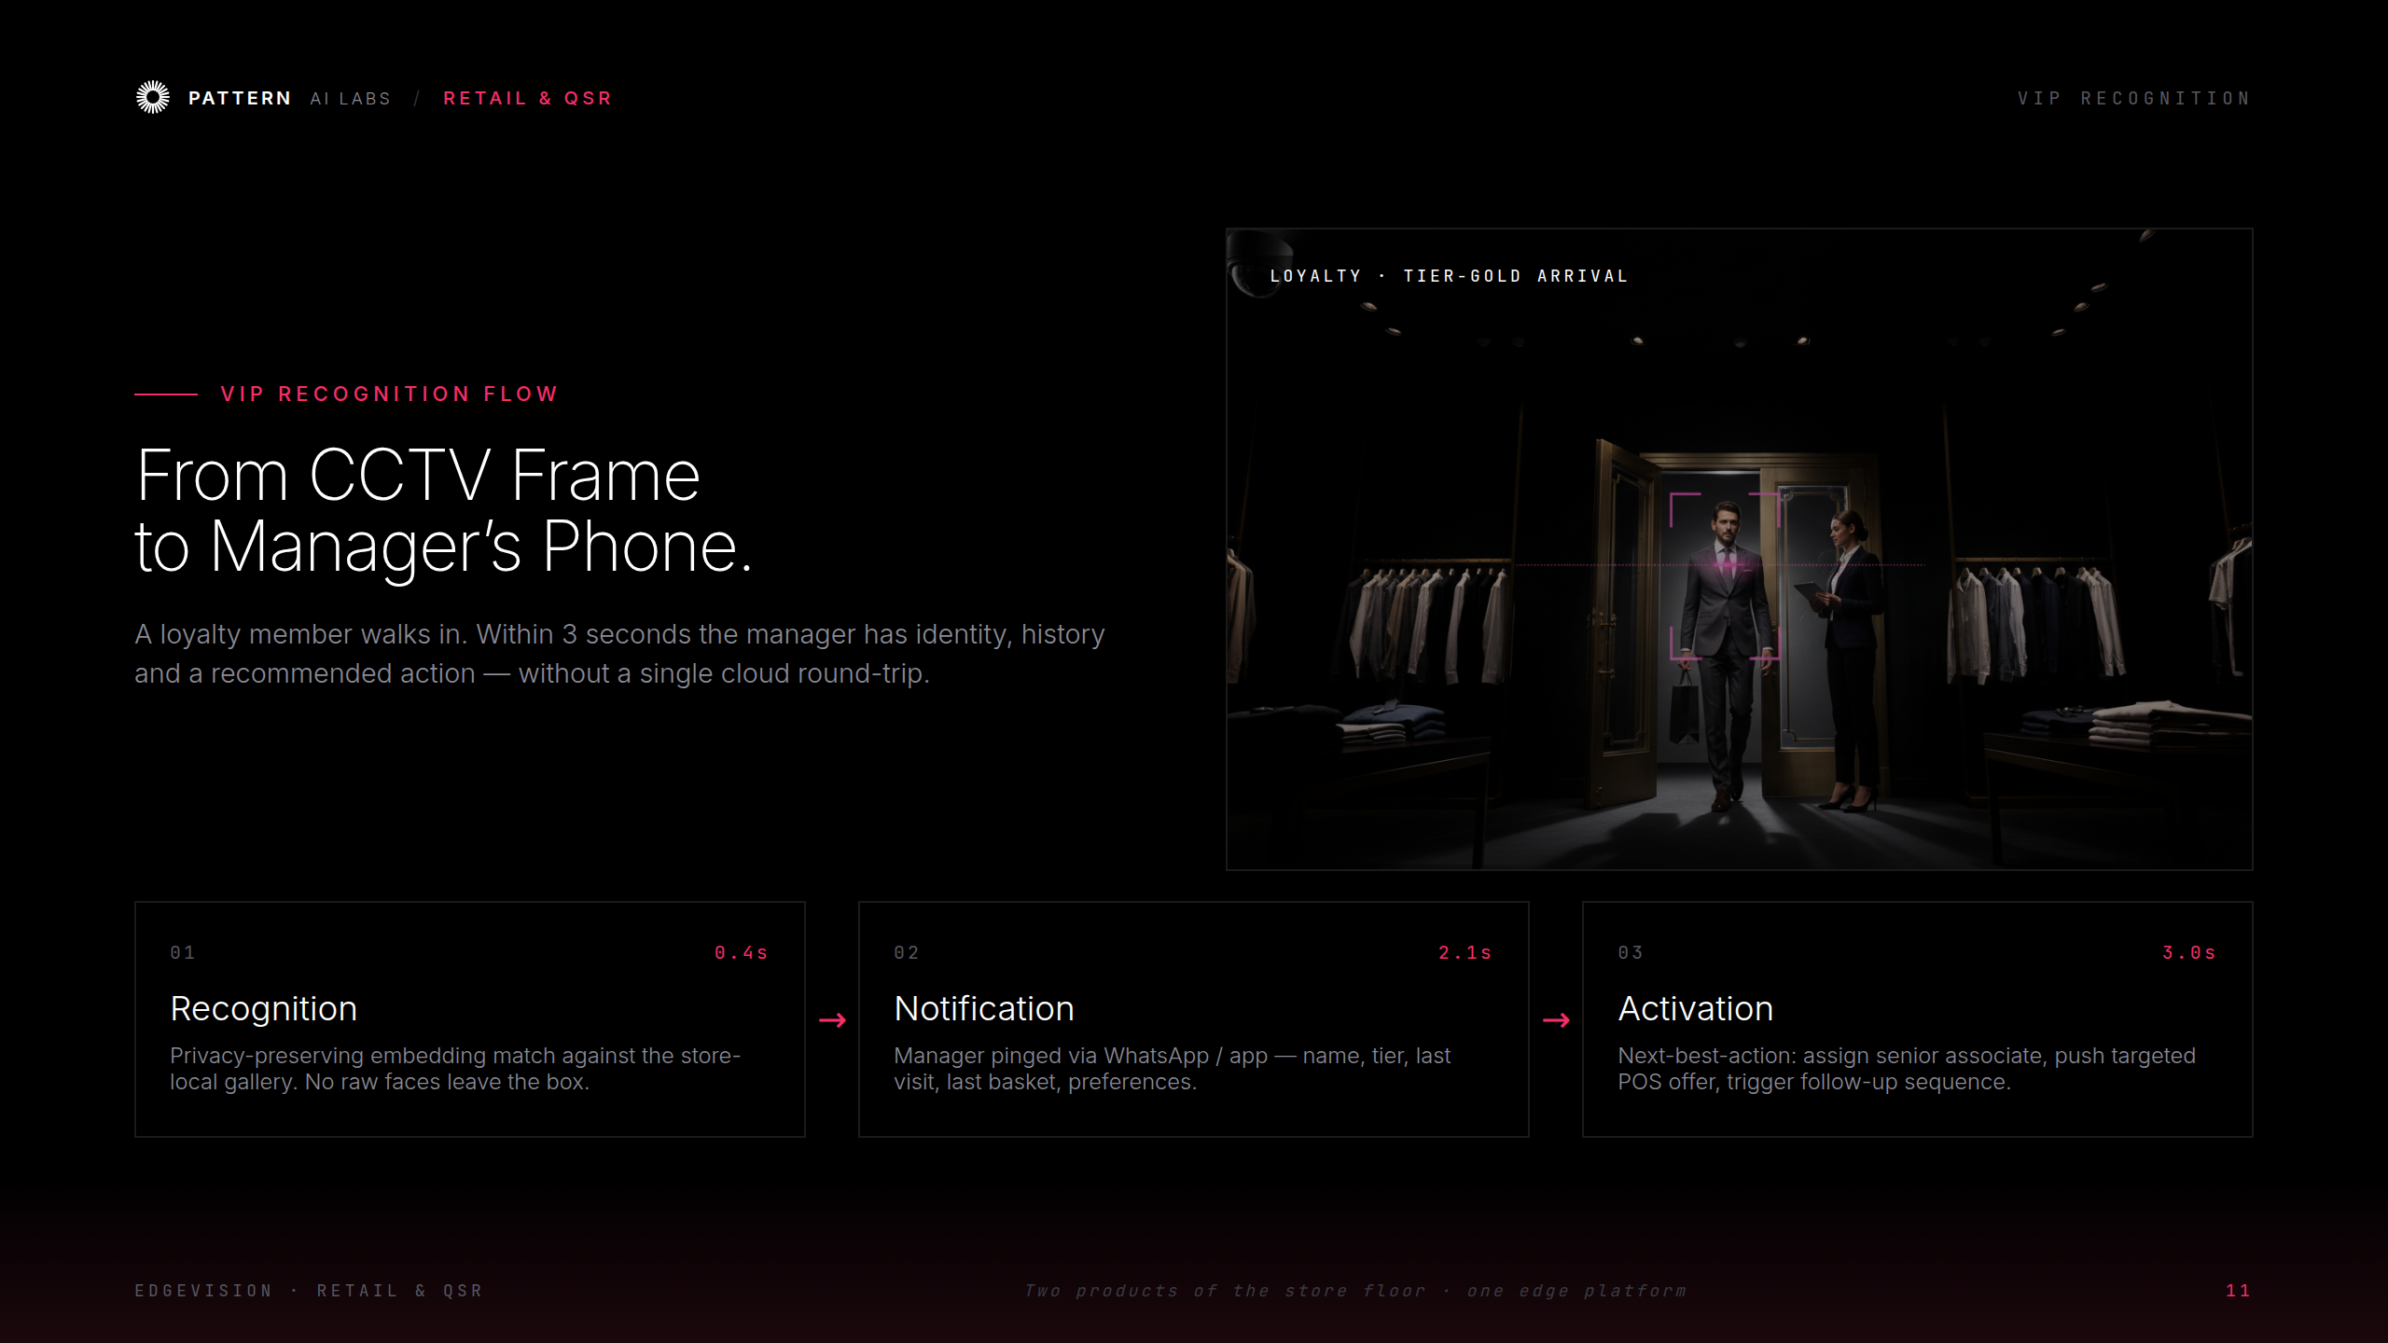
Notes:
VIP Recognition Flow

Slide 13
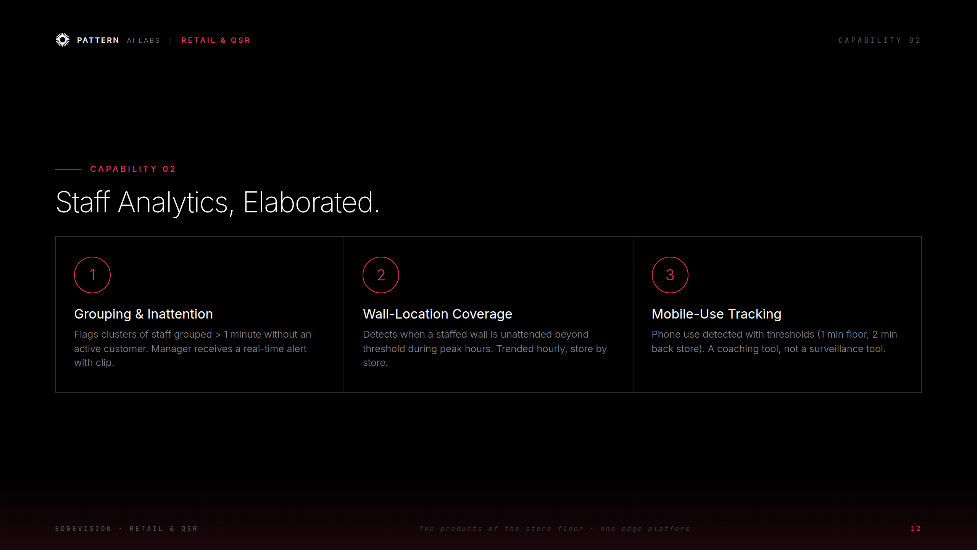
Notes:
Staff Analytics, elaborated

Slide 14
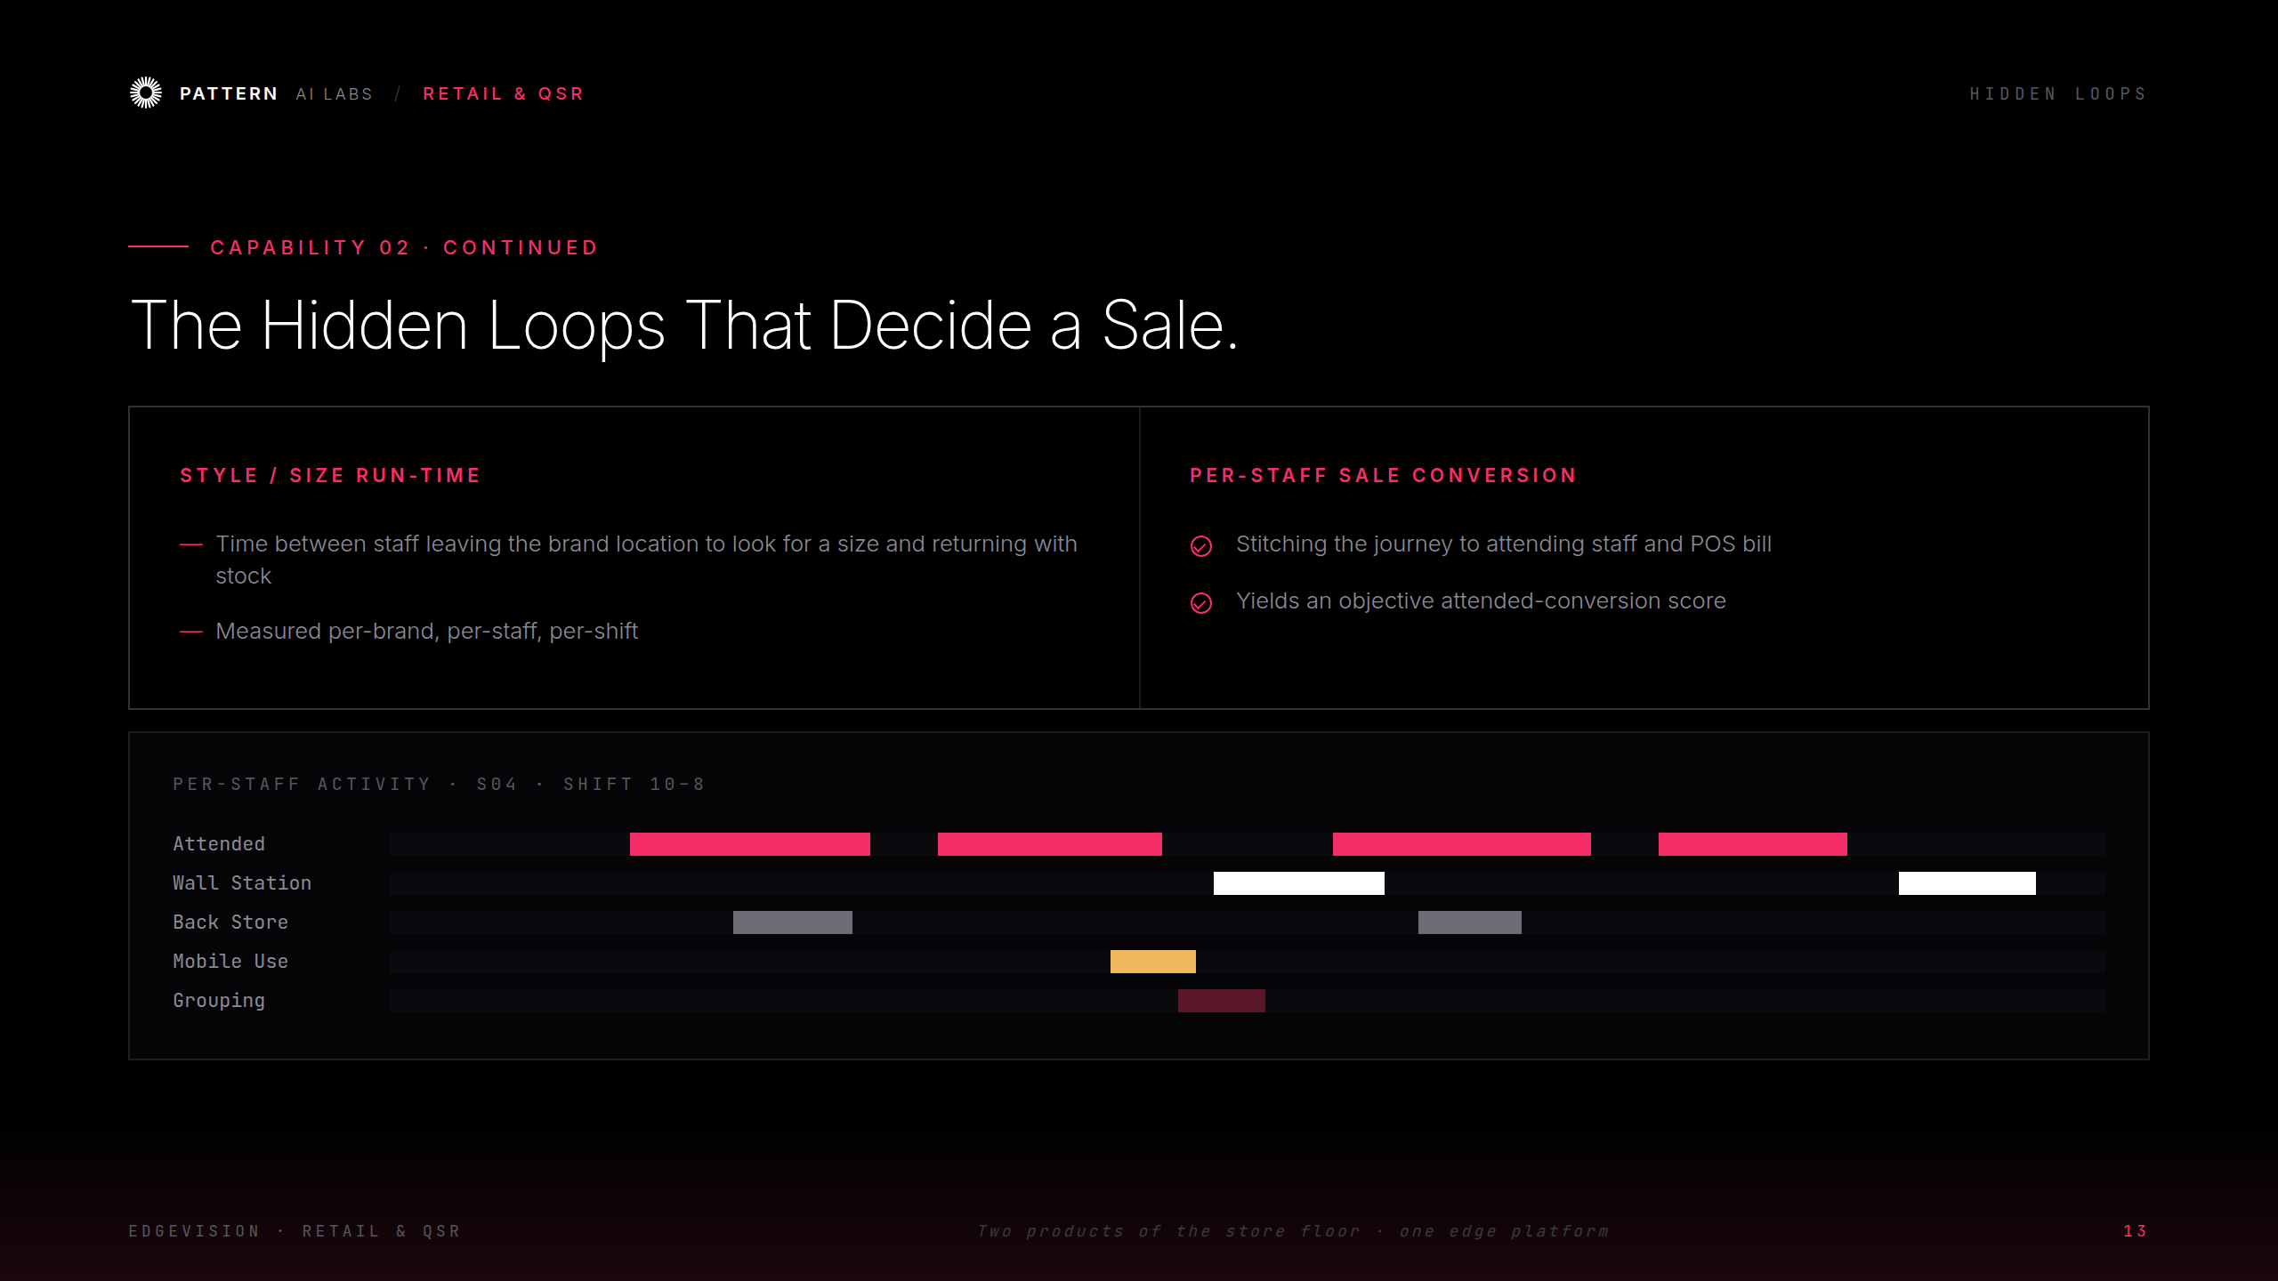
Notes:
The Hidden Loops (per-staff activity)

Slide 15
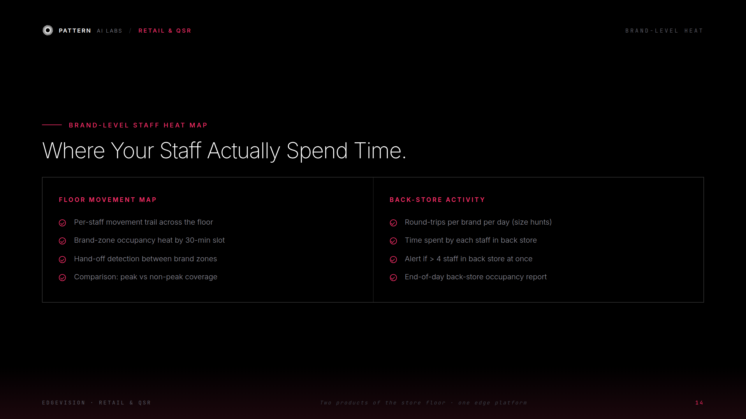
Notes:
Brand-Level Staff Heat Map

Slide 16
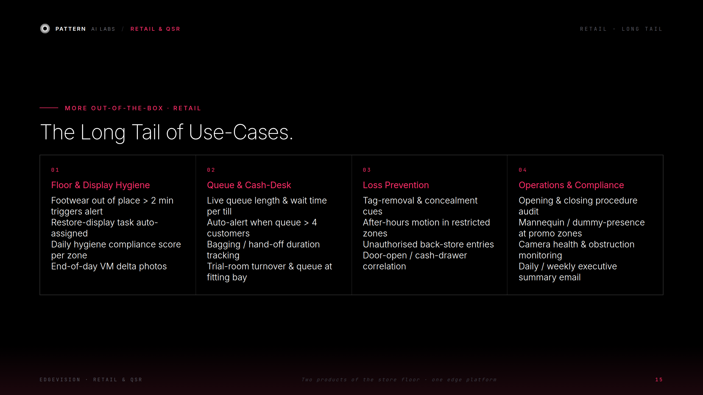
Notes:
Retail — the long tail of use-cases

Slide 17
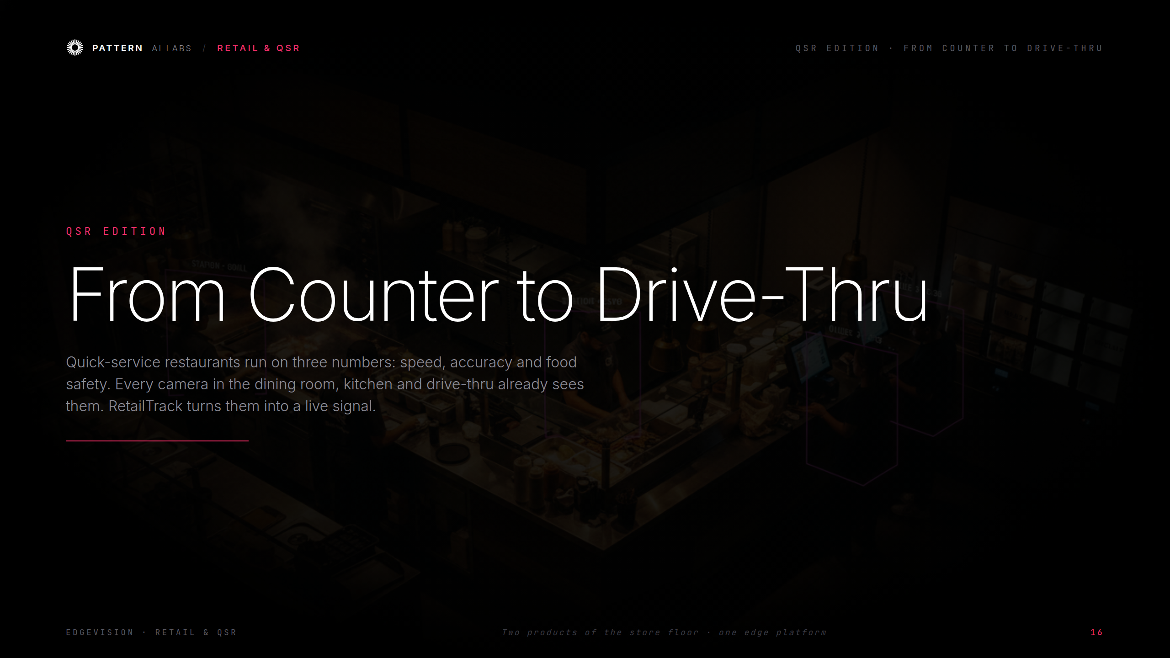
Notes:
QSR Edition — From Counter to Drive-Thru

Slide 18
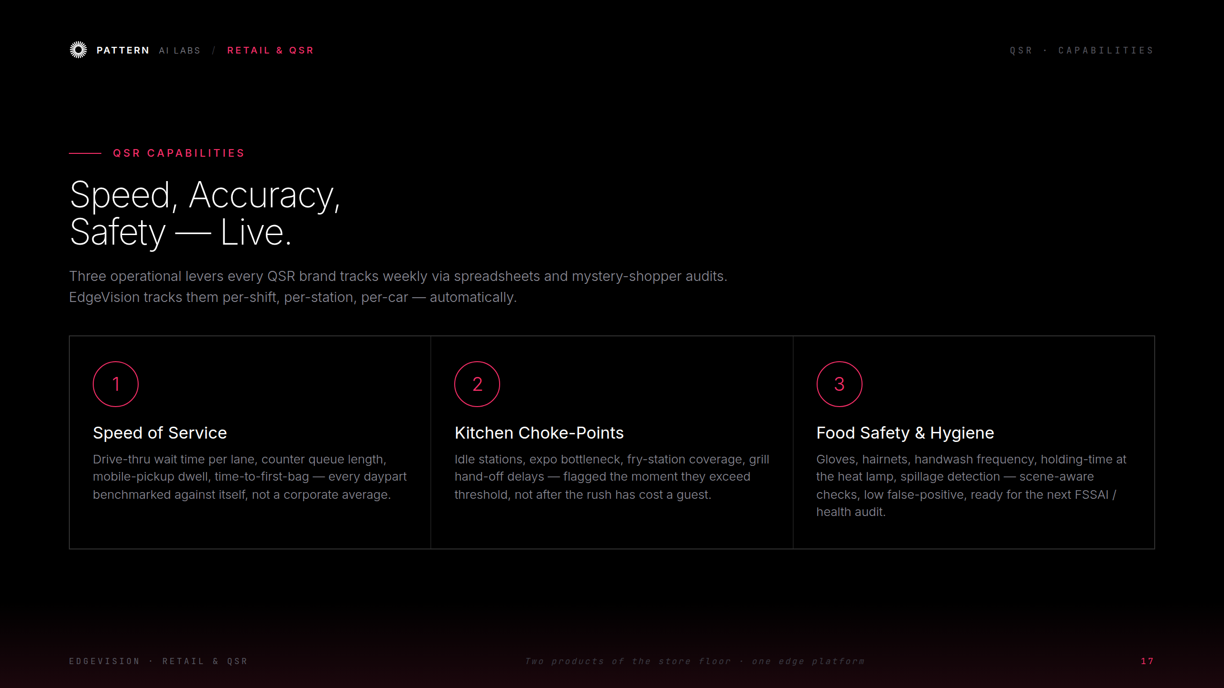
Notes:
QSR Capabilities — speed, accuracy, safety

Slide 19
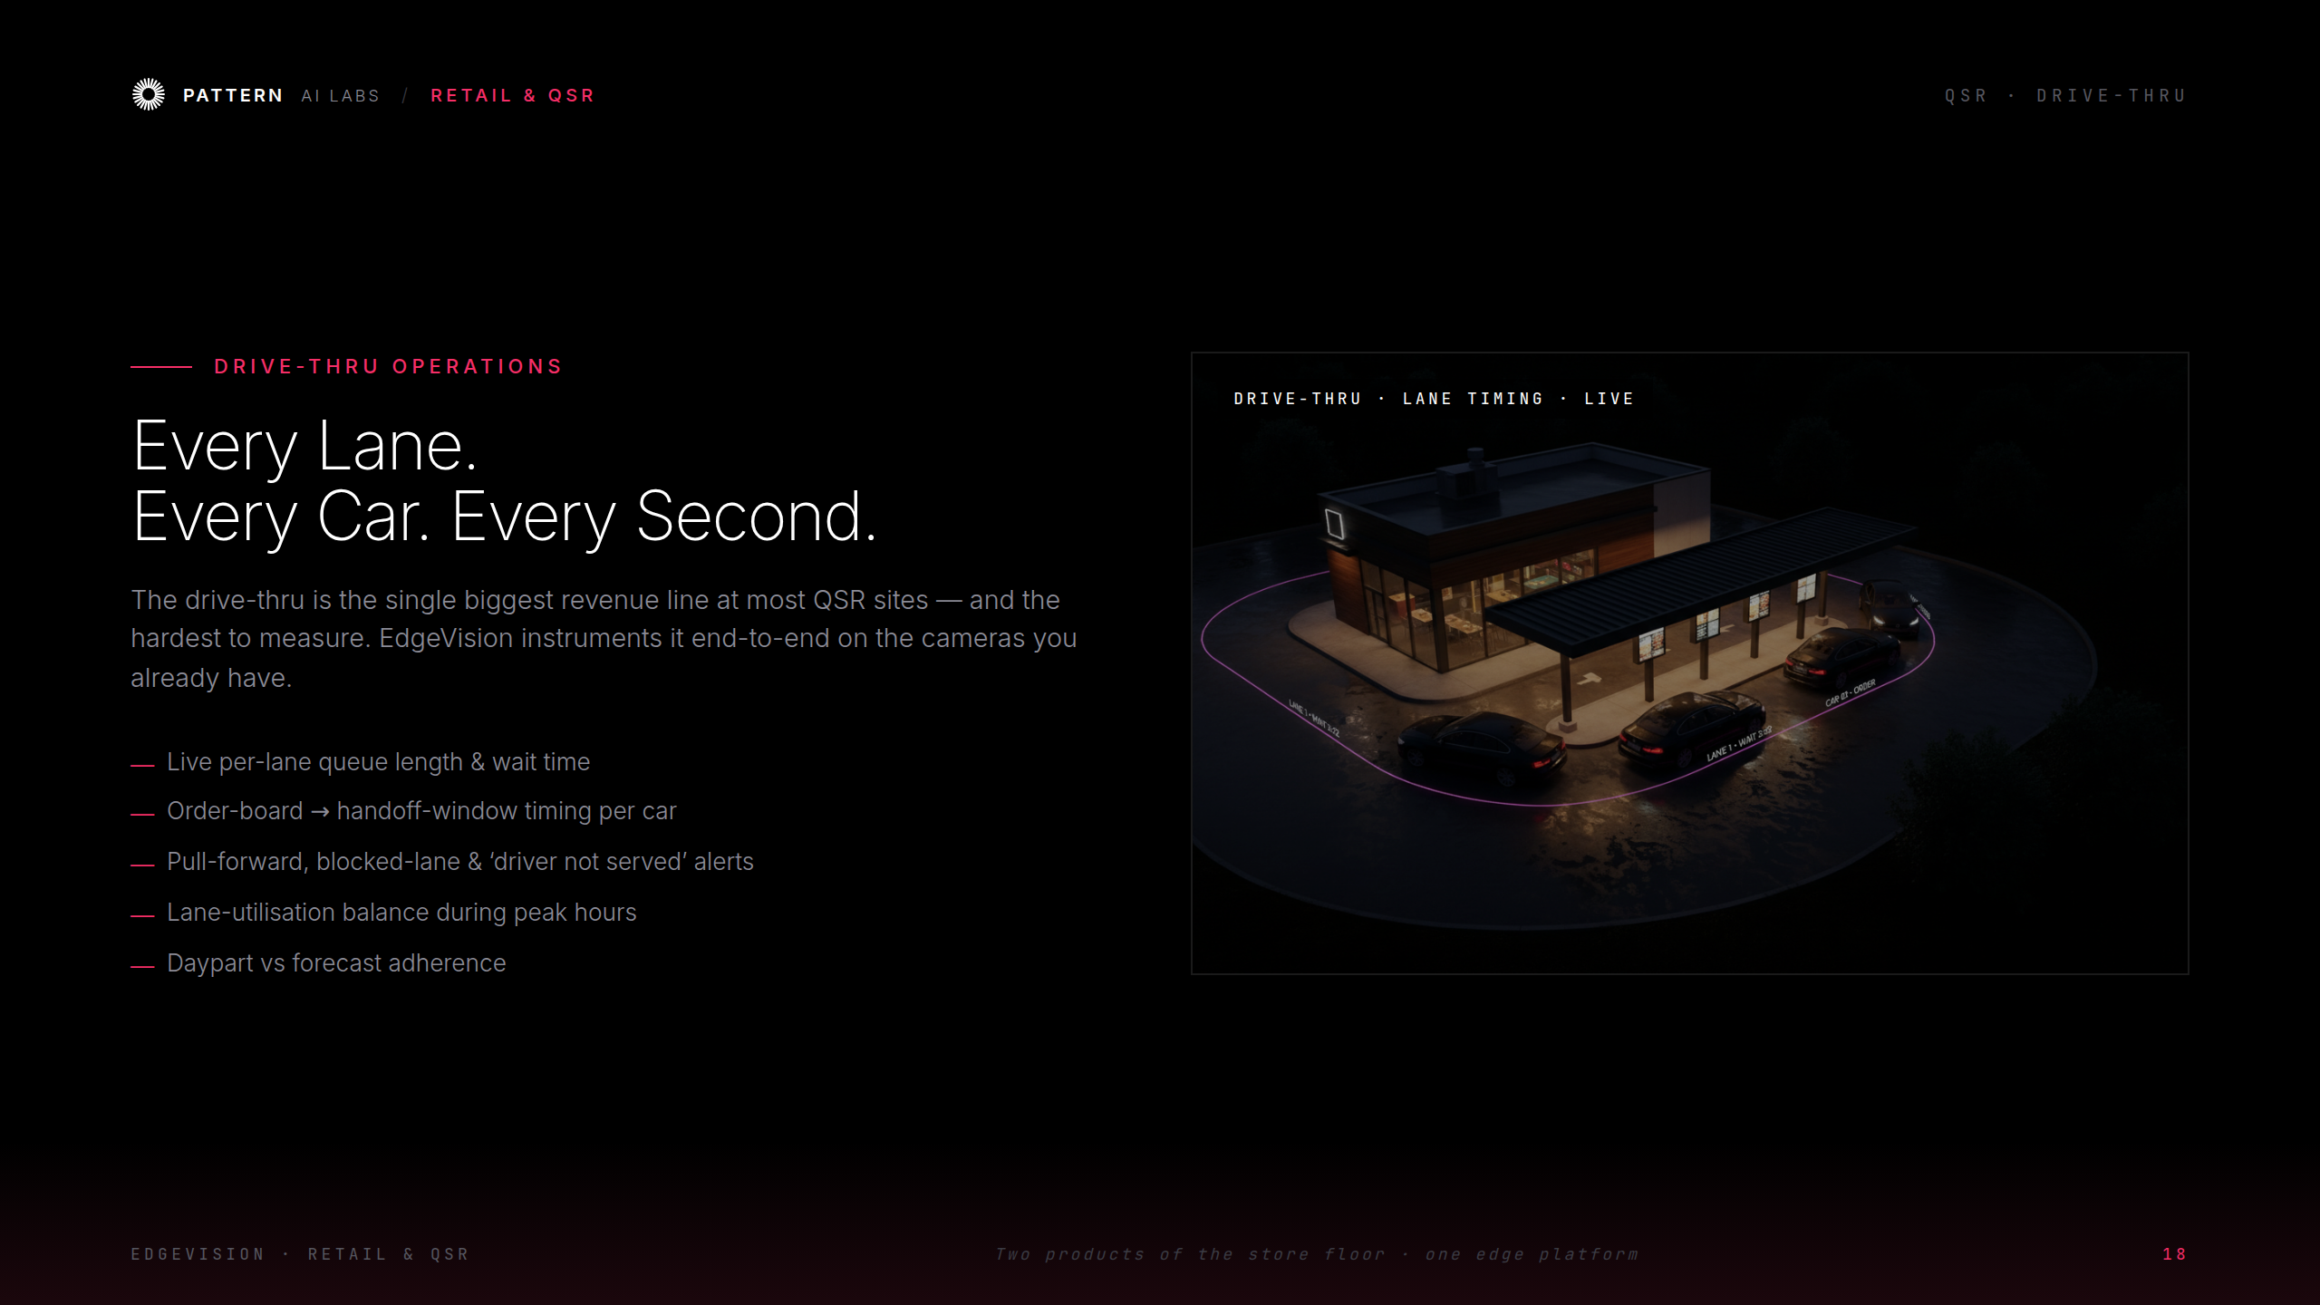
Notes:
QSR Drive-Thru Operations

Slide 20
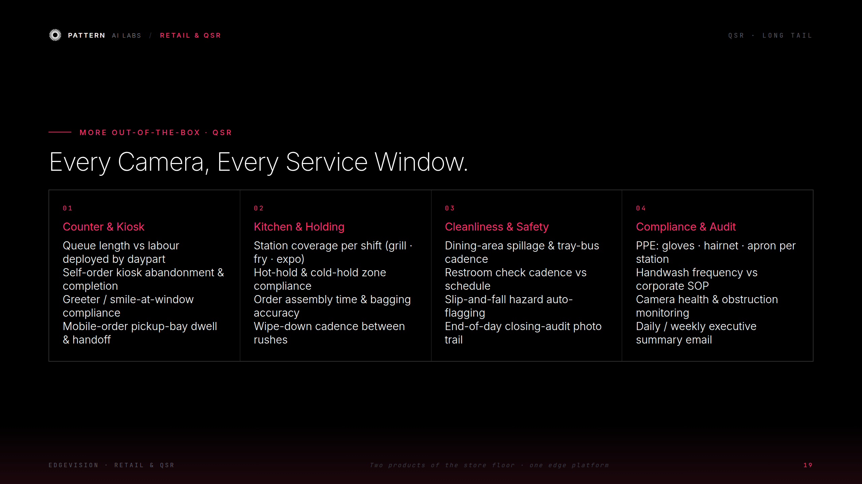
Notes:
QSR — every service window

Slide 21
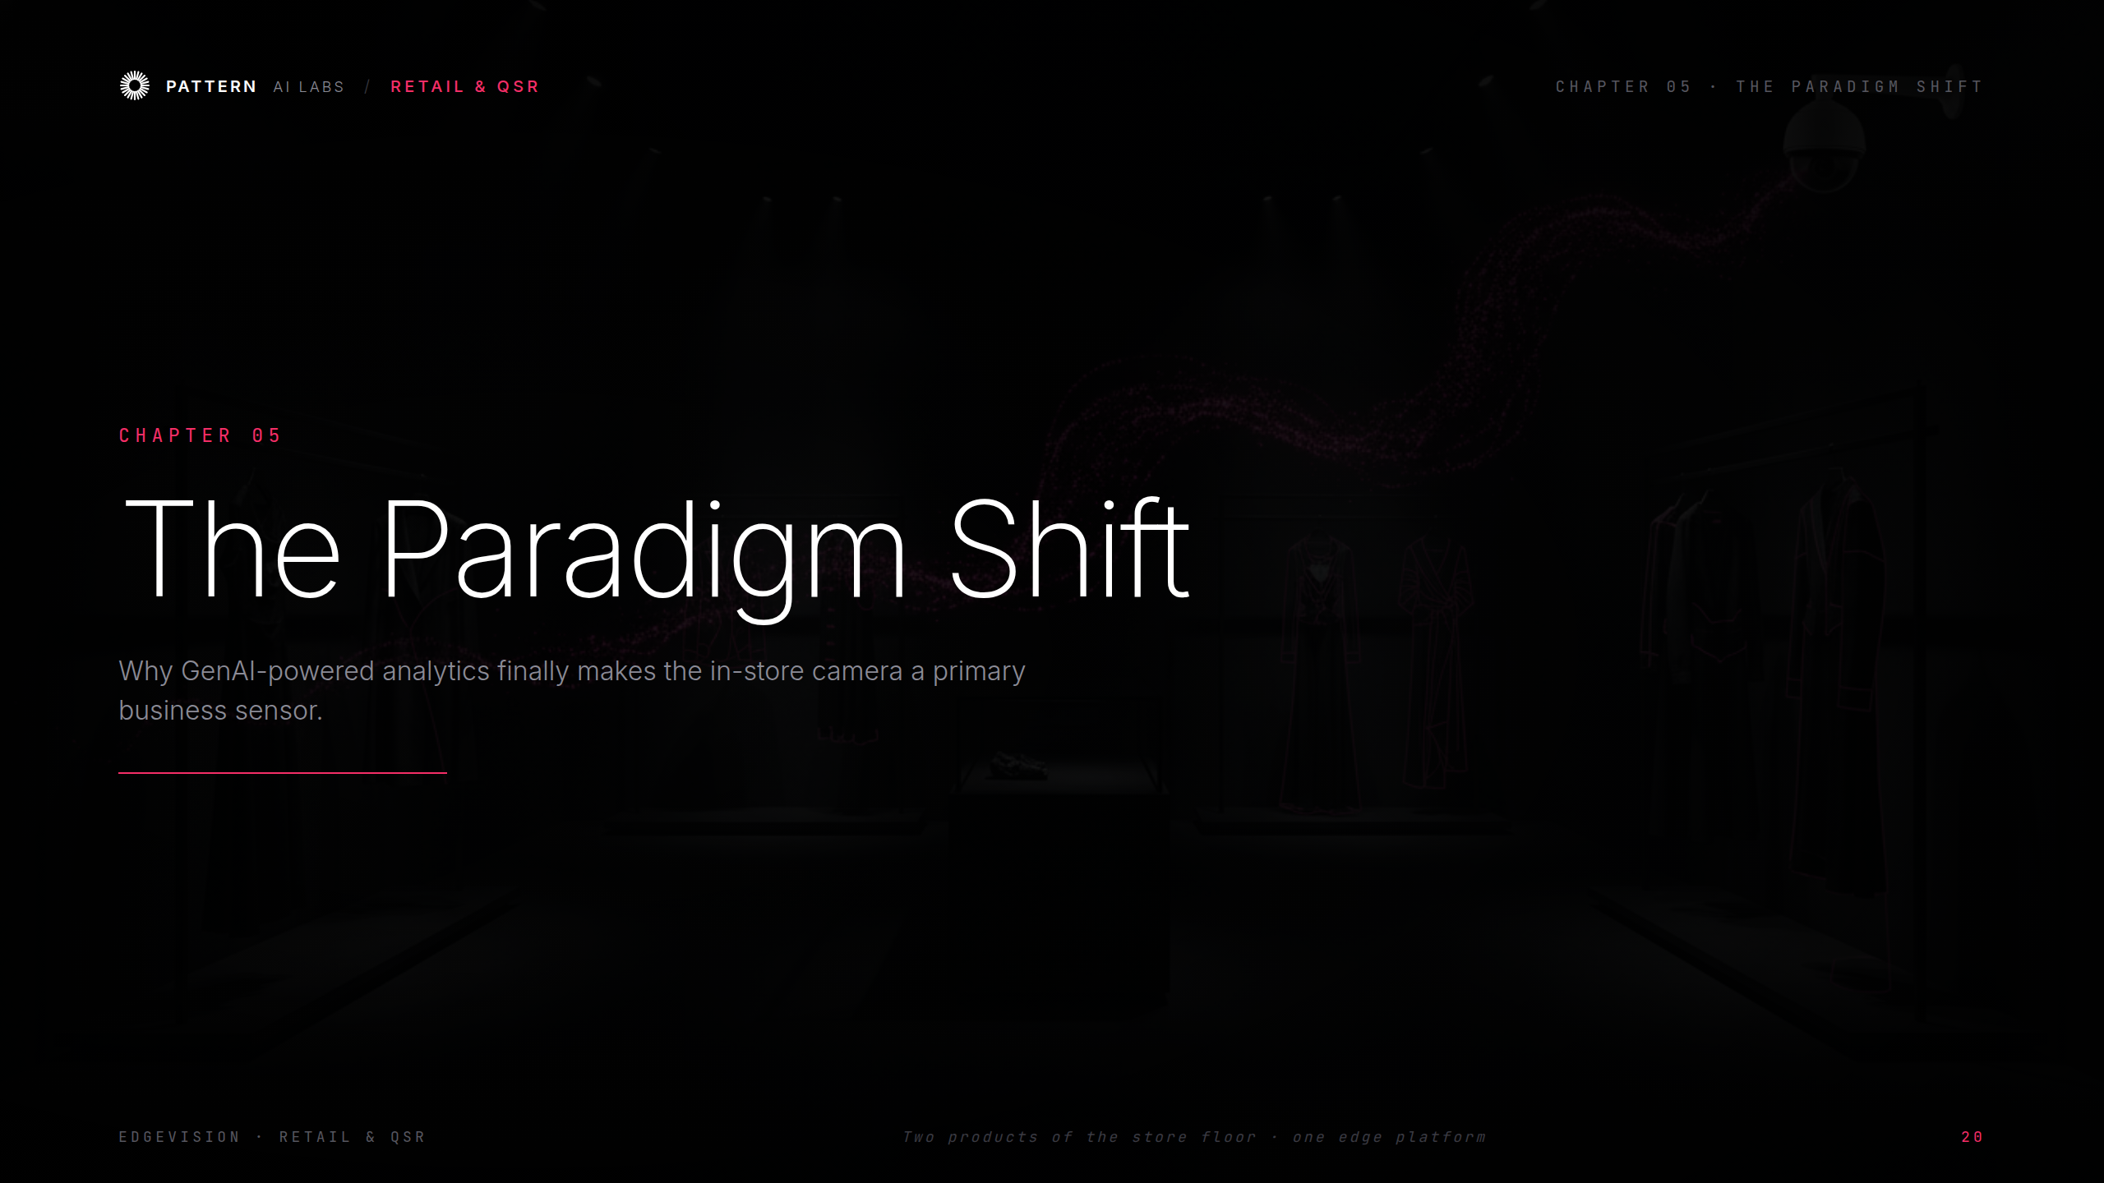
Notes:
Ch.05 The Paradigm Shift

Slide 22
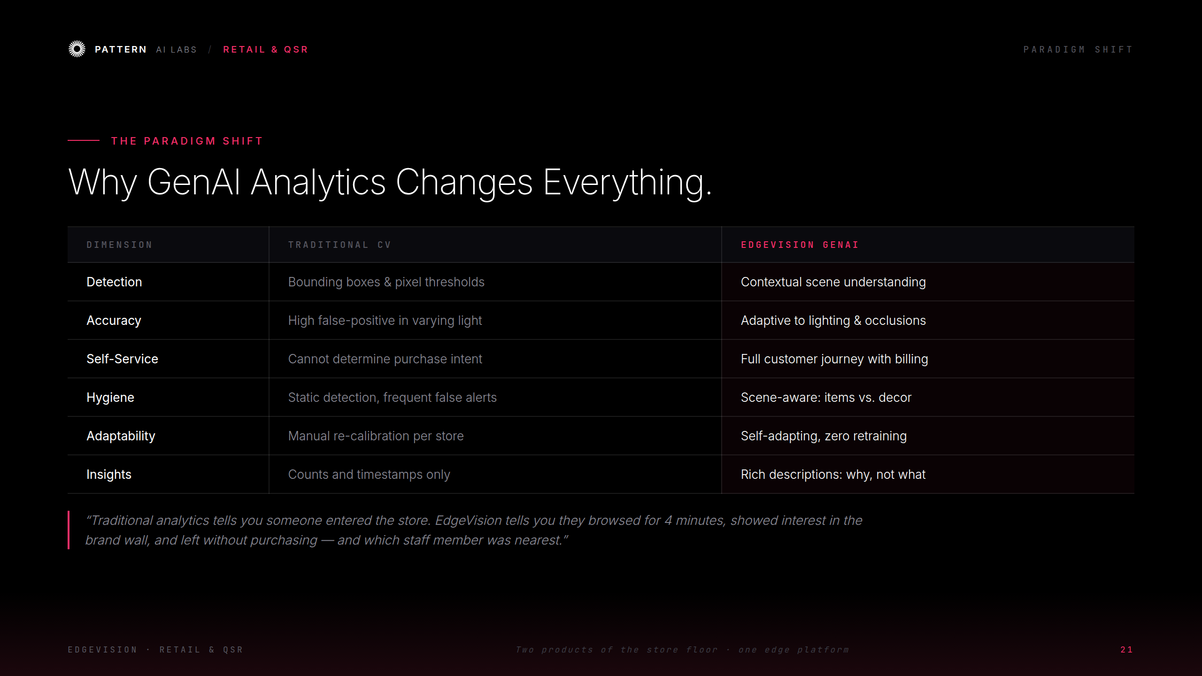
Notes:
Why GenAI analytics changes everything

Slide 23
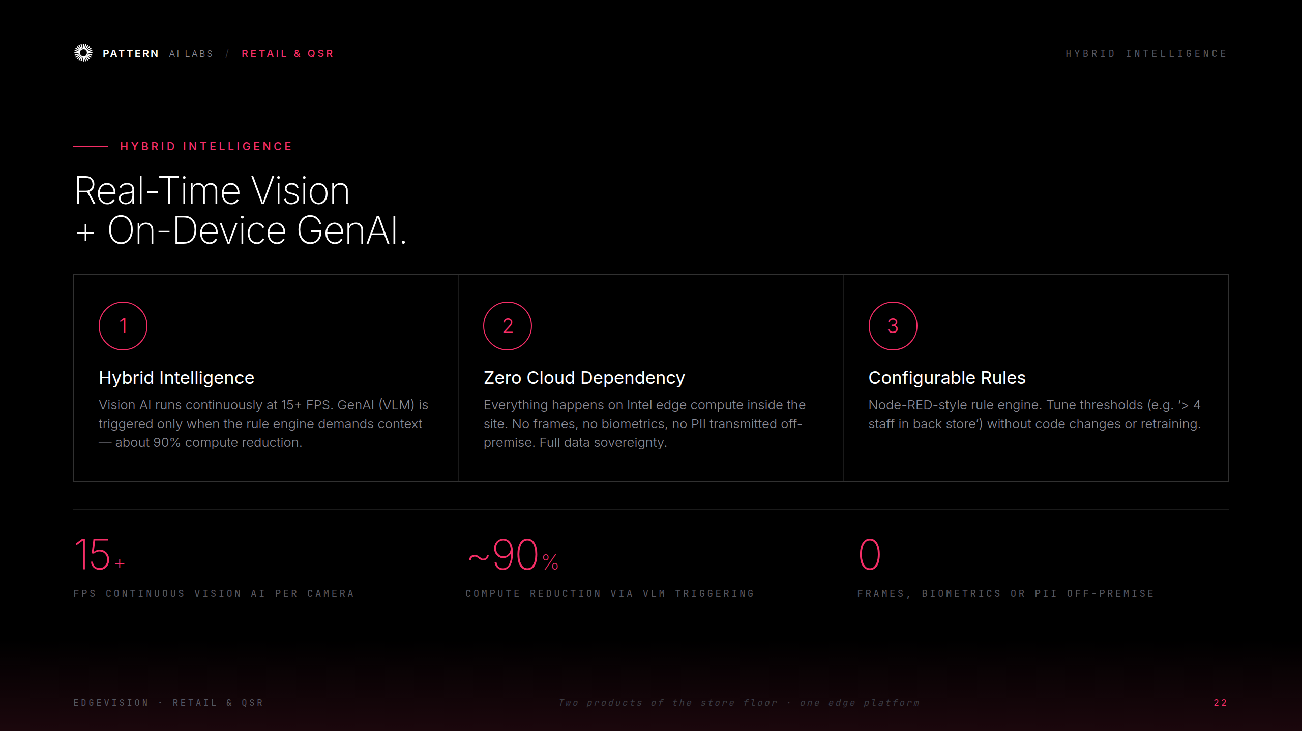
Notes:
Hybrid Intelligence

Slide 24
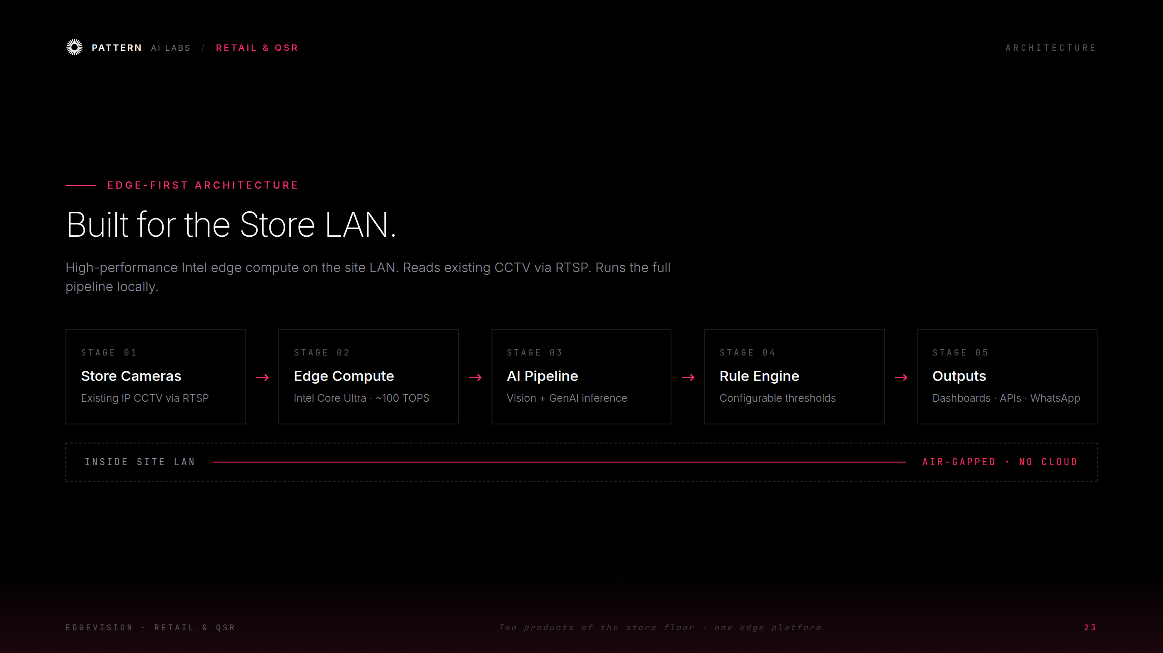
Notes:
Edge-First Architecture

Slide 25
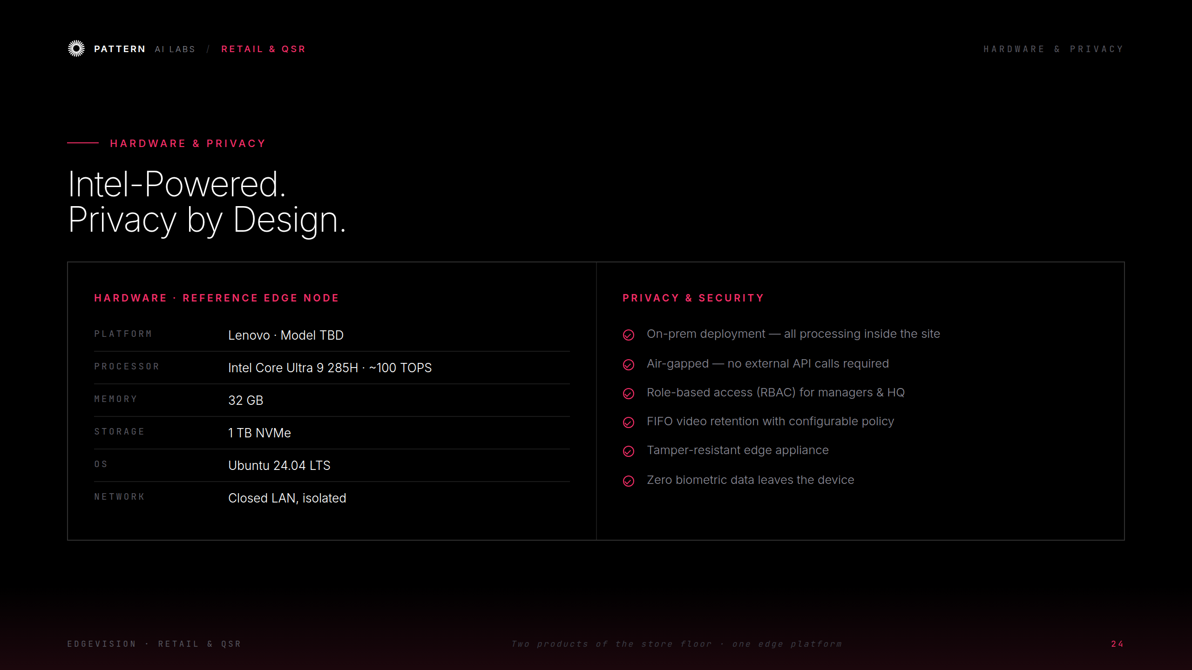
Notes:
Hardware & Privacy

Slide 26
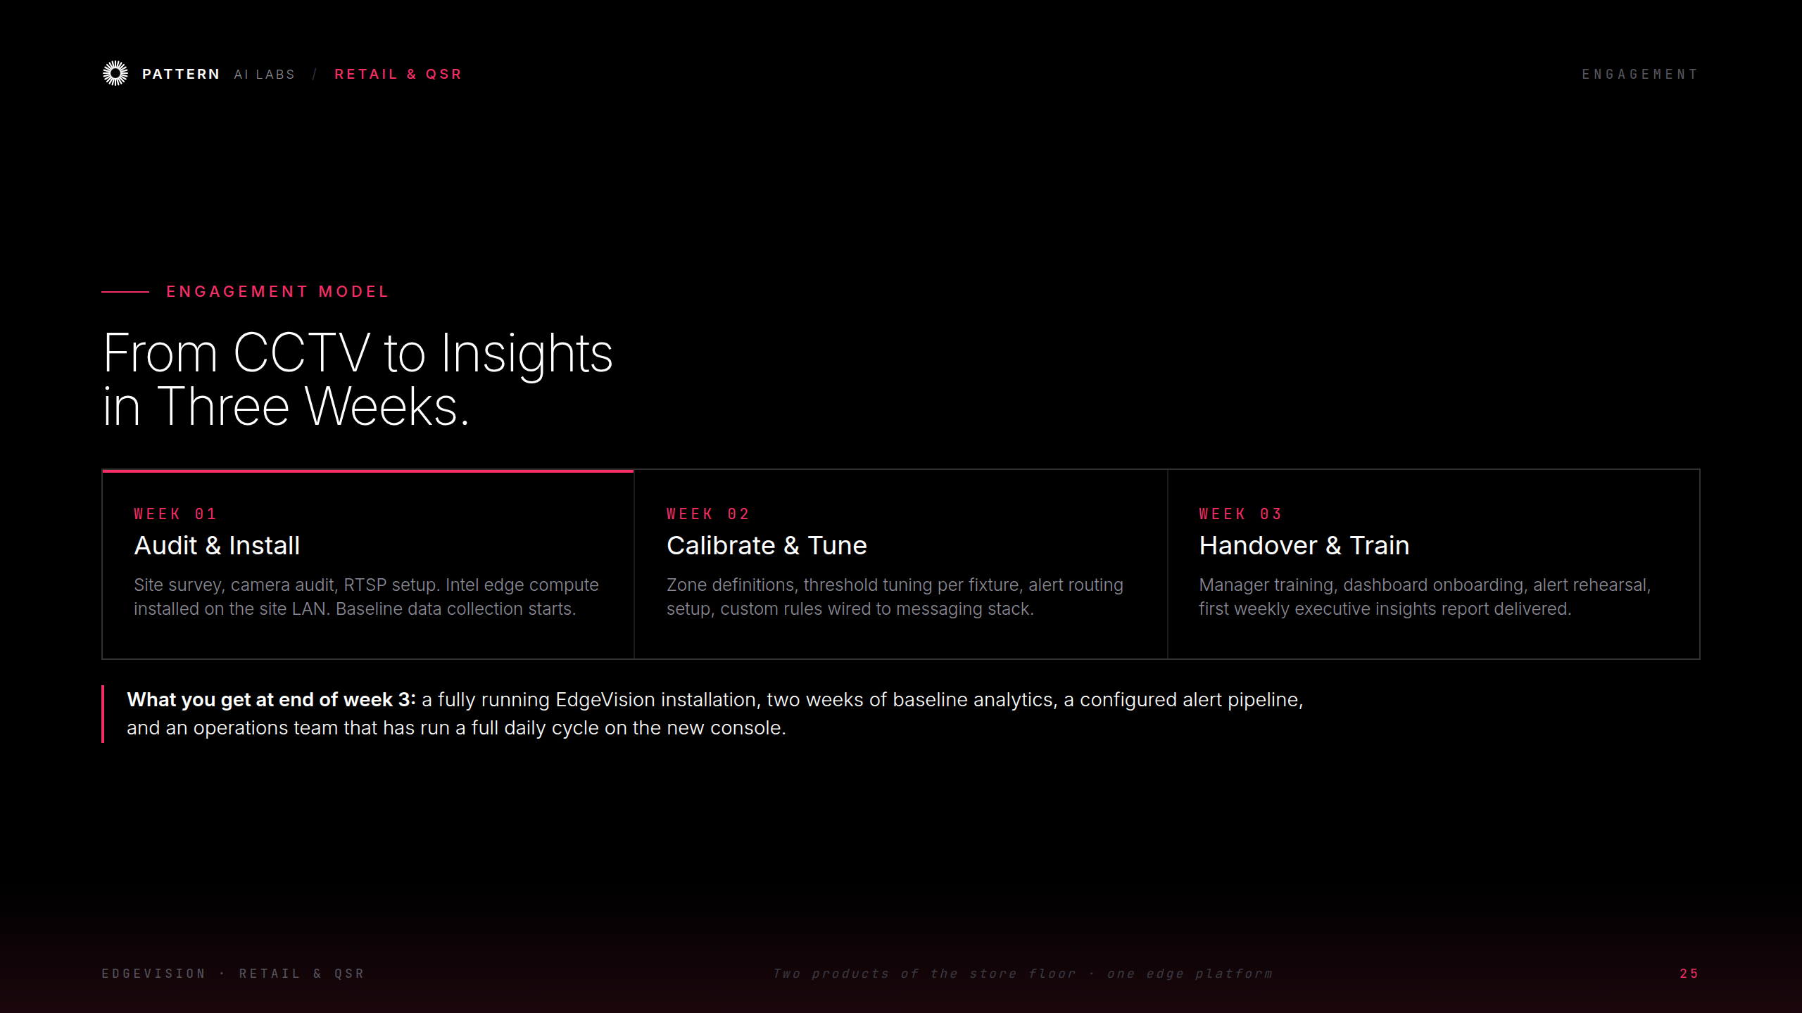
Notes:
Engagement — three weeks

Slide 27
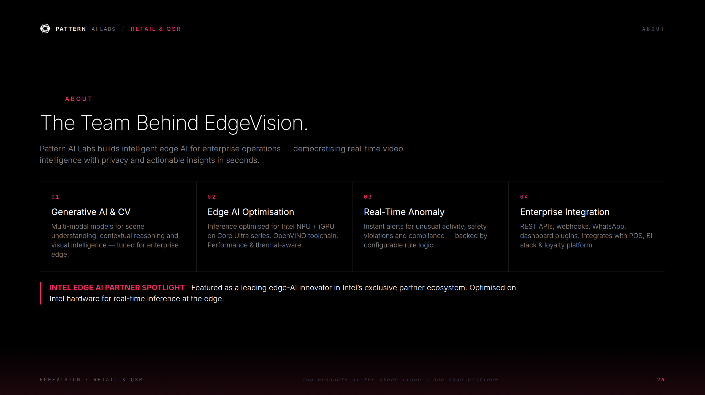
Notes:
About Pattern AI Labs

Slide 28
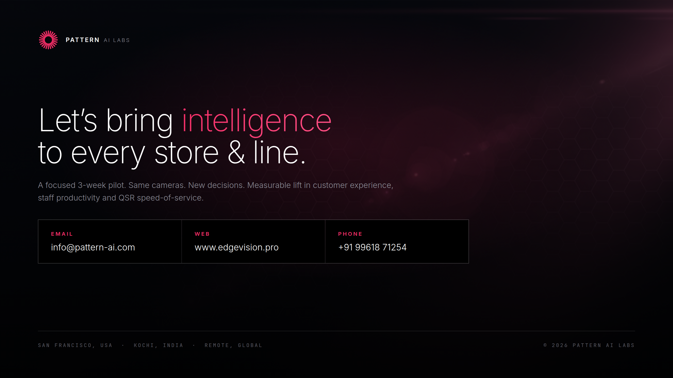
Notes:
Contact — every store & line

