Slide 1

Machine Learning approaches for dealing with Limited Bilingual Data in SMT
Gholamreza Haffari
Simon Fraser University
PhD Seminar, August 2009

Slide 2
Learning Problems (I)
Supervised Learning:
  Given a sample of object-label pairs (x_{i},y_{i}), find the predictive relationship between object and labels
Un-supervised learning:
  Given a sample consisting of only objects, look for interesting structures in the data, and group similar objects
Notes:
Let’s see what machine learning is about
Learning problems in machine learning are traditionally classified into two categories:
Supervised learning
Unsupervised learning

Slide 3
Learning Problems (II)
Now consider a training data consisting of:
  Labeled data: Object-label pairs (x_{i},y_{i})
  Unlabeled data: Objects x_{j}
Leads to the following learning scenarios:
  Semi-Supervised Learning: Find the best mapping from objects to labels benefiting from Unlabeled data
  Transductive Learning: Find the labels of unlabeled data
  Active Learning: Find the mapping while actively query an oracle for the label of unlabeled data
Notes:
Now consider the training data which includes labeled as well as unlabeled data
This leads to the following learning scenarios:
-

Slide 4
This Thesis
I consider semi-supervised / transductive / active learning scenarios for statistical machine translation
Facts:
  Untranslated sentences (unlabeled data) are much cheaper to collect than translated sentences (labeled data)
  Large number of labeled data (sentence pairs) is necessary to train a high quality SMT model
Notes:
In this thesis, I consider ssl, trans, and al s

Slide 5
Motivations
Low-density Language pairs
  Number of people speaking the language is small
  Limited online resources are available
Adapting to a new style/domain/topic
  Training on sports, and testing on politics
Overcome training and test mismatch
  Training on text, and testing on speech

Slide 6
Statistical Machine Translation
Translate from a source language to a target language by computer using a statistical model
M_{F→E} is a standard log-linear model:
M_{F→E}
Source Lang. F
Target Lang. E
Feature functions
Weights
Notes:
In statistical mt we are interested to translate from a source language F to a target language E using a statistical model which I denote by M_{f goes to E}
This model is a standard log-linear model,
meaning the probability of a target translation t given a sentence s can be written as
e to the weighted combination of some features of t and s

Slide 7
Phrase-based SMT Model
M_{F→E} is composed of two main components:
  The language model score f_{lm} : Takes care of the fluency of the generated translation in the target language
  The phrase table score f_{pt} : Takes care of keeping the content of the source sentence in the generated translation
Huge bitext is needed
to learn a high quality
phrase dictionary
Notes:
In phrase based smt, the model is composed of two main components
The lang model
The phrase table
The lang model takes care of the fluency of the generated translation in the target language. In other words, it gives high scores to the well formed sentences
The phrase table is essentially a phrase dictionary, and maps each source phrase to its equivalent target phrase. It’s mainly responsible for maintaining the content of the source sentence in the generated translation

Slide 8
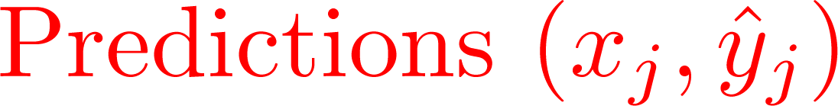
How to do it?
Self-Training
Data
Labaled
{(x_{i},y_{i})}
Unlabaled
{x_{j}}
Train
Select

Slide 9
Outline
An analysis of Self-training for Decision Lists
Semi-supervised / transductive Learning for SMT
Active Learning for SMT
  Single Language-Pair
  Multiple Language-Pair
Conclusions & Future Work

Slide 10
Outline
An analysis of Self-training for Decision Lists
Semi-supervised / transductive Learning for SMT
Active Learning for SMT
  Single Language-Pair
  Multiple Language-Pair
Conclusions & Future Work

Slide 11
Decision List (DL)
A Decision List is an ordered set of rules.
  Given an instance x, the first applicable rule determines the class label.
Instead of ordering the rules, we can give weight to them.
  Among all applicable rules to an instance x, apply the rule which has the highest weight.
The parameters are the weights which specify the ordering of the rules.
parameters
  Rules: If x has feature f ➔ class k
  , θ_{f,k}
Notes:
A decision list is an ordered set of rules with this form: if some object has a particular feature f, then predict class label k.
- given an object/instance x in the test time, we just consider the rules from the top of the list to the bottom, and apply the first applicable rule.
instead of ordering the rules, we can give weights/confidence scores to them: so \theta_f,k is the confidence of predicting class label k based on the feature f.
note that these weights are the parameters of the classifier that we wish to learn by the training alg.

Slide 12
DL for Word Sense Disambiguation
(Yarowsky 1995)
WSD: Specify the most appropriate sense (meaning) of a word in a given sentence.
Consider these two sentences:
  … company said the plant is still operating.
  factory sense +
  …and divide life into plant and animal kingdom.
  living organism sense -
Consider these two sentences:
  … company said the plant is still operating.
  sense +
  …and divide life into plant and animal kingdom.
  sense -
Consider these two sentences:
  … company said the plant is still operating.
  (company , operating) sense +
  …and divide life into plant and animal kingdom.
  (life , animal) sense -
  If company ➔ +1 , confidence weight .96
  If life ➔ -1 , confidence weight .97
  …
Notes:
Here is how decision lists can be applied to word-sense disambiguation task.
In word sense disambiguation task we are given a sentence, and a word in that sentence. The word is a multi-meaning word, and we are asked which meaning of the word is meant in this given sentence.
For example consider the word plant in these two sentences: 111-222
Clearly the word plant in the first sent reffers to company, and in the second sent reffers to a living organism.
To use decision list, we proceed as follows. We first somehow highlight some important words around ‘plant’ in these two sentences. Then we represent a particular instance of ‘plant’ with these highlighted words which form a binary feature vector representation. For example, the plant in the first sent is represented by ‘company’ and ‘operating’. And the plant in the second sent is represented by lif and animal.
here is what decision list may look like. Given an instance in the test time, if it has the word company in its feature vector, then the meaning/sense + is predicted with the confidence/weight .96

Slide 13
Bipartite Graph Representation
(Cordunneanu 2006, Haffari & Sarkar 2007)
(Features) F
X (Instances)
company
+1 company said the plant is still operating
operating
-1 divide life into plant and animal kingdom
life
animal
Unlabeled
…
…
We propose to view self-training as propagating the labels of initially labeled nodes to the rest of the graph nodes.

Slide 14
Self-Training on the Graph
(Haffari & Sarkar 2007)
(Features) F
X (Instances)
q_{x}
1
+
-
Labeling
distribution
θ_{f}
f
.7
1
θ_{f}
.3
q_{x}
+
-
+
-
π_{x}
q_{x}
Labeling
distribution
x
.6
.4
+
-
…
…

Slide 15
Goals of the Analysis
To find reasonable objective functions for the self-training algorithms on the bipartite graph.
The objective functions may shed light to the empirical success of different DL-based self-training algorithms.
  It can tell us the kind of properties in the data which are well exploited and captured by the algorithms.
  It is also useful in proving the convergence of the algorithms.
Notes:
It's a little bit busy
emphasize obj funcs

Slide 16
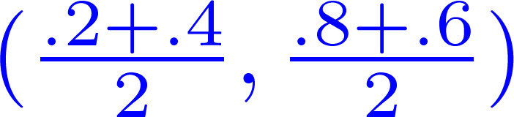

Useful Operations
Average: takes the average distribution of the neighbors
Majority: takes the majority label of the neighbors
(.2 , .8)
(.3 , .7)
(.4 , .6)
(.2 , .8)
(0 , 1)
(.4 , .6)

Slide 17
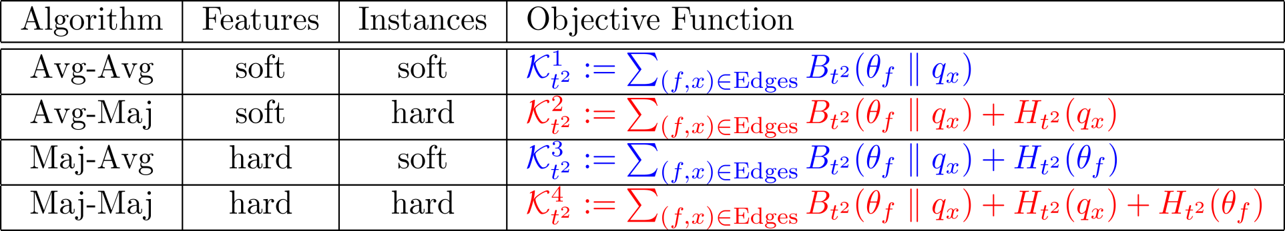
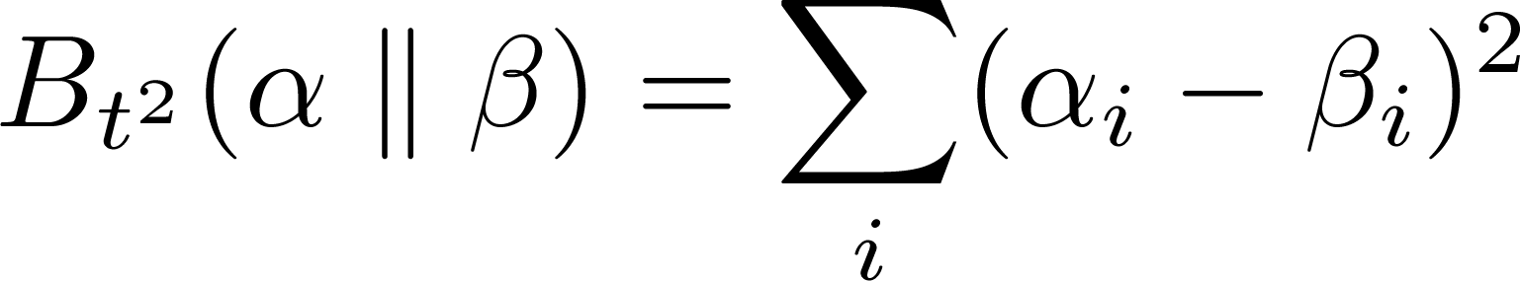
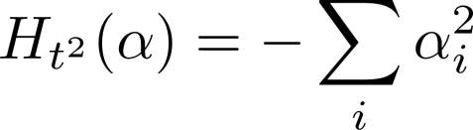
Analyzing Self-Training
F
X
Theorem. The following objective functions are optimized by the corresponding label propagation algorithms on the bipartite graph:
Related to graph-based SS learning (Zhu et al 2003)
Converges in Poly time O(|F|² |X^{|2|})
where:
Notes:
- This theorem shows each of the four ways of combining these two operators optimizes which obj function.
Also it shows at the convergence of the propagation algorithms, what the labeling distributions look like for the graph nodes.
- for example maj-maj tends to assign hard labels to both feature and instance nodes. A hard label means a labeling distribution in which all of the mass is put on only one label (as opposed to soft label).
I’m not going into the details of this theorem, but would like to point out the following remarks.

Slide 18

Another Useful Operation
Product: takes the label with the highest mass in (component-wise) product distribution of the neighbors.
This way of combining distributions is motivated by Product-of-Experts framework (Hinton 1999).
(.4 , .6)
(1 , 0)
(.8 , .2)

Slide 19
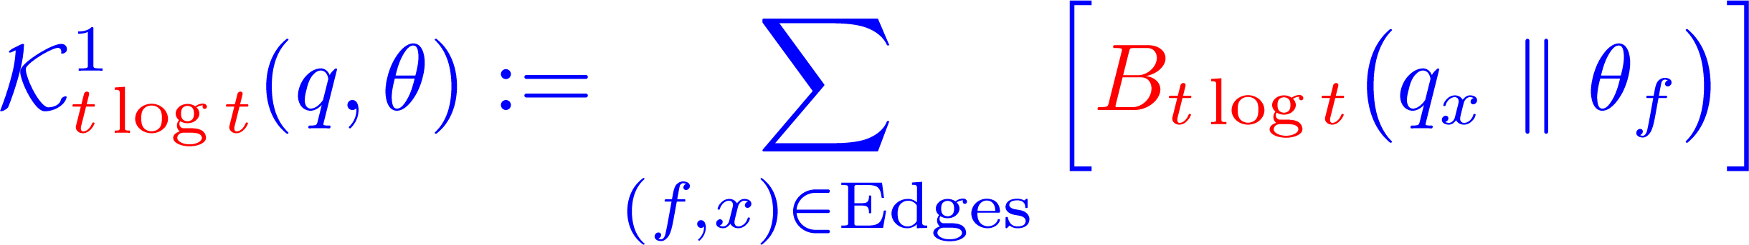
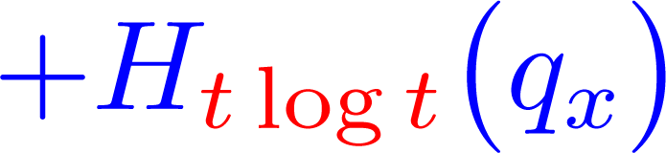
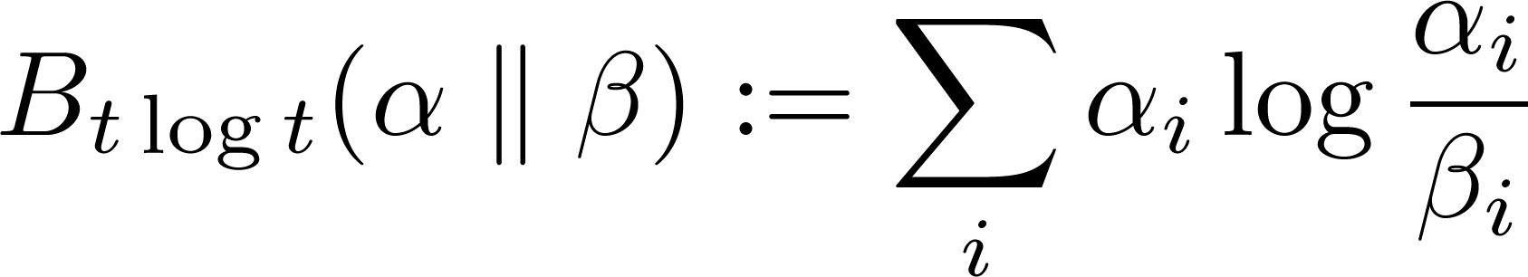
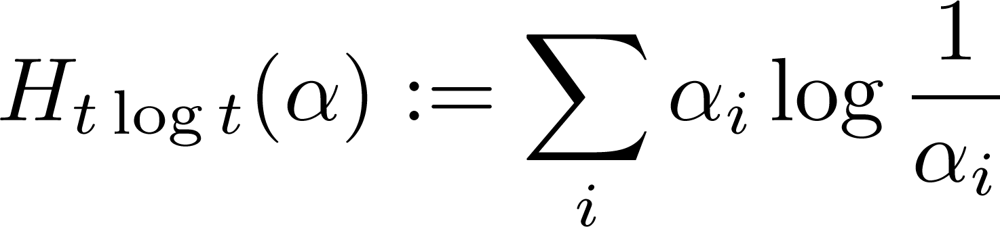
Average-Product
F
X
features
instances
Theorem. This algorithm Optimizes the following objective function:
where
The instances get hard labels and features get soft labels.

Slide 20
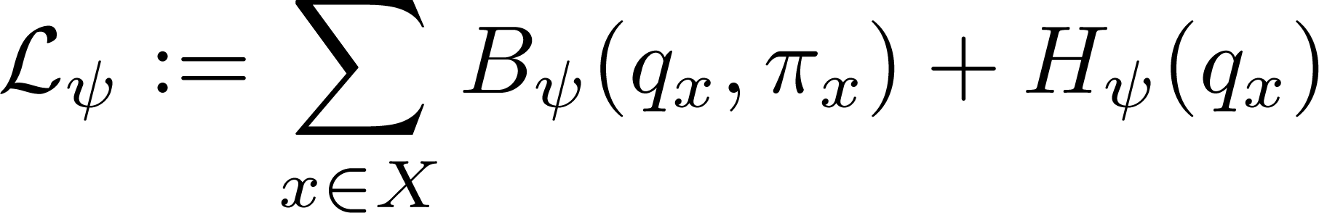
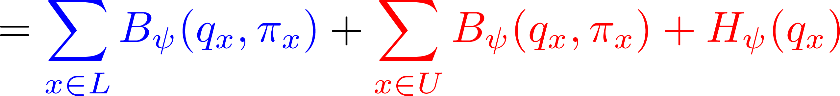
What about Log-Likelihood ?
Initially, the labeling distribution is uniform for unlabeled vertices and a δ-like distribution for labeled vertices.
By learning the parameters, we would like to reduce the uncertainty in the labeling distribution while respecting the labeled data:
Negative log-Likelihood of the
old and newly labeled data

Slide 21
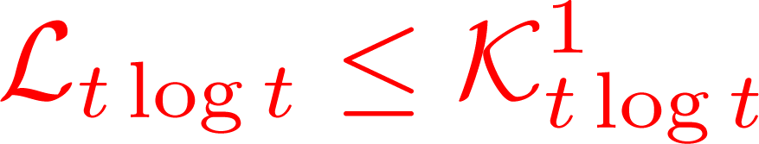


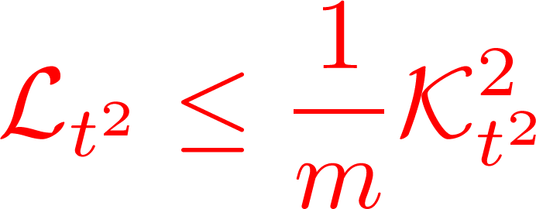


Connection between the two Analyses
Lemma. By minimizing K¹_{t log t} (Avg-Prod), we are minimizing an upperbound on negative log-likelihood:
Lemma. If m is the number of features connected to an instance, then:

Slide 22
Outline
An analysis of Self-training for Decision Lists
Semi-supervised / transductive Learning for SMT
Active Learning for SMT
  Single Language-Pair
  Multiple Language-Pair
Conclusions & Future Work

Slide 23

Self-Training for SMT
Log-linear Model
Translated text
Bilingual text
Re-
Train
Decode
F
E
F
E
M_{F→E}
Monolingual text
Re-training the SMT model
Select
high quality Sent. pairs
F
E
Notes:
Our approach to attack this problem is Active Learning
First we train a SMT system by the available bilingual parallel text
Then, we generate translation for the monolingual text that we have from the source language
we use all of this information to select a subset of most informative sentences
And ask their true translation from a human expert
Finally we use these new translated sents plus the initial bitext to re-train the smt model

Slide 24
Self-Training for SMT
Log-linear Model
Translated text
Bilingual text
Re-
Train
Decode
F
E
F
E
M_{F→E}
Monolingual text
Re-training the SMT model
Select
high quality Sent. pairs
F
E
Notes:
Our approach to attack this problem is Active Learning
First we train a SMT system by the available bilingual parallel text
Then, we generate translation for the monolingual text that we have from the source language
we use all of this information to select a subset of most informative sentences
And ask their true translation from a human expert
Finally we use these new translated sents plus the initial bitext to re-train the smt model

Slide 25
Selecting Sentence Pairs
First give scores:
  Use normalized decoder’s score
  Confidence estimation method (Ueffing & Ney 2007)
Then select based on the scores:
  Importance sampling:
  Those whose score is above a threshold
  Keep all sentence pairs

Slide 26
Self-Training for SMT
Log-linear Model
Translated text
Bilingual text
Re-
Train
Decode
F
E
F
E
M_{F→E}
Monolingual text
Re-training the SMT model
Select
high quality Sent. pairs
F
E
Notes:
Our approach to attack this problem is Active Learning
First we train a SMT system by the available bilingual parallel text
Then, we generate translation for the monolingual text that we have from the source language
we use all of this information to select a subset of most informative sentences
And ask their true translation from a human expert
Finally we use these new translated sents plus the initial bitext to re-train the smt model

Slide 27
Re-Training the SMT Model (I)
Simply add the newly selected sentence pairs to the initial bitext, and fully re-train the phrase table
A mixture model of phrase pair probabilities from training set combined with phrase pairs from the newly selected sentence pairs
Initial Phrase Table
New Phrase Table
λ
+
(1-λ)

Slide 28
Re-training the SMT Model (II)
Use new sentence pairs to train an additional phrase table and use it as a new feature function in the SMT log-linear model
  One phrase table trained on sentences for which we have the true translations
  One phrase table trained on sentences with their generated translations
Phrase Table 1
Phrase Table 2
Notes:
Now we address the second question: how to take advantage of the generated translations in improving the SMT model
For each SMt model, we use two phrae tables:
One is trained based on the sents for which we have true human translations
The other one based on the monolingual sents for which we have the generated translations by the smt model
This reminds us the self-training approach in machine learning in which the output of a learning model is used to improve it.

Slide 29
Experimental Setup
We use Portage from NRC as the underlying SMT system (Ueffing et al, 2007)
It is an implementation of the phrase-based SMT
We provide the following features among others:
  Language model
  Several (smoothed) phrase tables
  Distortion penalty based on the skipped words
Notes:
Cite portage and say that it’s from nrc
Add two more columns to the table for AL experimrents

Slide 30
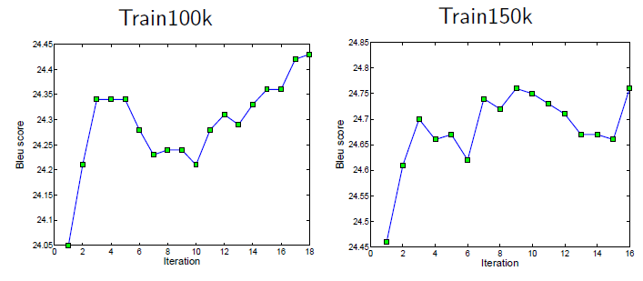
French to English (Transductive)
Select fixed number of newly translated sentences with importance sampling based on normalized decoder’s scores, fully re-train the phrase table.
  Improvement in BLEU score is almost equivalent to adding 50K training examples
Better

Slide 31
Chinese to English (Transductive)
Using additional phrase table
Selection | Scoring | BLEU% | WER% | PER%
Baseline |  | 27.9 ± .7 | 67.2 ± .6 | 44.0 ± .5
Keep all |  | 28.1 | 66.5 | 44.2
Importance Sampling | Norm. score | 28.7 | 66.1 | 43.6
 | Confidence | 28.4 | 65.8 | 43.2
Threshold | Norm. score | 28.3 | 66.1 | 43.5
 | confidence | 29.3 | 65.6 | 43.2
WER: Lower is better (Word error rate)
PER: Lower is better (Position independent WER )
BLEU: Higher is better
Bold: best result, italic: significantly better

Slide 32
Chinese to English (Inductive)
Using importance sampling and additional phrase table
system |  | BLEU% | WER% | PER%
Eval-04 (4 refs.)
Baseline |  | 31.8 ± .7 | 66.8 ± .7 | 41.5 ± .5
Add Chinese data | Iter 1 | 32.8 | 65.7 | 40.9
 | Iter 4 | 32.6 | 65.8 | 40.9
 | Iter 10 | 32.5 | 66.1 | 41.2
WER: Lower is better (Word error rate)
PER: Lower is better (Position independent WER )
BLEU: Higher is better
Bold: best result, italic: significantly better

Slide 33
Chinese to English (Inductive)
Using importance sampling and additional phrase table
system |  | BLEU% | WER% | PER%
Eval-06 NIST (4 refs.)
Baseline |  | 27.9 ± .7 | 67.2 ± .6 | 44.0 ± .5
Add Chinese data | Iter 1 | 28.1 | 65.8 | 43.2
 | Iter 4 | 28.2 | 65.9 | 43.4
 | Iter 10 | 27.7 | 66.4 | 43.8
WER: Lower is better (Word error rate)
PER: Lower is better (Position independent WER )
BLEU: Higher is better
Bold: best result, italic: significantly better

Slide 34
Why does it work?
Reinforces parts of the phrase translation model which are relevant for test corpus, hence obtain more focused probability distribution
Composes new phrases, for example:
Original parallel corpus | Additional source data | Possible new phrases
‘A B’, ‘C D E’ | ‘A B C D E’ | ‘A B C’, ‘B C D E’, …
Notes:
Cite portage and say that it’s from nrc
Add two more columns to the table for AL experimrents

Slide 35
Outline
An analysis of Self-training for Decision Lists
Semi-supervised / transductive Learning for SMT
Active Learning for SMT
  Single Language-Pair
  Multiple Language-Pair
Conclusions & Future Work

Slide 36

Active Learning for SMT
Log-linear Model
Translated text
Bilingual text
Re-
Train
Decode
F
E
F
E
M_{F→E}
Monolingual text
Re-training the SMT models
Select
Informative Sentences
F
E
F
Translate by human
Notes:
Our approach to attack this problem is Active Learning
First we train a SMT system by the available bilingual parallel text
Then, we generate translation for the monolingual text that we have from the source language
we use all of this information to select a subset of most informative sentences
And ask their true translation from a human expert
Finally we use these new translated sents plus the initial bitext to re-train the smt model

Slide 37
Active Learning for SMT
Log-linear Model
Translated text
Bilingual text
Re-
Train
Decode
F
E
F
E
M_{F→E}
Monolingual text
Re-training the SMT models
Select
Informative Sentences
F
E
F
Translate by human
Notes:
Our approach to attack this problem is Active Learning
First we train a SMT system by the available bilingual parallel text
Then, we generate translation for the monolingual text that we have from the source language
we use all of this information to select a subset of most informative sentences
And ask their true translation from a human expert
Finally we use these new translated sents plus the initial bitext to re-train the smt model

Slide 38

Sentence Selection strategies
Baselines:
  Randomly choose sentences from the pool of monolingual sentences
  Choose longer sentences from the monolingual corpus
Other methods
  Similarity to the bilingual training data
  Decoder’s confidence for the translations (Kato & Barnard, 2007)
  Entropy of the translations
  Reverse model
  Utility of the translation units
Notes:
Put check-mark for the first two
Mention decoder’s score as a related work, move it up

Slide 39
Similarity & Confidence
Sentences similar to bilingual text are easy to translate by the model
  Select the dissimilar sentences to the bilingual text
Sentences for which the model is not confident about their translations are selected first
  Hopefully high confident translations are good ones
  Use the normalized decoder’s score to measure confidence

Slide 40
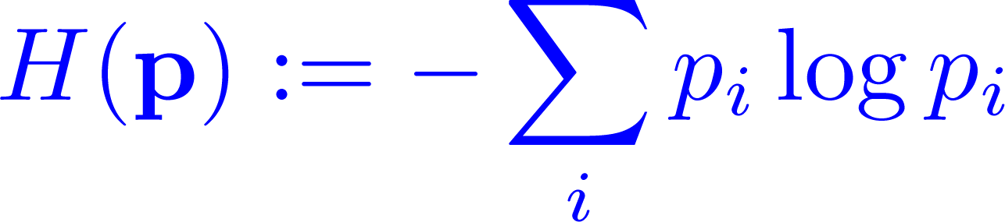
Entropy of the Translations
The higher the entropy of the translation distribution, the higher the chance of selecting that sentence
  Since the SMT model is not confident about the translation
  The entropy is approximated using the n-best list of translations

Slide 41
Reverse Model
M_{E→F}
I will let you know about the issue later
Je vais vous faire plus tard sur la question
I will later on the question
Rev: M_{F→E}
Comparing
  the original sentence, and
  the final sentence
Tells us something about the value of the sentence
Notes:
Humor !
Use french-englisg sentences as a running example!

Slide 42
Utility of the Translation Units
Phrases are the basic units of translations in phrase-based SMT
The more frequent a phrase is in the bilingual text, the less important it is
The more frequent a phrase is in the monolingual text, the more important it is
I will let you know about the issue later
Monolingual Text
θ_{m}
Bilingual Text
θ_{b}
6
5
6
6
1
1
8
2
3
3
7

Slide 43
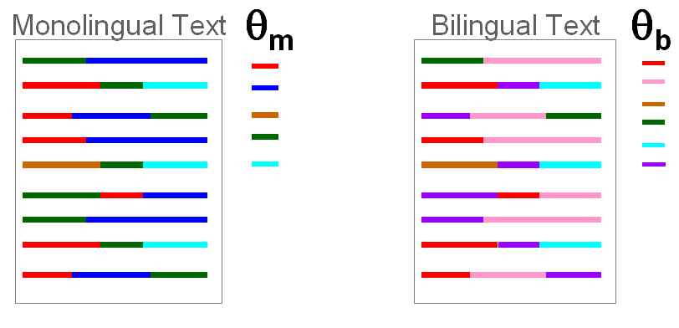
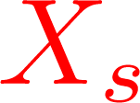
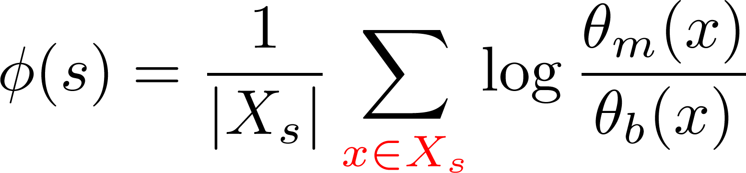
Sentence Selection: Probability Ratio Score
For a monolingual sentence S
  Consider the bag of its phrases:
  Score of S depends on its probability ratio:
  Phrase probability ratio captures our intuition about the utility of the translation units
= { , , }
Phrase
Prob. Ratio

Slide 44
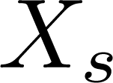
Sentence Segmentation
How to prepare the bag of phrases for a sentence S?
  For the bilingual text, we have the segmentation from the training phase of the SMT model
  For the monolingual text, we run the SMT model to produce the top-n translations and segmentations
Instead of phrases, we can use n-grams
Notes:
The question that I have not answered so far is that how to break the sentences into phrases and prepare the bag of phrases?
For he source side sentence in the bitext it is easy. We just use the segmentations produced in the training phase of the SMT model to produce phrase tables.
But what about the monolingual sentes? We can use the current SMT model to generate the top-n translations and their corresponding segmentations.
But in this case what about the out-of-vocab fragments? Namely those seq of words which are not covered by the phrases in the phrase table of the SMT model.

Slide 45
Active Learning for SMT
Log-linear Model
Translated text
Bilingual text
Re-
Train
Decode
F
E
F
E
M_{F→E}
Monolingual text
Re-training the SMT models
Select
Informative Sentences
F
E
F
Translate by human
Notes:
Our approach to attack this problem is Active Learning
First we train a SMT system by the available bilingual parallel text
Then, we generate translation for the monolingual text that we have from the source language
we use all of this information to select a subset of most informative sentences
And ask their true translation from a human expert
Finally we use these new translated sents plus the initial bitext to re-train the smt model

Slide 46
Re-training the SMT Model
We use two phrase tables in each SMT model M_{Fi→E}
  One trained on sents for which we have the true translations
  One trained on sents with their generated translations (Self-training)
F^{i}
E^{i}
Phrase Table 1
Phrase Table 2
Notes:
Now we address the second question: how to take advantage of the generated translations in improving the SMT model
For each SMt model, we use two phrae tables:
One is trained based on the sents for which we have true human translations
The other one based on the monolingual sents for which we have the generated translations by the smt model
This reminds us the self-training approach in machine learning in which the output of a learning model is used to improve it.

Slide 47
Experimental Setup
Dataset size:
We select 200 sentences from the monolingual sentence set for 25 iterations
We use Portage from NRC as the underlying SMT system (Ueffing et al, 2007)
 | Bilingual text | Monolingual Text | test
French-English | 5K | 20K | 2K
Notes:
Cite portage and say that it’s from nrc
Add two more columns to the table for AL experimrents

Slide 48
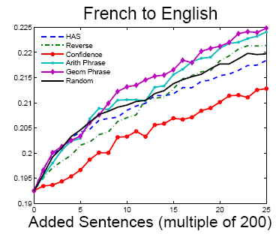
The Simulated AL Setting
Utility of phrases
Random
Decoder’s Confidence
Better
Notes:
Phrase-based utility score outperforms other methods
Decoder’s confidence is a poor measure for sentence selection
Similar figures for German-English and Spanish-English (see the paper for more experiments)

Slide 49
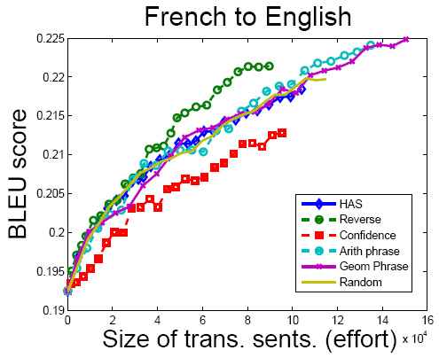
The Simulated AL Setting
Better
Notes:
Phrase-based utility score outperforms other methods
Decoder’s confidence is a poor measure for sentence selection
Similar figures for German-English and Spanish-English (see the paper for more experiments)

Slide 50
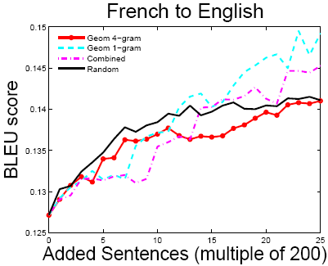
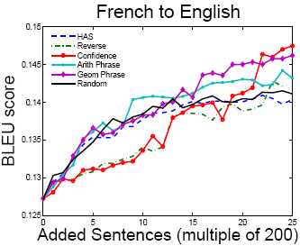
Domain Adaptation
Now suppose both test and monolingual text are out-of-domain with respect to the bilingual text
  The ‘Decoder’s Confidence’ does a good job
  The ‘Utility 1-gram’ outperforms other methods since it quickly expands the lexicon set in an effective manner
Utility 1-gram
Decoder’s Conf
Random
Random

Slide 51
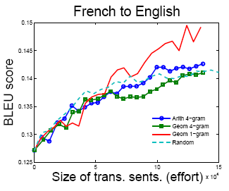
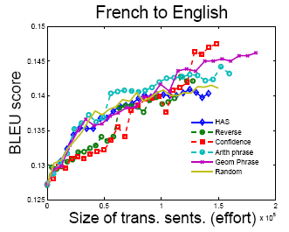
Domain Adaptation
Now suppose both test and monolingual text are out-of-domain with respect to the bilingual text
  The ‘Decoder’s Confidence’ does a good job
  The ‘Utility 1-gram’ outperforms other methods since it quickly expands the lexicon set in an effective manner
Utility 1-gram
Decoder’s Conf
Random
Random

Slide 52
Outline
An analysis of Self-training for Decision Lists
Semi-supervised / transductive Learning for SMT
Active Learning for SMT
  Single Language-Pair
  Multiple Language-Pair
Conclusions & Future Work

Slide 53
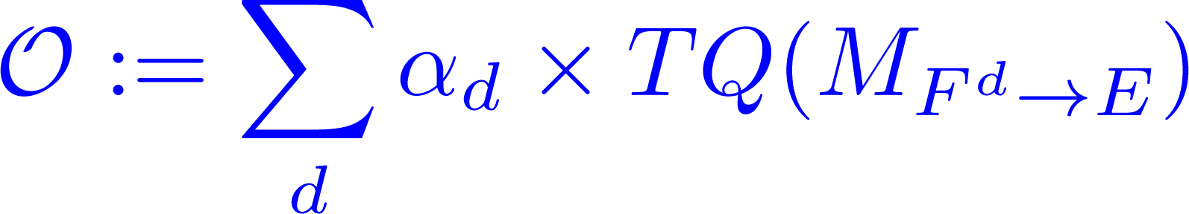
Multiple Language-Pair AL-SMT
F¹
(German)
F²
(French)
F³
(Spanish)
E
(English)
…
AL
Add a new lang. to a multilingual parallel corpus
To build high quality SMT systems from existing languages to the new lang.
Translation Quality
Notes:
We have a multilingual corpus of several parallel languages
Aim is to add a new language to this parallel multilingual corpus
First we select the most informative sentences by AL
Then add the translation of these selected multilingual sentences
We would like to build high quality SMT systems from each source lang to the this new lang
In other words, we want to maximize this obj function
Which is a linear combination of the translation quality of each individual SMT system

Slide 54
AL-SMT: Multilingual Setting
Log-linear Model
Re-
Train
Decode
F¹,F², …
E¹,E²,..
F¹,F², …
E
M_{F→E}
Monolingual text
Re-training the SMT models
Select
Informative Sentences
F¹,F², …
E
F¹,F², …
Translate by human
Notes:
Our approach to attack this problem is Active Learning
First we train a SMT system by the available bilingual parallel text
Then, we generate translation for the monolingual text that we have from the source language
we use all of this information to select a subset of most informative sentences
And ask their true translation from a human expert
Finally we use these new translated sents plus the initial bitext to re-train the smt model

Slide 55
Selecting Multilingual Sents. (I)
F¹
F²
F³
2
3
2
Rank
35
19
17
1
2
3
…
…
…
Alternate Method: To choose informative sents. based on a specific F^{i} in each AL iteration
(Reichart et al, 2008)
Notes:
Consider each individual source language and the target language
Give rank to the sentens by any sentence selection methods designed for a single language pair
Now for multilingual parallel sents, we have several lists of ranks, each of which is associated with a source lang
One method for sent selection is to alternate among these lists.
Meaning that in the first iteration of the AL loop, we select sents based on the first list, …

Slide 56
Selecting Multilingual Sents. (II)
F¹
F²
F³
2
3
2
35
19
17
1
2
3
…
…
…
Combined Method: To sort sents. based on their ranks in all lists
7=2+3+2
Combined Rank
71=35+19+17
6=1+2+3
…
(Reichart et al, 2008)
Notes:
Another method to identify the most informative sentences is to combine these lists of ranks to a single list
We give a score to each multilingual sentence which is the sum of its ranks in individual rank lists
For example, here the score of the first sent is 7 which is the sum of its score in these three rank lists
Then we sort the sentences based on these score and give rank to them

Slide 57
AL-SMT: Multilingual Setting
Log-linear Model
Re-
Train
Decode
F¹,F², …
E¹,E²,..
F¹,F², …
E
M_{F→E}
Monolingual text
Re-training the SMT models
Select
Informative Sentences
F¹,F², …
E
F¹,F², …
Translate by human
Notes:
Our approach to attack this problem is Active Learning
First we train a SMT system by the available bilingual parallel text
Then, we generate translation for the monolingual text that we have from the source language
we use all of this information to select a subset of most informative sentences
And ask their true translation from a human expert
Finally we use these new translated sents plus the initial bitext to re-train the smt model

Slide 58
Re-training the SMT Models (I)
We use two phrase tables in each SMT model M_{Fi→E}
  One trained on sents for which we have the true translations
  One trained on sents with their generated translations (Self-training)
F^{i}
E^{i}
Phrase Table 1
Phrase Table 2
Notes:
Now we address the second question: how to take advantage of the generated translations in improving the SMT model
For each SMt model, we use two phrae tables:
One is trained based on the sents for which we have true human translations
The other one based on the monolingual sents for which we have the generated translations by the smt model
This reminds us the self-training approach in machine learning in which the output of a learning model is used to improve it.

Slide 59
Re-training the SMT Models (II)
Phrase Table 2: We can instead use the consensus translations (Co-Training)
Phrase Table 1
Phrase Table 2
F^{i}
E¹
E²
E^{consensus}
E³
Notes:
Another approch to build the phrae table number 2 is as follows
Consider all the translations generated by individual SMT models for each multilingual source sentence
Take the consensus among these generated translations
And build Phrase table number 2 by the source sents from lang F_i and these consensus translations
This strategy reminds us the Co-training approach in machine learning, in which the output of a learning model or a group of learning models is used to retrain the other one (and vice versa)

Slide 60
Experimental Setup
We want to add English to a multilingual parallel corpus containing Germanic languages:
  Germanic Langs: German, Dutch, Danish, Swedish
Sizes of dataset and selected sentences
  Initially there are 5k multilingual sents parallel to English sents
  20k parallel sents in multilingual corpora.
  10 AL iterations, and select 500 sentences in each iteration
We use Portage from NRC as the underlying SMT system (Ueffing et al, 2007)
Notes:
Cite portage and say that it’s from nrc
Add two more columns to the table for AL experimrents

Slide 61
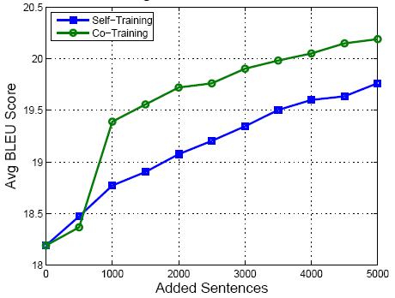
Self-training vs Co-training
Germanic Langs to English
20.20
19.75
Co-Training mode outperforms Self-Training mode
Notes:
Put check-mark for the first two
Mention decoder’s score as a related work, move it up

Slide 62
Germanic Languages to English
method | Self-Training WER / PER / BLEU | Co-Training WER / PER / BLEU
Combined Rank
Alternate
Random
40.2
30.0
20.0
40.0
29.6
20.3
41.0
30.2
19.9
40.1
30.1
20.2
41.6
31.0
19.4
40.5
30.7
20.2
WER: Lower is better (Word error rate)
PER: Lower is better (Position independent WER )
BLEU: Higher is better
Bold: best result, italic: significantly better
Notes:
Put check-mark for the first two
Mention decoder’s score as a related work, move it up

Slide 63
Outline
An analysis of Self-training for Decision Lists
Semi-supervised / transductive Learning for SMT
Active Learning for SMT
  Single Language-Pair
  Multiple Language-Pair
Conclusions & Future Work

Slide 64
Conclusions
Gave an analysis of self-training when the base classifier is a Decision List
Designed effective bootstrapping style algorithms in Semi-Supervised / Transductive / Active Learning scenarios for phrase-based SMT to deal with shortage of bilingual training data
  For resource poor languages
  For domain adaptation

Slide 65
Future Work
Co-train a phrase-based and syntax-based SMT model in transductive/semi-supervised setting
Active Learning sentence selection methods for syntax-based SMT models
Bootstrapping gives an elegant framework to deal with shortage of annotated training data for complex natural language processing tasks
  Specially those having structured output/latent variables, such as MT/Parsing
  Apply it to other NLP tasks

Slide 66
Merci
Thanks

Slide 67
Sentence Segmentation
How to prepare the bag of phrases for a sentence S?
  For the bilingual text, we have the segmentation from the training phase of the SMT model
  For the monolingual text, we run the SMT model to produce the top-n translations and segmentations
  What about OOV fragments in the sentences of the monolingual text?
Notes:
The question that I have not answered so far is that how to break the sentences into phrases and prepare the bag of phrases?
For he source side sentence in the bitext it is easy. We just use the segmentations produced in the training phase of the SMT model to produce phrase tables.
But what about the monolingual sentes? We can use the current SMT model to generate the top-n translations and their corresponding segmentations.
But in this case what about the out-of-vocab fragments? Namely those seq of words which are not covered by the phrases in the phrase table of the SMT model.

Slide 68
OOV Fragments: An Example
Which can be long
OOV Fragment
i will go to school on friday
go to
school
on friday
OOV Phrases
go to school
on friday
go
to school on
friday
Notes:
Fix an OOV fragment x
Our solution is to consider all of the segmentations of this fragment and the resulting phrases

Slide 69

Two Generative Models
We introduce two models for generating a phrase x in the monolingual text:
  Model 1: One multinomial generating both OOV and regular phrases:
  Model 2: A mixture of two multinomials, one for OOV and the other for regular phrases:
Regular Phrases
OOV Phrases
Notes:
Having a separate slide for the bottom 2 methods
A slide to recap that we have seen these methods to do AL, now we are going to exprmnts

Slide 70
Scoring the Sentences
We use phrase or fragment probability ratios P(x| θ_{m})/P(x| θ_{b}) in scoring the sentences
The contribution of an OOV fragment x:
  For each segmentation, take the product of the probability ratios of the resulted phrases
  LEPR: takes the Log of the Expectation of these products of Probability Ratios under uniform distribution
  ELPR: takes the Expectation of the Log of these products of Probability Ratios under uniform distribution
Notes:
Having a separate slide for the bottom 2 methods
A slide to recap that we have seen these methods to do AL, now we are going to exprmnts

Slide 71
Selecting Multilingual Sents. (III)
F¹
E¹
F²
E²
F³
E³
…
…
…
…
…
…
Consensus Translation
Disagreement Method
  Pairwise BLEU score of the generated translations
  Sum of BLEU scores from a consensus translation
Notes:
Having a separate slide for the bottom 2 methods
A slide to recap that we have seen these methods to do AL, now we are going to exprmnts

