Slide 1

Analysis of Semi-supervised Learning with the Yarowsky Algorithm
Gholamreza Haffari
School of Computing Sciences
Simon Fraser University
Notes:
Hi
I’m gholamreza haffari. Thanks for the invitation. I’m going to talk about the analysis of semi-supervised learning with the yarowsky alg. Which is a part of my phd thesis.

Slide 2
Outline
Introduction
  Semi-supervised Learning, Self-training (Yarowsky Algorithm)
Bipartite Graph Representation
  Yarowsky Algorithm on the Bipartite Graph
Analysing variants of the Yarowsky Algorithm
  Objective Functions, Optimization Algorithms
Concluding Remarks
Notes:
Here is the outline off the talk
1)First I give some general background about ssl and the yarowsky alg
2) Then I show how we can translate the yarowsky alg as an alg for propagating messages on a bipartite graph .
3) Then we go into the main part of the talk in which I give analyses of some variants of the yarowsky alg
4) Finally I conclude with some remarks

Slide 3
Outline
Introduction
  Semi-supervised Learning, Self-training (Yarowsky Algorithm)
Bipartite Graph Representation
  Yarowsky Algorithm on the Bipartite Graph
Analysing variants of the Yarowsky Algorithm
  Objective Functions, Optimization Algorithms
  Haffari & Sarkar, UAI, 2007.
Concluding Remarks

Slide 4
Outline
Introduction
  Semi-supervised Learning, Self-training (Yarowsky Algorithm)
Bipartite Graph Representation
  Yarowsky Algorithm on the Bipartite Graph
Analysing variants of the Yarowsky Algorithm
  Objective Functions, Optimization Algorithms
Concluding Remarks

Slide 5
Semi-supervised Learning (SSL)
Supervised learning:
  Given a sample consisting of object-label pairs (x_{i},y_{i}), find the predictive relationship between objects and labels.
Un-supervised learning:
  Given a sample consisting of only objects, look for interesting structures in the data, and group similar objects.
What is Semi-supervised learning?
  Supervised learning + Additional unlabeled data
  Unsupervised learning + Additional labeled data
Notes:
Among classical learning scenarios, consider the following two scenarios: namely supervised and unsupervised learning.
In supervised learning, we are given some objects together with their labels as the labeled training data. The goal is to fins a predictive relationship between the objects and their labels. For example to find a classifier which maps objects to labels.
In unsupervised learning, we are given just a bunch of objects as the unlabeled training data, and we are asked to group similar objects together.
In semi-supervised learning, as the training data, we are given a set consisting of labeled as well as unlabeled data. The goal is to find a classifier to map objects to labels. And we would like to take advantage of the additional unlabeled data to build a more accurate classifier.

Slide 6
Motivation for Semi-Supervised Learning
(Belkin & Niyogi 2005)
Philosophical:
  Human brain can exploit unlabeled data.
Pragmatic:
  Unlabeled data is usually cheap to collect.

Slide 7
Two Algorithmic Approaches to SSL
Classifier based methods:
  Start from initial classifier/s, and iteratively enhance it/them.
  EM, Self-training (Yarowsky Algorithm), Co-training, …
Data based methods:
  Discover an inherent geometry in the data, and exploit it in finding a good classifier.
  Manifold regularization, …

Slide 8
What is Self-Training?
A base classifier is trained with a small amount of labeled data.
The base classifier is then used to classify the unlabeled data.
3. The most confident unlabeled points, along with the predicted labels, are incorporated into the labeled training set (pseudo-labeled data).
The base classifier is re-trained, and the process is repeated.

Slide 9
Remarks on Self-Training
It can be applied to any base learning algorithm as far as it can produce confidence weights for its predictions.
Differences with EM:
  Self-training only uses the mode of the prediction distribution.
  Unlike hard-EM, it can abstain:“I do not know the label”.
Differences with Co-training:
  In co-training there are two views, in each of which a model is learned.
  The model in one view trains the model in another view by providing pseudo-labeled examples.
Notes:
Since it sees the base learner as a black box, it can be applied to “any” base learning alg as far as …

Slide 10
History of Self-Training
(Yarowsky 1995) used it with Decision List base classifier for Word Sense Disambiguation (WSD) task.
  It achieved nearly the same performance level as the supervised algorithm, but with much less labeled training data.
(Collins & Singer 1999) used it for Named Entity Recognition task with Decision List base classifier.
  Using only 7 initial rules, it achieved over 91% accuracy.
  It achieved nearly the same performance level as the Co-training.
(McClosky, Charniak & Johnson 2006 ) applied it successfully to Statistical Parsing task, and improved the performance of the state of the art.
Notes:
Here is a little bit history of the self-training.
1- despite its simlicity, it has been successfully applied to a wide verity of tasks in different fields.

Slide 11
History of Self-Training
(Ueffing, Haffari & Sarkar 2007) applied it successfully to Statistical Machine Translation task, and improved the performance of the state of the art.
(Abney 2004) started the first serious mathematical analysis of the Yarowsky algorithm.
  It could not mathematically analyze the original Yarowsky algorithm, but introduces new variants of it (we will see later).
(Haffari & Sarkar 2007) advanced the Abney’s analysis and gave a general framework together with mathematical analysis of the variants of the Yarowsky algorithm introduced by Abney.

Slide 12
Outline
Introduction
  Semi-supervised Learning, Self-training (Yarowsky Algorithm)
Bipartite Graph Representation
  Yarowsky Algorithm on the Bipartite Graph
Analysing variants of the Yarowsky Algorithm
  Objective Functions, Optimization Algorithms
Concluding Remarks
Notes:
How to represent the problem as a bipartite graph, and translate self-training as an alg for propagating messages on this graph.

Slide 13
Decision List (DL)
A Decision List is an ordered set of rules.
  Given an instance x, the first applicable rule determines the class label.
Instead of ordering the rules, we can give weight to them.
  Among all applicable rules to an instance x, apply the rule which has the highest weight.
The parameters are the weights which specify the ordering of the rules.
parameters
  Rules: If x has feature f ➔ class k
  , θ_{f,k}
Notes:
A decision list is an ordered set of rules with this form: if some object has a particular feature f, then predict class label k.
- given an object/instance x in the test time, we just consider the rules from the top of the list to the bottom, and apply the first applicable rule.
instead of ordering the rules, we can give weights/confidence scores to them: so \theta_f,k is the confidence of predicting class label k based on the feature f.
note that these weights are the parameters of the classifier that we wish to learn by the training alg.

Slide 14
DL for Word Sense Disambiguation
(Yarowsky 1995)
WSD: Specify the most appropriate sense (meaning) of a word in a given sentence.
Consider these two sentences:
  … company said the plant is still operating.
  factory sense +
  …and divide life into plant and animal kingdom.
  living organism sense -
Consider these two sentences:
  … company said the plant is still operating.
  sense +
  …and divide life into plant and animal kingdom.
  sense -
Consider these two sentences:
  … company said the plant is still operating.
  (company , operating) sense +
  …and divide life into plant and animal kingdom.
  (life , animal) sense -
  If company ➔ +1 , confidence weight .96
  If life ➔ -1 , confidence weight .97
  …
Notes:
Here is how decision lists can be applied to word-sense disambiguation task.
In word sense disambiguation task we are given a sentence, and a word in that sentence. The word is a multi-meaning word, and we are asked which meaning of the word is meant in this given sentence.
For example consider the word plant in these two sentences: 111-222
Clearly the word plant in the first sent reffers to company, and in the second sent reffers to a living organism.
To use decision list, we proceed as follows. We first somehow highlight some important words around ‘plant’ in these two sentences. Then we represent a particular instance of ‘plant’ with these highlighted words which form a binary feature vector representation. For example, the plant in the first sent is represented by ‘company’ and ‘operating’. And the plant in the second sent is represented by lif and animal.
here is what decision list may look like. Given an instance in the test time, if it has the word company in its feature vector, then the meaning/sense + is predicted with the confidence/weight .96

Slide 15
Original Yarowsky Algorithm
(Yarowsky 1995)
The Yarowsky algorithm is the self-training with the Decision List base classifier.
The predicted label is k* if the confidence of the applied rule is above some threshold η.
An instance may become unlabeled in the future iterations of the self-training.
Notes:
- Yarowsky alg is the self-training with decision list base lcassifier, which we just saw.
In the yarowsky alg the predicted label is k* if the confidence (weight) of the applied rule is above some threshold.
in the future iterations of the self-training loop in the yarowsky alg, a pseudo-labeled instance may become unlabeled again if the confidence of the prediction is not above the threshold.

Slide 16
Modified Yarowsky Algorithm
(Abney 2004)
The predicted label is k* if the confidence of the applied rule is above the threshold 1/K.
  K: is the number of labels.
An instance must stay labeled once it becomes labeled, but the label may change.
These are the conditions in all self-training algorithms we will see in the rest of the talk.
  Analyzing the original Yarowsky algorithm is still an open question.

Slide 17
Bipartite Graph Representation
(Cordunneanu 2006, Haffari & Sarkar 2007)
(Features) F
X (Instances)
company
+1 company said the plant is still operating
operating
-1 divide life into plant and animal kingdom
life
animal
Unlabeled
…
…
We propose to view self-training as propagating the labels of initially labeled nodes to the rest of the graph nodes.

Slide 18
Self-Training on the Graph
(Haffari & Sarkar 2007)
(Features) F
X (Instances)
Labeling
distribution
θ_{f}
f
.7
.6
θ_{f}
.3
q_{x}
.4
+
-
+
-
π_{x}
q_{x}
Labeling
distribution
x
…
…

Slide 19
Outline
(Haffari & Sarkar 2007)
Introduction
  Semi-supervised Learning, Self-training (Yarowsky Algorithm)
Bipartite Graph Representation
  Yarowsky Algorithm on the Bipartite Graph
Analysing variants of the Yarowsky Algorithm
  Objective Functions, Optimization Algorithms
Concluding Remarks

Slide 20
The Goals of Our Analysis
To find reasonable objective functions for the modified Yarowsky family of algorithms.
The objective functions may shed light to the empirical success of different DL-based self-training algorithms.
  It can tell us the kind of properties in the data which are well exploited and captured by the algorithms.
  It is also useful in proving the convergence of the algorithms.
Notes:
It's a little bit busy
emphasize obj funcs

Slide 21
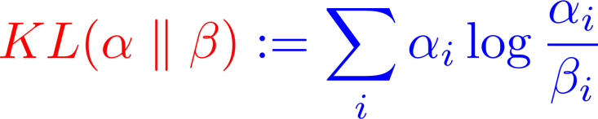
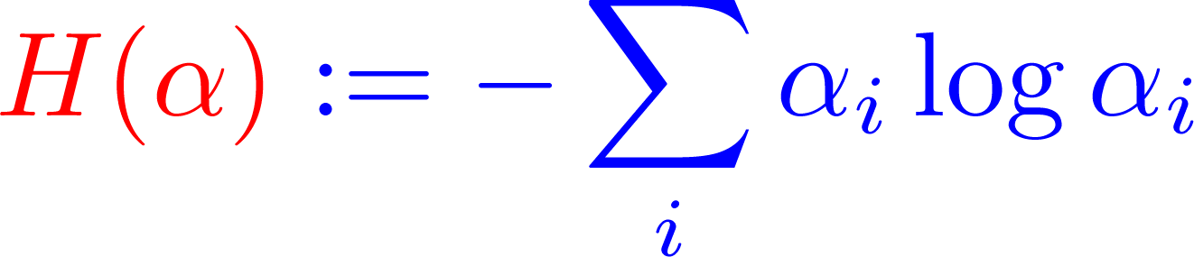
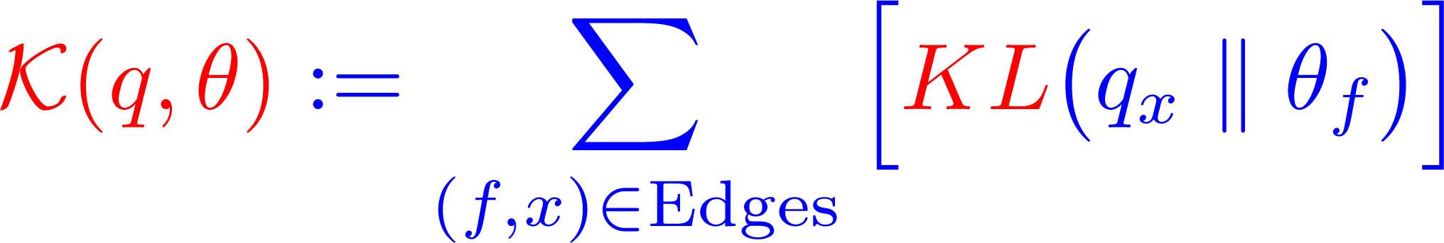
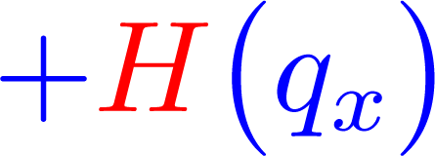
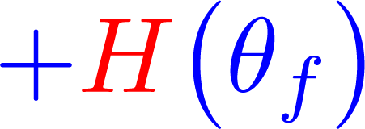
Objective Function
KL-divergence is a measure of distance between two probability distributions:
Entropy H is a measure of randomness in a distribution:
The objective function:
F
X
Notes:
In this slide we are going to see the form of the objective function. First let’s review two concepts from information theory.
The first one is called KL divergence which is a distance measure between two distributions. The larger the distance, the more unsimilar the two distributions.
The second one is called entropy which gives the amount of randomness in a distribution. Based on this operator, the uniform distribution has the highest randomness which coincides with the intuition.

Slide 22
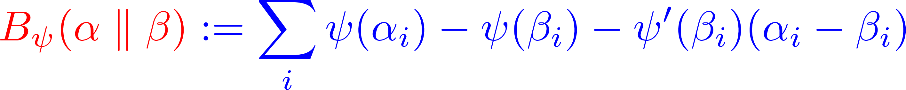
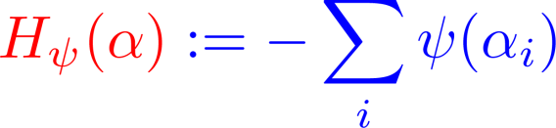
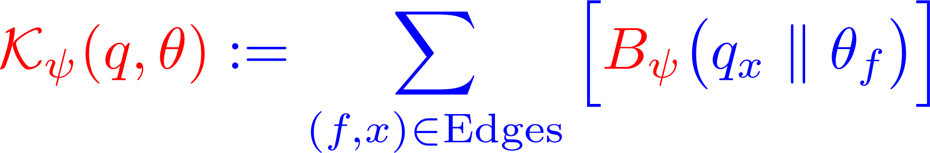
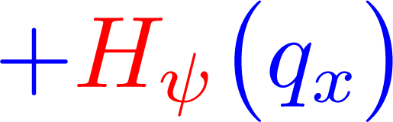
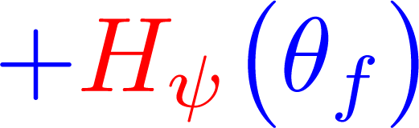
Generalizing the Objective Function
Given a strictly convex function ψ, the Bregman distance B_{ψ} between two probability distributions is defined as:
The ψ-entropy H_{ψ} is defined as:
The generalized objective function:
F
X
Notes:
We can generalize our objective function, by generalizing distance measures operator between distributions and accordingly the randomness-measuring operator.
First we can generalize the distance measures to the class of Bregman-distances. Given a convex function \psi, the bregman distance is instantiated to a particular distance measure.
Acordingly, the \psi-entropy is defined this way which generalizes the entropy operator in the last slide.
So, here is our general obj function. It is the sum of the bregman-distances of labeling distribs of the two end-points on the edges, possibly plus the entropy term for labeling distribution of the instances and features.

Slide 23
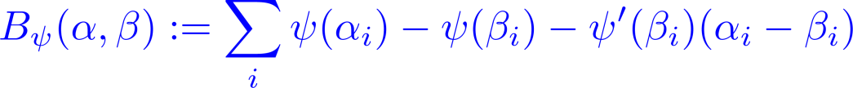
The Bregman Distance
ψ(α_{i})
ψ(t)
α_{i}
t
β_{i}
Examples:
  If ψ(t) = t log t Then B_{ψ}(α,β) = KL(α,β)
  If ψ(t) = t² Then B_{ψ}(α,β) = Σ_{i} (α_{i} - β_{i})²

Slide 24
How to Optimize the Objective Functions ?
In what follows, we mention some specific objective functions together with their optimization algorithms in a self-training manner.
These specific optimization algorithms correspond to some variants of the modified Yarowsky algorithm.
  In particular, DL-1 and DL-2-S variants that we will see shortly.
In general, it is not easy to come up with algorithms for optimizing the generalized objective functions.

Slide 25
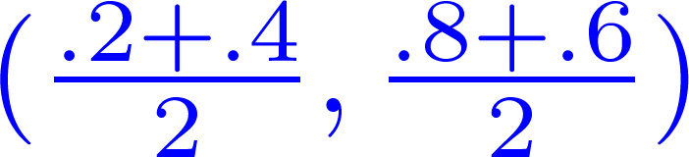

Useful Operations
Average: takes the average distribution of the neighbors
Majority: takes the majority label of the neighbors
(.2 , .8)
(.3 , .7)
(.4 , .6)
(.2 , .8)
(0 , 1)
(.4 , .6)

Slide 26
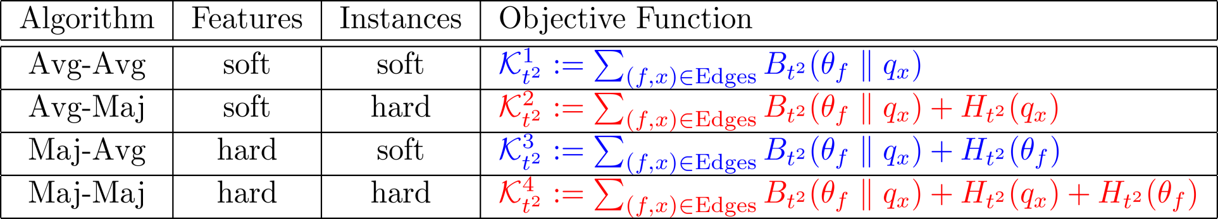
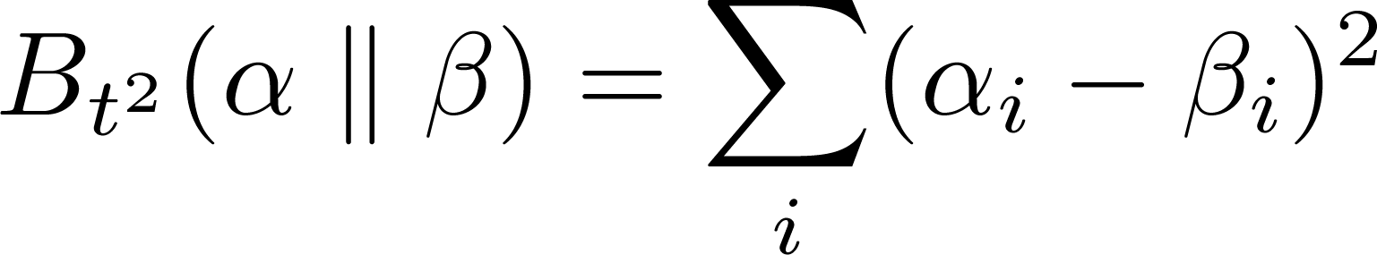
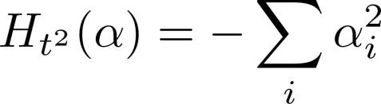
Analyzing Self-Training
F
X
Theorem. The following objective functions are optimized by the corresponding label propagation algorithms on the bipartite graph:
where:
Notes:
- This theorem shows each of the four ways of combining these two operators optimizes which obj function.
Also it shows at the convergence of the propagation algorithms, what the labeling distributions look like for the graph nodes.
- for example maj-maj tends to assign hard labels to both feature and instance nodes. A hard label means a labeling distribution in which all of the mass is put on only one label (as opposed to soft label).
I’m not going into the details of this theorem, but would like to point out the following remarks.

Slide 27
Remarks on the Theorem
The final solution of the Average-Average algorithm is related to the graph-based semi-supervised learning using harmonic functions (Zhu et al 2003).
The Average-Majority algorithm is the so-called DL-1 variant of the modified Yarowsky algorithm.
We can show that the Majority-Majority algorithm converges in polynomial-time O(|F|^{2 .}|X|²).
Notes:
- In the squared number of features times squared number of instances.

Slide 28
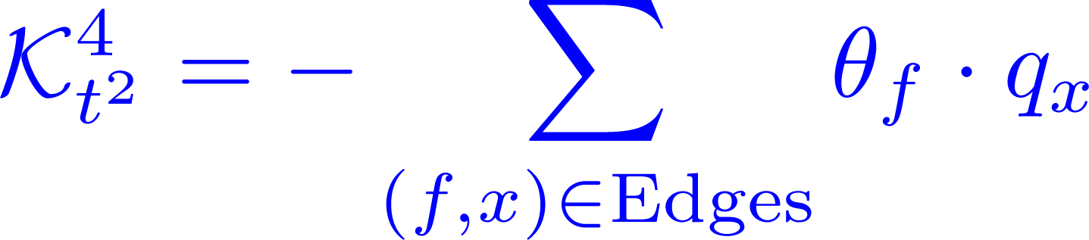
Majority-Majority
F
X
Sketch of the Proof. The objective function can be rewritten as:
Fixing the labels q_{x}, the parameters θ_{f} should change to the majority label among the neighbors to maximally reduce the objective function.
Re-labeling the labeled nodes reduces the cut size between the sets of positive and negative nodes.
Notes:
I refer the interested people to read the proof the theorem for all 4 cases in our paper. But here I just give a high level proof for the simple case of majority-majority propagation scheme.
With some algabric manipulation, the obj func to minimize is the following:
- this sum simply means add the number of edges for which you see the same label at the end points. Recomputing the labels based on majotrity-majority rule, indeed tend to increase such edges and hence optimizing the obj function.
To prove that the alg converges in poly-time, put all labeled nodes with the same label into one set.

Slide 29

Another Useful Operation
Product: takes the label with the highest mass in (component-wise) product distribution of the neighbors.
This way of combining distributions is motivated by Product-of-Experts framework (Hinton 1999).
(.4 , .6)
(1 , 0)
(.8 , .2)

Slide 30
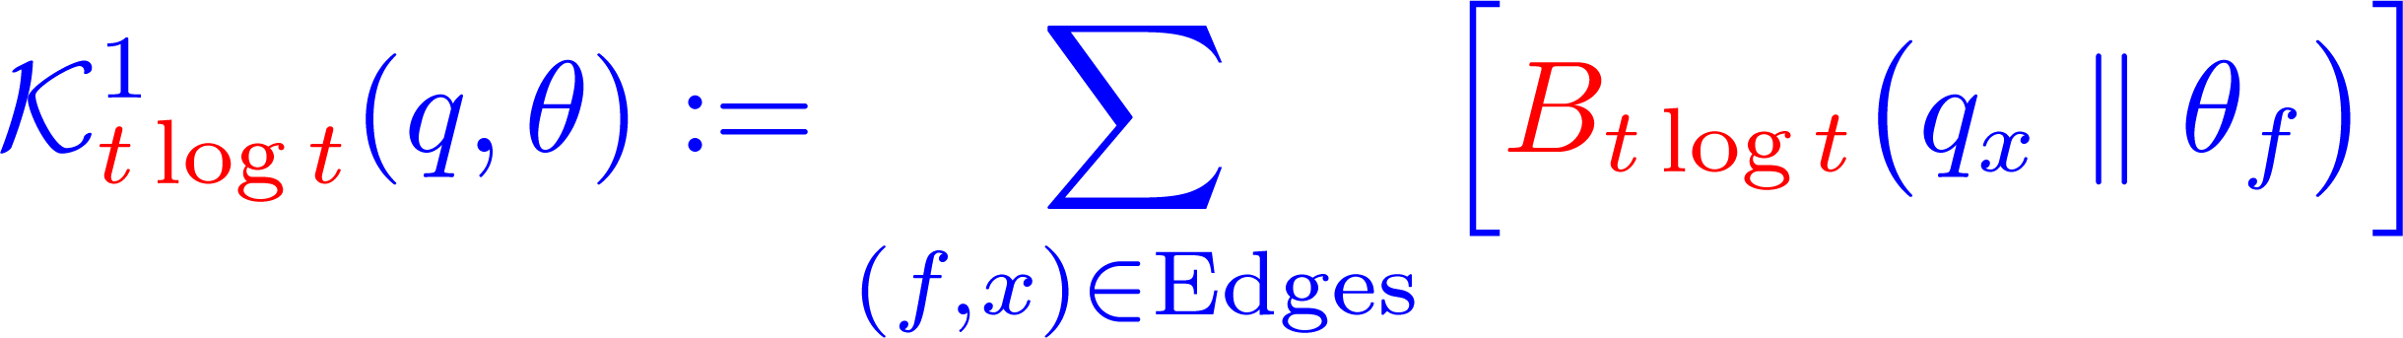
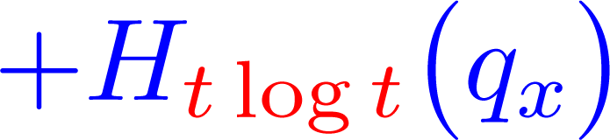
Average-Product
F
X
features
instances
Theorem. This algorithm Optimizes the following objective function:
This is the so-called the DL-2-S variant of the Yarowsky algorithm .
The instances get hard labels and features get soft labels.

Slide 31
What about Log-Likelihood?
Can we say anything about the log-likelihood of the data under the learned model?
Recall the Prediction Distribution:
(Features) F
X (Instances)
Labeling
distribution
θ_{f}
π_{x}
q_{x}
Labeling
distribution
Prediction
distribution
…
…

Slide 32
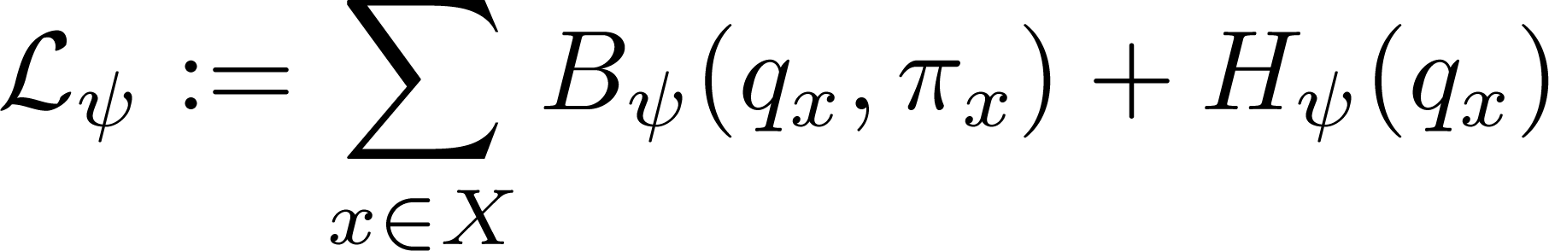
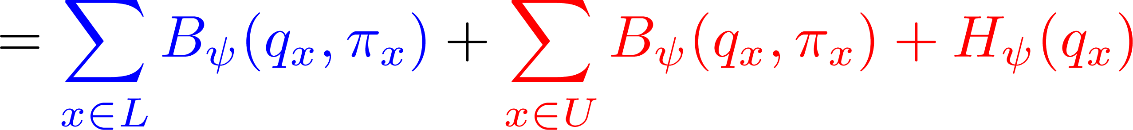
Log-Likelihood
Initially, the labeling distribution is uniform for unlabeled vertices and a δ-like distribution for labeled vertices.
By learning the parameters, we would like to reduce the uncertainty in the labeling distribution while respecting the labeled data:
Negative log-Likelihood of the
old and newly labeled data

Slide 33
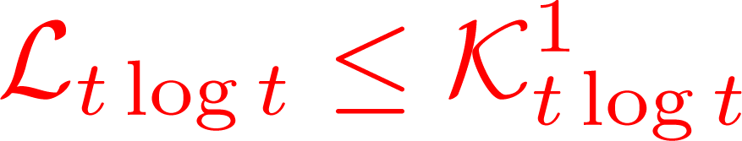


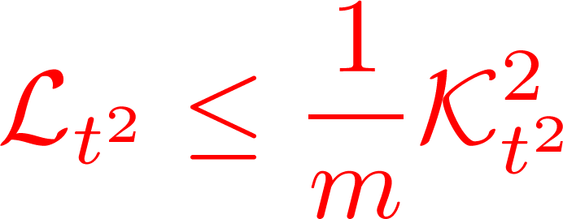


Connection between the two Analyses
Lemma. By minimizing K¹_{t log t} , we are minimizing an upperbound on negative log-likelihood:
Lemma. If m is the number of features connected to an instance, then:

Slide 34
Outline
Introduction
  Semi-supervised Learning, Self-training, Yarowsky Algorithm
Problem Formulation
  Bipartite-graph Representation, Modified Yarowsky family of Algorithms
Analysing variants of the Yarowsky Algorithm
  Objective Functions, Optimization Algorithms
Concluding Remarks

Slide 35
Summary
We have reviewed variants of the Yarowsky algorithms for rule-based semi-supervised learning.
We have proposed a general framework to unify and analyze variants of the Yarowsky algorithm and some other semi-supervised learning algorithms. It allows us to:
  introduce new self-training style algorithms.
  shed light to the reasons of the success of some of the existing bootstrapping algorithms.
Still there exist important and interesting un-answered questions which are avenues for future research.

Slide 36
Thank You

Slide 37
References
Belkin & Niyogi, Chicago Machine Learning Summer School, 2005.
D. Yarowsky, Unsupervised Word Sense Disambiguation Rivaling Supervised Methods, ACL, 1995.
M. Collins and Y. Singer, Unsupervised Models for Named Entity Classification, EMNLP, 1999.
D. McClosky, E. Charniak, and M. Johnson, Reranking and Self-Training for Parser Adaptation, COLING-ACL, 2006.
G. Haffari, A. Sarkar, Analysis of Semi-Supervised Learning with the Yarowsky Algorithm, UAI, 2007.
N. Ueffing, G. Haffari, A. Sarkar, Transductive Learning for Statistical Machine Translation, ACL, 2007.
S. Abney, Understanding the Yarowsky Algorithm, Computational Linguistics 30(3). 2004.
A. Corduneanu, The Information Regularization Framework for Semi-Supervised Learning, Ph.D. thesis, MIT, 2006.
M. Balan, and A. Blum, An Augmented PAC Model for Semi-Supervised Learning, Book Chapter in Semi-Supervised Learning, MIT Press, 2006.
J. Eisner and D. Karakos, Bootstrapping Without the Boot, HLT-EMNLP, 2005.

Slide 38
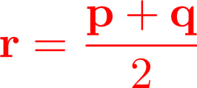
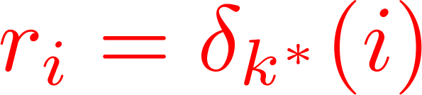
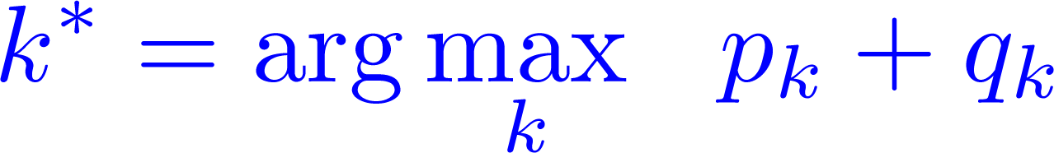
Useful Operations
Average: takes the average distribution of the neighbors
Majority: takes the majority label of the neighbors
p
q
p
q

Slide 39
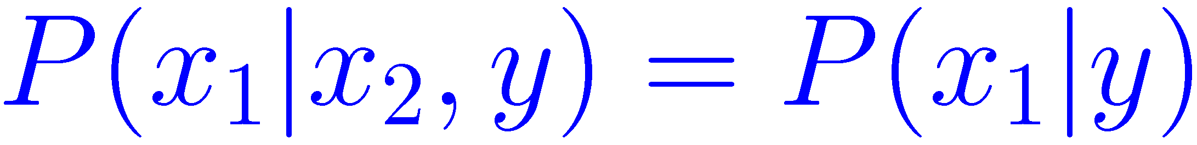
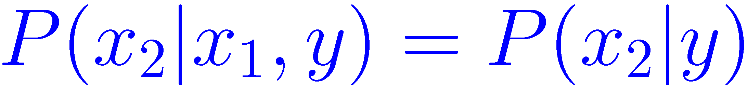
Co-Training
(Blum and Mitchell 1998)
Instances contain two sufficient sets of features
  i.e. an instance is x=(x₁,x₂)
  Each set of features is called a View
Two views are independent given the label:
Two views are consistent:
x
x₁
x₂

Slide 40
Co-Training
Allow C1 to label
Some instances
Iteration: t
Iteration: t+1
+
C1: A
Classifier
trained
on view 1
+
Add self-labeled
instances to the pool
of training data
……
C2: A
Classifier
trained
on view 2
-
-
Allow C2 to label
Some instances

