Slide 1
Automatic Acquisition of Subcategorization Frames for Czech
Anoop Sarkar
Daniel Zeman
Notes:
Abstract:
The subcategorization of verbs is one of the most essential issues in parsing, helping us to attach the right arguments to the verb and also to understand their function and meaning. Several techniques and results have been reported on learning subcat frames (SFs) from text corpora. All of this work deals with English. We were able to automatically extract SFs for Czech, which is a free-word-order language, where verb complements are marked by inflection. Unlike existing work, we do not assume that the set of SFs is known to us in advance. Also in contrast, we work with syntactically annotated data (a dependency treebank) where the subcategorization information is NOT given; although this is less noisy compared to using raw text, we have discovered interesting problems that a user of a raw or tagged corpus is unlikely to face.
The talk will give a brief description of those properties of Czech that have to be taken into account when searching for SFs. Then we will show the differences from the other research efforts: we are able to find all the complements of verbs but since many of them are to be treated as adjuncts we have to filter them out. I will describe a novel technique that uses intersections of observed frames to distinguish arguments from adjuncts.
Using our techniques, we are able to achieve nearly 90% accuracy in distinguishing arguments from adjuncts in new parsed text. We will also mention some future work which tries to extract the same SF information using only morphologically tagged text, and also the use of SFs in parsing, improving annotations in treebanks, and treebank-grammar extraction.

Slide 2
The task
Arguments vs. adjuncts.
Discover valid subcategorization frames for each verb.
Learning from data not annotated with SF information.

Slide 3
Previous work | Current work
Predefined set of subcat frames | SFs are learned from data
Learns from parsed / chunked data | Adds SF information to an existing treebank
Difficult to add info to an existing treebank parser | Existing treebank parser can easily use SF info
English | Czech

Slide 4
Comparison to previous work
Previous methods use binomial models of miscue probabilities
Current method compares three statistical techniques for hypothesis testing
Useful for treebanks where heuristic techniques cannot be applied (unlike Penn Treebank)

Slide 5
The Prague Dependency Treebank (PDT)
[#, 0]
[však, 8]
but
[., 12]
[mají, 2]
have
[\,, 6]
[chybí, 10]
miss
[studenti, 1]
students
[zájem, 5]
interest
[o, 3]
in
[fakultě, 7]
faculty (dative)
[letos, 9]
this year
[angličtináři, 11]
teachers of English
[jazyky, 4]
languages

Slide 6
Output of the algorithm
[ZSB]
[JE]
but
[ZIP]
[VPP3A]
have
[ZIP]
[VPP3A]
miss
[N1]
students
[N4]
interest
[R4]
in
[N3]
faculty
[DB]
this year
[N1]
teachers of English
[NIP4A]
languages
Notes:
We don’t use passive verb forms and reflexive passive (there is an AuxR complement of the verb). All other forms are useful, even in relative clauses (refer to previous slides).
We don’t include subjects in the frames (usually N1, always /Sb). They are missing often, so hard to collect.

Slide 7
Statistical methods used
Likelihood ratio test
T-score test
Binomial models of miscue probabilities

Slide 8
Likelihood ratio and T-scores
Hypothesis: distribution of observed frame is independent of verb
  p(f | v) = p(f | !v) = p(f)
Log likelihood statistic
  – 2 log λ = 2[log L(p₁, k₁, n₁) + log L(p₂, k₂, n₂) – log L(p, k₁, n₂) – log L(p, k₂, n₂)]
  log L(p, n, k) = k log p + (n – k) log (1 – p)
Same hypothesis with the T-score test
Notes:
100% for one occurrence counts less than 100% for 100 occurrences.
But we anyway throw away all verbs seen less than 5 times.
Variables: we don’t know how to set them.
Assumptions: we don’t know whether they are true.

Slide 9
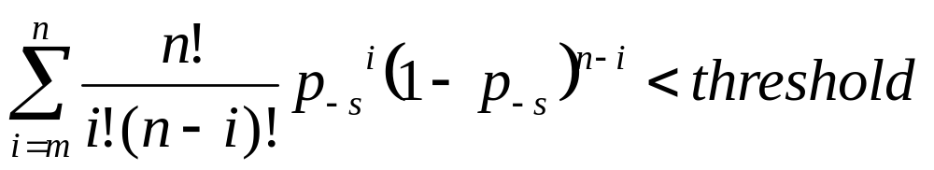
Binomial models of miscue probability
p_{–s} = probability of frame co-occurring with the verb when frame is not a SF
Count of verb = n
Computes likelihood of a verb seen m or more times with frame which is not SF
threshold = 0.05 (confidence value of 95%)
Notes:
100% for one occurrence counts less than 100% for 100 occurrences.
But we anyway throw away all verbs seen less than 5 times.
Variables: we don’t know how to set them.
Assumptions: we don’t know whether they are true.

Slide 10
Relevant properties of Czech
Free word order
Rich morphology

Slide 11
Free word order in Czech
Mark opens the file.
The file opens Mark.
* Mark the file opens.
* Opens Mark the file.
Mark otvírá soubor.
Soubor otvírá Mark.
× Soubor otvírá Marka.
Mark soubor otvírá.
* Otvírá Mark soubor.
(poor, but if not pronoun-ced as a question, still understood the same way)
Notes:
In general, Czech is a SVO language. There is a default word order for a sentence.
Some of the possible permutations are plausible and change the topic-focus articulation.
Many others are poor language (ungrammatical) but still can be understood without confusion.
Anyway, confusion is possible due to morphological ambiguity.
It is not so simple to write a small finite state grammar to chunk the sentence, find the verb and its complements.
A grammar can handle the morphology but it is difficult to capture the word order.

Slide 12
Czech morphology
singular
1. Bill
2. Billa
3. Billovi
4. Billa
5. Bille
6. Billovi
7. Billem
plural
1. Billové
2. Billů
3. Billům
4. Billy
5. Billové
6. Billech
7. Billy
nominative
genitive
dative
accusative
vocative
locative
instrumental
Notes:
N4, N3, N2, N7 and N1 can be arguments.
The case information is important for the subcategorization — similar to different prepositions in other languages.
In addition, prepositions are also present.

Slide 13
Argument types — examples
Noun phrases: N4, N3, N2, N7, N1
Prepositional phrases: R2(bez), R3(k), R4(na), R6(na), R7(s)…
Reflexive pronouns “se”, “si”: PR4, PR3.
Clauses: S, JS(že), JS(zda)…
Infinitives (VINF), passive participles (VPAS), adverbs (DB)…

Slide 14
Frame intersections seem to be useful
3× absolvovat N4
2× absolvovat N4 R2(od) R2(do)
1× absolvovat N4 R6(po)
1× absolvovat N4 R6(v)
1× absolvovat N4 R6(v) R6(na)
1× absolvovat N4 DB
1× absolvovat N4 DB DB

Slide 15
Counting the Subsets (1) example
Example observations:
2× N4 od do
1× N4 v na
1× N4 na
1× N4 po
1× N4
= total 6
Subsets:
N4 od do
N4 v na
N4 od
N4 do
od do
N4 v
N4 na
v na
N4 po
N4
∅

Slide 16
Counting the Subsets (2) initialization
List of frames for the verb. Refining observed frames ⇒ real frames.
Initially: observed frames only.
N4 od do (2)
N4 (1)
N4 v na (1)
N4 na (1)
N4 po (1)
3 elements
2 elements
1 element
empty

Slide 17
Counting the Subsets (3) frame rejection
Start from the longest frames (3 elements):
consider N4 od do.
Rejected ⇒ a subset with 2 elements inherits its count (even if not observed).
N4 od do (2)
N4 od
N4 v na (1)
N4 do
od do

Slide 18
Counting the Subsets (4) successor selection
How to select the successor?
Idea: lowest entropy, strongest preference ⇒ exponential complexity.
Zero approach: first come, first served (= random selection).
Heuristic 1: highest frequency at the given moment (not observing possible later heritages from other frames).

Slide 19
Counting the Subsets (5) successor selection
If (N4 na) is the successor it’ll have 2 obs.
(1 own + 1 inherited).
first come first served
N4 od do (2)
N4 v
N4 v na (1)
N4 na (1)
v na
highest frequency

Slide 20
Counting the Subsets (7) summary
Random selection (first come first served) leads — surprisingly — to best results.
All rejected frames devise their frequencies to their subsets.
All frames, that are not rejected, are considered real frames of the verb (at least the empty frame should survive).

Slide 21
Results
19,126 sent. (300K words) training data.
33,641 verb occurrences.
2,993 different verbs.
28,765 observed “dependent” frames.
13,665 frames after preprocessing.
914 verbs seen 5 or more times.
1,831 frames survived filtering.
137 frame classes learned (known lbound: 184).

Slide 22
Evaluation method
No electronic subcategorization dictionary.
Only a small (556 verbs) paper dictionary.
So I annotated 495 sentences.
Evaluation: go through the test data, try to apply a learned frame (longest match wins), compare to annotated arg/adj value (contiguous 0 to 1).
We do not test unknown verbs.

Slide 23
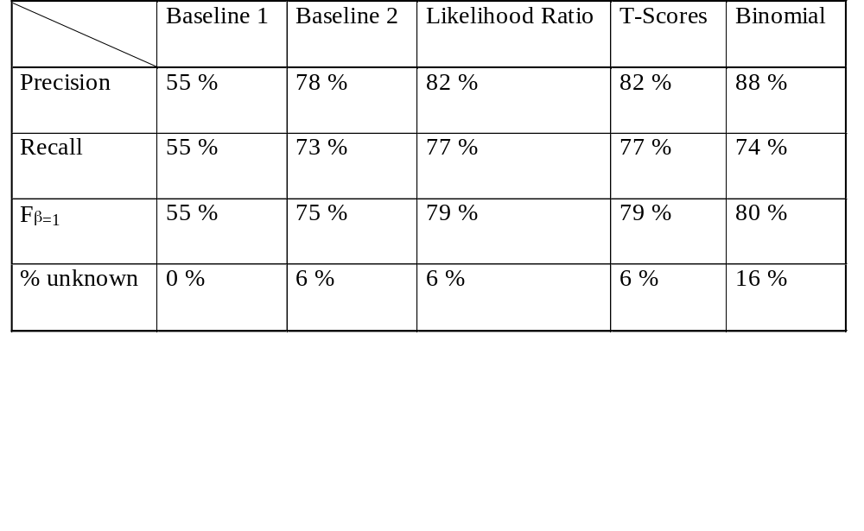
Results

Slide 24
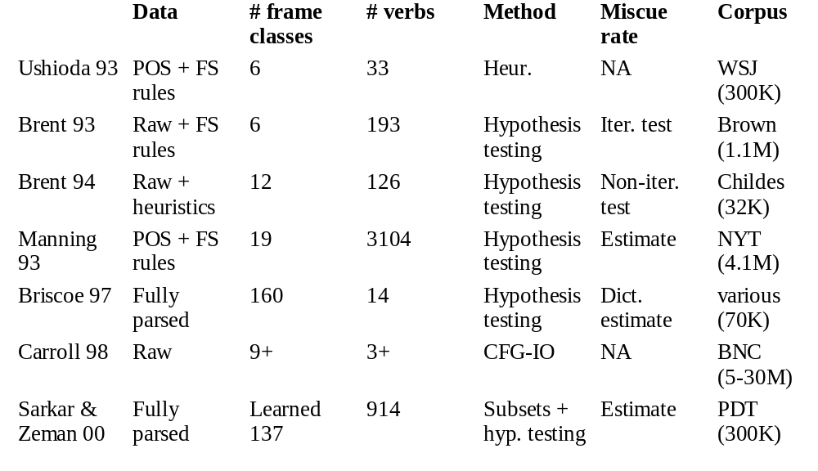
Summary of previous work

Slide 25
Current work
PDT 1.0
  Morphology tagged automatically (7 % error rate)
  Much more data (82K sent. instead of 19K)
  Result: 89% (1% improvement)
  2047 verbs now seen 5 or more times
Subsets with likelihood ratio method
Estimate miscue rate for the binomial model

Slide 26
Conclusion
We achieved 88 % accuracy in finding SFs for unseen data.
Future work:
  Statistical parsing using PDT with subcat info
  Using less data or using output of a chunker

Slide 27
Learning frames for Czech verbs
What and why?
The language: Czech.
Filtering method.
Evaluation method and results.
Conclusion, future work.

Slide 28
Is it interesting for those not processing Czech?
Novel filtering method (subsets).
Frame classes learned from data (unlike existing work).
Parsed training data (treebank).
Notes:
Treebank: is it a step backwards? It is simpler but not completely problem-free.
We address the interesting problems (I will talk about them later.)
Once we have the treebank, why not use it?

Slide 29
Parsed data: different, not simpler!
More accurate data, correct identification of verbs and their complements.
A typical observed frame contains noise: all the adjuncts are visible.
Treebanks are expensive ⇒ less data ⇒ sparser data.
Notes:
If there is a treebank, why not use it?
There are clear advantages of using a treebank.
But is it still interesting, or is it just a straightforward procedure?
The interesting point is working around the main disadvantage of a treebank: getting rid of noise.

Slide 30
The observed frames contain noise
John saw Mary.
vs.
John saw Mary yesterday around four o’clock at the station.

Slide 31
Why?
Subcategorization can help parsers.
We don’t have it yet for Czech.
Subcat info can be added to the treebank.
Forms the basis for tree families in TAG.
Can help word sense disambiguation.
Notes:
Now there is no electronical subcategorization dictionary for Czech.
The only one paper dictionary is a small sample only: 450 most frequent verbs.

Slide 32
Prepositions in Czech
In some frames, a particular preposition is required by the verb.
Sometimes a locational phrase is required but it can be expressed by various prepositions: in, on, behind, under…
Adjuncts can use many different prepositions.

Slide 33
Prepositions in Czech
Prepositions specify the case of their noun: with Dan = s Danem but about Dan = o Danovi.
Some prepositions allow multiple cases with different meanings: na mostě = on the bridge, na most = onto the bridge.
Verbs specify both the prepositions and the cases for their arguments.

Slide 34
We can also use verbs in relative clauses
* The man I saw.
The man whom I saw.

Slide 35
PDT: morphological tags
[ZSB]
[JE]
but
[ZIP]
[VPP3A]
have
[ZIP]
[VPP3A]
miss
[NMP1A]
students
[NIS4A]
interest
[R4]
in
[NFS3A]
faculty
[NMP1A]
teachers of English
[NIP4A]
languages

Slide 36
PDT: functional tags
[AuxS]
[Coord]
but
[AuxK]
[Pred_Co]
have
[AuxX]
[Pred_Co]
miss
[Sb]
students
[Obj]
interest
[AuxP]
in
[Obj]
faculty
[Sb]
teachers of English
[Atr]
languages

Slide 37
Objects vs. adverbials
Obj (= argument?)
He changed water into wine.
Adv (= adjunct?)
He crashed the car into my house.
I expect approx. 50 verbs out of 3000 to require adverbial argument. And not every Obj is argument — it can be adjunct or error.
Notes:
Mention that just forgetting any observed adverbials gives a good accuracy.
Approximately 50 verbs out of 3000 take adverbial arguments.
Some objects are adjuncts or errors.
So it’s still useful to have some good filtering method.

Slide 38
Counting the Subsets (6) successor selection
Heuristic 2: candidates get points from subsets of the removed frame that are their subsets as well.
N4 od do (2)
N4 v
N4 (1)
N4 v na (1)
N4 na (1)
v
v na
na

Slide 39
Future work (2)
Try not to use functional tags (use morph. tags only).
Trees from Mike Collins’ parser (80%, no functions), tagged corpus without trees…
Develop an evaluation method to use weights for frames.
Current experiments: parser application.

Slide 40
Preprocessing
Word order normalization: sort frame members.
Rule out technical nodes (punctuation etc.).
Coordination of verbs, coordinated frame members and similar constructions.

