Slide 1


SFU Q/A Summary Handler (SQuASH) for DUC-2005
Oct. 10, 2005
Gabor Melli, Yang Wang, Yudong Liu,
Mehdi M. Kashani, Zhongmin Shi,
Baohua Gu, Anoop Sarkar and Fred Popowich
http://natlang.cs.sfu.ca/

Slide 2
Talk Overview
Task and Approach
System design
  Document Annotation
  Document Synthesis
  Sentence/Paragraph Editing
Evaluation
Future Work

Slide 3
Reminder of Task
Former Panamanian leader General Manuel Antonio Noriega's defence against
drug trafficking charges in Miami gained ground this week. A Drug Enforcement Administration agent ack-nowledged that a man iden-tified by the prosecution
The testimony by Mr James L. Bramble, in charge of the DEA's Panama operations from August 1982 until June 1984, raised questions abo-ut earlier prosecution claims that Gen Noriega had pro-tected the cartel's opera-tions in Panama in return for pay-offs. …
Prosecutors had cited the money launderer, Mr Ramon Milian Rodriguez, as a conduit for drug money from the US to bank ac-counts controlled by the cartel in Panama. According to the DEA, Mr Milian was responsible for transferring
Dollars 200m in drug profits from the US to Panama. Mr Bramble acknowledged that the information that led to Mr Milian's arrest had been independently developed by Panamanian narcotics officers and passed on to the DEA….
…
Question
What is the relationship between Manueal Noriega and drug cartels?
Specific?
Prosecutors had cited the money launderer, Mr Ramon Milian Rodriguez, as a conduit for drug money from the US to bank ac-counts controlled by the cartel in Panama. According to the DEA, Mr Milian was responsible for transferring

Slide 4
Approach: synthesize and edit
1) Highlight relevant sentences.
Former Panamanian leader General Manuel Antonio Noriega's defence against
drug trafficking charges in Miami gained ground this week. A Drug Enforcement Administration agent ack-nowledged that a man iden-tified by the prosecution
The testimony by Mr James L. Bramble, in charge of the DEA's Panama operations from August 1982 until June 1984, raised questions abo-ut earlier prosecution claims that Gen Noriega had pro-tected the cartel's opera-tions in Panama in return for pay-offs. …
Prosecutors had cited the money launderer, Mr Ramon Milian Rodriguez, as a conduit for drug money from the US to bank ac-counts controlled by the cartel in Panama. According to the DEA, Mr Milian was responsible for transferring
Dollars 200m in drug profits from the US to Panama. Mr Bramble acknowledged that the information that led to Mr Milian's arrest had been independently developed by Panamanian narcotics officers and passed on to the DEA….
…
Synthesize
2) Extract the highlighted sentences.
The testimony by Mr James L. Bramble, in charge of the DEA's …
The defence, by calling current and former government officials and …
Prosecutors had cited the money launderer, Mr Ramon Rodriguez …
…
Mr Bramble acknowledged that the information that led to Mr. …
A federal jury in Miami yesterday found General Manuel Antonio …
Question
What is the relationship between Manueal Noriega and drug cartels?
Edit
Specific?
3) Reorder and edit.
Prosecutors had cited the money launderer, Mr Ramon Milian Rodriguez, as a conduit for drug money from the US to bank ac-counts controlled by the cartel in Panama. According to the DEA, Mr Milian was responsible for transferring

Slide 5
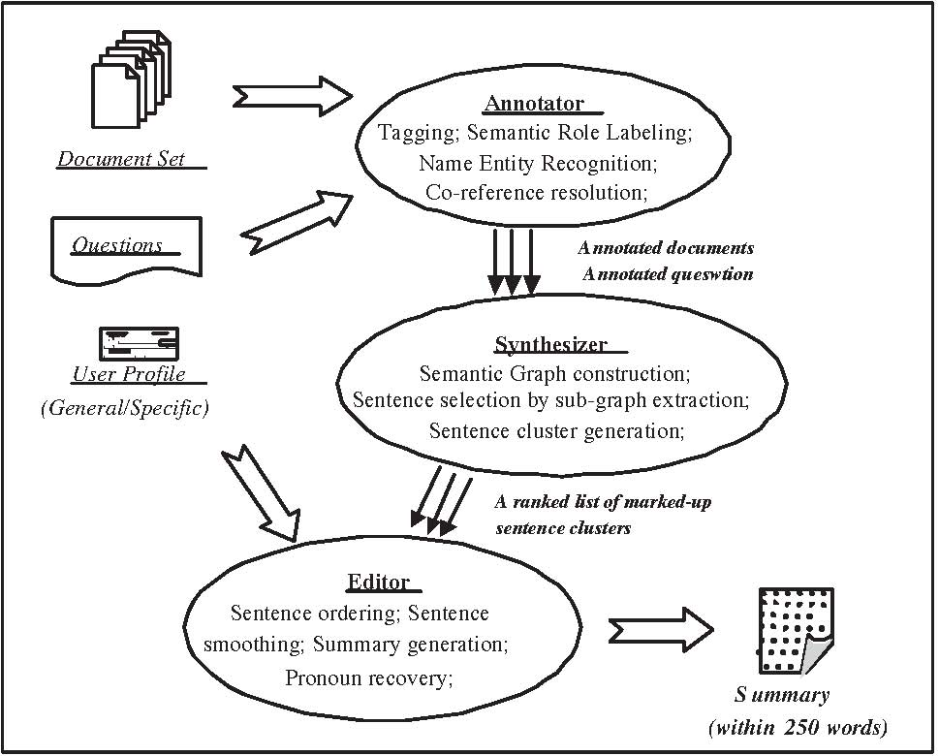
System Design
Annotate
Synthesize
Edit

Slide 6
Annotation INPUT Example
Doc1: Former Panamanian leader General Manuel Antonio Noriega's defence against drug trafficking charges in Miami gained ground this week….
…
Doc5: … A Drug Enforcement Administration agent acknowledged that a man identified by the prosecution as a Medelin cocaine cartel money launderer had been arrested on the basis of information from forces commanded by Gen Noriega…

Slide 7
Annotation OUTPUT Example
N.E.R.
N.E.R.
N.E.R.
S.R.L.
S.R.L.
S.R.L.
Parse
S.R.L.
Mul
t
i
-
doc
Parse
Mul
t
i
-
doc
Mul
t
i
-
doc
Syntact
ic
Syntact
ic
Tokenize

Slide 8
Annotation Module Components
Preprocess articles
Tokenize (Lingpipe+Charniak)
Syntactic Parsing (Charniak)
NER and Coreference
  Single-document (Lingpipe)
  Multi-document (SFU-naïve)
Semantic Role Labeling
  Predicate identification (SFU-naive)
  Argument labeling (SFU)

Slide 9
NER – Single Document
Used Lingpipe
  http://www.alias-i.com/lingpipe
Two versions
  One, the default, was used for:
    PERSON, LOCATION, ORGANIZATION
  A customized version was used for:
    MONEY, TIME,

Slide 10
NER – Multi-Document
Naïve: match on any one word.
Compare the single document NERs
  If any one word matches.
  E.g. Manuel Antonio Noriega & General Noriega
Assume no overlap in named entities
  E.g. Only one “John Smith” per document set
Gather all aliases for each entity
  E.g. Manuel Antonio Noriega; Manuel Noriega; General Noriega; Noriega.

Slide 11
Semantic Role Labeling (SRL)
Task: For each predicate in a sentence, identify all constituents that fill a semantic role, and determine their roles, if any [Gildea,Jurafsky,2002]
Design
  Predicate identification (naïve)
  Argument Label Candidates
    Based on augmented pushdown automata (PDT)
  Select Best Candidate (greedy)

Slide 12
SRL – Example
A Drug Enforcement Agency agent acknowledged that …
[A₀ A Drug Enforcement Agency agent] [acknowledge]
[A₁ that … ]

Slide 13
SRL – Example (cont)
S
NP-{A0} VP
NP NN VBD-{PRED} SBAR-{A1}
DT NNP NNP NNP agent acknowledged IN S
A Drug [Enforcement Administration] that NP
[ Organization ]
… ….

Slide 14
Annotation OUTPUT Example

Slide 15
System Design

Annotate
Synthesize
Edit

Slide 16
Summarization by way of sentence selection and editing
1) Highlight relevant sentences.
The testimony by Mr James L. Bramble, in charge of the DEA's Panama operations from August 1982 until June 1984, raised questions abo-ut earlier prosecution claims that Gen Noriega had pro-tected the cartel's opera-tions in Panama in return for pay-offs. …
The testimony by Mr James L. Bramble, in charge of the DEA's Panama operations from August 1982 until June 1984, raised questions abo-ut earlier prosecution claims that Gen Noriega had pro-tected the cartel's opera-tions in Panama in return for pay-offs. …
Prosecutors had cited the money launderer, Mr Ramon Milian Rodriguez, as a conduit for drug money from the US to bank ac-counts controlled by the cartel in Panama. According to the DEA, Mr Milian was responsible for transferring
Prosecutors had cited the money launderer, Mr Ramon Milian Rodriguez, as a conduit for drug money from the US to bank ac-counts controlled by the cartel in Panama. According to the DEA, Mr Milian was responsible for transferring
Dollars 200m in drug profits from the US to Panama. Mr Bramble acknowledged that the information that led to Mr Milian's arrest had been independently developed by Panamanian narcotics officers and passed on to the DEA….
Former Panamanian leader General Manuel Antonio Noriega's defence against
drug trafficking charges in Miami gained ground this week. A Drug Enforcement Administration agent ack-nowledged that a man iden-tified by the prosecution
Dollars 200m in drug profits from the US to Panama. Mr Bramble acknowledged that the information that led to Mr Milian's arrest had been independently developed by Panamanian narcotics officers and passed on to the DEA….
Former Panamanian leader General Manuel Antonio Noriega's defence against
drug trafficking charges in Miami gained ground this week. A Drug Enforcement Administration agent ack-nowledged that a man iden-tified by the prosecution
…
…
Synthesize
2) Extract the highlighted sentences.
The testimony by Mr James L. Bramble, in charge of the DEA's …
The defence, by calling current and former government officials and …
Prosecutors had cited the money launderer, Mr Ramon Rodriguez …
…
Mr Bramble acknowledged that the information that led to Mr. …
A federal jury in Miami yesterday found General Manuel Antonio …
Question
What is the relationship between Manueal Noriega and drug cartels?
Specific?

Slide 17
Approach to Synthesizer
1) Locate and qualify “entities”
Former Panamanian leader General Manuel Antonio Noriega's defence against
drug trafficking charges in Miami gained ground this week. A Drug Enforcement Administration agent ack-nowledged that a man iden-tified by the prosecution
The testimony by Mr James L. Bramble, in charge of the DEA's Panama operations from August 1982 until June 1984, raised questions abo-ut earlier prosecution claims that Gen Noriega had pro-tected the cartel's opera-tions in Panama in return for pay-offs. …
Prosecutors had cited the money launderer, Mr Ramon Milian Rodriguez, as a conduit for drug money from the US to bank ac-counts controlled by the cartel in Panama. According to the DEA, Mr Milian was responsible for transferring
Dollars 200m in drug profits from the US to Panama. Mr Bramble acknowledged that the information that led to Mr Milian's arrest had been independently developed by Panamanian narcotics officers and passed on to the DEA….
…
2) Locate and qualify relationships
…
3) Synthesize

Slide 18
Sentence Selection
Former Panamanian leader General Manuel Antonio Noriega's defence against
drug trafficking charges in Miami gained ground this week. A Drug Enforcement Administration agent ack-nowledged that a man iden-tified by the prosecution
Prosecutors had cited the money launderer, Mr Ramon Milian Rodriguez, as a conduit for drug money from the US to bank ac-counts controlled by the cartel in Panama. According to the DEA, Mr Milian was responsible for transferring
The testimony by Mr James L. Bramble, in charge of the DEA's Panama operations from August 1982 until June 1984, raised questions abo-ut earlier prosecution claims that Gen Noriega had pro-tected the cartel's opera-tions in Panama in return for pay-offs. …
Dollars 200m in drug profits from the US to Panama. Mr Bramble acknowledged that the information that led to Mr Milian's arrest had been independently developed by Panamanian narcotics officers and passed on to the DEA….
i) Measure each sentences’ significance
ii) Iteratively select a set of x sentences.
1) The testimony by Mr James L. Bramble, in charge of the DEA's …
Question
What is the relationship between Manueal Noriega and drug cartels?
2) The defence, by calling current and former government officials and …
…
x) Prosecutors had cited the money launderer, Mr Ramon Rodriguez …
Specific?

Slide 19
System Design

Annotate

Synthesize
Edit

Slide 20
Summarization by way of sentence selection and editing
Former Panamanian leader General Manuel Antonio Noriega's defence against
drug trafficking charges in Miami gained ground this week. A Drug Enforcement Administration agent ack-nowledged that a man iden-tified by the prosecution
The testimony by Mr James L. Bramble, in charge of the DEA's Panama operations from August 1982 until June 1984, raised questions abo-ut earlier prosecution claims that Gen Noriega had pro-tected the cartel's opera-tions in Panama in return for pay-offs. …
Prosecutors had cited the money launderer, Mr Ramon Milian Rodriguez, as a conduit for drug money from the US to bank ac-counts controlled by the cartel in Panama. According to the DEA, Mr Milian was responsible for transferring
Dollars 200m in drug profits from the US to Panama. Mr Bramble acknowledged that the information that led to Mr Milian's arrest had been independently developed by Panamanian narcotics officers and passed on to the DEA….
…
The testimony by Mr James L. Bramble, in charge of the DEA's …
The defence, by calling current and former government officials and …
Prosecutors had cited the money launderer, Mr Ramon Rodriguez …
…
Mr Bramble acknowledged that the information that led to Mr. …
A federal jury in Miami yesterday found General Manuel Antonio …
Question
What is the relationship between Manueal Noriega and drug cartels?
Edit
3) Reorder and edit.
Prosecutors had cited the money launderer, Mr Ramon Milian Rodriguez, as a conduit for drug money from the US to bank ac-counts controlled by the cartel in Panama. According to the DEA, Mr Milian was responsible for transferring

Slide 21
Edit Module
Produce a summary of high linguistic quality
Preprocessing
  E.g. Pronoun expansion (he → Manuel Noriega)
Sentence ordering
  Heuristic-based scoring
    User Profile Added
  Coherence-based reordering
    Longest Common Subsequence (LCF)
Summary Generation
  E.g. Pronoun generation (if/then M. Noriega → he)

Slide 22
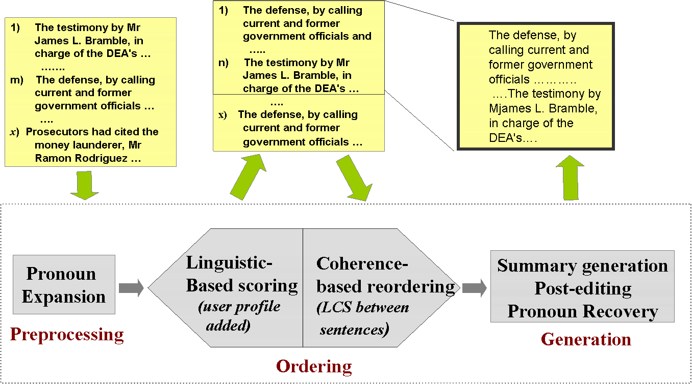
Editor – Data Flow

Slide 23
System Design

Annotate

Synthesize

Edit

Slide 24
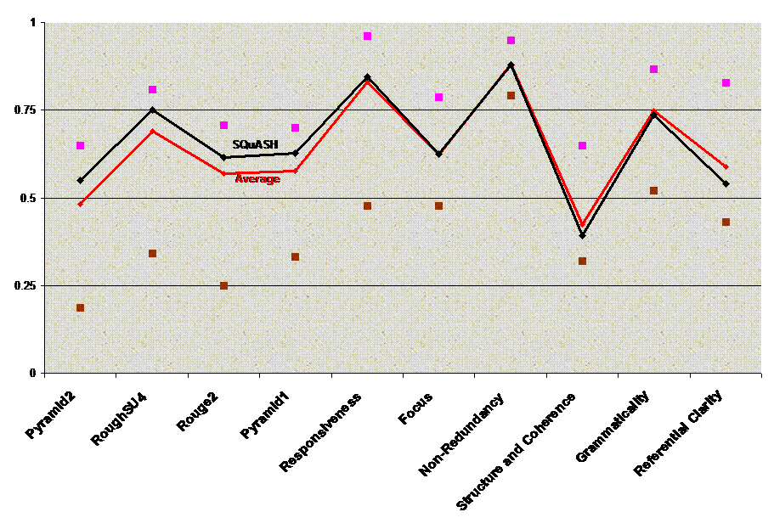
Compared to system’s avg(&min,&max) perf.
Evaluation Results
Point to PDF file

Slide 25
Future Work
Annotator
  NER: Improve accuracy: in single & multi-doc
  SRL: Improve accuracy (e.g. use off-line approach)
Synthesizer
  Optimize parameters (e.g. with machine learning).
Editor
  Optmize parameters (e.g. with machine learning).
  Improve referential resolution
Evaluation
  More of it. (e.g. each component’s contribution)

Slide 26
References
B. Carpenter, B. Baldwin. 2005. “Lingpipe named-entity recognizer and corefencer" v1.0.7, http://www.alias-i.com/lingpipe
E. Charniak. 2000. “A maximum-entropy-inspired parser”, NAACL
D. Gildea and D. Jurafsky. 2002. Automatic labeling of semantic roles”. Computational Linguistics, 28(3):245-288
J. Leskovec, J. Stefan and N. Milic-Frayling. 2004. “Learning Sub-structures of Document Semantic Graphs for Document Summarization”, LinkKDD Workshop
I. Mani and E. Bloedorn, 1997. “Multi-Document Summarization by Graph Search and Matching”, AAAI
M. Palmer, D. Gildea, and P. Kingsbury. 2005. “The Proposition Bank”. Computational Linguistics, 31(1).

