Slide 1
Faculty Of Applied Science Simon Fraser University
Cmpt 825 presentation
Corpus Based PP Attachment Ambiguity Resolution with a Semantic Dictionary
Jiri Stetina, Makoto Nagao
Presented by:
Xianghua Jiang

Slide 2
Agenda
Introduction
  PP-Attachment & Word Sense Ambiguity
Word Sense Disambiguation
PP-Attachment
  Decision Tree Induction, Classification
Evaluation and Experimental Result
Conclusion and Future Work

Slide 3
PP-Attachment Ambiguous
Problem: ambiguous prepositional phrase attachment
  Buy books for money
    adverbial attach to the verb buy
  Buy books for children
    adjectival attach to the object noun book
    adverbial attach to the verb buy

Slide 4
PP-Attachment Ambiguous
Backed–off model (Collins and Brooks in [C&B95])
  Overall accuracy: 84.5%
  Accuracy of full quadruple matches : 92.6%
  Accuracy for a match on three words : 90.1%
Increase the percentage of full quadruple and triple matches by employing the semantic distance measure instead of word-string matching.

Slide 5
PP-Attachment Ambiguous
Example
  Buy books for children
  Buy magazines for children
  2 sentences should be matched due to small
  conceptual distance between books and magazines.

Slide 6
PP-Attachment Ambiguous
2 Problems
  What is unknown is the limit distance for two concepts to be matched.
  Most of the words are semantically ambiguous and unless disambiguated, it is difficult to establish distances between them.

Slide 7
Word Sense Ambiguous
Why?
  Because we want to match two different words based on their semantic distance.
  In order to determine the position of a word in the semantic hierarchy, we have to determine the sense of the word from the context in which it appears.

Slide 8
Semantic Hierarchy
Semantic hierarchy
  The hierarchy for semantic matching is the semantic network of WordNet.
  Nouns are organized as 11 topical hierarchies, where each root represents the most general concept for each topic.
  Verbs are formed into 15 groups and have altogether 337 possible roots.

Slide 9
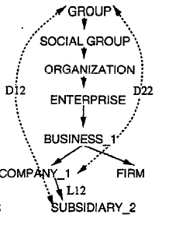
Semantic Distance
Semantic Distance
D = ½ (L1/D1 + L2/D2)
  L1, L2 are the lengths of paths between the concepts and the nearest common ancestor
  D1, D2 are the depths of each concept in the hierarchy

Slide 10
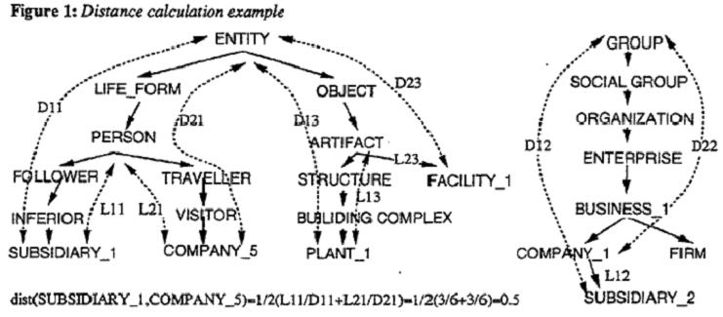
Semantic Distance 2

Slide 11
Word Sense Disambiguation
Reason of the Word Sense Disambiguation
  Disambiguated senses PP Attachment Resolution

Slide 12
Word Sense Disambiguation Algorithm
1 From the training corpus, extract all the sentences which contain a prepositional phrase with a verb-object-preposition-description quadruple. Mark each quadruple with the corresponding PP attachment

Slide 13
Word Sense Disambiguation Algorithm 2
2 Set the Similarity Distance Threshold SDT = 0
  SDT : define the limit matching distance between two quadruples.
  We say two quadruples are similar, if their distance is less or equal to the current SDT
  The matching distance between two quadruples Q1 = v1-n1-p-d1 and Q2 = v2-n2-p-d2 is defined as follows:
  1 Dqv(Q1, Q2) = (D(v1, v2)^2)+D(n1,n2)+D(d1,d2))/P
  2 Dqn(Q1, Q2 = (D(v1,v2)+D(n1,n2)^2+D(d1,d2))/P
  3 Dqd(Q1, Q2) = (D(v1,v2)+D(n1,n2)+D(d1,d2)^2)/P
  P is the number of pairs of words in the quadruples
  which have a common semantic ancestor.

Slide 14
Word Sense Disambiguation Algorithm 3
3 Repeat
  For each quadruple Q in the training set:
    For each ambiguous word in the quadruple:
      Among the remaining quadruples find a set S of similar quadruples
      For each non-empty set S:
        Choose the nearest similar quadruple from the set S
        Disambiguate the ambiguous word to the nearest sense of the corresponding word of the chosen nearest quadruple
  increase the Similarity Distance Threshold SDT=SDT + 0.1
  Until all the quadruples are disambiguated or SDT = 3

Slide 15
Word Sense Disambiguation Algorithm 4
Example:
  Q1. Shut plant for week
  Q2. Buy company for million
  Q3. Acquire business for million
  Q4. Purchase company for million
  Q5. Shut facility for inspection
  Q6. Acquire subsidiary for million
  SDT = 0 : quadruples with all the words with
  semantic distance = 0.

Slide 16
Word Sense Disambiguation Algorithm 6
Example:
  Q1. Shut plant for week
  Q2. Buy company for million
  Q3. Acquire business for million
  Q4. Purchase company for million
  Q5. Shut facility for inspection
  Q6. Acquire subsidiary for million
  SDT = 0.0
  Min(dis(buy,purchase)) = dist(BUY-1,PURCHASE-1)=0.0
  Dqv(Q2,Q4) = 0.0
  SDT = 0.1

Slide 17
PP-ATTACHMENT Algorithm
Decision Tree Induction
Classification

Slide 18
PP-ATTACHMENT Algorithm 2
Decision Tree Induction
  Algorithm uses the concepts of the WordNet hierarchy as attribute values and create the decision tree.
Classification

Slide 19
Decision Tree Induction
Let T be a training set of classified quadruples.
1. If all the examples in T are of the same PP attachment type then the result is a leaf labeled with this type,
Else
2. Select the most informative attribute A among verb, noun and description
3. For each possible value Aw of the selected attribute A construct recursively a subtree Sw calling the same algorithm on a set of quadruples for which A belongs to the same WordNet class as Aw.
4. Return a tree whose root is A and whose subtrees are Sw and links between A and Sw are labelled Aw.

Slide 20
Decision Tree Induction 2
Most Informative attribute is the one which splits the set T into the most homogenous subsets.
  The attribute with the lowest overall heterogeneity is selected for the decision tree expansion.
  Conditional Probabilities of Adverbial
  Conditional Probabilities of Adjectival

Slide 21
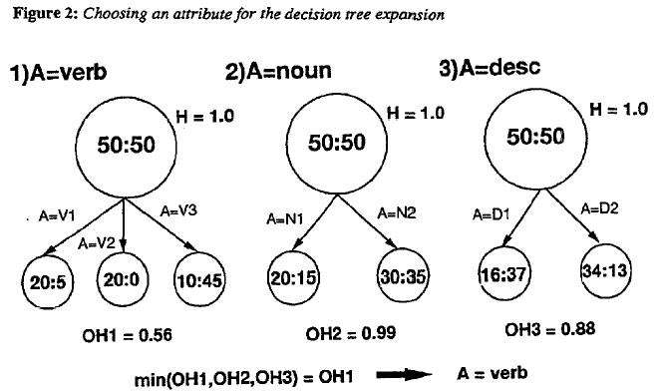
Decision Tree Induction 3

Slide 22
Decision Tree Induction 4
At first, all the training examples are split into subsets which correspond to the topmost concepts of WordNet.
Each subset is further split by the attribute which provides less heterogeneous splitting.

Slide 23
PP-ATTACHMENT Algorithm 4
Classification
  Then a path is traversed in the decision tree, starting at its root and ending at a leaf.
  The quadruple is assigned the attachment type associated with the leaf, i.e. adjectival or adverbial.

Slide 24
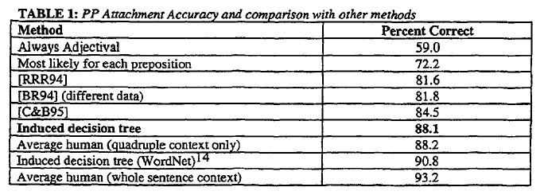
Evaluation And Experimental Result

Slide 25
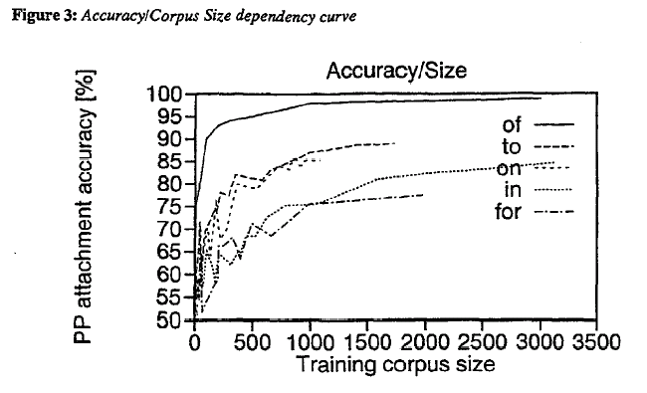
Evaluation And Experimental Result

Slide 26
Conclusion and Future Work
Word sense disambiguation can be accompanied by PP attachment resolution, and they complement each other.
The most computationally expensive part of the system is the word sense disambiguation of the training corpus.
There is still a space for improvement, more training data and/or more accurate sense disambiguation.

Slide 27
Thank you!

