Slide 1
Topic : algorithms on FSA
-- M.Mohri,on some applications of Finite-state automata theory to natural language processing. Natural Language Eng 1 (1996)
---Determinization of transducer
---Indexation with automata

Slide 2
Motivation
Consideration of time and space efficiency
Time efficiency is usually achieved by deterministic automata
Space efficiency is achieved by classic minimization algorithms for deterministic automata
Applications such as large scale dictionary compilation have shown deterministic transducer to be very efficient in practice.
Indexation of natural language texts

Slide 3
Determinization of Transducer
Concepts and Notations
Main Idea
Example

Slide 4
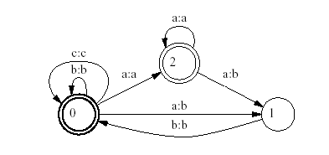
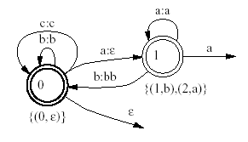
Concepts and Notations--transducer

Slide 5
Concepts and Notations(cont.)
^ (x,y)--Longest common prefix of two strings x and y
eg: ^ (a,b)=ε, ^ (aa,a)=a, ^ (ab,εb)= ε
x⁻¹(xy)--the string y obtained by dividing (xy) at left by x
eg: a⁻¹(ab)=b, (bb)⁻¹(εbb)= ε
Q--the queue to maintain the set of states of the resulting transducer T₂

Slide 6
Main Idea
New state---Set of (state,output) pairs
_:a b:c b:?
{(1,a),..}
New output---Greatest common output
{(1,a),..}
1

Slide 7
Example—step1:initial state
T1:
T2:
{(0, ε)}
Final state:∅
Initial state:{(0,ε)}
Q:{(0, ε)}
0

Slide 8
Determinization-step2:final state
T1:
T2:
ε
{(0, ε)} {(0, ε)}
q2: {(0, ε)}
(0, ε) ∈ q2 ,0∈ F1
φ = ε
0
00, )}

Slide 9
Determinization-step3:output & transition
T1:
c:?
T2: b:?
a:?
{(0, ε)}
ε
For each input label of transitions leaving the state of {(0, ε)}:a,b,c
consider respectively:
σ₂ ({(0, ε)},a),δ₂({(0,ε)},a)
σ₂ ({(0, ε)},b),δ₂({(0,ε)},b)
σ₂ ({(0, ε)},c),δ₂({(0,ε)},c)
?
?
0, 
?

Slide 10

Determinization-step4
T1:
c:?
T2: b:?
a: ε
{(0, ε)}
ε {(2,a),(1,b)}
σ₂ ({(0, ε)},a)=ε(^(a,b))=ε
δ₂({(0, ε)},a)= {(2, ε⁻¹ (εa)}
∪{(1, ε⁻¹ (εb)}
={(2,a),(1,b)}
New state! ->Q
σ₂ ( (0, ε),b),δ₂( (0, ε),b)
σ₂ ( (0, ε),c),δ₂( (0, ε),c)
?
?
0, 

Slide 11
Determinization-step5
T1:
c:c
T2:
b:b
a: ε
{(0, ε)}
ε {(2,a),(1,b)}
σ₂ ({(0, ε)},b)= ε(b)= b
δ₂({(0, ε)},b)= {(0, b⁻¹ (εb)}
={(0, ε)}
not a new state!
σ₂ ({(0, ε)},c)= ε(c)= c
δ₂({(0, ε)},c)= {(0, c⁻¹ (εc)}
={(0, ε)}
not a new state!
Q:{(2, a),(1,b)}
0, 

Slide 12
Determinization-step6
T1:
c:c
T2:
b:b
{(0, ε) a: ε a:a
b:bb
ε {(2,a),(1,b)}
a
F2=F2 ∪{(2, a),(1,b)} , φ =a
σ₂({(2, a),(1,b)},a)= a(^(a,b))=a
δ₂({(2, a),(1,b)},a)= {(2, a⁻¹ (aa)),(1, a⁻¹ (ab)}
= {(2, a)),(1, b)}
not a new state!
σ₂ ({(2, a),(1,b)},b)= b(b)=bb
δ₂({(2, a),(1,b)},b)
= {(0, (bb)⁻¹ bb)}
={(0, ε)}
not a new state!
Q empty-- done!
0, 

Slide 13
summary
Time efficiency
Not all transducers can be determinized
Extension:p-subsequential
Notes:
Critically depends on the hashing method used to determineif the state defined is new.all other operations are less time consuming. P13

Slide 14
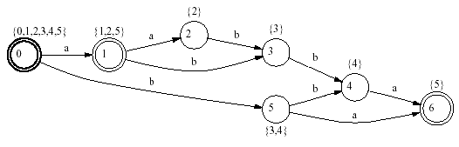
Indexation with automata
States with positions’ lists
Each list corresponds to the set of ending positions of any word reaching this state when read from the initial state
Eg :aabba

Slide 15
a a b b a
art p
init p a p a p b p b p a p
b P b a
b
b
l=0 l=1 l=2 3:l=3 l=4 l=5
s0=art s1=init s2=1 s3=init s4=r s5=1
s3=r list=4 list=5
list=1 list=2 list=3
list=1,2 r:
list=1,2,5 list=3,4
sr=init
lr=1
0
1
2
3
4
5
r

Slide 16
summary
The automaton constructed this way is the minimal automaton recognizing the set of suffixes of a given text (Blumer et al.1987)
Time efficiency:quadratic
Deterministic automaton

Slide 17
Questions?
Thanks!

