Slide 1
Head-Driven Statistical Models for Natural Language Parsing
CMPT 825 Presentation
Author: Michael Collins
Speaker: Zhongmin Shi

Slide 2
Road Map
Head-Driven Lexicalized PCFGs
Three parsing models
Some refinements
Experiment Results
Conclusions

Slide 3
Head-Driven Lexicalized PCFGs
Motivation
  “saw, man, with, telescope” => Noun or Verb-attach
Lexicalization
  Associate lexical information with each non-terminal X
    X(w, t) -w: head word
        - t: POS tag of w
  Head: central constituent determines syntactic character
    I saw a man.
    With a large telescope
Method | Accuracy
Normal PCFG | Depends POS tag distributions
Always noun-attach | 59%
P(noun-attach | saw, man, with, telescope) | 84.1%

Slide 4
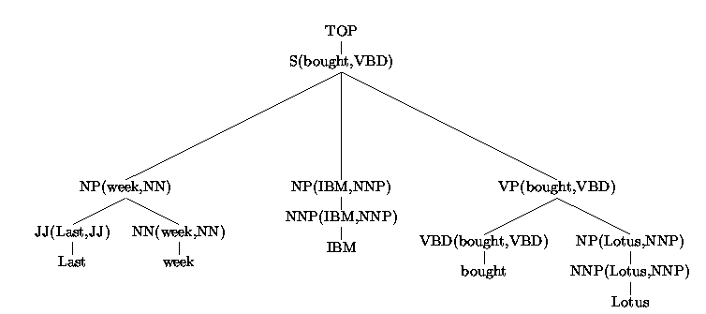
Head-Driven Lexicalized PCFGs: example
Internal rule: VP(bought, VBD) -> VBD(bought, VBD) NP(Lotus, NNP)
Lexical rule: VBD(bought, VBD) -> bought
Probability of S(bought, VBD) -> NP(week, NN) NP(IBM, NNP) VP(bought, VBD):
Count(VP(bought, VBD) -> VBD(bought, VBD) NP(lotus, NNP))
Count(VP(bought, VBD) )

Slide 5
(continue)
Problem
  Numerator is very likely to be zero
Possible solutions
  Break RHS of rule into smaller steps
  Independence assumption for each smaller step

Slide 6
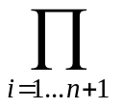
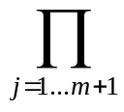
Model 1
Internal rule:
  P(h) -> L_{n}(l_{n})…L₁(l₁)H(h)R₁(r₁)…R_{m}(r_{m})
    Example:
    S(bought, VBD) -> NP(week, NN) NP(IBM, NNP) VP(bought, VBD)
    n = 2 m = 0 P = S H = VP
    L₁ = NP L₂ = NP L₃ = STOP R₁ = STOP
    h = <bought, VBD> l₁ = <IBM, NNP> l₂ = <week, NN>
Lexical rule:
P(h) -> w
Independence assumption
P(L_{n}(l_{n})…L₁(l₁)H(h)R₁(r₁)…R_{m}(r_{m}) | P, h) =
P_{h}(H | P,h) * P_{l}(L_{i}(l_{i}) | P, h, H) * P_{r}(R_{j}(r_{j}) | P, h, H)

Slide 7
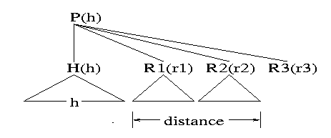
Distance
Reality: modifiers may not be totally independent with each other.
Distance between words is important (collins 1996)
Add distance to the model
  P_{l}(L_{i}(l_{i}) | P, h, H, distance_{l}(i –1))
  P_{r}(R_{j}(r_{j}) | P, h, H, distance_{r}(j –1))
Notes:
A function to all previous modifiers: string length, if includes a verb.

Slide 8
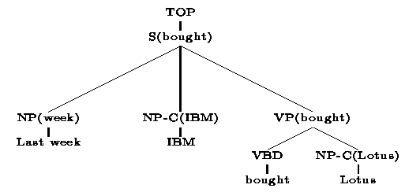
Complement/adjunct distinction
Problem: no distinction between complement and adjunct.
Solution: attach a -C suffix to non-terminals following some pre-defined conditions.
Notes:
Complement/adjunct: Obligatory/optional

Slide 9
Subcategorization Frames
Problem:
  Complements/adjuncts may not be independent
Solution:
  Models include a probabilistic choice of left and right subcat frames.
    LC: set of left subcat frames
    RC: set of right subcat frames.
    P_{lc}(LC | P, H, h)
    P_{rc}(RC | P, H, h)
    P_{l}(L_{i}(l_{i}) | H, P, h, distance_{l}(i-1), LC)
    P_{l}(R_{j}(r_{j}) | H, P, h, distance_{r}(j-1), RC)
Notes:
Models consider all words in left/right subcat frame as a whole, I.e., dependent.

Slide 10
Traces
Wh-movement
  Eamples: The store that (TRACE) bought Lotus.
  The store that IBM bought (TRACE).
  The store that IBM bought Lotus from (TRACE).
Solution:
  Add a gap feature to each non-terminal in the tree
  Propagating gaps through the tree until reaching TRACE

Slide 11
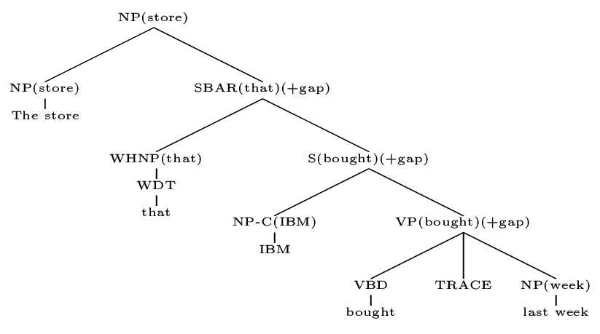
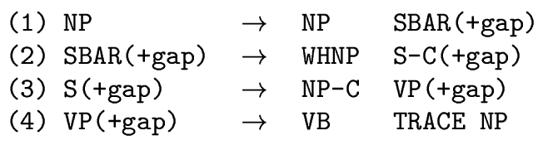
Traces - example

Slide 12
Base-NPs
Boundaries of base-NPs often quite obvious
e.g., the dog
Modification on models:
  Label of base-NPs: NPB
  Different independent assumption:
    If H = NPB, then
    P_{l}((L_{i}(l_{i}) | H, P, h, L₁(l₁) …L_{i-1}(l_{i-1}) ) = P_{l}((L_{i}(l_{i}) | P, L_{i-1}(l_{i-1}) )

Slide 13
Coordination
Problem:
  Independence assumptions fail to learn there is exactly 1 phrase following the coordination(CC)
Solution:
  Associate a coord flag with each non-terminal
  Coord = 1 indicates the coordination relationship and triggers a generation of coordinator tag/word pair.
  e.g., NP(man) -> NP(man) CC(and)NP(dog)

Slide 14
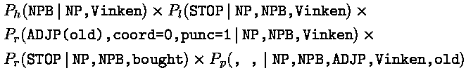
Punctuation
Current parsing models fail to generate comma and colon.
Solution: same as that for coordination
  e.g., NP(Vinken) -> NPB(Vinken), (,), ADJP(old)

Slide 15
Empty Subjects
Problem
  E.g., Flying planes is dangerous.
  P_{lc} ({NP-C} | S, VP, verb) is fairly high
Solution
  A new label, SG, to non-terminal without subject
  P_{lc} ({NP-C} | SG, VP, verb) is very low

Slide 16
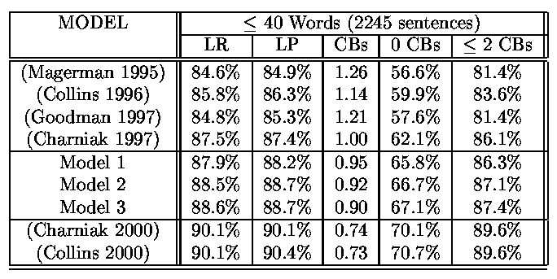
Results
LR: Label Recall LP: Label Precision
CB: Crossing Brackets, number of constituents which violate constituent boundaries with a constituent in the treebank parse.

Slide 17
Conclusion
Parsing models are feasible and plausible by decomposing parse trees into smaller steps
Derivation and independence assumption are carefully chosen
Working well with a number of linguistic phenomena
  Word distance
  Complement/adjunct distinction
  Subcategorization frames
  Traces
  Base-NPs
  Coordination, punctuation
  Empty subject

