Slide 1
Re-ranking for NP-Chunking:
Maximum-Entropy Framework
By: Mona Vajihollahi

Slide 2
Agenda
Background
Training approach
Reranking
Results
Conclusion
Future Directions
Comparison: VP, MaxEnt and Baseline
Application

Slide 3
Background
MRF framework was previously used in re-ranking for natural language parsing
MRF can be viewed in terms of principle of maximum entropy
It was found to be “too inefficient to run on the full data set”
The experiment was not completed
No final results on the performance is provided

Slide 4
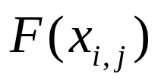
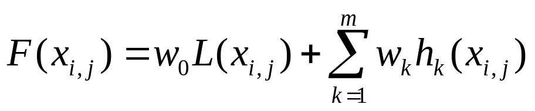
Training Approach ⁽¹⁾
Goal: Learning a ranking function
  x_{i,j} : The j’th chunking candidate for the i’th sentence
  L(x_{i,j}): Log-probability that the base chunking model assigns to x_{i,j}
  h_{k}(x_{i,j}): A function specifying the existence of feature f_{k} in x_{i,j}
  w_{k}: A parameter corresponding to weight of each feature f_{k}
  x_{i,1} :The candidate with the highest golden score
We need to find parameters of the model, w_{k}’s, such that it leads to good scores on test data

Slide 5
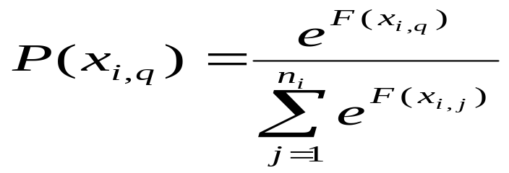
Training Approach ⁽²⁾
How to find a good parameter setting?
Try to minimize number of ranking errors F makes on the training data
Ranking error: a candidate with lower golden score is ranked above the best candidate
Maximize Likelihood of the golden candidates
Log-Linear Model:
  The probabilty of x_{i,j} being the correct chunking for the i’th sentence is defined as:
Use Maximum Entropy framework to estimate probability distribution

Slide 6
Training Approach ⁽³⁾
First approach, Feature Selection
  Goal: Find a small subset of features that contribute most to maximizing the likelihood of training data
  Greedily pick the feature with additive weight, δ, which has the most impact in maximizing likelihood
The complexity is O(TNFC), where
    T: number of iterations (number of selected features)
    N: number of sentences in the training set
    F: number of features
    C: number of iterations needed for convergence of the weight of each feature
Finding the feature/weight pair with the highest gain, is too expensive

Slide 7
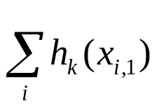
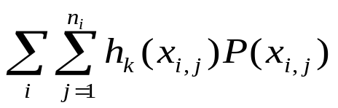
Training Approach ⁽⁴⁾
Second approach, forget about gain, just use GIS
  w₀ =1 and w₀ …w_{m} =0
  For each feature f_{k} , expected[k] is the number of times that feature k is seen in the best chunking:
  For each feature f_{k}, observed[k] is the number of times that feature k is seen under the model:
  For each feature f_{k}
    w_{k} = w_{k} + log(observed[k]/expected[k])
  Repeat steps 2-4 until convergence

Slide 8
Training Approach⁽⁵⁾
Instead of updating just one weight in each pass over the training data, all the weights are updated
The procedure can be repeated until a fixed number of iterations or until no significant change in log-likelihood happens
Experiment showed that convergence is achieved after about 100 rounds
First method might lead to better performance, but it was too inefficient to be applied!

Slide 9
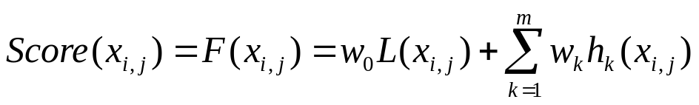
Reranking
The output of the training phase is a weight vector
For each sentence in the test set
  Function specifies the score for each of its candidates
  The candidate with the highest score is the best one

Slide 10
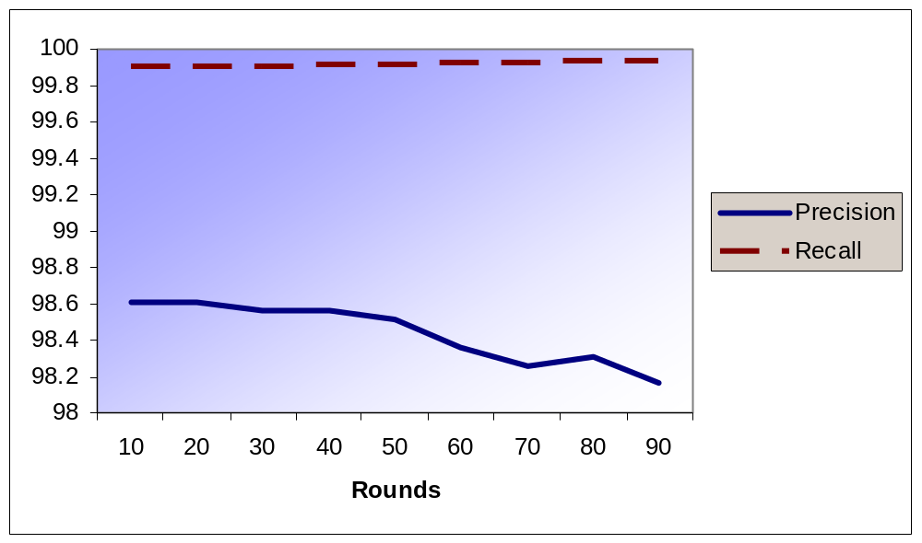
Results ⁽¹⁾
Initial experiment:
  Cut-Off: 10
  (features with less than 10 counts where omitted)
Training is making it WORSE?!

Slide 11
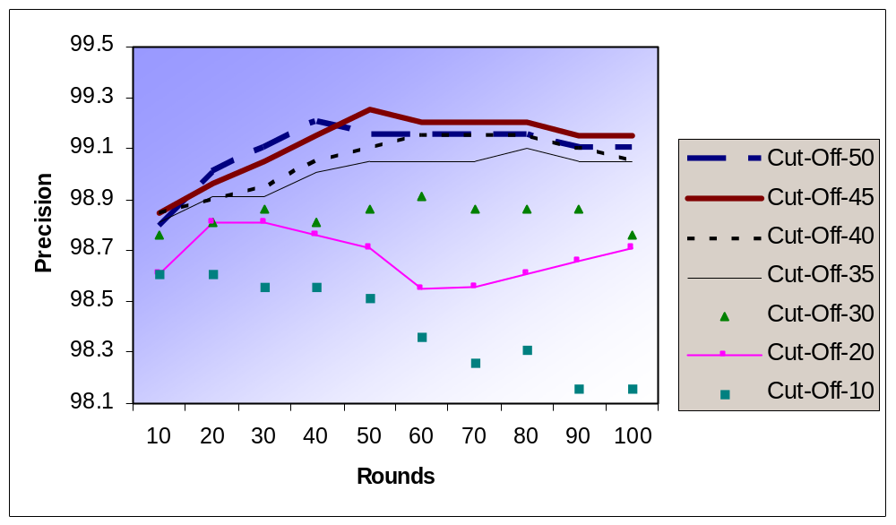
Results ⁽²⁾
Try other cut-offs
Convergence was occurred by round 100
Cut-off 50 is worse than 45

Slide 12
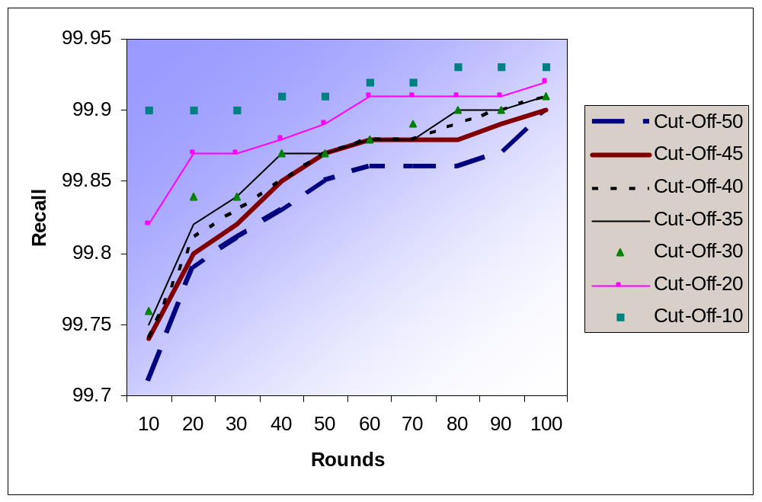
Results ⁽³⁾

Slide 13
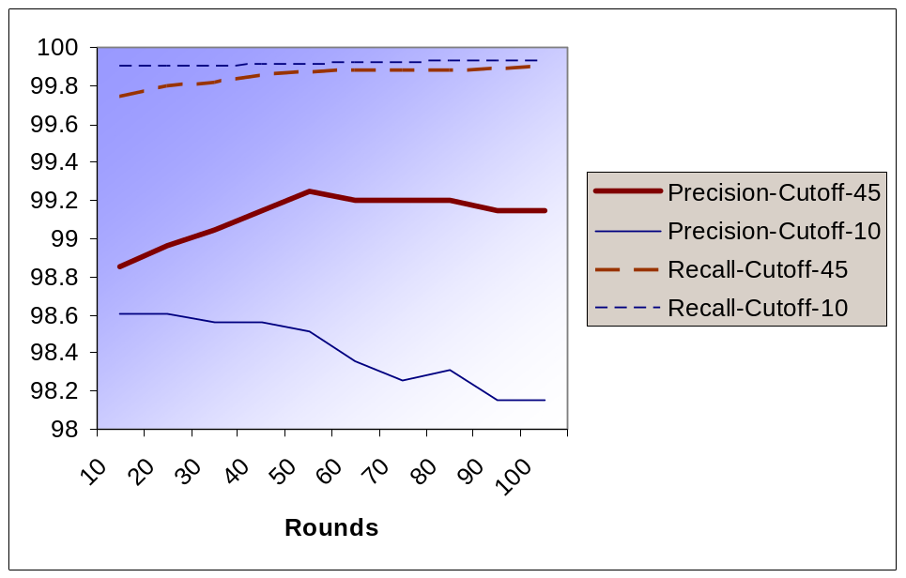
Results ⁽⁴⁾
Why cut-off 45 performs better than 10?
  Feature set is extracted from the training data set
  Features with low counts, are probably the dataset-specific ones
  As training proceeds, rare features become more important!
Label-Bias Problem: The problem happens when some decision is made locally, regardless of global history
Why cut-off 45 is better than 10?

Slide 14
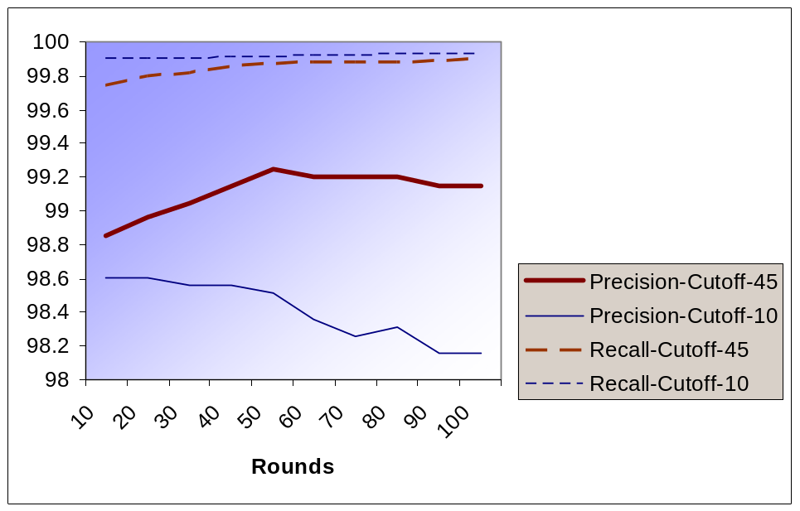
Results ⁽⁵⁾
Training process is supposed to increase the likelihood of the training data
Recall is always increasing
Precision is not!
Overfitting!
Why does the precision decrease?

Slide 15
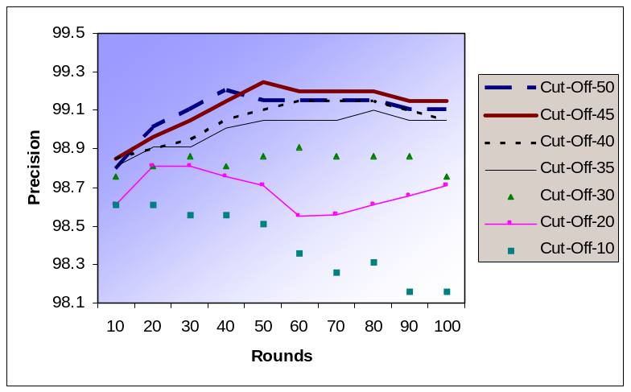
Conclusion
Considering the trade-off between precision and recall, cut-off 45 has the best performance
Cut-Off | Precision | Recall | Num. of Rounds
10 | 98.51 | 99.91 | 50
20 | 98.76 | 99.89 | 40
30 | 98.91 | 99.88 | 60
40 | 99.15 | 99.89 | 80
45 | 99.25 | 99.87 | 50
50 | 99.20 | 99.83 | 40

Slide 16
Future Directions
Expand the template set
  Find more useful feature templates
Try to solve Label Bias problem
  Apply a smoothing method (like applying a discount factor, or Guassian Prior)

Slide 17
Comparison:
VP, MaxEnt, Baseline
Both re-ranking methods performs better than the baseline
MaxEnt
  is more complex
  should solve Label Bias problem
Voted Perceptron
  is a simple algorithm
  achieves better results
 | Precision | Recall
VP | 99.65% | 99.98%
MaxEnt | 99.25% | 99.87%
Base Line | 97.71% | 99.32%
Max. | 99.95% | 100.0%

Slide 18
Applications
Both methods, can be applied to any probabilistic baseline chunker (HMM chunker)
The only restriction:
  Baseline has to produce n-best candidates for each sentence
Same framework can be used for VP-chunking
  Same feature templates are used to extract features for VP-chunking
Higher accuracy in text chunking leads to higher accuracy in the related tasks
  like larger-scale grouping and subunit extraction

Slide 19
Re-ranking for NP-Chunking:
Maximum-Entropy Framework
By: Mona Vajihollahi

