Slide 1
Review of :
Yoav Freund, and Robert E. Schapire,
“A Short Introduction to Boosting”, (1999)
Michael Collins, Discriminative Reranking for Natural Language Parsing,
ICML 2000 by Gabor Melli melli@sfu.ca for CMPT-825 @ SFU
Nov 21, 2003

Slide 2
Presentation Overview
First paper: Boosting
  Example
  AdaBoost algorithm
Second paper: Natural Language Parsing
  Reranking technique overview
  Boosting-based solution

Slide 3
Review of
Yoav Freund, and Robert E. Schapire,
“A Short Introduction to Boosting”, (1999) by Gabor Melli melli@sfu.ca for CMPT-825 @ SFU
Nov 21, 2003

Slide 4
What is Boosting?
A method for improving classifier accuracy
Basic idea:
  Perform iterative search to locate the regions/ examples that are more difficult to predict.
  Thorough each iteration reward accurate predictions on those regions.
  Combines the rules from each iteration.
Only requires that the underlying learning algorithm be better than guessing.

Slide 5
Example of a Good Classifier
+
−
+
+
−
+
−
−
+
−

Slide 6
Round 1 of 3
+
+

−
−
+
+

+
+

−
−
+
−
+
−
−
−
+
+
−
−
h₁
ε₁ = 0.300
α₁=0.424
D₂

Slide 7
Round 2 of 3
+
+
−
−
+
+
+
+
−
−

−
+
−
+

−
−
+
+
−
−

ε₂ = 0.196
α₂=0.704
h₂
D₂

Slide 8
Round 3 of 3
+
−

+
+
−
h₃
−
STOP
+

−
+

−
ε₃ = 0.344
α₂=0.323

Slide 9
Final Hypothesis
0.42
+ 0.70
+ 0.32
H_{final} = sign[ 0.42(h1? 1|-1) + 0.70(h2? 1|-1) + 0.32(h3? 1|-1) ]
+
−
+
+
+
−
−
−
+
−

Slide 10
History of Boosting
"Kearns & Valiant (1989) proved that learners performing only slightly better than random, can be combined to form an arbitrarily good ensemble hypothesis."
Schapire (1990) provided the first polynomial time Boosting algorithm.
Freund (1995) “Boosting a weak learning algorithm by majority”
Freund & Schapire (1995) AdaBoost. Solved many practical problems of boosting algorithms. “Ada” stands for adaptive.

Slide 11

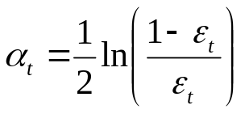
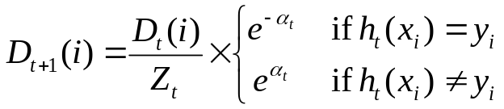
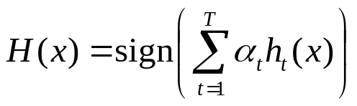
AdaBoost
Given: m examples (x₁, y₁), …, (x_{m}, y_{m}) where x_{i}∈X, y_{i}∈Y={-1, +1}
Initialize D₁(i) = 1/m
The goodness of h_{t} is calculated over D_{t} and the bad guesses.
For t = 1 to T
1. Train learner h_{t} with min error
The weight Adapts. The bigger ε_{t} becomes the smaller α_{t} becomes.
2. Compute the hypothesis weight
3. For each example i = 1 to m
Boost example if incorrectly predicted.
Output
Z_{t} is a normalization factor.
Linear combination of models.

Slide 12
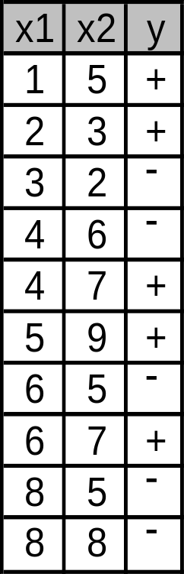
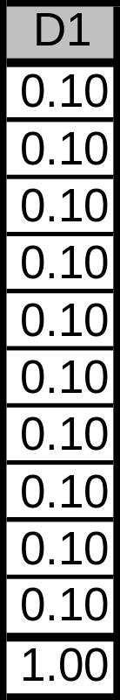
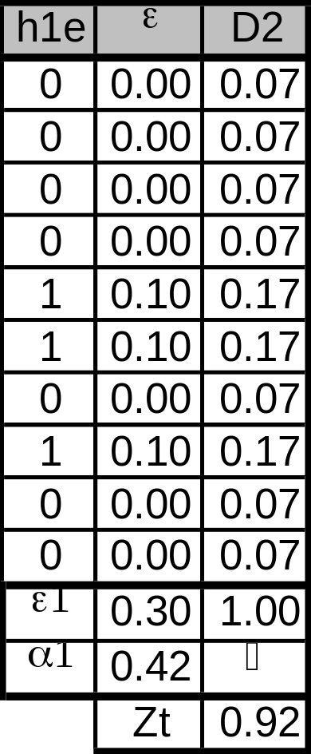
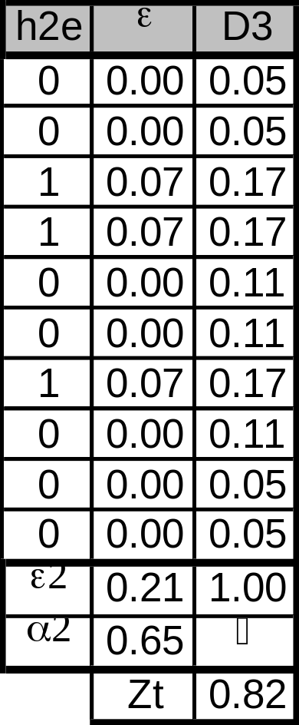
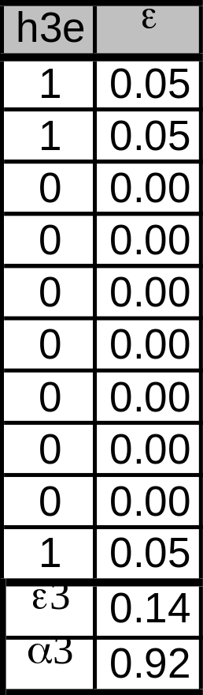
AdaBoost on our Example
Train data
Round 1
Round 2
Round 3
Initialization

Slide 13
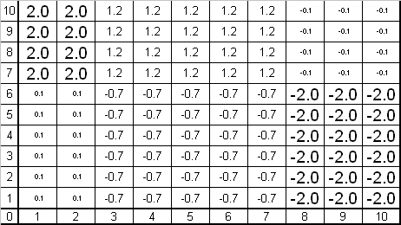
The Example’s Search Space
H_{final} = 0.42(h1? 1|-1) + 0.65(h2? 1|-1) + 0.92(h3? 1|-1)
+
+
-
-
-
+

Slide 14
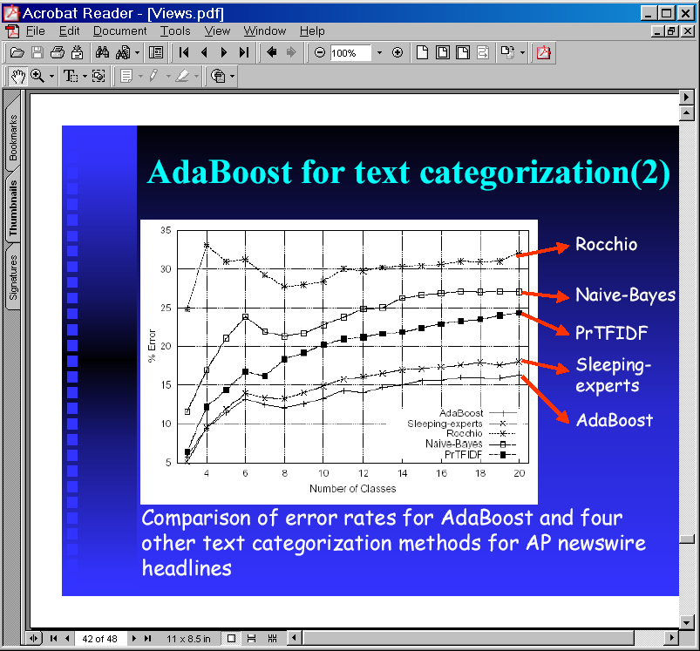
AdaBoost for Text Categ.

Slide 15
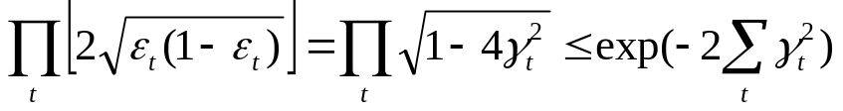
AdaBoost & Training Error Reduction
Most basic theoretical property of AdaBoost is its ability to reduce the training error of the final hypothesis H(). Freund & Schapire(1995)
The better that h_{t} predicts over ‘random’ the faster the training error rate drops – exponentially so.
If error ε_{t} of h_{t} is = ½ - γ_{t}
training error drops exponentially fast

Slide 16
No Overfitting
Curious phenomenon
  For graph “Using <10,000 training examples we fit >2,000,000 parameters”
Expected to overfit
  First bound on generalization error rate implies that overfit may occur as T gets large
Does not
  Empirical results show the generalization error rate still decreasing after the training error has reached zero.
  Resistance explained by “margin” of error. Though,
  Gorve and Schurmans 1998 showed that the margin of error cannot be the explanation

Slide 17
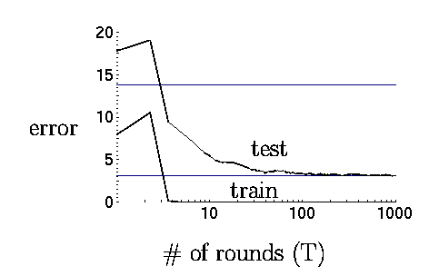
Accuracy Change per Round

Slide 18
Shortcomings
Actual performance of boosting can be:
  dependent on the data and the weak learner
Boosting can fail to perform when:
  Insufficient data
  Overly complex weak hypotheses
  Weak hypotheses which are too weak
Empirically shown to be especially susceptible to noise

Slide 19
Areas of Research
Outliers
  AdaBoost can identify them. In fact can be hurt by them
  “Gentle AdaBoost” and “BrownBoost” de-emphasize outliers
Non-binary Targets
  Continuous-valued Predictions

Slide 20
References
Y.Freund and R.E. Schapire. A short introduction to boosting. Journal of Japanese Society for Artificial Intelligence, 14(5):771-780, September 1999.
Http://www.boosting.org

Slide 21
Margins and boosting
Boosting concentrates on the examples with smallest margins
It is aggressive at increasing the margins
Margins built a strong connection between boosting and SVM, which is known as an explicit attempt to maximize the minimum margin.
See experimental evidence (5, 100, 1000)

Slide 22
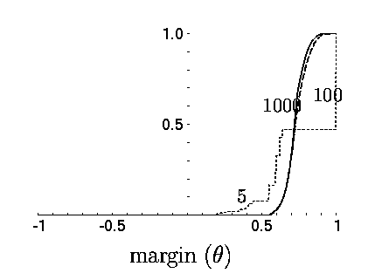
Cumulative Distr. of Margins
Cumulative distribution of margins for the training sample after 5, 100, and 1,000 iterations.

Slide 23
Review of
Michael Collins, Discriminative Reranking for Natural Language Parsing,
ICML 2000. by Gabor Melli melli@sfu.ca for CMPT-825 @ SFU
Nov 21, 2003

Slide 24
Recall The Parsing Problem
Green ideas sleep furiously.
You looking at me?
The blue jays flew.
Can you parse me?
?

Slide 25
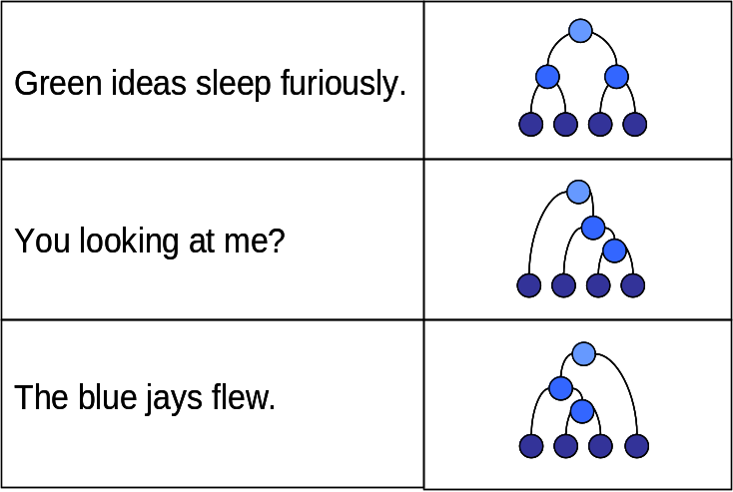
Train a Supervised Learning Alg. Model
Supervised
Learning
Algorithm
G()

Slide 26
Recall Parse Tree Rankings
true
Score()
Q()
“Can you parse this?”
G()
0.65
0.60
0.30
0.90
0.05
0.01

Slide 27
Post-Analyze the G() Parses
rerankScore()
true
Score()
“Can you parse this?”
Q()

0.65
-0.1
0.70
0.90

+0.4
G()
F()
0.30
0.55
0.60
0.05
0.10
0.01

Slide 28


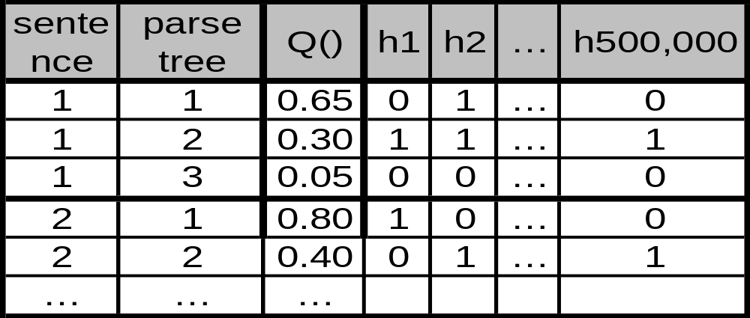
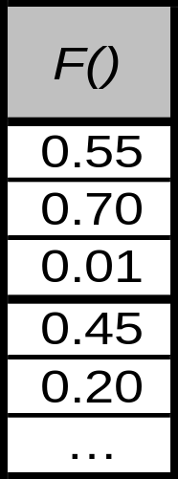
Indicator Functions
1 if x contains the rule <S → NP VP>
0 otherwise
500,000 weak learners!!
AdaBoost was not expecting this many hypotheses.
...
1 if x contains …
0 otherwise
Fortunately, we can precalculate membership.

Slide 29
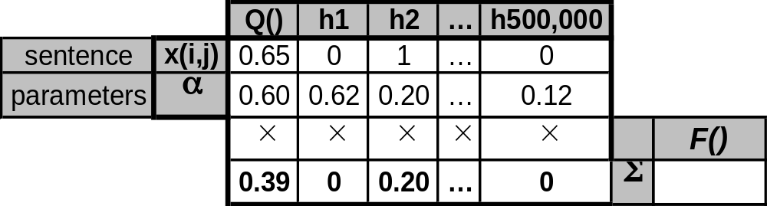
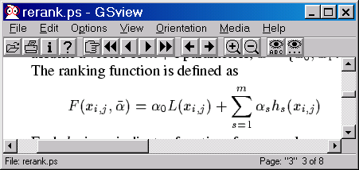
Ranking Function F()
Sample calculation for 1 sentence
How to infer an α that improves ranking accuracy?
0.55
Old rank score
New rank score

Slide 30
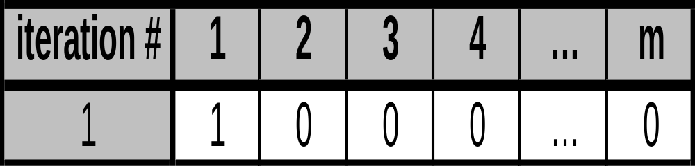
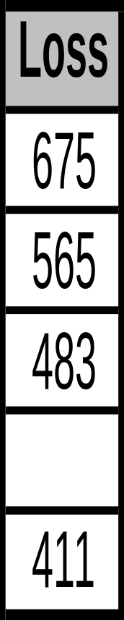
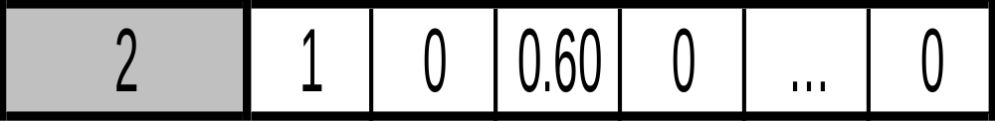
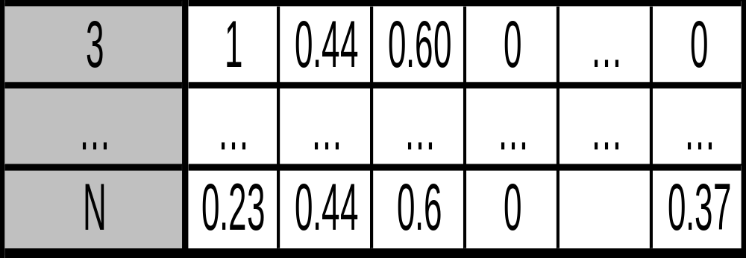
Iterative Feature/Hypothesis Selection
α =
α∗ =

Slide 31
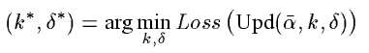
Which feature to update per iteration?
Which k* (and δ∗) to pick?
Upd(α, k_{feature}, δ_{weight}) = Upd(α, k=3, δ=0.60)
The one that minimizes error!
Test every combination of k and δ and test against every sentence.

Slide 32
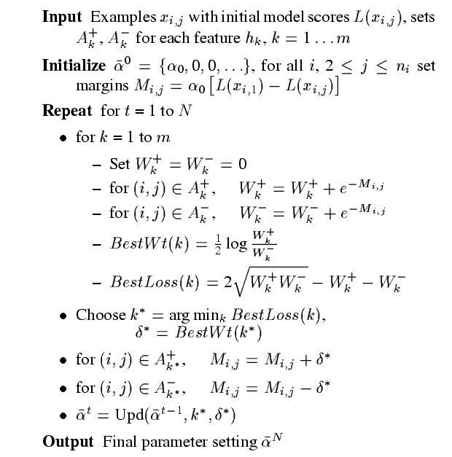
Find the best new hypothesis
Update each example’s weights.
Commit the new hypothesis to the final H.

Slide 33
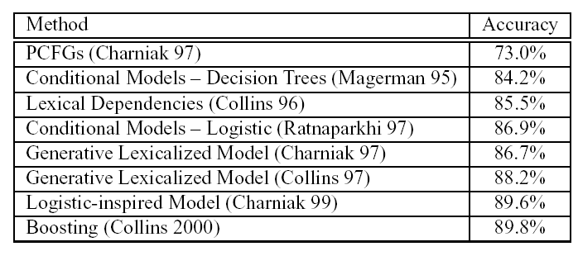
High-Accuracy

Slide 34
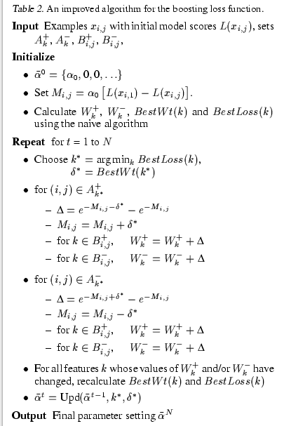
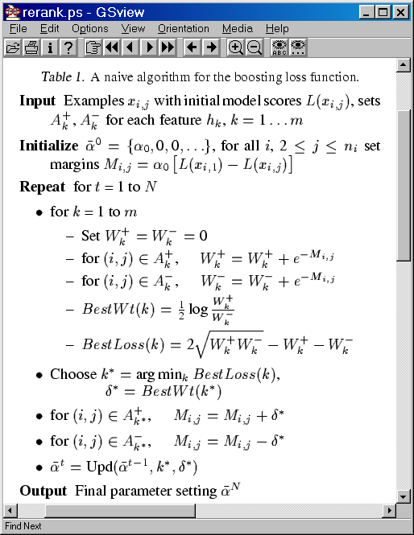
Time consuming to traverse the entire search space.
Take advantage of the data sparcity.
O(m,i,j)
O(m,i,j) w/ smaller constant

Slide 35
References
M. Collins, Discriminative Reranking for Natural Language Parsing, In Machine Learning: Proceedings of the Fifteenth International Conference, ICML, 2000.
Y. Freund, R. Iyer, R.E. Schapire, and Y. Singer. An efficient boosting algorithm for combining preferences. In Machine Learning: Proceedings of the Fifteenth International Conference, ICML, 1998.

Slide 36
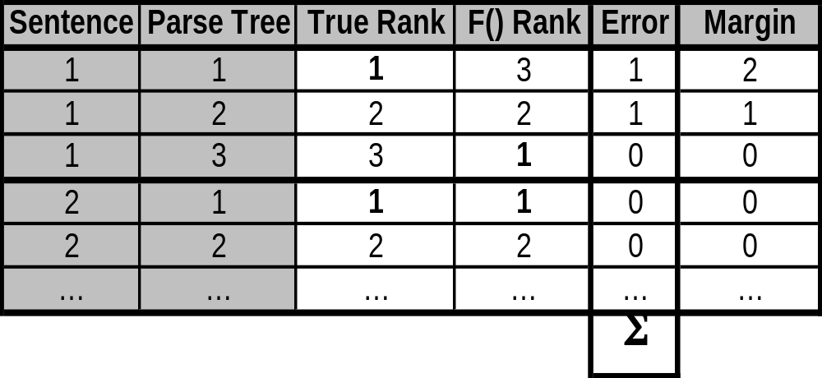
Error Definition
Find the α that minimizes the misranking of the top parse.

