Slide 1

CMPT-825 (Natural Language Processing) Presentation on
Zipf’s Law & Edit distance with extensions
Presented by: Kaustav Mukherjee
School of Computing Science,
Simon Fraser University

Slide 2
Zipf’s Law
f . r = k
“Principle of conservation of effort”
The plotted graph (on logarithmic axes)
does not fit too well for words of high & low
ranks
Implications for NLP – On unseen text,
we cannot hope to find the low frequency
words in our dictionary

Slide 3
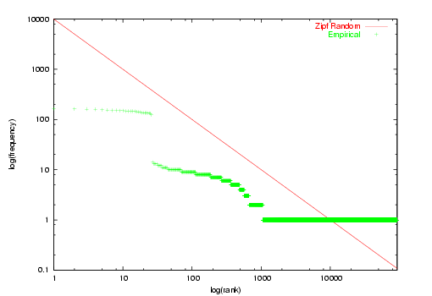
Random Sequences
Any random process does not share the same
property (as Zipf’s Law) as this graph of
randomly generated words depicts

Slide 4
Edit distance
Minimum edit distance : minimum no. of
changes to transform one string into another
Worst case : total number of alignments is
cubic in the size of the dynamic programming
matrix
A special case of the single source shortest
paths problem

Slide 5
Multiple sequences
An extension – using an alignment between
string A and string B and one between string
B and string C, find one between A and C
G A M B L E
| | |
G U M B _ O
| | |
J I M B O

Slide 6
Edit distance over automata
Definition of edit distance extended to
measure similarity between two sets of strings
This value is the minimum of the edit distance
between any two strings, one in each set
In some applications (speech recognition,
Computational Biology…), strings may
represent range of alternative hypothesis with
associated probabilities given as a weighted
automaton

Slide 7
Edit distance over automata(contd.)
Weighted automaton (transducer M) : same
as a finite automaton with a weight element
on each transition
If for any string x there is at most one
successful path labelled with x then M is
unambiguous & M computes a function

Slide 8
Edit distance over trees
Why trees ?
Trees generalize strings in a very direct sense
We can think of a string as an ordered tree
Can the string edit problem be used to
efficiently solve the tree edit problem ?
…open problem
(for unordered trees, editing problem is
NP-hard)

Slide 9
Edit operations and edit distance
Changing a node (n) : changing label on n
Deleting a node : making children of n the
children of the parent of n & removing n
Inserting a node : complement of deletion.
inserting n as the child of m will make n the
parent of a consecutive subsequence of the
current children of m

Slide 10
Tree edit distance computation
7
f
7
f
4
c
6
e
4
d
6
e
3
d
5
h
1
c
5
g
a
3
1
a
2
b
2
b
Total cost of edit operation is the sum of the
costs of individual edit operations

Slide 11
Applications
NLP : comparison of parse trees
NLP : Comparison of structured documents
based on tree edit distance
Biology : Determining functionality of RNA
secondary structures depends on their
topology, hence topology comparison

Slide 12
References
Approximate tree matching : Sasha & Zhang
Edit distance of weighted automata : Mohri
Foundations of statistical NLP : Manning &
Schütze

