Slide 1
Xformations
Statistical Natural Language Processing
Presented by : Charu Jain

Slide 2
Motivation
Language Learning, a Generalization problem
Bayes’ theorem : P(Θ).P(D/ Θ)
Size of the Lexicon
Extract higher level generalizations from D, hypothesize for unseen lexical entries.
Generalizations are Transformational.

Slide 3
Parsing
Probabilistic parsing requires a lexicon that specifies each word's syntactic preferences in terms of probabilities. To estimate these probabilities for words that were poorly observed during training, we may assume the existence of arbitrarily powerful transformations (also known to linguists as lexical redundancy rules or metarules) that can add, delete, retype or reorder the argument and adjunct positions specified by a lexical entry.

Slide 4
Transformation Graph
PCFGs, Independence Assumption
Vertices – Lexical Entries
Arcs – Linguistically possible transformations, single edits and generation of lexical entries (if from Start).
Weights

Slide 5
Weights
Exception Weight
Generalization Weight
Narrower generalization Weight
Transformationally related rules have related probabilities that rise and fall toghether.

Slide 6
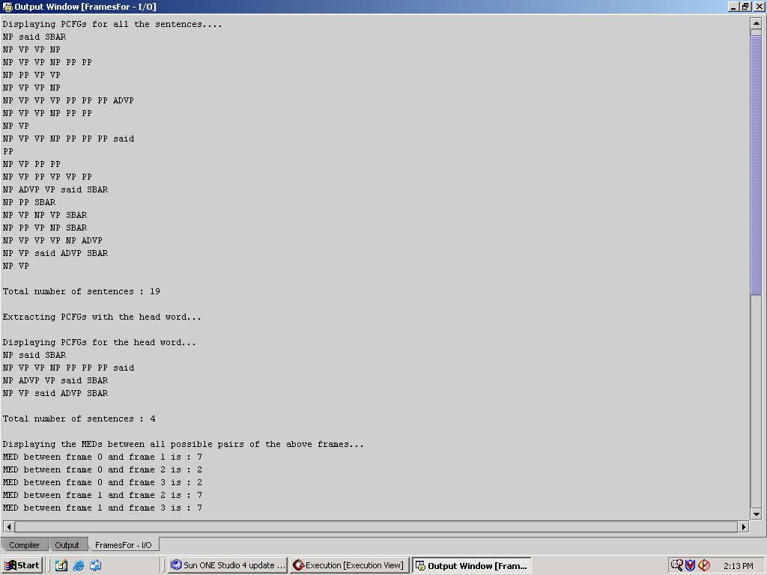

Slide 7
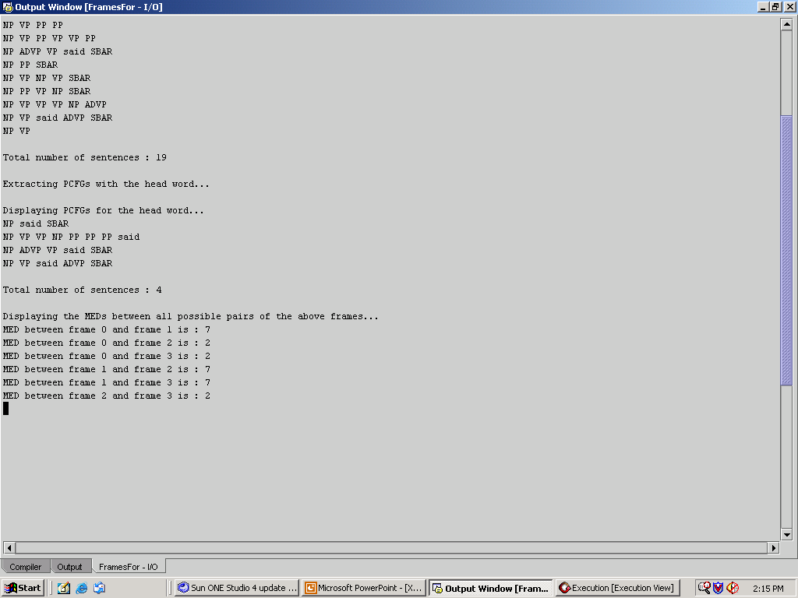

Slide 8
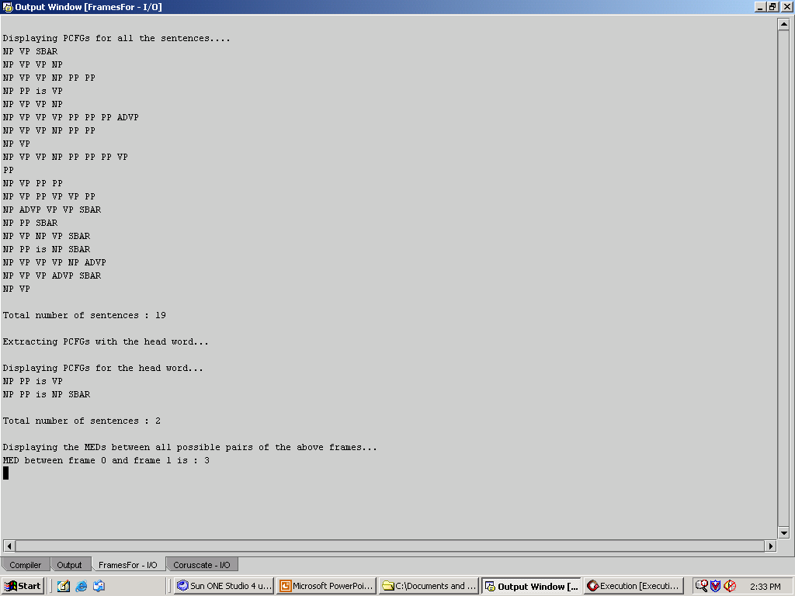

Slide 9
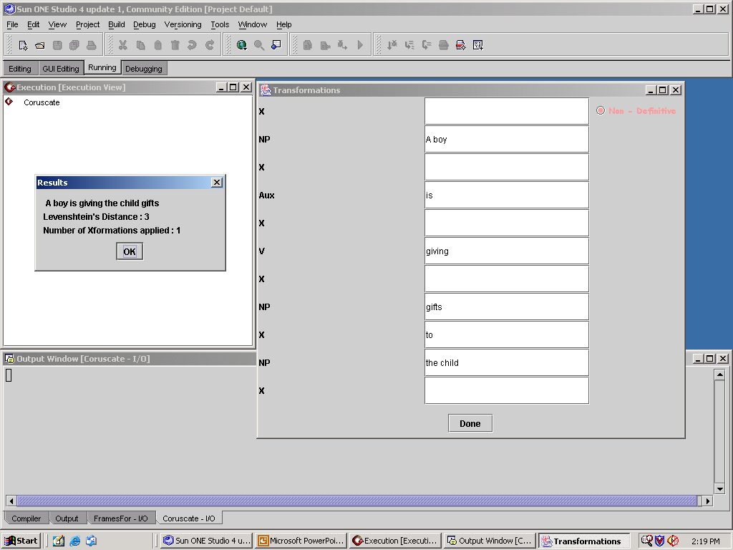

Slide 10
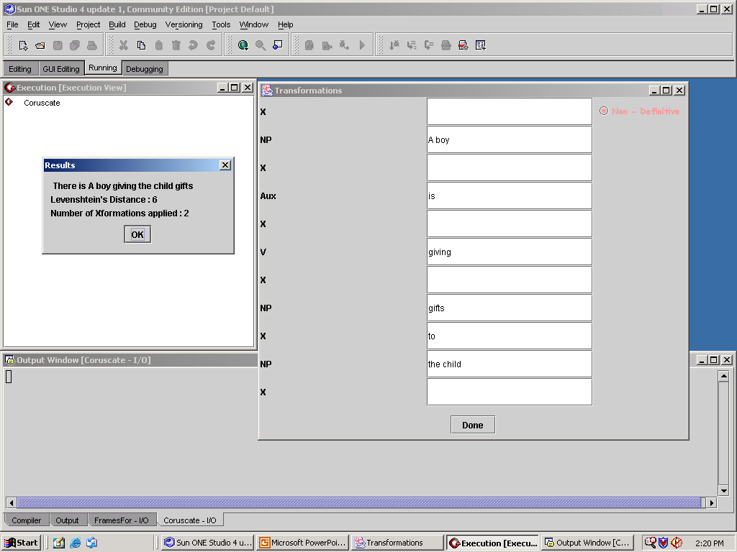

Slide 11


Slide 12
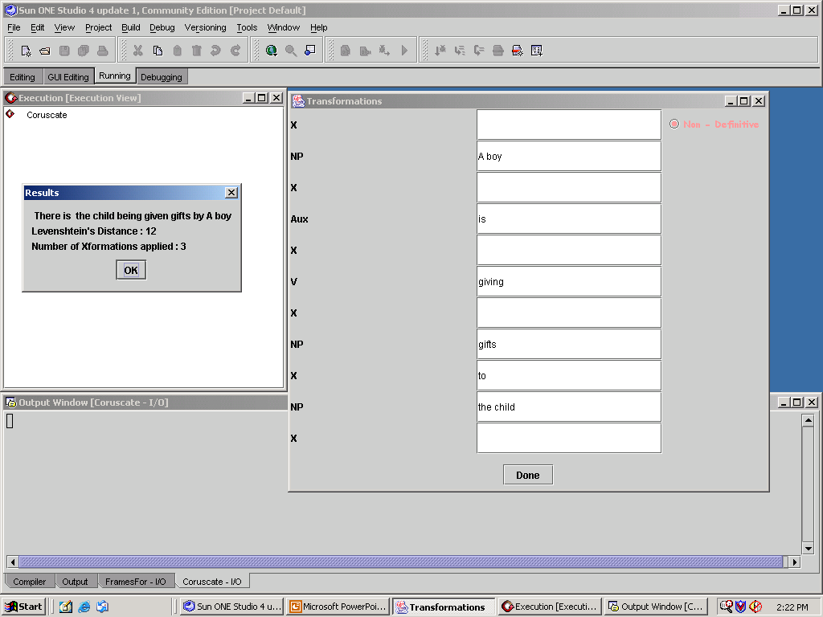

Slide 13
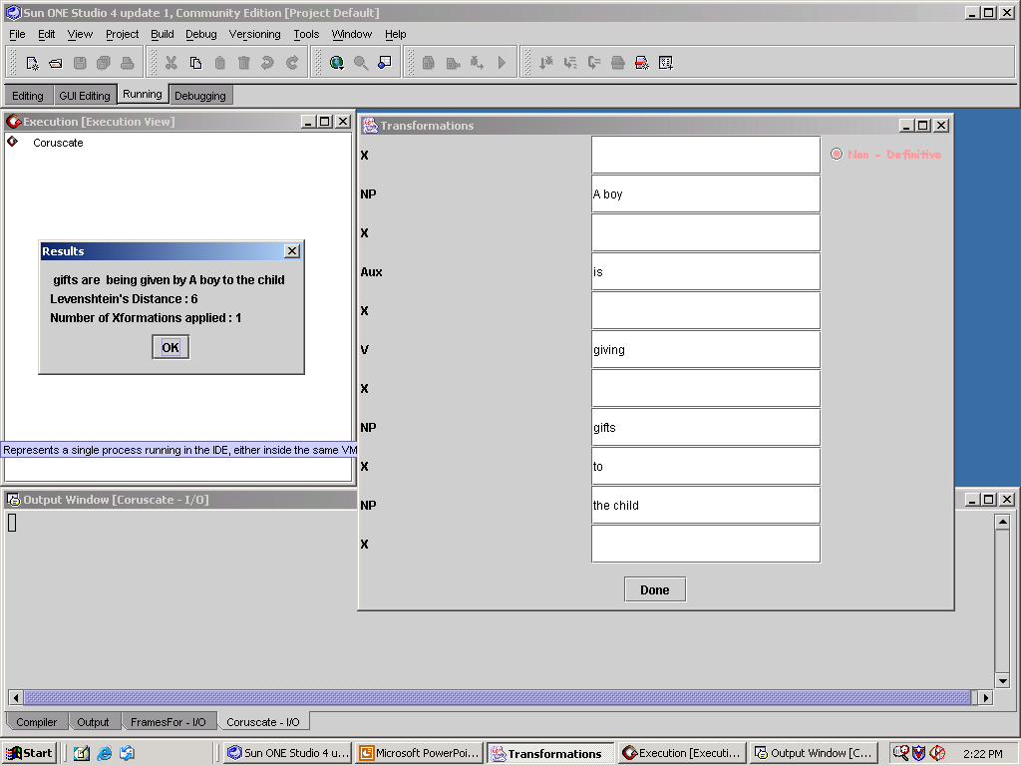

Slide 14


Slide 15
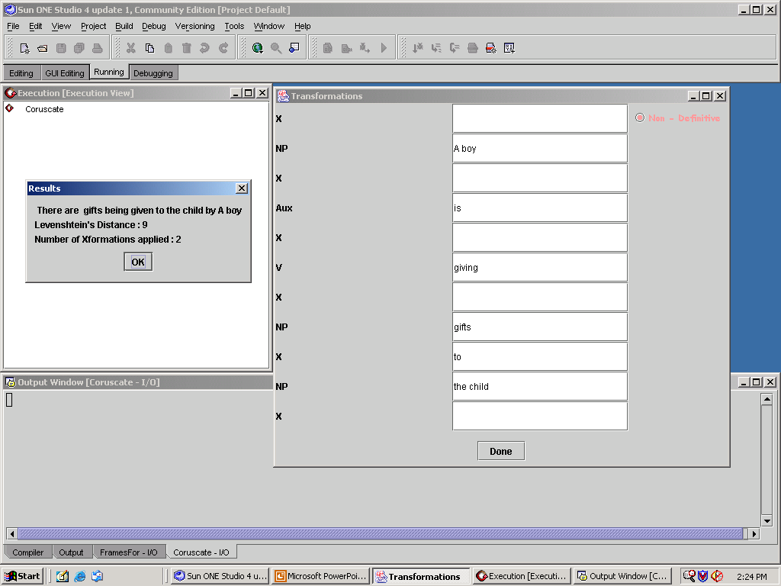

Slide 16


