Slide 1
Tagging with Hidden Markov Models
CMPT 882 Final Project
Chris Demwell
Simon Fraser University

Slide 2
The Tagging Task
Identification of the part of speech of each word of a corpus
Supervised: Training corpus provided consisting of correctly tagged text
Unsupervised: Uses only plain text

Slide 3
Hidden Markov Models 1
Observable states (corpus text) generated by hidden states (tags)
Generative model

Slide 4
Hidden Markov Models 2
Model: λ = {A, B, π}
A: State transition probability matrix
  a_{i,j} = probability of changing from state i to state j
B: Emission probability matrix
  b_{j,k} = probability that word at location k is associated with tag j
π: Intial state probability
  π_{i} = probability of starting in state i

Slide 5
Hidden Markov Models 3
Terms in this presentation
  N: Number of hidden states in each column (distinct tags)
  T: Number of columns in trellis (time ticks)
  M: Number of symbols (distinct words)
  O: The observation (the untagged text)
  b_{j}(t): The probability of emitting the symbol found at tick t, given state j
  α_{t,j} and β_{t,j} : The probability of arriving at state i in time tick t, given the observation before and after tick t (respectively)

Slide 6
Hidden Markov Models 4
a_{1,1}
π₁
b_{1,1}
a_{1,2}
π₂
b_{1,2}
A is a NxN matrix
B is a NxT matrix
π is a vector of size N

Slide 7
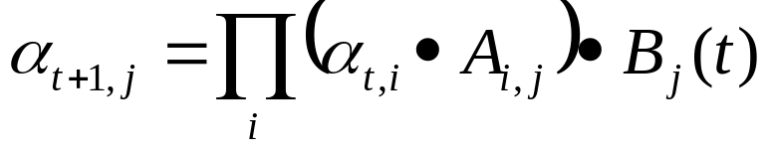
Forward Algorithm
Used for calculating Likelihood quickly
α_{t,i}: The probability of arriving at trellis node (t,j) given the observation seen “so far”.
Initialization
  α_{1,i} = π_{i}
Induction
α_{1,1}
α_{1,2}
α_{2,2}
α_{1,3}

Slide 8
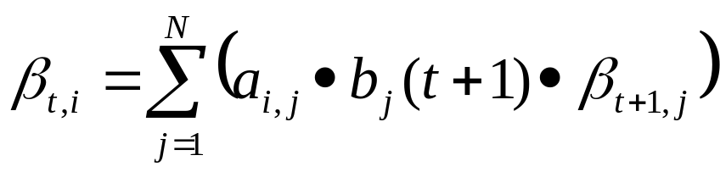
Backward Algorithm
Symmetrical to Forward Algorithm
Initialization
  β_{T,i} =1 for all I
Induction:
β_{2,1}
β_{1,2}
β_{2,2}
β_{2,3}

Slide 9
Baum-Welch Re-estimation
Calculate two new matrices of intermediate probabilities δ,γ
Calculate new A, B, π given these probabilities
Recalculate α and β, p(O | λ)
Repeat until p(O | λ) doesn’t change much

Slide 10
HMM Tagging 1
Training Method
  Supervised
    Relative Frequency
    Relative Frequency with further Maximum Likelihood training
  Unsupervised
    Maximum Likelihood training with random start

Slide 11
HMM Tagging 2
Read corpus, take counts and make translation tables
Train HMM using BW or compute HMM using RF
Compute most likely hidden state sequence
Determine POS role that each state most likely plays

Slide 12
HMM Tagging: Pitfalls 1
Monolithic HMM
  Relatively opaque to debugging strategies
  Difficult to modularize
  Significant time/space efficiency concerns
  Varied techniques for prior implementations
Numerical Stability
  Very small probabilities likely to underflow
  Log likelihood
Text Chunking
  Sentences? Fixed? Stream?

Slide 13
HMM Tagging: Pitfalls 2
State role identification
  Lexicon giving p(tag | word) from supervised corpus
  Unseen words
  Equally likely tags for multiple states
Local maxima
  HMM not guaranteed to converge on correct model
Initial conditions
  Random
  Trained
  Degenerate

Slide 14
HMM Tagging: Prior Work 1
Cutting et al.
  Elaborate reduction of complexity (ambiguity classes)
  Integration of bias for tuning (lexicon choice, initial FB values)
  Fixed-size text chunks, model averaging between chunks for final model
  500,000 words of Brown corpus: 96% accurate after eight iterations

Slide 15
HMM Tagging: Prior Work 2
Merialdo
  Contrasted computed (Relative Frequency) vs trained (BWRE) models
  Constrained training
    Keep p(tag | word) constant from bootstrap corpus’ RF
    Keep p(tag) constant from bootstrap corpus’ RF
  Constraints allow degradation, but more slowly
  Constraints required extensive calculation

Slide 16
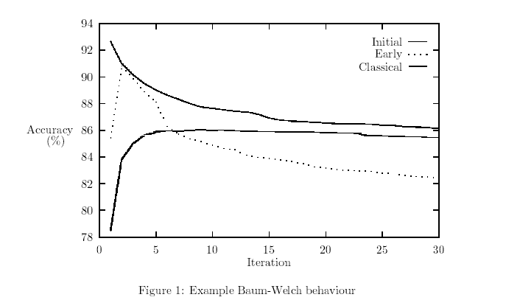
Constraints and HMM Tagging 1
Elworthy: Accuracy of classic trained HMM always decreases after some point
From Elworthy, “Does Baum-Welch Re-Estimation Help Taggers?”

Slide 17
Constraints and HMM Tagging 2
Tagging: An excellent candidate for a CSP
  Many degrees of freedom in naïve case
  Linguistically, only some few tagging solutions are possible
  HMM, like modern CSP techniques, does not make final choices in order
Merialdo’s t and t-w constraints
  Expensive, but helpful

Slide 18
Constraints and HMM Tagging 3
Obvious places to incorporate constraints
  Updates to λ
    A, B, π
    Deny an update to A if tag at (t+1) should not follow tag at (t)
    Deny an update to B if we are confident that word at (t) should not be associated with tag at (t)
    Merialdo’s t and t-w constraints

Slide 19
Constraints and HMM Tagging 4
Obvious places to incorporate constraints
  Forward-Backward calculations
    Some tags are linguistically impossible sequentially
    Deny transition probability

Slide 20
Constraints and HMM Tagging 5
Where to get constraints?
  Grammar databases (WordNet)
  Bootstrap corpus
    Use relative frequencies of tags to guess rules
    Use frequencies of words to estimate confidence
    Allow violations?

Slide 21
reMarker: Motivation
reMarker, an implementation in Java of HMM tagging
Support for multiple models
Modular updates for constraint implementation

Slide 22
reMarker: The Reality
HMM component too time-consuming to debug
Preliminary rule implementations based on corpus RF
Using Tapas Kanugo’s HMM implementation in C, externally

Slide 23
reMarker: Method
Penn-Treebank Wall Street Journal part-of-speech tagged data
Corpus handled as stream of words
  Restriciton of Kanugo’s HMM implementation
  Results in enormous resource requirements
  Results in degradation of accuracy with increase in training data size

Slide 24
reMarker: Experiment
Two corpora
  200 words of PT WSJ Section 00
  5000 words of PT WSJ Section 00
Three training methods
  Relative Frequency, computed
  Supervised, but with BWRE
  Unsupervised BWRE

Slide 25
reMarker: Results
 | 200 word corpus | 5000 word corpus
Relative Frequency | 100% | 98.0%
Supervised, BW estimated | 80.09% | 50.04%
Unsupervised, BW estimated | 43.69% | 22.96%

Slide 26
Future Work
Fix the reMarker HMM
  Allow corpus chunking
  Allow more complicated constraints
Incorporate tighter constraints
  Merialdo’s t and t-w
  Possible POS for each word: WordNet
Machine-learned rules

Slide 27
References
A Tutorial on Hidden Markov Models. Rakesh Dugad and U. B. Desai. Technical Report, Signal Processing and Artificial Neural Networks Laboratory, Indian Institute of Technology, SPANN-96.1.
Does Baum-Welch Re-estimation help taggers? (1994). David Elworthy. Proceedings of 4th ACL Conf on ANLP, Stuttgart. pp. 53-58.
A Practical Part-of-Speech Tagger (1992). Doug Cutting, Julian Kupiec, Jan Pedersen and Penelope Sibun. In Proceedings of ANLP-92.
Tagging text with a probabilistic model (1994). Bernard Merialdo. Computational Linguistics 20(2):155-172.
A Gentle Tutorial on the EM Algorithm and its Application to Parameter Estimation for Gaussian Mixture and Hidden Markov Models (1997). Jeff A. Bilmes, Technical Report, University of Berkeley, ICSI-TR-97-021.

