Slide 1

RNA Secondary Structure Prediction with
Error-Driven Transformation-Based Learning (TBL)
CMPT 881 Computational Biology
Daniel Zimmerman
Notes:
Intro page

Slide 2
Outline
Short background – RNA, Secondary structure
Historical work in structure prediction
  Nussinov, Zuker
TBL Overview
  Previous applications, Discussion of rules and transformations
Present work
  Algorithm, Complexity
Data Set
Results
Discussion, Conclusion

Slide 3
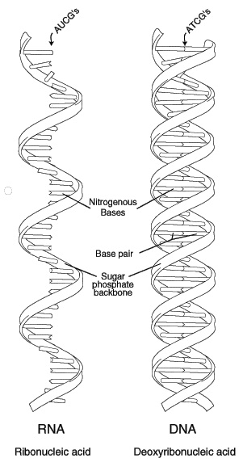
What is RNA, 1
Organic molecule, composed of ribose sugars (which form a backbone), and a sequence of phosphate groups and bases hanging off the side. Four bases:
        adenine (A)
        uracil (U)
        cytosine (C)
        guanine (G)
The sequence of bases is usually the key.
DNA molecules are also composed of a similar backbone and bases, substitute thymine (T) for U.
DNA sequences are the codes that specify all the structures in a body; the cell contains machinery to read and process the DNA, and construct appropriate proteins
RNAs are synthesized from DNA in the nucleus
Notes:
For CMPT Class

Slide 4
What is Secondary Structure
Nucleotides are looking for something to bind with.
Standard pairings: G-C, A-T (DNA), A-U (RNA)
GC: 3 H bonds, more stable than AU: 2 bonds. They are known as Watson-Crick base pairs. GU: 1 bond, known as a wobble pair.
DNA comes double-stranded, there is always another base to pair with.
RNA is single-stranded, so it folds over itself as it is being created
Not surprisingly, structure plays an important role in the function:
  For example, in the case of mRNA, it plays a part in determining the structure of the peptide chains of a protein
Notes:
For both classes

Slide 5
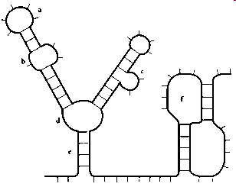
Types of secondary structure
hairpin loop
internal loop
bulge loop
multi-branched loop
stem
pseudoknot
a through e are all properly nested: if a base pair (i,j), i < j, encloses structure 1, and base pair (k,l), k < l, encloses structure 2, then either
i < j < k < l, or i < k < l < j, or k < i < j < l
Never i < k < j < l
Pseudoknots violate this property

Slide 6
Types of secondary structure
If we ignore pseudoknots, then having the base pairing information tells us all we need to know about the structure of the sequence
typically structure predictors ignore pseudoknots because if they are included, then the problem becomes very hard

Slide 7
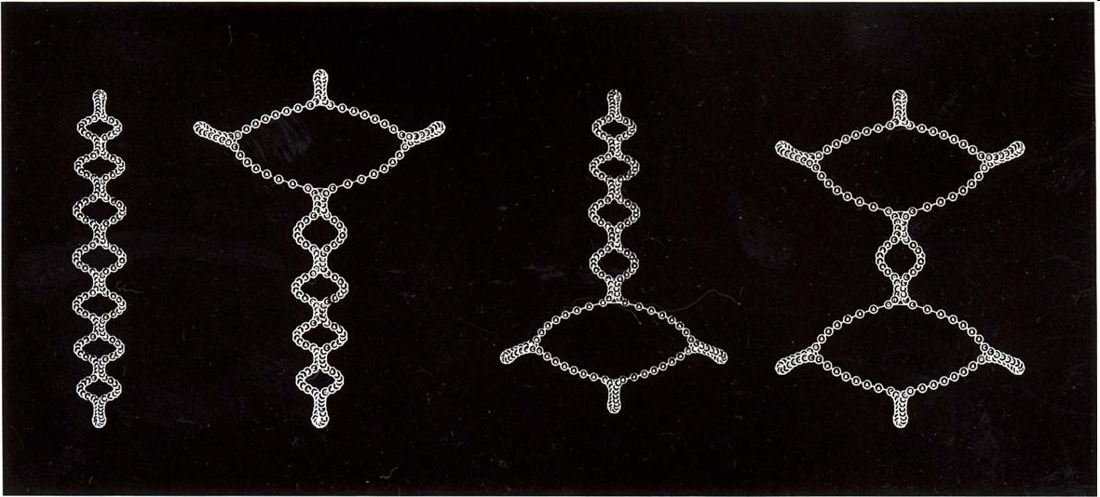
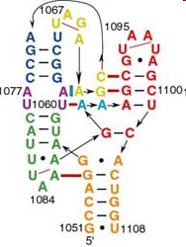
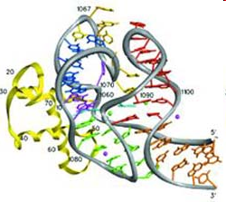
A. Nakaya et al. Phylogenetic Tree Analysis Using RNA Secondary Structure. Bio Images. 1999.
http://www.nih.go.jp/yoken/bioimaging/issues/7-4.html
Conn, G. L., Draper, D. E., Lattman, E. E. & Gittis, A. G. (1999). Crystal Structure of a Conserved Ribosomal Protein - RNA Complex. Science 284, 1171- 1174.
http://www.jhu.edu/~chem/draper/RecentPublications.html
Notes:
Pictures

Slide 8
How to predict secondary structure?
Given an RNA sequence, can we predict structure?
Complication: structure tends to be conserved more than sequence
Previous approaches
  Base pair maximization (Nussinov et al, 1978)
  Energy minimization (Zuker, 1989) (70%)
  Covariance model (Rivas, Eddy) – includes pseudoknots
  Evolutionary approach, with SCFGs (Knudsen and Hein, 1999) – combine CFG productions with probabilities of mutations
        S -> Loop S | Loop
        Stem -> base Stem base | Loop S
        Loop -> base Stem Base
Notes:
Both classes

Slide 9
What is Transformation-based Error-driven Learning?
Goal: to develop a program to accurately perform a task on a corpus.
    A tagger to assign parts of speech (POS) to the words in a document
    A program to predict the secondary structure of an RNA sequence
The learner has access to
    a set of rules which will transform the corpus,
    the annotated version of the corpus (for POS, this is the document with the correct parts of speech indicated)
Learning proceeds by making guesses: performs a rule, and compares the result to the annotated version to see how many mistakes there are
The learner eventually ranks all the rules
Notes:
Both classes

Slide 10
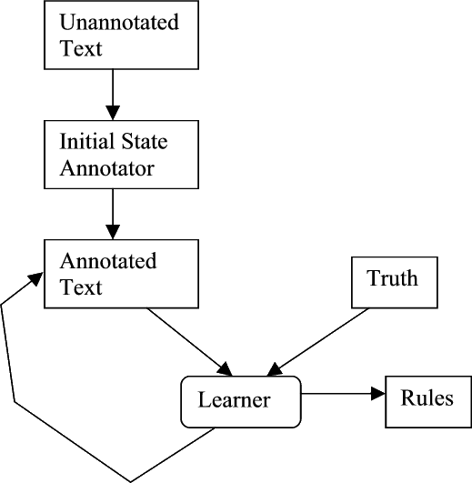
TBL Flow

Slide 11
Previous applications of TBL
The TBL algorithm used here was developed by Eric Brill in 1992, for part-of-speech tagging
He noted that corpus-based approaches do not need sophisticated domain knowledge, but that simple n-gram models hide too much linguistic information in the statistics
Achieved very good results for the task: 97.2%, when trained on 600 000 words, and tested on a different set of 150 000 words
These lead to the motivations for trying it on RNA: simple, has achieved good results in the past, and very fast in application!
Notes:
Biology class only

Slide 12
TBL Rules
Rules consist of two parts:
    triggering environment
    transformation
Example for the POS application (non-lexical):
    trigger: the POS of the preceding word is TO
    transformation: change the POS of the current word to be VB (stem form of the verb)

Slide 13
Part-of-speech tagging transformations
It started to rain
Initial annotation:
PP VB TO NN
Score: 1
Transformation
If preceding tag is TO,
change NN to VB
It started to rain
PP VB TO VB
Score: 0
New annotation:

Slide 14
The current approach
In general, the algorithm is the same as Brill
  1) create set of rules
  2) rank the rules
  3) assign structure to new strings
All rules have the same format: the triggering environment is two strings. If these strings are encountered in the correct, nested circumstance, then they will be assigned to be pairs of each other.
Example of a triggering environment: left string is CCG, right string is GGC.
If these two strings are found, they will be paired.
A | C | C | G | U | A | G | G | C | A
- | ( | ( | ( | - | - | ) | ) | ) | -
Notes:
Both classes

Slide 15
Applying TBL Rules
 | Left String | Right String
Rule 1 | ACC | GGU
Rule 2 | GC | GC
String 1
C | A | C | C | G | U | G | C | G | G | U | G | C | A
Apply R1
- | ( | ( | ( | - | - | - | - | ) | ) | ) | - | - | -
Apply R2
- | ( | ( | ( | - | - | - | - | ) | ) | ) | - | - | -
No change after R2, even though it appears to match
String 2
C | A | C | C | G | C | U | A | G | C | G | G | U | A
Apply R1
- | ( | ( | ( | - | - | - | - | - | - | ) | ) | ) | -
Apply R2
- | ( | ( | ( | ( | ( | - | - | ) | ) | ) | ) | ) | -

Slide 16
Creating, ranking the rules
Creating: the rules are found automatically, by reading the input strings. The input strings are annotated with the base pair information.
Ranking:
  1. start with all the rules, unranked
  2. for each rule
  3. for each unranked rule
  4. for each input sting
  5. find all locations in which the rule would apply
  6. apply the rule
  7. evaluate: compare the result with the truth
  8. find the rule that results in the best score
  9. mark this as the next best rule
  10. apply it to all input text
  11. continue, until all rules have been ranked
  12. if no rules improve the score, discard all unranked rules

Slide 17
Evaluating the rules
The result of applying the rule is a string of characters “_”, “(“, “)”. This is compared to the truth.
Every position in the string which does not agree with the truth increments the score by 1.
The lower the score, the closer the results are to the truth

Slide 18
Differences between Brill and RNA Structure implementation
 | Brill | RNA Structure
lexcalized rules | Both lexicalized and non | Only lexcialized
Initial state annotator | Assign most common tag | none
Initial set of rules | Learned through trial and error from templates | Learned by examining the files
Can correct errors | Later transformations can fix errors introduced earlier | Nucleotides can only be classified once

Slide 19

Complexity
Let n = total length of initial input
Let m = number of rules (worst case n = m/2)
Let p = average length of the triggers in the rules (worst case n = p * m)
Let t = total length of the test input
 | Time | Space
Part 1 | O(m) Each string is scanned once for strings of base pairs. | O(m) Worst case: each base is in a transformation, and the size for storing the rules would be linear with the length of the input
Finding and applying all rules | Finding: O(n*t) Need one comparison for every character in the rules, time ever character in the test input Applying: Constant time | O(t+n) Worst case: total length of rules is n, hence O(n). In all cases, size for applying = 2 * t, hence O(t)
Part2 | Finding matches for all input: O(n * t) Performing the outer loop: = O(t²) Total: O(n * t³) When n=t, O(n⁴) | O(t+n) The space is not preserved between iterations of the loop, so it is the same space as for one loop
Part 3 | O(n*t) | O(t+n)

Slide 20
Data set
Obtained from the online GOBASE database – hosted at Université de Montréal
Unable to find text RNA sequences with secondary structure information embedded
Therefore took unannotated sequences and ran them through the program RNAStructure. It uses the energy minimization algorithm and generates a data file with secondary structure information – used these as the input
Therefore, not training on real RNA structure data – but on incorrect estimates.
Notes:
Both classes

Slide 21
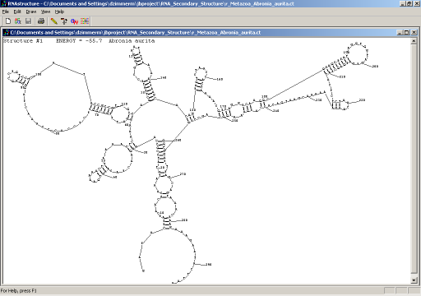
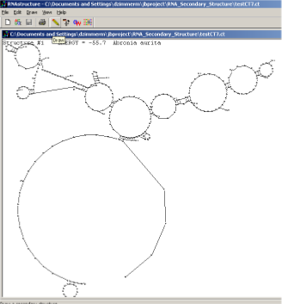
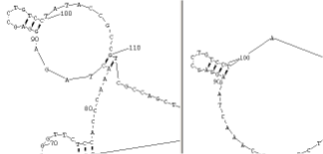
RNA Structures’s prediction
TBL’s prediction
Similar Regions, near base 100

Slide 22
Results
Baseline: since there are 3 symbols, we can assign to a position, a minimal baseline we could expect would be the random score, 33%. The top score to aim for would be the optimal score for the energy minimization algorithm approximately 70%.
For these trials, since the data was generated by the energy algorithm, no reason accuracy could not be higher than 70%.
In practice, because of the constraints on the output, the baseline should be higher than 33%, but since the results are so poor, i have not investigated what a more reasonable number would be.
Notes:
Both classes

Slide 23
Results
# Input Strings
Total Length of Input
# Rules
# Eval Strings
Total Length of Eval
% Accuracy
10
4709
35 (216 originally)
20
6310
41.4%
20
16440
64 (659 originally)
20
6310
41.7%
30
20309
68 (777 originally)
20
6310
41.7%
9 (all tRNA from Metazoa)
617
14 (19 originally)
6
422
40.0%
20 (same strings for training and eval)
6310
29 (280 originally)
20
6310
43.8%

Slide 24
What went wrong
Results were very poor, in the low-40%
Better than random, but not by much.
Possibilities:
  buggy implementation
  invalid data (need to try again on RNA with real structures)
  the premise is invalid: RNA structure prediction depends on more than the sequence, and there is no way to fix it
  wrong data representation

Slide 25
Ideas for improving performance
Change data representation – use CFG-type productions. In this case, the relationships between the structures themselves would be captured, not just base pairs
Separate data sets by family of organism, or by specific type or function of RNA. (Despite the poor results from the tRNA test) – changing representations would help this.
Allow rewrite rules – currently each base can only be assigned once – could this restriction be lifted?
Some potentially valid transformations ignored – try these as well
Notes:
Both classes

Slide 26
Ideas for general improvements
Include pseudoknots – the only reason for restricting them was to make a comparison against other methods.
Can it be combined with another method, which includes an evolutionary approach? Maybe seed the sequence with some initial structures from related sequences, then build from that starting point.

Slide 27
Conclusion
Disappointing results, but still want to test it on real data before drawing the obvious conclusion
A hybrid approach might be the way to improve it
A fun exercise
Questions

