Slide 1
Metaphoinder
A Study in Metaphor Clustering
or
A Study in Sheep Herding

Slide 2
You: I’m sooo sad! Can you tell me how to drown my sorrows?
Expert: Push them off the Second Narrows Bridge when their backs are turned.

Slide 3
Outline
Introduction to Metaphor
Approaches to Processing Metaphor
Metaphor Interpretation as
an Example-based System
A Nostalgic Look at
Word-Sense Disambiguation
Metaphoinder
  How does it work?
  How well does it work?
Conclusion

Slide 4
The Importance of Processing Metaphor
Accurate and efficient metaphor
processing is important for:
Expert Systems
Machine Translation
Language Recognition
Language Generation
Text Extraction and Information Retrieval

Slide 5
IR: Search for Livestock News
The price of pheasant has gone through the roof since news of the impending turkey famine hit
airwaves late yesterday.
The Minister of the Environment was dismissed today after making a public statement that
the president was,
in fact, a turkey.

Slide 6
Types of Metaphor
dead (fossilized)
  ‘the eye of a needle’; ‘the are transplanting the community’
cliché
  ‘filthy lucre’; ‘they left me high and dry’; ‘we must leverage our assets’
standard (stock; idioms)
  ‘plant a kiss’; ‘lose heart’; ‘drown one’s sorrows’
recent
  ‘kill a program’; ‘he was head-hunted’; ‘she’s all that and a bag of chips’; ‘spaghetti code’
original (creative)
  ‘A coil of cord, a colleen coy, a blush on a bush turned first men’s laughter into wailful mother’ (Joyce)
  ‘I ran a lawnmower over his flowering poetry’

Slide 7
Anatomy of a Metaphor
metaphor
object
target
source
a sunny smile
sense (tenor)
= ‘cheerful’, ‘happy’, ‘bright’, ‘warm’
image (vehicle) = ‘sun’

Slide 8
Traditional Methods
Metaphor Maps
  a type of semantic network linking sources to targets
Metaphor Databases
  large collections of metaphors organized around sources, targets, and psychologically motivated categories

Slide 9
Metaphor Maps
Action
Event
Actor
Kill
Result
Killing
Death Event
Patient
Killer
Kill
Victim
Dier
Animate
Living-Thing
Killing (Martin 1990)

Slide 10
Metaphor Databases
  PROPERTIES ARE POSSESSIONS
  She has a pleasant disposition.
  CHANGE IS GETTING/LOSING
  CAUSATION IS CONTROL OVER AN OBJECT RELATIVE TO A POSSESSOR
  ATTRIBUTES ARE ENTITIES
  STATES ARE LOCATIONS and PROPERTIES ARE POSSESSION.
  STATES ARE LOCATIONS
  He is in love.
  What kind of a state was he in when you saw him?
  She can stay/remain silent for days.
  He is at rest/at play.
  He remained standing.
  He is at a certain stage in his studies.
  What state is the project in?
  It took him hours to reach a state of perfect concentation.
  STATES ARE SHAPES
  What shape is the car in?
  His prison stay failed to reform him.
  This metaphor may actually be more narrow:
  STATES THAT ARE IMPORTANT TO PURPOSES ARE SHAPES.
  Thus one can be 'fit for service' or 'in no shape to drive'
  It may not be a way to talk about states IN GENERAL.
  This metaphor is often used transitively with SHAPES ARE CONTAINERS.
  He doesn't fit in
  She's a square peg

Slide 11
Attempts to Automate
Using surrounding context to interpret metaphor
  James H. Martin and KODIAK
Using word relationships to interpret metaphor
  William B. Dolan and the LKB

Slide 12

KICK
THE
BUCKET

Slide 13
Metaphor Interpretation as an Example-based System
kick the bucket
bite the dust
pass on
croak
cross over to
the other side
go the way of
the dodo
ins Grass
beissen
entweichen
hinueber treten
dem Jenseits
entgegentreten
abkratzen
kick the bucket
ins Grass beissen
die
decease
perish
sterben

Slide 14
Word-Sense Disambiguation #1
An unsupervised bootstrapping algorithm for word-sense disambiguation (Yarowsky 1995)
  Start with set of seed collocations for each sense
  Tag sentences accordingly
  Train supervised decision list learner on the tagged set -- learn additional collocations
  Retag corpus with above learner; add any tagged sentences to the training set
  Add extra examples according to ‘one sense per discourse constraint’
  Repeat

Slide 15
Problems with Algorithm #1
Need clearly defined collocation seed sets
Need to be able to extract other features from training examples
Need to be able to trust the one sense per discourse constraint
Hard to define for Metaphor vs Literal
Difficult to determine what those features should be since many metaphors are unique
People will often mix literal and metaphorical uses of a word

Slide 16
Similarity-based Word-Sense Disambiguation
Uses machine-readable dictionary definitions as input
Creates clusters of similar contexts for each sense using iterative similarity calculations
Disambiguates according to the level of attraction shown by a new sentence containing the target word to a given sense cluster
Karov & Edelman 1997

Slide 17
Metasheep

Slide 18
Metaphoinder
The Corpus
  is vp->vbz-np factsheet aid
  affect vp->vbz-np viru system
  normal vp->jj blood,mosquito
  report vp->vbd-np 16,000 infect
  project vp->vbz-np-pp organis infect
  put vp->vbd-np factsheet back
  bought vp->vbd peopl
  cut vp->vbd-np cliff cake
  happen vp->vbz-advp it
  need vp->vbp-s you
  work vp->vp-cc-vp volunt
  need vp->vbp-s i
  feel vp->vbp-adjp you
  like vp->vbp-s we
  form vp->vb-cc-rb-s you
  find vp->vbp-s i
  inform vp->vbn-pp leader
  went vp->vbd visit
  hold vp->vp-cc-vp we
  ask vp->vb-pp telephon

Slide 19
‘Plant’ -- Original Sentences
  bulb
  varieti
  box
  corm
  parent tree
  kiss
  descend rome
  bomb
  ford worst
  lang
  tree
  patch
  talb bomb
  tomato
  everyon pine
  drift
  plant vp->vb-advp-pp bulb
  plant vp->vb-np you varieti
  plant vp->vb-prt box
  plant vp->vbd-np-pp-pp we corm
  plant vp->vbd-pp-sbar i
  plant vp->vbn-np-pp-sbar parent tree
  plant vp->nn-np he kiss
  plant vp->vbn-np descend rome
  plant vp->vbd-np-pp we bomb
  plant vp->vb-np-pp ford worst
  plant vp->advp-vbn lang
  plant vp->vbd-np he tree
  plant vp->advp-vbn-pp patch
  plant vp->vbd-np thei it
  plant vp->vbd-np-pp-pp-pp talb bomb
  plant vp->vb-np-pp-pp you tomato
  plant vp->vbd-np-pp everyon pine
  plant vp->vbd-np he drift
  plant vp->vbd he
  plant vp->vbd-np-pp-sbar he them

Slide 20
‘Plant’ -- Feedback Seed Set
  ^constitut\b
  ^emb\b
  ^engraft\b
  ^establish\b
  ^imb\b
  ^implant\b
  ^institut\b
  ^root\b
  ^puddle\b
  ^checkrow\b
  ^dibble\b
  ^afforest\b
  ^forest\b
  ^re-forest\b
  ^reforest\b
  ^replant\b
  ^pot\b
  ^repot\b
  ^nest\b
  ^bury\b
  ^sink\b
  ^countersink\b
  ^fix\b
  ^appoint\b
  ^nam\b
  ^nominat\b
  ^pack\b
  ^co-opt\b
  ^grow\b
  ^sow\b
  ^harvest\b

Slide 21
‘Plant’ -- Feedback Set
  grow vp->vb-adjp brain
  grow vp->vb-pp
  grow vp->vbp-prt
  grow vp->vbz-pp
  grow vp->vbg-prt-pp boi
  grow vp->vbp-np veget guid
  grow vp->vp-cc-vp-cc-vp rosi
  grow vp->vbg-pp the
  grow vp->vbg-advp-pp
  grow vp->vbg-pp tree
  grow vp->vbp-adjp
  grow vp->vbz-pp
  grow vp->vbp-pp appl
  grow vp->vbg-pp tree
  grow vp->vbz-advp tree
  grow vp->vbg-adjp-pp espali
  grow vp->vp-cc-vp
  grow vp->vbp-adjp
  grow vp->vbp-np-np veget guid
  grow vp->vp-cc-vp-cc-vp inula
  brain
  boi
  veget guid
  rosi
  the
  tree
  appl
  tree
  tree
  espali
  veget guid
  inula

Slide 22
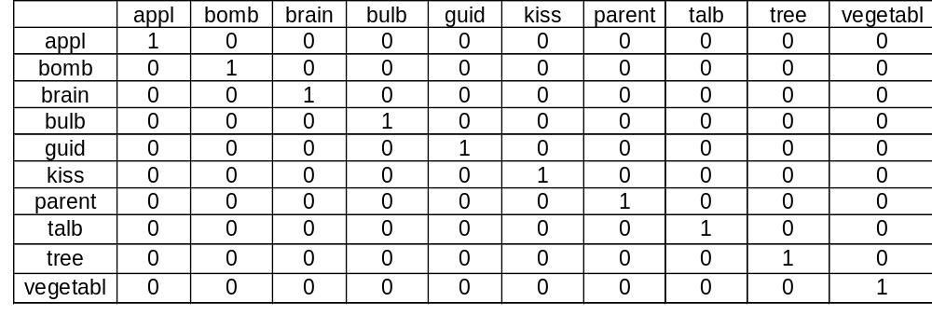
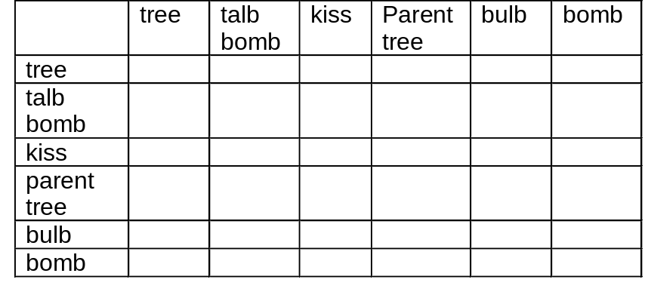
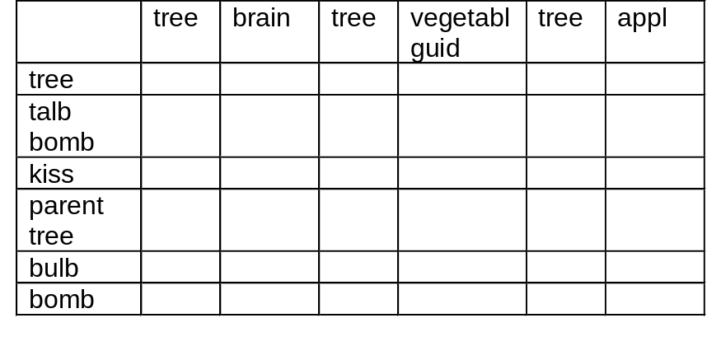
WSM
Original
SSM
Feedback
SSM

Slide 23
The Long-Awaited Formulas
aff_{n}(W, S) = max_{Wi ∈ S} sim_{n}(W, W_{i})
aff_{n}(S, W) = max_{Sj ∋ W} sim_{n}(S, S_{j})
sim_{n+1}(S₁, S₂) = ∑_{W ∈ S1} weight(W, S₁) · aff_{n}(W, S₂)
sim_{n+1}(W₁, W₂) = ∑_{S ∋ W1} weight(S, W₁) · aff_{n}(S, W₂)

Slide 24
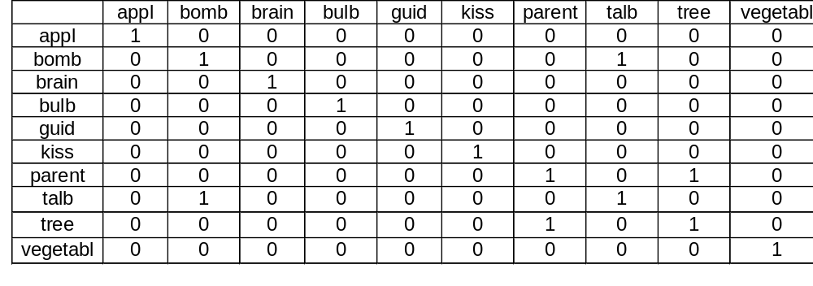
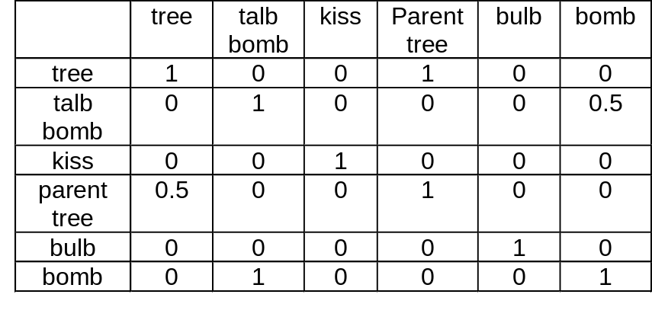
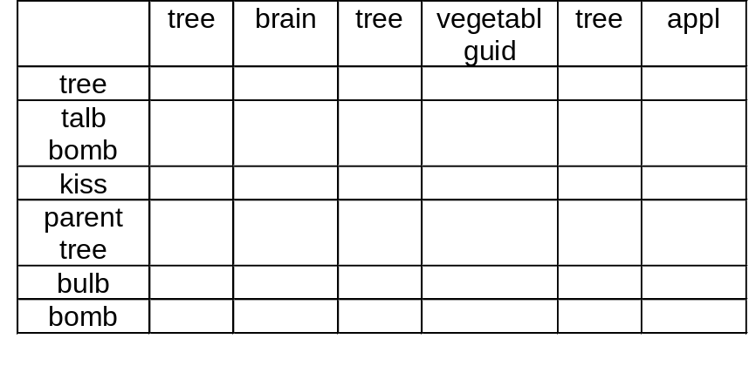
WSM
Original
SSM
Feedback
SSM

Slide 25
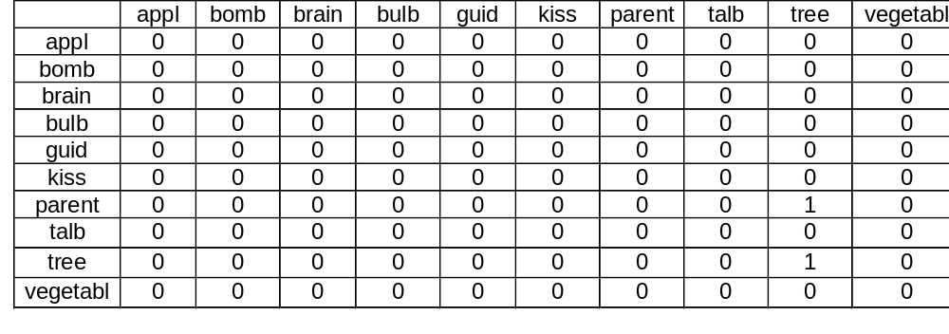
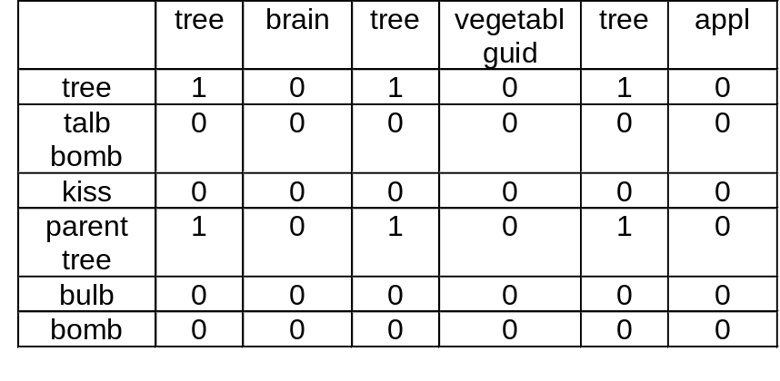
WSM
Original
SSM
Feedback
SSM

Slide 26
‘Plant’ Output
  Possible metaphors are:
  bulb
  varieti
  box
  corm
  kiss
  descend rome
  bomb
  ford worst
  lang
  patch
  talb bomb
  tomato
  everyon pine
  drift
  Possible literals are:
  parent tree --ATTRACTED BY-- tree * 1 * tree * 1 * tree * 1 *
  tree --ATTRACTED BY-- tree * 1 * tree * 1 * tree * 1 *

Slide 27
  Possible metaphors are:
  breweri
  consum 3.3kg
  consum 4.7kg
  briton
  someth
  bradi heart
  anyth
  more
  miner song
  diner feast
  spring
  kid
  mileston
  rate
  better
  deer
  flymo monei
  zander
  puffin
  bread
  jame chop
  cours
  your
  emilio
  myself leftov
  take-awai
  bread
  home
  the 5kg,11lb
  cost 44%
  anyth
  everyon
  cake
  norman
  exercis
  major
  protein
  calori
  biscuit
  brother
  mother
  men
  design peach
  word
  passeng
  inflat invest
  burger
  gui
  american
  ye mair
  polyunsatur
  individu
  thing
  drink
  garlic
  cake
  everyon
  runner
  base
  oxen
  vultur
  offspr even
  fig
  floyd
  locust grass
  word
  piec
  thing
  more
  ladi crumpet
  onli
  desir
  all
  crocodil
  predat
  mammal
  speci littl
  three
  brother snotter
  rice
  pastri
  homosexu pork
  diet
  bean
  rang
  chick crumb

Slide 28
Possible literals are:
resid dinner --ATTRACTED BY-- dinner * 1 *
varieti --ATTRACTED BY-- whole * 1 * owl whole * 1 * mani whole * 1 * owl * 1 *
lip --ATTRACTED BY-- keith lip * 1 * headmast lip * 1 * william lip * 1 *
benni lot --ATTRACTED BY-- child between * 1 * child lot * 1 * benni * 1 * lot * 1 *
rest --ATTRACTED BY-- mcgowan rest * 1 *
person averag --ATTRACTED BY-- person * 1 *
egg --ATTRACTED BY-- egg * 1 * cuckoo egg * 1 *
camp meal --ATTRACTED BY-- odd-knut dog * 0.0868055555555556 * dog meat * 0.0868055555555556 * dog finger * 0.0868055555555556 *
georg spam --ATTRACTED BY-- georg * 1 *
's god --ATTRACTED BY-- 's * 1 *
lot --ATTRACTED BY-- child between * 1 * child lot * 1 * benni * 1 * lot * 1 *
tadpol --ATTRACTED BY-- tadpol * 1 * tadpol * 1 *
meal --ATTRACTED BY-- odd-knut dog * 0.131944444444444 * dog meat * 0.131944444444444 * dog finger * 0.131944444444444 *
lot --ATTRACTED BY-- child between * 1 * child lot * 1 * benni * 1 * lot * 1 *
peopl food --ATTRACTED BY-- man growth * 0.462734375 * man tonight * 0.462734375 * food * 0.8390625 * jesu peopl * 0.931875 * messiah peopl * 0.931875 * peopl * 0.931875 *
lot --ATTRACTED BY-- child between * 1 * child lot * 1 * benni * 1 * lot * 1 *
fruit --ATTRACTED BY-- anim busi * 0.75 * whole * 0.211111111111111 * owl whole * 0.211111111111111 * mani whole * 0.211111111111111 * per-cent * 0.75 * per-cent anim * 0.75 * plant * 0.211111111111111 * south-east per-cent * 0.75 * maureen bird * 0.738888888888889 * owl * 0.211111111111111 *
wai --ATTRACTED BY-- roller wai * 1 * earthworm * 1 *
hedgehog beetl --ATTRACTED BY-- beetl * 1 *
pud --ATTRACTED BY-- anim busi * 0.0277777777777778 * per-cent * 0.0277777777777778 * per-cent anim * 0.0277777777777778 * south-east per-cent * 0.0277777777777778 * maureen bird * 1 *
parent --ATTRACTED BY-- parent cream * 1 * parent * 1 *
peopl veget --ATTRACTED BY-- man growth * 0.065234375 * man tonight * 0.065234375 * food * 0.6640625 * jesu peopl * 0.996875 * messiah peopl * 0.996875 * peopl * 0.996875 *
worker lunch --ATTRACTED BY-- billson lunch * 1 *
mexican fish --ATTRACTED BY-- fish * 1 * fish * 1 * fish * 1 * fish * 1 * fishkeep fish * 1 * fish * 1 * fish * 1 * fish * 1 * fish * 1 * fish * 1 *
fish --ATTRACTED BY-- fish * 1 * fish * 1 * fish * 1 * fish * 1 * fishkeep fish * 1 * fish * 1 * fish * 1 * fish * 1 * fish * 1 * fish * 1 *
whale prei --ATTRACTED BY-- whale * 1 *
wai --ATTRACTED BY-- roller wai * 1 * earthworm * 1 *
dinner --ATTRACTED BY-- dinner * 1 *
women snack --ATTRACTED BY-- women genit * 1 *

Slide 29
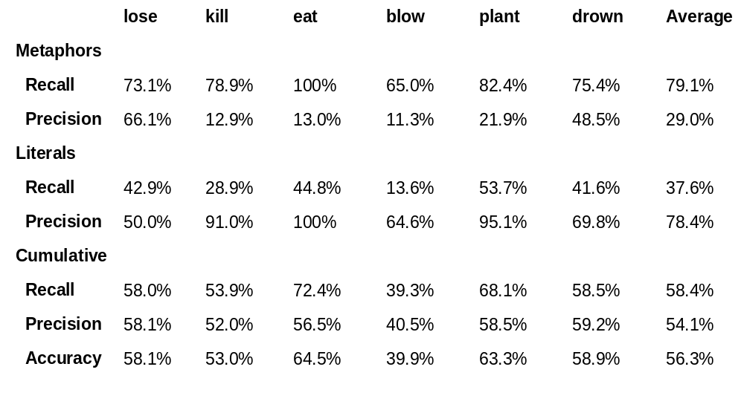
Results: Initial

Slide 30
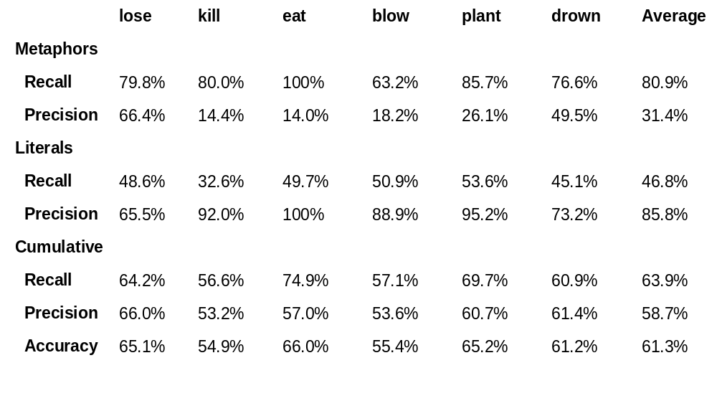
Results: MRD Examples Added

Slide 31
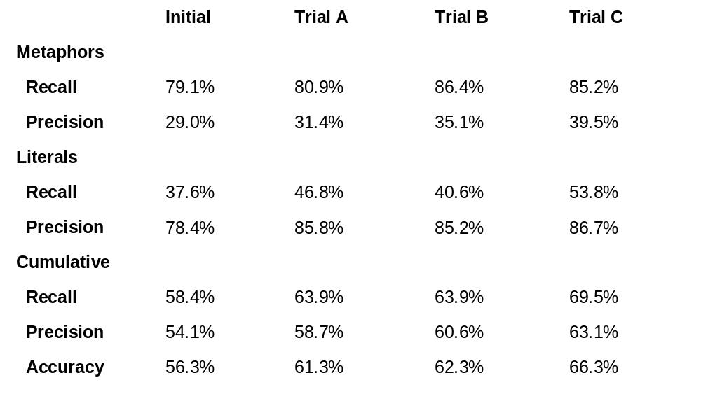
Results: Four Set Comparison

Slide 32
Future Improvements
Increase efficiency to allow running program with larger feedback sets
Augment available sentence context by using more detailed corpus
Optimize extraction of seed words
Use metaphor feedback set in addition to literal in order to pull words in both directions

Slide 33
Conclusion
Metaphors can make your head spin
They are thus a prime target for statistical methods
Metaphoinder provides evidence that similarity-based word-sense disambiguation algorithms may be able to shed some light on the subject
(And not just when pigs fly, either.)

