Slide 1
Modified
Voted Perceptron:
A Re-ranking Method
for NP-Chunking
Prepared and presented by Roozbeh Farahbod
rfarahbo@cs.sfu.ca

Slide 2
Agenda
Introduction
  Base-line Model
  Data Set
  Features
The Problem
  Perceptron
  Voted Perceptron
  Iterated Perceptron
  Averaged Perceptron
  Best Votes
Conclusion

Slide 3
Introduction
Different models exists that perform different natural language processing tasks.
Existing models usually can produce a set of probable candidates (rankings).
In re-ranking, the goal is to improve these initial rankings
How?
  Using the score (probability) that the base model produce
  Using additional features to discriminate between candidates

Slide 4
Introduction ⁽²⁾
Previous works:
  Reranking for Parsing
    Using MRF framework and Boosting Models
    Using Perceptron algorithm
  Reranking for Tagging
    Using Perceptron algorithm
  Reranking for Named-Entity Extraction
    Using Boosting and Voted Perceptron
Our work:
  Reranking for NP-Chunking
    Using Maximum Entropy framework and Voted Perceptron

Slide 5
Base-line Model
Our base-line model is a Transformation-Based Learning model that is modified to produce n-best candidates.
For each candidate, GoldenScore is then calculated to be:
  The percentage of correct chunking tags in the sentence.
Statistical Info:
  Precision: 97.71%
  Recall: 99.32%
  Max. possible precision: 100.00%
  Max. possible recall: 99.95%
  Definitions:
    Precision: % of corrected samples in test data
    Recall: % of corrected samples in training data

Slide 6
Data Set
Wall Street Journal
  Training: section 15 to 18
  Testing: section 20
Input to base-line model is a set of sentences, each a set of:
Word-POS
Output of base-line model:
  A list of chunked sentences where each chunked sentence is in the form of:
  Sentence: # Length: #
  list_of_candidates
  List of candidates consists of candidates in the form of:
  probability chunked_sentence
  Chunked sentence is a set of:
  Word-POS_C
  Tag C is either O (out), I (in), or B (beginning of another)

Slide 7
Sample Output
.
.
.
Sentence: 23 Length: 23
-1.958923016120783 Look-VB_O at-IN_O what-WP_I happened-VBD_O to-TO_O ...
-3.647396670336614 Look-VB_I at-IN_O what-WP_I happened-VBD_O to-TO_O ...
-6.433996605689296 Look-VB_O at-IN_O what-WP_I happened-VBD_O to-TO_O ...
-6.807987710344688 Look-VB_O at-IN_O what-WP_I happened-VBD_O to-TO_O ...
-8.122470259905127 Look-VB_I at-IN_O what-WP_I happened-VBD_O to-TO_O ...
-8.496461364560519 Look-VB_I at-IN_O what-WP_I happened-VBD_O to-TO_O ...
-9.511921807126118 Look-VB_B at-IN_O what-WP_I happened-VBD_O to-TO_O ...
-11.283061299913198 Look-VB_O at-IN_O what-WP_I happened-VBD_O to-TO_O ...
-11.554750108109571 Look-VB_O at-IN_O what-WP_I happened-VBD_O to-TO_O ...
-11.641182440962153 Look-VB_O at-IN_O what-WP_I happened-VBD_O to-TO_O ...
Sentence: 24 Length: 54
-7.55365196238661 On-IN_O a-DT_I day-NN_I some-DT_I United-NNP_I ...
.
.
.

Slide 8
Features
A = {0, first_word_in_chunk, last_word_in_chunk, last_word_in_prev_chunk}
B = {0, {-1, 0}, {0, 1}, {0, 1, 2}, {-2, -1, 0}}
Feature Templates:
  In the form of: (Word_{A} X Chunk_{B}) U (POS_{A} X Chunk_{B})
  Total of 40 templates
Feature templates are then applied to the WSJ 15-18.
Features with frequency less than 5 are removed.
75,220 features were extracted.
  Samples:
    p0=IN c0=O c1=I
    wF=the c0=I c-1=I c-2=O
Features then applied to the training data and test data.
  (1:3):-5.978112261344084:94,30:2,800:1,287:1,31:2,95:2...

Slide 9
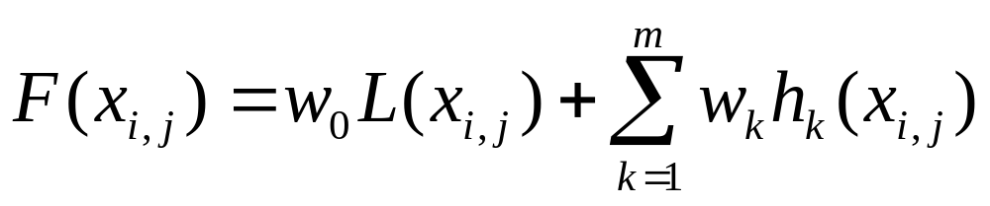
The Problem
Re-ranking candidates of a sentence
Having the set of features, h_{k}’s, and the weight vector W, looking for the j^{th} candidate of X_{i} that maximizes F :
  x_{i,j} : The j^{th} chunking candidate for the i^{th} sentence
  L(x_{i,j}): Log-probability that the base chunking model assigns to x_{i,j}
  h_{k}(x_{i,j}): A function specifying the existence of feature f_{k} in x_{i,j}
  w_{k}: A parameter corresponding to weight of each feature f_{k}
The goal is to find W_{best} that finds the best candidate of X_{i}.

Slide 10
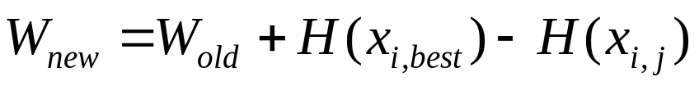
Perceptron
One of the oldest algorithms in machine learning
Maintains a weight vector while making a pass over the training data
For every sentence that the selected candidate, (X_{i,j}) maximizing F, is not the best candidate, the weight vector is updated to:
  Where H(X_{i,j}) is the feature vector for the j^{th} candidate of the i^{th} sentence.

Slide 11
The Algorithm
Training:
  define F(x)= W.H(x)
  W = 0;
  for i=1 to n
  j = argmax_{j=1..ni} F(x_{i,j})
  if (j != bestj(x))
  W = W + H(x_{i,best}) – H(x_{i,j})
Test (x_{i}):
  return argmax_{j=1..ni} F(x_{i,j})

Slide 12
Voted Perceptron
A slight modification to the Perceptron Algorithm:
  Instead of using the final weight vector, let all the intermediate weight vectors vote for the candidates.
Advantage:
  It is said to improve the results in cases of noisy or inseparable data.
  The same time complexity for the training phase
Disadvantage:
  More complex testing

Slide 13
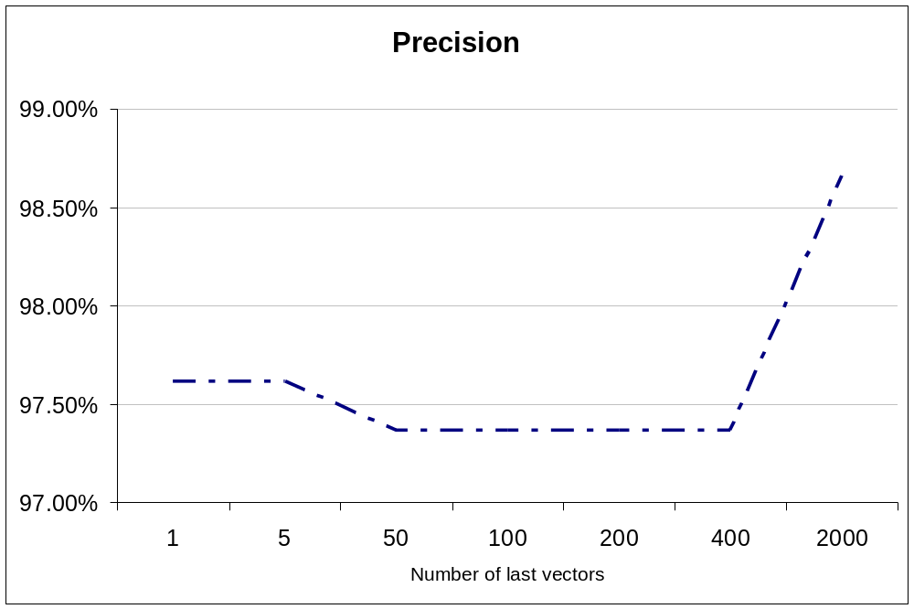
Voted Perceptron
Voted Perceptron needs all calculated vectors to vote. It is not enough to have only a small number of last ones.

Slide 14
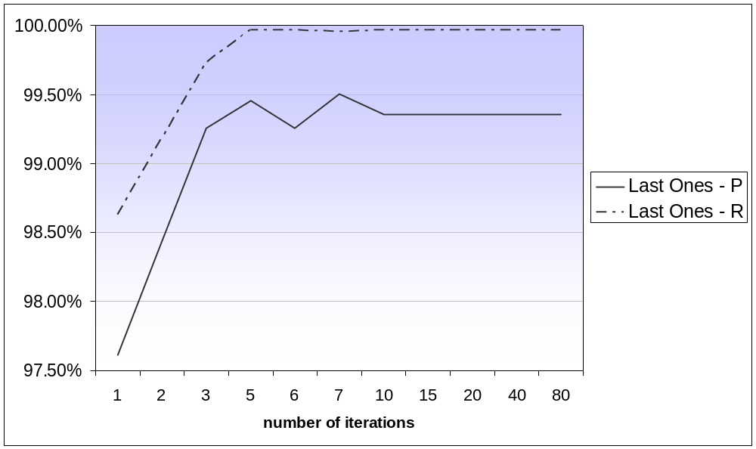
Iterated Perceptron
Instead of making one pass over the training data, make n pass.
maximum precision
P = 99.50%

Slide 15
Overfitting
In general:
  “A hypothesis overfits the training examples if some other hypothesis that fits the training examples less well actually performs better over the entire distribution of instances.”
It happens when:
  There is noise in the training data,
  or
  The training data is too small.
Two approaches to deal with overfitting:
  Stop the learning process earlier, before it perfectly fits the training data.
  Let the learning be completed, and then post-prune the results.

Slide 16
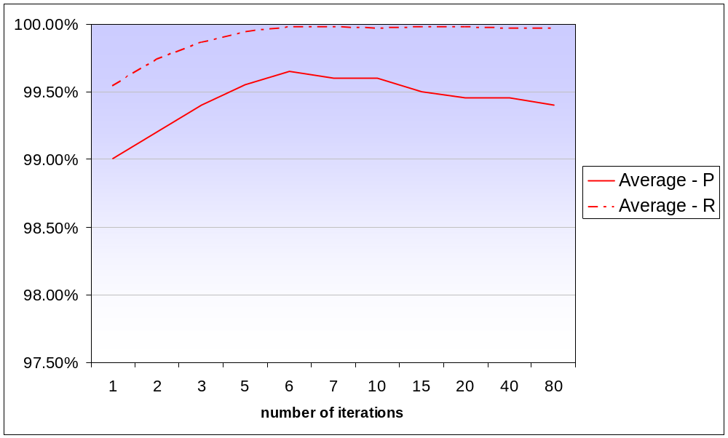
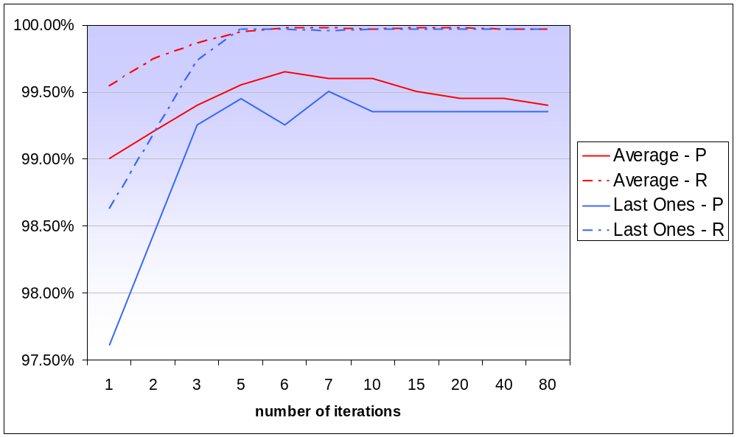
Averaged Perceptron
Instead of keeping the last calculated weight vector, or keeping all the calculated weight vectors, keep the average.
maximum precision
P = 99.65%

Slide 17
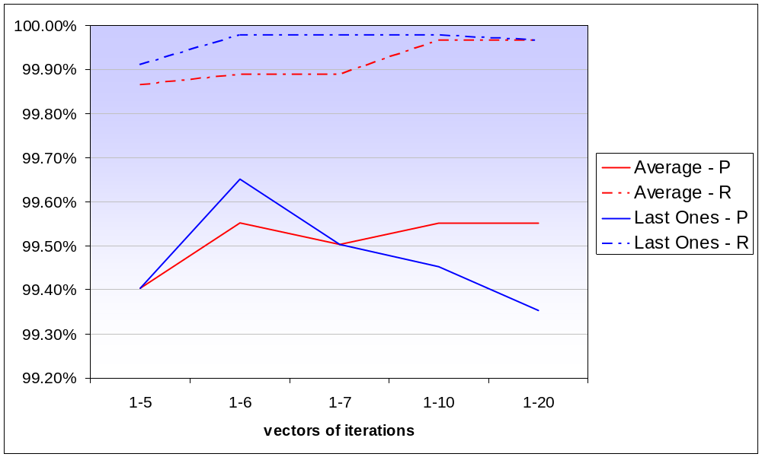
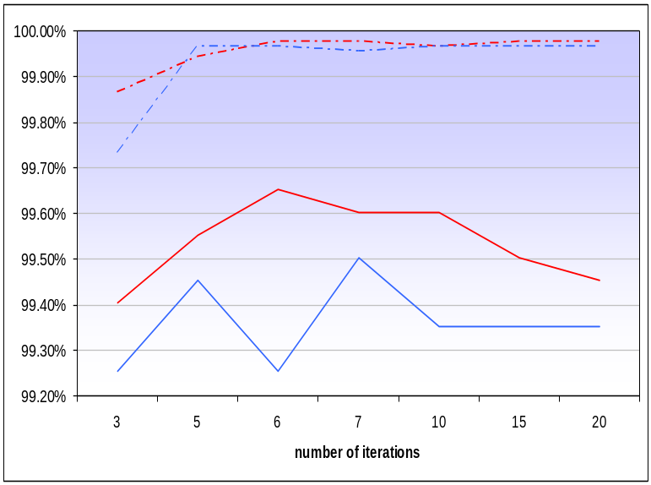
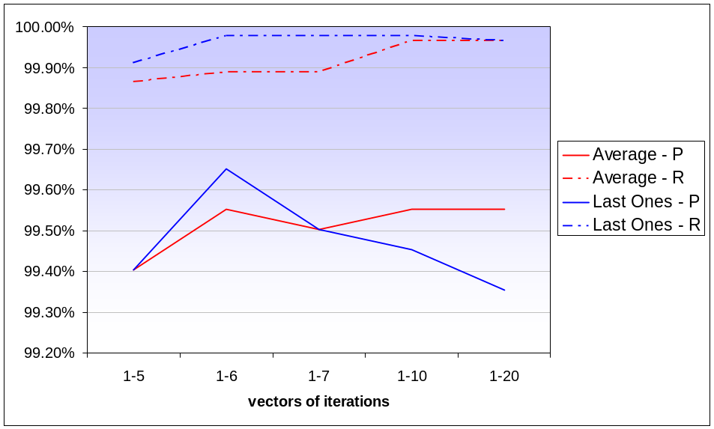
Best Votes
Asking the Last/Average vectors of each iteration to vote for the candidates.
Maximum R & P
R = 99.98%
P = 99.65%
Maximum R & P
R = 99.98%
P = 99.65%

Slide 18
Conclusion
Iteration improves the results of the Perceptron Algorithm:
  Recall always improves
  Precision improves until overfitting happens
Averaged Perceptron is a simpler and more efficient substitution for the Voted Perceptron.
Best-Votes resulted its highest precision on the final vectors of each iteration.
Model | Precision | Recall
Naïve Perceptron | 97.61% | 98.62%
Iterated Perceptron | 99.50% | 99.97%
Averaged Perceptron | 99.65% | 99.98%
Best Votes [over averaged vectors] | 99.55% | 99.97%
Best Votes [over last vectors] | 99.65% | 99.98%

Slide 19
Presented for
Statistical Learning of Natural Language
a course by
Dr. Anoop Sarkar
School of Computing Science
Simon Fraser University
December 2002
This presentation continues in
Re-ranking for NP-Chunking: Maximum-Entropy Framework
by
Mona Vajihollahi
mvajihol@cs.sfu.ca

