Slide 1
Image captioning app for blind people
Submitted in the partial fulfillment for the award of the degree of
BACHELOR OF ENGINEERING
IN
Computer Science Engineering
Submitted by:
Anmol Malik 21BCS5335
Anoop Sethi 21BCS6690
Arya Kumar 21BCS7457
MD QURESHI 21BCS10475
Under the Supervision of:
Shivani (E11286)
Department of AIT-CSE
DISCOVER . LEARN . EMPOWER

Slide 2
Outline
Introduction to Project
Problem Formulation
Objectives of the work
Methodology used
Results and Outputs
Conclusion
Future Scope
References

Slide 3
Introduction to Project
Project Title: Image Captioning App for Blind People
Objective: Enhancing accessibility for the visually impaired through image captioning technology
Problem Statement: According to the World Health Organization, approximately 285 million people worldwide are visually impaired, with 39 million of them being blind. These individuals face challenges in accessing visual information, impacting their daily activities and quality of life.

Slide 4
Solution: Our project aims to address this issue by developing an Image Captioning App using Natural Language Processing (NLP) and Machine Learning (ML) techniques. This app will enable blind individuals to receive descriptive captions of images, facilitating improved navigation and enhancing their overall lifestyle.
Expected Impact: By providing accessible technology, we strive to empower visually impaired individuals, fostering independence and inclusion in society.

Slide 5
Challenges Faced by the Visually Impaired:
Limited Access to Visual Information: Visually impaired individuals encounter difficulties in accessing visual content such as images, hindering their ability to comprehend the world around them.
Dependence on Others: Due to the lack of accessible technology, blind individuals often rely on assistance from others for tasks involving visual information, compromising their independence.
Barrier to Social Inclusion: Inaccessible visual content acts as a barrier to the social inclusion of visually impaired individuals, hindering their participation in various aspects of life.

Slide 6
Impact on Daily Life
Educational Limitations: Visual impairment affects educational opportunities, limiting access to learning materials and hindering academic progress.
Employment Challenges: Difficulty in accessing visual information poses challenges in the workplace, reducing employment opportunities for visually impaired individuals.
Emotional Well-being: The inability to independently access visual content can lead to feelings of isolation, frustration, and a diminished sense of self-worth.

Slide 7
Objectives of the Work
Enhancing Accessibility: Our primary objective is to develop an Image Captioning App that enhances accessibility for visually impaired individuals by providing descriptive captions for images.
Improving Independence: We aim to empower visually impaired users to navigate their surroundings independently by enabling them to access visual information through the app without relying on external assistance.
Facilitating Social Inclusion: By providing a tool that enables visually impaired individuals to engage with visual content, our objective is to promote social inclusion and participation in various aspects of life, including education, employment, and leisure activities.
Utilizing NLP and ML: Leveraging advancements in Natural Language Processing (NLP) and Machine Learning (ML), our objective is to develop a robust model capable of accurately generating descriptive captions for a wide range of images.
User-Centric Design: We prioritize the needs and preferences of visually impaired users throughout the development process, ensuring that the app's interface and features are intuitive, accessible, and tailored to their requirements.

Slide 8
Methodology
Data Collection: Gather a large dataset of images along with their corresponding captions. This dataset should cover a diverse range of scenes and objects.
Preprocessing: Resize all images to a uniform size to ensure consistency. You may also perform normalization to adjust brightness and color levels. Tokenize the captions into words or subwords. This involves splitting each caption into individual meaningful units.
Feature Extraction: Utilize a pre-trained convolutional neural network (CNN), such as ResNet or VGG, to extract features from the images. These features capture important visual information.
Sequence Processing: Implement a recurrent neural network (RNN), like LSTM or GRU, to process the sequential nature of the captions. This network will learn to generate captions word by word.
Model Training: Train the combined CNN-RNN model using the image features and corresponding caption sequences. The goal is to minimize the difference between the predicted captions and the actual captions.
Evaluation: Assess the performance of the model using metrics such as BLEU score, METEOR, or CIDEr. These metrics measure the quality of generated captions compared to human-written references.
Testing: Evaluate the trained model on unseen images to generate captions. This step ensures that the model generalizes well to new data.
Iterative Improvement: Analyze the generated captions and user feedback to identify areas for improvement. Iterate on the model architecture, training process, or dataset to enhance performance.

Slide 9
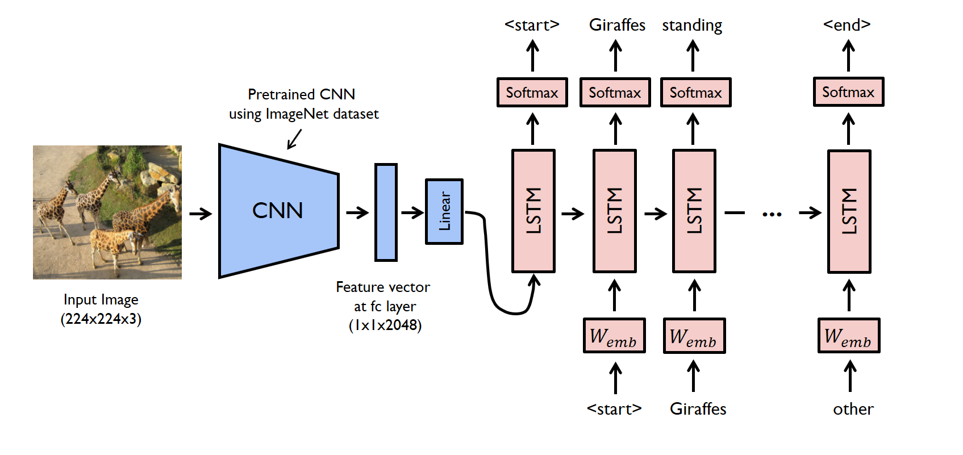
Flow Chart

Slide 10
Analytics of Features
ResNet Feature Extraction: Utilize ResNet, a powerful convolutional neural network (CNN) architecture, for feature extraction from live video frames. ResNet's deep architecture allows it to capture intricate visual features effectively, aiding in understanding the content of each frame.
Artificial Neural Networks (ANNs) for Caption Generation: Employ artificial neural networks (ANNs), such as recurrent neural networks (RNNs) or transformer-based models like BERT or GPT, for generating captions based on the features extracted by ResNet. These ANNs can process the visual features alongside textual context to produce coherent and contextually relevant captions.
Real-time Processing in a Mobile App: Implement real-time video processing capabilities within a mobile application. By leveraging the processing power of mobile devices and optimizing algorithms for efficiency, users can capture live video streams and receive instant captions directly on their mobile devices.

Slide 11
Analytics of Features
3. Feedback Integration for Continuous Improvement: Incorporate user feedback mechanisms within the mobile app to gather input on the accuracy and relevance of generated captions. This feedback loop can be used to iteratively improve the model's performance over time, enhancing its ability to generate high-quality captions for live video streams.
4. On-device Inference for Low Latency: Optimize the model for on-device inference to minimize latency and provide a seamless user experience. By deploying the model directly on the user's device, captions can be generated in real-time without relying on server-side processing, ensuring minimal delay in caption delivery.

Slide 12
Results and Outputs
Accurate Image Captioning: The primary output of our work is an Image Captioning App capable of accurately generating descriptive captions for a wide variety of images. Users can simply capture or upload an image, and the app will provide a detailed textual description of its contents.
Improved Accessibility: Through the app, visually impaired individuals gain enhanced access to visual information, allowing them to better understand and interact with their environment. This improved accessibility promotes independence and autonomy in daily activities.
Enhanced Quality of Life: By providing a tool that facilitates access to visual content, our app contributes to an enhanced quality of life for visually impaired users. They can engage more fully in educational, professional, and recreational activities, leading to greater social inclusion and fulfillment.
Positive User Experiences: We aim to deliver a user-friendly and intuitive app interface that prioritizes accessibility and usability for visually impaired users. Positive user experiences are central to our objectives, fostering satisfaction and continued engagement with the app.

Slide 13
Conclusion
Development of an Image Captioning App for visually impaired individuals, leveraging NLP and ML technologies.
Focus on enhancing accessibility, improving independence, and promoting social inclusion.
User-centric design approach to ensure the app meets the diverse needs of its users effectively.
Collaboration with the visually impaired community and relevant stakeholders to gather insights and validate assumptions.
Continuous improvement process to enhance the app's functionality, accuracy, and user experience over time.

Slide 14
Future Scope
Expansion of Features: Our Image Captioning App can be further enhanced with additional features such as object recognition, scene description, and text-to-speech capabilities, providing even greater utility to visually impaired users.
Integration with Wearable Technology: Future iterations of the app could explore integration with wearable devices such as smart glasses, allowing users to receive real-time audio descriptions of their surroundings and navigate with greater ease.
Multi-Language Support: To cater to a broader user base, incorporating support for multiple languages would enable users from diverse linguistic backgrounds to access visual information in their preferred language.
Community Engagement and Education: Continued collaboration with the visually impaired community is essential for gathering feedback, identifying evolving needs, and raising awareness about the app's capabilities and benefits.
Partnerships and Outreach: Collaborating with organizations, educational institutions, and government agencies focused on accessibility and disability rights can facilitate broader outreach and adoption of the app, ensuring it reaches those who stand to benefit the most.

Slide 15
References
He, K., Zhang, X., Ren, S., & Sun, J. (2016). Deep residual learning for image recognition. In Proceedings of the IEEE conference on computer vision and pattern recognition (CVPR) (pp. 770-778).
Vinyals, O., Toshev, A., Bengio, S., & Erhan, D. (2015). Show and tell: A neural image caption generator. In Proceedings of the IEEE conference on computer vision and pattern recognition (CVPR) (pp. 3156-3164).
Vaswani, A., Shazeer, N., Parmar, N., Uszkoreit, J., Jones, L., Gomez, A. N., ... & Polosukhin, I. (2017). Attention is all you need. In Advances in neural information processing systems (pp. 5998-6008).
Chen, L. C., Papandreou, G., Kokkinos, I., Murphy, K., & Yuille, A. L. (2018). DeepLab: Semantic image segmentation with deep convolutional nets, atrous convolution, and fully connected CRFs. IEEE transactions on pattern analysis and machine intelligence, 40(4), 834-848.
Papineni, K., Roukos, S., Ward, T., & Zhu, W. J. (2002). BLEU: a method for automatic evaluation of machine translation. In Proceedings of the 40th annual meeting of the Association for Computational Linguistics (ACL) (pp. 311-318).
Lin, C. Y. (2004). ROUGE: A package for automatic evaluation of summaries. In Text summarization branches out: Proceedings of the ACL-04 workshop (Vol. 8, pp. 74-81).
Singh, A., & Lee, K. M. (2016). Look before you leap: Bridging model-free and model-based reinforcement learning for planned-ahead vision-and-language navigation. In Proceedings of the IEEE conference on computer vision and pattern recognition (CVPR) (pp. 2873-2882).
Howard, A. G., Zhu, M., Chen, B., Kalenichenko, D., Wang, W., Weyand, T., ... & Adam, H. (2017). MobileNets: Efficient convolutional neural networks for mobile vision applications. arXiv preprint arXiv:1704.04861.

