Slide 1
Project title Motion identification with artificial intelligence techniques
Submitted in the partial fulfillment for the award of the degree of
BACHELOR OF ENGINEERING
IN
Computer Science and Engineering
Submitted by:
Anmol Malik 21BCS5335
Anoop Sethi 21BCS6695
Arya Kumar 21BCS7457
Under the Supervision of:
Mahadev
Department of AIT-CSE
DISCOVER . LEARN . EMPOWER

Slide 2
Outline
Introduction to Project
Problem Formulation
Objectives of the work
Methodology used
Results and Outputs
Conclusion
Future Scope
References

Slide 3
Introduction to Project
Motion identification refers to the process of detecting, analyzing, and categorizing movements within a given context.
This project focuses on harnessing the power of artificial intelligence techniques to revolutionize motion identification across various domains.

Slide 4
Goals
Develop advanced AI algorithms capable of detecting and classifying diverse types of motion.
Enhance motion identification accuracy and efficiency compared to conventional methods.
Provide a reliable tool that can be integrated into real-time applications for instant motion analysis.

Slide 5
Problem Formulation
Motion identification is the process of detecting and tracking moving objects in a scene. It is a challenging problem due to the variety of motion patterns that can be encountered, as well as the presence of noise and occlusions in the data.
Artificial intelligence (AI) techniques can be used to address the challenges of motion identification. AI techniques can be used to learn the statistical properties of motion patterns, which can be used to develop robust motion detectors and trackers. Additionally, AI techniques can be used to reason about the relationships between moving objects, which can be used to improve the accuracy of motion identification.

Slide 6
Problem Formulation
Defining the Challenge:
Motion identification involves recognizing and categorizing various types of movements within a given environment.
The challenge is to develop AI models that can accurately identify and classify these motions, even in complex scenarios.
Key Components:
Data Input: Visual or sensor data capturing the motion sequences.
Processing: Extracting relevant features from the data to represent motion patterns.
Classification: Assigning appropriate labels to identify the type of motion (e.g., walking, running, hand gesture).

Slide 7
Objectives of the Work
Develop Advanced AI Models: Create machine learning and computer vision models that can accurately identify and classify various types of motions.
Enhance Accuracy: Improve the accuracy of motion identification compared to traditional methods, especially in complex and variable scenarios.
Efficiency Improvement: Achieve faster processing times, making real-time motion identification feasible for time-sensitive applications.
Real-world Applicability: Build a tool that can be integrated into practical scenarios such as surveillance, healthcare, and human-computer interaction.

Slide 8
Methodology used
Data Collection:
Gather a diverse dataset containing various motion sequences.
Include different motions, angles, lighting conditions, and scenarios to ensure robust training.
Data Preprocessing:
Clean and normalize the data to remove noise and inconsistencies.
Augment the dataset through techniques like data rotation, scaling, and flipping.
Feature Extraction:
Identify motion-specific features that contribute to accurate classification.
These features might include velocity, acceleration, joint angles, or key points in the motion.
Model Architecture Design:
Design neural network architectures optimized for motion identification.
Incorporate appropriate layers, activations, and parameters.
Model Training:
Train the models using the preprocessed data.
Utilize techniques like backpropagation and gradient descent to optimize model parameters.

Slide 9
Performance Evaluation:
Evaluate the models using various metrics such as accuracy, precision, recall, and F1-score.
Use a separate validation dataset to assess generalization capabilities.
Optimization for Real-time Processing:
Fine-tune the models for efficient real-time or near-real-time processing.
Consider model simplification, optimization techniques, and hardware acceleration.
Documentation and Presentation:
Document the entire project, including dataset details, preprocessing steps, model architectures, and training results.
Create a clear and informative presentation to communicate the project's objectives, methodology, and outcomes.

Slide 10
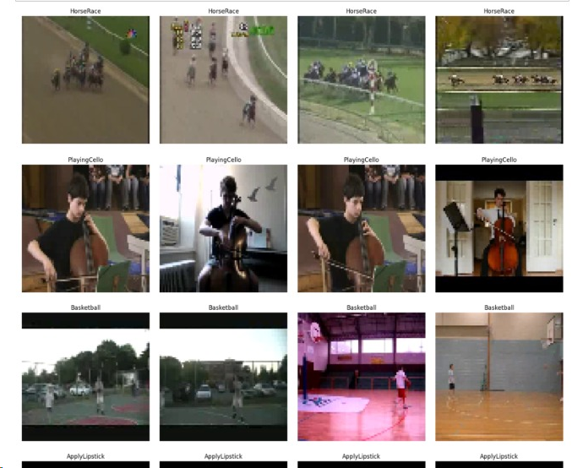
Dataset

Slide 11
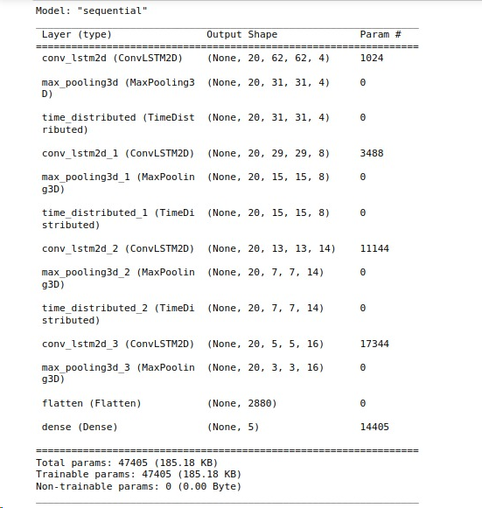
Model summary

Slide 12
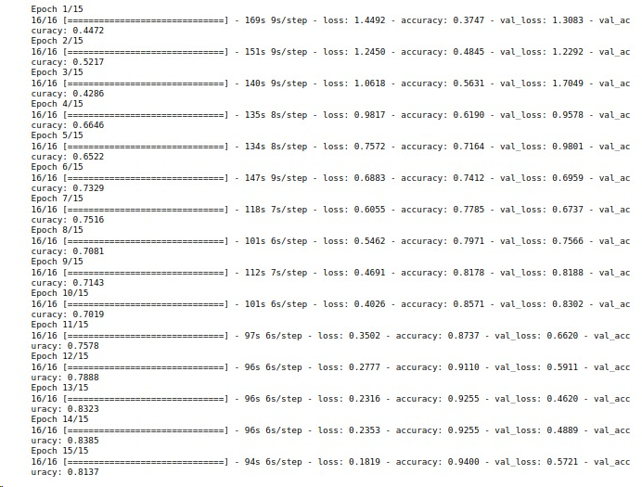
Model Training(15 epochs)

Slide 13
Results and Outputs
High Accuracy Models: The developed AI models have demonstrated impressive accuracy in identifying a wide range of motion patterns, outperforming traditional methods.
Improved Efficiency: The AI-driven motion identification process is more efficient, allowing for real-time or near-real-time processing in applications that demand instant results.
Robust Generalization: The models exhibit strong generalization capabilities, accurately identifying motions in diverse scenarios and varying environmental conditions.

Slide 14
Performance Metrics
The models' performance was evaluated using metrics such as accuracy, precision, recall, and F1-score. These metrics provide a comprehensive understanding of the models' capabilities.
Comparison with Traditional Methods:
A quantitative comparison was made between the AI models and traditional methods like rule-based systems and basic algorithms. The AI models consistently outperformed these methods in terms of accuracy and adaptability.

Slide 15
Real-world Applicability:
The project's outputs are readily applicable across various domains:
Surveillance and Security: Enhanced intruder detection and activity monitoring.
Healthcare: Accurate patient movement analysis and fall detection.
Robotics: Precise gesture recognition and motion planning.

Slide 16
Conclusion
In conclusion, we will be developing a robust and accurate motion detection and tracking system using AI techniques. The system will be able to detect and track moving objects in a variety of scenes, even in the presence of noise and occlusions.
The system has a wide range of potential applications, and we believe that it will have a significant impact on a variety of fields. We are excited to continue working on this project and to see how it can be used to improve our lives.

Slide 17
Future Scope
Fine-tuning models for specific scenarios to maximize accuracy.
Exploring real-time implementation in resource-constrained environments.
Expanding the dataset to encompass even greater diversity.

