Slide 1


Slide 2


Slide 3
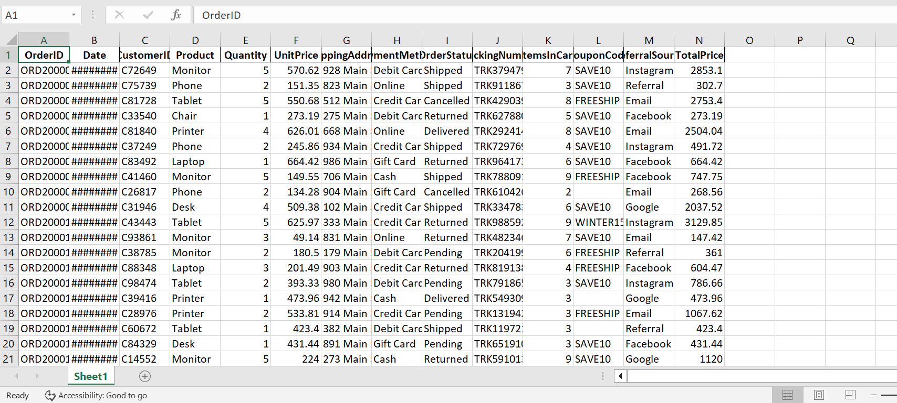
THE RAW REALITY / Before the Cleanup

Slide 4
The 3-Phase Data Cleaning Process
Phase 1 · Imputation (Handling Nulls)
All-Column Pass: Selected all columns and replaced empty cells with a standardized "Null" flag.
Numerical Median Imputation: Calculated column medians to replace missing rows, preserving data scale.
Categorical Imputation: Replaced missing text cells in categorical fields with a "None" placeholder.
Phase 2 · Integrity Audit (Deduplication)
Audited row configurations to identify transaction data duplication.
Applied native Excel data tools to completely remove duplicate records based on primary identifiers.
Phase 3 · Formatting & Type Conversion
Checked structural layouts across all 14 variable dataset columns.
Converted raw strings into precise data types (Short Dates, Currency layouts, and Integer counts).

Slide 5
Project 1: Data Cleaning Change Log
Phase 1: Imputation
• Columns: Quantity, ItemsInCart, CouponCode
• Action: Filled missing numeric cells with Median (=3); replaced empty text strings with a "None" flag.
• Impact: Preserved all 1,200 rows without statistical data loss.
Phase 2: Audit
• Columns: OrderID
• Action: Audited transaction records and executed native Remove Duplicates engine on identifier keys.
• Impact: Secured a strict 0% transaction duplicate error rate.
Phase 3: Formatting
• Columns: Date, UnitPrice, TotalPrice
• Action: Mapped numeric serial strings to Date formats; forced strict currency to exactly 2 decimal places.
• Impact: Resolved date masking layouts and standardized financial precision.
General Cleanup
• Columns: Quantity – Copy
• Action: Deleted redundant data processing helper columns left over from median calculations.
• Impact: Optimized the database file structure and compressed the overall spreadsheet size.

Slide 6
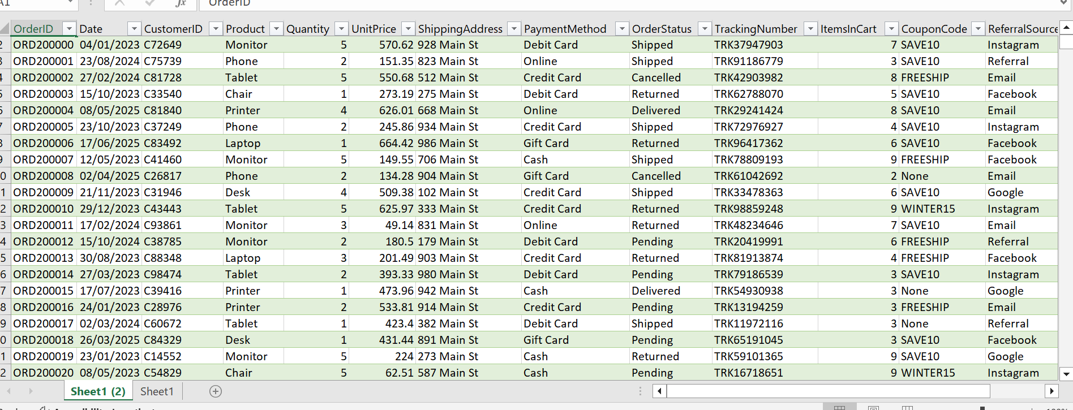
VERIFICATION GATE
🟢 0 Missing Cells: Achieved 100% data completeness by filling empty slots with median values and "None" placeholders.
🟢 0 Duplicate Records: Verified 1,200 unique rows to protect database metrics against inflation.
🟢 100% Uniform Data Types: Successfully converted raw date strings, numeric item counts, and forced financial figures to 2 decimal places.

