Slide 1
Personal Finance Tracker
A React + Vite Web Application
Team Members
React | Vite | Tailwind CSS
Web Programming Mini Project

Slide 2
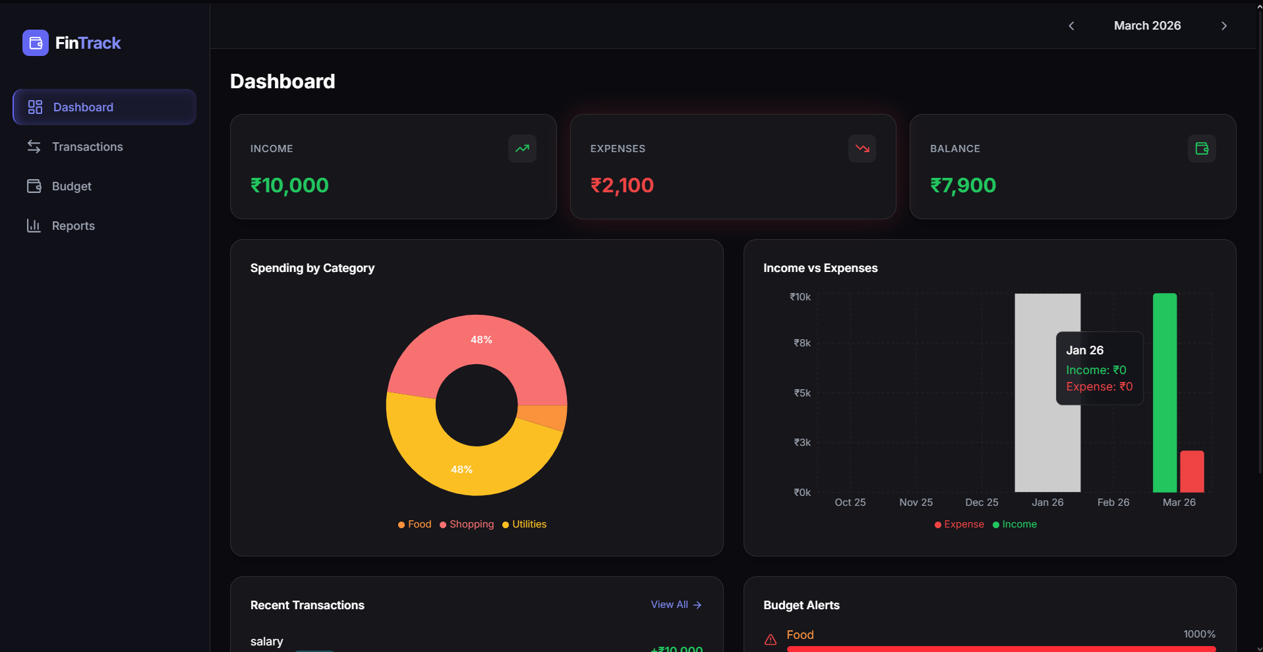
DASHBOARD PAGE

Slide 3
HTML AND CSS
Dark theme layout uses bg-dark-900 Tailwind class for a deep charcoal background throughout the app
Sidebar navigation uses flex flex-col with fixed width and collapsible on mobile using responsive breakpoints
GlassCard shared component uses glassmorphism with backdrop-filter: blur and semi-transparent backgrounds for card containers
Summary cards display income, expense, and balance using color-coded text: text-income (green), text-expense (red), and text-accent (blue) for net balance
Grid layout with grid-cols-1 lg:grid-cols-2 places charts side by side on large screens, stacking vertically on mobile
Navbar includes a month selector dropdown allowing users to switch between months for historical data view
Responsive design adapts to all screen sizes using Tailwind’s breakpoints (sm, md, lg) with overflow handling via overflow-auto

Slide 4
JAVASCRIPT
SummaryCards Component receives income, expense, and balance as props and renders three GlassCard components with formatted currency values using formatCurrency() utility
useFinance Hook is called inside Dashboard to access getMonthlyTotals(), getSpentByCategory(), and activeMonth from the global FinanceContext
useMemo optimization caches pieData and barData computations so charts only recalculate when activeMonth or transactions change, preventing unnecessary re-renders
BudgetWarnings Component scans all active budgets, highlights categories where spending exceeds 80% of limit with warnings, and shows alerts when limits are exceeded
RecentTransactions Component fetches the last 5 transactions for the active month, sorted by createdAt timestamp in descending order for the quick-view panel

Slide 5
RECHARTS DATA VISUALIZATION
SpendingPieChart: Uses Recharts PieChart with custom colors per spending category. pieData is derived from getSpentByCategory() and filtered to exclude zero-value entries before rendering.
IncomeExpenseBar: Renders a grouped BarChart showing income vs. expenses for the last 6 months using getLastNMonths() and getShortMonthLabel() helpers for the x-axis
TrendLineChart: Used in the Reports page with a LineChart and smooth curves. Supports 3, 6, or 12-month ranges via the range state variable toggled by the user
CategoryBreakdown: Aggregates spending across all months in the selected range and renders a horizontal bar chart sorted by highest spending category to lowest
All chart components use ResponsiveContainer from Recharts for automatic width/height adaptation to parent container dimensions

Slide 6
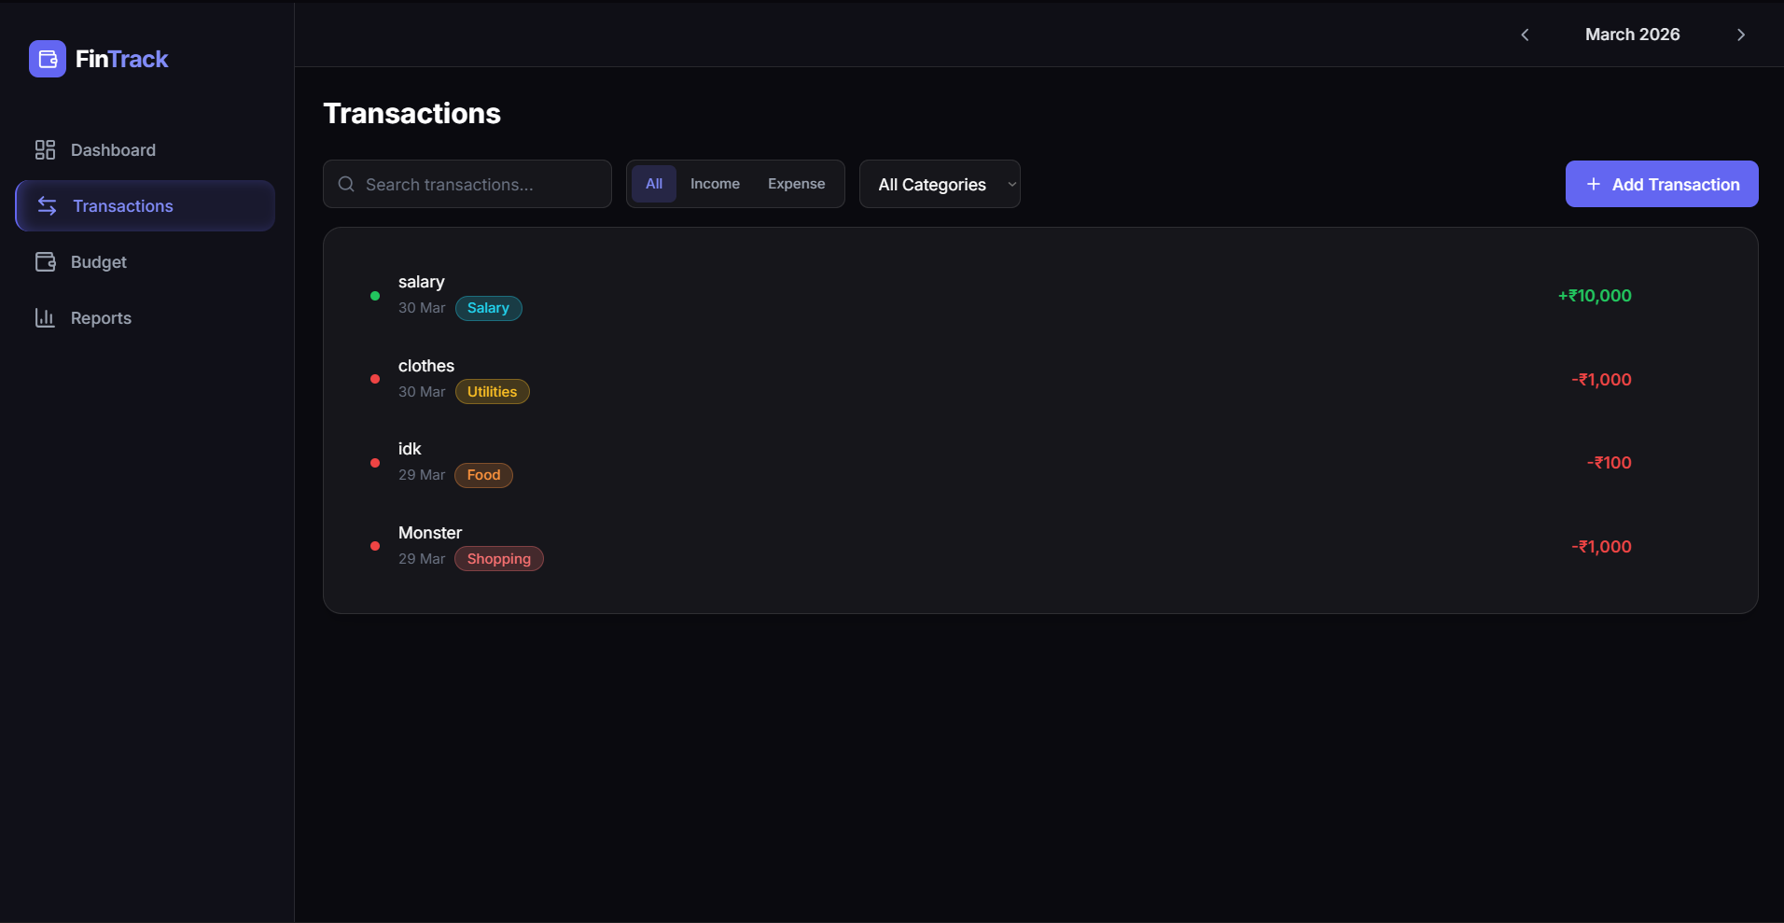
TRANSACTIONS PAGE

Slide 7
HTML and CSS
TransactionList Component: renders each transaction as a row with category badge, description, date, and amount. Income entries show green amounts; expenses show red.
Modal Component: a reusable overlay with fixed positioning and a semi-transparent backdrop, used for Add/Edit transaction forms
TransactionForm: input fields for description, amount, type (income/expense), category, and date. Controlled inputs with React state for Add and Edit modes
TransactionFilters: includes a search bar and two dropdowns for type filter (income/expense/all) and category filter, styled with Tailwind focus rings
ConfirmDialog Component: accessible confirmation dialog before deleting a transaction, with Cancel and Confirm buttons styled distinctly
EmptyState Component: displays a friendly illustration and message when no transactions match the current filter criteria

Slide 8
JAVASCRIPT
addTransaction(data): generates a unique ID via crypto.randomUUID() and a createdAt timestamp, then merges with form data and appends to the transactions array in context state
updateTransaction(id, patch): uses Array.map() to find the matching transaction by ID and spread-merges the patch object, preserving all other fields immutably
deleteTransaction(id): filters out the transaction with matching ID from state. A ConfirmDialog is shown before calling this function to prevent accidental deletion
Modal state management: useState controls modalOpen (boolean) and editingTxn (null or transaction object). openAdd() clears editingTxn before opening; openEdit(txn) sets it
handleSubmit(data): checks if editingTxn exists to decide between updateTransaction() and addTransaction(), then closes the modal after successful submission

Slide 9
FILTERING AND SEARCH LOGIC
useMemo filtered array: transactions are first filtered by typeFilter, then categoryFilter, then searched by lowercase description/category match. Final result is sorted by createdAt descending
getMonthlyTransactions(activeMonth): scoped to the selected month by filtering transactions where date startsWith the YYYY-MM key, ensuring cross-month isolation
Search input uses trim() and toLowerCase() to normalize both query and target fields for case-insensitive fuzzy matching across description and category fields
All filter state (search, categoryFilter, typeFilter) is maintained in local component state and does not affect the global context, keeping the filter UI ephemeral

Slide 10
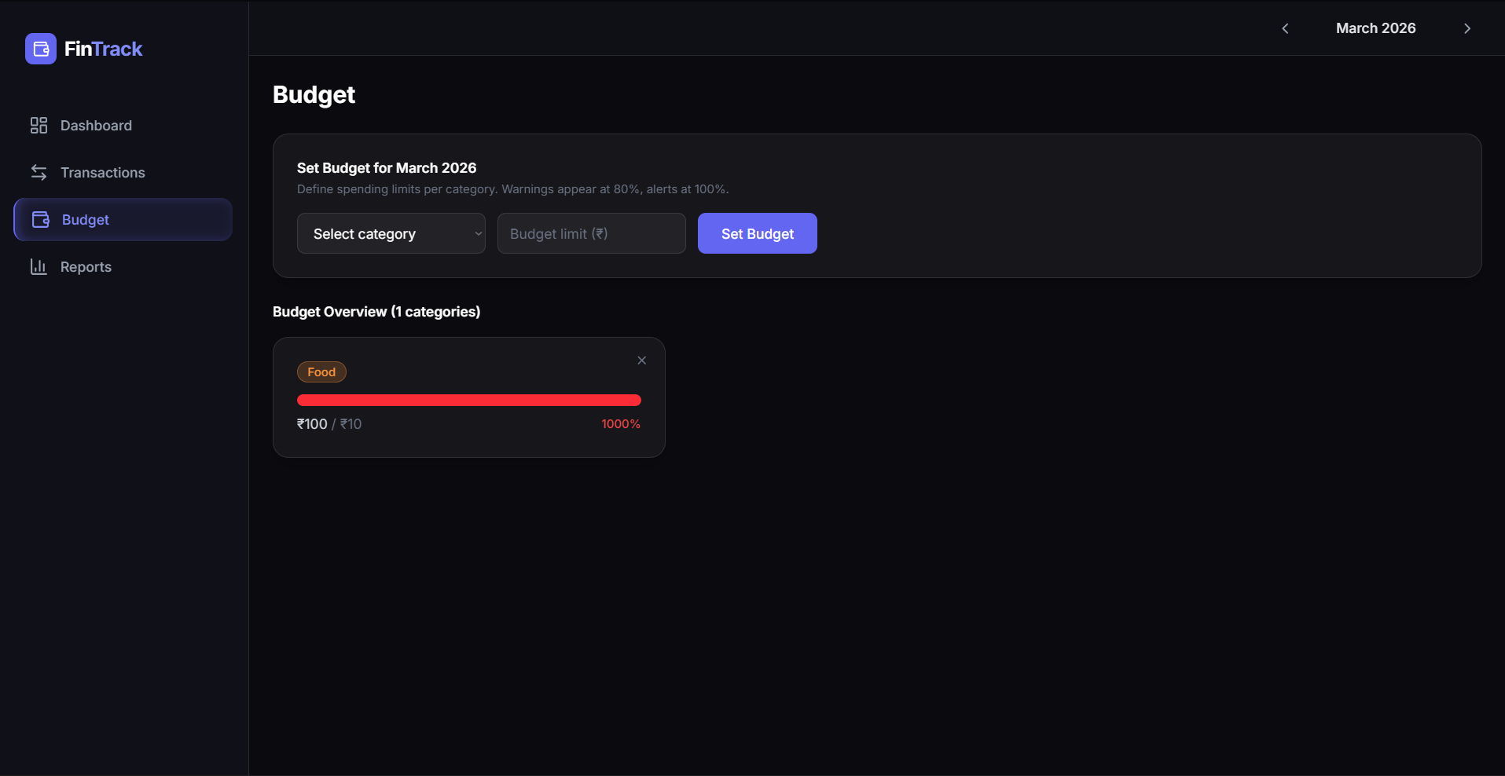
BUDGET PAGE

Slide 11
HTML AND CSS
BudgetForm Component: a category dropdown and number input for setting monthly spending limits. The submit button is styled with an accent gradient and disabled if fields are empty
BudgetOverview Component: lists all budget categories with ProgressBar showing spend percentage. Bars turn yellow at 80% and red at 100% to signal budget status visually
ProgressBar Component: a shared UI element using a filled div whose width is set via inline style (percent). Colors are determined dynamically based on the ratio of spent to limit
Header with month label uses getMonthLabel(activeMonth) to display the human-readable month name (e.g. “March 2026”) and shows count of active budget categories
Warning text in BudgetForm uses muted gray color (text-gray-500) with small font size (text-xs) to indicate threshold behavior without overwhelming the form UI

Slide 12
JAVASCRIPT
setBudget(category, month, limit): checks if a budget for the same category+month already exists; updates the limit if found or appends a new budget entry if not
deleteBudget(category, month): filters out the budget entry matching both category and month, allowing users to remove a specific budget without affecting others
getBudgetStatus(spent, limit): utility in budgetHelpers.js that returns “ok”, “warning”, or “exceeded” based on the percentage of budget consumed
calcSpentPerCategory(transactions, month): reduces the expense transactions for a given month into a {category: totalAmount} map used by both BudgetOverview and BudgetWarnings
getMonthBudgets(month): filters the global budgets array to return only entries for the active month, driving what the Budget page renders in its overview section

Slide 13
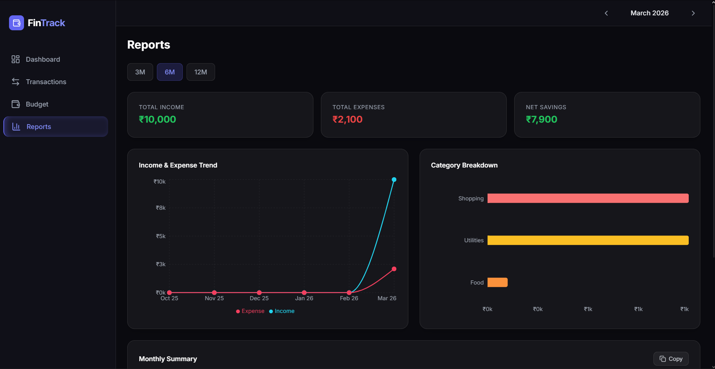
REPORTS PAGE

Slide 14
HTML AND CSS
Range Selector Buttons: three styled buttons (3M, 6M, 12M) with active state using bg-accent/20 background and border highlight; inactive buttons use muted bg-white/5 styling
Aggregate Summary Cards: three GlassCards display total income, expenses, and savings over the selected range with uppercase tracking-wider labels and bold currency amounts
Monthly Summary Table: a data table with Month, Income, Expenses, Savings columns. Each row has alternating hover background for readability, with a copy-to-clipboard button in the header
TrendLineChart Section: placed in a full-width GlassCard container below summary cards. Uses Recharts LineChart with smooth curves and two data series (income/expense) with distinct colors
CategoryBreakdown Section: beside the trend chart in a two-column layout on large screens. Shows aggregated category spending across the selected date range sorted highest to lowest

Slide 15
JAVASCRIPT
trendData computation: maps over the months array (generated by getLastNMonths) and calls getMonthlyTotals() for each to build the chart data array with {month, income, expense} shape
aggregateTotals computation: iterates all months in range and sums income and expense values. Savings is computed as income minus expense and shown as the third aggregate card
categoryData aggregation: loops over all months calling getSpentByCategory(), merges results into a running totals object, then converts to array and sorts descending by amount
summaryRows computation: maps months to rows with {month, income, expense, savings} shape using getMonthLabel() for the human-readable month name in the table display
Range state (useState): clicking a range button updates the range string (“3”, “6”, or “12”), which triggers recalculation of months via useMemo and cascades through all derived data

Slide 16
EXPORT AND COPY FUNCTIONALITY
handleCopy(): constructs a tab-delimited string with a header row (Month, Income, Expenses, Savings) followed by data rows from summaryRows, then writes it to the clipboard via navigator.clipboard.writeText()
Copied state feedback: useState(copied) toggles the button icon between Copy and Check after successful copy, auto-reverting after 2 seconds using setTimeout()
getLastNMonths(n, activeMonth): date helper utility that computes an array of N consecutive YYYY-MM keys ending at the current activeMonth, used to drive all range-based computations
The tab-delimited output format is compatible with spreadsheet applications like Microsoft Excel and Google Sheets, enabling users to paste data directly for further analysis

Slide 17

CONTEXT API & STATE MANAGEMENT
FinanceContext: created with createContext(null) and exported from FinanceContext.jsx. Provides global access to transactions, budgets, activeMonth, and all CRUD functions without prop-drilling
FinanceProvider: wraps the entire app in main.jsx, initializing transactions and budgets from localStorage via useLocalStorage hook, and managing activeMonth with useState
useCallback optimization: all context functions (addTransaction, updateTransaction, deleteTransaction, setBudget, deleteBudget) are wrapped in useCallback to maintain stable references and prevent unnecessary re-renders in consumers
Context value object: exposes transactions, budgets, activeMonth, setActiveMonth, and all CRUD functions plus derived getters: getMonthlyTransactions, getSpentByCategory, getMonthlyTotals, getMonthBudgets

Slide 18
CUSTOM HOOKS
useLocalStorage(key, initialValue): a generic hook that wraps useState, reading from localStorage on initialization and writing back with every state update using JSON.stringify/JSON.parse
Persistence behavior: data survives page refresh and browser closure. Keys “finance_transactions” and “finance_budgets” are used in FinanceProvider to store all app data
useFinance(): a thin wrapper around useContext(FinanceContext) that throws an error if used outside FinanceProvider, ensuring safe context consumption with a clear error message
getCurrentMonthKey(): date utility returning the current month as “YYYY-MM” format, used as the default activeMonth when the app first loads in the FinanceProvider
formatCurrency(amount): utility in formatCurrency.js that formats numeric values using Intl.NumberFormat with currency style, used across all monetary display in the app

Slide 19
TECHNOLOGY STACK
React 19 + Vite 8: the core UI framework with HMR-powered development server. Components use functional style with hooks (useState, useMemo, useCallback, useContext)
React Router DOM v7: client-side routing with Routes, Route, and Navigate components. Four main routes: / (Dashboard), /transactions, /budget, /reports with wildcard fallback redirect
Tailwind CSS v4: utility-first CSS with dark theme color tokens (bg-dark-900, text-income, text-expense, text-accent) and responsive grid layouts across all pages
Recharts v3: data visualization library providing PieChart, BarChart, and LineChart with responsive containers. Used in Dashboard and Reports pages for financial data display
Lucide React + LocalStorage API: Lucide provides consistent SVG icons (Plus, Copy, Check, Trash) across the UI; LocalStorage persists all transaction and budget data client-side without a backend

