Slide 1
Halfmile First-Break Picking
Presentation source for a 25-35 minute technical talk. All metrics and artifact paths below come from the current shot-disjoint Halfmile run in this repository.
Autogenerated from Markdown

Slide 2
Slide 1. Problem Statement and Goal
Objective: detect seismic first breaks automatically from labeled HDF5 trace data.
Business value: first-break quality affects downstream statics, refraction analysis, and tomography workflows.
Technical requirement: reconstruct usable 2D seismic images from flat trace storage, then predict picks robustly under variable noise and changing line behavior.
Constraint: this implementation is CPU-only because the local environment has no GPU.
Notes:
The key point is that the problem is not only a picker problem. The input is not already arranged as clean images; it is a large flat trace table with geometry and labels. A practical solution has to solve organization, leakage control, and evaluation discipline before the model choice matters.

Slide 3
Slide 2. Dataset Overview and HDF5 Structure
Target assets in the task: Brunswick, Halfmile, Lalor, Sudbury.
Local verified asset: Halfmile only.
Halfmile raw file contains 1,099,559 traces, each with 751 samples at 2.0 ms.
Label field is SPARE1 in milliseconds; 0 or -1 means unlabeled.
Halfmile label coverage is 90.33% with 993,189 labeled traces across 690 shots.
Relevant geometry fields include SHOTID, SHOT_PEG, REC_PEG, REC_X, REC_Y, SOURCE_X, SOURCE_Y, COORD_SCALE, and HT_SCALE.
Notes:
This slide establishes scale. The dataset is large enough that sloppy experimental design can produce misleadingly good numbers. It also explains why the loader had to be made generic: different assets may use slightly different combinations of the same fields, so the ingest stage needs sensible fallbacks.

Slide 4
Slide 2. Dataset Overview and HDF5 Structure (Cont.)
Figure reference: reports/evaluation/methodology_results_summary.md
Notes:
This slide establishes scale. The dataset is large enough that sloppy experimental design can produce misleadingly good numbers. It also explains why the loader had to be made generic: different assets may use slightly different combinations of the same fields, so the ingest stage needs sensible fallbacks.

Slide 5
Slide 3. Why 2D Seismic Images Must Be Reconstructed
The HDF5 file stores traces in a flat table, not as final shot images.
First-break behavior is easier to model when traces are placed in receiver order within each shot.
Receiver geometry also reveals large gaps that should split one shot into multiple coherent 2D panels.
Without reconstruction, neighboring traces in memory are not guaranteed to be meaningful neighbors in the image domain.
Notes:
The task description explicitly asks for this reorganization step, and it matters. The ML stage uses local spatial context, so the panel layout has to reflect actual receiver continuity. This is where many shortcut solutions become brittle.

Slide 6
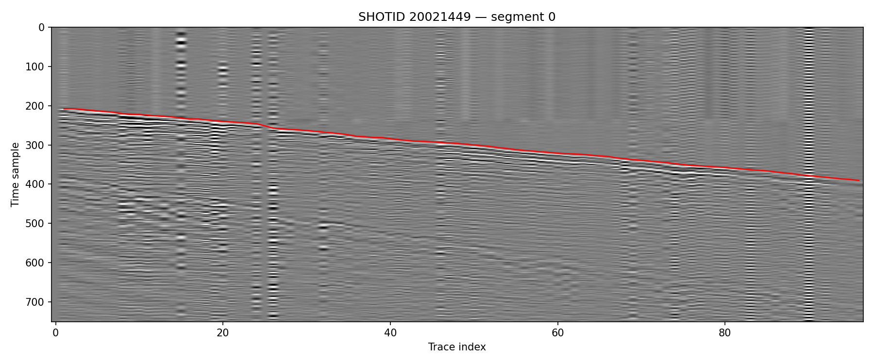
Slide 3. Why 2D Seismic Images Must Be Reconstructed (Cont.)
Figure source: reports/figures/split_preview_20021449/shot_20021449_segment_00.png
Notes:
The task description explicitly asks for this reorganization step, and it matters. The ML stage uses local spatial context, so the panel layout has to reflect actual receiver continuity. This is where many shortcut solutions become brittle.

Slide 7
Slide 4. Halfmile Data Preparation and Segment Export
Group traces by shot using SHOTID, with SHOT_PEG fallback for asset readiness.
Apply SEG-Y scaling rules to coordinates and elevations before using geometry.
Within each shot, sort by REC_PEG; if receiver peg is not informative, fall back to REC_X.
Detect large geometry jumps with jump_factor=8.0 and split into separate segments.
Keep only usable segments with at least 80 traces and at least 70 valid labels.
Notes:
This slide is where I would show the transformation from raw traces to clean panels. The filters are pragmatic rather than academic. Segments that are too short or too sparsely labeled are not useful for either training or honest evaluation.

Slide 8
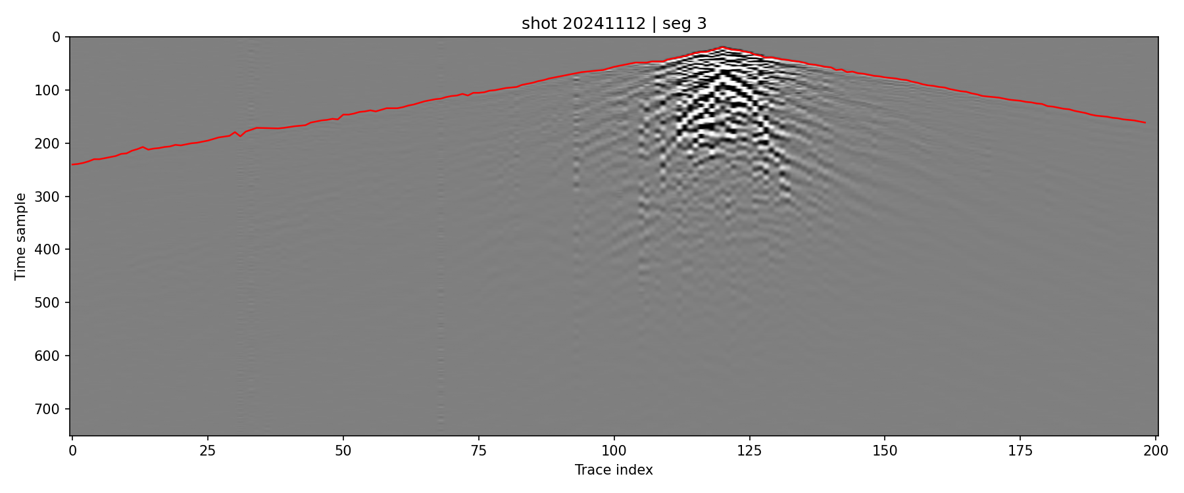
Slide 4. Halfmile Data Preparation and Segment Export (Cont.)
Figure source: reports/figures/exported_segment_previews/Halfmile_shot20241112_seg003.png
Notes:
This slide is where I would show the transformation from raw traces to clean panels. The filters are pragmatic rather than academic. Segments that are too short or too sparsely labeled are not useful for either training or honest evaluation.

Slide 9
Slide 5. Label Coverage and Segmentation Statistics
Final export produced 5,391 Halfmile segments.
689 shots remained after segment filtering; 1 raw shot produced no retained segment.
Segment trace count ranges from 97 to 201, with mean 149.51.
Valid labels per segment range from 70 to 201, with mean 135.32.
The resulting segments are large enough to preserve local structure but small enough for CPU-friendly repeated inference.
Notes:
These numbers matter because they define the operating unit of the pipeline. Every later stage, including the split protocol and the evaluation plots, is segment-based. The segmentation rules also reduce the chance that one pathological receiver gap distorts an entire shot panel.

Slide 10
Slide 5. Label Coverage and Segmentation Statistics (Cont.)
Figure reference: reports/evaluation/methodology_results_summary.md
Notes:
These numbers matter because they define the operating unit of the pipeline. Every later stage, including the split protocol and the evaluation plots, is segment-based. The segmentation rules also reduce the chance that one pathological receiver gap distorts an entire shot panel.

Slide 11
Slide 6. Baseline First-Break Picker Methodology
Step 1: compute a smoothed envelope on each trace.
Step 2: estimate early-time noise and trigger a rough pick using a threshold crossing.
Step 3: smooth the rough pick line across traces to create a prior.
Step 4: refine each trace locally with a derivative-based search around the prior.
Step 5: smooth the final line again to suppress isolated trace noise.
Notes:
This baseline is not trivial. It already uses both single-trace and cross-trace information, which makes it a meaningful benchmark. That is important because the correction model is judged against a fairly strong classical method, not against a naive threshold-only picker.

Slide 12
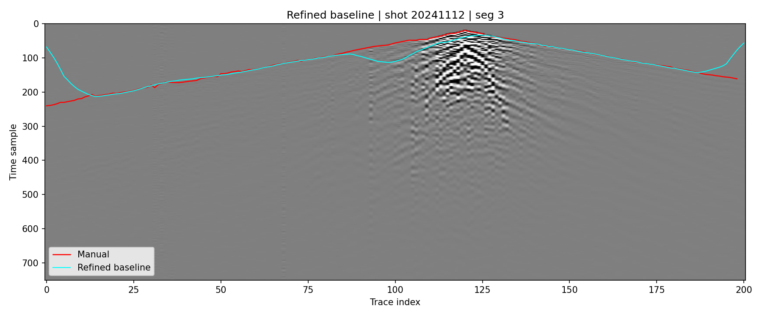
Slide 6. Baseline First-Break Picker Methodology (Cont.)
Figure source: reports/figures/baseline_refined_preview_shot20241112_seg003.png
Notes:
This baseline is not trivial. It already uses both single-trace and cross-trace information, which makes it a meaningful benchmark. That is important because the correction model is judged against a fairly strong classical method, not against a naive threshold-only picker.

Slide 13
Slide 7. Why the Baseline Needs Correction
The refined baseline is consistent on many segments but still drifts under strong noise or structural complexity.
Errors are often locally systematic rather than random, which makes them good candidates for a learned correction model.
Predicting a bounded correction is easier on CPU than training a full deep network from scratch.
This two-stage design also preserves a usable fallback line if the learned stage fails.
Notes:
The key design decision was to learn the residual instead of replacing the entire picker. In this dataset, the baseline often lands in roughly the right neighborhood, and the job becomes local cleanup. That is a better fit for a CPU-first workflow.

Slide 14
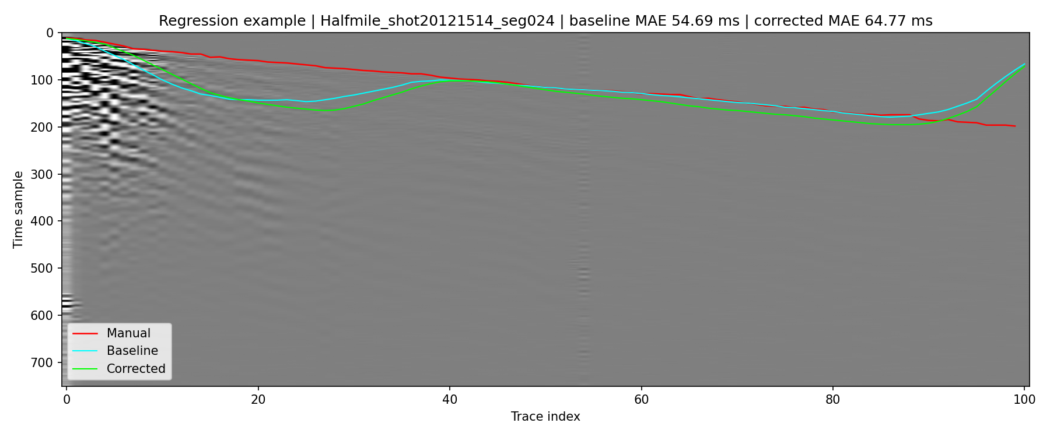
Slide 7. Why the Baseline Needs Correction (Cont.)
Figure source: reports/evaluation/figures/regression_Halfmile_shot20121514_seg024.png
Notes:
The key design decision was to learn the residual instead of replacing the entire picker. In this dataset, the baseline often lands in roughly the right neighborhood, and the job becomes local cleanup. That is a better fit for a CPU-first workflow.

Slide 15
Slide 8. ML Correction Dataset Design
For each valid trace, build a patch centered on the baseline pick.
Patch size is 81 x 5, which captures time context and a small neighborhood of adjacent traces.
Flatten each patch into 405 tabular features.
Sample every third valid trace with trace_stride=3.
Discard extreme labels where |true - baseline| > 60 samples to avoid making the model chase rare outliers.
Notes:
This is intentionally simple and defensible. The model sees local image texture around the current pick and learns whether the line should move up or down. The patch shape is wide enough to catch cross-trace continuity but still compact enough for fast training.

Slide 16
Slide 9. CPU-First Model Choice and Training Setup
Model family: HistGradientBoostingRegressor.
Training datasets: 146,767 train examples and 21,354 validation examples.
Four small candidate configurations were tested on the validation split.
Final model is refit on combined train plus validation examples after selection.
No GPU dependency, no deep learning framework, and no expensive hyperparameter sweep.
Notes:
This slide is where I would explicitly justify not using a CNN. With no GPU and only one locally available asset, a classical boosted regressor is a better engineering choice. It is easy to train, easy to inspect, and strong enough to show measurable value on held-out shots.

Slide 17
Slide 9. CPU-First Model Choice and Training Setup (Cont.)
Figure reference: reports/evaluation/methodology_results_summary.md
Notes:
This slide is where I would explicitly justify not using a CNN. With no GPU and only one locally available asset, a classical boosted regressor is a better engineering choice. It is easy to train, easy to inspect, and strong enough to show measurable value on held-out shots.

Slide 18
Slide 10. Validation Protocol and Leakage Control
The original risk in this project was segment-level leakage: segments from the same shot can look too similar across train and test.
The final protocol splits by asset_name + shot_id, not by individual segment file.
Split seed is 42 with ratios 70/10/20.
Result: 482 train shots, 68 validation shots, 139 test shots.
Overlap checks are explicit and all split-pair overlaps are 0.
Notes:
This slide is central to the credibility of the results. Once the evaluation became shot-disjoint, the numbers got harder, but they became believable. That tradeoff is worth making because the goal is generalization, not a flattering offline score.

Slide 19
Slide 10. Validation Protocol and Leakage Control (Cont.)
Figure reference: data/processed/splits/split_summary.json
Notes:
This slide is central to the credibility of the results. Once the evaluation became shot-disjoint, the numbers got harder, but they became believable. That tradeoff is worth making because the goal is generalization, not a flattering offline score.

Slide 20
Slide 11. Validation Selection Results
Candidate search metric: corrected MAE on validation correction examples.
Best configuration: learning_rate=0.04, max_iter=260, max_depth=8, min_samples_leaf=25, l2_regularization=0.0.
Best validation baseline MAE: 18.769 ms.
Best validation corrected MAE: 10.643 ms.
Best validation baseline RMSE: 33.427 ms.
Best validation corrected RMSE: 22.079 ms.
Table path: data/processed/ml_correction_training_report.json
Notes:
I would make it clear here that these are patch-level validation numbers, not the final test numbers. They are used for model selection only. The real claim comes from the next slide, where the full held-out segments are evaluated end to end.

Slide 21
Slide 12. Quantitative Held-Out Test Results
Test set contains 1,086 held-out segments from 139 shots.
Metrics are computed over 146,594 valid labeled traces.
The ML correction stage improves every reported aggregate metric over the refined baseline.
Notes:
This is the main result slide. The absolute errors are still large enough that there is room for improvement, but the direction is clear: the correction stage materially improves both average error and tolerance-based accuracy on unseen shots.

Slide 22
Slide 12. Quantitative Held-Out Test Results (Cont.)
Method | MAE (ms) | RMSE (ms) | Acc <= 2 ms | Acc <= 4 ms | Acc <= 8 ms
Refined baseline | 47.694 | 96.458 | 22.662% | 34.172% | 48.610%
ML corrected | 37.213 | 87.026 | 36.186% | 50.193% | 62.340%
Improvement | 10.481 | 9.433 | +13.524 pts | +16.021 pts | +13.729 pts
Notes:
This is the main result slide. The absolute errors are still large enough that there is room for improvement, but the direction is clear: the correction stage materially improves both average error and tolerance-based accuracy on unseen shots.

Slide 23
Slide 12. Quantitative Held-Out Test Results (Cont.)
Table path: reports/evaluation/test_summary_table.csv
Notes:
This is the main result slide. The absolute errors are still large enough that there is room for improvement, but the direction is clear: the correction stage materially improves both average error and tolerance-based accuracy on unseen shots.

Slide 24
Slide 13. Visual Comparison Examples
Best example: Halfmile_shot20301149_seg000, MAE improves from 7.06 ms to 5.06 ms.
Median example: Halfmile_shot20261181_seg001, MAE improves from 47.30 ms to 31.72 ms.
Worst example: Halfmile_shot20041590_seg005, MAE improves only slightly from 436.57 ms to 428.82 ms.
The model helps most when the baseline is close but locally biased.
Notes:
I would walk through these three examples quickly. The point is not to hide difficult cases. The point is to show where the model is strong, where it is merely acceptable, and where the entire two-stage approach still struggles.

Slide 25
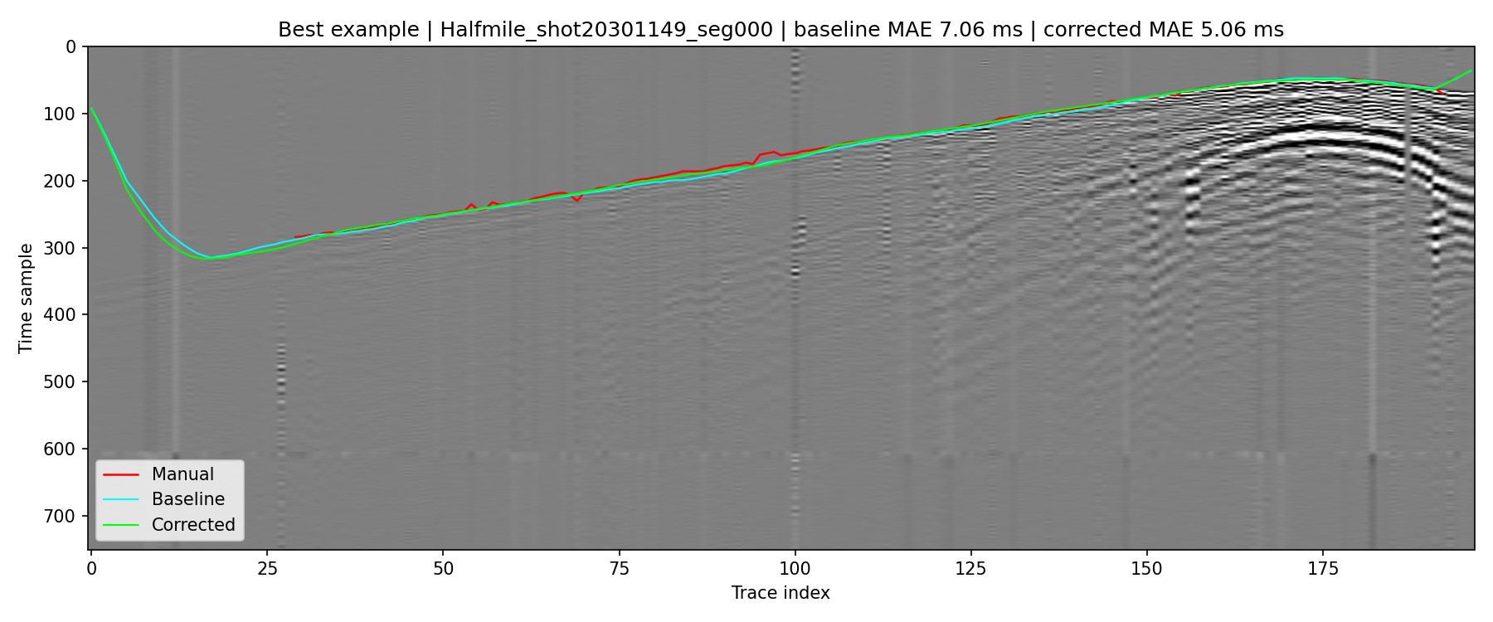
Slide 13. Visual Comparison Examples (Cont.)
Figure source: reports/evaluation/figures/best_Halfmile_shot20301149_seg000.png
Notes:
I would walk through these three examples quickly. The point is not to hide difficult cases. The point is to show where the model is strong, where it is merely acceptable, and where the entire two-stage approach still struggles.

Slide 26
Slide 13. Visual Comparison Examples (Cont.)
reports/evaluation/figures/median_Halfmile_shot20261181_seg001.png
reports/evaluation/figures/worst_Halfmile_shot20041590_seg005.png
Notes:
I would walk through these three examples quickly. The point is not to hide difficult cases. The point is to show where the model is strong, where it is merely acceptable, and where the entire two-stage approach still struggles.

Slide 27
Slide 14. Error Analysis and Failure Cases
1,048 of 1,086 test segments improved (96.50%).
36 segments worsened and 2 were unchanged.
Mean per-segment MAE gain is 10.325 ms; median gain is 7.747 ms.
Worst regression case is Halfmile_shot20121514_seg024, where MAE changes from 54.69 ms to 64.77 ms.
Remaining failures are concentrated in segments where the baseline starts far from the true line.
Notes:
This slide keeps the presentation honest. The correction model is not magic. If the baseline is badly wrong, a small local patch around that bad pick may not contain the information needed to recover the true first break.

Slide 28
Slide 14. Error Analysis and Failure Cases (Cont.)
Figure source: reports/evaluation/figures/regression_Halfmile_shot20121514_seg024.png
Notes:
This slide keeps the presentation honest. The correction model is not magic. If the baseline is badly wrong, a small local patch around that bad pick may not contain the information needed to recover the true first break.

Slide 29
Slide 15. Robustness, Limitations, and No-GPU Tradeoffs
Strength: the final workflow is reproducible, fast enough on CPU, and uses a leakage-safe split.
Strength: the code path is modular and shared across export, training, and evaluation.
Limitation: only one asset was locally available for execution, so cross-asset generalization is not yet validated.
Limitation: the model learns local residuals and can fail when the baseline is globally misaligned.
Tradeoff: skipping GPU-oriented deep learning reduced infrastructure cost but also capped model expressiveness.
Notes:
This is where I would explain the engineering stance. Given the local constraints, it was better to produce a trustworthy CPU pipeline and real held-out results than to add an unvalidated deep model that could not be trained properly in this environment.

Slide 30
Slide 16. Multi-Asset Readiness and What Remains Unverified
The loader now supports SHOTID with SHOT_PEG fallback.
Coordinate and elevation scaling are handled generically through COORD_SCALE and HT_SCALE.
asset_name is carried through manifests, splits, datasets, and evaluation outputs.
The same pipeline should run on Brunswick, Lalor, and Sudbury once their raw HDF5 files are added.
What remains unverified is not the interface, but the empirical behavior on those assets.
Notes:
I would be explicit here: the code is multi-asset ready by design, but the reported numbers are Halfmile numbers only. That distinction matters in a technical review.

Slide 31
Slide 17. Final Conclusion
A full CPU-only Halfmile pipeline was built and validated end to end.
The final workflow reconstructs 2D panels, enforces shot-disjoint evaluation, learns a residual correction, and reports held-out full-segment metrics.
On held-out Halfmile shots, ML correction improves MAE by 10.48 ms and RMSE by 9.43 ms over the refined baseline.
The current result is submission-ready for a Halfmile-centered demonstration and provides a clean base for multi-asset extension.
Notes:
I would close by emphasizing credibility over flash. The main contribution is not only a better score; it is a reproducible workflow with leakage control, CPU feasibility, and clear next steps for multi-asset validation.

Slide 32
Slide 17. Final Conclusion (Cont.)
Figure reference: reports/evaluation/test_summary_table.csv
Notes:
I would close by emphasizing credibility over flash. The main contribution is not only a better score; it is a reproducible workflow with leakage control, CPU feasibility, and clear next steps for multi-asset validation.

Slide 33
Appendix A. Commands Used for the Final Run
BASH
python scripts/export_segments.py --path data/raw/Halfmile3D_add_geom_sorted.hdf5 --out_dir data/interim/Halfmile_segments --asset_name Halfmile python scripts/split_segments_train_test.py --segments_dir data/interim/Halfmile_segments --manifest_path data/interim/Halfmile_segments/Halfmile_segments_manifest.json --out_dir data/processed/splits --train_ratio 0.7 --val_ratio 0.1 --seed 42 python scripts/build_ml_dataset.py --segments_dir data/interim/Halfmile_segments --split_json data/processed/splits/train_segments.json --out_npz data/processed/ml_train_dataset.npz python scripts/build_ml_dataset.py --segments_dir data/interim/Halfmile_segments --split_json data/processed/splits/val_segments.json --out_npz data/processed/ml_val_dataset.npz python scripts/build_ml_dataset.py --segments_dir data/interim/Halfmile_segments --split_json data/processed/splits/test_segments.json --out_npz data/processed/ml_test_dataset.npz python scripts/train_ml_correction_model.py --train_npz data/processed/ml_train_dataset.npz --val_npz data/processed/ml_val_dataset.npz --out_model data/processed/ml_correction_model.pkl --out_report data/processed/ml_correction_training_report.json python scripts/evaluate_ml_correction_model.py --segments_dir data/interim/Halfmile_segments --test_split_json data/processed/splits/test_segments.json --model_pkl data/processed/ml_correction_model.pkl --out_dir reports/evaluation python -m unittest discover -s tests -v

Slide 34
Appendix B. Artifact Inventory
Split summary: data/processed/splits/split_summary.json
Training report: data/processed/ml_correction_training_report.json
Held-out summary: reports/evaluation/test_summary.json
Held-out summary table: reports/evaluation/test_summary_table.csv
Per-segment metrics: reports/evaluation/test_segment_metrics.csv
Best, median, worst, regression figures: reports/evaluation/figures/
Compact report summary: reports/evaluation/methodology_results_summary.md

Slide 35
Appendix C. Final Hyperparameters
JSON
{ "model": "HistGradientBoostingRegressor", "learning_rate": 0.04, "max_iter": 260, "max_depth": 8, "min_samples_leaf": 25, "l2_regularization": 0.0, "half_width": 2, "half_height": 40, "trace_stride": 3, "max_abs_correction": 60 }

Slide 36
Appendix D. Extra Qualitative Examples
Best example figure: reports/evaluation/figures/best_Halfmile_shot20301149_seg000.png
Median example figure: reports/evaluation/figures/median_Halfmile_shot20261181_seg001.png
Worst example figure: reports/evaluation/figures/worst_Halfmile_shot20041590_seg005.png
Regression example figure: reports/evaluation/figures/regression_Halfmile_shot20121514_seg024.png

