Slide 1
GROUP #08
Binary Label Text Classification
Mental Health Text Analysis
25MSDS035
25MSDS008
25MSDS033
Anosha Mohsin
Hafiza Alishba Fareed
Maryam Shaikh

Slide 2
Binary Label Text Classification
Mental Health Text Analysis
1,957
653
5
69.96%
Train Samples
Val / Test Each
Models Trained
Best Macro F1

Slide 3
Binary: Data, Preprocessing & Features
Dataset Splits
Class Distribution (Train)
Train
1,957 samples
Label 0
1551 (79.3%)
Validation
653 samples
Label 1
406 (20.7%)
Test
653 samples
⚠ 79.3% vs 20.7% imbalance — SMOTE required
Preprocessing → TF-IDF → SMOTE Oversampling
Lowercase
Remove URLs/HTML
Strip punct
Remove digits
Trim whitespace
TF-IDF
SMOTE
Class Weights
DL Tokens
5,000 features
(1,2)-gram
Label 0: 1,551
Label 1: 1,551 (balanced)
Label 0: 0.631
Label 1: 2.410
10,000 vocab
MAXLEN=200, Embed 100

Slide 4
Binary Classification — Model Results
Rank
Model
F1
Acc
Tag
Best: Logistic Regression
#1
Logistic Regression
0.6996
0.7810
Top1
Macro F1 = 0.6996 • Acc = 0.7810
#2
Linear SVM
0.6878
0.7902
Per-Class Performance:
Top2
Prec
Rec
F1
#3
LSTM (BiLSTM)
0.6782
0.8270
Top3
Class 0 (518)
0.890
0.820
0.860
#4
XGBoost
0.6294
0.7871
Class 1 (135)
0.480
0.630
0.540
#5
Random Forest
0.5686
0.7902

Slide 5
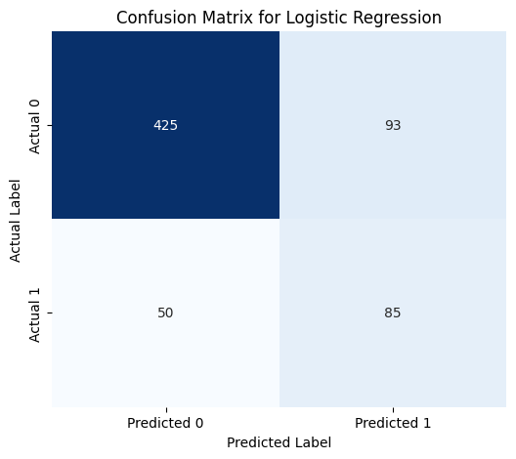
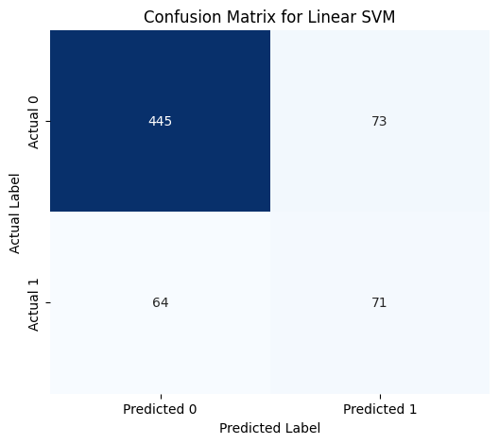
Confusion Matrices — Top Models

Slide 6
Binary Task Submissions
Summary
Attempt 1
Logistic Regression
F1: 0.6996
Attempt 2
Linear SVM
F1: 0.6878
Attempt 3
LSTM (BiLSTM)
F1: 0.6782
5
Total Models
Key Findings — Binary Task
0.70
✓
LR again tops all models — fast, balanced, reliable for text classification regardless of task type
Peak Binary
Macro F1
✓
SMOTE produced perfectly balanced training (1,551 vs 1,551) and helped minority class recall significantly
✓
LSTM reached F1=0.678 — the only DL model that worked well, benefiting from larger effective training set
⚠
Random Forest (F1=0.57) lagged despite SMOTE — decision boundaries are too coarse for high-dim TF-IDF space

Slide 7
Multi-Label Text
Classification
2,131
711
9
45.6%
Train Samples
Val / Test Each
Models Trained
Best Macro F1
Task: Predict label (0/1/2/3) from free-text posts • Metric: Macro F1 Score

Slide 8
Dataset & Preprocessing
Dataset Splits
Label Distribution (Train)
Train
2,131 samples
Label 0
1551 (72.8%)
Validation
711 samples
Label 1
174 (8.2%)
Test
Label 2
236 (11.1%)
711 samples
Label 3
170 (8%)
⚠ Class imbalance: Label 0 = 72.8% of train data → minority classes (1,2,3) are harder to predict
Preprocessing → Feature Engineering
Lowercase
Remove URLs
NUM token
Strip punct
Trim spaces
Word TF-IDF
Char TF-IDF
Combined
Dense (DL)
20K feat, (1,2)-gram
15K feat, (3,5)-gram
Combining word-level (1-2 grams) and character-level (3-5 grams) TF-IDF captures both semantic and morphological patterns in text.
5K feat,
for MLP input

Slide 9
Model Results
Rank
Model
Macro F1
Tag
Best Model: LR (C=1)
#1
LR (C=1)
0.4556
Top1
Macro F1 = 0.4556
#2
Linear SVM
0.4267
Top2
Per-class Performance:
#3
LightGBM
0.4053
Prec
Rec
F1
TOP 3
Class 0 (1551)
0.867
0.770
0.816
#4
XGBoost
0.3024
Class 1 (174)
#5
Complement NB
0.2968
0.295
0.310
0.302
#6
Random Forest
0.2194
Class 2 (236)
0.331
0.506
0.400
#7
Deep MLP
0.1207
Class 3 (170)
0.275
0.339
0.304
#8
CNN
0.1207
#9
Bi-LSTM
070.04
Accuracy: 0.6695 • Val samples: 711

Slide 10
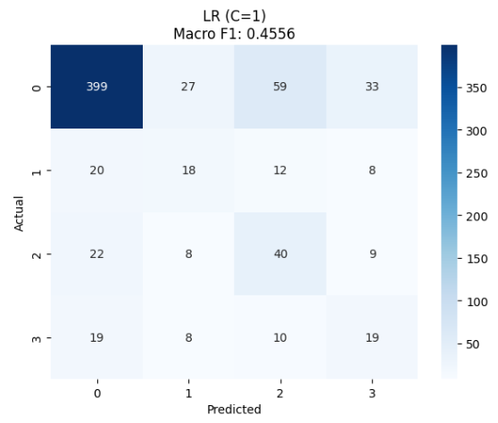
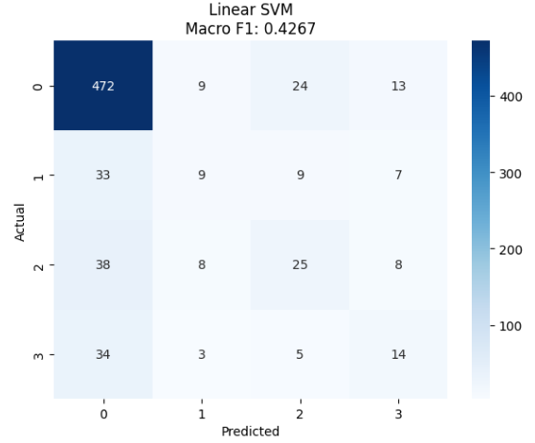
Confusion Matrices — Top Models

Slide 11
Model Performance Comparison
0.0
0.1
0.2
0.3
0.4
0.5
ML
LR (C=1)
0.4556
ML
Linear SVM
0.4267
ML
LightGBM
0.4053
ML
XGBoost
0.3024
ML
Complement NB
0.2968
ML
Random Forest
0.2194
DL
Deep MLP
0.2107
DL
1D CNN
0.2107
DL
Bi-LSTM
0.0407
ML
= Machine Learning
DL
= Deep Learning • DL models significantly underperformed ML — likely due to small dataset size (2,131 samples)

Slide 12
Summary
Key Findings
✓
LR (C=1) topped all 12 models at F1=0.4556 — simpler regularization helped generalize to minority classes
✓
Dual TF-IDF (word + char n-grams, 35K features) was critical for capturing linguistic patterns in social posts
0.4556
Best Macro F1
(LR C=1)
✓
Ensemble LR (soft vote) ranked #3 — still useful backup but didn't beat individual best this run
9
⚠
All DL models collapsed or near-collapsed — small training set (2,131) is insufficient for embedding-based models
Total Models
Trained
⚠
Severe class imbalance (72.8% label 0) — balanced class weights partially helped but minority F1 stayed low (~0.30)
→
Future improvements: pre-trained embeddings (BERT), larger DL dataset or transfer learning

Slide 13
Thank You

