Slide 1

Axis Insurance

Slide 2
Background
AXIS INSURANCE is A medical insurance company
Dataset available to me is for its customers.

Slide 3
Objective
Explore the dataset and extract insights using Exploratory Data Analysis. Then answer the following questions:
Prove (or disprove) that the medical claims made by the people who smoke is greater than those who don't?
Prove (or disprove) with statistical evidence that the BMI of females is different from that of males.
Is the proportion of smokers significantly different across different regions?
Is the mean BMI of women with no children, one child and two children the same? Explain your answer with statistical evidence.

Slide 4
Data Information
Variable | Description
Age | Age of the customer in years
Sex | Customer’s gender
BMI | Body Mass Index of the customer
Children | Number of children each customer has
Smoker | Shows whether the customer smokes or not
Region | Region where the customer lives
Charges | Amount of money customers are claiming as medical fees
Observations/Rows | Variables
1338 | 7

Slide 5
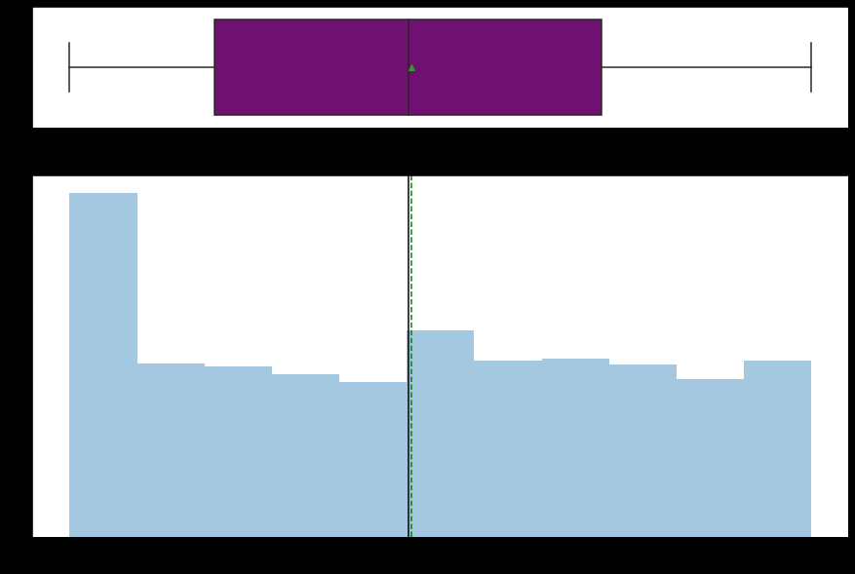
Exploratory Data Analysis – Age
Observations
We have more customer on the 20 years of age more than any other age
Median age is 39 while mean is 39.2
There are no outliers this variable.
While the minimum age is 18 the maximum age above 60 years

Slide 6
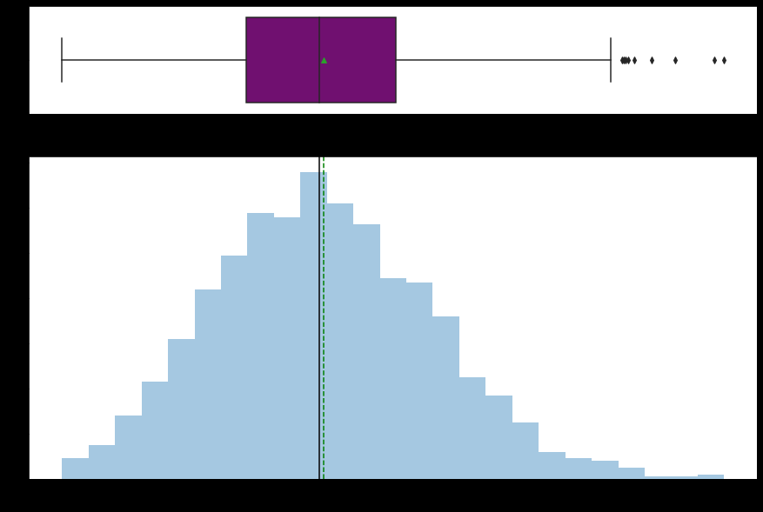
Exploratory Data Analysis – BMI
Observations
This is normally distributed with a number of outlier to the right
Both mean and median are quite close at 30 and 30.4 respectively

Slide 7
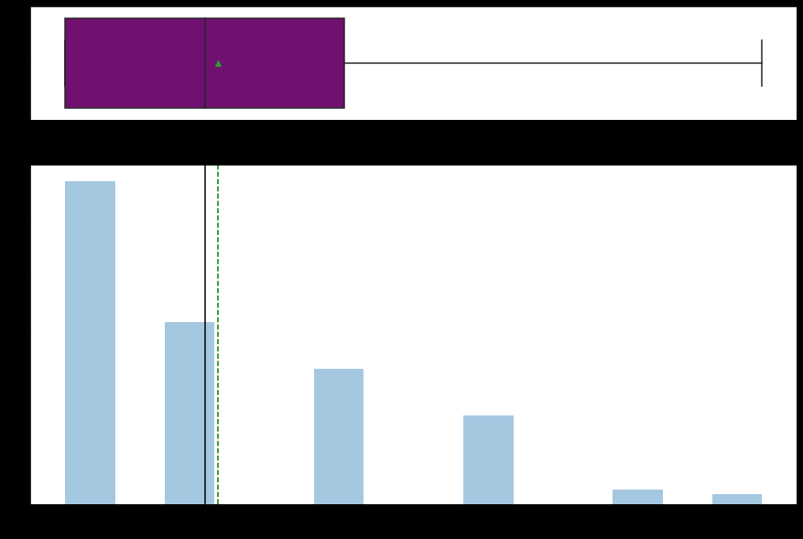
Exploratory Data Analysis – Children
Observations
The distribution of children is right skewed
Median and mean are at 1 child
There are no outliers

Slide 8
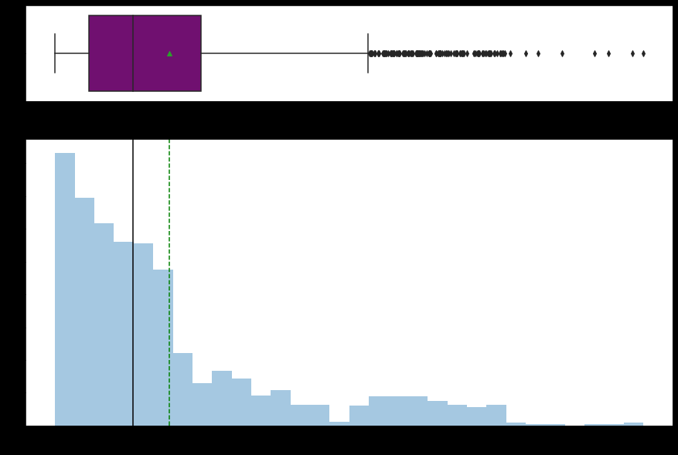
Exploratory Data Analysis – Charges
Observations
Charges is heavely skewed to the right
Median charge is 13270 and mean is 9382
There are so many outliers to the right
Most charges are below 9000

Slide 9
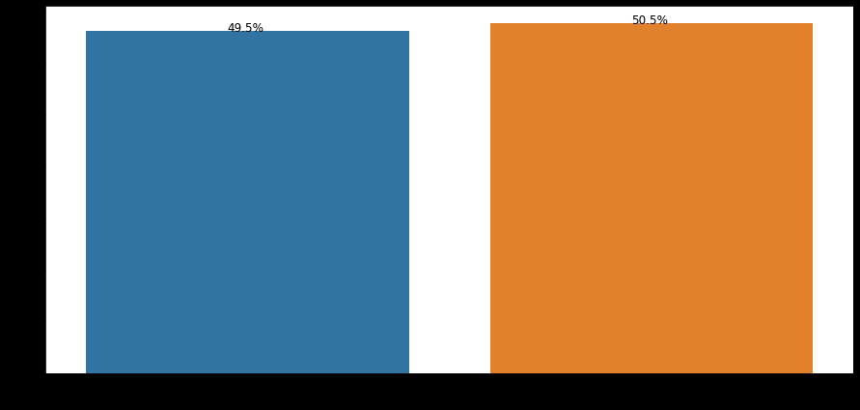
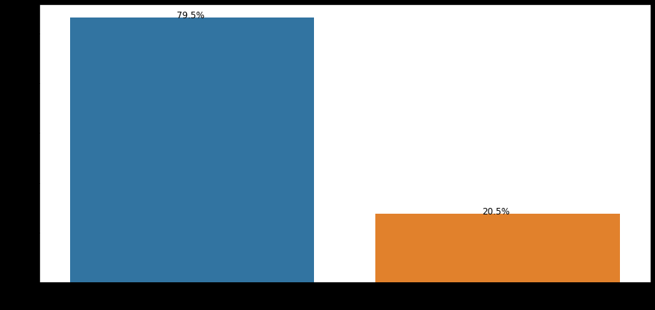
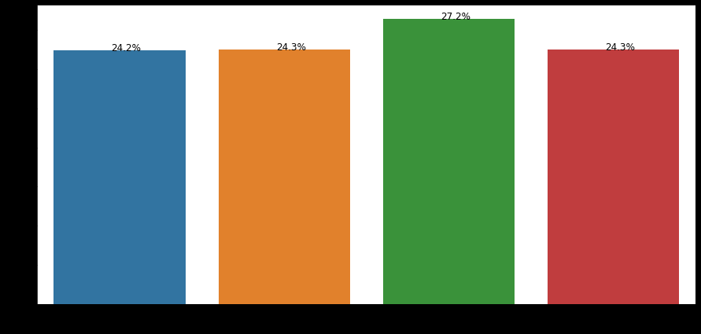
Exploratory Data Analysis– Sex, Smoker, Region
Sex
Smoker
Region
50.5% of the customers are male while 49.5% are female.
79.5% of the customers are non-smokers.
It will be interesting to see the relationship between smoking and BMI
From data available here, is not true that people who smoke are greater than those who don't. In fact, approximately 80% of the customers do not smoke.
Region is uniformly distributed, except that Southeast is at 27.2% while other 3 regions are at ~24%

Slide 10
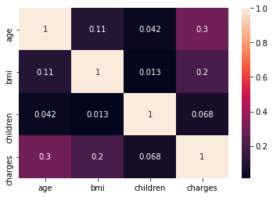
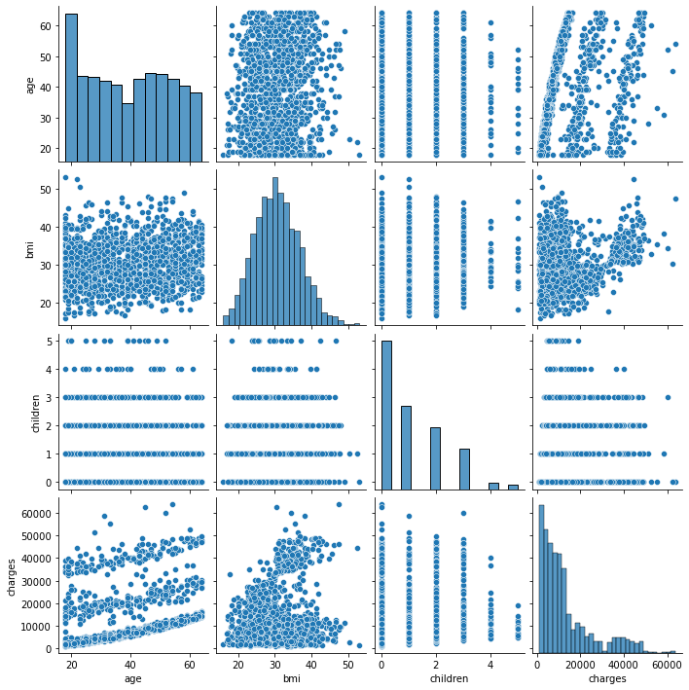
Relationship Between All Variables Using Heatmap and Pairplot
Observations
A quick glance shows that there is more positive correction between Age and Charges.
I was actually expecting a higher positive correction than 0.2 between BMI and Charges than I see in the heatmap above
No negative correction observed.

Slide 11
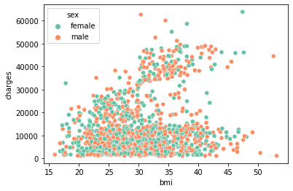
Relationship BMI and Charges
Observations
There is a slight positive correction between the 2 variables.
Most charges within the 20000 are between the BMI of 20 and 45
Both male and female customers are evenly represented.

Slide 12
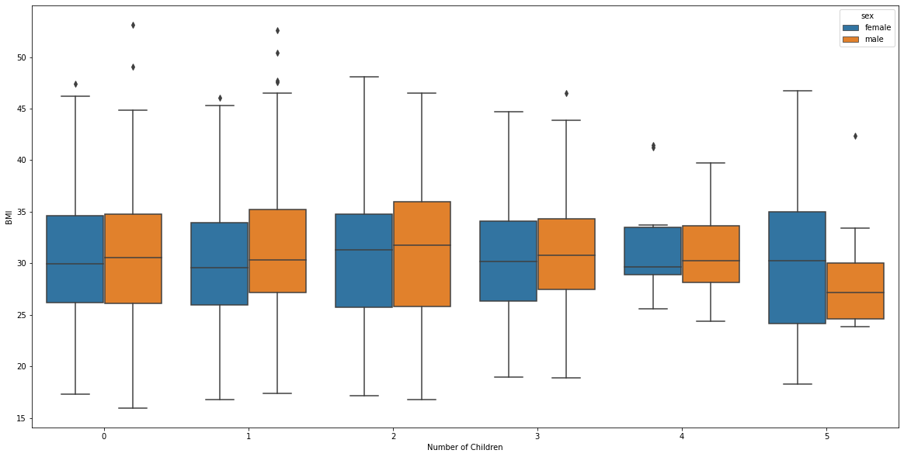
Relationship BMI and Children
Observations
The mean BMI of Female with no children, 1 child and 2 children are approximately 30.

Slide 13
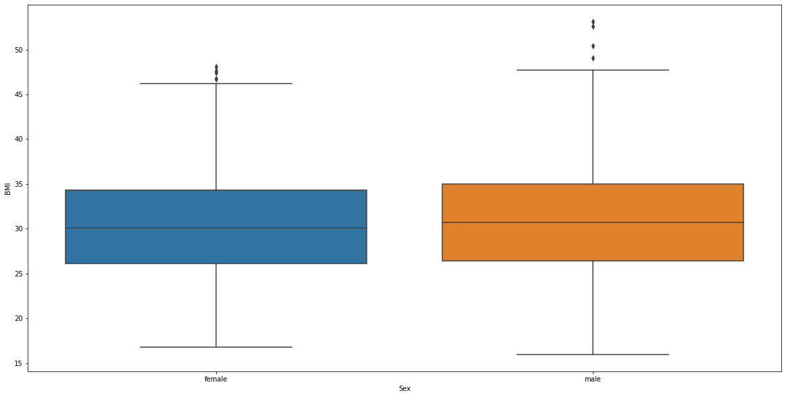
Relationship BMI and Sex
Observations
There is no clear difference between BMI of Male and Female customers
Both male and female have average BMI around the 30 mark, with lower quantile around 26 and upper quantile around 34.
Both have a few outlier toward the BMI of 50

Slide 14
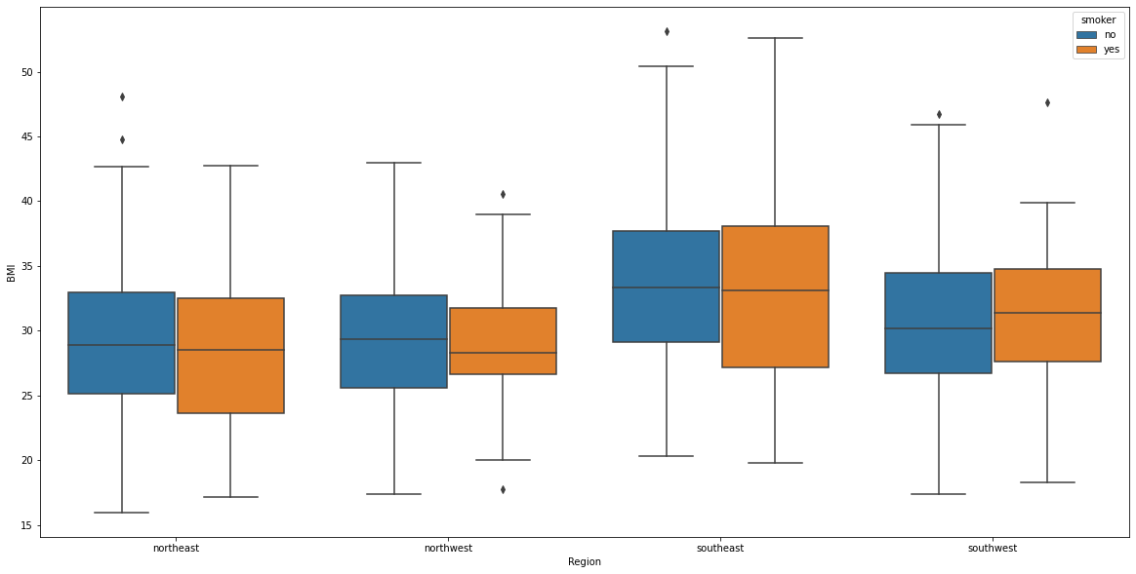
Relationship Smoker and Region
Observations
There is no significant difference between smokers across the different regions
We will perform analysis of variance on this later.

Slide 15
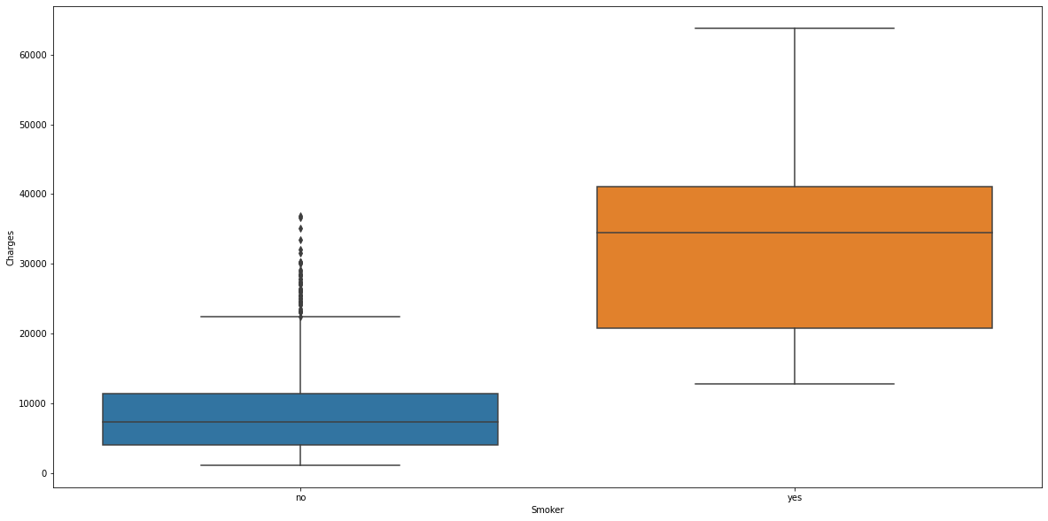
Relationship Smoker and Charges
Observations
There is significant difference between smokers and non smokers charges
Medical claims by people who smoke is significantly higher than that of those who do not smoke

Slide 16
Hypothesis Testing
Assumptions:
The level of significance (Alpha ) = 0.05.
The sample size, N = 1338 which is sufficiently large.

Slide 17
Prove (or disprove) that the medical claims made by the people who smoke is greater than those who don’t.
Null and alternative hypothesis
𝐻0 : Medical claim of smokers is less than or equal to non smokers
𝐻1 : Medical claim of smokers are greater than non smokers
Result of our test
Statistic : 46.6649
P Value : 8.271436e-283
Conclusion
Since the p value in this scenario is less than 𝛼 (0.05), we reject the Null Hypothesis (𝐻0) which states that medical claims of smokers is less than or equal to that of non smokers

Slide 18
Prove (or disprove) with statistical evidence that the BMI of females is different from that of males.
Null and alternative hypothesis
𝐻0 : BMI of females is equal to males
𝐻1 : BMI of females is not equal to males
Result of our test
Statistic : -1.6968
P Value : 0.0900
Conclusion
With a P-Value of 0.09 which is greater than 0.05 level of significant value, we fail to reject the null hypothesis.

Slide 19
Is the proportion of smokers significantly different across different regions?
Null and alternative hypothesis
𝐻0 : Proportion of smokers is not significantly different across different regions
𝐻1 : Proportion of smokers is significantly different across different regions.
Result of our test
P Value : 0.5001
Conclusion
With a p-value of 0.5001 the difference is not significant. So we fail to reject the null| hypothesis.

Slide 20
Is the mean BMI of women with no children, one child and two children the same? Explain your answer with statistical evidence?
Null and alternative hypothesis
𝐻0 : The mean BMI of women with respect to 0,1 and 2 children are equal.
𝐻1 : At least one of the means BMI of women with respect to 0,1, and 2 children are unequal.
Result of our test
df sum_sq mean_sq F PR(>F)
C(children) 2.0 24.590123 12.295062 0.334472 0.715858
Residual 563.0 20695.661583 36.759612 NaN NaN
Conclusion
Since the p value in this scenario is greater than 𝛼 (0.05), we can say that we fail to reject the Null Hypothesis ( 𝐻0 ).

