Slide 1

Cardio Good Fitness

Slide 2
Background
Cardio Good Fitness is a retail store that sells different treadmill products.
Dataset available to me is for its treadmill customers.

Slide 3
Objective
Explore the dataset and practice extracting basic observations about the data. The idea is to get comfortable working in Python.
I will be focusing on:
Coming up with a customer profile of the different products
Performing uni-variate and multi-variate analyses
Generate a set of insights and recommendations that will help the company in targeting new customers

Slide 4
Data Information
Variable | Description
Product | The model number of the treadmill
Age | Age of the customer in years
Education | Customer’s years of education
Marital Status | OF the customer
Usage | Average usage per week
Fitness | Self rated fitness score
Income | Income level of the customer
Miles | Expected to run
Observations/Rows | Variables
180 | 9

Slide 5
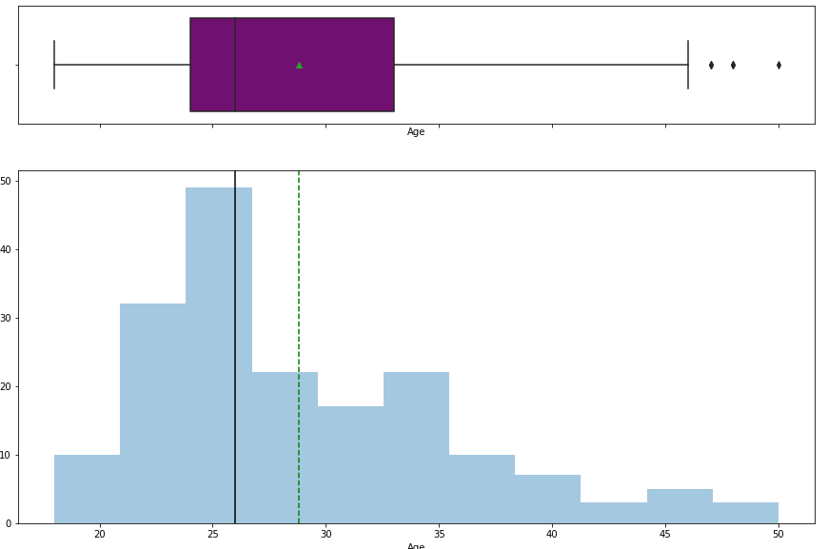
Exploratory Data Analysis – Age
Observations
The distribution of Age is slightly right skewed
Majority of the customers are between the ages of ~20 to ~35
Median age is 26 while mean in ~28
There are 3 outliers to the right in this variable.
While the minimum age is 18 the maximum age sits at 50 years

Slide 6
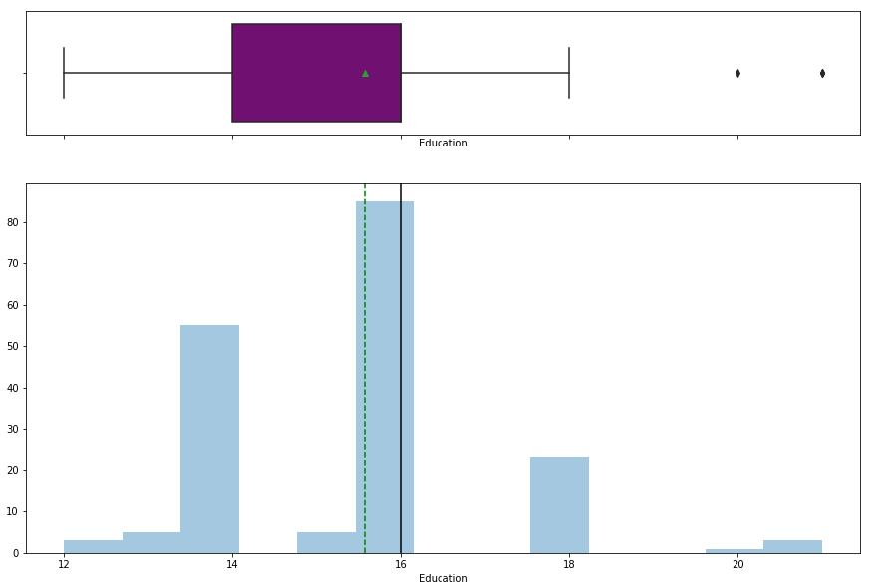
Exploratory Data Analysis – Education
Observations
Both mean and median are quite close at ~15.6 and 16 respectively
There are 2 outliers to the right of the distribution

Slide 7
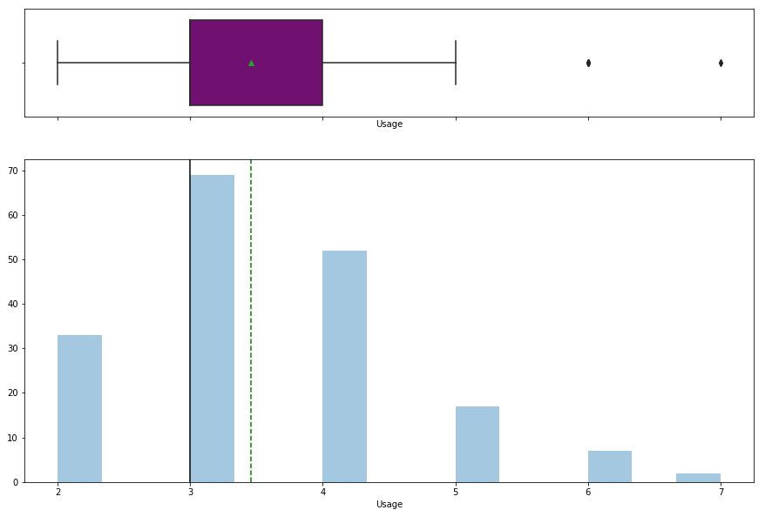
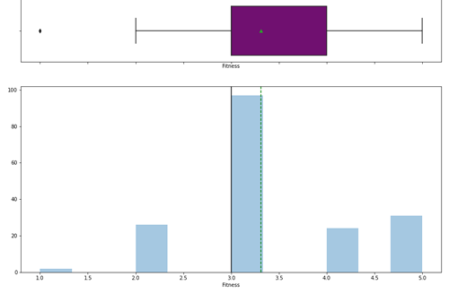
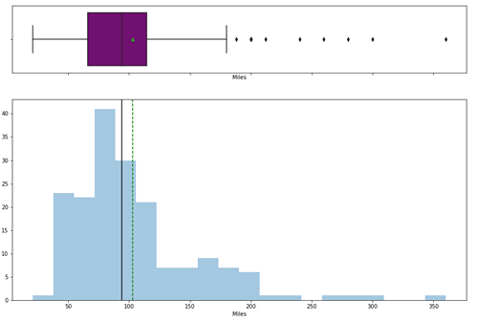
Exploratory Data Analysis– Usage, Fitness, Miles
Usage
Fitness
Miles
Both mean and median are quite close at ~15.6 and 16 respectively
There are 2 outliers to the right of the distribution
Majority of the Fitness levels are around 3
Median Fitness = 3 and mean approximately at 3.3
There is an outlier to the left in this variable.
While most Fitness levels are around 3, we have observations as low as 1 and as high as 5
Miles is positively skewed
Majority of the Miles covered is around the ~50 and ~150
Median pickups = 94 but the mean is ~103
Like Income, and unlike the other variables, this variable has a few more outliers to the right

Slide 8
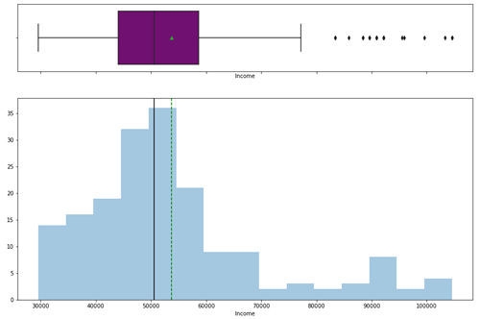
Exploratory Data Analysis – Income
Observations
The distribution of Income is positively skewed
Most of the customers have incomes around the region of 50,000
Unlike the other variables we have studied so far, Income has quite a number of outliers to the right
While most Income are at lower end, we have observations where Incomes is above 100,000
Most of the customers have income before 70,000

Slide 9
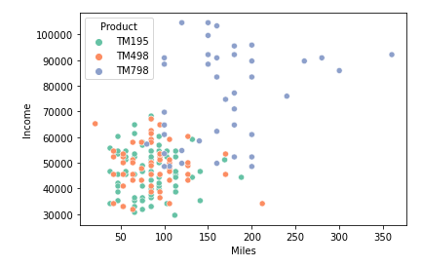
Exploratory Data Analysis – Relationship Between Miles and Income Using Products
Observations
It is obvious to see that people with higher Income levels purchase more of TM798 and also cover more Miles
While both TM195 and TM498 are concentrated below Income of 70000 and 150 Miles

Slide 10
Conclusion
Customers with higher income buy more of TM798
TM798 tend to cover more Miles than the other products
The most popular product is TM195
The business has more male customer than female, and more people with partners
The customers have average income level above 50,000
Average age of the customers is 28 years.

Slide 11
Recommendation
Based on the analysis, below are my recommendations to the business:
TM195 is the most popular product but TM798 attracts more customer with higher income levels.
The business should consider discount options on the TM798 treadmill machine to encourage more sells.
More of the customers are male, so I suggest some level of incentive to female customers to encourage them to buy from the store.
We need to precure pricing information to study more about the relationship between income levels and treadmill choices.

