Slide 1
Visit With Us Business Presentation

Slide 2
Contents

Slide 3
Business Problem Overview and Solution Approach
Core business idea
AllLife Bank is a US bank that wishes to convert its liability customers to asset customers by selling personal loan products to these customers, thereby making more revenue from the loans.
A campaign that the bank ran last year for liability customers showed a healthy conversion rate of over 9% success. This has encouraged the retail marketing department to devise campaigns with better target marketing to increase the success ratio.

Slide 4
Business Problem Overview and Solution Approach
Problem to tackle
To predict which customer is more likely to purchase the newly introduced travel package..
How to use ML model to solve the problem
First, we will to try to understand the problem, review the dataset available, set an end game, list alternative solutions, select a solution, implement our selected solution, and evaluate our result.

Slide 5
Data Overview
Brief description of data provided
There are 4888 rows and 20 columns. Columns of the dataset are described below:
CustomerID: Unique customer ID
ProdTaken: Whether the customer has purchased a package or not (0: No, 1: Yes)
Age: Age of customer
TypeofContact: How customer was contacted (Company Invited or Self Inquiry)
CityTier: City tier depends on the development of a city, population, facilities, and living standards
Occupation: Occupation of customer
Gender: Gender of customer
NumberOfPersonVisiting: Total number of persons planning to take the trip with the customer
PreferredPropertyStar: Preferred hotel property rating by customer
MaritalStatus: Marital status of customer
NumberOfTrips: Average number of trips in a year by customer
Passport: The customer has a passport or not (0: No, 1: Yes)
OwnCar: Whether the customers own a car or not (0: No, 1: Yes)
NumberOfChildrenVisiting: Total number of children with age less than 5 planning to take the trip with the customer
Designation: Designation of the customer in the current organization
MonthlyIncome: Gross monthly income of the customer
PitchSatisfactionScore: Sales pitch satisfaction score
ProductPitched: Product pitched by the salesperson
NumberOfFollowups: Total number of follow-ups has been done by the salesperson after the sales pitch
DurationOfPitch: Duration of the pitch by a salesperson to the customer

Slide 6
Data Overview
Brief description of significant manipulations made to raw data
CustomerID: This will be dropped as we do not have further use for it
Categorical Variables - The following will be converted to categorical variables:
ProdTaken, CityTier, TypeofContact, Occupation, Gender, NumberOfPersonVisiting, ProductPitched, MaritalStatus, Designation, Passport, PitchSatisfactionScore, OwnCar, NumberOfFollowups, PreferredPropertyStar, NumberOfPersonVisiting, PitchSatisfactionScore, and NumberOfChildrenVisiting
Numeric Variables - The following will remain as numeric variables: Age, DurationOfPitch, NumberOfTrips, and MonthlyIncome
Gender: We will be replacing “Fe Male” with “Female”
Marital Status: We will also replace “Unmarried” with “Single”
Missing Values: We will replace missing numerical values with mean() of the column and mode() for categorical variables.

Slide 7
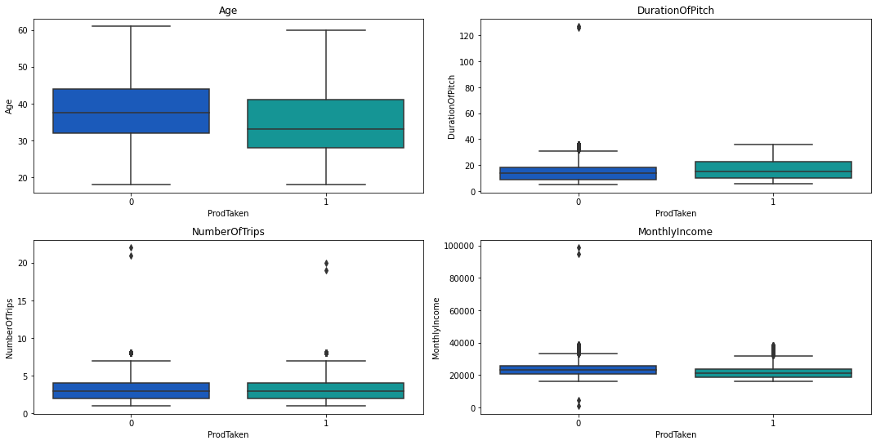
EDA
Graphs showing the factors most heavily impacting the target attribute.

Slide 8
EDA
Insights from the graphs
Younger people seem to purchase more packages than older ones.
Higher duration of pitch has slight positive effect on purchases.
Number of trips doesn't seem to have any effect of purchase of packages.

Slide 9
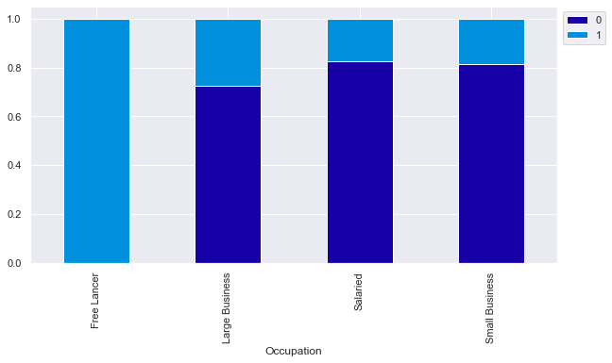
EDA
Graphs showing the factors most heavily impacting the target attribute.
Insight
Customers who work for large business seem to purchase packages more than others.
We have a 100% purchase from freelancers. But with only 2 customers in this category it will not be wise to make significant decision with this.

Slide 10
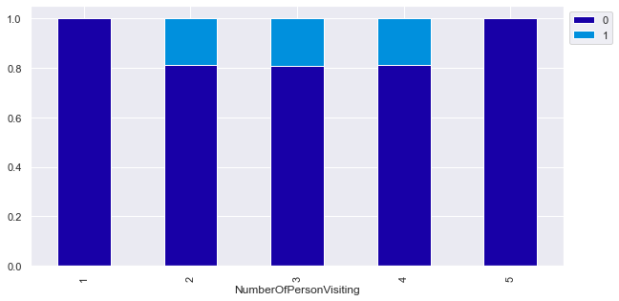
EDA
Graphs showing the factors most heavily impacting the target attribute.
Insight
We notice that we have ~20% purchase with customers visiting with 2,3 and 4 persons.

Slide 11
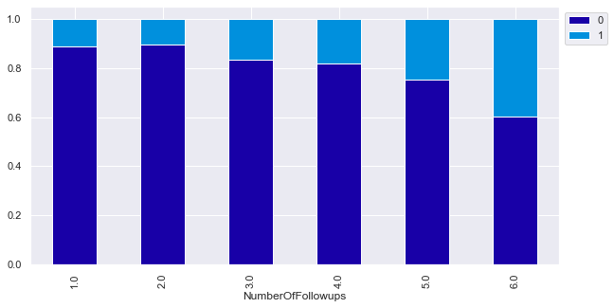
EDA
Graphs showing the factors most heavily impacting the target attribute.
Insight
There seem to be a slight increase in purchase as number of follows increase.
We have a 40% purchase with 6 follow ups.

Slide 12
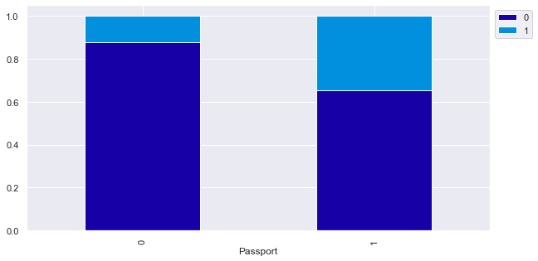
EDA
Graphs showing the factors most heavily impacting the target attribute.
Insight
An expected behavior here, that people with passport are more likely to purchase.
We have about 37% purchase from customer with passport and ~10% purchase from customer without passport

Slide 13
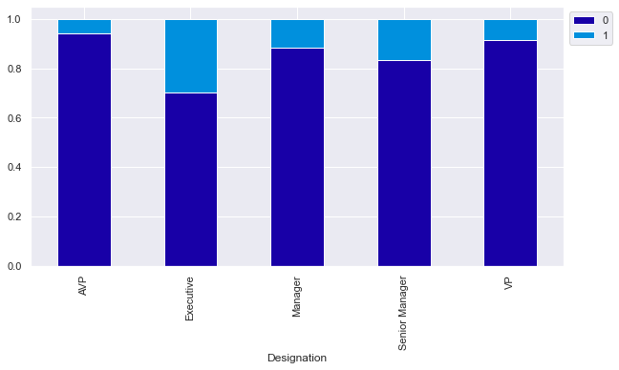
EDA
Graphs showing the factors most heavily impacting the target attribute.
Insight
About 30% of executives purchased packages.
18% of senior managers purchased
Then ~10% of managers and VIP purchased packages too

Slide 14
Model Performance Summary
Overview of ML model and its parameters
We are going to build 12 models here - Bagging Classifier (default and class weight), Random Forest(default and class weight), Decision Tree, AdaBoost Classifier(default and tuned parameters), Gradient Boosting Classifier (default and tuned parameters), XGBoost Classifier (default and tuned parameters), and Stacking Classifier.
First, let's build these models with default parameters and then use hyperparameter tuning to optimize the model performance.
We will calculate all four metrics - Accuracy, Precision, Recall, and F1 Score but the metric of interest here is recall.
Recall - It gives the ratio of True positives to Actual positives, so high Recall implies low false negatives, i.e. low chances of predicting a customer will buy the new product when the he does not.

Slide 15
Model Performance Summary
Summary of most important factors about the ML models used for prediction
Bagging and Boosting decrease the variance of your single estimate as they combine several estimates from different models. So the result may be a model with higher stability.
Our method will combine different weak learners to have a better model used for predication instead of a single model.

Slide 16
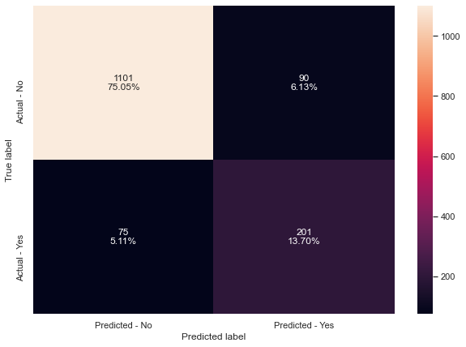
Model Performance Summary
Summary of key performance metrics for different models for comparison
Decision Tree

Slide 17
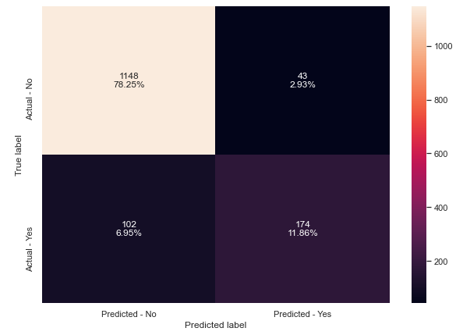
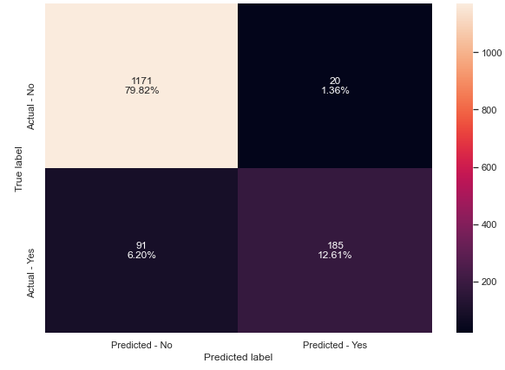
Model Performance Summary
Bagging Bagging Class Weight

Slide 18

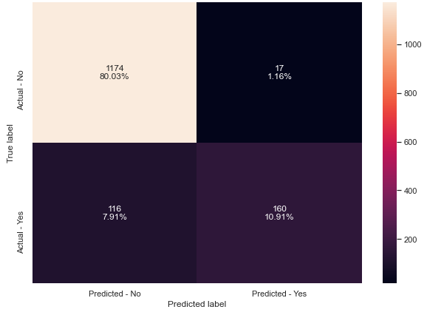
Model Performance Summary
Random Forest Random Forest Class Weight

Slide 19
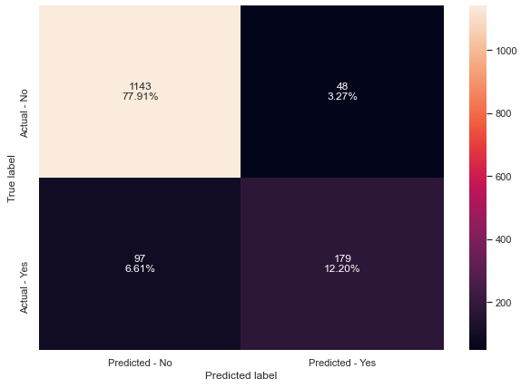
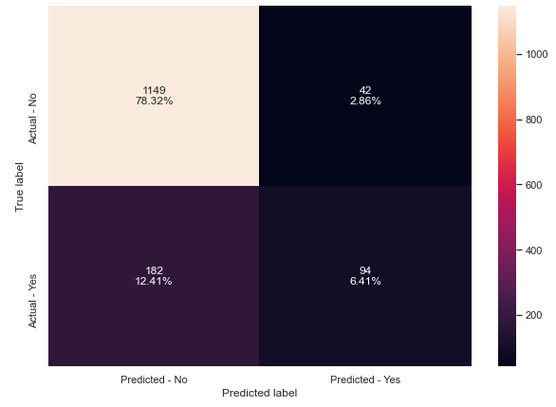
Model Performance Summary
Adaboost Tuned Adaboost

Slide 20
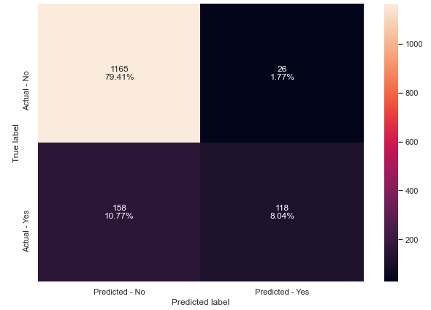
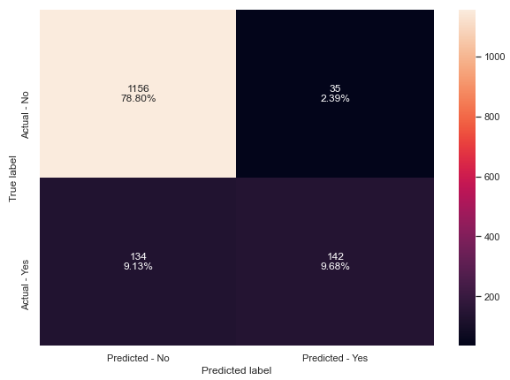
Model Performance Summary
Gradient Boost Tuned Gradient Boost

Slide 21

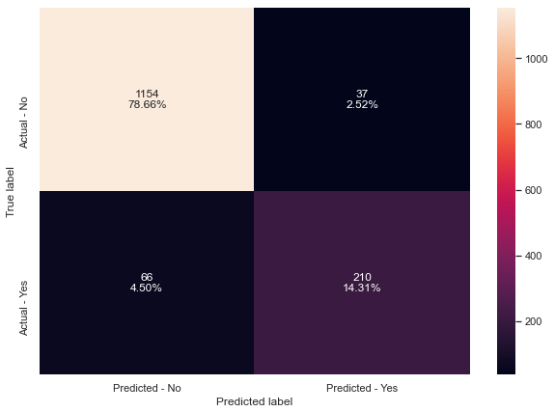
Model Performance Summary
XGBoost Tuned XGBoost

Slide 22
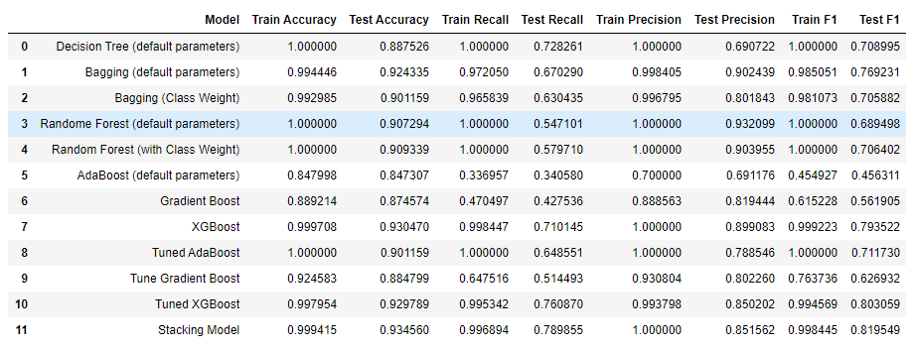
Model Performance Summary - Table

Slide 23
Business Insights and Recommendations
Recommendations based on interpretation of the model input variables
The business can choose a model depending on their cost function which they want to minimize. The cost function can depend on a number of factors.
Factors that drive purchase of packages the most include: monthly income, age, designation, duration of pitch
We emphasized that recall is the metric of interest here and we tuned our model on recall. But this does not mean that other metrics should be ignored completely.
As number of follow ups increase we noticed that sales increase too. It is only natural that the business should increase the number of follow ups to drive sales.
People who work for large business, with passport and at the executive level are more likely to purchase packages.
Younger people seem to purchase more packages than older ones. This is also evident with more higher percentage of customers buying more than others.
Higher duration of pitch has slight positive effect on purchases.
Finally, I think the business need spend more time explaining the packages, features and it’s benefit to the customers because we notice that more follow ups and higher duration of pitch contribute positively to customers purchasing the packages.

