Slide 1

Project-2 Hospital data analysis using HDFS and Spark
Under guidance of: Developed by:
Alwyn Micaiah Anosh Shaju
(Trainer) Omkar gaikwad
David Stephen RaJ
Ashish Fulwade
Akshay Paurush Singh

Slide 2
Content
Introduction
i) Aim
ii) Description
iii) Objectives
iv)Query question
Applications used
Output Screenshots
Spark query result into a File
Spark-submit
Partition in Spark
Bucketing in Spark
Hive In Spark
Conclusion

Slide 3
1-Introduction
AIM: The goal of the project is to analysis the Hospital dataset using HDFS and Spark.
Description:
For this Big-data project, We took the Hospital data from Kaggle website, and converted that data into CSV file.
The dataset contains 14 columns and 137K rows approximately. Then using Ambari We imported the CSV file data into HDFS.
After that we created one dataframe in spark and with the help of that dataframe we loaded our csv file into spark.
Then we performed some dataframes methods on it and also create one temporary view for the spark-sql queries. We also stored our output queries into a file in HDFS directory.
Then we performed partitioning and bucketing in spark, whose partition files are created in HDFS directory.

Slide 4
Objective: Our objective is to help hospitals to identify patients of high LOS risk (patients who will stay longer) at the time of admission. Once identified, patients with high LOS risk can have their treatment plan optimized to minimize LOS and lower the chance of staff/visitor infection. Also, prior knowledge of LOS can aid in logistics such as room and bed allocation planning.
Query questions: We are answering the following questions about this data set.
To count the no.of patients who are admitted in the hospitals.
To check in which department more no.of patients got admitted.
To check the bed grade quality(1-4) for different wards of hospitals.
How much initial money deposited in the hospitals by different patients.
To check how many rooms are available in different departments.
To count no.of patients with a specific illness type for a given department.

Slide 5
2-Applications used
HDFS: For storing large hospital dataset and provides easier access to Spark framework.
Spark: Spark is an open source framework focused on interactive query, machine learning, and real-time workloads. It does not have its own storage system, but runs analytics on other storage systems like HDFS, or other popular stores like Amazon Redshift, Amazon S3, Couchbase, Cassandra, etc.

Slide 6
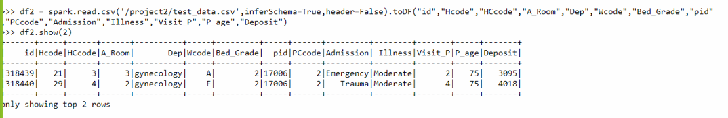
LOADING INPUT FILE USING A DATAFRAME
import pyspark
from pyspark.sql import sparksession
df2 = spark.read.csv('/project2/test_data.csv',inferSchema=True,header=False).toDF("id","Hcode","HCcode","A_Room","Dep","Wcode","Bed_Grade","pid"
,"PCcode","Admission","Illness","Visit_P","P_age","Deposit")
df2.show(2)

Slide 7
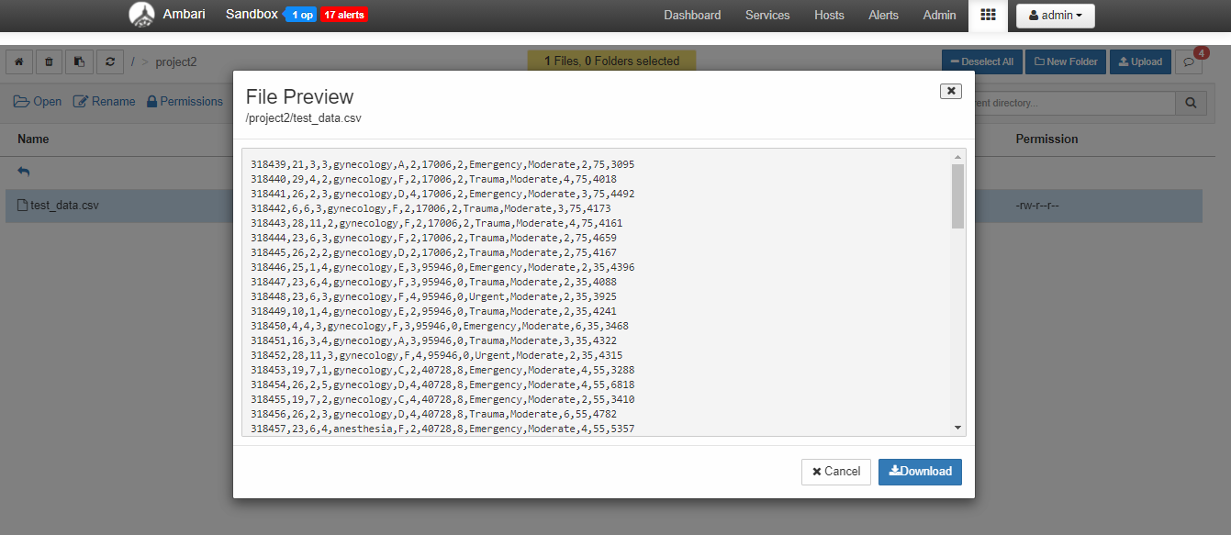
CONTENT OF INPUT FILE IN AMBARI

Slide 8
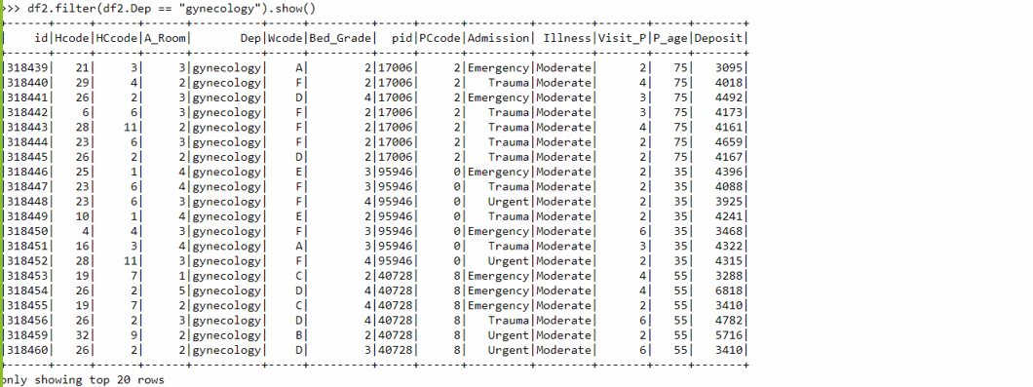
DATAFRAME METHODS FOR QUERY
df2.filter(df2.Dep == "gynecology").show()

Slide 9
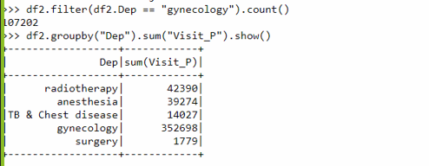
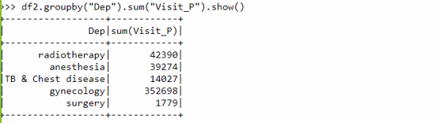
df2.filter(df2.Dep == "gynecology").count()
df2.groupby("Dep").sum("Visit_P").show()

Slide 10
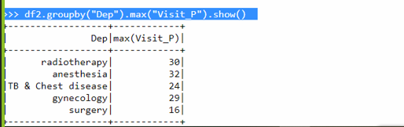
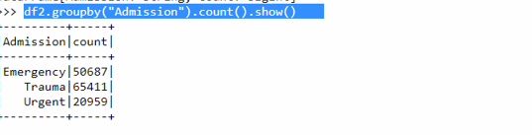
df2.groupby("Dep").max("Visit_P").show()
df2.groupby("Admission").count().show()

Slide 11
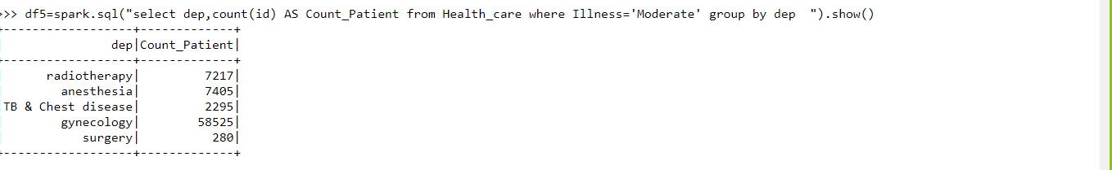
CREATING VIEW TO PERFORM SPARK-SQL QUERY
df3=df2.createOrReplaceTempView("Health_Care")
df5=spark.sql("select dep,count(id) AS Count_Patient from Health_care where Illness='Moderate' group by dep ").show()

Slide 12
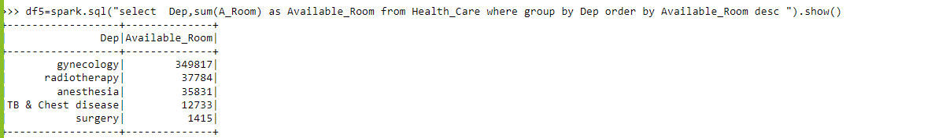
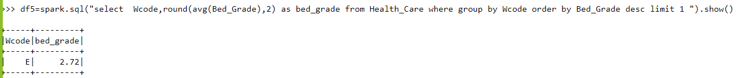
df5=spark.sql("select Dep,sum(A_Room) as Available_Room from Health_Care where group by Dep order by Available_Room desc ").show()
df5=spark.sql("select Wcode,round(avg(Bed_Grade),2) as bed_grade from Health_Care where group by Wcode order by Bed_Grade desc limit 1 ").show()

Slide 13
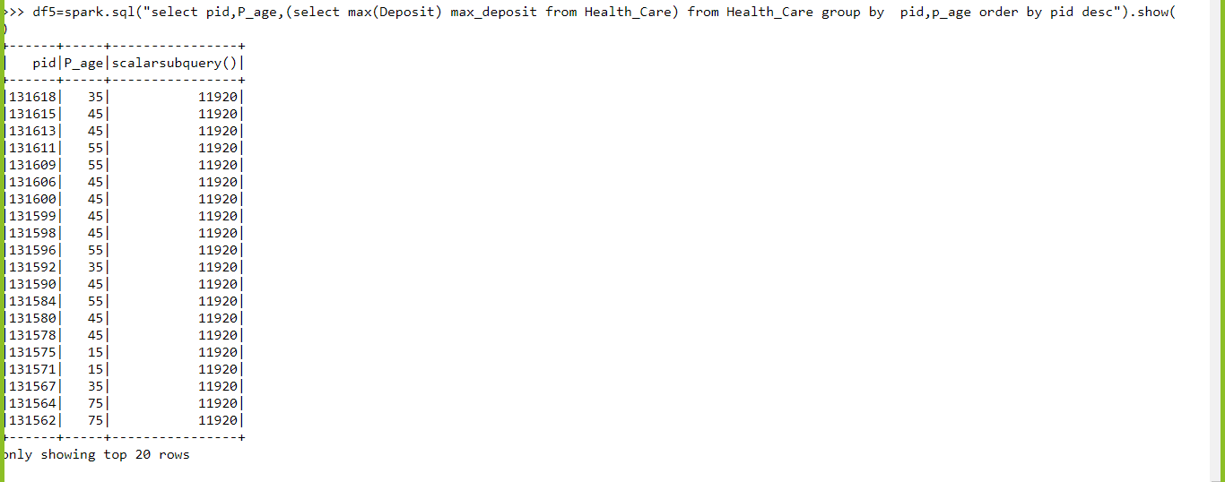
Finding the patient who deposited the max amount in hospital
df5=spark.sql("select pid,P_age,(select max(Deposit) max_deposit from Health_Care) from Health_Care group by pid,p_age order by pid desc").show()

Slide 14
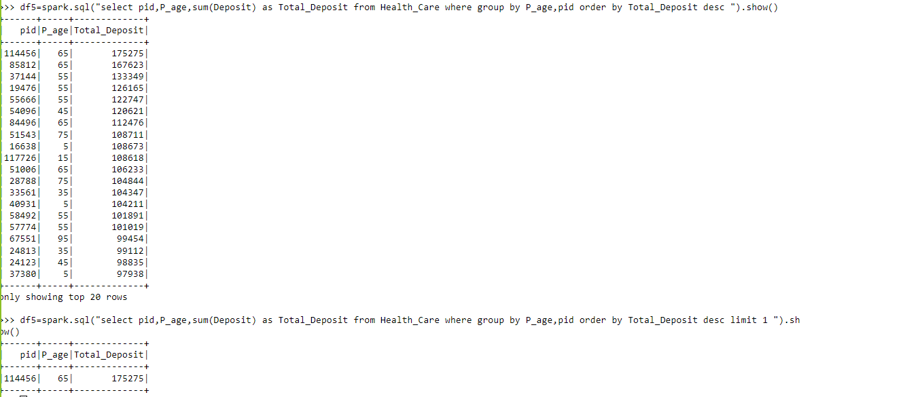
Finding the total amount deposited by patients in hospital
df5=spark.sql("select pid,P_age,sum(Deposit) as Total_Deposit from Health_Care where group by P_age,pid order by Total_Deposit desc ").show()
df5=spark.sql("select pid,P_age,sum(Deposit) as Total_Deposit from Health_Care where group by P_age,pid order by Total_Deposit desc limit 1 ").show()

Slide 15
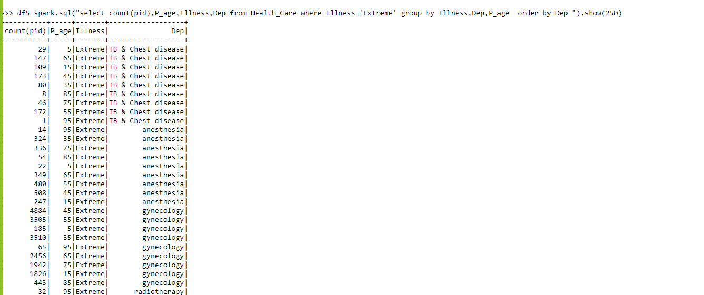
To get the Count of patients who are suffering from extreme illness
df5=spark.sql("select count(pid),P_age,Illness,Dep from Health_Care where Illness='Extreme' group by Illness,Dep,P_age order by Dep ").show(250)

Slide 16
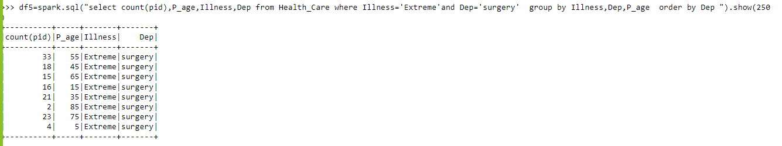
To get the Count of patients who are suffering from extreme illness and adviced to do surgery immediately.
df5=spark.sql("select count(pid),P_age,Illness,Dep from Health_Care where Illness='Extreme'and Dep='surgery' group by Illness,Dep,P_age order by Dep ").show(250)

Slide 17
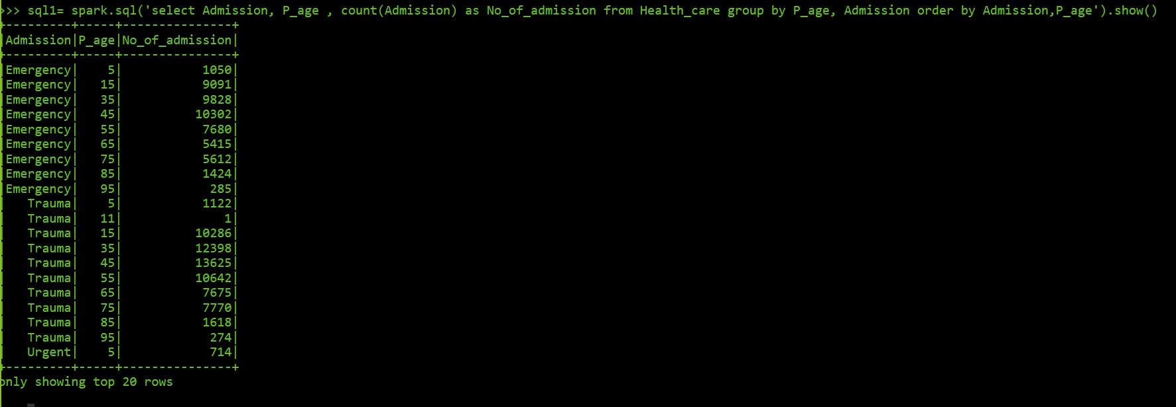
To count the no. of patients admitted in different admission rooms based on particular age group.
sql1= spark.sql(‘select Admission, P_age, count(Admission) as No_of_admission from Health_care group by P_age, Admission order by Admission, P_age’).show()

Slide 18
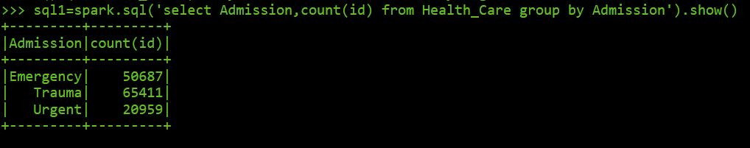
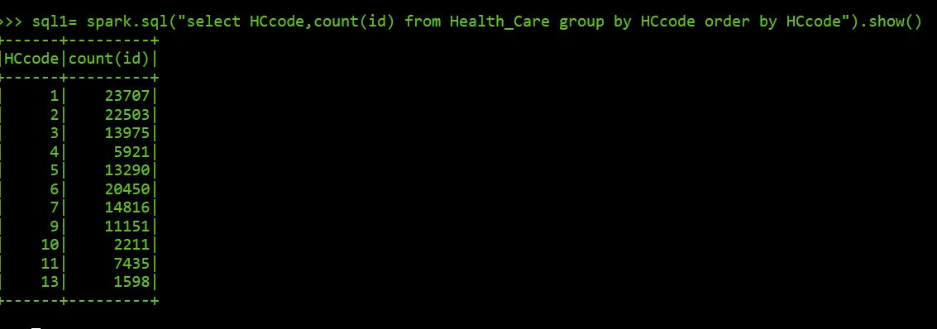
sql1= spark.sql(‘select Admission, count(id) from Health_care group by Admission’).show()
sql1= spark.sql(“select HCcode,count(id) from Health_care group by HCcode order by HCcode”).show()

Slide 19
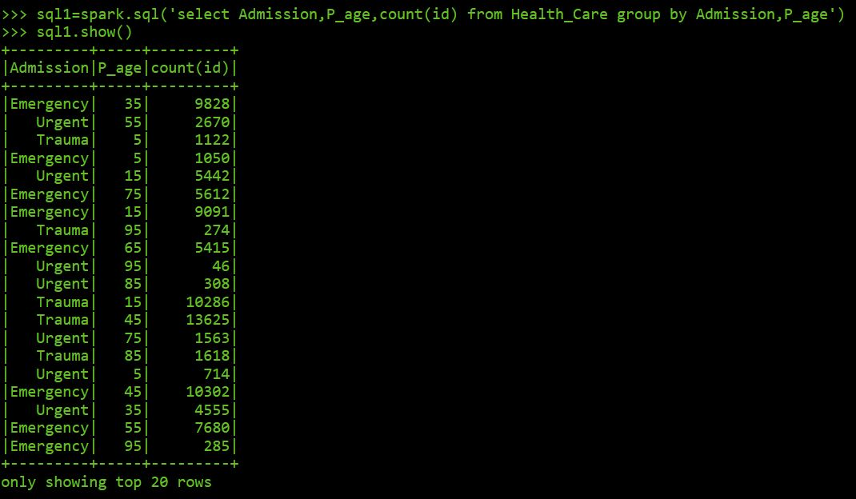
SPARK-SQL QUERY OUTPUT INTO HDFS
sql1= spark.sql(‘select Admission, P_age, count(Id) from Health_care group by Admission, p_age’).show()
(CONTINUE..)

Slide 20
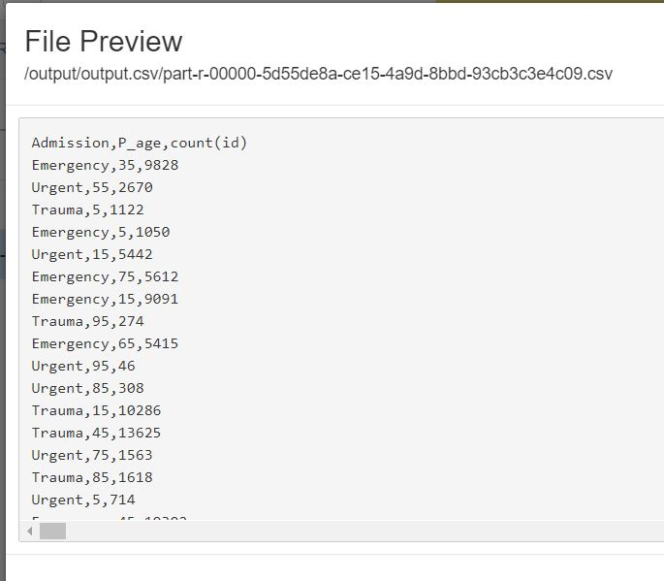
sql1.coalesce(1).write.mode(“overwrite”).csv(“/output/output.csv”,
header = True)

Slide 21
SPARK-SUBMIT
import pyspark
from pyspark.sql import SparkSession
spark=SparkSession.builder.appName("project2").getOrCreate()
Df2=spark.read.csv('/project2/test_data.csv',inferSchema=True,header=False).toDF("id","Hcode","HCcode","A_Room","Dep","Wcode","Bed_Grade","pid","PCcode","Admission","Illness","Visit_P","P_age","Deposit")
df2.show(10)
df3=df2.createOrReplaceTempView("Health_Care")
df5=spark.sql("select pid,P_age,(select max(Deposit) max_deposit from Health_Care) from Health_Care group by pid,p_age order by pid desc").show()
df5=spark.sql("select Dep,sum(A_Room) as Available_Room from Health_Care where group by Dep order by Available_Room desc ").show()

Slide 22
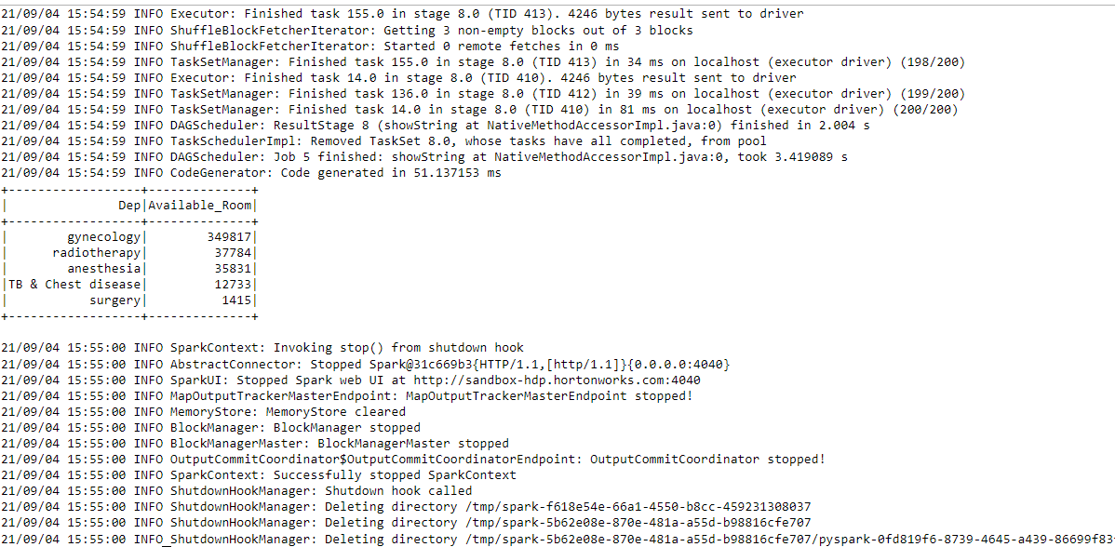
OUTPUT OF SPARK SUBMIT

Slide 23
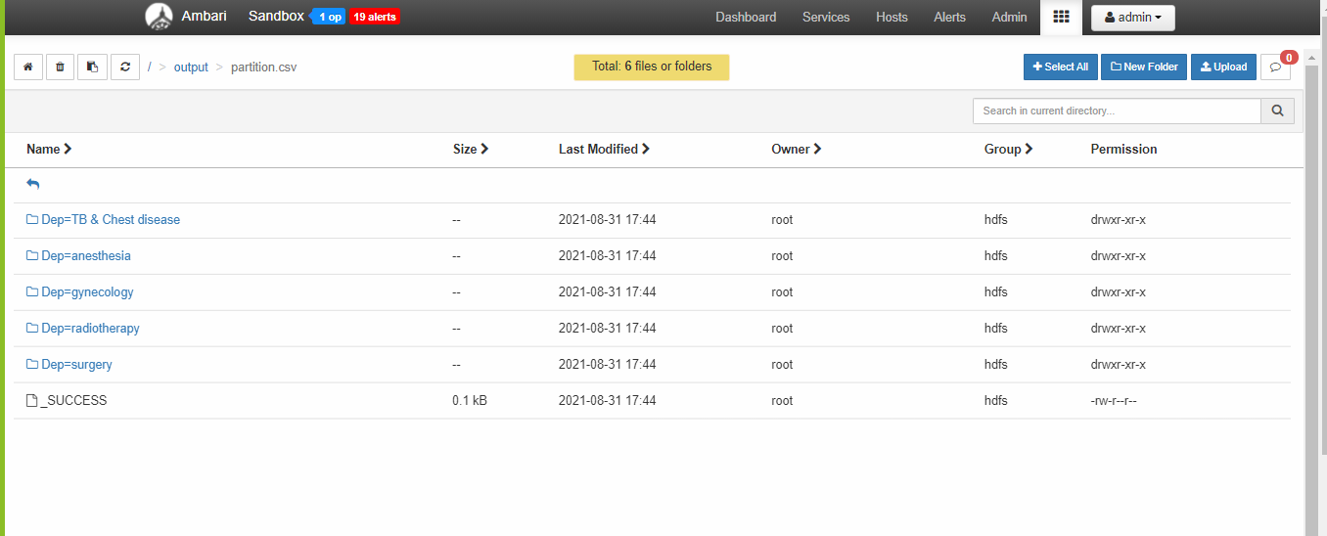
PARTITION IN SPARK-SQL
df2.write.partitionBy("Dep").mode("overwrite").csv("/output/partition.csv")

Slide 24
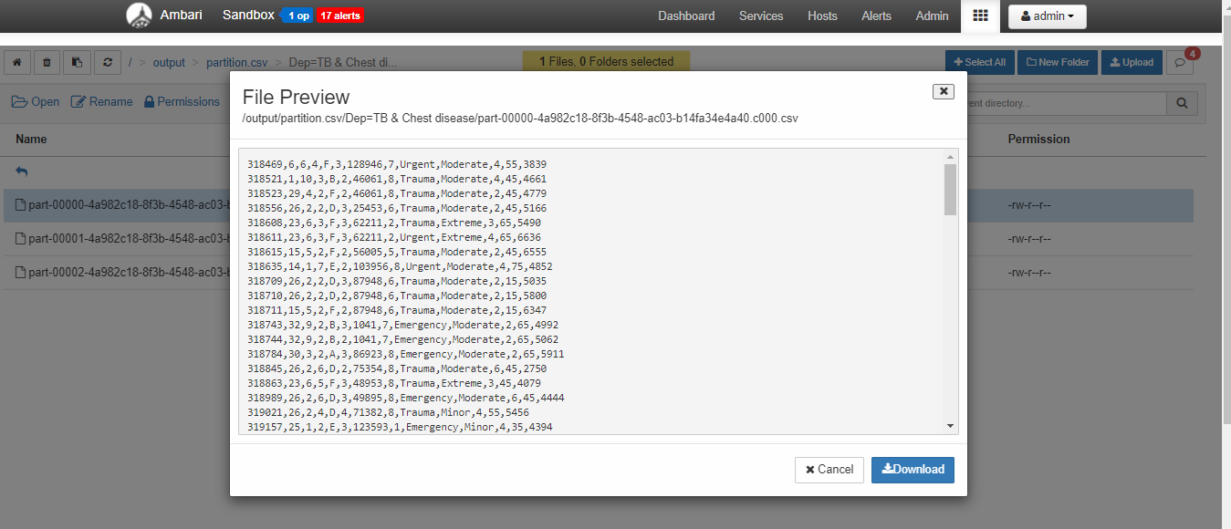
CONTENT OF PARTITIONED FILE IN HDFS

Slide 25
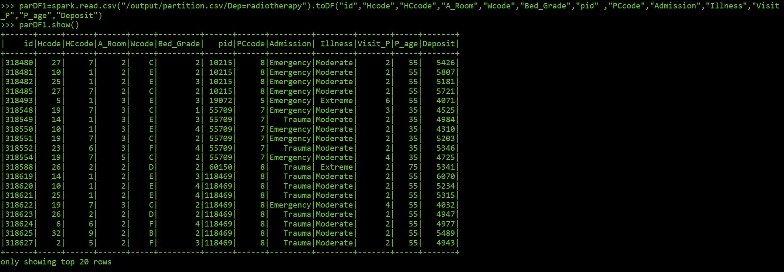
part1=spark.read.csv("/output/partition.csv/Dep=radiotherapy").toDF("id","Hcode","HCcode","A_Room","Wcode","Bed_Grade","pid","PCcode","Admission","Illness","Visit_P","P_age","Deposit")
Part1.show()

Slide 26
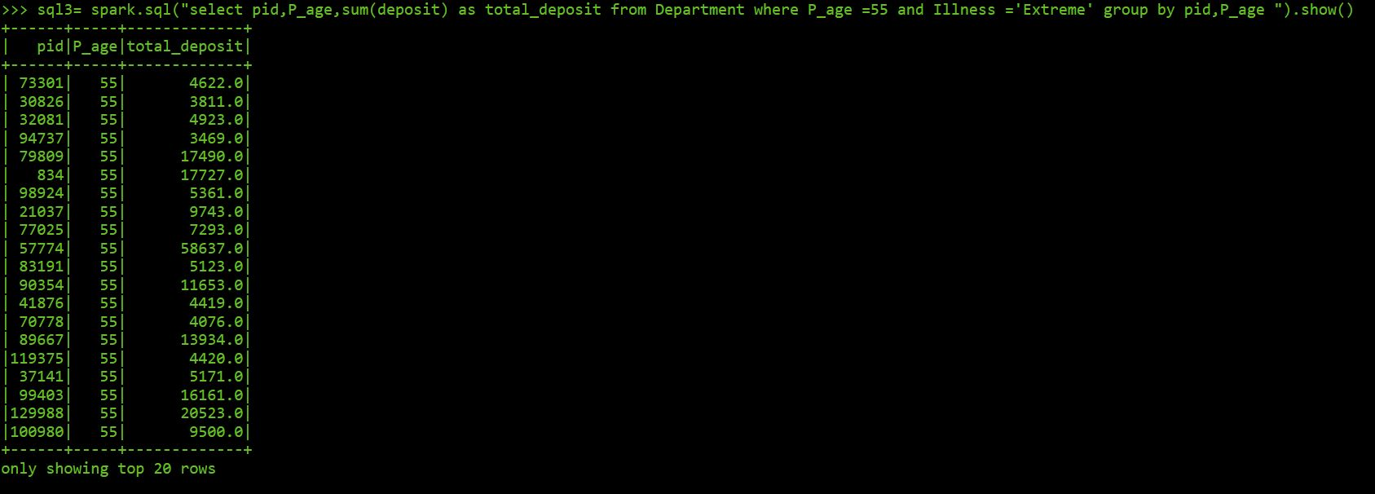
df4= part1.createOrReplaceTempView("Department")
sql3= spark.sql("select pid,P_age,sum(deposit) as total_deposit from Department where P_age =55 and Illness ='Extreme' group by pid,P_age ").show()

Slide 27
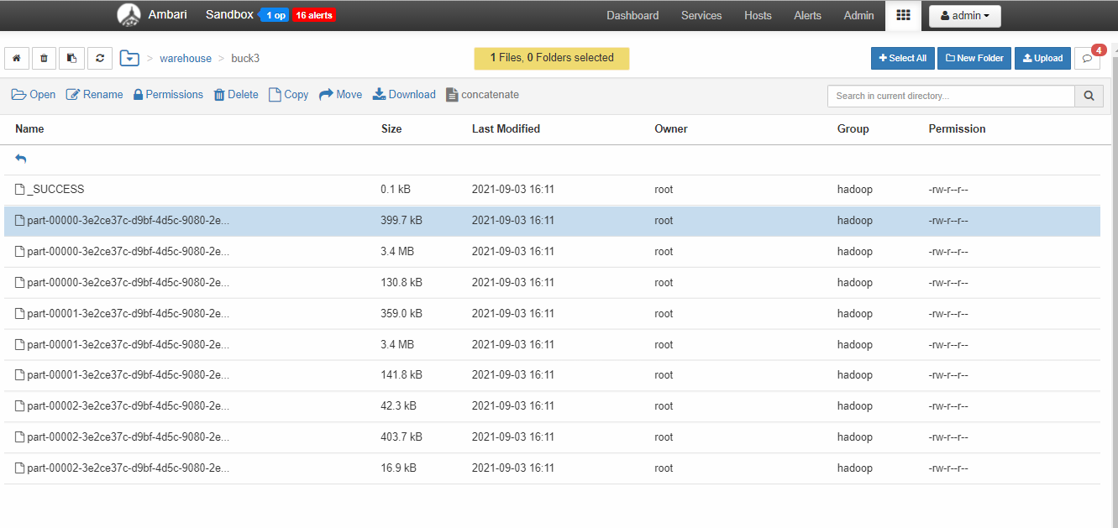
BUCKETING IN SPARK-SQL
df2.write.format("csv").bucketBy(10,"Dep").saveAsTable("Buck3")

Slide 28
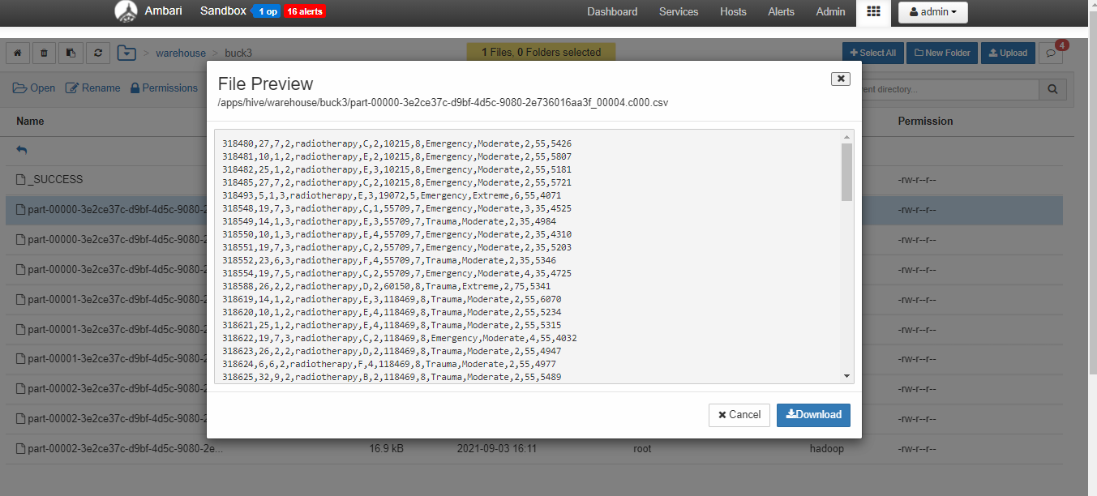
CONTENT OF BUCKETED FILE

Slide 29
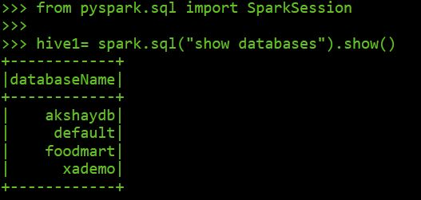
HIVE IN SPARK
from pyspark.sql import SparkSession
hive1= spark.sql("show databases").show()

Slide 30
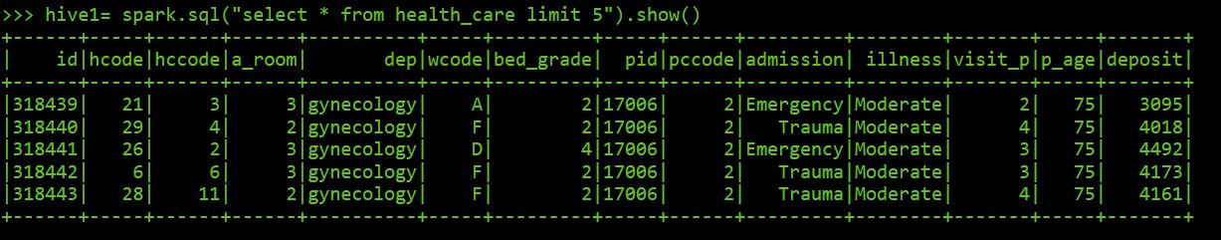
hive1 =spark.sql("use akshaydb")
hive1= spark.sql("select * from health_care limit 5").show()

Slide 31
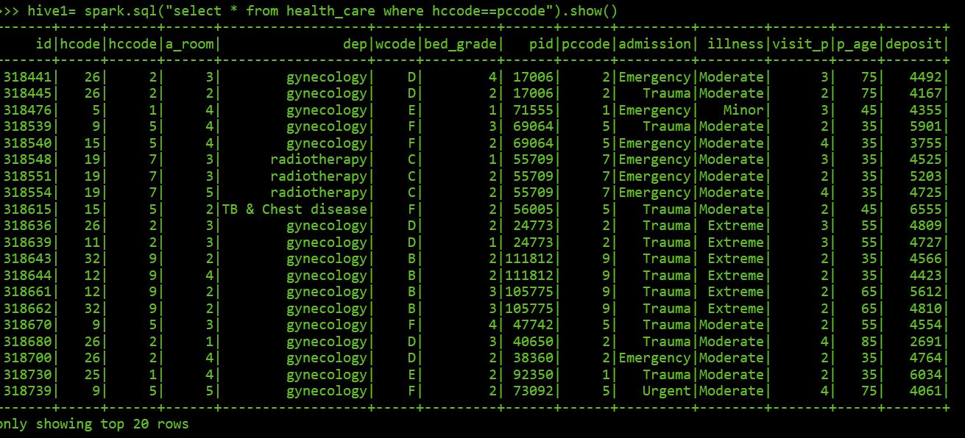
hive1= spark.sql("select * from health_care where hccode==pccode").show()

Slide 32
Conclusion
Big data analytics has the potential to transform the way healthcare providers use sophisticated technologies to gain insight from their clinical and other data repositories and make informed decisions. In the future we’ll see the rapid, widespread implementation and use of big data analytics across the healthcare organization and the healthcare industry. To that end, the several challenges highlighted above, must be addressed. As big data analytics becomes more mainstream, issues such as guaranteeing privacy, safeguarding security, establishing standards and governance, and continually improving the tools and technologies will garner attention. Big data analytics and applications in healthcare are at a nascent stage of development, but rapid advances in platforms and tools can accelerate their maturing process.

Slide 33
THANKYOU

