Slide 1
Beamer-Style Decks in PowerPoint
Write content once, get a fully editable deck
A. Researcher
Department of Presentation Science
September 27, 2026

Slide 2
Outline
Motivation
Results
Diagrams
Animation

Slide 3
Motivation

Slide 4
Why separate content from formatting?
Consistency - every slide follows the slide master
Speed - edit a text file, rebuild in a second
  Charts rebuilt from data, not screenshots
  Equations stay editable
Editability - the output is an ordinary PowerPoint deck
Notes:
Speaker notes go here. They appear in PowerPoint's presenter view.

Slide 5
Beamer blocks
block, alertblock and exampleblock
A template holds all formatting: theme colours, fonts, the slide master and layouts.
Definition
Formatting typed into the content file is limited to bold, italic, code, alert and links.
Watch out
Theme accent 3
Bullets work too
Example

Slide 6
Equations are native and editable
The Gaussian integral, with inline math such as $σ^{2}$ and $e^{−x^{2}}$:
$$\int_{−∞}^{∞}{e^{−x^{2}}} dx=\sqrt{π}$$
Bayes' rule:
$$P(A∣B)=\frac{P(B∣A) P(A)}{P(B)}$$

Slide 7
Results
Charts, tables and figures

Slide 8
Native chart - right-click, Edit Data

Slide 9
Chart next to text
Our method pulls ahead after 2020
  +58% by 2025
Baseline growth is roughly linear
Synthetic data for illustration.
Caveat

Slide 10
Pie and doughnut charts

Slide 11
Tables in booktabs style
Model | Params | Accuracy | Latency (ms)
Baseline | 12M | 81.4% | 14
Wide | 48M | 84.9% | 31
Ours | 20M | 86.2% | 17
Striped style:
Region | Q1 | Q2 | Q3
North | 120 | 135 | 140
South | 98 | 110 | 125

Slide 12
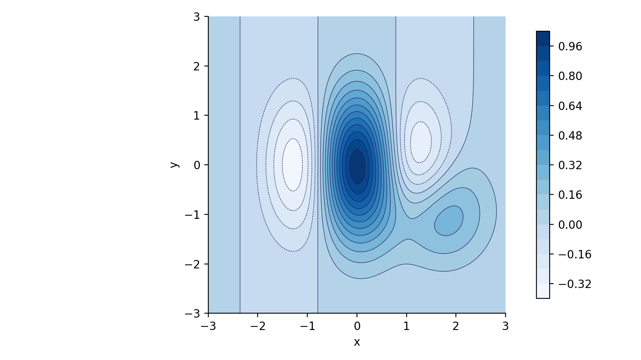
Figures from any tool
Contour plots have no native PowerPoint form, so they come in as images.

Slide 13
Code listings
from ppt_templated import build_deck
# content.yaml + template -> editable deck
build_deck("talk.yaml", "talk.pptx")
Write or edit the YAML file
Run python ppt_templated.py talk.yaml
Open the .pptx and edit freely

Slide 14
Diagrams
Flowcharts and workflows

Slide 15
Flowchart from nodes and edges
Preprocessing
Quality OK?
Raw data
Clean + normalize
yes
Train model $f_{θ}$
Model registry
no
Native shapes and connectors: drag a box in PowerPoint and its arrows follow.

Slide 16
Top-down flow, revealed step by step
Start
direction: down for classic flowcharts
Shapes: terminal, data, decision, document, database, ...
build: true reveals one step per click
Read batch
More data?
no
yes
Gradient step
Save weights

Slide 17
Workflow steps
Collect
Clean
Train
Evaluate
Deploy
Plan
Build
Measure
Learn

Slide 18
Animation

Slide 19
Morph transitions (1/2)
This block moves and grows on the next slide.
Focus

Slide 20
Morph transitions (2/2)
Shapes with the same name ("!!focus") are matched by Morph, so PowerPoint animates the move. Older PowerPoint versions fall back to a fade.
Focus

Slide 21
Thank you!
Questions?

