Slide 1
Image Segmentation Methods
From thresholding to transformers
Your Name
Computer Vision Seminar
September 27, 2026

Slide 2
Outline
Introduction
Classical methods
Deep learning methods
Training and evaluation
Summary

Slide 3
Introduction
What does it mean to segment an image?

Slide 4
Three flavours of segmentation
Semantic vs instance vs panoptic
same street scene, three outputs side by side
One class label per pixel; objects of the same class merge
Semantic
Separate mask per countable object; background ignored
Instance
Both: every pixel gets a class and an instance id
Panoptic

Slide 5
Problem formulation
Segmentation as dense, per-pixel classification:
$$f_{θ}:R^{H×W×3}→\{1,…,C\}^{H×W}$$
$${\hat{y}}_{i}=arg\max_{c} p_{θ}(c∣x,i), i=1,…,HW$$
Needs global context (what) and fine localisation (where) at once
Class imbalance - road pixels vastly outnumber pedestrians
Dense labels are expensive to annotate
Why it is hard

Slide 6
Classical methods
Intensity, regions, clusters and graphs

Slide 7
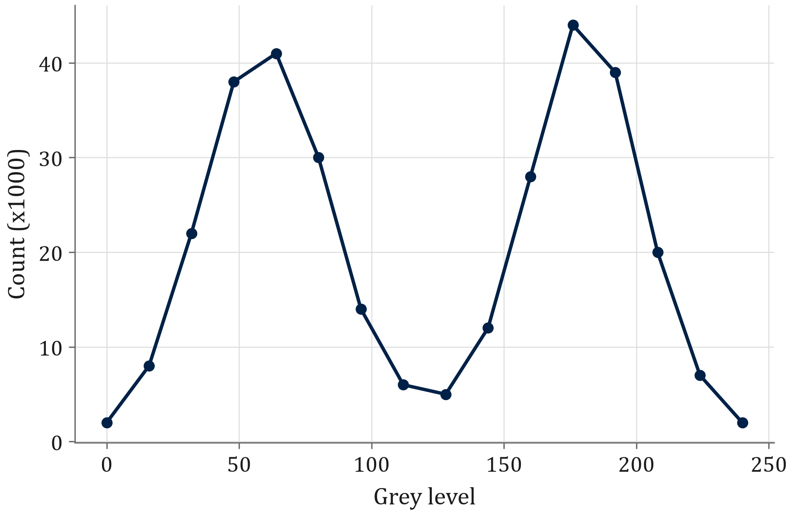
Thresholding and Otsu's method
Pick the threshold that best separates two classes:
$$σ_{B}^{2}(t)=ω_{0}(t) ω_{1}(t) [μ_{0}(t)−μ_{1}(t)]^{2}$$
$$t^{*}=arg\max_{t} σ_{B}^{2}(t)$$
Fast, parameter-free
Fails on uneven lighting - use adaptive thresholds
Sample bimodal histogram - Otsu picks t* near the valley (~120)

Slide 8
Region-based methods
Region growing
seed pixel expands to similar neighbours
Watershed
gradient magnitude as terrain, flooding from minima
Grow from seeds while $|I(p)−μ_{R}|<τ$
Split-and-merge on a quadtree
Flood the gradient image from markers
Over-segments without marker control

Slide 9
Clustering in feature space
Treat each pixel as a feature vector, e.g. $(L,a,b,x,y)$, and cluster:
min{Ck},{μk} k=1Kxi∈Ck​xi−μk2
K-means / SLIC superpixels
image overlaid with superpixel boundaries
K-means: $K$ fixed in advance
Mean shift: finds modes, $K$ is automatic
SLIC: local k-means, compact superpixels

Slide 10
Graph-based segmentation
Pixels are nodes; edges weight similarity between neighbours.
E(L)=p​Dp(Lp) + λ(p,q)∈N​Vpq(Lp,Lq)
Graph cut
pixel grid with source / sink terminals and min cut
$$Ncut(A,B)=\frac{cut(A,B)}{assoc(A,V)}+\frac{cut(A,B)}{assoc(B,V)}$$
Binary graph cuts are solved exactly by max-flow
Normalized cuts avoid tiny isolated segments
GrabCut adds interactive box prompts

Slide 11
Active contours and level sets
Evolving contour
snake shrinking onto an object boundary over iterations
Snake energy of a curve $v(s)$:
$$E=\int_{0}^{1}{1/2}\left(α{\left\|v^{′}(s)\right\|}^{2}+β{\left\|v^{′′}(s)\right\|}^{2}\right)+E_{\text{img}}(v(s)) ds$$
Internal terms keep the curve smooth
Image term pulls it to edges
Level sets handle topology changes

Slide 12
Deep learning methods
End-to-end dense prediction

Slide 13
Fully convolutional networks (FCN)
FCN architecture
conv backbone, 1x1 classifier, upsampling with skip fusion (FCN-32s/16s/8s)
Replace fully connected layers with $1×1$ convolutions
Learned upsampling (transposed convolution) back to input size
Skip connections fuse coarse semantics with fine detail

Slide 14
U-Net - encoder-decoder with skips
U-Net
contracting path, expanding path, copy-and-crop skips
Symmetric encoder / decoder
Skip connections concatenate encoder features at each scale
Works with very few labelled images
  Standard in medical imaging
Variants - U-Net++, Attention U-Net, nnU-Net

Slide 15
DeepLab - atrous convolution and ASPP
Dilated convolution enlarges the receptive field without losing resolution:
y[i]=k​x[i+r⋅k] w[k], r=dilation rate
ASPP module
parallel atrous convs at rates 6, 12, 18 + image pooling
Multi-scale context in parallel branches
DeepLabv3+ adds a light decoder for sharp boundaries

Slide 16
Instance segmentation - Mask R-CNN
Mask R-CNN pipeline
backbone + FPN, RPN proposals, RoIAlign, box / class / mask heads
A small FCN predicts a $28×28$ mask per detected box
Detect then segment
Bilinear sampling without quantisation keeps masks aligned
RoIAlign

Slide 17
Transformer-based segmentation
Model | Year | Key idea | Task
SETR | 2021 | ViT encoder + simple decoder | Semantic
SegFormer | 2021 | Hierarchical encoder + all-MLP decoder | Semantic
MaskFormer / Mask2Former | 2021-22 | Mask classification with queries | Universal
SAM | 2023 | Promptable foundation model | Any mask
Query-based mask decoding
N learned queries -> N (class, mask) pairs

Slide 18
Segment Anything (SAM)
SAM architecture
image encoder, prompt encoder (points / box / mask), mask decoder
Trained on SA-1B - over 1 billion masks
Prompts - points, boxes, coarse masks
Zero-shot transfer to new domains
Outputs several candidate masks per prompt

Slide 19
Training and evaluation

Slide 20
Loss functions
$$L_{\text{CE}}=−\frac{1}{N}\sum_{i=1}^{N}{\sum_{c=1}^{C}{y_{ic}}}logp_{ic}$$
LDice=1−2i​pigii​pi+i​gi
$$L_{\text{Focal}}=−α (1−p_{t})^{γ}logp_{t}$$
Combine them, e.g. $L=L_{\text{CE}}+L_{\text{Dice}}$: CE for stable gradients, Dice for class imbalance.
In practice

Slide 21
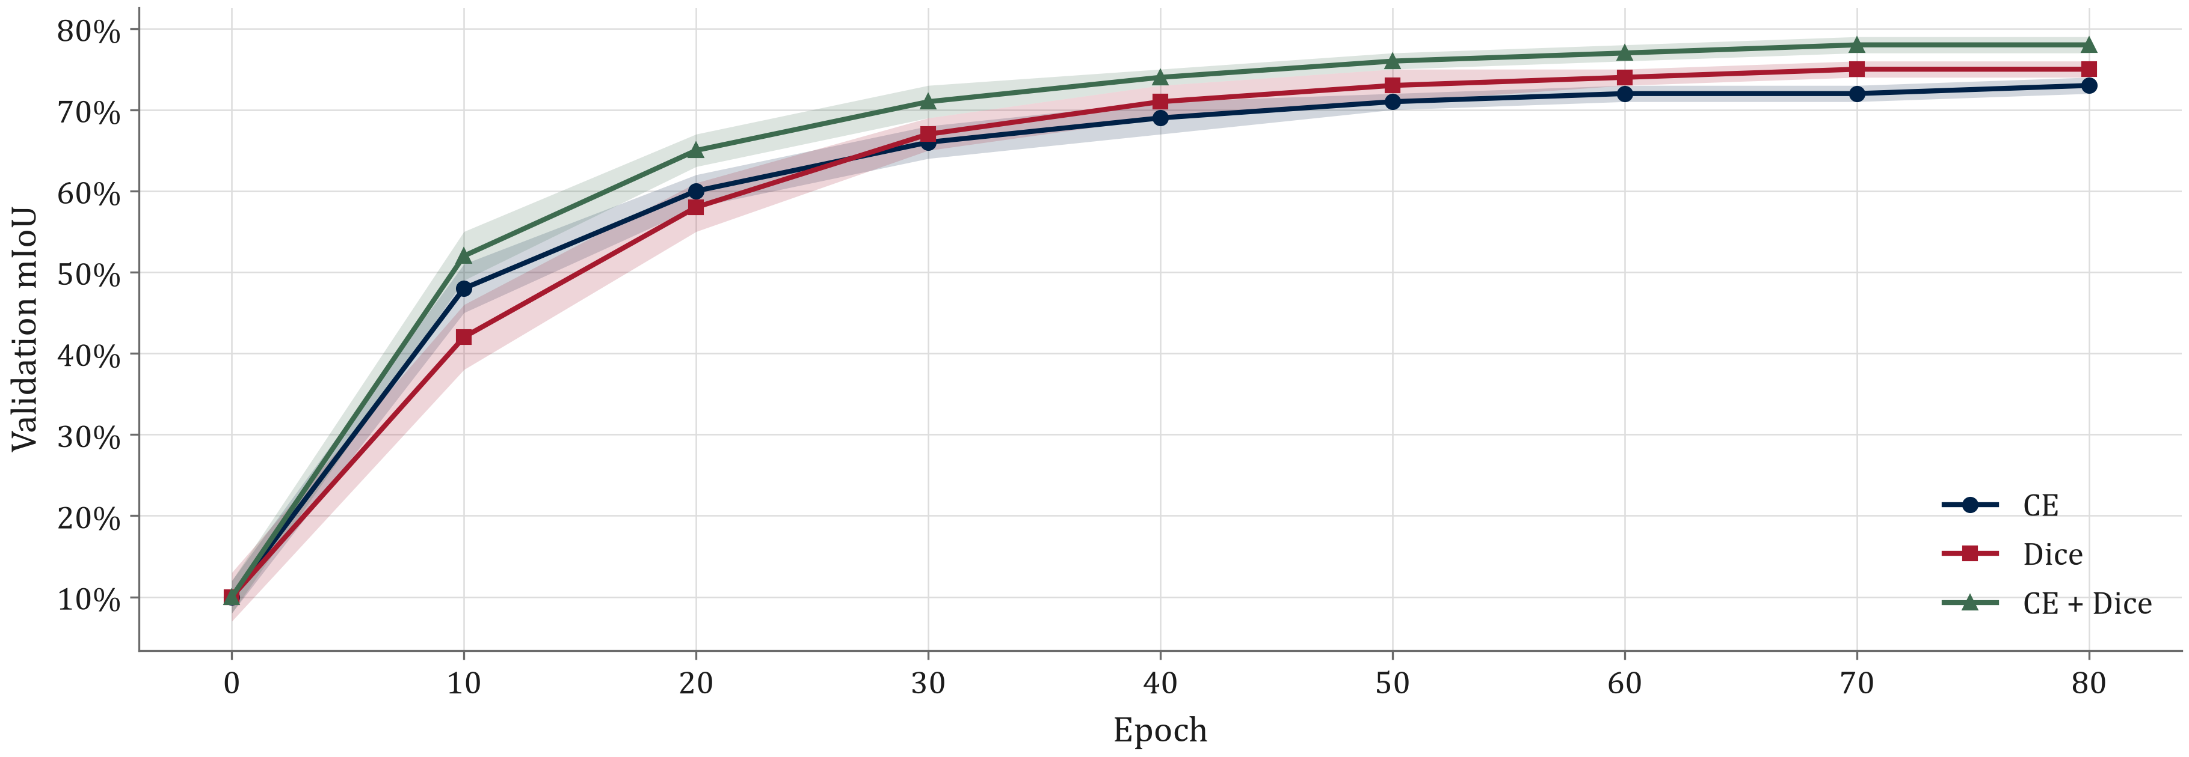
Loss choice matters (sample curves)
Sample data - U-Net on an imbalanced dataset, mean +/- std over 3 seeds

Slide 22
Evaluation metrics
$$IoU=\frac{|A∩B|}{|A∪B|}=\frac{TP}{TP+FP+FN}$$
$$Dice=\frac{2 TP}{2 TP+FP+FN}$$
$$mIoU=\frac{1}{C}\sum_{c=1}^{C}{{IoU}_{c}}$$
PQ=(p,g)∈TP​IoU(p,g)|TP|+12|FP|+12|FN|
mIoU - standard for semantic segmentation
Dice - common in medical imaging
PQ - panoptic quality, combines recognition and segmentation

Slide 23
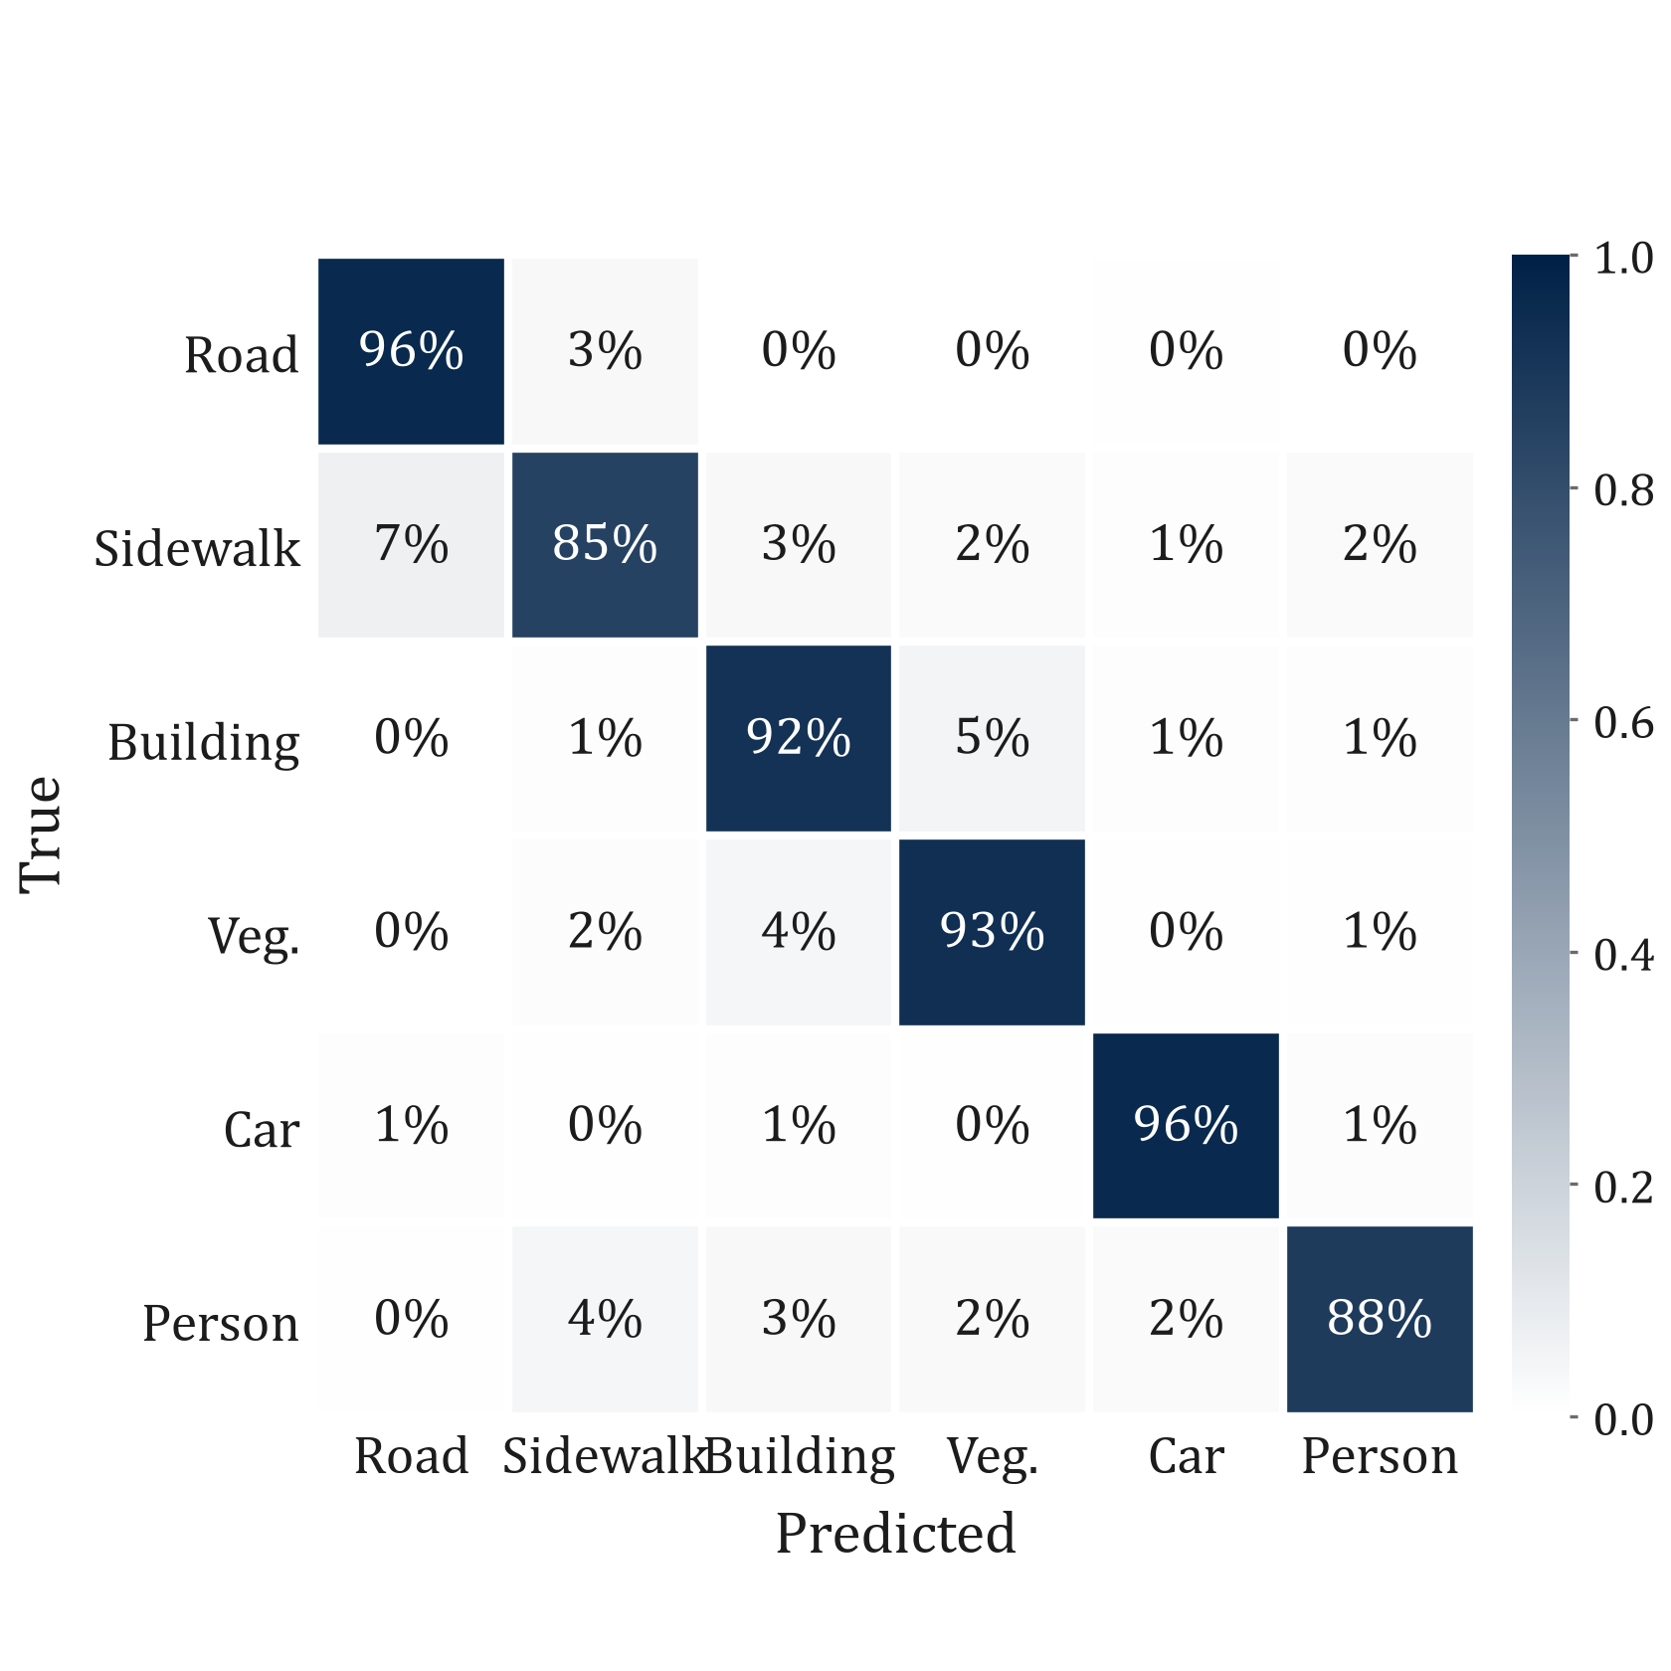
Per-class errors (sample confusion matrix)
Rows = ground truth, normalised to recall
Sidewalk is often confused with road
Thin / small classes (person) suffer most
Boundary pixels account for much of the error
Sample data for illustration

Slide 24
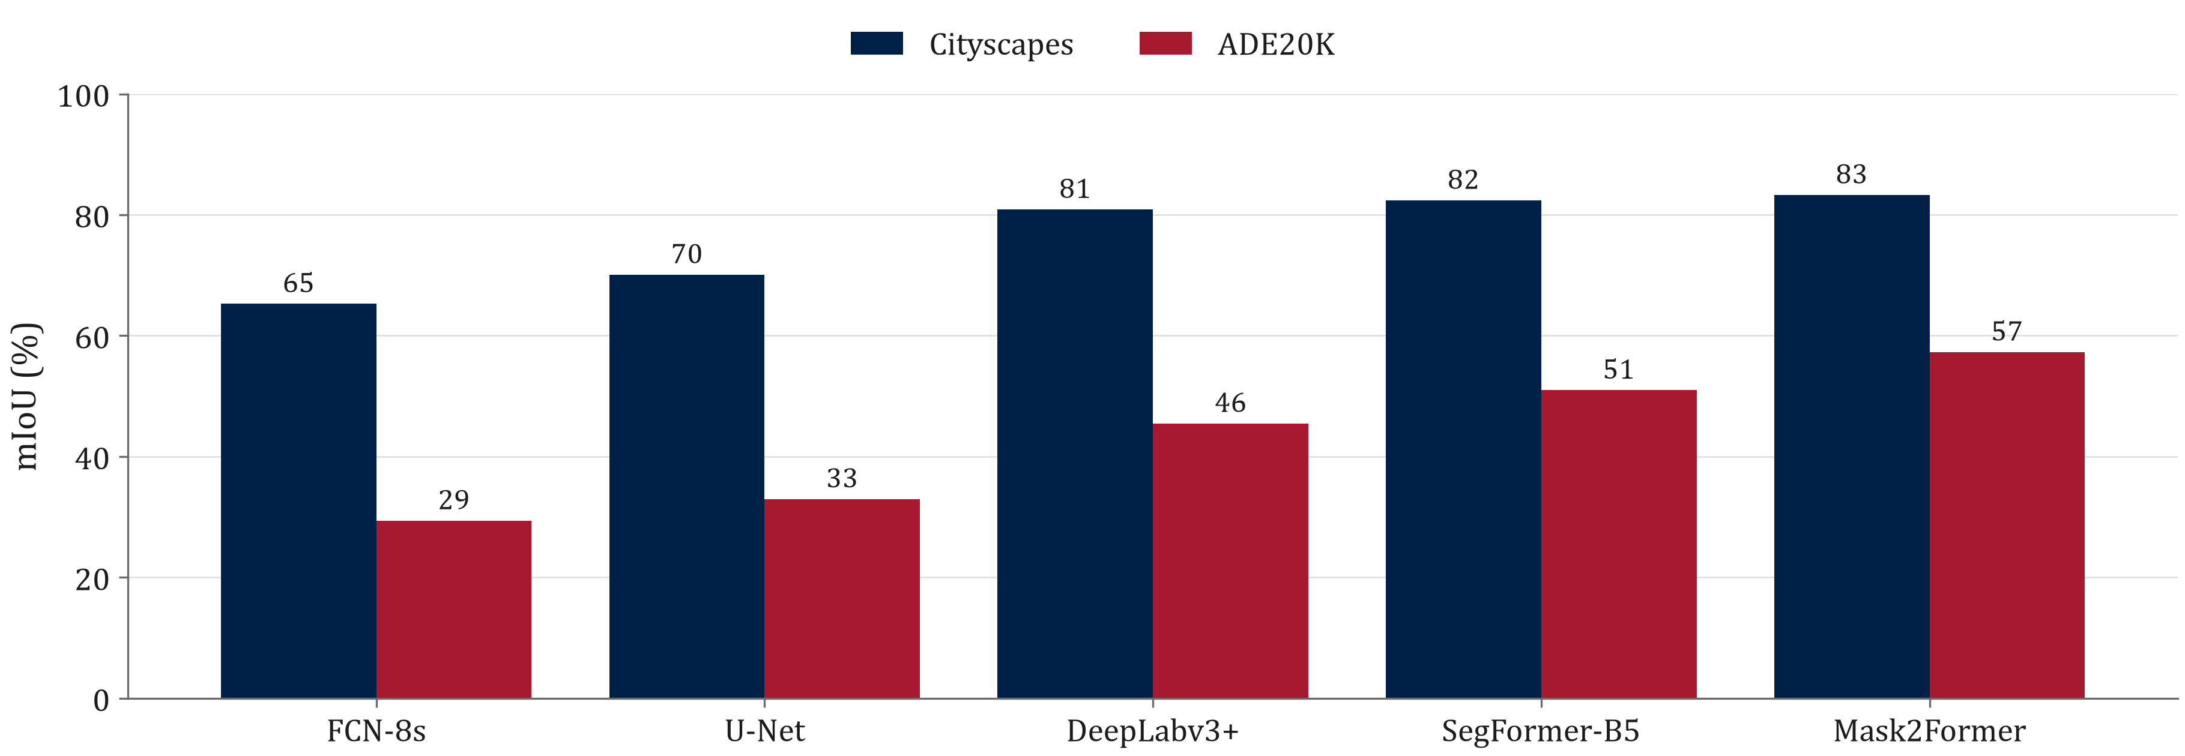
Benchmark comparison (sample)
Illustrative values only - replace with numbers from your own experiments or cited papers

Slide 25
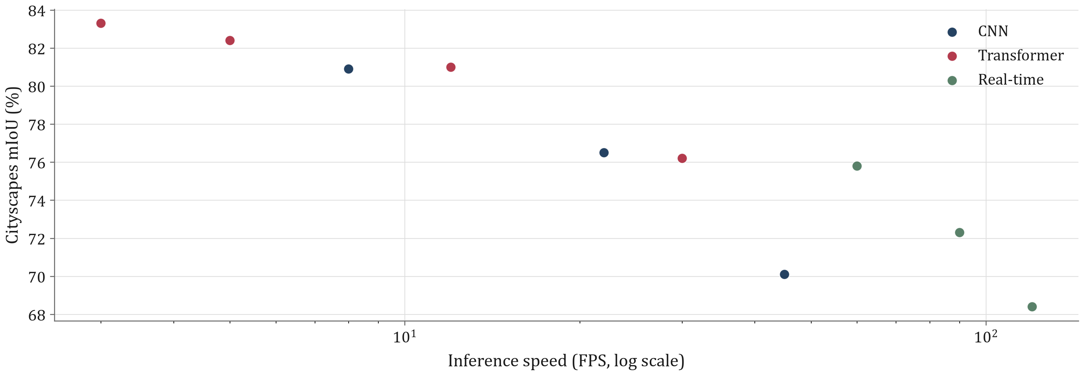
Accuracy vs speed (sample)
Sample data - the accuracy / latency trade-off

Slide 26
Summary

Slide 27
Classical vs deep methods
Aspect | Classical | Deep learning
Labelled data | None or little | Large dense annotations
Semantics | Low-level cues only | Learned object categories
Compute | CPU friendly | GPU for training and often inference
Interpretability | High | Low
Best use | Preprocessing, simple scenes, interactive tools | Complex scenes, production systems

Slide 28
Summary
Timeline of segmentation methods
Otsu 1979 -> watershed -> normalized cuts -> FCN 2015 -> U-Net -> DeepLab -> Mask2Former -> SAM 2023
Classical methods group pixels by intensity, regions, clusters or graph energies
FCN made segmentation end-to-end; U-Net and DeepLab refined resolution and context
Transformers unify semantic, instance and panoptic tasks
Foundation models (SAM) segment anything from prompts

Slide 29
Thank you!
Questions?

