Slide 1
Study and Observation of the Variation of Accuracies of KNN, SVM, LMNN, ENN Algorithms on Eleven Different Datasets from UCI Machine Learning Repository
Team member: ZheYu He

Slide 2
Paper Abstract
Machine learning qualifies computers to assimilate with data, without being solely programmed [1, 2].Machine learning can be classified as supervised and unsupervised learning. In supervised learning, computers learn an objective that portrays an input to an output hinged on training input-output pairs [3]. Most efficient and widely used supervised learning algorithms are K-Nearest Neighbors (KNN), Support Vector Machine (SVM), Large Margin Nearest Neighbor (LMNN), and Extended Nearest Neighbor (ENN). The main contribution of this paper is to implement these elegant learning algorithms on eleven different datasets from the UCI machine learning repository to observe the variation of accuracies for each of the algorithms on all datasets. Analyzing the accuracy of the algorithms will give us a brief idea about the relationship of the machine learning algorithms and the data dimensionality. All the algorithms are developed in Matlab. Upon such accuracy observation, the comparison can be built among KNN, SVM, LMNN, and ENN regarding their performances on each dataset.
In general, this is a paper that reviews several popular supervised learning algorithm by testing their performance on UCI dataset

Slide 3
Paper resource
Using google scholar and searching “UCI repository”
The paper is presented in 4th international conferernce on electronical engineering and information & communication technology
Link: https://ieeexplore.ieee.org/abstract/document/8628041
The datasets it used are from UCI repository

Slide 4
Algorithm
KNN: K-Nearest Neighbors-Nearest Neighbors
ENN: Extended Nearest Neighbors
SVM ：support vector machine
LMNN：Large Margin Nearest Neighbors（ object function: optimized mahala Nobis metric )
ENN and LMNN can be regarded as adaptation of KNN and SVM

Slide 5
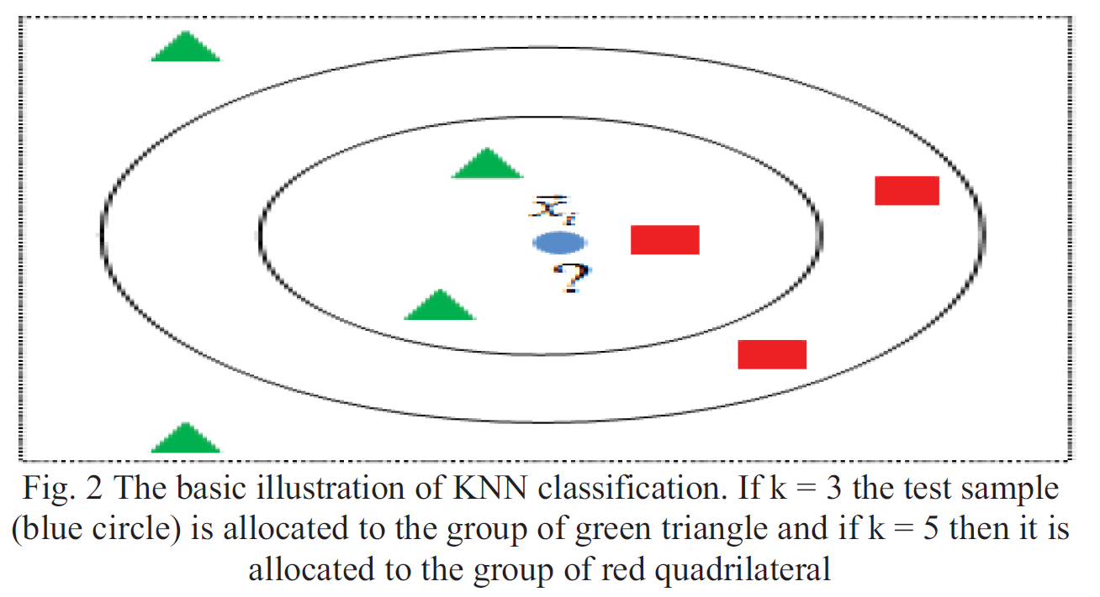
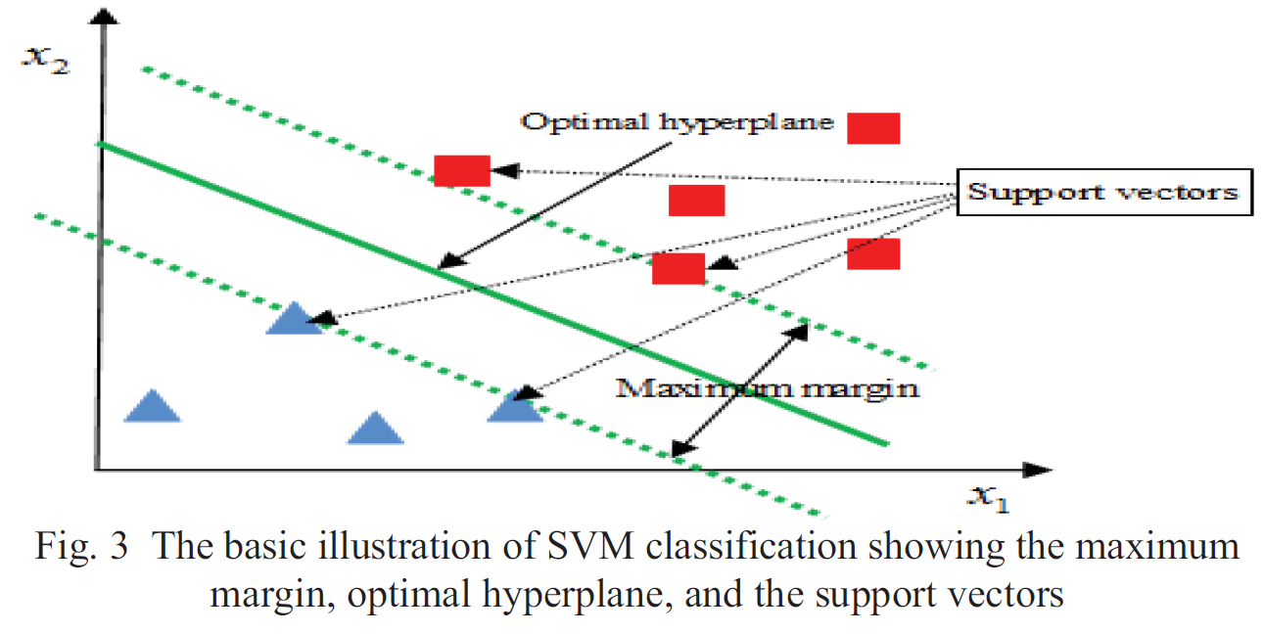
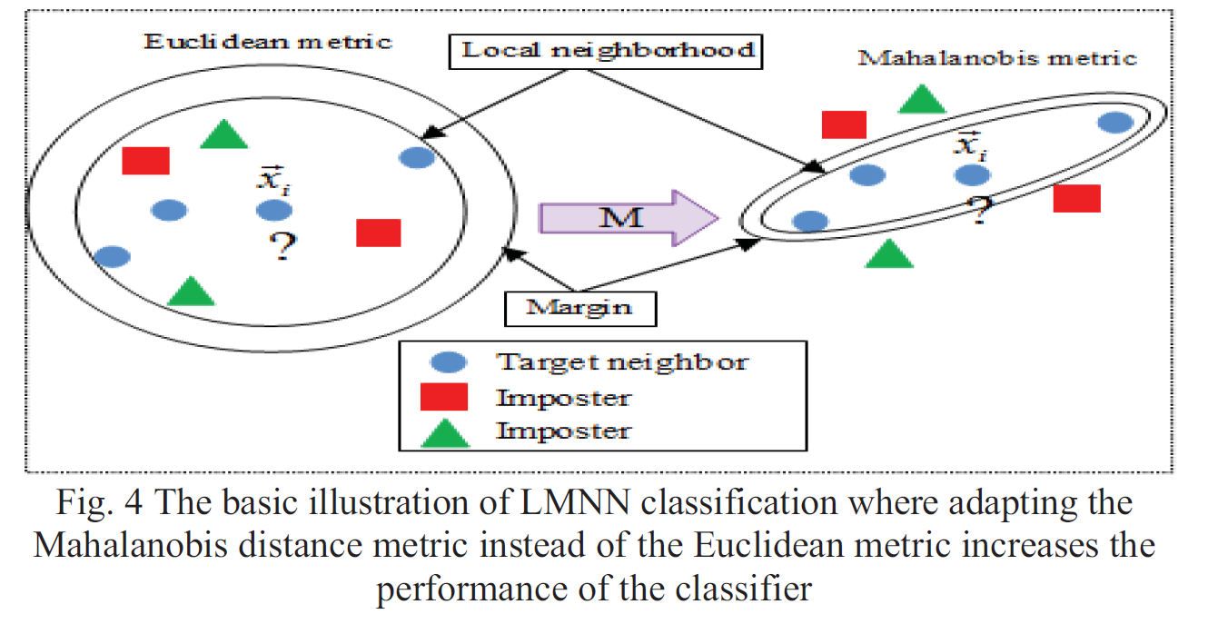
Basic illustration
LMNN is to optimize the mahalaNobis metric, while svn is to maximize the margin between hyperplane

Slide 6
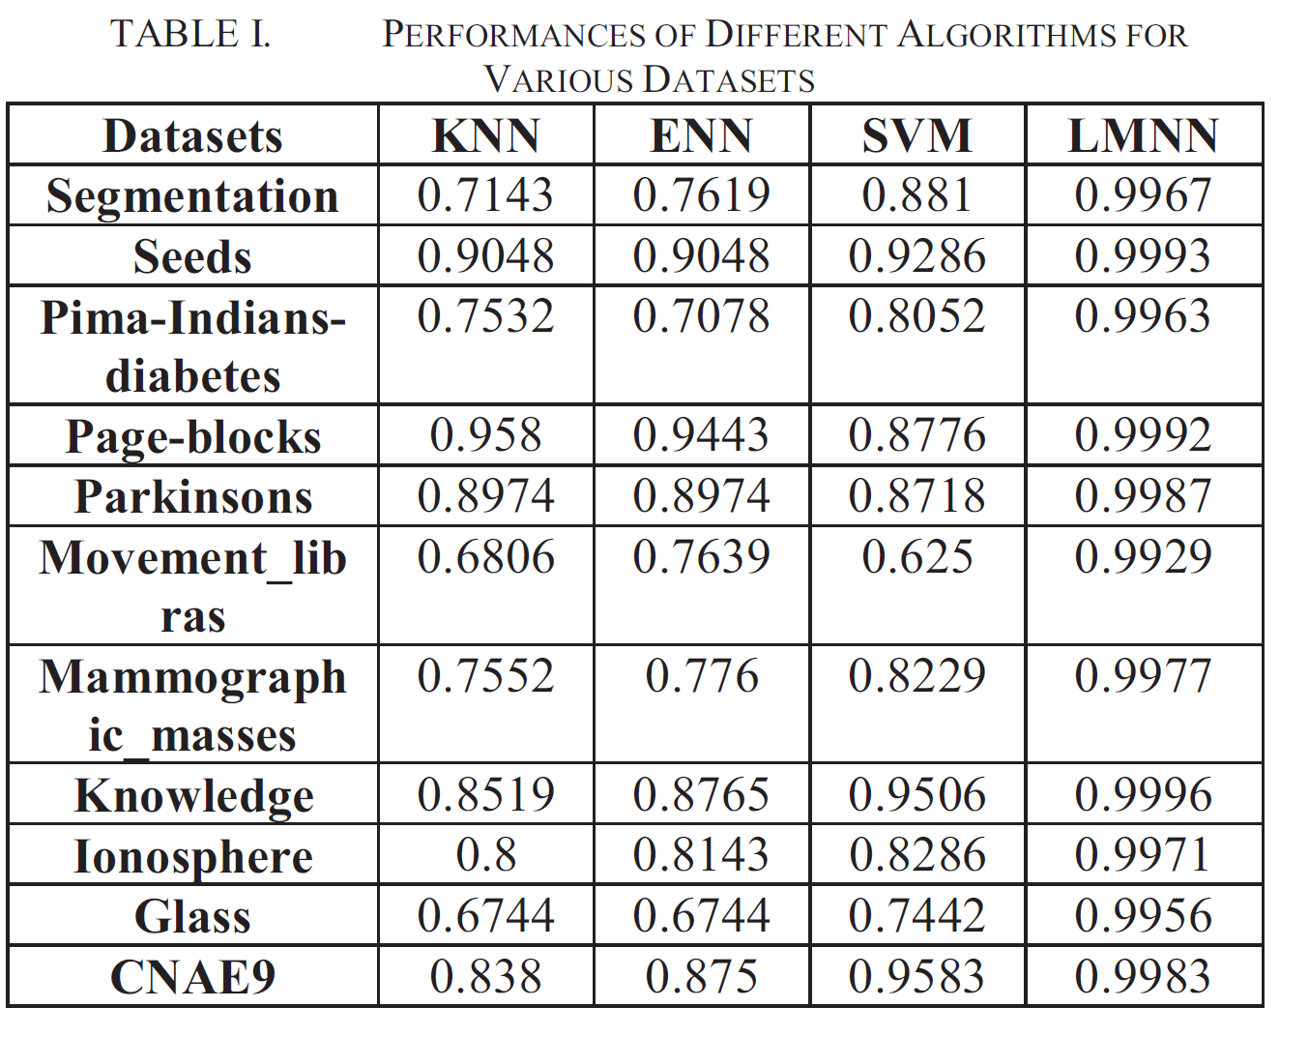
Dataset
They used 11 datasets from UCI repository to compare the performance of 4 algorithms
The general format of the data
[feature1, feature2, ……feature n , label]
Here are two instances of seeds_dataset
15.26 14.84 0.871 5.763 3.312 2.221 5.22 1
14.88 14.57 0.8811 5.554 3.333 1.018 4.956 1

Slide 7
Project description
Main purpose
Added two supervised learning algorithms: decision tree and naïve Bayes
Comparing the performance of all the algorithms on those UCI repository
Implementation details
Using python 3.6 and scikit-learn machine learning library
All the dataset are downloaded from UCI repository and necessarily processed (except movement_lib and diabetes)

Slide 8
Comparison
DT | NB
0.8809 | 0.8857
0.9047 | 0.8904
? | ?
0.9546 | 0.8785
0.8295 | 0.6958
? | ?
0.7677 | 0.8101
0.8856 | 0.8878
0.8471 | 0.8836
0.6236 | 0.4327
0.9277 | 0.8926
Decision tree tend to be more accurate than NB because it has much better performance on some datasets while its counterpart performs bad
In general, the performance of Naïve bayes is stable, but it drop dramatically in Glass dataset. So does KNN, ENN, and DT.

Slide 9
Conclusion
It’s is impossible to assume one algorithm is better than other for all the cases
Some improved algorithms are generally better than it’s original one

