Slide 1
System Presentation
in
Systems Integration and Architecture 2

Slide 2
ASSIGNED TASKS: SYSTEM/DESKTOP
MEMBERS:
LEADER: MORALES, MARIEL D.
AGUSTIN, DAPHINE A.
CARRANZA, YURI T.
CINENSE, CRISLAINE C.
GONZALES, ANNE CLARISSE H.
LATOSA, JASMIN A.
LIMBING, ABEGAIL H.
MAGADO, BLESSIE V.
MOSENABRE, ARNEL
PARALES, QUIMUEL C.
REGIS, JOHN CARLO C.
ZACARIAS, MARY JANE F.

Slide 3
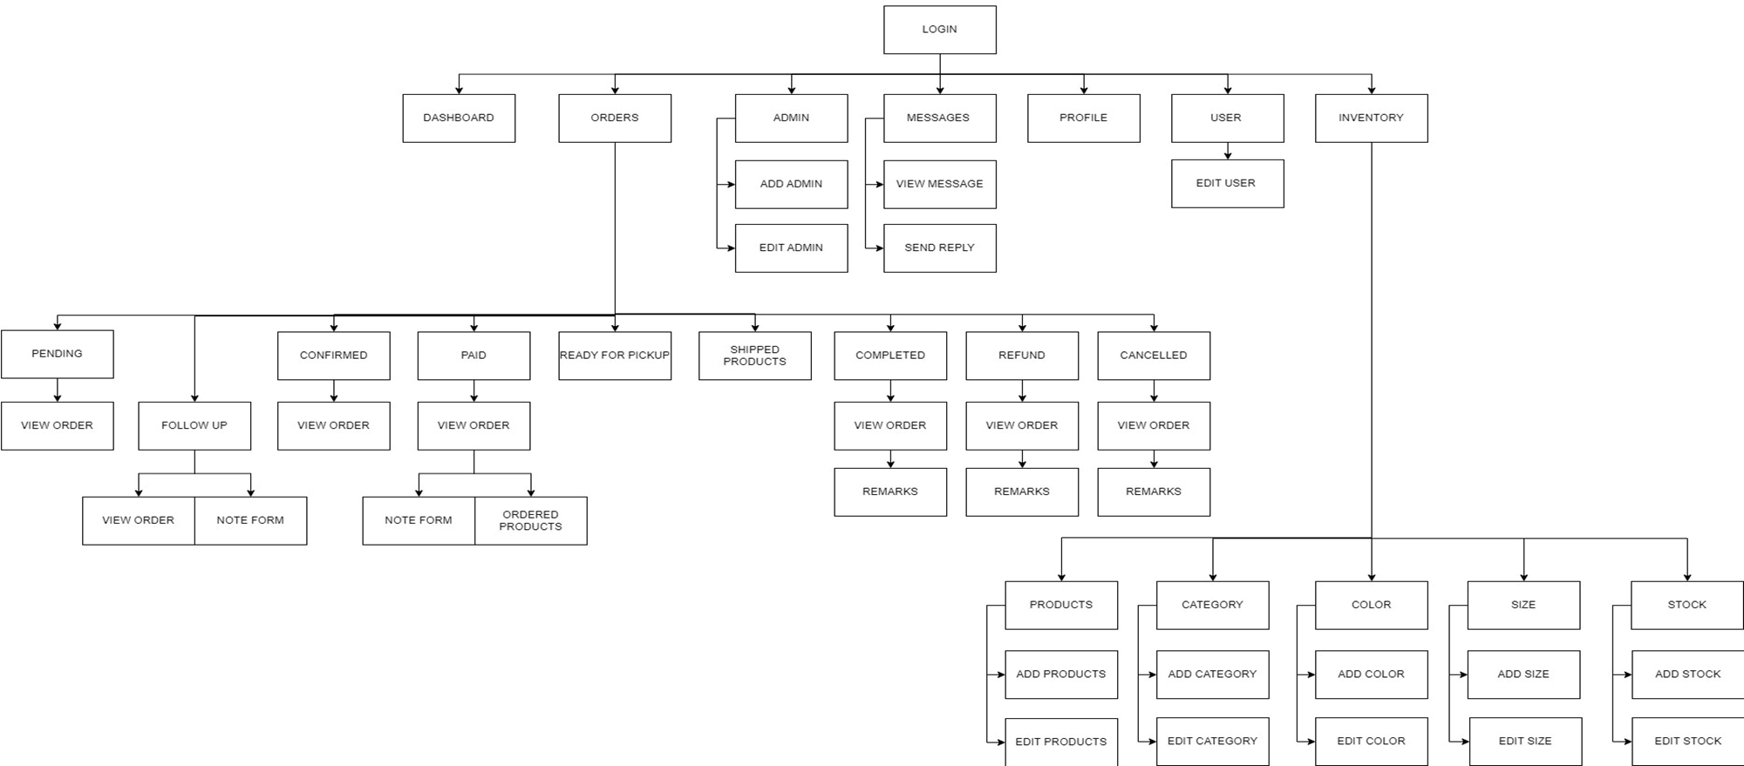
HIERARCHY CHART

Slide 4
SYSTEM UI

Slide 5
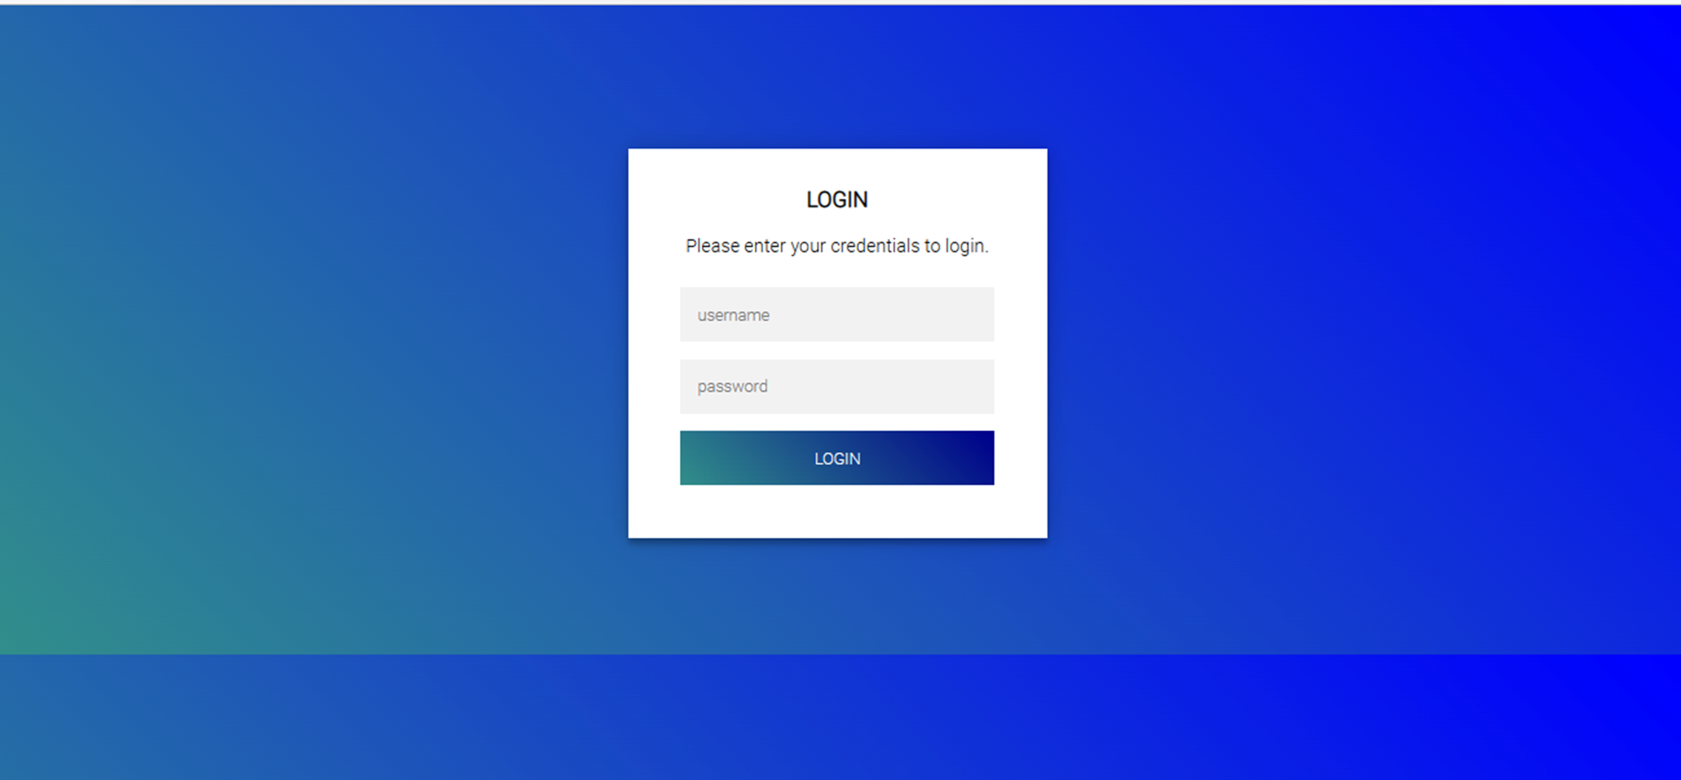
LOGIN

Slide 6
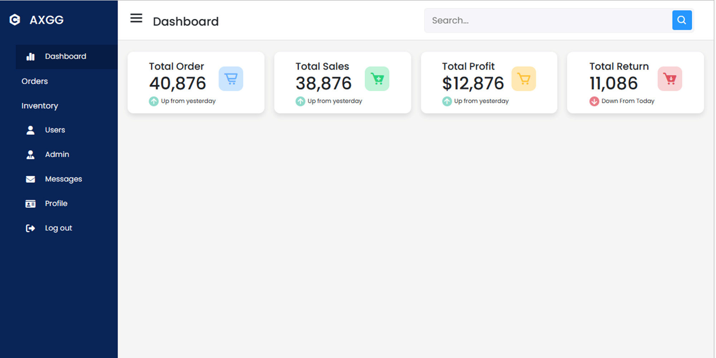
DASHBOARD

Slide 7
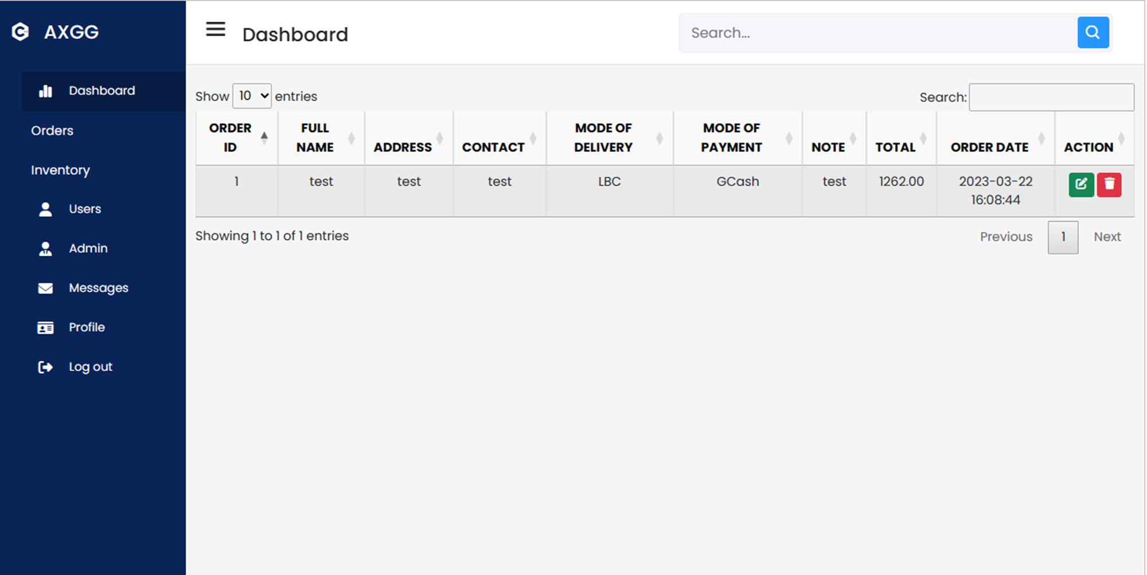
ORDERS

Slide 8
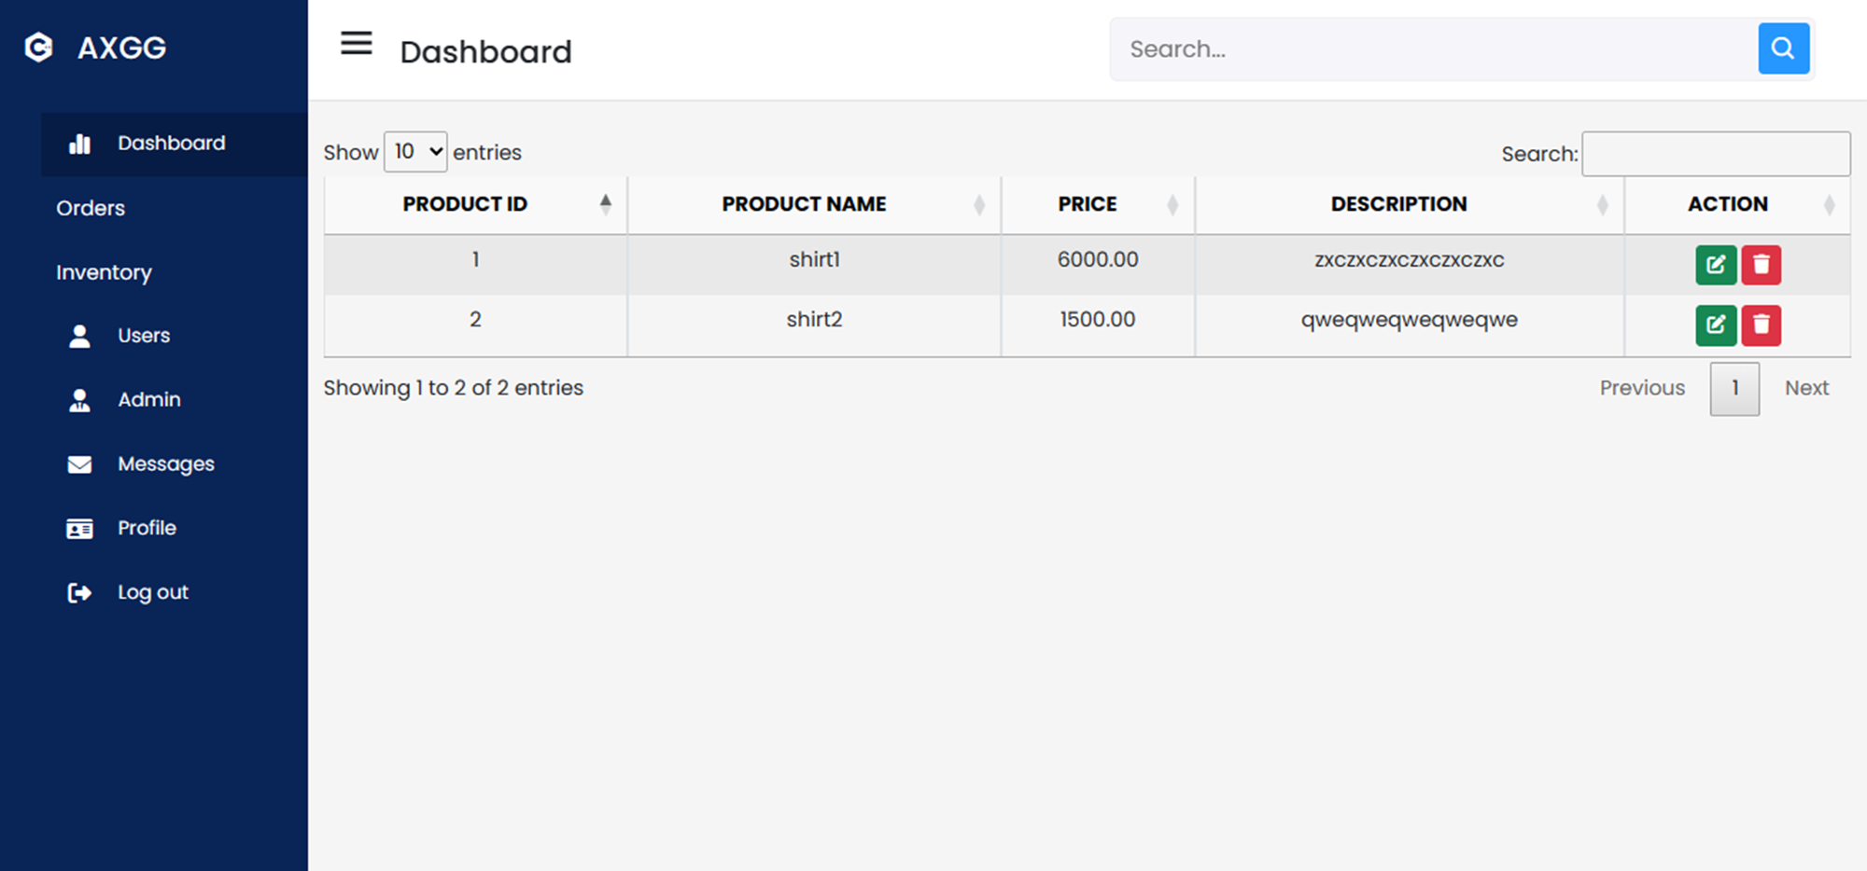
PRODUCTS

Slide 9
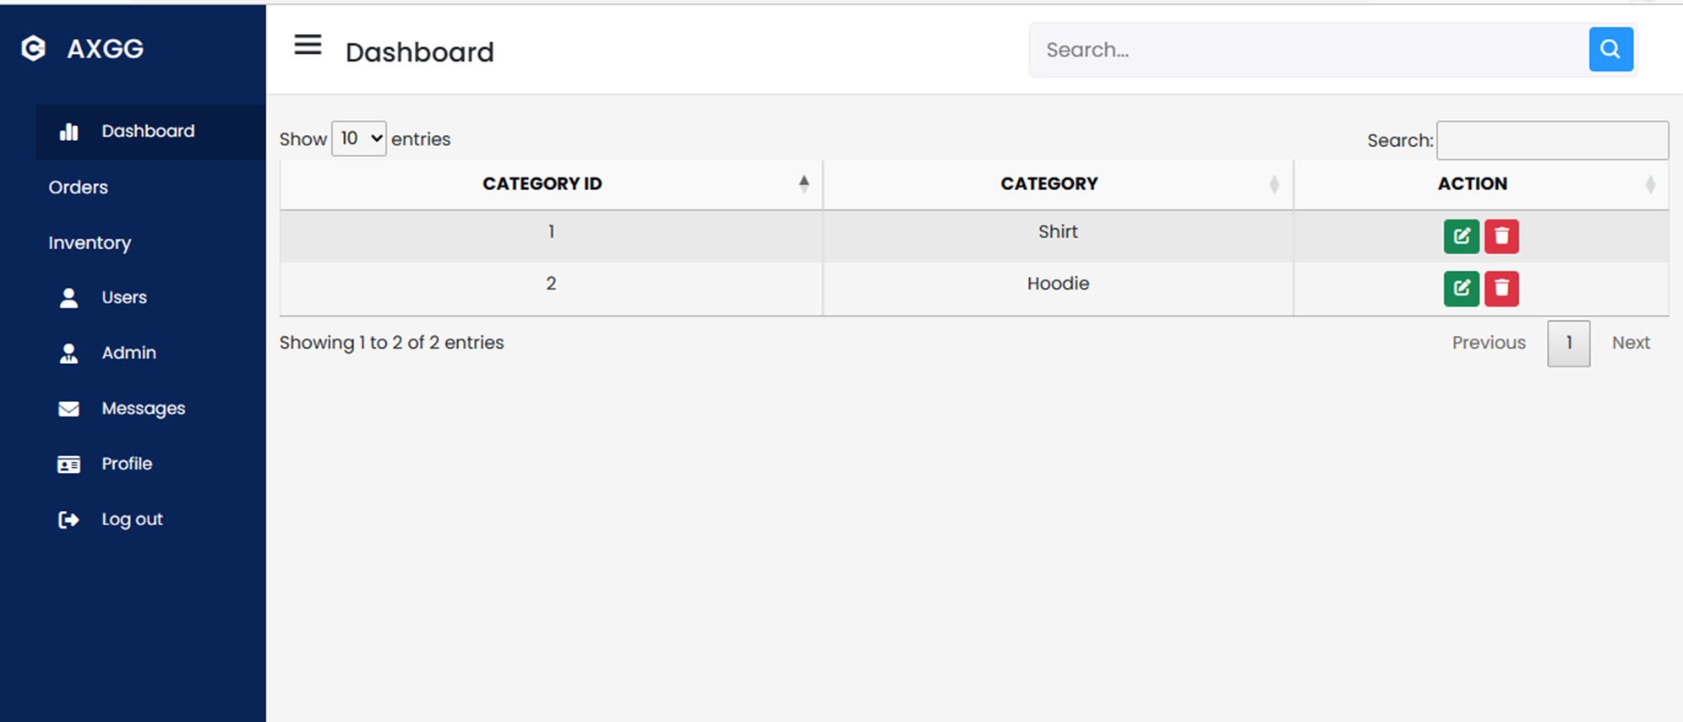
CATEGORY

Slide 10
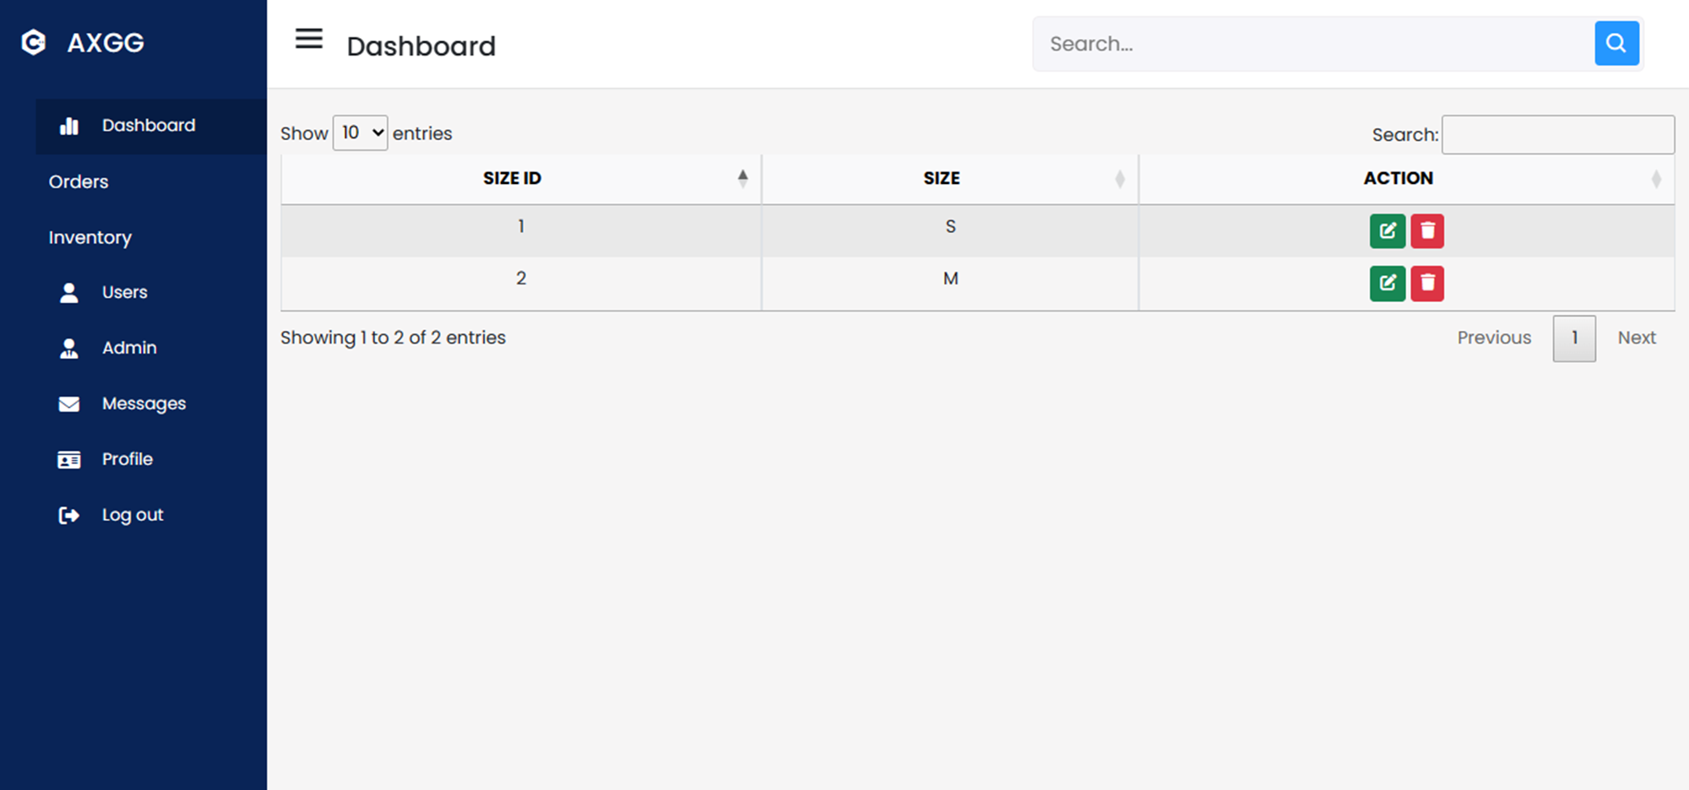
SIZE

Slide 11
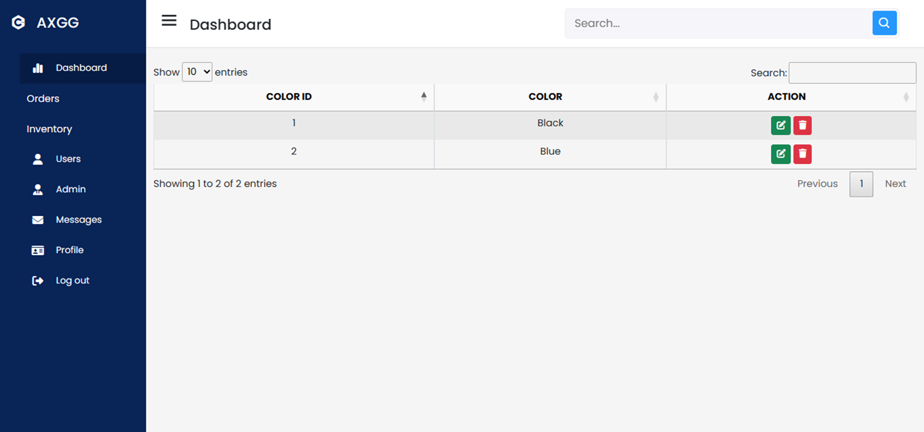
COLOR

Slide 12
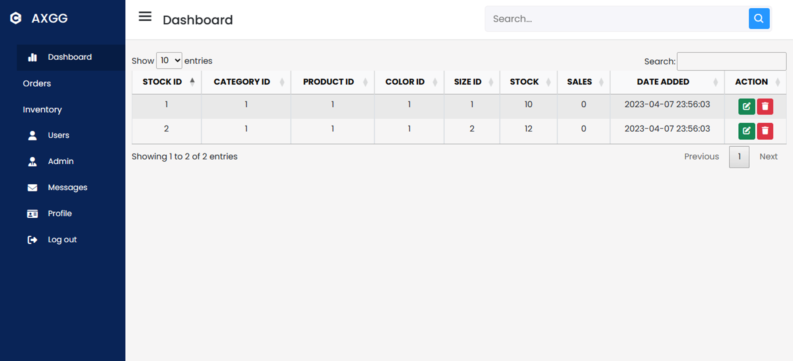
STOCK

Slide 13
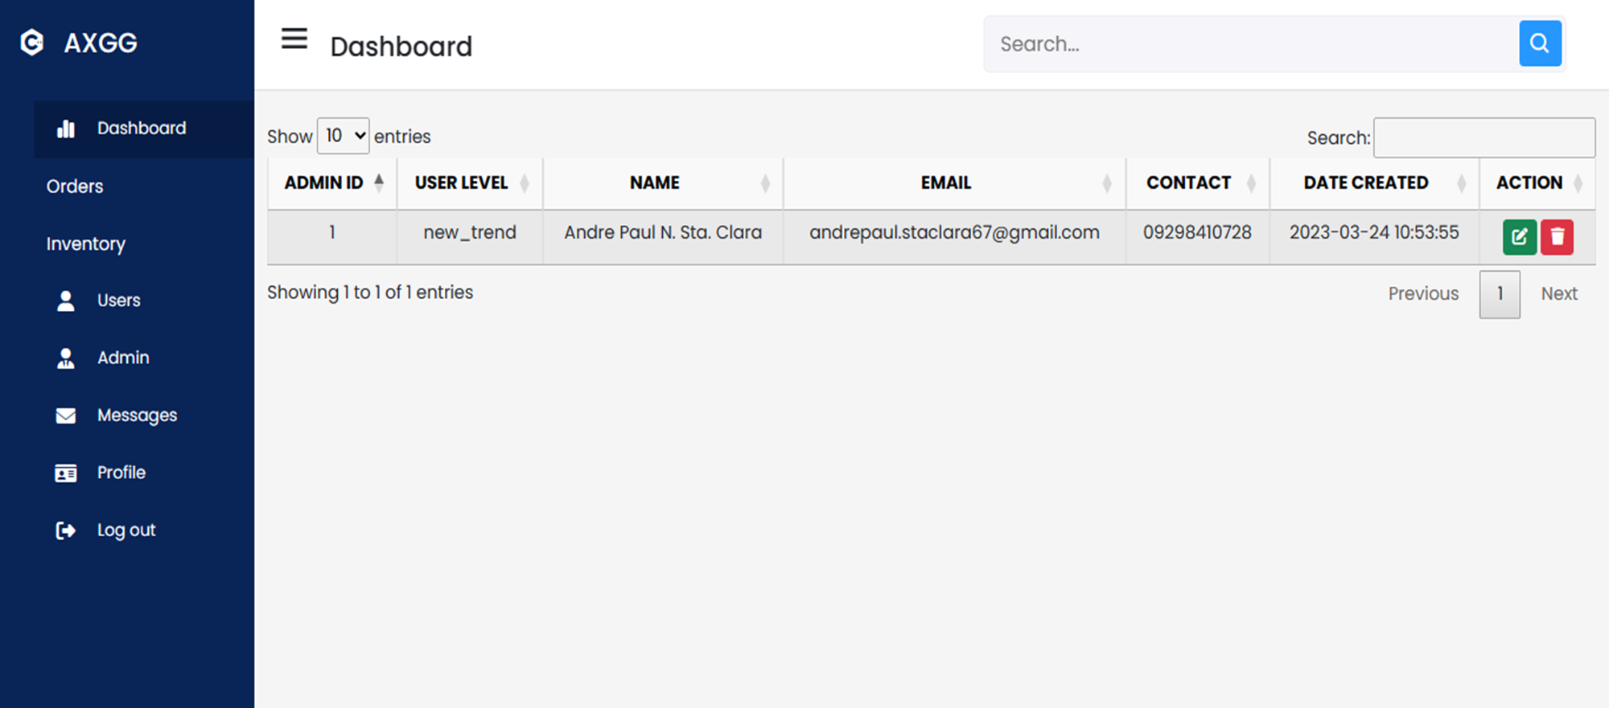
ADMIN

Slide 14
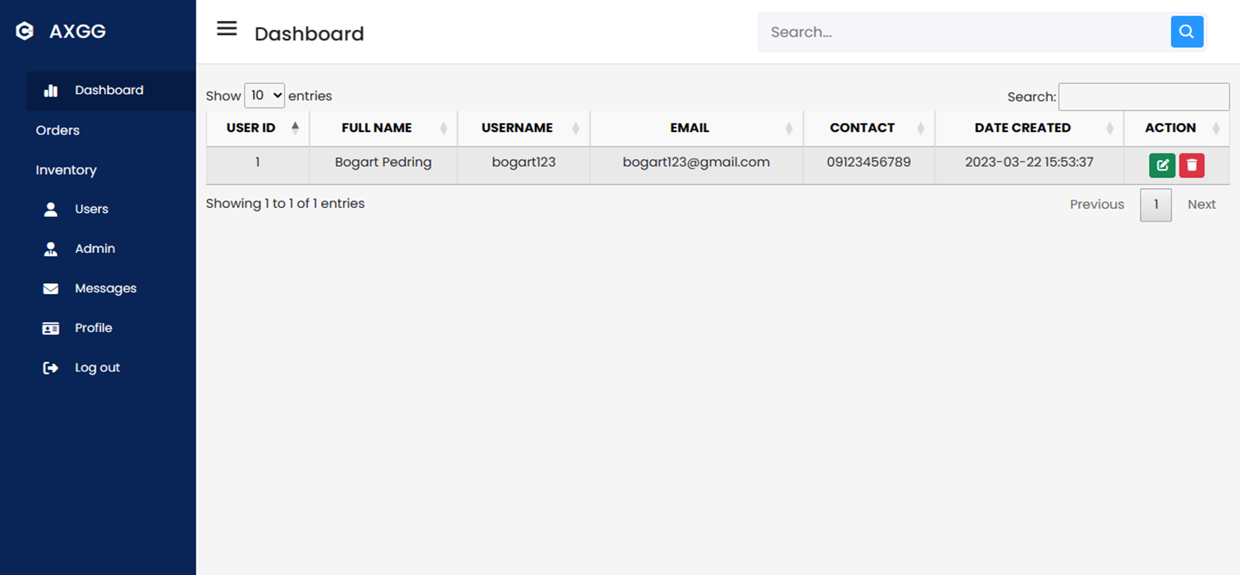
USER

Slide 15
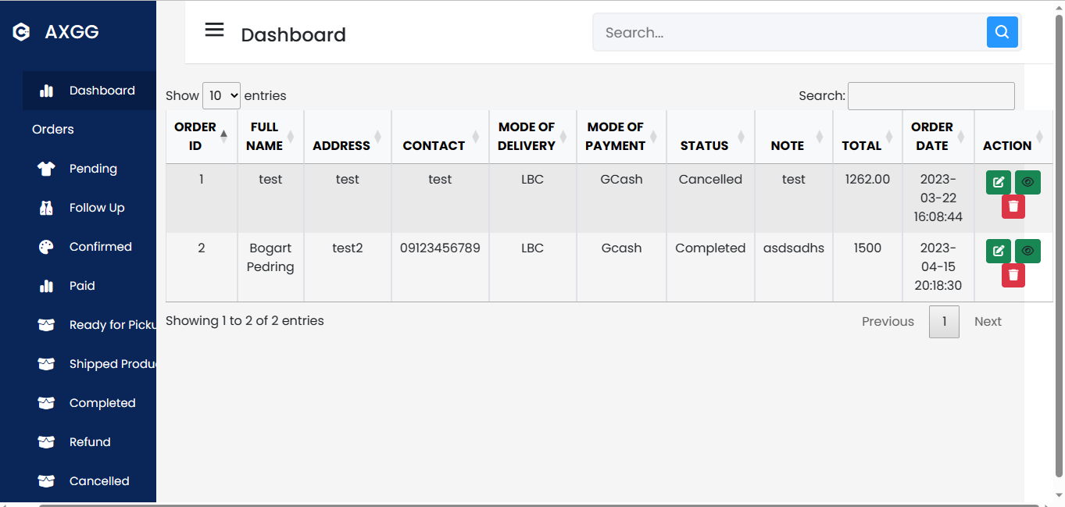
PENDING

Slide 16
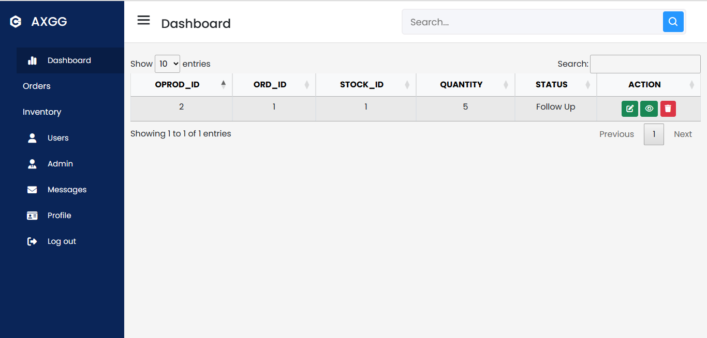
FOLLOW UP

Slide 17
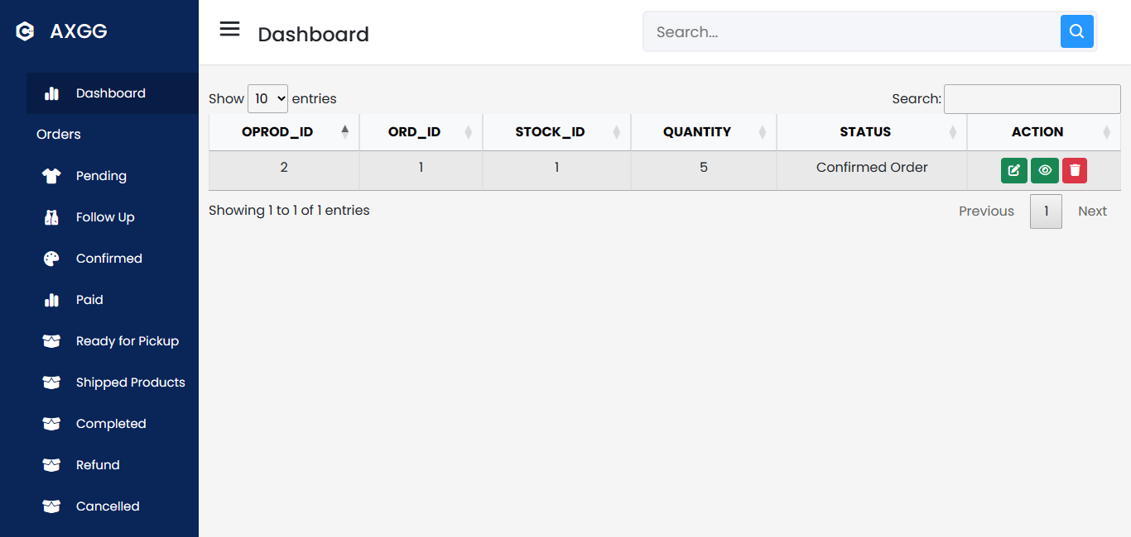
CONFIRMED ORDER

Slide 18
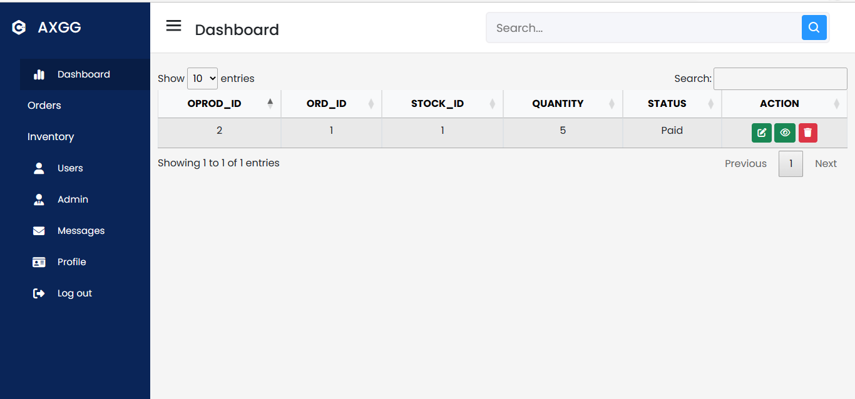
PAID

Slide 19
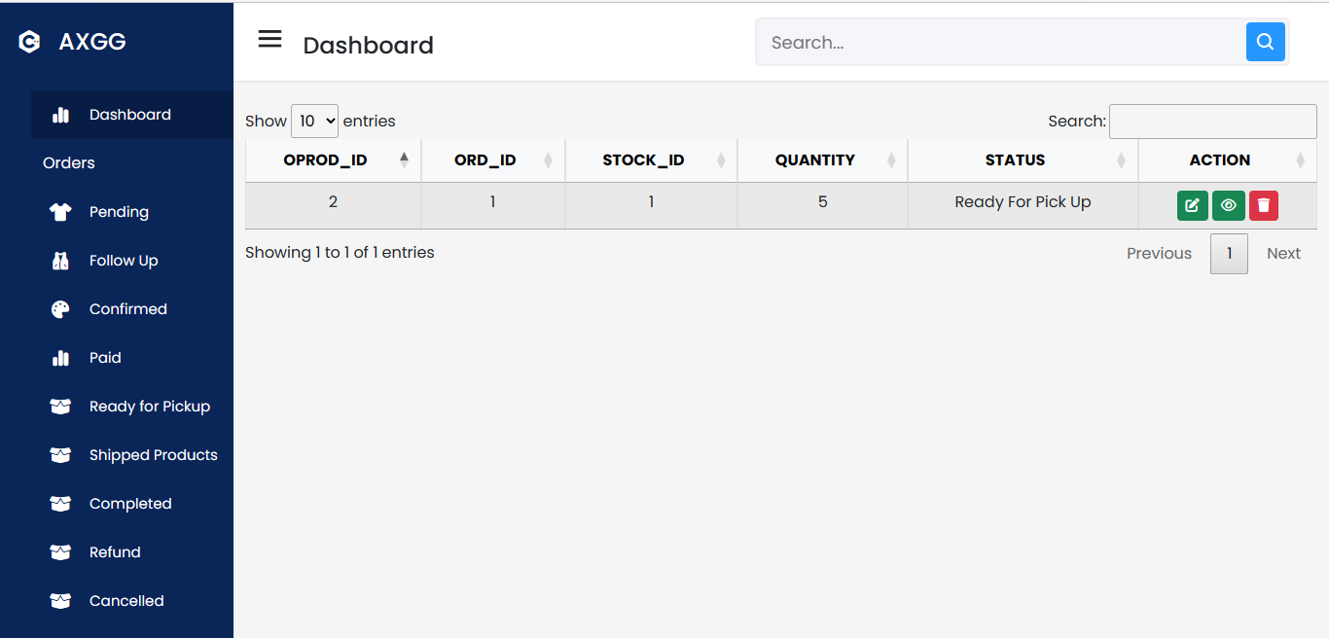
READY FOR PICK UP

Slide 20
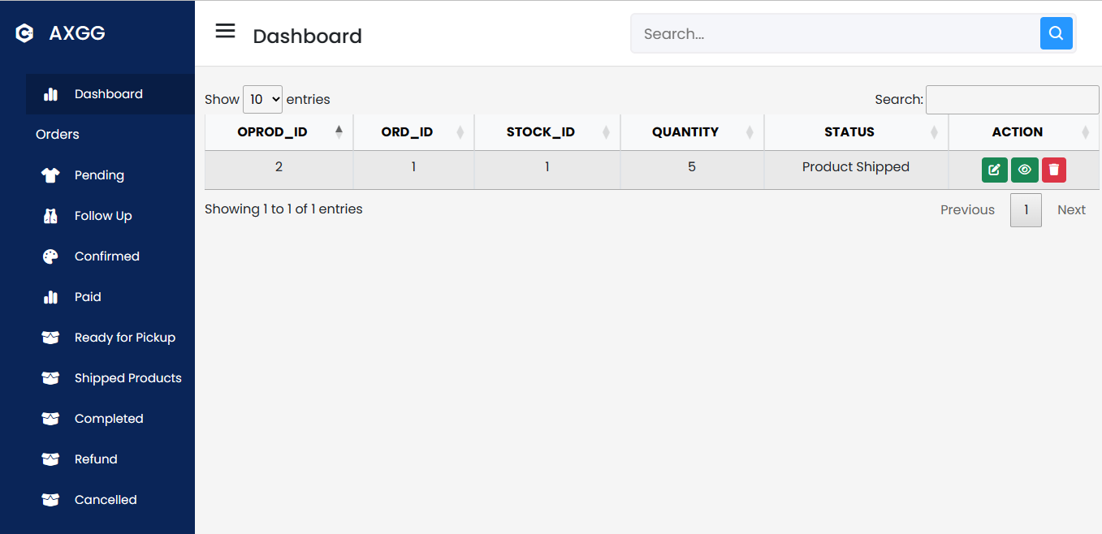
PRODUCT SHIPPED

Slide 21
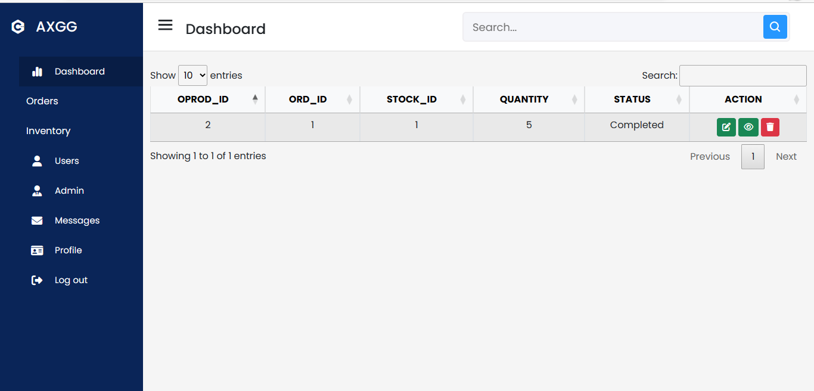
COMPLETED

Slide 22
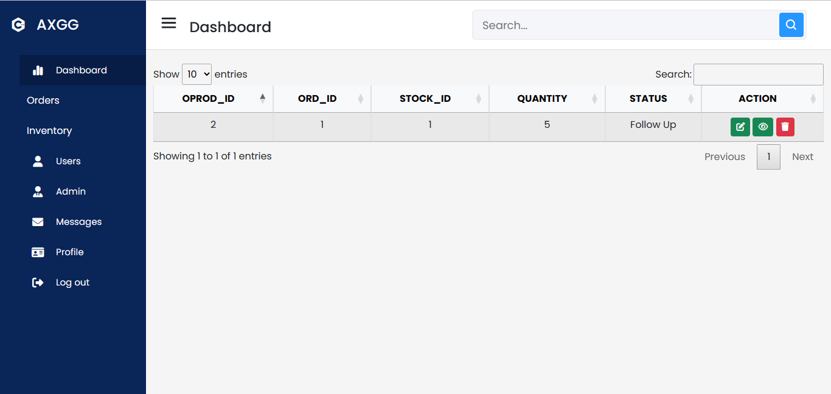
REFUND

Slide 23
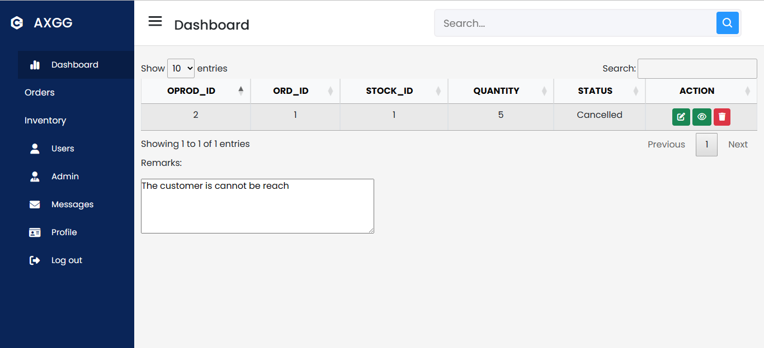
CANCELLED

