Slide 1
Superstore Profitability Analysis
Team Members:
Shemiramoth Mugo (SCT212-0061/2023)
Nicholas Ndegwa Mwangi (SCT212-0046/2023)
Samuel Kuria (SCT212-0476/2023)
Gabriella Muthoni (SCT212-0330/2023)
Emmanuel Mwangangi (SCT212-0331/2023)
Linet Waithira (SCT212-0042/2023)
Cecil Kioko (SCT212-0047/2023)
Felix Wanyoike (SCC212-0248/2023)
Lee Kariuki (SCT212-0049/2023)

Slide 2
Executive Summary
Problem: Despite strong sales, Superstore faces declining profitability in key areas.
Drivers of Loss: 1) Furniture Category, 2) Excessive Discounts, 3) Central Region Operations.
Opportunity: Recover over $70,000 in annual profit by eliminating negative-margin transactions.
Framework: We applied the EPIC framework to analyzing 9,994 transactions.

Slide 3
Methodology & Data
Data Source: Superstore Sales Dataset (Cleaned & Processed).
Preprocessing: Removed duplicates, converted timestamps, engineered 'Delivery Days'.
Tools: Python (Pandas for ETL, Seaborn for Visualization).
Analysis Scope: Product profitability, Regional performance, and Discount impact.

Slide 4
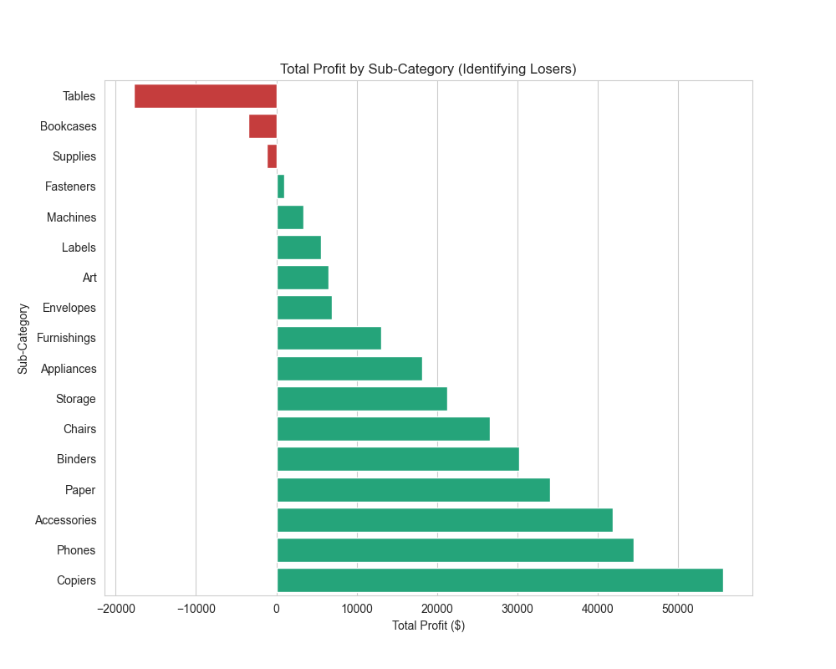
The 'Furniture' Problem
Insight: Tables are the single worst-performing sub-category.
Financial Impact: Tables generate a total loss of approx -$17,000.
Root Cause: High shipping costs for heavy items combined with deep discounts make this category unsustainable.

Slide 5
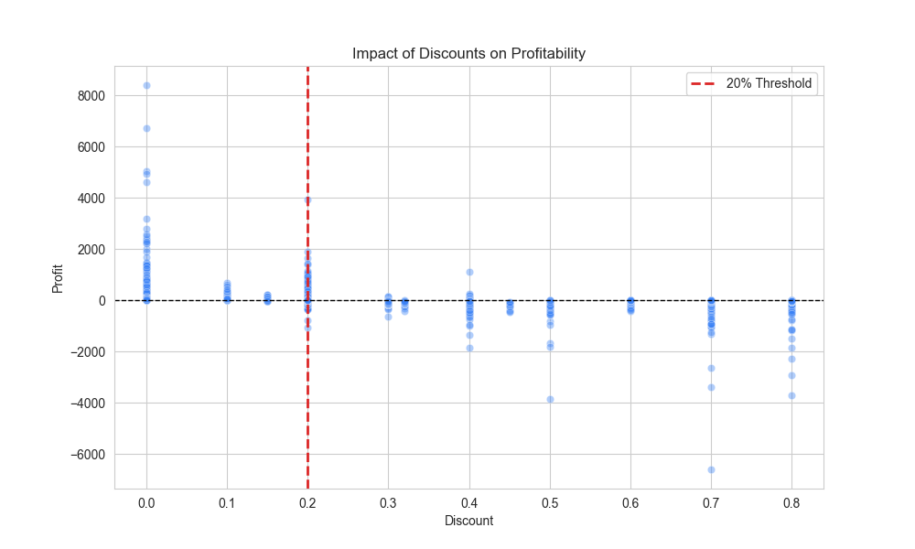
The 20% Discount Trap
Insight: There is a clear profitability threshold at 20% discount.
Observation: Transactions with discounts >20% consistently result in a loss.
Inefficiency: We are effectively paying customers to take our inventory in these scenarios.

Slide 6
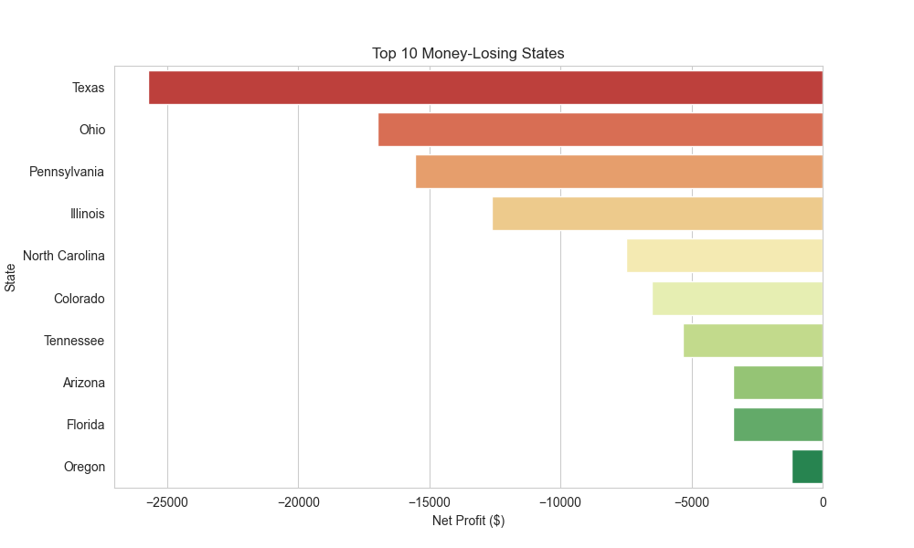
Regional Profit Drain
Insight: Texas is the primary driver of loss in the Central Region.
Financial Impact: Texas accounts for -$26,000 in net losses.
Context: High operational costs and aggressive promotions in Texas/Ohio are eroding gains from profitable states like California.

Slide 7
Strategic Recommendations
1. Discount Cap: Implement a hard 20% cap on discounts in the POS system.
2. Fix Central Region: Pause marketing spend in Texas and renegotiate shipping contracts.
3. Reprice Tables: Increase base price by 10% to cover logistics costs or discontinue specific SKUs.
4. Focus Q4: Shift Q4 strategy from volume-chasing to margin-preservation.

Slide 8
Questions?
Thank You.

