Slide 1
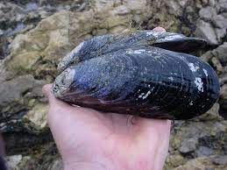
Preliminary Analysis of Population Structure in Mytilus californianus
Vanessa Garcia, Nate Jue and Eric Crandall

Slide 2
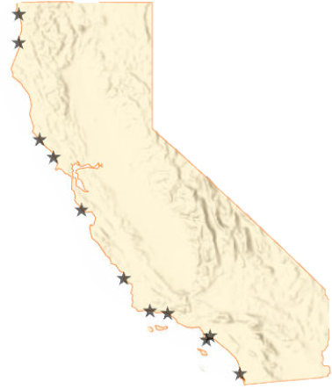

Data Collection & Processing
Enderts Beach n = 0
Trinidad Head n = 0
Isolated mitochondrial DNA from 138 mussels in 10% Chelex solution
Amplified cytochrome c oxidase (COI) gene with polymerase chain reactions (PCR)
Sequenced at MCLAB
Edited chromatograms and aligned sequences in Geneious software
Walk On Beach n = 7
Bodega Head n = 7
Davenport Landing n = 17
Hazard Reef n = 23
Refugio Beach n =16
Carpinteria n = 19
White Point n = 10
Vista Del Mar n = 19
La Jolla n = 8
Notes:
https://www.google.com/url?sa=i&url=https%3A%2F%2Fwww.pinterest.com%2Fpin%2F507921664207733377%2F&psig=AOvVaw2qcqMGiirBoj6yooD55Z1t&ust=1621291547964000&source=images&cd=vfe&ved=0CA0QjhxqFwoTCOCm-Oejz_ACFQAAAAAdAAAAABAD

Slide 3
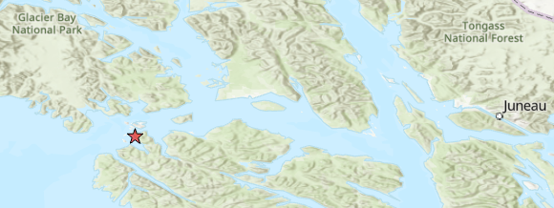
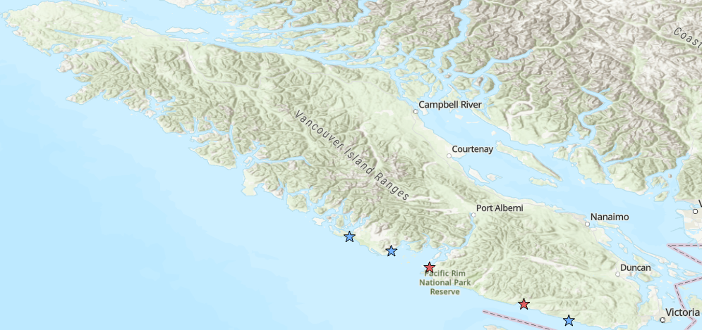
Additional Data
Criego-Prieto et al. 2015 n = 95
Marko et al. 2009 n = 57
Elfin Cove n = 19
Long Beach
Salmon Beach
Bamfield n = 23
Port Renfrew n = 15
China Beach

Slide 5
Models
Panmixia
Pt Conception
N-Island
Symmetric
Stepping-Stone
Southward
Stepping-Stone
(California Current)
Full
Stepping-Stone

Slide 6
P = 0.006

Slide 7
Model | Marg_Like | Marg_Like_SD | Rank | lbf | modelprob
Island | -2266.94 | 7.41 | 6 | -276.5616 | 0.0000
Panmixia | -2133.31 | 4.73 | 2 | -9.2930 | 0.0095
Point_Conception | -2150.70 | 8.22 | 4 | -44.0650 | 0.0000
Stepping_Stone | -2136.54 | 7.91 | 3 | -15.7485 | 0.0004
Stepping_Stone_CC | -2128.66 | 5.67 | 1 | 0.0000 | 0.9901
Symmetrical_Stepping_Stone | -2163.39 | 9.23 | 5 | -69.4452 | 0.0000

Slide 8
Very Preliminary Dispersal Kernel!
Mean parent-offspring distance = 41 km
95% HPD 7 km – 142 km

