Slide 1

Turtle Games Increase sales & drive loyalty
Presented to: Sales Director & Marketing Director
By: Alex Nott
July 2023

Slide 2

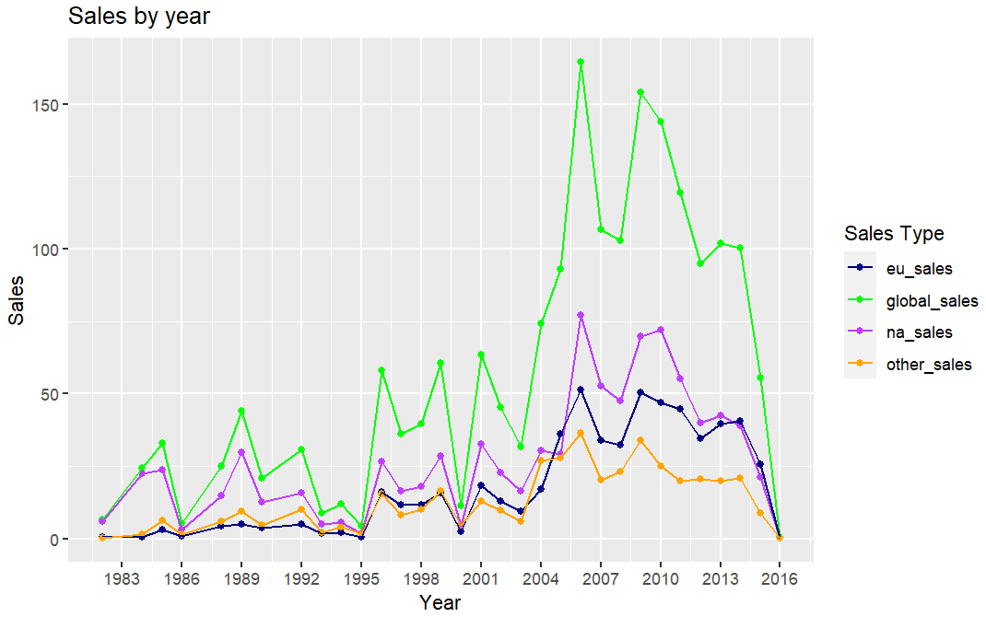
Context
Turtle Games sales dropping in all markets
Games industry is high growth
Total market is £191bn (2023)
2006 peak was £164m – 0.086% of market
Goals:
Focus for sales & marketing
Target customer groups
Optimising for retention (loyalty)
Benchmark sentiment
Content for targeted campaigns
Reducing costs – optimising products or platforms, targeted marketing
Forecast sales based on current data

Slide 3
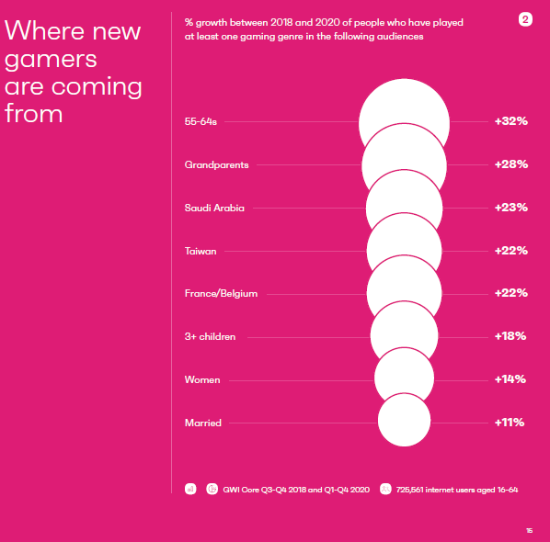


Gaming Industry
GWI’s recent report:
Growth of older gamers, new geographical markets, family games
Marketing through gamers with active social presence
In-game purchases / extensions drive additional sales
Mordor report:
Asia-Pacific is fastest growing region for gaming
https://www.gwi.com/reports/the-gaming-playbook
https://www.mordorintelligence.com/industry-reports/global-gaming-market

Slide 4



Data
Reviews with remuneration, age, gender, loyalty and spending
Sales with North America & EU and Global, release year, platform and product
Github – Python and R
Limitations
Data source / collection including English only reviews
Recency
Costs & profits or margins
Assumptions:
Year of release
2016 incomplete data
Other markets = Global Sales - North America + EU
Spending score & loyalty linked

Slide 5
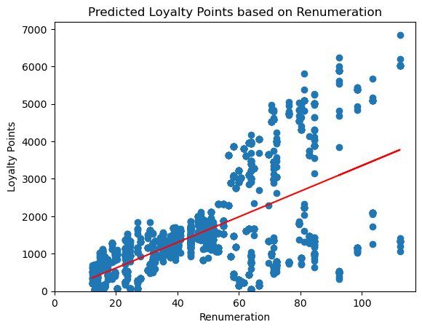
Loyalty Points
Retention is cheaper than acquisition
Remuneration and Age are independent variables
Every increase of £1000 remuneration = 34 more loyalty points
But as remuneration increases the more varied the loyalty points
Every 1 year older = 4.2 drop in loyalty points
Actions:
Indicates our ageing audience is less loyal - opportunity to improve product offering to retain for longer
Target higher earning customers

Slide 6
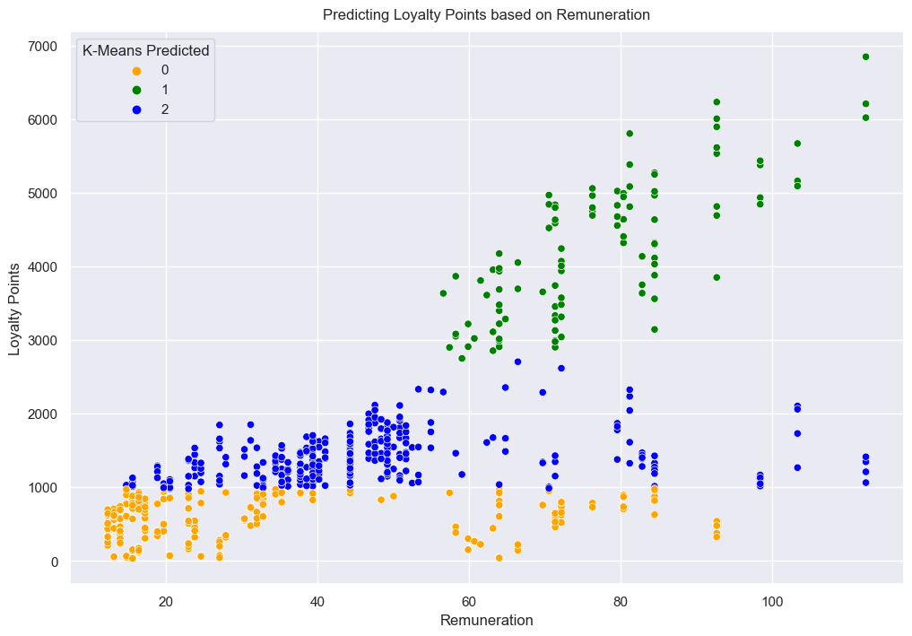
Target customer group for marketing
Used remuneration to predict loyalty points
Splits customer base into 3 roughly equal groups
Actions:
Target customers in remuneration bracket £57-112k for optimal loyalty points

Slide 7
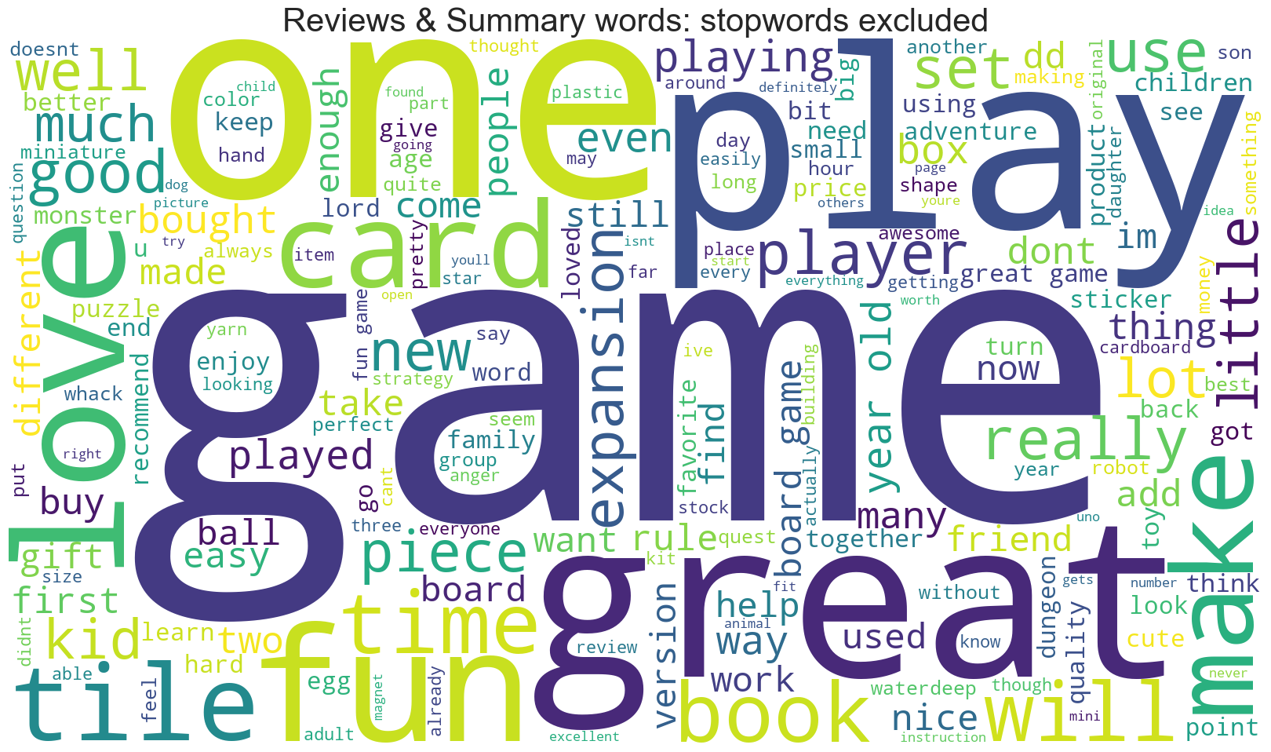
Review sentiment & insights
Overall Sentiment 0.22, subjectivity 0.45.
Segmented group 0.24 – indicates performing better for target remuneration group
“Game” above “book”, “card”– product preference
“Kid” - products bought for kids.
Actions:
Use reviews by target renumeration group to:
Negative - improve product
Positive – use in social media campaigns
Review polarity every 6 months using 0.22, 0.24 for target customer group and 0.45
Review non-English reviews for other market campaigns
Target customers buying for kids
Use top keywords in paid and organic search campaigns

Slide 8
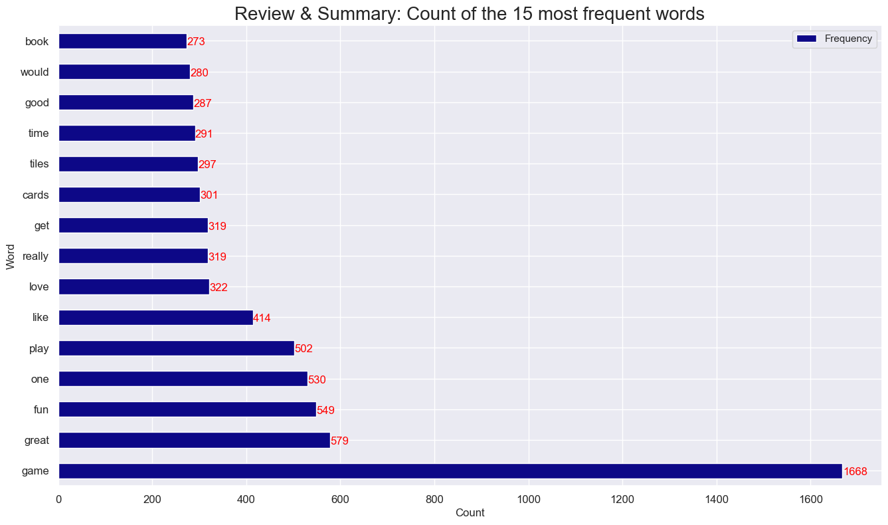
Reviews

Slide 9
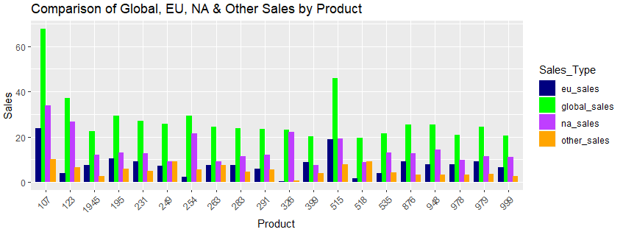
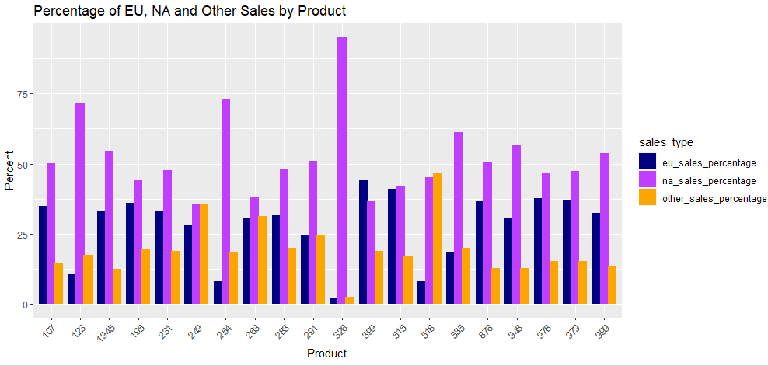
Sales by Product
175 products, 22 platforms
Platforms: Wii - highest sales but the least products
Top 20 products: bestseller 107 on wii
Different products perform better in different markets:
107 and 515 from all markets
NA drives almost all sales for 326
EU drives product 399 sales
Other markets drive product 518 sales
Actions:
Opportunity for growth in EU and other markets on bestsellers
Segment marketing and sales for individual products by market
Consider reducing product range by market to reduce costs

Slide 10
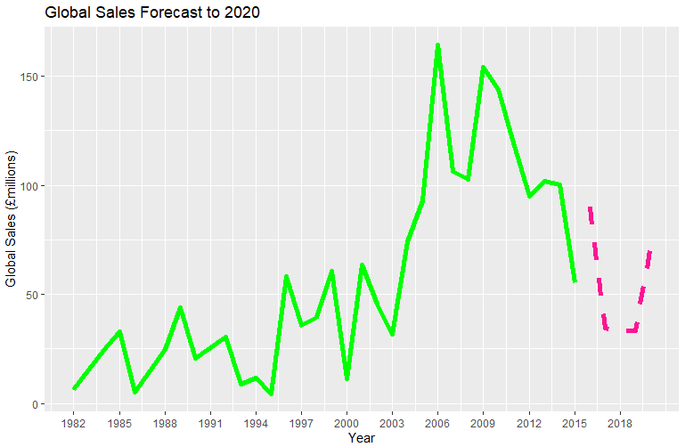
Relationships between markets
Metadata states relationship between NA and EU sales with Global Sales
NA and EU as closely correlated to Global Sales (97%), Other markets 94% and Year 76%
Best forecast model uses Year with NA_Sales - forecasts 2020 sales of £72million
(Residual standard error of 7.535)
Actions:
Run model with more recent data to review model accuracy
Re-forecast with more recent data
Opportunity to gain more market share

Slide 11
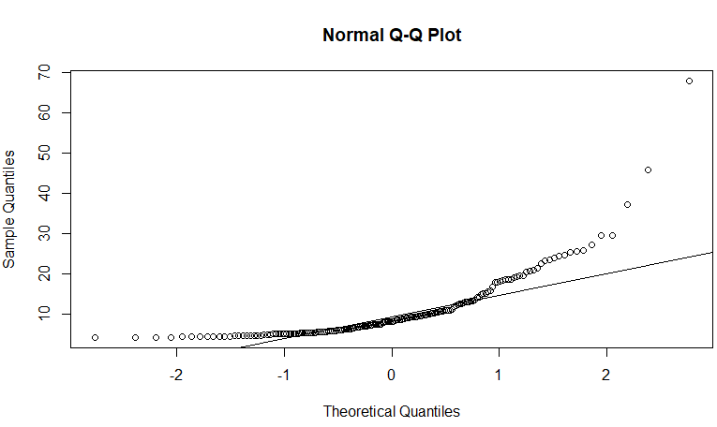
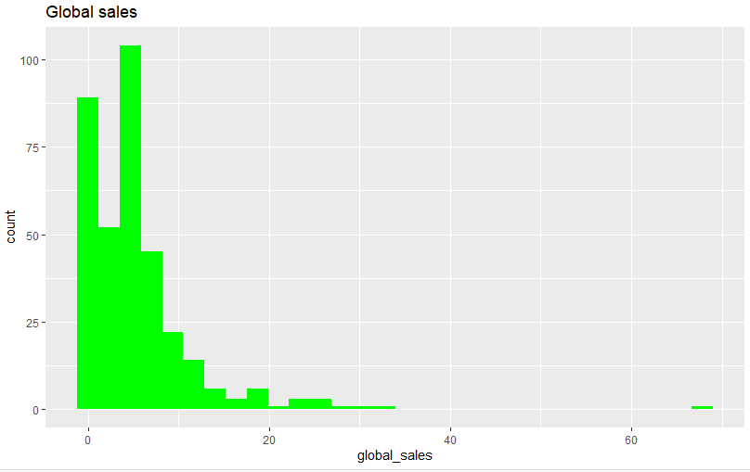
How reliable is the data?
Global sales data:
Not normally distributed – outliers above the expected line – there will be a margin of error on predictions
Positive skew +3.07 (there are outliers)
Kurtosis of +17.8 - tail is a long way from the mean (the outliers are significant)
Actions:
Sales very reliant on single outlier. Use product data to spread risk
Collect more information about the data and data collection methods
More recent data
Use skew and kurtosis as benchmarks to review data every year

Slide 12
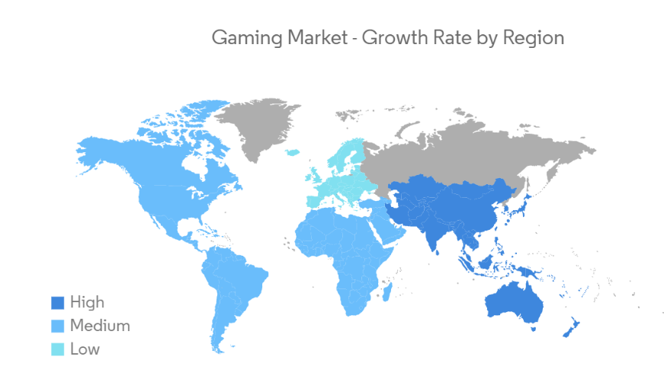
Summary
Recommendations:
Focus on remuneration customer group £57-112k driving loyalty
Use extracted positive reviews for social media marketing
Use negative reviews to improve product
Review products to target older market and improve loyalty by age
Focus on best performing platforms and products by market
Diversify product portfolio to reduce reliance on single outlier
Explore in-game sales and new geographical markets
Data actions:
Update for recent data and review forecast model
Explore seasonality within a year to optimise marketing and sales campaigns
Review sentiment polarity every 6 months based on 0.22 polarity (0.24 for target group) benchmark with 0.45 subjectivity
Review skew and kurtosis every year for product portfolio diversity
Investigate data collection process to review data reliability
Your feedback: https://forms.gle/hFHSTN4frDCH6Rbc9

