Slide 1
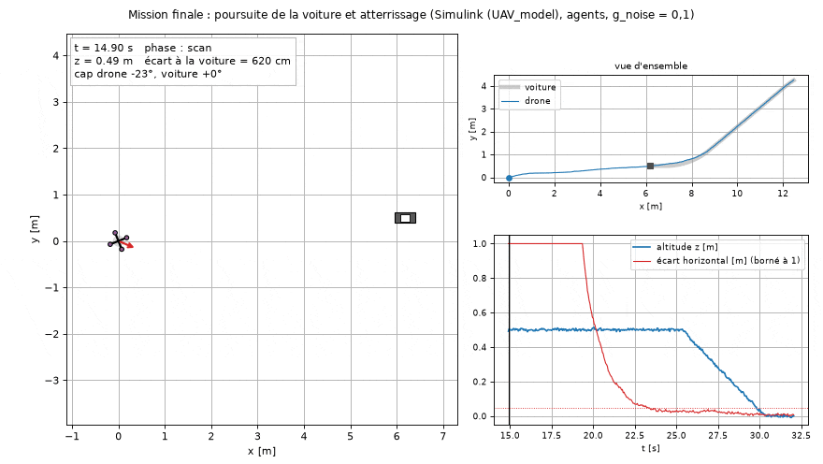
LANDING A QUADROTOR ON A MOVING CAR · [TEAM NAMES] · [SCHOOL / COURSE] · [DATE] · [SUPERVISOR]
Our reinforcement-learning agents take off, scan 360°, chase a turning car and land on it.
Simulink flight, RL agents, g_noise = 0.1: landed at 30.1 s, 0.8 cm from the centre
1 / 18
Notes:
0:30
• Simulink UAV_model (4 motors, 18 outputs), controller at 20 Hz (Ts = 0.05 s).
• Mission: hold, climb to 0.5 m, 360° scan in 10 s, chase a turning car, land on it.
• This flight (Simulink, agents, g = 0.1): 30.10 s, 0.8 cm from centre, 1.3 cm/s, heading −0.20°.
• Title placeholders: [TEAM NAMES], [SCHOOL / COURSE], [DATE], [SUPERVISOR].

Slide 2
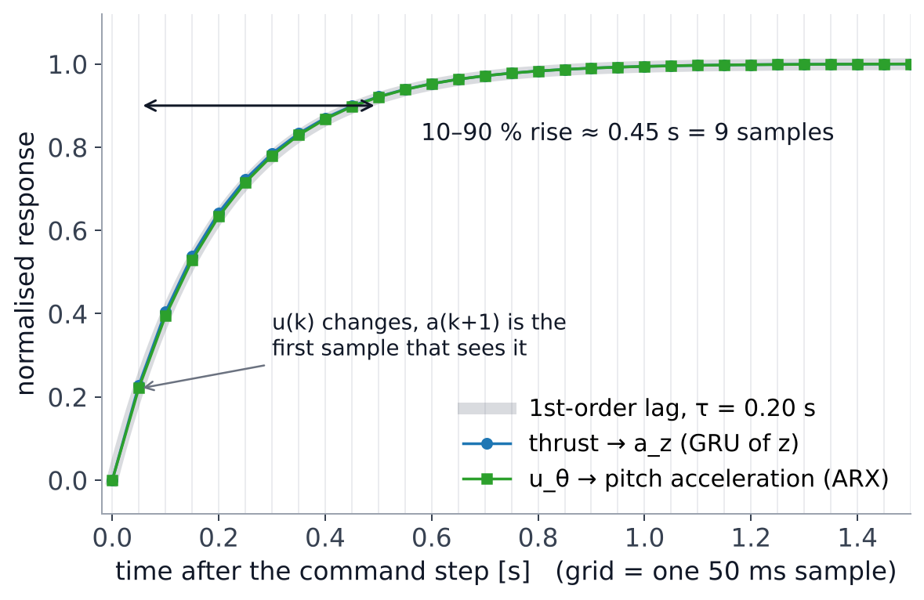
THE DRONE · SAMPLING PERIOD AND MODEL
Each axis is a 0.2 s motor lag followed by a double integrator; sampling at 50 ms puts 9 samples in every motor rise.
WHY T_{s} = 0.05 s
τ / 4
the 0.45 s motor rise spans 9 samples: every transient is seen
10 Hz
Nyquist, 4× the fastest closed loop (2.3 Hz)
slower ×
the loop delay grows with T_{s}: 1.5·T_{s} = 75 ms already costs 40° of phase at 1.5 Hz
faster ×
nothing new to see, noisier differences, longer RL episodes
OUR MODEL, AXIS BY AXIS
u
→
motor lag
τ ≈ 0.2 s
→
gain k
→ acceleration →
∫ ∫
→
position / angle
z
k ≈ 18.4 m/s²
nonlinear S-shaped thrust, hover at u = 0.39 → GRU
ψ, θ, φ
k ≈ 172 rad/s²
small differential command, linear → ARX
x, y
a_{x} = 9.9·θ
a_{y} = −9.9·φ, no measurable drag
Step on the command of the identified models (GRU of z, ARX of θ): both are the same 0.2 s motor lag.
“+” layout: u_{1,3} = u_{z} + u_{ψ} ∓ u_{θ} (front, rear), u_{2,4} = u_{z} − u_{ψ} ± u_{φ} · 50 ms is also the rate of the recorded data and of the RL interface
2 / 18
Notes:
0:45
• Subject: 'justify Ts = 0.05 s'. The data show a first-order motor lag τ ≈ 0.20 s; u(k) first shows in a(k+1).
• Ts = τ/4: the 10–90 % rise (0.45 s) spans 9 samples (rule of thumb: 4 to 10 samples per rise time).
• Nyquist 10 Hz vs fastest closed loop 2.3 Hz (z agent). Slower: loop delay ≈ 1.5·Ts, 75 ms already costs 40° at 1.5 Hz, which is what made the LQI oscillate. Faster: motor already filters, noisier finite differences, RL episodes longer than 200 steps.
• Model: z thrust gain 18.4 m/s² (global fit; local slope 22.7 near hover), hover u = 0.39; ψ, θ, φ: 172 rad/s² (ARX 171.8, impulses 172.5); a_x = 9.907·θ, a_y = −9.911·φ, drag 0.0024·v_x.
• Mixer '+': M1 front, M3 rear (pitch), M2/M4 (roll); yaw = pair 1+3 vs pair 2+4.

Slide 3
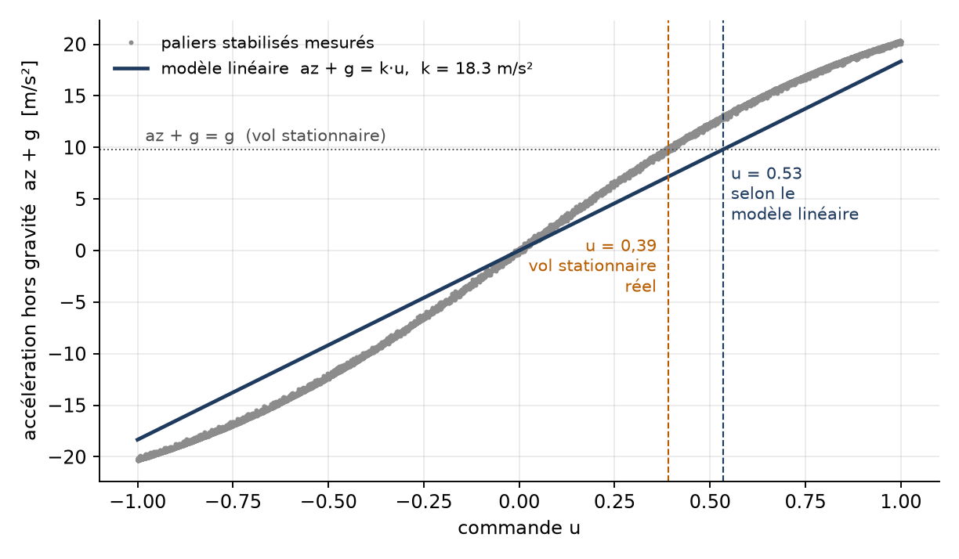
BASELINE · LQ CONTROL WITH INTEGRAL ACTION
Our reference is an LQ regulator on a double integrator, with an integral state for the hover point the linear model gets wrong.
STATE
x = [ z , v_{z} , ∫(z − z_{ref}) ]
position and speed of the double integrator, plus the integral state that absorbs the wrong hover point
MODEL PARAMETERS
thrust gain k
sampling T_{s}
hover feedforward u₀
18.4 m/s²
0.05 s
0.39
LQ SYNTHESIS (dlqr)
u = u₀ − K x , K = argmin Σ xᵀQx + R u²
weights
gains K_{p} / K_{d} / K_{i}
Q = diag(80, 25, 25), R = 1
1.86 / 0.88 / 0.79
The least-squares line puts hover at u = 0.53; the real hover is u = 0.39. Without an integral the drone settles at 0.9 m for 1 m.
Same method for yaw (k_{ψ} = 168 rad/s²) and pitch · gains then fit so that the 20 Hz response matches the continuous Simulink one · “LQI” means this version from now on
3 / 18
Notes:
0:40
• State x = [z, v_z, ∫e]; ZOH at 0.05 s; dlqr minimises Σ xᵀQx + Ru².
• Without ∫e: 0.9 m for a 1 m target (line puts hover at u = 0.53, real 0.39).
• dlqr gives 2.32 / 1.10 / 0.98, kept ×0.8 = 1.86 / 0.88 / 0.79 (robustness); reference filter τ = 1.2 s, anti-windup.
• Same method: ψ (k = 168, Q = diag(120, 40, 30), R = 10) → 0.252 / 0.125 / 0.097; θ → 0.443 / 0.130 / 0.280; x PD 0.23 / 0.28 from ωn = 1.5, ζ = 0.9.
• 20 Hz refit (z 5.2 → 2.6 cm from Simulink; θ diverging → stable): detail, say it in one sentence.

Slide 4
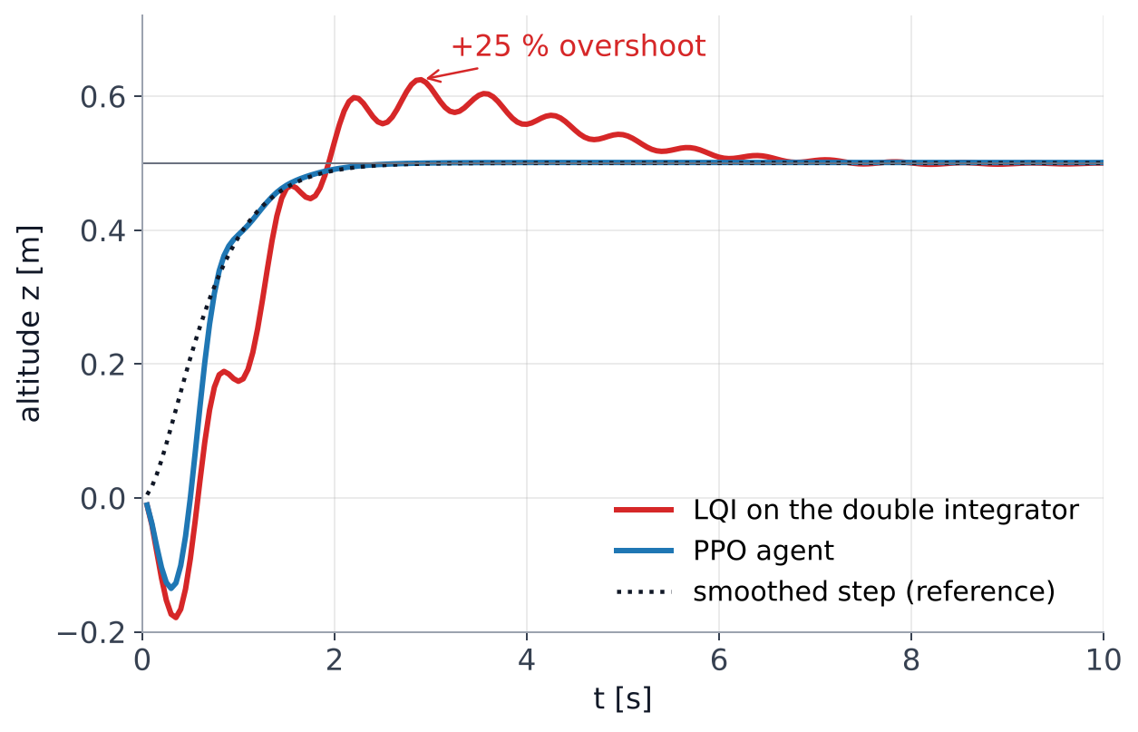
WHY LEARNING · SAME STEP, TWO CONTROLLERS
On the same smoothed 0.5 m step, the LQI overshoots by 25 % and settles in 6.5 s; the trained agent does not overshoot and settles in 2 s.
LQI
PPO agent
rise 10–90 %
0.85 s
0.85 s
overshoot
25 %
0.2 %
settling (2 %)
6.5 s
2.0 s
PRBS RMSE (noise)
8.3 cm
2.7 cm
The double integrator ignores the 0.2 s motor lag and the S-shaped thrust. We learn both instead: a GRU model of the drone, then a PPO policy trained on it.
Same smoothed reference, same simulated drone, no noise. Both start in free fall, as in Simulink.
Altitude, 20 Hz, simulated drone = GRU identified from the data · PRBS: long pseudo-random sequence of targets, g_noise = 0.1
4 / 18
Notes:
0:40
• Same smoothed step (critical 2nd order, τ = 0.35 s), same GRU drone, no noise.
• LQI 0.85 s rise, 24.9 % overshoot, 6.5 s to 2 %; agent 0.85 s, 0.17 %, 2.0 s.
• With noise on a long PRBS: 8.3 vs 2.7 cm RMSE (3.1× better).
• Cause: double integrator ignores the 0.2 s motor lag and the S-shaped thrust; the RL route learns a model (GRU) then a policy (PPO) on it.
• Dip at start = free fall from z = 0, as in Simulink.

Slide 5
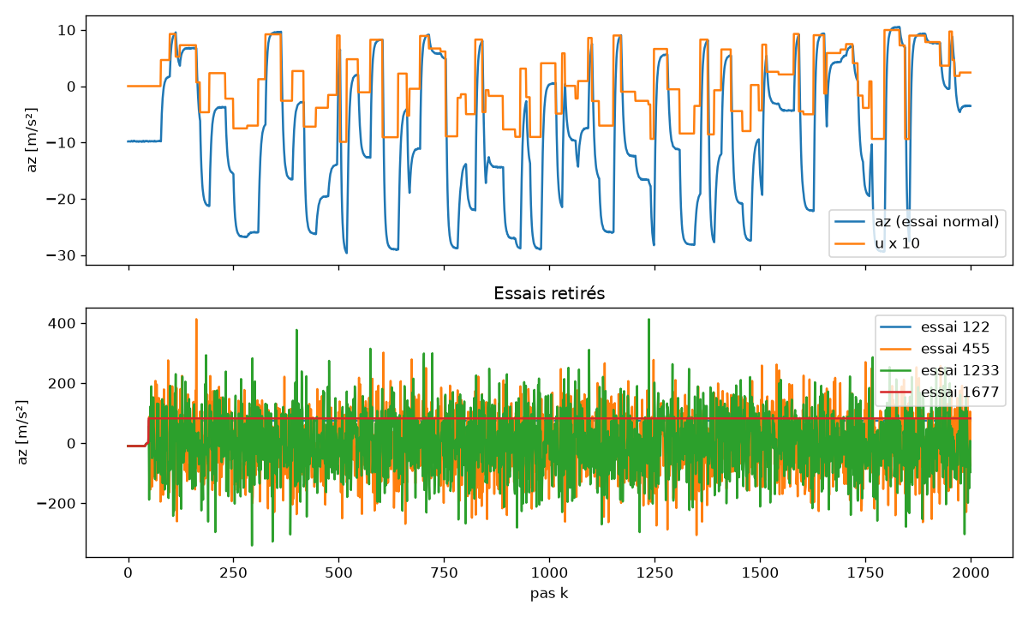
METHOD · FROM RAW DATA TO A SIMULATOR
We sorted the 3000 recorded flights, then trained a recurrent network until its error reached the sensor noise.
1
3000 recorded flights
random steps of u in [−1, 1], a_{z} from an unreliable sensor, 2000 samples at 50 ms
2
Sort: drop a flight whole if…
a value is missing · a_{z} leaves [−40, 20] m/s² (physics gives −30 to +10) · the sensor repeats a value more than 10 times. 4 dropped, 2996 kept: a recurrent model needs an unbroken history
3
Split by flight, 70 / 15 / 15
no flight is shared between training, validation and test
4
Train a GRU
1 layer, 64 units, u(k−1) → a_{z}(k), fixed scales (Simulink works in SI units), 150 epochs × 3 seeds
Top: a normal flight (u × 10 and a_{z}). Bottom: the 4 rejected flights, noise up to 400 m/s² or a frozen sensor (1677).
5
Check in free run
test RMSE 0.045 m/s² for a sensor noise of 0.044; z drifts 0.21 m in 10 s
Next steps, said orally: environment and reward, PPO training, export to MATLAB and check against Simulink
5 / 18
Notes:
0:45
• 3000 flights × 2000 samples, u = random steps; unreliable sensor.
• A flight is dropped whole: missing value, a_z outside [−40, 20] m/s², or > 10 identical values in a row. Dropped: 122, 455, 1233 (noise up to 400 m/s²), 1677 (frozen).
• Fixed scales instead of learned normalisation: the same numbers work in Simulink (SI units).
• GRU 1×64, 150 epochs, 3 seeds, best validation: 0.0451 m/s²; test 0.0450 vs noise 0.044; z drift 0.21 m in 10 s (group RNN 0.0906 m/s², 1.13 m).
• Said orally: environment (200 steps, smoothed targets in [−0.5, 1] m), PPO, export to MATLAB (checks 1e-9 / 1e-5 / 1e-4), Simulink 0.043 m vs GRU 0.046 m.

Slide 6
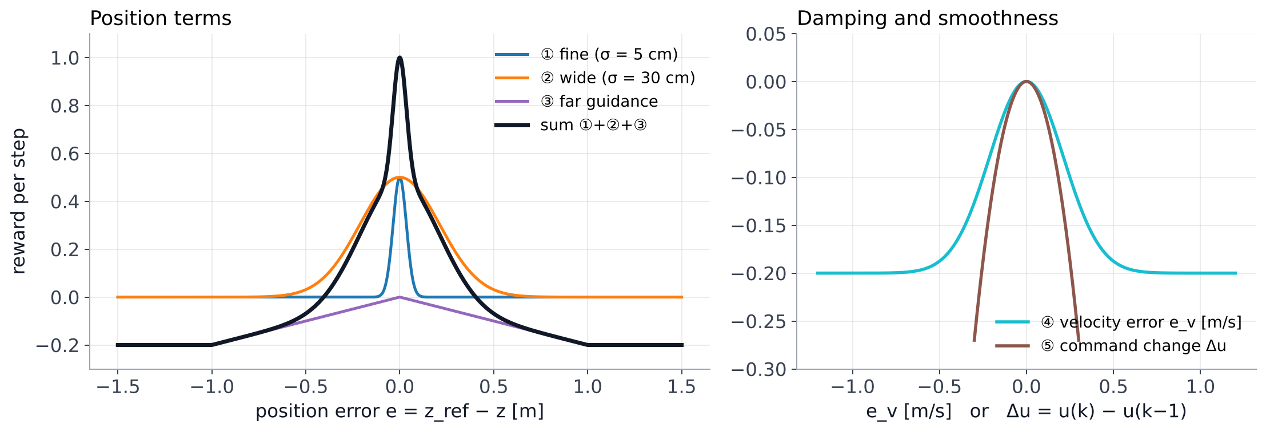
REINFORCEMENT LEARNING · THE REWARD
The reward is a sum of five bounded terms, each with one job: be precise, find the target from far, damp, and stay smooth.
r =
0.5·e^{−(e/0.05)²}
+
0.5·e^{−(e/0.30)²}
−
0.2·min(|e|, 1)
−
0.2·(1 − e^{−(ev/0.3)²})
−
3·Δu²
① precision
② guidance
③ far guidance
④ damping
⑤ smoothness
e = z_{ref} − z on the smoothed reference, e_{v} = v_{ref} − v_{z}, Δu = u(k) − u(k−1) · bounded: a failed flight costs about −100, a perfect one earns about +200
6 / 18
Notes:
0:45
• ① narrow gaussian: precision under ~5 cm, no static error. ② wide gaussian: direction up to ~50 cm.
• ③ linear slope up to 1 m: gaussians are flat far away; without it the first PPO run fell (160 m RMSE).
• ④ speed error: damps, limits overshoot. ⑤ Δu²: smooth command (with SAC's V1 it was < 1 % of the total, so the agent bought speed with oscillations).
• All bounded: −100 worst flight, +200 perfect: stable value estimates.
• Observation: e/0.5, v_z, a_z,prev/10, u_prev, conditional ∫e (|e| < 0.1 m), v_ref − v_z.

Slide 7
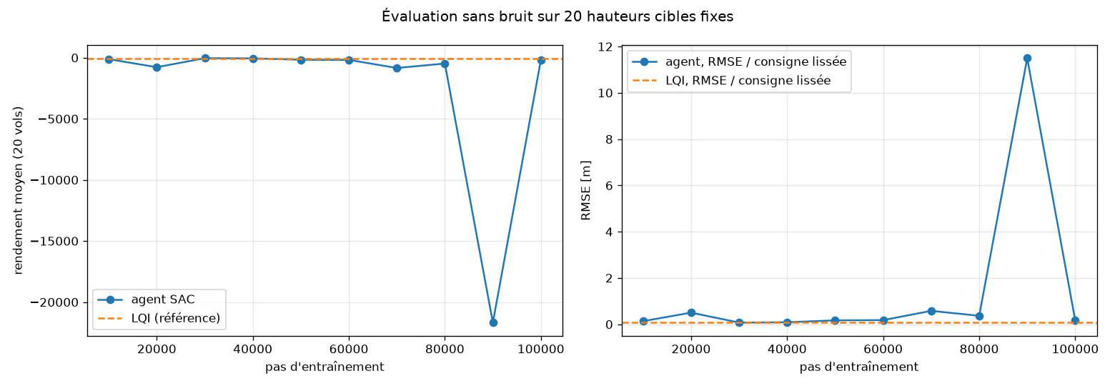
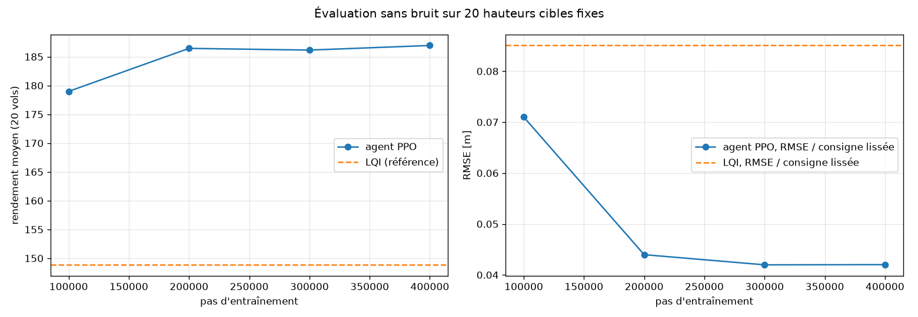
REINFORCEMENT LEARNING · CHOOSING THE ALGORITHM
SAC collapsed on our first reward; PPO with 16 parallel drones learned steadily and is better on every indicator.
SAC, first try
PPO, kept
• unbounded reward: from −0.01 to −40 000
• bounded reward, 16 drones in parallel
• critic loss spikes from 700 to 190 000
• clipped updates: no collapse, 179 → 187
• collapses at 90 000 steps (drone 11 m away)
• starts hovering (output bias 0.39)
PPO vs best SAC agent, 20 targets: RMSE 0.042 vs 0.072 m · overshoot 0.9 vs 8.2 cm · final error 0.08 vs 3.9 cm
7 / 18
Notes:
0:35
• SAC (V1 reward, pseudo-Huber 10 cm): best at 30k steps, −774 at 20k then −21 680 at 90k (drone > 11 m away).
• Diagnosis: rewards −0.01 to −40 000, critic loss 700 → 190 000, entropy α stuck at 0.7–0.85, integral saturating.
• PPO: on-policy, clipped updates; 16 drones in parallel; output bias 0.39 so it starts hovering.
• Result (20 targets, no noise): RMSE 0.042 vs 0.072 m, overshoot 0.009 vs 0.082 m, final error 0.8 mm vs 3.9 cm.

Slide 8
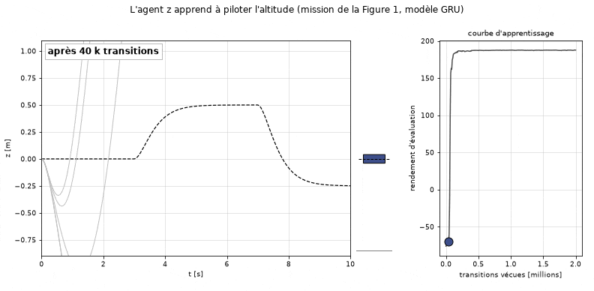
REINFORCEMENT LEARNING · WATCHING IT LEARN
Until 40 000 transitions the drone falls or flies away; between 48 000 and 96 000 its error drops from 161 cm to 7 cm.
z agent flying the Figure 1 mission (0 → 0.5 → −0.25 m) at successive checkpoints · 3 cm after 400 000 transitions
8 / 18
Notes:
0:25
• z agent on the Figure-1 mission at successive checkpoints.
• ≤ 40 000 transitions: falls or flies away. 48 000 → 64 000 → 96 000: 161 → 16 → 7 cm RMS.
• 400 000: 3 cm; up to 2 M only refines.

Slide 9
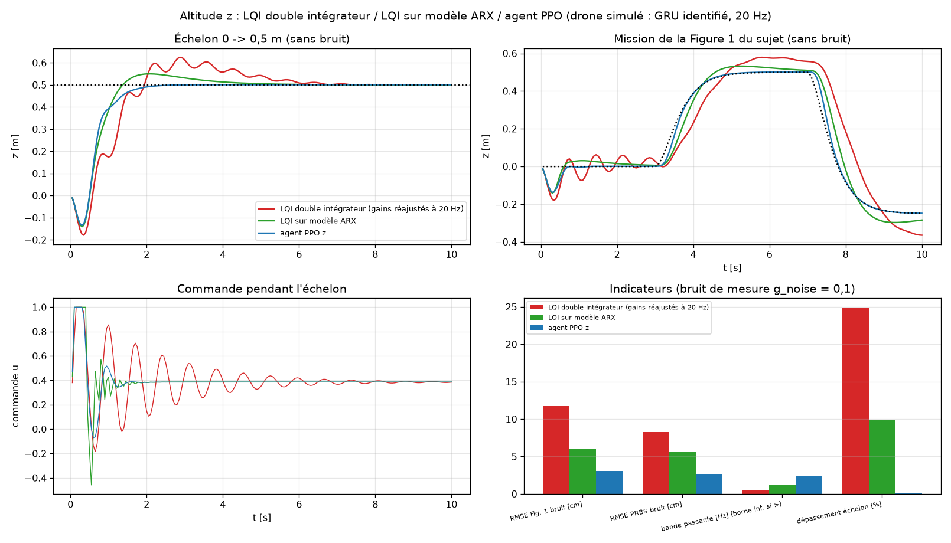
ALTITUDE · THREE CONTROLLERS ON THE SAME DRONE
The altitude agent tracks with 2.7 cm error, against 5.6 cm for the LQ on the ARX model and 8.3 cm for our LQI, with almost no overshoot.
double-integrator LQI
LQ(I) on ARX
RL agent
· step, Figure-1 mission, PRBS · 20 Hz, g_noise = 0.1
9 / 18
Notes:
0:30
• LQI / LQ(I) on ARX / RL agent, same GRU drone, 20 Hz, g = 0.1.
• Step rise 0.85 / 0.65 / 0.85 s; overshoot 24.9 / 10.0 / 0.2 %.
• RMSE Figure-1 mission 11.7 / 5.9 / 3.1 cm; PRBS 8.3 / 5.6 / 2.7 cm; bandwidth 0.47 / 1.25 / 2.34 Hz.
• The ARX of z is less faithful than the GRU (free-run 0.82 m/s²): hence its 10 % overshoot.
• Price: z command agitation 0.019 / 0.137 / 0.036.

Slide 10
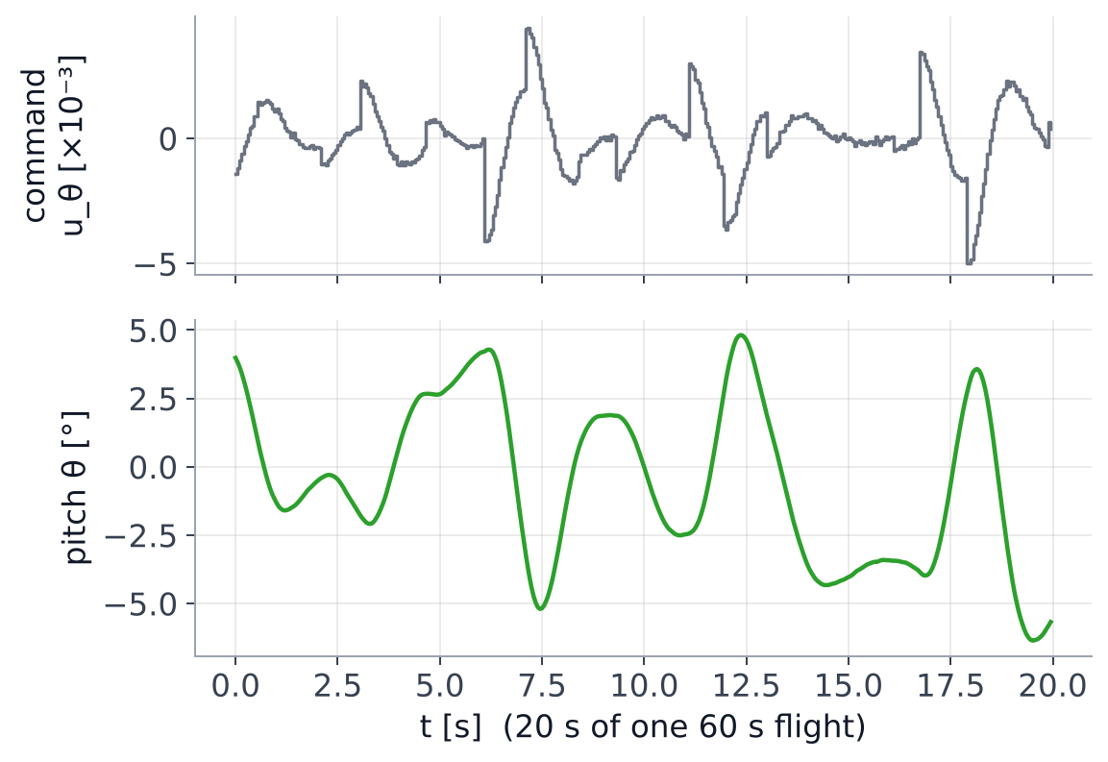
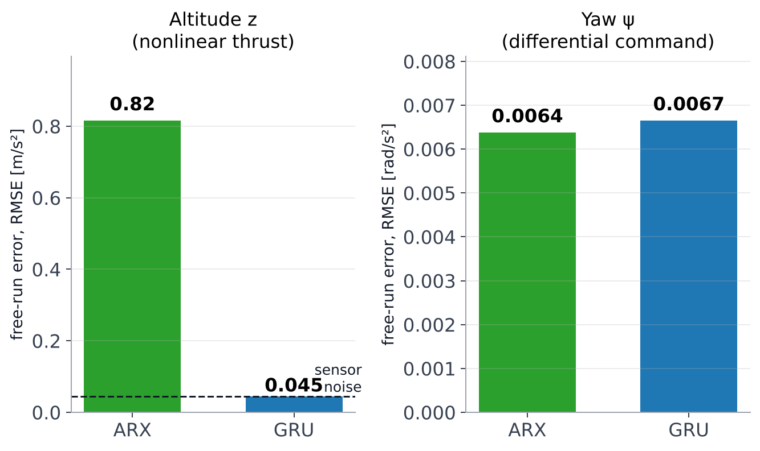
POSITION CONTROL · FIRST, A MODEL OF THE TILT
For the tilt, a linear ARX model is enough: it is as accurate as a GRU, and it can be fed straight into an LQ design.
1 · WE GENERATED FLIGHTS IN SIMULINK
2 · FREE-RUN ERROR OF THE TWO MODELS ON TEST FLIGHTS
150 flights × 60 s, z and ψ held; u_{θ}, u_{φ} = random steps (|u| ≤ 0.006, 0.05–2 s) + a weak PD so θ stays under 16°.
Thrust is an S-curve, so z needs the GRU. A tilt or yaw command is a small difference around hover: the yaw gain stays 172 rad/s² from |u| = 0.003 to 0.03, the dynamics are linear and the ARX is as good. Tilt ARX: 0.0046 rad/s², the sensor noise.
ARX(2,6): command → angular acceleration · yaw and tilt use the same motors and the same excitation · pole 0.775 = e^{−0.05/0.197}: the 0.2 s motor lag
10 / 18
Notes:
0:45
• 150 Simulink flights × 60 s (2.5 h), g = 0.1; z by the LQI, ψ by a PD; u_θ, u_φ random multi-level, |u| ≤ 0.006, held 0.05–2 s, weak PD (0.0235 / 0.0165).
• Same protocol for yaw, where ARX(2,6) and GRU(32) were both trained: 0.0064 vs 0.0067 rad/s², ψ drift 1.9° vs 2.5° in 10 s.
• For z the ARX fails in free run (0.82 m/s² vs 0.045): S-shaped thrust. Tilt/yaw: small differential around hover, gain 172 constant from 0.003 to 0.03.
• Tilt ARX: gain 171.8, RMSE 0.0046 = noise 0.0047, poles 0.775 (= 0.2 s motor) and −0.468, coupling 0.01 %.
• No GRU trained on the tilt data itself: the yaw comparison decided it. ARX also feeds dlqr directly.

Slide 11
POSITION CONTROL · TWO NESTED LOOPS
A fast loop holds the tilt, a slower loop turns the position error into a tilt; only the front and rear motors move the drone forward.
x_{ref}, v_{ref}
OUTER LOOP · SLOW
θ_{ref}
INNER LOOP · FAST
u_{θ}
MIXER
DRONE
→
x agent (or PD)
→
LQ on the ARX model
→
u₁ = u_{z} − u_{θ}
→
θ → a_{x} ≈ g·θ
from the car
θ_{ref} = 0.2·a, ω_{n} ≈ 1.5 rad/s
0.30 s rise, motor lag included
u₃ = u_{z} + u_{θ}
→ v_{x} → x
▲
▲
θ, ω_{y} fed back every 50 ms
x, v_{x} fed back: the outer loop is 3–5× slower
Top view, “+” layout
Side view
thrust
M2
M3 rear ↑
M3
M1
+x →
→
M1 front ↓
a_{x} ≈ g·θ
M4
rear M3: + u_{θ} · front M1: − u_{θ} · M2, M4: unchanged (on the pitch axis)
tilt θ ≤ 0.2 rad, so at most ≈ 2 m/s² of acceleration
Same structure for y with φ, motors M2 and M4
11 / 18
Notes:
0:50
• Inner loop: LQ on the ARX, 9 states incl. 5 past inputs (motor delay); 0.30 s rise, 2.8 % overshoot.
• Outer loop: θref = Kp·ex + Kd·(vref − vx), ωn ≈ 1.5 rad/s, 3–5× slower; |θref| ≤ 0.2 rad ≈ 2 m/s². The agent replaces this PD (θref = 0.2·a).
• The C1 LQ (0.85 s rise, ~2 rad/s) was too close to the outer loop → unstable cascade; R = 200 fixed it.
• Mixer '+': u1 = u_z + u_ψ − u_θ (front), u3 = u_z + u_ψ + u_θ (rear): rear pushes more, front less → nose tilts, the drone accelerates forward (a_x ≈ g·θ). M2 and M4 sit on the pitch axis: no effect.
• Same for y with φ: M2 and M4, a_y = −g·φ.

Slide 12
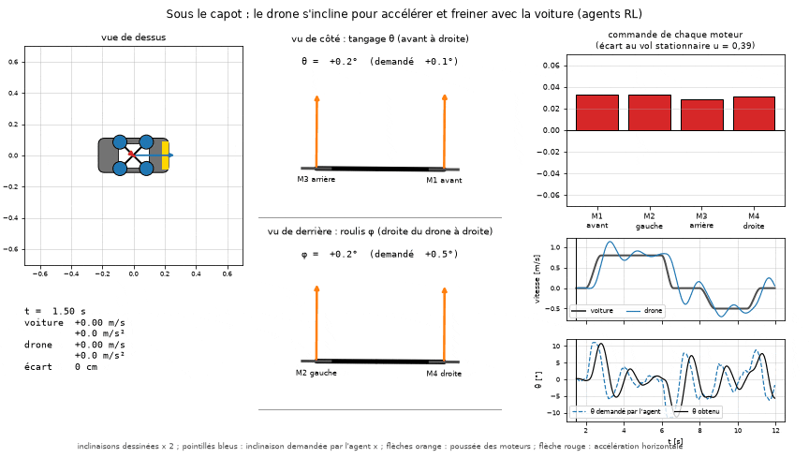
HIERARCHY · LEARN THE OUTER LOOP, MODEL THE INNER LOOP
The x agent only asks for a tilt; an LQ designed on the ARX model tracks it, motor delay included.
Start, brake, reverse · tilt drawn ×2 · four motor thrusts · θ asked by the agent vs θ obtained
12 / 18
Notes:
0:25
• θref = 0.2·a (±0.2 rad ≈ 2 m/s²).
• Inner LQ on ARX: 9 states incl. 5 past inputs = motor delay; 0.30 s rise, 2.8 % overshoot.
• The C1 LQ (0.85 s rise) made the cascade unstable; R = 200 fixed it.
• GIF: rear motor pushes to tilt, then the LQ counter-steers ~3 steps early.

Slide 13
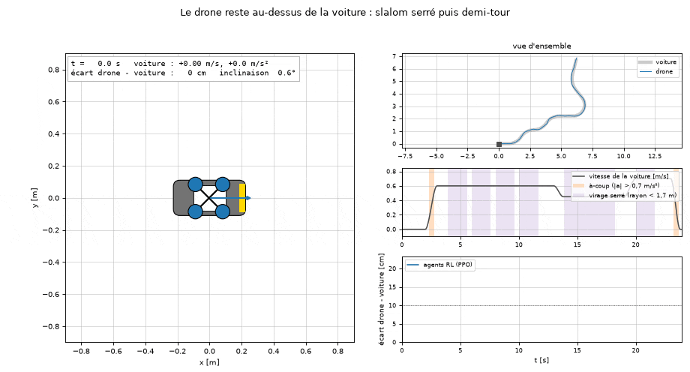
POSITION · ONE AGENT, BOTH AXES
With its errors rotated by the heading, the same x agent drives x and y at once: it follows a car through a slalom and a U-turn.
RL agents, slalom of radius 1.2 m then a U-turn of radius 0.9 m · after the first start the error stays under 10 cm (RMS 5.4 cm)
13 / 18
Notes:
0:25
• Same x agent on y (φ gain 171.76 vs θ 171.78 rad/s²) with errors rotated by ψ: without rotation, 900 m drift at ψ = 90°; with, 0.090 m.
• Slalom radius 1.2 m, then U-turn radius 0.9 m; the drone turns its heading with the car.
• RMS 5.4 cm (ARX family 6.3, LQI 8.9); after the first start the error stays under 10 cm.

Slide 14
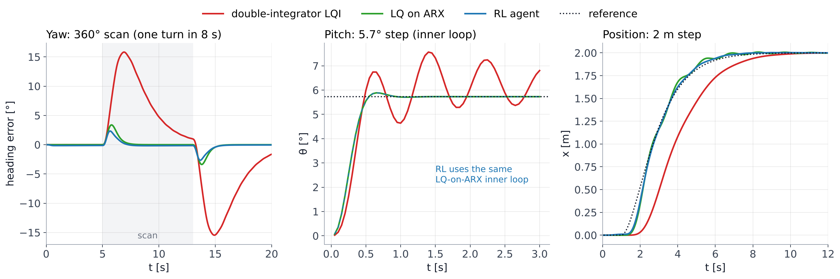
COMPARISON · THREE CONTROLLER FAMILIES, AXIS BY AXIS
Most of the gain over the LQI comes from modelling the motors; the agents then shave off the rest.
With noise:
yaw RMS during the scan 9.75 / 0.65 / 0.39 °
pitch overshoot 32 / 3 / 3 %
x RMSE on a PRBS 26.4 / 7.3 / 6.0 cm
Curves without noise · same simulated drone, 20 Hz · the RL family uses the LQ on ARX as its inner pitch loop
14 / 18
Notes:
0:35
• Yaw scan RMS 9.75 / 0.65 / 0.39°; LQI end-of-turn overshoot 15° (integral loaded during the ramp).
• Pitch 0.1 rad step on the ARX: LQI 0.25 s rise but 32 % and slow oscillation; LQ on ARX 0.30 s, 2.8 %. No pitch agent: the RL family uses this LQ.
• x 2 m step: LQI cascade slow (lag 36 cm on a car); x PRBS RMSE 26.4 / 7.3 / 6.0 cm; bandwidth 0.31 / 1.17 / 1.48 Hz.
• Message: the model of the motors explains most of the gap; RL adds the last 20–40 %.

Slide 15
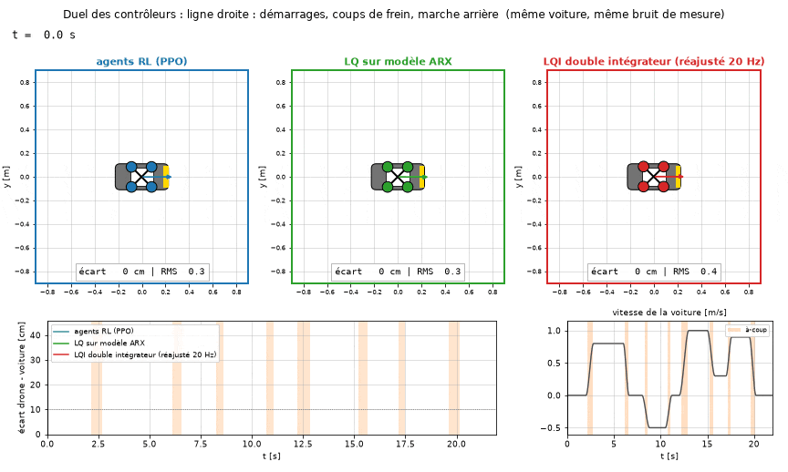
DUEL ON A JERKY CAR
Same car, same noise: the RL agents stay closest, 12.1 cm RMS against 15.1 cm and 16.3 cm.
RL agents
LQ(I) on ARX
double-integrator LQI
· car accelerations up to 2 m/s²
15 / 18
Notes:
0:30
• Car jerks up to 2 m/s², the drone's limit.
• Straight RMS / max: 12.1/31, 15.1/42, 16.3/41 cm.
• Slalom + U-turn: 5.4/21, 6.3/21.5, 8.9/29 cm.
• Red family has velocity feedforward here.

Slide 16
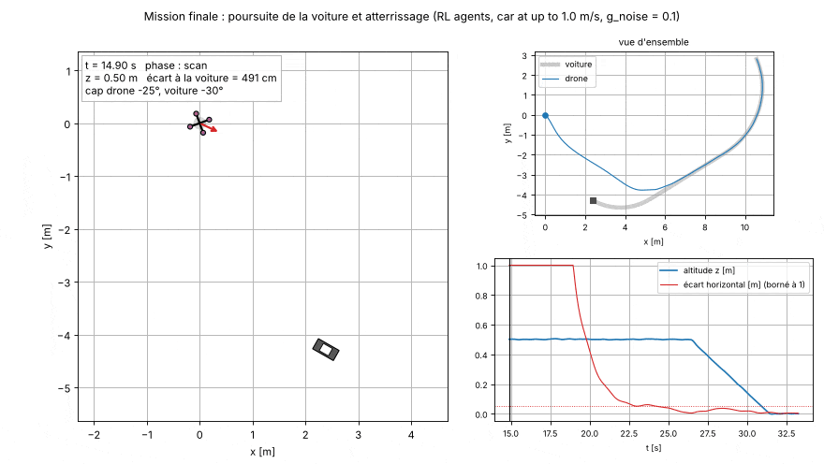
FINAL RESULT · CHASE AND LANDING
On a car turning at up to 1 m/s, the agents catch up, align and land 1 cm from the centre.
RL agents, car 1050 of the 100-car test, g_noise = 0.1 · landed at 31.3 s · simulator from identified models
16 / 18
Notes:
0:30
• Car 1050 of the 100-car test: up to 0.97 m/s, lateral acceleration 0.37 m/s², keeps turning until the end.
• RL agents, g = 0.1: landed at 31.3 s, 0.96 cm from the centre.
• Supervisor gates: aligned < 5 cm and < 10 cm/s with heading < 3° for 2 s, then 0.1 m/s down.
• Heading turns towards the car, then takes the car's heading before descending.

Slide 17
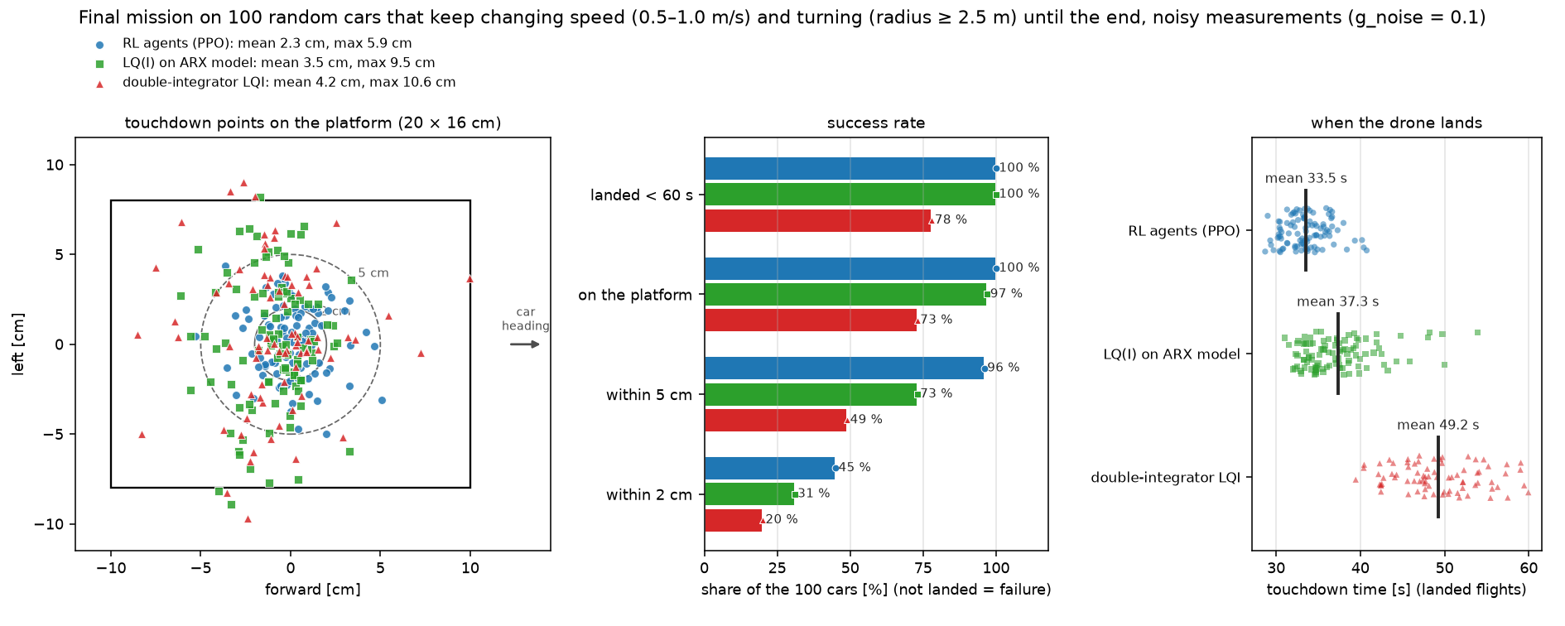
ROBUSTNESS · 100 RANDOM CARS THAT KEEP MANOEUVRING
On 100 cars that never stop manoeuvring, the RL agents land every time, 96 % within 5 cm, 15.7 s before the LQI.
Blue RL agents · green LQ(I) on ARX · red LQI · Python simulator from identified models (7 mm from Simulink), seeds 1000–1099
17 / 18
Notes:
0:45
• Landed < 60 s 100 / 100 / 78 %; on platform 100 / 97 / 73 %; within 5 cm 96 / 73 / 49 %; mean 2.3 / 3.5 / 4.2 cm; 33.5 / 37.3 / 49.2 s.
• LQI delay: climb +3.9 s, scan +4.4 s, chase +8.8 s (heading gate; B2).
• 22 LQI failures hover 10–15 cm away, never diverge.
• Earlier cars (calm by ~40 s) made the LQI look most precise (0.8 cm).

Slide 18
CONCLUSION · EVERY TASK, THREE FAMILIES
On every task, the RL agents have the smallest error: 26 to 96 % below our LQI, and below the LQ on the ARX model.
double-integrator LQI
LQ(I) on ARX
RL agents
· error relative to the LQI, further left is better
TRACKING
Altitude (PRBS)
−68 %
8.3 → 2.7 cm
Yaw during the scan
−96 %
9.75 → 0.39°
Position (PRBS)
−77 %
26.4 → 6.0 cm
Jerky car
−26 %
16.3 → 12.1 cm
Slalom car
−39 %
8.9 → 5.4 cm
MISSION, 100 CARS
Landing error
−45 %
4.2 → 2.3 cm
Landing time
−32 %
49.2 → 33.5 s
0
50
LQI = 100
RL vs LQI
LQI → RL
Simulation from identified models, 20 Hz, g_noise = 0.1 · no ground in the simulator, car position known · the agents' commands are busier than the LQI's · Thank you, questions?
18 / 18
Notes:
0:35
• RL error relative to LQI: altitude −68 %, yaw −96 %, x −77 %, jerky car −26 %, slalom −39 %, landing error −45 %, landing time −32 %.
• Raw LQI / ARX / RL: 8.3 / 5.6 / 2.7 cm; 9.75 / 0.65 / 0.39°; 26.4 / 7.3 / 6.0 cm; 16.3 / 15.1 / 12.1; 8.9 / 6.3 / 5.4 cm; 4.2 / 3.5 / 2.3 cm; 49.2 / 37.3 / 33.5 s. Landed < 60 s: 78 / 100 / 100 %.
• Limits: simulation only, no ground, car pose known; busier commands (z agitation 0.036 vs 0.019); gain mostly z and yaw.
• Close: 'Thank you, questions?'

Slide 19
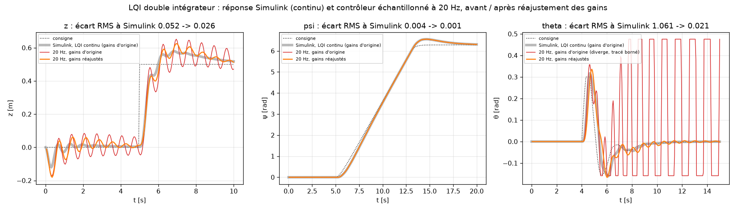
BACKUP B1 · IS THE COMPARISON FAIR?
The LQI keeps its control law; its gains are fit so the 20 Hz response matches its own continuous Simulink response.
Continuous Simulink · 20 Hz with the original gains (θ diverges) · 20 Hz with the refit gains
B1
Notes:
Backup
• Shared: supervisor, mixer, 1/cos anticipation, noise, simulated drone, 20 Hz; PD baselines get velocity feedforward (36 → 0.1 cm).
• Gains original → fit: z 1.856/0.882/0.787 → 1.195/0.765/0.695 (5.2 → 2.6 cm); ψ 0.252/0.125/0.097 → 0.226/0.115/0.090; θ 0.443/0.130/0.280 → 0.189/0.078/0.078 (diverges → 0.021 rad).
• Agent on Simulink vs noise g = 0 / 0.1 / 0.3 / 1: RMSE 0.043 / 0.043 / 0.045 / 0.063 m; agitation 0.012 / 0.028 / 0.057 / 0.174.

Slide 20
BACKUP B2 · WHY THE LQI IS LATE
The LQI’s yaw lags a turning car by 0.51 s × ω, so its heading sits above the 3° gate that opens the descent.
Heading error during the chase [°]
dashed line: 3° gate
Reference not turning
RL agents
0.10
LQ(I) on ARX
0.10
LQI
3.17
Reference turning
RL agents
0.66
LQ(I) on ARX
0.89
LQI
5.50
Measured on the 13 reference cars, Python simulator, g_noise = 0.1
B2
Notes:
Backup
• uψ = Kp e − Kd ωz + Ki ∫e: damping on the absolute rate.
• Lag = (Kd/Kp)·ω ≈ 0.51 s × ω: 5° at 0.17 rad/s (0.5 m/s, R = 3 m).
• Integral (Ki = 0.09) removes it slowly then overshoots: same as 12.3° after the scan and the 36 cm x lag.
• Heading blocks the descent 33 % of the time (13 cars), 46 % on the 22 failures.

Slide 21
BACKUP B3 · DECISIONS
Every design decision was kept only if its impact could be measured.
3
Integral state on z
static error removed (0.9 m → 1 m)
3
Refit LQI gains for 20 Hz
z 5.2 → 2.6 cm, θ diverging → 0.021 rad
5
Drop whole corrupted trials
2996 trials, GRU at the noise floor
10
GRU for z, ARX for yaw and attitude
ARX of z alone → 10 % overshoot
6
Bounded 5-term reward
overshoot 0.009 vs 0.082 m (SAC)
6
Conditional integral
final error 0.8 mm vs 3.9 cm
7
PPO with 16 envs
5,248 vs 67 transitions/s
7
Output bias = hover 0.39
160 m failure → convergence
11
Agent → θref, LQ on ARX inner loop
attitude overshoot 3 % vs 32 %
11
Faster inner LQ (R = 200)
unstable → stable, 0.30 s rise
13
Retrain x on saturations
car overshoot 0.60 → 0.02 m
13
Same agent on y
no retraining, y PRBS 0.060 m
13
Rotate errors by ψ
900 m divergence → 0.090 m
15
Velocity feedforward in the PD
lag 36 → 0.1 cm
16
Supervisor decided on measurements
Simulink vs Python ≤ 7 mm
16
Keep τ = 1 s
shorter τ: no faster, more overshoot
16
Subtract the agent bias a(0)
chase 8.7 → 8.4 s
16
Point the heading at the car
touchdown heading −40° → < 0.3°
17
Fair alignment criterion
agent better on every robustness metric
17
Cars manoeuvre until the end
“LQI most precise” artefact removed
Left: slide where the decision appears · reasons in each slide's speaker notes
B3
Notes:
Backup
• For 'why did you…?' questions: decision, reason, measured impact, slide.

