Slide 1
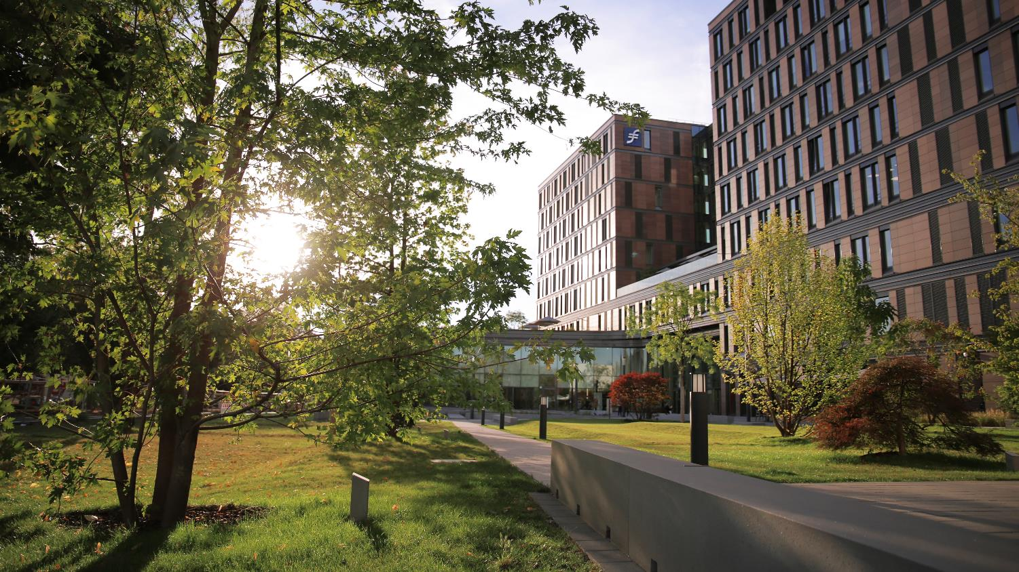

WELCOME TO
FRANKFURT SCHOOL

Slide 2


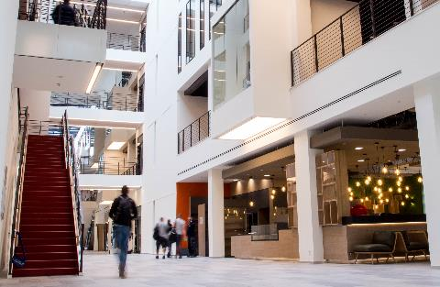
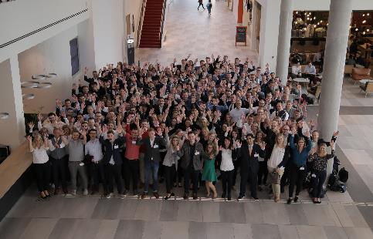
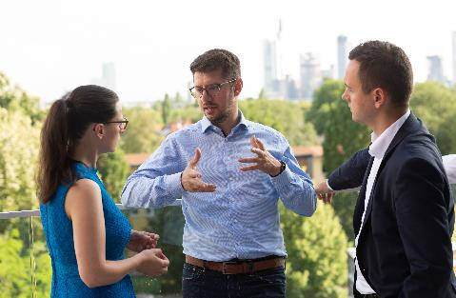
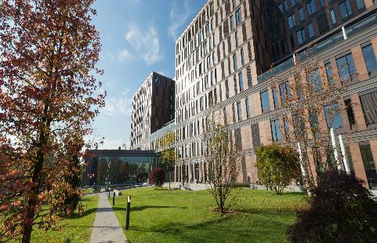
CONTENT
HISTORY
FACTS & FIGURES
VISION & MISSION
ACADEMIC PROGRAMS
FS DEPARTMENTS
CAMPUS LIFE

Slide 3

VISION & MISSION

Slide 4
Vision & mission
VISION & MISSION
SUSTAINABLE
LEADING
MISSION Frankfurt School advances and disseminates sustainable international business practice in finance and management through education, research, training and advisory services. Across industries, our students become responsible experts and executives by applying scientific knowledge and practical experience.
Frankfurt School offers education and training for ambitious people who are prepared to make a significant contribution to the development of the international economy.
VISION Frankfurt School aims to be one of the top five business schools in Europe and the premier choice for education in finance by 2020.
DYNAMIC
AUTHENTIC
PROGRESSIVE
INTERNATIONAL
DETERMINED
SCIENTIFIC
PROFESSIONAL
INNOVATIVE
COMMUNAL
SOPHISTICATED
PRESTIGIOUS
MODERN
COOPERATIVE
ENGAGED
FUTURE ORIENTED

Slide 5

HISTORY

Slide 6
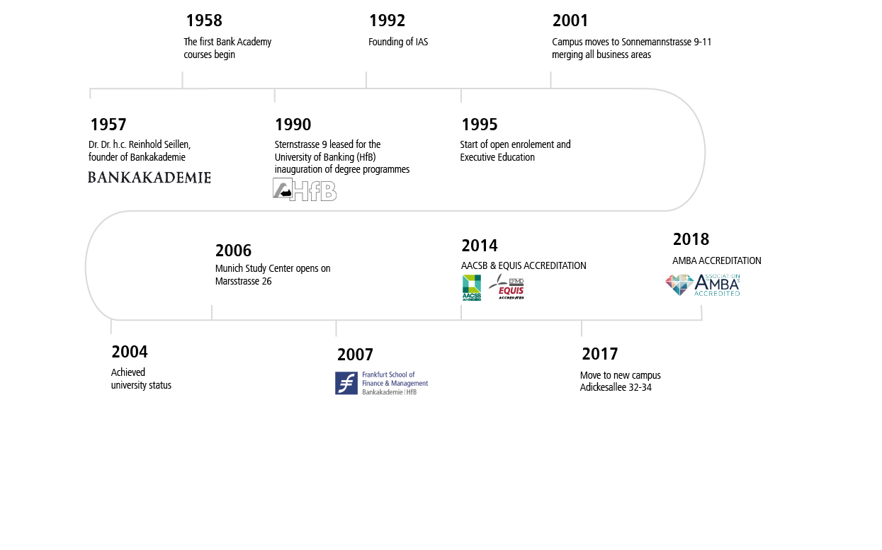
History
HISTORY
With a history of success that goes back decades, Frankfurt School is now one of Germany’s leading business schools. In 1957, Professor Dr Karl Friedrich Hagenmüller and Dr Reinhold Sellien founded Bankakademie e.V. (the Banking Academy) as an association. Initially based at the premises of the Gabler-Verlag publishing house in Wiesbaden, this organisation would later become Frankfurt School of Finance & Management. The Academy’s mission was to provide professional training to bank employees – an activity in which it swiftly set new standards.

Slide 7
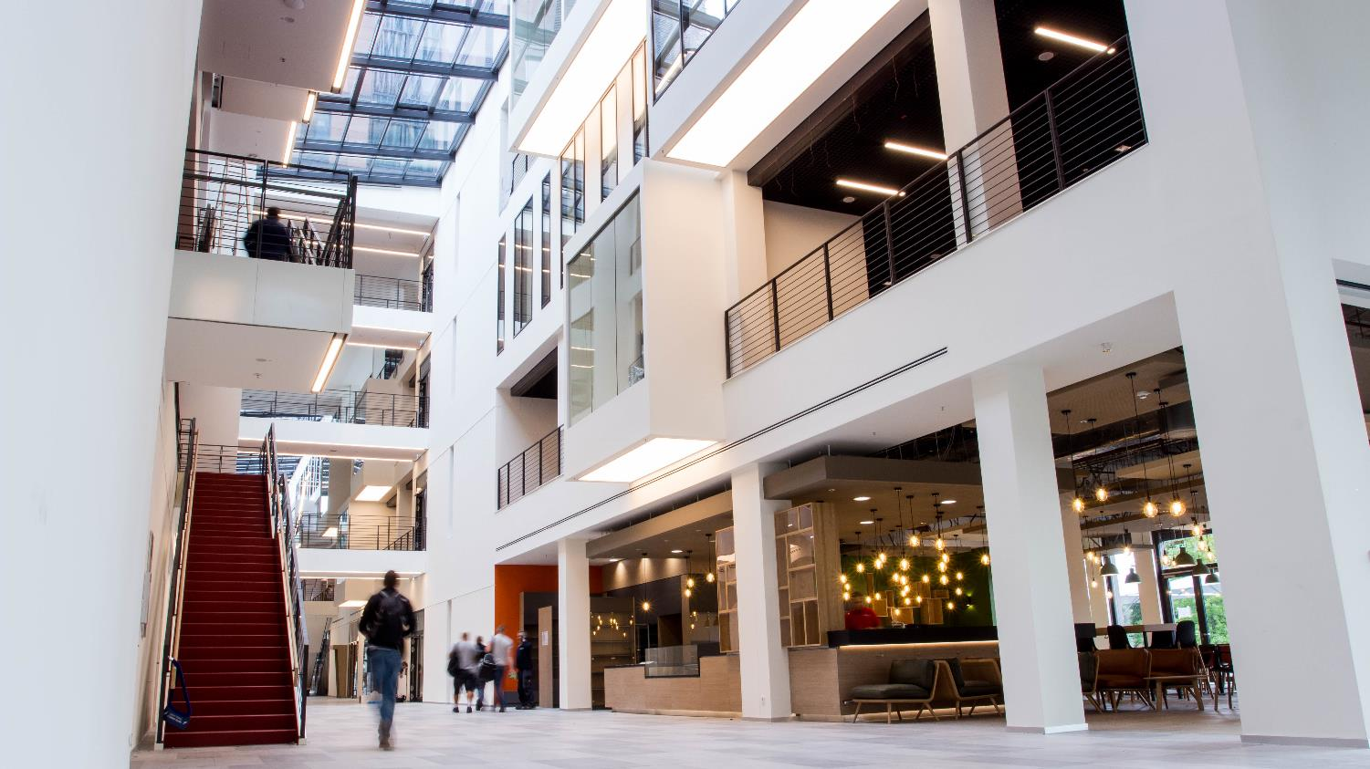
FACTS & FIGURes

Slide 8
Facts & figures 2019
FACTS & FIGURES
67 Professors
63 Doctoral students
2,462 Students
469 Employees (Including faculty and student assistant / temporary staff, excluding subsidiaries)
70 Certificated studies / series of seminar
265 Modern Media Learning: E-Books, videos & webinars
712 Open seminars & inhouse activities (692) & conferences
€ 80.5M Revenue (excl. subsidiaries) in 2019
13 Competence Center
100 Professional books from Frankfurt School‘s publishers
1,566 Events (Inhouse & open projects)

Slide 9








Accreditation & rankings
Facts & Figures
FT European Business School Ranking 2020 #4 in Germany #26 worldwide
FT master of finance Ranking 2020 #2 in Germany #32 worldwide
FT master in management Ranking 2020 #5 in Germany #34 worldwide FT Executive MBA Ranking 2020 #5 in Germany #76 worldwide FT EXECUTIVE EDUCATION WORLDWIDE 2020 #3 in Germany #50 open enrolment worldwide #76 customised programmes worldwide
QS Global 100 EMBA Ranking 2020 #21 in Europe #48 worldwide QS MANAGEMENT MASTER Ranking 2021 #37 in Europe
#48 worldwide QS FINANCE MASTER Ranking 2021 #35 Europe #59 worldwide
CHE – CENTRUM FÜR HOCHSCHULENTWICKLUNG 2020/21 Top placements in 11 of 12 examined criteria
THE Global University employability ranking 2020 #1 Business School in Germany #6 in Germany
ACCREDITATION

Slide 10
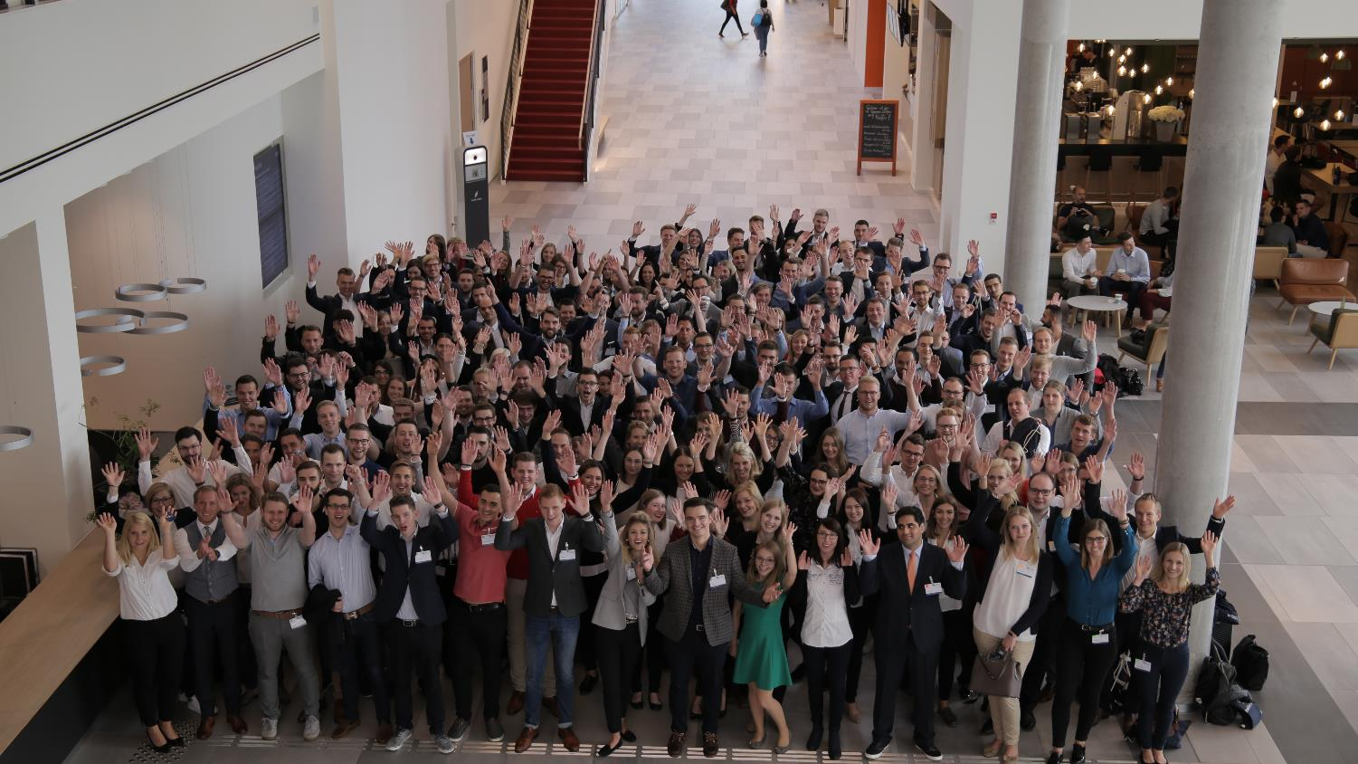

Campus life

Slide 11





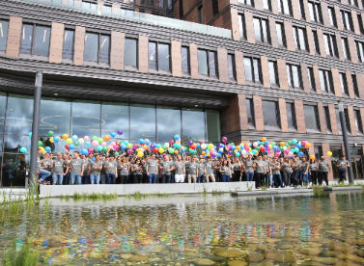

Campus life
Campus Life
STUDENT INITIATIVES
Students are encouraged to grow personally both inside and outside of the classroom by participating in a growing list of sporting and non-sporting initiatives. The FS Initiatives programme allows students to found and run their own groups, supported where necessary by the institution. This has led to a number of highly successful events including the FS Business Game, participation in the Model United Nations and the recent launch of TEDxFS talks on campus. KNOWLEDGE SHARING
With its policy of lifelong and extracurricular learning, Frankfurt School regularly hosts talks on campus. Every week there are opportunities to attend one of over 20 annual conferences, research seminars, alumni talks and reunions or networking events. Students, alumni and partners are continuously welcomed on campus as part of a growing community at FS.
a

Slide 12
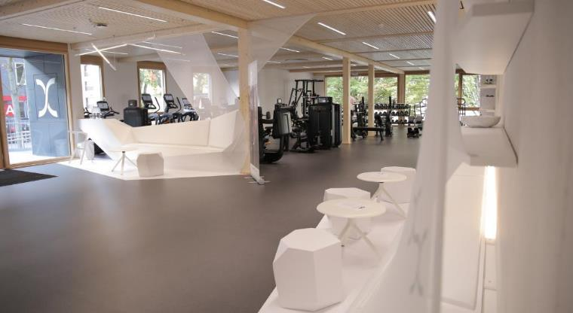
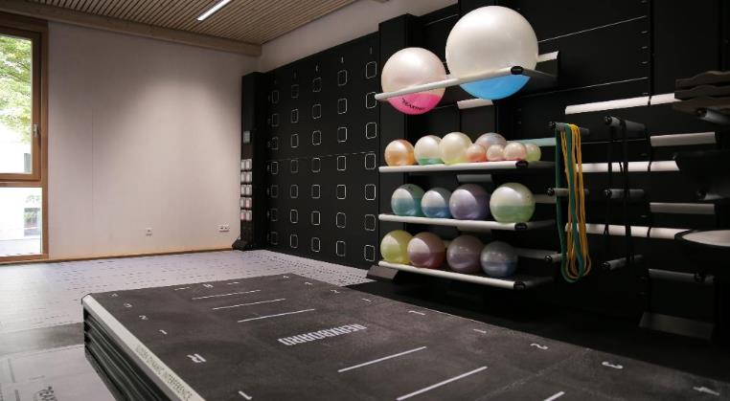
Fs-life studios
Campus life
HEALTH & WELLNESS
Fostering a healthy environment for both staff and students is at the heart of Frankfurt School’s mission and was the key reason for the founding of a brand new fitness studio on campus. The fitness studio offers a range of state-of-the-art equipment and training programmes supported by specialist fitness experts and a variety of courses catering to the needs of students.
a

Slide 13
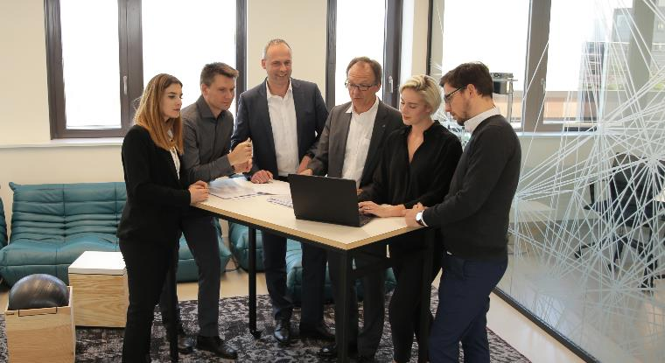
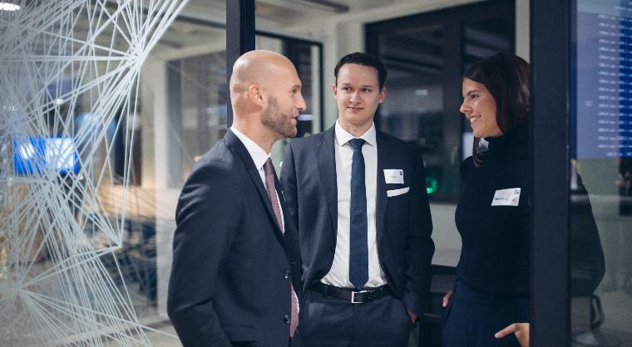
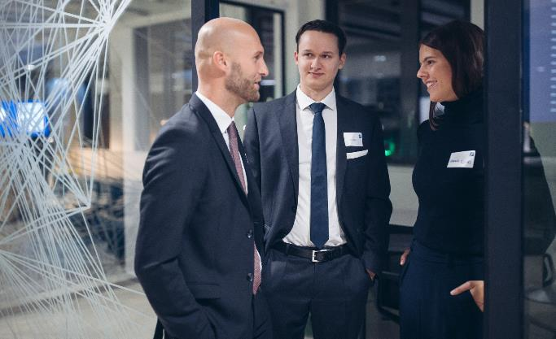

AI Lab
Campus life
The AI Lab forms part of the AI Initiative at Frankfurt School and shows the university's commitment to this topic. It is the home for artificial intelligence and digital transformation at FS. Here, innovation-oriented and collaborative students, employees, faculty members and partners come together. The AI Lab is a hub for projects and topics within AI, ranging from Machine Learning and Deep Learning to image recognition and natural language processing. From internal digitalisation projects to external tech events, the AI Lab offers a designated space for open and collaborative learning and working, both on a department level and institution wide.
a

Slide 14
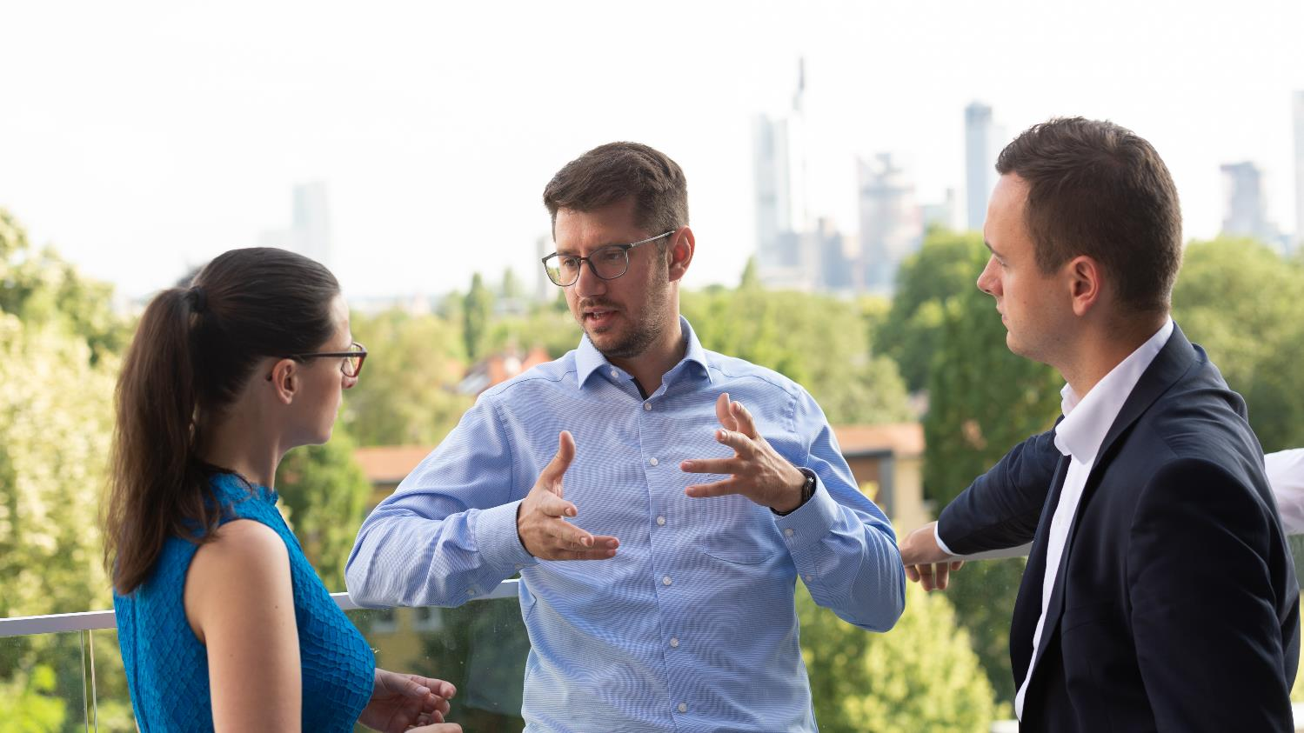
Academic programmes

Slide 15

Academic programmes
Academic programmes
Frankfurt School is committed to providing the latest education and research for our graduates and partners. It has invested heavily in recent years not only in a state of the art campus, but more importantly in developing the research capabilities and teaching in some of the most relevant topics to face industry in the 21st century. Our educational programmes are all based on the practical results of real-world research projects, providing solid, up-to-date foundations on which to build successful careers. Frankfurt School is the perfect fit for outstanding young student professionals studying for degrees while working full-time, and executives seeking new horizons. The proven, practical focus of all Frankfurt School activities – degree courses, continuing education and coaching alike – provides the ideal springboard to professional success.
a

Slide 16
Academic programmes
AcADEMIc programmes
Frankfurt School offers a full range of academic degree programmes from Bachelor to Doctoral that are internationally accredited and regularly represented in international rankings as one of Europe’s leading business schools.
Students in our programmes benefit from highly interactive classes with a focus on providing a mixture of scientific rigour and practical relevance with a participant-centred approach to learning.
DOCTORAL PROGRAMME
FULL-TIME MBA
PART-TIME MBA
EXECUTIVE MBA
MBA IN INTERNATIONAL HEALTHCARE MANAGEMENT
MBA FOR EXECUTIVES
THE FS AFRICA INITIATIVE
POST-EXPERIENCE
MASTER IN AUDITING
MASTER OF MERGERS &
ACQUISITIONS
MASTER OF FINANCIAL LAW
MASTER IN CORPORATE PERFORMANCE & RESTRUCTURING
MASTER IN DATA ANALYTICS & MANAGEMENT
MASTER OF FINANCE
MASTER IN MANAGEMENT
MASTER IN APPLIED DATA SCIENCE
PRE--EXPERIENCE
BACHELOR OF SCIENCE
BACHELOR OF ARTS

Slide 17

Bachelor programMEs
Academic programmes
BACHELOR OF SCIENCE IN BUSINESS ADMINISTRATION | BACHELOR OF ARTS IN BUSINESS ECONOMICS
Bachelor of Science (BSc) | Bachelor of Arts
Auditing and Consulting (with KMPG) Banking and Finance Digital Business General Management International Management Management, Philosophy & Economics Marketing | Betriebswirtschaftslehre - General Management - Financial Management - Digital Management
7 semesters (full-time) | 7 semesters (part-time)
www.fs.de/bsc | www.fs.de/ba

Slide 18

Master programme
Academic programmes
FS ABTEILUNGEN
Master programMEs
MASTER OF FINANCE | MASTER IN MANAGEMENT | MASTER IN APPLIED DATA SCIENCE | MASTER IN AUDITING
Master of Science (MSc) | Master of Science (MSc) | Master of Science (MSc) | Master of Science (MSc)
Capital Markets Corporate Finance Risk Management Financial Advisory | Digital Business International Business Marketing Strategy & Organization Technology & Operations Business Analytics | Data Science Machine Learning Business Problem Solving | Auditing
4 semesters / 24 months | 4 semesters / 24 months | 4 semesters / 24 months | 7 semesters / 42 months
www.fs.de/mof | www.fs.de/mim | www.fs.de/mads | www.fs.de/miau

Slide 19
Master programme
Academic programmes
FS ABTEILUNGEN
Master programMEs
MASTER OF MERGERS & ACQUISITIONS | MASTER OF FINANCIAL LAW | MASTER OF LEADERSHIP IN DEVELOPMENT FINANCE - ONLINE | MASTER IN CORPORATE PERFORMANCE & RESTRUCTURING
Master of Laws (LL.M.) | Master of Laws (LL.M.) | Master of Arts (MA) | Master of Science (MSc)
Mergers & Acquisitions “Fachanwalt für Handels- und Gesellschaftsrecht” | Financial Law “Fachanwalt für Bank- und Kapitalrecht” | Modular approach – up to five FSDF e-Campus certificates can get recognized for this Master programme
4 semesters / 24 months | 4 semesters / 24 months | 4 semesters / 24 months | 4 semesters / 24 months
www.fs.de/mma | www.fs.de/mfl | www.fs.de/online-master | www.fs.de/mcpr

Slide 20

Academic programmes
Mba programMEs
THE FRANKFURT MBA FULL-TIME | THE FRANKFURT MBA PART-TIME | MBA IN INTERNATIONAL HEALTHCARE MANAGEMENT | EXECUTIVE MBA | MBA FOR EXECUTIVES- THE FS AFRICA INITIATIVE
Master of Business Administration (MBA) | Master of Business Administration (MBA) | Master of Business Administration (MBA) | Master of Business Administration (MBA) | Master of Business Administration (MBA)
General Management | General Management | International Healthcare Management | General Management | General Management
12 months (full-time) | 21 months (part-time) | 20 months (part-time) | 18 months (part-time) | 18 months (part-time)
www.fs.de/mba | www.fs.de/mba | www.fs.de/ihm | www.fs.de/emba | www.fs.de/mba-kin

Slide 21
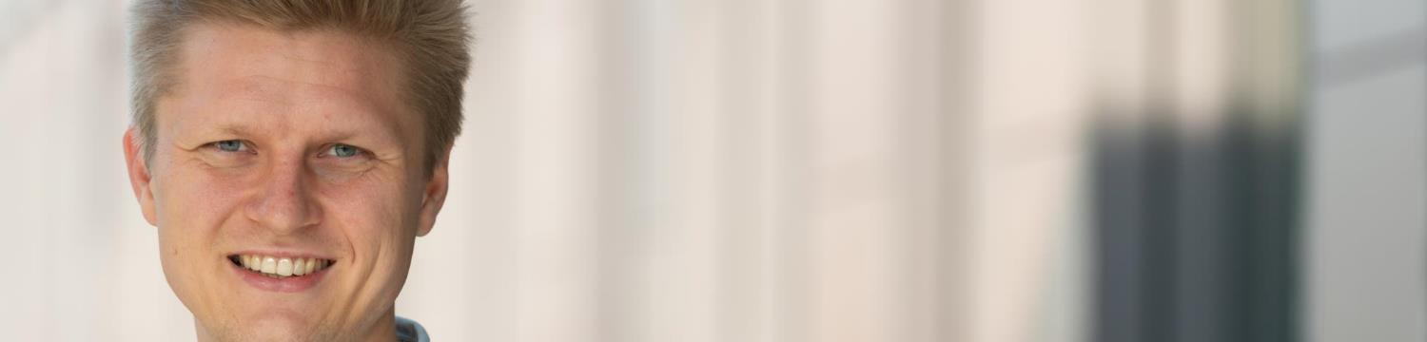
Academic programmes
DoCtoral programME
The Frankfurt School offers a truly academic climate, in the best sense of the world. The faculty is passionate about research and is committed to training Ph.D. students to become educated scholars who will lead in their fields of business. Frankfurt School is among only a handful of schools in Europe to offer a structured two-year coursework programme that provides students with the necessary skills to do rigorous research. Faculty sees the training of Ph.D. students as a group responsibility and students are encouraged to benefit from the expertise of all professors.
Ph.D. students benefit from having an experienced faculty with well-established networks around the world not only in terms of the training they receive, but also because these connections are essential in placing students in academic positions. Faculty have personally placed students at schools around the world including the University of Melbourne, the University of Chicago, University of Mannheim, London Business School, Erasmus University Rotterdam, and Michigan State University.
DOCTORAL PROGRAMME FINANCE, MANAGEMENT & ACCOUNTING
DR.RER.POL
Finance Management Accounting
4 Years (full-time)
www.fs.de/phd

Slide 22
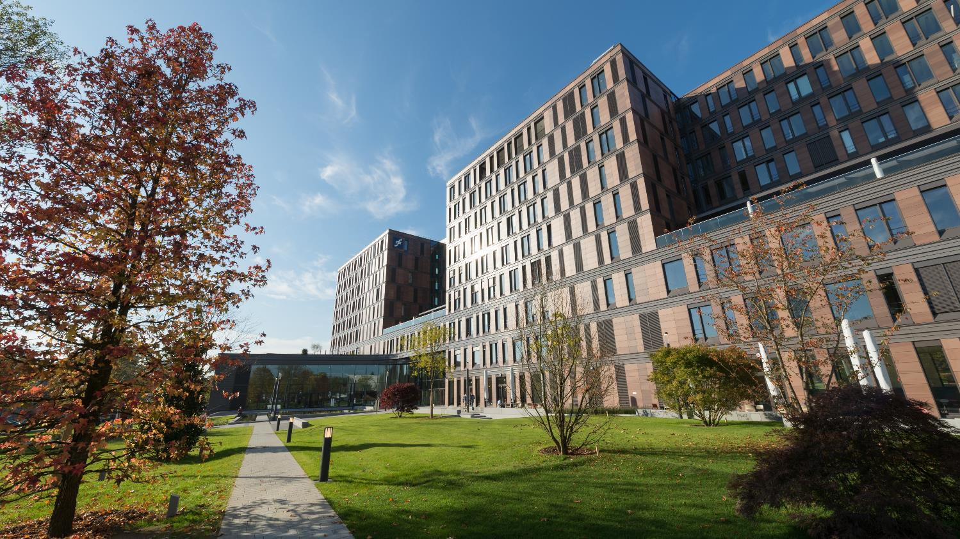
FS DEPartments

Slide 23



CAREER SERVICES
FS DEPARTMENTS
STUDENTS
At Frankfurt School of Finance & Management, Career Services represent a gateway between the business school’s academic activities and entry into the jobs market. Working closely with students and businesses, our Career Services team provides the platforms and access pathways that keep information flowing smoothly between Frankfurt School, our students and alumni, and existing or prospective employers. The result is mutual benefit for all parties involved.
Company events
Career fair
Career news
Consultation
Job market
Professional network
CAREER
SERVICES
ALUMNI
CORPORATES

Slide 24
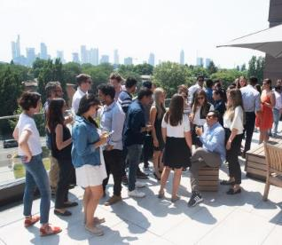

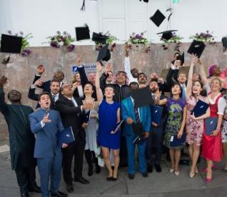
Alumni relations
Fs departments
FS CAREER DEVELOPMENT EVENTS & CONTINUING EDUCATION
Mentoring programmes (for Bachelor students)
Alumni insights, series of events such as Ladies
First, FS Entrepreneurs etc.
Alumni perks for programmes and training
sessions
FS ALUMNI & FRIENDS EVENTS
Find us in Berlin, Hamburg, as well as global
centres like New York, London, Zürich or
Shanghai
Anniversary class meetups and homecoming
events, guest presentations, workshops, cultural
and social activities, exclusive fundraising events
etc.
FS INFO & NETWORKING
Alumni directory – Update your profile (synchronise your XING-/LinkedIn accounts), get in contact with other alumni and apply for a lifelong alumni e-mail address to not miss any news.
Alumni and friends can register and find out more information about events in FS Online Campus
The Alumni-Newsletter is released quarterly and is a popular source of news, information about events, alumni portraits etc.
Alumni groups on XING and LinkedIn help to build up personal networks

Slide 25
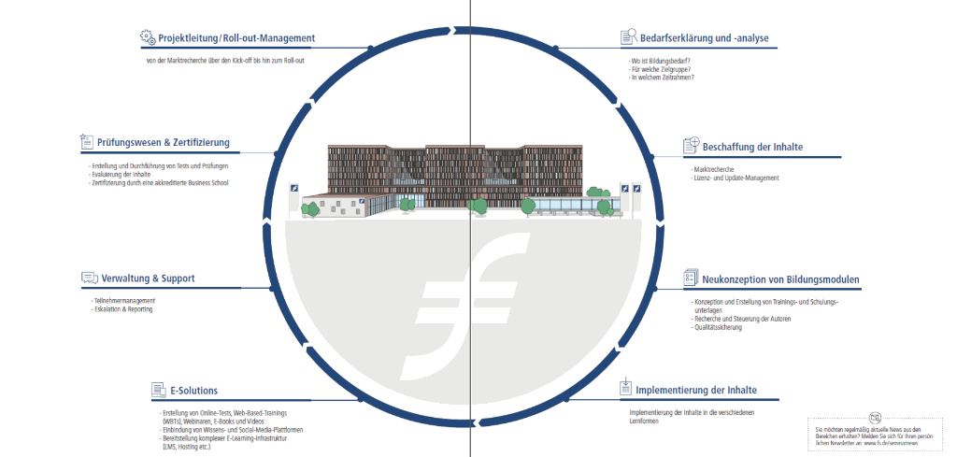
Professional & executive education
Fs departments
INDIVIDUAL, FLEXIBLE, DIGITAL AND
CLOSE AT HAND
Frankfurt School's new annual programmes enable professional & executive education in all their facets. Whether at the beginning, at the height of your career or as an HR manager, we accompany you and your employees to the next level, strengthening you professionally and personally in your tasks and goals.
With figures, data & facts, product information, project examples and technical contributions from internal as well as external authors, we cover the complete range of continuing vocational education and training.

Slide 26
Executive education
Fs departments
Frankfurt School’s Executive Education portfolio includes both open enrolment courses as well as in-house customised education for executives tailored to the specific requirements of participants and companies. Clients range from automotive manufacturers to pharmaceutical companies and from IT firms to financial institutions.
Over 60 years of experience in professional and executive education make Frankfurt School a first-class provider of further education in disruptive and challenging environments and meeting the changing educational requirements in the business world.
1,561 Banking specialist & banking economist
3,900 Trainees
2,300 Professional speeches
399 Training and coaching sessions
43,470 Seminar & training participants
LEADERSHIP
STRATEGY
MARKETING & SALES
MITTELSTAND & FAMILY BUSINESS
ENTREPRENEURSHIP & INNOVATION
MONEY
& CREDIT
INSURANCE
BANKING & WEALTH
MANAGEMENT
CORPORATE
FINANCE
SUSTAINABLE
DEVELOPMENT
GOVERNANCE & AUDIT
IT &
DIGITALISATION
RISK &
COMPLIANCE
TECHNOLOGY &
OPERATIONS
REAL ESTATE

Slide 27
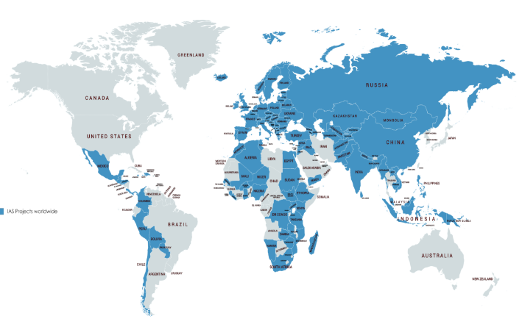



Sustainable world academy
Fs departments
TRAINING & EDUCATION Our areas of excellence
Institution building and strategic
partnerships with bank trainings
institutes
Development finance e-campus
Post- experience degree programmes
Open enrolment and tailor-made
Executive Education Programmes
ADVISORY Our competence centres
SME Banking & Development
Financial Inclusion
Affordable Housing Finance
Risk, Governance & Regulation
Rural and Smart Agriculture Development
Human Resource Development
Empowering Women in Banking
UNEP Centre for Climate &
Sustainable Energy Finance
ICT Solutions
RESEARCH & POLICIES IAS analytical unit
Study & in-depth analysis
Policy advice
Assessments
Research & data
REGIONAL OFFICES
REGIONAL OFFICES
Regional office: Nairobi - Kenya kenya@fs.de
Regional office: Amman - Jordan
mena@fs.de
Regional office: Dubai - UAE
dubai@fs.de
Regional office: Amman - Jordan
mena@fs.de
Regional office: Dubai - UAE
dubai@fs.de
Regional office: Nairobi - Kenya kenya@fs.de
Regional office: Istanbul/Ankara - Turkey
turkey@fs.de
Regional office: Beijing - China
china@fs.de
Regional office: Hadapsar - India
india@fs.de
Regional office: Istanbul/Ankara - Turkey
turkey@fs.de
Regional office: Beijing - China
china@fs.de
Regional office: Hadapsar - India
india@fs.de
Regional office: Brussels – Belgium
brussels@fs.de

Slide 28












Sustainable world academy
Fs departments
SUSTAINABLE DEVELOPMENT
Frankfurt School of Finance & Management has joined the UN Global Compact, the world’s largest corporate sustainability initiative aiming to mobilise a global movement of sustainable companies and stakeholders to implement universal sustainability principles and to take steps to support UN goals. Frankfurt School has therefore committed to do business responsibly by aligning its strategy and operations with Ten Principles on human rights, labour, environment and anti-corruption. We take strategic actions to advance broader societal goals, such as the UN Sustainable Development Goals (UN SDGs), with an emphasis on collaboration and innovation.
Frankfurt School contributes to UN SDGs

Slide 29
Sustainable World Academy
Fs departments
SDG-RELATED EXECUTIVE EDUCATION PROGRAMMES OFFERED BY FS APRIL 2019
ONLINE PROGRAMMES
CEMF - Certified Expert in Microfinance (EN, FR) CEMI - Certified Expert in Microinsurance CESF - Certified Expert in SME Finance (EN, RU) CERM - Certified Expert in Risk Management (EN, ES, FR & RU) CECRF - Certified Expert in Climate & Renewable Energy Finance CEIM - Certified Expert in Islamic Microfinance CECAF - Certified Expert in Climate Adaptation Finance CEFMA - Certified Expert in Financial & Managerial Accounting CEFI - Certified Expert in Financial Inclusion Policy CEDF - Certified Expert in Digital Finance CEAF - Certified Expert in Agricultural Finance New: Master Class Blockchain Business Strategy New: CEHF - Certified Expert in Housing Finance New: CESFi - Certified Expert in Sustainable Finance Master of Leadership in Development Finance - Online
OPEN ENROLMENT AND CUSTOMISED ON CAMPUS/ IN HOUSE
AFFP - Adaptation Finance Fellowship Programme The Frankfurt School Mini MBA Leading with Impact Developing and Executing Strategy Business Development through Innovation Managing Projects Effectively Mastering Digital Transformation Treasury Management Micro, SME & Housing Finance Summer Academy Winter Leadership Academy Climate & Sustainable Energy Finance Summer Academy & Executive Training Women's Leadership Academy Customized trainings (e.g. Delegations, Study tours, etc.)
MISSION Education is central to development - both in the sense of personal advancement and in a wider context, defined as the development of countries. Our online programmes help to systematically and successfully develop qualifications and build a career while recognising the social function of education. Locations FSDF e-Campus online courses are conducted completely online, with the exception of the final exam. The paper-based final exams can be taken on fixed dates at one of our partner institutions spread around the world.

Slide 30



Fs-unep centre
Fs departments
SUPPLY OF
FINANCE
INTERNATIONAL
POLITICS
DEVELOPING
WORLD
The aim of the Centre is to drive public and private sector investment in reducing greenhouse gas emissions, but also in the area of climate change adaptation in developing and emerging countries, as well as in developed countries.
The Centre provides advice and training to help many financial services providers develop innovative financial products and risk-spreading tools that facilitate investment in more resource-efficient and climate-friendly production systems and adaptation to climate change. Three partners
PRIVATE
SECTOR
PUBLIC
SECTOR
DEVELOPED
WORLD
PROJECT
LEVEL
DEMAND FOR
FINANCE

Slide 31
Faculty & research
Fs departments
10 ACCOUNTING
Frankfurt School’s faculty has grown substantially during recent years matching its commitment to the increasing student population. By autumn 2018, 66 professors, 6 visiting and honorary professors and 6 full-time lecturers are working at the business school, making Frankfurt School one of the largest finance, business and economics faculties in Germany.
Built on science and practical experience, leading experts create a no-nonsense classroom atmosphere where novel solutions to today’s and tomorrow’s problems are discussed. The thought leadership and research excellence of Frankfurt School’s faculty is recognised by the fact that Frankfurt School today belongs to the top 20 European business schools in terms of contribution to high-ranking publications. Frankfurt School’s Accounting Department is ranked #10 in Europe and #1 in the DACH region (German-speaking Europe) in 2017.
21 FINANCE
6 PHILOSOPHY & LAW
13 ECONOMICS
28 MANAGEMENT

Slide 32

Faculty & research
Fs departments
ARTIFICIAL INTELLIGENCE
Frankfurt School serves the growing need for professionals to understand artificial intelligence by developing not just new research capabilities through the newly-launched Centre for Human and Machine Intelligence but also practical application through the Masters in Applied Data Science and seminars for professionals in the field of artificial intelligence. In addition, Frankfurt School has become a hub for numerous AI and data science conferences and forums including the annual AI Summit.
a

Slide 33
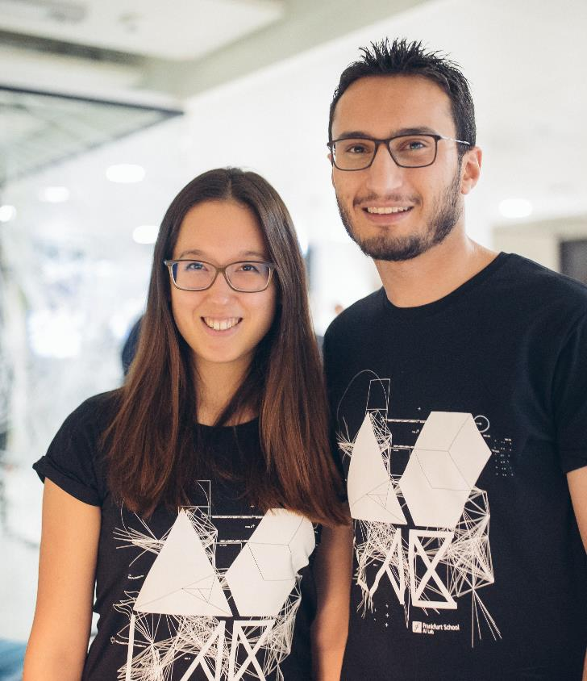
Faculty & research
Fs departments
BLOCKCHAIN
Blockchain is a revolutionary secure transaction ledger database, made famous through Bitcoin, that has the potential to change the face of the finance industry. Thanks to its position as one of the leading finance specialist business schools, Frankfurt School has founded a new research centre to explore this technology‘s potential and to educate future leaders in its use.
Frankfurt School Blockchain Centre is a think tank researching implications of the technology for companies and their business models.
a

Slide 34
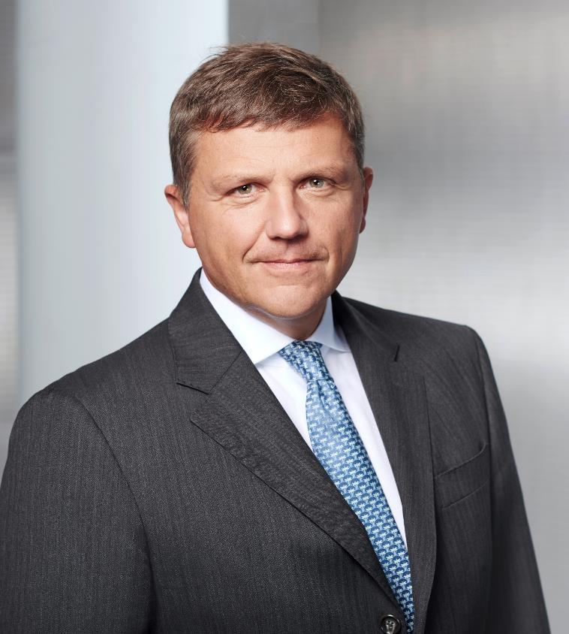
“Success needs competence. Frankfurt School of Finance & Management offers competence in many fields: outstanding research as well as excellent education and training.“
STEPHAN STURM CEO Fresenius SE & Co. KGaA

Slide 35
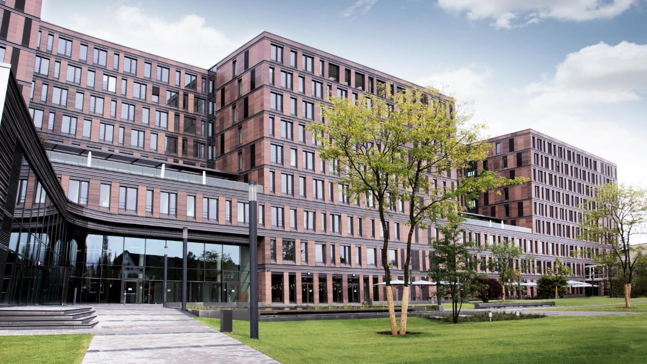
THANKS FOR YOUR ATTENTION

Slide 36








Frankfurt School of Finance & Management gGmbH
Adickesallee 32-34 60322 Frankfurt am Main
First name last name
Position
Phone: +49 69 154008-0
Fax: +49 69 154008-650
E-Mail: info@fs.de
www.frankfurt-school.de
twitter.com/FrankfurtSchool
facebook.com/FrankfurtSchool
youtube.com/FrankfurtSchoolLive
linkedin.com/company/frankfurtschool
instagram.com/frankfurtschool

