Slide 1
Data Scientist Professional Practical Exam
Presentation
Dr. Anoushiravan Zahedi

Slide 2
Tasty Bytes
Company Description
Tasty Bytes was founded in 2020 in the midst of the Covid Pandemic.
  Search engine for recipes
  Monthly subscription -> full healthy, balanced diet, meal plan whatever your budget.
Problem Description
  At the moment, the owner chooses their favorite recipe from a selection and displays it on the home page.
  The company has noticed that traffic to the rest of the website goes up by as much as 40% if they pick a popular recipe.
We should:
  Predict which recipes will lead to high traffic?
  Correctly predict high traffic recipes 80% of the time?

Slide 3
Data Validation

Slide 4
Columns
Column Name | Details | Changes
recipe | Numeric, unique identifier of recipe | No duplicates: Eliminated for the final modeling
calories | Numeric, number of calories | (1) Validated values are within logical range: i.e., non-negative (2) 52 rows out of 947 (5.5%) had missing values for nutritional columns. Imputed based on servings and category columns
carbohydrate | Numeric, amount of carbohydrates in grams
sugar | Numeric, amount of sugar in grams
protein | Numeric, amount of protein in grams
category | Character, type of recipe. Recipes are listed in one of ten possible groupings: 'Lunch/Snacks', 'Beverages', 'Potato', 'Vegetable', 'Meat', 'Chicken', 'Pork', 'Dessert', 'Breakfast', 'One Dish Meal'. | Corrected typos and inconsistent naming (['Chicken Breast']-> ['Chicken']).
servings | Numeric, number of servings for the recipe | Removed text entries like "as a snack" Converted to a category type.
high-traffic (Target Variable) | Character, if the traffic to the site was high when this recipe was shown, this is marked with "High". | 373 from 947 [39.4%] were NaN -> low traffic Recoded: 0 = low traffic, 1 = high traffic

Slide 5
Exploratory analysis

Slide 6
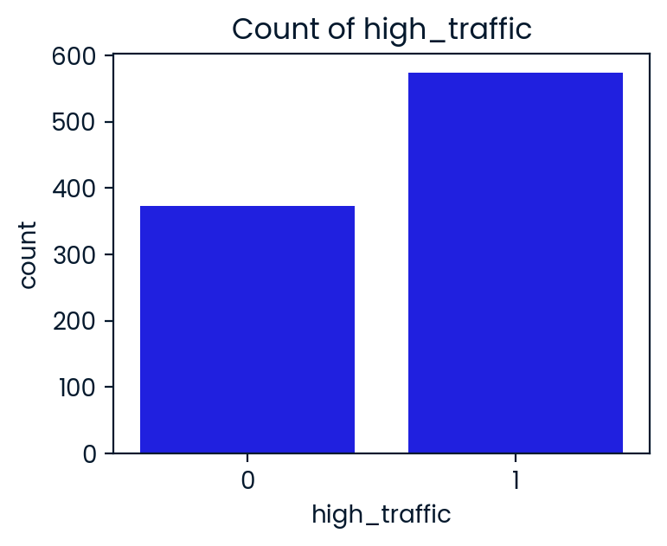
High Traffic Distribution (Count Plot)
Class imbalance: imblearn.over_sampling.SMOTE()
The baseline accuracy ~ 60% (majority class)

Slide 7
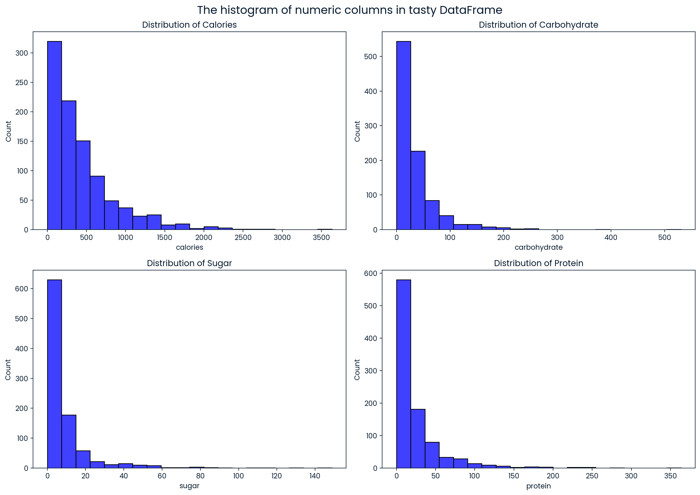
Numerical Feature Distributions (Histograms)
Nutritional features show right-skewed distributions: PowerTransformer()
Different scales (calories in hundreds vs. protein in tens): StandardScaler()

Slide 8
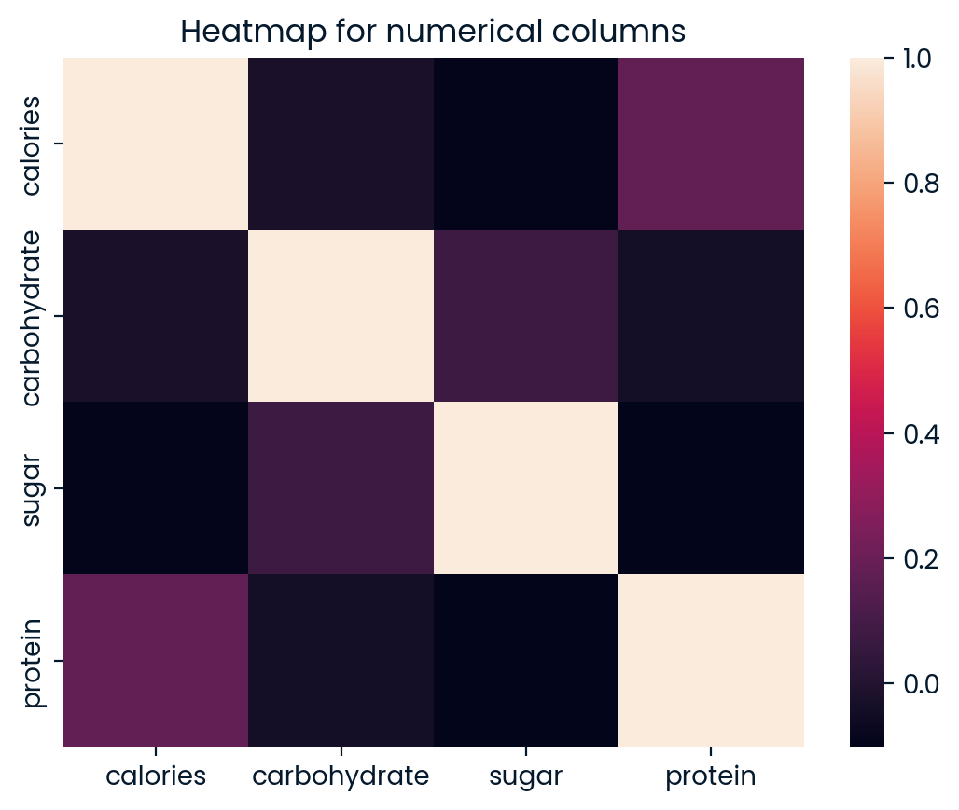
Correlation Heatmap
Heatmap helps identify redundant features.
Weak correlations between features, implying no multicollinearity.

Slide 9
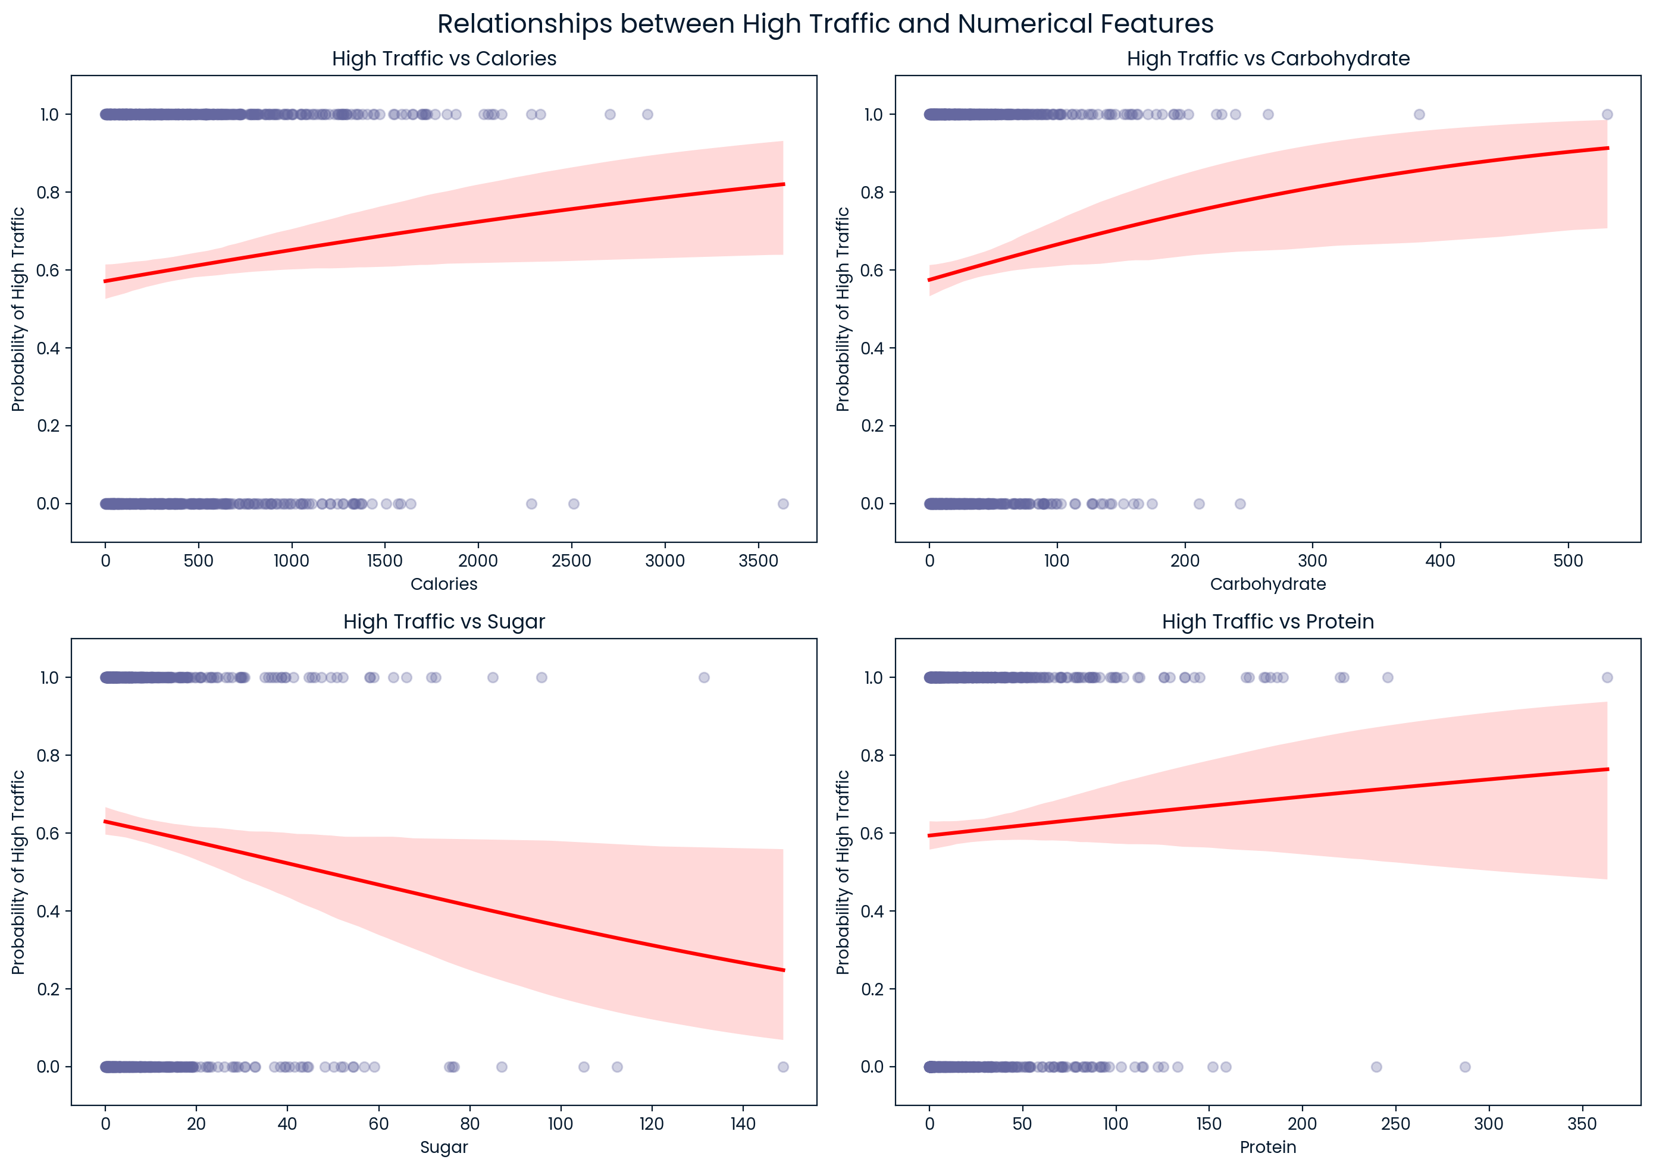
Numerical Features vs. High Traffic
seaborn.regplot shows how nutritional features (calories, protein, sugar, carbohydrates) predict whether recipes are high- or low-traffic.
High-traffic recipes tend to have higher carbohydrate, calorie, and protein content and lower sugar.

Slide 10
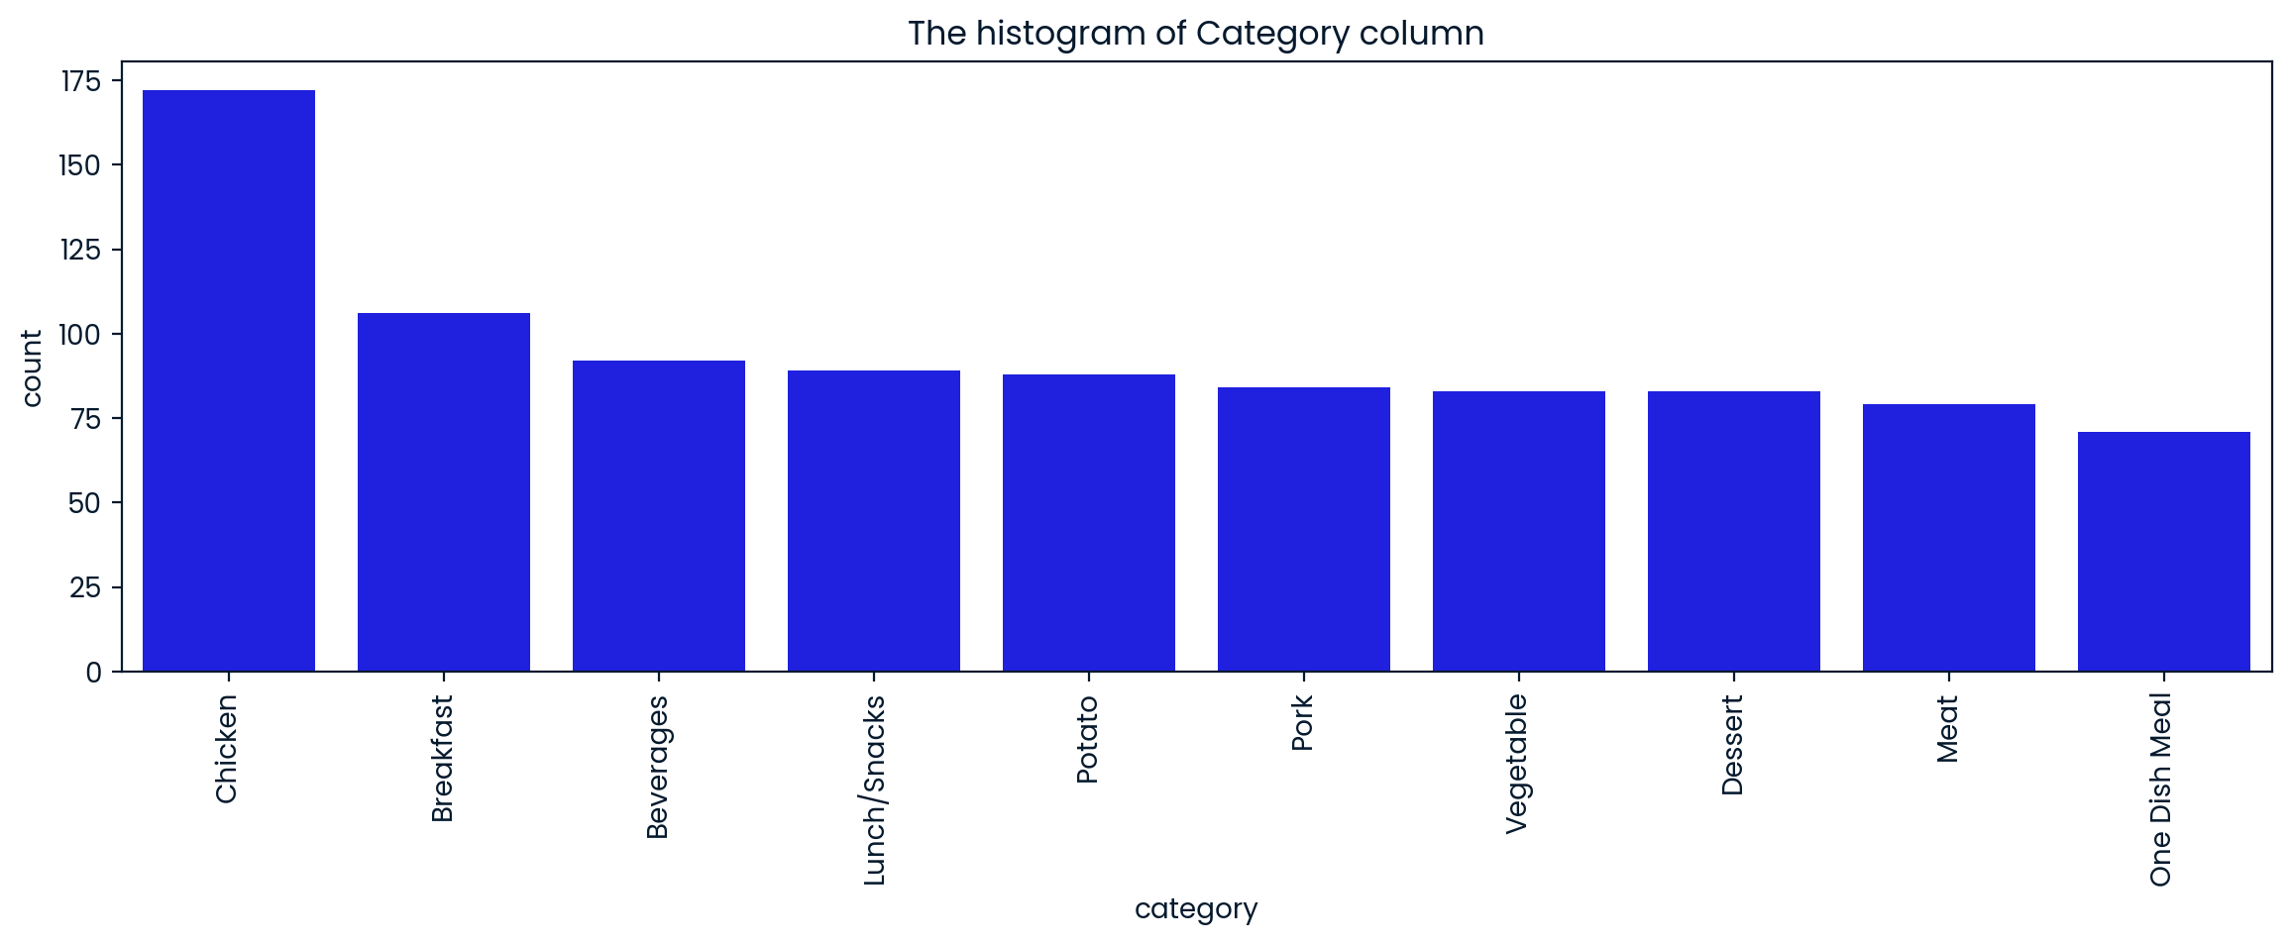
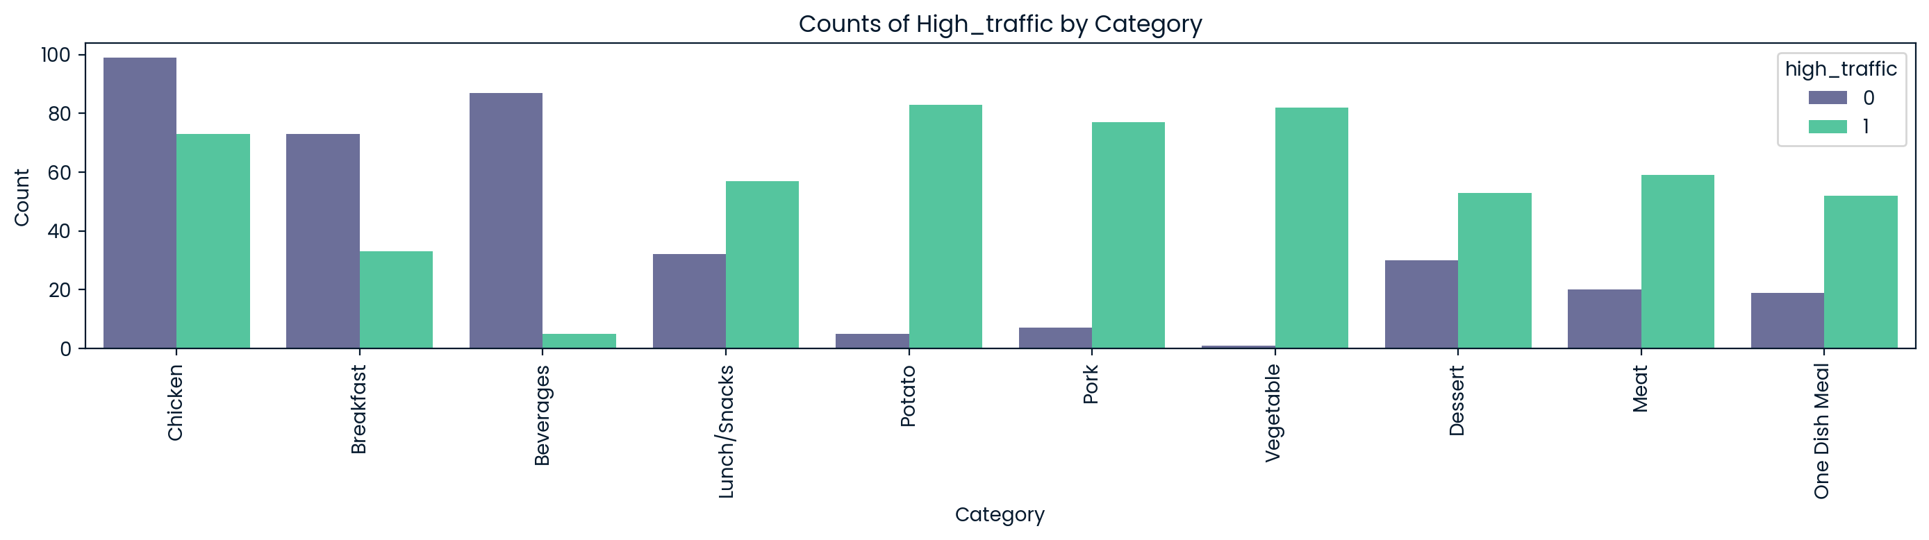
Categorical Feature Distributions and
Categorical Features vs. High Traffic
Specific categories (e.g., Potato, Pork, and Vegetable) have higher proportions of high-traffic recipes.

Slide 11
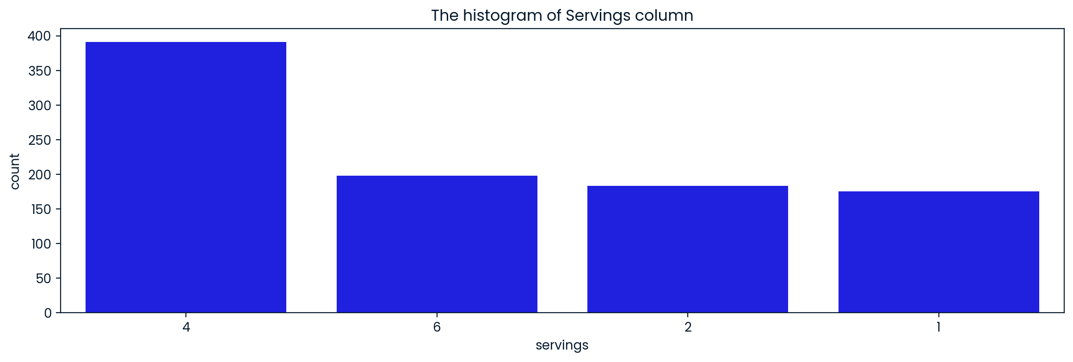
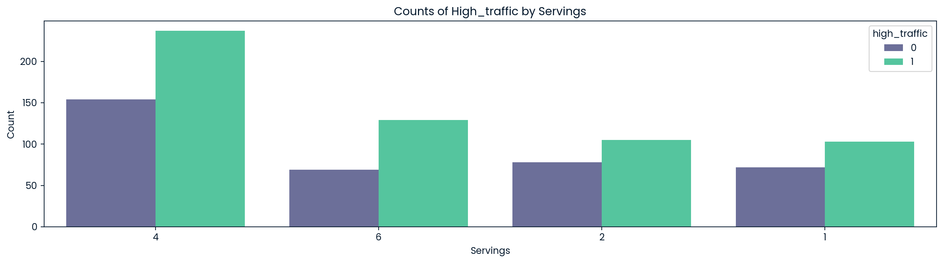
Categorical Feature Distributions and
Categorical Features vs. High Traffic
Serving sizes for 4-6 people might be more popular than individual servings

Slide 12
Model Development

Slide 13
Problem Type:
  This is a binary classification problem.
Preprocessing Strategy:
  Train-test split (80/20) with stratification to maintain class distribution
  SMOTE to address class imbalance by generating synthetic minority class examples
  Numerical features:
    Median imputation (already implemented during data validation) +
    PowerTransformer with yeo-johnson method +
    StandardScaler normalization
  Categorical features: One-hot encoding
Hyperparameter tuning:
  GridSearchCV (for simpler models) and RandomizedSearchCV (for the most complicated model) with 5-fold cross-validation

Slide 14
Model Selection Rationale
Baseline Model: Logistic Regression
Comparison Model 1: Support Vector Classifier (SVC)
Comparison Model 2: Gradient Boosting (XGBoost)
(LR): It is well-suited for binary classification problems
(LR): It is computationally efficient and fast to train
(LR): It works well when there is a roughly linear relationship between features and the log-odds of the target
(SVC): It can capture non-linear relationships through kernel functions (RBF kernel)
(SVC): It works well in high-dimensional spaces (important after one-hot encoding categorical features)
(XGBoost): It automatically captures feature interactions and non-linear relationships
(XGBoost): It handles missing values and outliers well

Slide 15
Model Evaluation and Selection

Slide 16
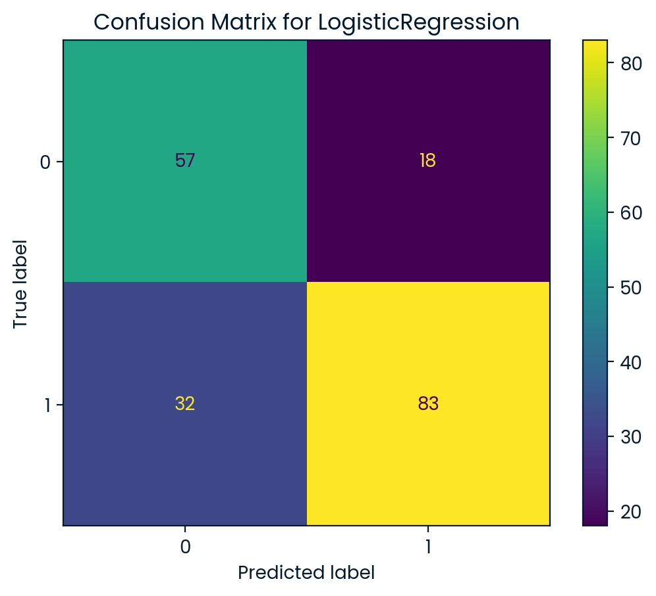
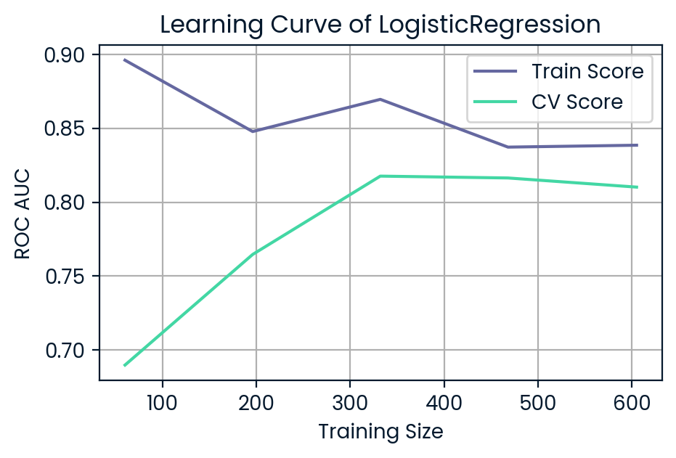
Logistic Regression
Metric | Value
Accuracy | 73.68%
Precision | 82.18%
Recall | 72.17%
F1 Score | 76.85%

Slide 17
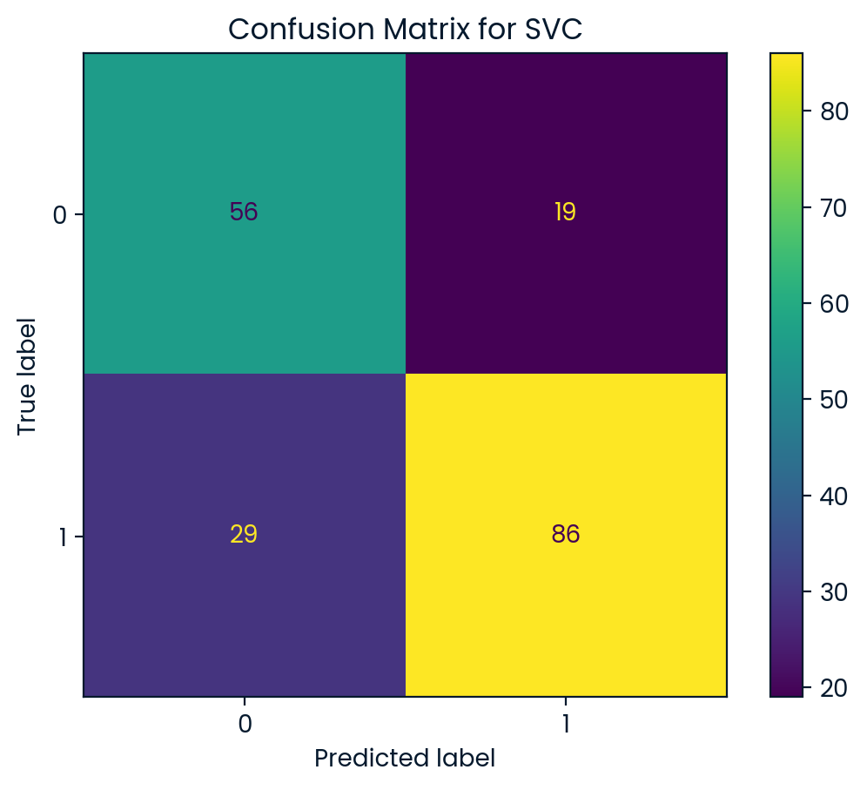
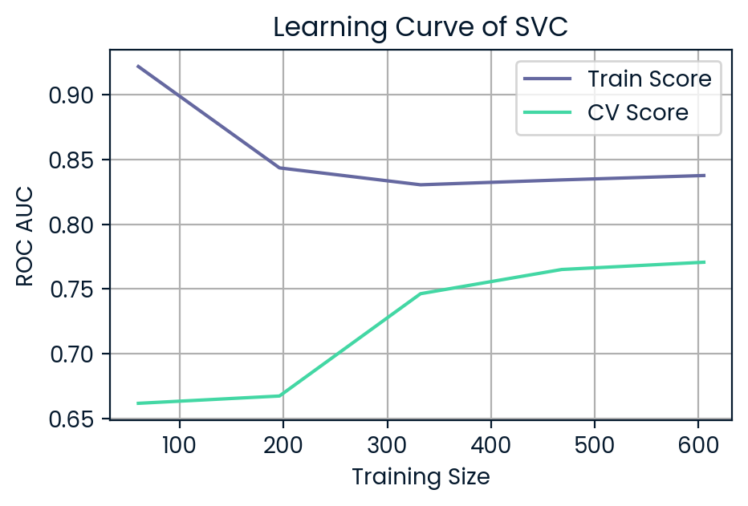
Support Vector Classifier
Metric | Value
Accuracy | 74.74%
Precision | 81.90%
Recall | 74.78%
F1 Score | 78.18%

Slide 18
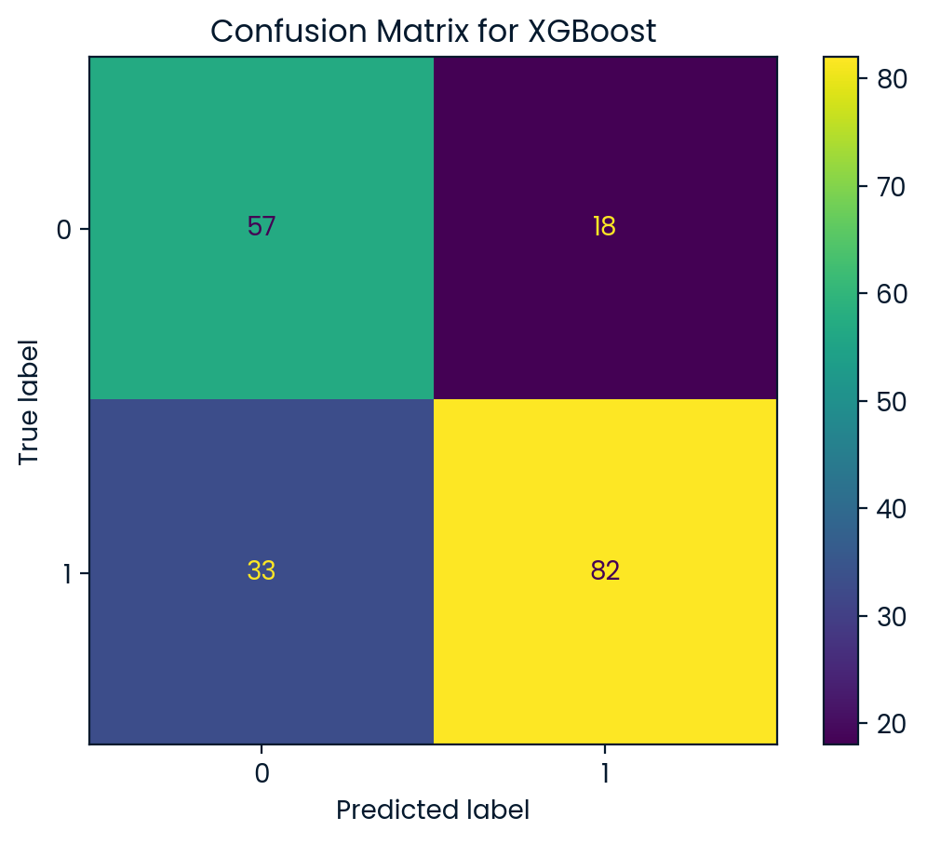
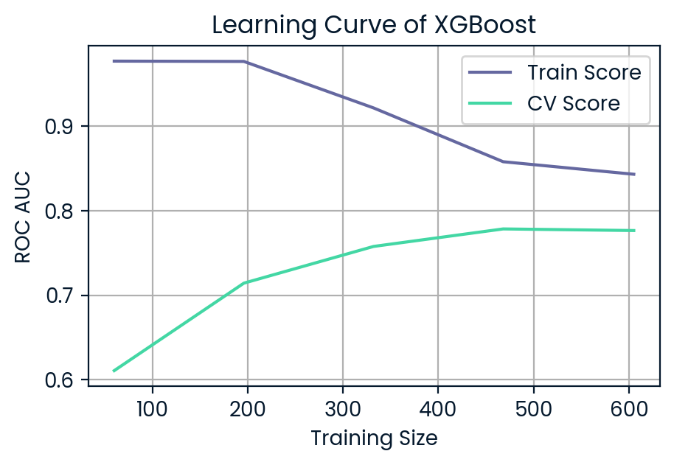
Gradient Boosting Classifier
Metric | Value
Accuracy | 73.68%
Precision | 82.18%
Recall | 72.17%
F1 Score | 76.85%

Slide 19
Best Model Selection
Based on test-set performance, the model with the highest F1 score is selected.
The models will be ranked in terms of complexity as follows:
Logistic Regression Model
Support Vector Classifier
Gradient Boosting Classifier
Support Vector Classifier
Metric | Value
Accuracy | 74.74%
Precision | 81.90%
Recall | 74.78%
F1 Score | 78.18%

Slide 20
Business Metrics

Slide 21
Cost-Benefit Analysis
True Positive (Correct high-traffic prediction): Business promotes the recipe and gains traffic/revenue.
False Positive (Incorrectly predict high traffic): Business wastes resources promoting a low-traffic recipe.
True Negative (Correct low-traffic prediction): Business correctly avoids promoting low-traffic recipe.
False Negative (Miss a high-traffic recipe): Business misses opportunity to promote popular recipe.

Slide 22
Logistic Regression:
  ROI = (83 × $100) + (18 × -$20) + (32 × -$80) + (57 × $0)= $8,300 - $360 - $2,560 + $0= $5,380
SVC:
  ROI = (86 × $100) + (19 × -$20) + (29 × -$80) + (56 × $0)= $8,600 - $380 - $2,320 + $0= $5,900
  Compared with Logistic Regression, SVC yields a higher ROI, providing better business value.
Gradient Boosting Classifier (XGBoost):
  ROI = (82 × $100) + (18 × -$20) + (33 × -$80) + (57 × $0)= $8,400 - $360 - $2,640 + $0= $5,200
  XGBoost has a lower ROI than both SVC and Logistic Regression.

Slide 23
Final Summary and Recommendations
After a comprehensive evaluation, the Support Vector Classifier (SVC) achieved the best performance with:
This model successfully predicts recipe traffic with 74.74% accuracy, significantly outperforming the baseline accuracy of 60% (majority class prediction). Further, the model satisfies the task assignment with 81.90% precision, meaning it can predict a high-traffic recipe above the required threshold of 80%.
Business Recommendations:
Content Strategy
Resource Allocation
Content Optimization
Continuous Improvement

Slide 24
Thank you
Dr. Anoushiravan Zahedi
anoushiravanzahedi@gmail.com

